Slide 1

Detecting and Diagnosing Diabetic Retinopathy using CNN Framework
Group: GA1
Course no: EEE 4100
Group Members: ID
Sumaieta Tasnim 180021101
Abdur Rahman Akib 180021122
Nadim Ahmed 180021134
Mohd. Abu Bakar Siddique 180021139
Abdijaibar khadar Jibril 180021145
Supervised by-
Professor Syed Iftekhar Ali
Department of Electrical and Electronic Engineering,
Islamic University of Technology.

Slide 2
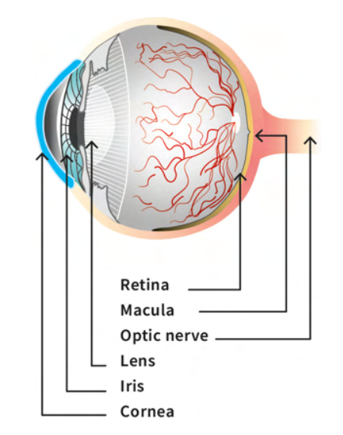
Diabetic retinopathy
Diabetic retinopathy is a diabetes complication that affects eyes. It's caused by damage to the blood vessels of the light-sensitive tissue at the back of the eye (retina).
Pictures are taken of the back of the eyes to check for damaged blood vessels.

Slide 3
motivation
425 millions
Affected world-wide every year
30%
2.6%
Diabetic Retinopathy causes blindness
Diabetic patients have chance to get Diabetic Retinopathy

Slide 4
Literature REVIEW:
Chetoui et al.
[1]
Chalakkal et al. [2]
Gulshan et al.
[3]
Grinsven et al.
[4]
Colas et al.
[5]
Technique: ML & CV
Algorithm: LBP, LTP, LESH for feature extraction. SVM for classification
Dataset: MESSIDOR
Result: AUC= 0.831(LESH), 0.816(LTP), 0.897(LBP)
Technique: CNN for feature extraction and k-NN classifier
Algorithm: InceptionResNet-v2
Dataset: MESSIDOR, IDRID, UoA-DR
Result: AUC=0.853
Technique: Deep Learning for detecting DR
Algorithm: Inception v3
Dataset: MESSIDOR, EyePACS
Result: AUC=0.891(EyePACS), 0.890(MESSIDOR)
Technique: CNN
Algorithm: OxfordNet
Dataset: EyePACS MESSIDOR, IDRID
Result: AUC=0.872(MESSIDOR), 0.894(EyePACS)
Technique: DCNN model
Dataset: EyePACS;
Result: AUC= 0.846

Slide 5
OBJECTIVES:
Identify people with diabetes who are at higher risk of developing sight threatening Diabetic Retinopathy(DR)
Developing a suitable framework for the effective diagnosis of DR
Make automated DR screening precise and cost effective

Slide 6

solution
Early Diabetic Retinopathy (DR) detection and accurate DR grading using Convolution Neural Network.
Image classification of DR using CNN architecture

Slide 7
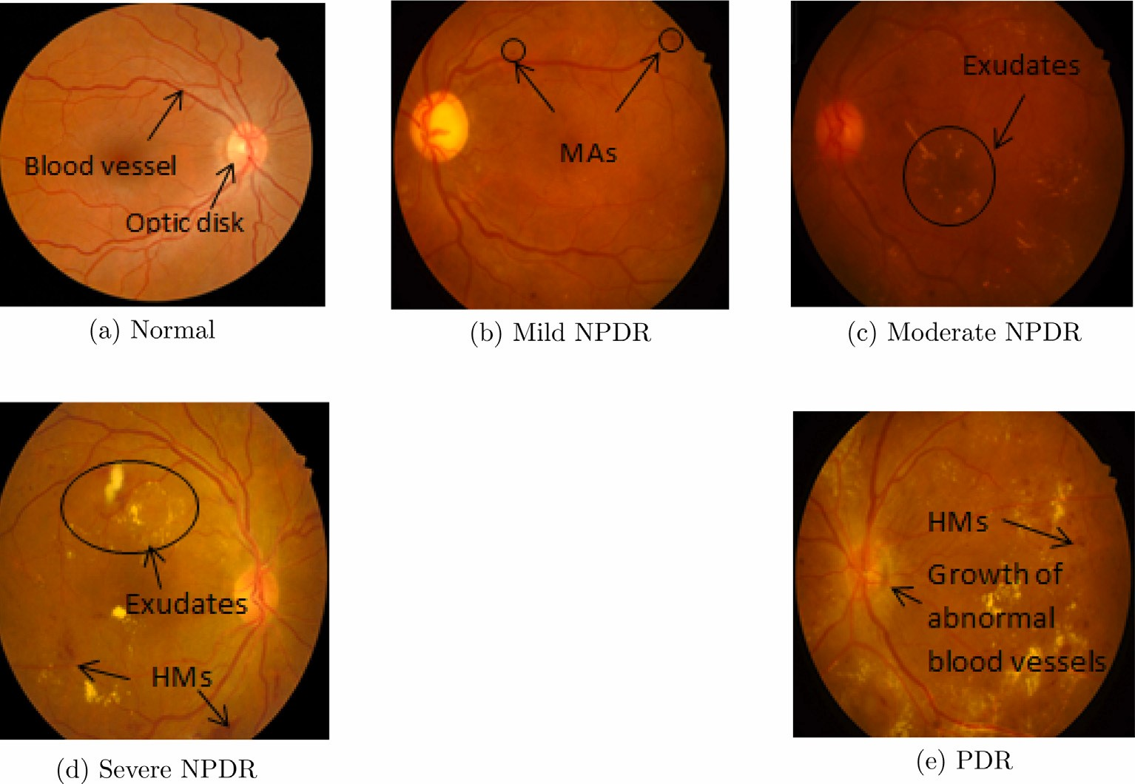
dr screening using cnn:
The major lesion considered while grading:
MicroAneurysms (MA)
Blood vessels
Haemorrhage(HM)
Exudates

Slide 8
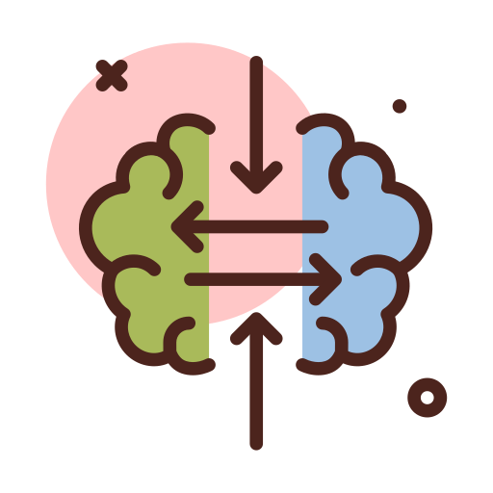

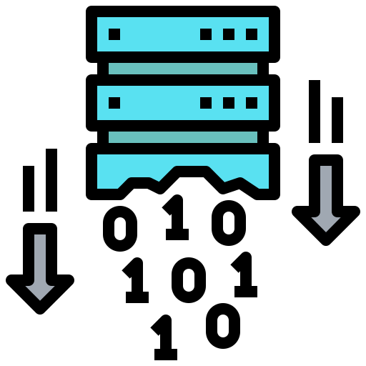
Why cnn?
Transfer Learning
Extract unique features from image data
Its built-in convolutional layer simplifies images without losing data.

Slide 9


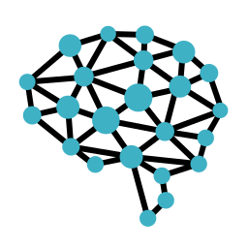

Methodology
Data Augmentation
Convolution Neural Network
Software Implementation
Data Processing

Slide 10
CNN models:
AlexNet
DenseNet121
ResNet50
InceptionV3

Slide 11
Impact:
01
Provide quantitative information to professionals in detecting early stage DR
Similar model can be applied to similar disease detection
02
04
Improves productivity of people by preventing vision loss
Making it available on root level where DR screening is rare.
03

Slide 12
Complex engineering problems:
01
Shallow models for medical image classification
Requires fully annotated large amount of data
02
03
Tradition detection takes high computational cost and lower accuracy
Extracted features lack representation on high level domain concepts
04

Slide 13
dataset:
Class No. | Class Name | Number of Images | Percentage of Images
0 | No DR | 25806 | 73.4%
1 | Mild | 2443 | 7%
2 | Moderate | 5292 | 15.1%
3 | Severe | 873 | 2.5%
4 | Proliferative DR | 708 | 2%

Slide 14
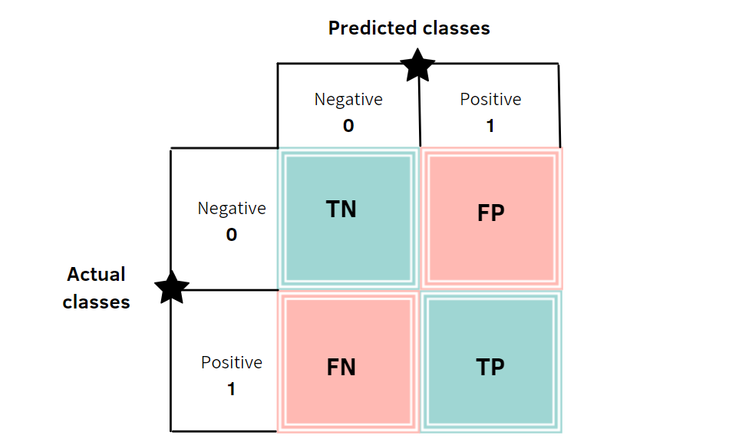
Figure of merits: Confusion matrix:
Parameter Name | Equation
Accuracy | (TN+TP)/(TN+TP+FP+FN)
Sensitivity | TP/(TP+FN)
Specificity | TN/(TN+FP)

Slide 15
Results:
AlexNet
Accuracy | 0.834
Sensitivity | 0.8
Specificity | 0.2
DenseNet121
Accuracy | 0.8378
Sensitivity | 0.8
Specificity | 0.2
ResNet50
Accuracy | 0.8544
Sensitivity | 0.799
Specificity | 0.19
InceptionV3
Accuracy | 0.7071
Sensitivity | 0.75
Specificity | 0.25

Slide 16




Workflow
Building CNN Models
Hyper-parameter Optimization
Performance Analysis
DR Dataset
Data Analysis

Slide 17



Required TOOLS:

Slide 18
Future works
Continuous assessment of the CNN model
Developing advanced algorithm for retinal diseases
Similar network can be modified to predict other retinal diseases
Building a user friendly interface

Slide 19
REFERENCE:
[1] Diabetic Retinopathy Detection Using Machine Learning and Texture Features
[2] An Efficient Framework for Automated Screening of Clinically Significant Macular Edema
[3] Development and Validation of a Deep Learning Algorithm for Detection of Diabetic Retinopathy in Retinal Fundus Photographs
[4] Fast Convolutional Neural Network Training Using Selective Data Sampling: Application to Hemorrhage Detection in Color Fundus Images
[5] Deep learning approach for diabetic retinopathy screening
[6] Diabetic retinopathy detection through deep learning techniques: A review

Slide 20
Thank you

