Slide 1
Street Fighter
jQuery Example

Slide 2
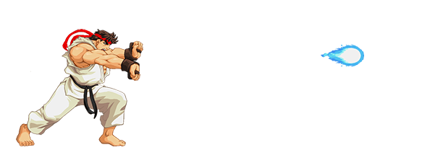
Your First jQuery Project
Let's make Ryu fire a hadouken.
Here is how it looks:

Slide 3
Step 1: create a webpage
<!DOCTYPE html>
<html>
<head>
<script src="http://ajax.googleapis.com/ajax/libs/jquery/1.11.3/jquery.min.js"></script>
<script>
$(document).ready(function(){
//Your jQuery Code here
});
</script>
</head>
<body>
<div id="my-div" style="position:absolute; top:100px; left:100px"></div>
</body>
</html>

Slide 4
Step 2: Add Jquery code
Adding Ryu at a Stand Still:
Adding our Animated Ryu:
If you hover over Ryu now he should start jumping up and down.
$('#my-div').html('<img src="http://cs.ucmo.edu/~dding/StreetFighter/Stand.png">')
$('#my-div img').hover( function() {
this.src = 'http://cs.ucmo.edu/~dding/StreetFighter/MouseOver.gif'
}, function() {
this.src = 'http://cs.ucmo.edu/~dding/StreetFighter/Stand.png‘
});

Slide 5
Step 3: Add hadouken
Add the Hadouken Pose:
Adding The Hadouken:
$('#my-div img').mousedown( function() {
this.src = 'http://cs.ucmo.edu/~dding/StreetFighter/MouseDown.png'
});
$('#my-div img').mousedown(function() {
$('#my-div').append(
'<img class="demo-hadouken" style="position:inherit;top:50px;" src=“ http://cs.ucmo.edu/~dding/StreetFighter/Hadouken.gif">' );
});

Slide 6
Step 4: Animating the hadouken
Add Animation:
Restore Ryu Position:
$('#my-div img').mousedown(function() {
$('.demo-hadouken').animate( {
"margin-left": "600px"
}, 1000, 'swing', function() {
this.remove();
})
})
$('#my-div img').mouseup(function() {
this.src = 'http://cs.ucmo.edu/~dding/StreetFighter/Stand.png'
});

Slide 7
Well done!
Check your street fighter!
One step further: add audio to your little game.

