Slide 1
jQuery: An Introduction
Content from W3Schools.com

Slide 2
jQuery Introduction
What is jQuery?
jQuery is a lightweight, "write less, do more", JavaScript library.
jQuery simplifies a lot of the complicated things from JavaScript, like AJAX calls and DOM manipulation.

Slide 3
jQuery Introduction
The jQuery library contains the following features:
HTML/DOM manipulation
CSS manipulation
HTML event methods
Effects and animations
AJAX
Utilities

Slide 4
jQuery Get Started
Adding jQuery to Your Web Pages
Download the jQuery library from jQuery.com
Include jQuery from a CDN, like Google
<head> <script src="jquery-1.11.3.min.js"></script> </head>
<head> <script src="https://ajax.googleapis.com/ajax/libs/jquery/1.11.3/jquery.min.js"></script> </head>

Slide 5
jQuery Syntax
With jQuery you select (query) HTML elements and perform "actions" on them.
Basic syntax is: $(selector).action()
A $ sign to define/access jQuery
A (selector) to "query (or find)" HTML elements
A jQuery action() to be performed on the element(s)
Examples
$(this).hide() - hides the current element.
$("p").hide() - hides all <p> elements.
$(".test").hide() - hides all elements with class="test".
$(".test").addClass(‘panel’).hide().fadein(1500); //chaining of methods

Slide 6
Why Use jQuery
Simple Selectors
Use CSS selectors
Common tasks in less code
Loop through elements
Add/remove elements from the DOM tree
Handle events
Fade elements into / out of view
Handle Ajax requests

Slide 7
The Document Ready Event
Most of the times, jQuery code are placed inside a document ready event:
This is to prevent any jQuery code from running before the document is finished loading (is ready).
$(document).ready(function(){ // jQuery methods go here... });
Even shorter version:
$(function(){ // jQuery methods go here... });
Notes:
It is good practice to wait for the document to be fully loaded and ready before working with it. This also allows you to have your JavaScript code before the body of your document, in the head section.
Here are some examples of actions that can fail if methods are run before the document is fully loaded:
Trying to hide an element that is not created yet
Trying to get the size of an image that is not loaded yet

Slide 8
jQuery Selectors
jQuery selectors allow you to select and manipulate HTML element(s).
Allow you to "find" (or select) HTML elements based on their id, classes, types, attributes, values of attributes and much more.
The element Selector: $("p")
The #id Selector: $("#test")
The .class Selector: $(".test")
More Examples of jQuery Selectors

Slide 9
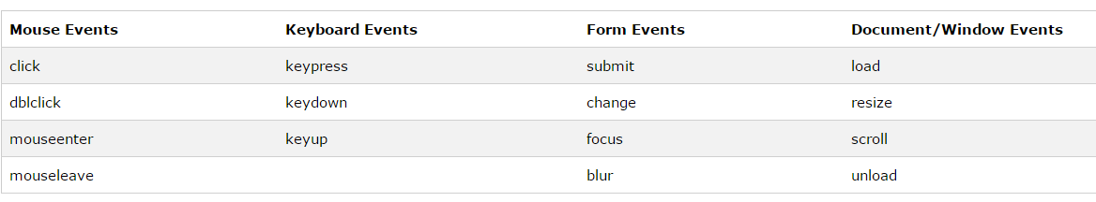
jQuery Event Methods
An event represents the precise moment when something happens.
Some common events:

Slide 10
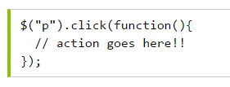
jQuery Syntax For Event Methods
In jQuery, most DOM events have an equivalent jQuery method.
Commonly Used jQuery Event Methods
Use the example of click on table row

Slide 11
jQuery Effects
Additional methods provided by jQuery
Hide/Show
Fade
Slide
Animate
Stop()
The jQuery stop() method is used to stop animations or effects before it is finished.
Callback
A callback function is executed after the current effect is 100% finished
Chaining

Slide 12
Slide
jQuery has the following slide methods:
slideDown()
slideUp()
slideToggle()
Syntax:
$(selector). slideToggle(speed,callback);
Example:
http://www.w3schools.com/jquery/tryit.asp?filename=tryjquery_slide_toggle

Slide 13
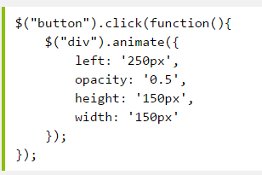
Animation
The jQuery animate() method lets you create custom animations.
Syntax:
$(selector).animate({params},speed,callback);
multiple properties can be animated at the same time:
More examples:
http://www.w3schools.com/jquery/jquery_animate.asp

Slide 14
Chaining
Chaining allows us to run multiple jQuery methods (on the same element) within a single statement.
browsers do not have to find the same element(s) more than once.
you can format it like you want, including line breaks and indentations.

Slide 15
jQuery DOM Manipulation
Get Content - text(), html(), and val()
Get Attributes - attr()
Set Content - text(), html(), and val()
Add New HTML Content : append(), prepend()
Remove Elements/Content : Remove(), empty()

Slide 16
jQuery Manipulating CSS
jQuery has several methods for CSS manipulation. We will look at the following methods:
addClass() - Adds one or more classes to the selected elements
removeClass() - Removes one or more classes from the selected elements
toggleClass() - Toggles between adding/removing classes from the selected elements
css() - Sets or returns the style attribute

Slide 17
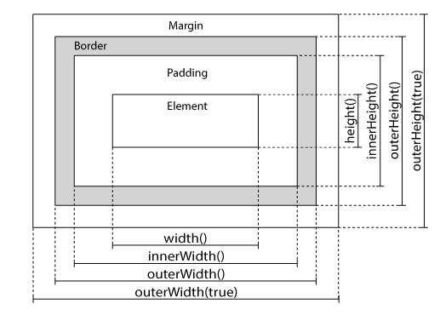
jQuery Dimensions
jQuery has several important methods for working with dimensions:
width()
height()
innerWidth()
innerHeight()
outerWidth()
outerHeight()

Slide 18
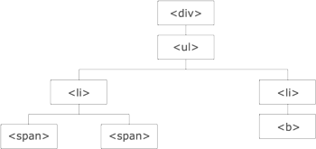
jQuery Traversing
"move through“ the DOM tree to find specific elements.
Find Ancestors
Find Descendants
Find Siblings
Filtering: first(), last(), eq()

Slide 19
jQuery - AJAX
AJAX = Asynchronous JavaScript and XML.
AJAX is about loading data in the background and display it on the webpage, without reloading the whole page.
Examples of applications using AJAX: Gmail, Google Maps, Youtube, and Facebook tabs.
jQuery provides several methods for AJAX functionality.

Slide 20

jQuery - AJAX Methods
The load() method loads data from a server and puts the returned data into the selected element.
Syntax:
$(selector).load(URL,data,callback);
jQuery $.get() Method
Syntax:
$.get(URL,callback);
jQuery $.post() Method
Syntax:
$.post(URL,data,callback);

Slide 21
jQuery examples and project
List of Examples:
http://www.w3schools.com/jquery/jquery_examples.asp
Street Fighter Project

