Slide 1
PHP and MySQL for Dynamic Web Sites
4th Edition
Instructor’s Notes
Chapter 2: Programming with PHP
Copyright © 2012 by Larry Ullman

Slide 2
Learning Outcomes
Identify how key pieces of an HTML form relate to PHP
Choose the proper HTML form method
Handle HTML form data in a PHP script
Use common conditionals
Recognize and use the standard operators
Validate form data in several ways

Slide 3
Learning Outcomes
Identify what arrays are
Recognize the superglobal arrays
Create arrays using different approaches
Access every element in an array
Sort arrays
Convert between arrays and strings
Use loops

Slide 4
An HTML Form
<form action="handle_form.php" method="post">
<p><label>Name: <input type="text" name="name" size="20" maxlength="40" /></label></p>
<p><label>Email Address: <input type="text" name="email" size="40" maxlength="60" /></label></p>
<p><label for="gender">Gender: </label><input type="radio" name="gender" value="M" /> Male <input type="radio" name="gender" value="F" /> Female</p>
<p><label>Age:
<select name="age">
<option value="0-29">Under 30</option>
<option value="30-60">Between 30 and 60</option>
<option value="60+">Over 60</option>
</select></label></p>
<p><label>Comments: <textarea name="comments" rows="3" cols="40"></textarea></label></p>
<p align="center"><input type="submit" name="submit" value="Submit My Information" /></p>
</form>
Notes:
Have to pay attention to three things: the action attribute, the method, and the names of the form elements. All three will dictate how you handle the form in PHP.

Slide 5
Choosing a Method
GET
POST
The standard method for all server requests
Data appended to the URL
Can be bookmarked
User can click Back
Used for requesting information
Data is not visible in the URL
Much larger limit on the amount of data that can be submitted
Can send files
Users see warnings if they click Back
Used for requesting action
Notes:
For example, just loading a page is GET. Search engines also use GET.
Post is used for requesting actions, such as changing a database record or sending an email.

Slide 6
Handling a Form
Use $_REQUEST['name']
Or use $_GET['name'] and $_POST['name'], depending upon the form’s method value
Always load the form through a URL!
Notes:
“name” comes from the form elements. This is all case-sensitive!
$_REQUEST is an easy way to start; you’ll learn more precise options later.
If the form is not loaded through a URL, then the PHP script won’t be run through a URL and the PHP code won’t be executed.

Slide 7
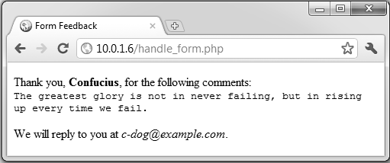
Handling a Form
<?php # Script 2.2 - handle_form.php
// Create a shorthand for the form data:
$name = $_REQUEST['name'];
$email = $_REQUEST['email'];
$comments = $_REQUEST['comments'];
// Print the submitted information:
echo "<p>Thank you, <b>$name</b>, for the following comments:<br />
<tt>$comments</tt></p>
<p>We will reply to you at <i>$email</i>.</p>\n”;
?>

Slide 8
Common Problems
Failure to load the form through a URL
Incorrect reference to the PHP script (e.g., location or name)
Case-sensitivity issue with PHP variables
Incorrect element names in the HTML form
Notes:
These are the most common problems beginners will have.
If the PHP code does not execute, it’s probably the first issue.
If the PHP script is not found (i.e., a server error), it’s probably the second.
If nothing is printed for an element’s value, it’s probably the third or fourth.

Slide 9
Conditionals
if (condition) {
// Do this!
}
if (condition) {
// Do this!
} else {
// Do that!
}
if (condition1) {
// Do this!
} elseif (condition2) {
// Do that!
} else {
// Do whatever!
}
Notes:
When a condition is true, the code in the corresponding brackets will be executed.
The if-else is the basic conditional. else is always optional.
elseif allows you to check for other conditions

Slide 10
What is true?
$var, if $var has a value other than 0, “0”, an empty string, FALSE, or NULL
isset($var), if $var has any value other than NULL, including 0, FALSE, or an empty string
TRUE, true, True, etc.
Notes:
All the above are true

Slide 11
Operators
Symbol | Meaning | Type
== | is equal to | comparison
!= | is not equal to | comparison
< | less than | comparison
> | greater than | comparison
<= | less than or equal to | comparison
>= | greater than or equal to | comparison
! | not | logical
&& | and | logical
AND | and | logical
|| | or | logical
OR | or | logical
XOR | and not | logical
=== identical, value and type
!===
Notes:
The operators generally work as you’d expect. Also use parentheses to create groupings.
Note the difference between the equality operator and the assignment operator!

Slide 12
Validating Form Data
Never trust external data!
Use isset() to confirm variable has a value
Use !empty() to confirm variable has a non-empty value
Check the data’s type, when appropriate, for example, using is_numeric()
Check the data’s value, when appropriate.
Notes:
These are some starting points for validating form data.
A variable is considered empty if it does not exist or if its value equals FALSE.empty() does not generate a warning if the variable does not exist

Slide 13
Introducing Arrays
Arrays hold multiple values in one variable
Series of key-value pairs
Indexed arrays use numbers for keys
Associative arrays use strings
Indexed arrays begin at 0 by default
Notes:
These are also multidimensional arrays: arrays whose element values are also arrays.

Slide 14


Accessing Arrays
// Use array notation to access individual elements:
$band = $artists[0];
echo $states['MD'];
// You can’t do this:
echo "My list of states: $states";
// Or this:
echo "IL is $states['IL']."; // BAD!
Associative arrays must be wrapped in curly brackets or else a parse error will occur.
Notes:
Arrays are trickier to print.
Use array notation to access the value of an individual element.
Associative arrays must be wrapped in curly brackets or else a parse error will occur.

Slide 15
Creating Arrays
$band[] = 'Jemaine';
$band[] = 'Bret';
$band[] = 'Murray';
$band['fan'] = 'Mel';
$band['fan'] = 'Dave'; // New value
$fruit[2] = 'apple';
$fruit[2] = 'orange'; // New value
$states = array (
'IA' => 'Iowa',
'MD' => 'Maryland'
);
$artists = array ('Clem Snide', 'Shins', 'Eels');
Notes:
Arrays can be created by adding an element at a time. You can specify the key or not.
Arrays can also be created using the array() function. Again, you can specify the keys or not.

Slide 16
Superglobal Arrays
$_GET
$_POST
$_REQUEST
$_SERVER
  holds information about headers, paths, and script locations.
$_ENV
  Environment variables
$_SESSION
$_COOKIE
$GLOBALS
Notes:
Special arrays built into PHP. All are associative.
$_GET, $_POST, and $_COOKIE are all in $_REQUEST
These are often also multidimensional arrays: arrays whose element values are also arrays.

Slide 17
Looping Through Arrays
foreach ($array as $value) {
// Do something with $value.
}
// Or:
foreach ($array as $key => $value) {
echo "The value at $key is $value.";
}
Notes:
The variables $key and $value can be named anything.

Slide 18
Sorting Arrays
sort(), by value, dropping the keys
asort(), by value, maintaining the keys
ksort(), by key, maintaining the values
rsort(), sort() in reverse order
arsort(), asort() in reverse order
krsort(), ksort() in reverse order
Notes:
These functions can sort a one-dimensional array using the key or the value.

Slide 19
Arrays and Strings
$array = explode (separator, $string);
$string = implode (glue, $array);
$s1 = 'Mon-Tue-Wed-Thu-Fri';
$days_array = explode ('-', $s1);
// $days_array now a five-element array, with Mon indexed at 0.
$s2 = implode (', ', $days_array);
// $s2 now a comma-separated list of days: Mon, Tue, Wed, Thu, Fri.
Notes:
Use explode() and implode() to convert between an array and a string

Slide 20
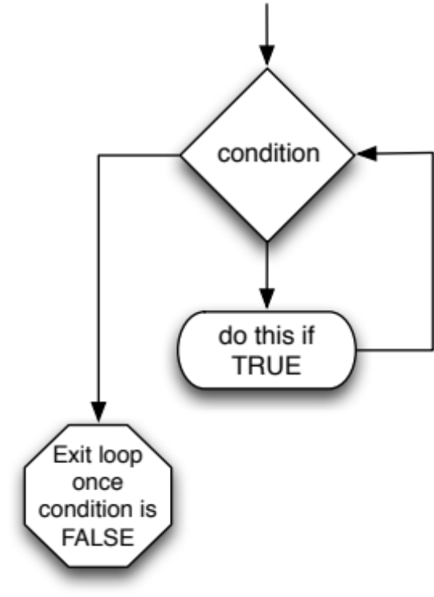
While Loops
while (condition) {
// Do something.
}
Notes:
A while loop runs so long as a condition is true.
Normally used when it’s not known in advance how many times the loop is needed (e.g., when retrieving database query results).

Slide 21
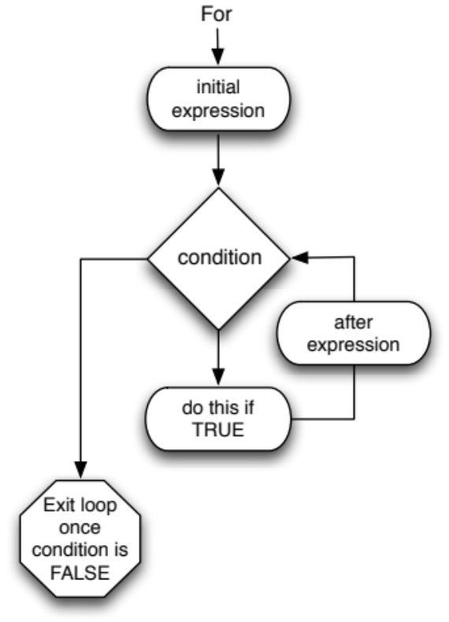
For Loops
for (initial expression; condition; closing expression) {
// Do something.
}
for ($i = 1; $i <= 10; $i++) {
echo $i;
}
Notes:
The for loop uses a more complicated syntax.
The initial expression is only executed once.
The closing expression is executed once for each loop iteration.
The for loop is normally used when you’ll do something a known number of times.

