Slide 1
PHP and MySQL for Dynamic Web Sites
4th Edition
Instructor’s Notes
Chapter 3: Creating Dynamic Web Sites
Copyright © 2012 by Larry Ullman

Slide 2
Learning Outcomes
Break longer scripts into multiple files
Demonstrate how to properly write file paths
Have a single page both display and handle an HTML form
Create a sticky form
Write simple functions

Slide 3
Learning Outcomes
Write functions that take arguments
Provide default argument values
Return a value from a function
Explain variable scope
Follow the PHP manual

Slide 4
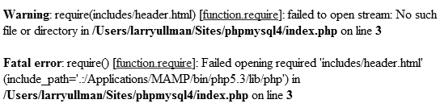
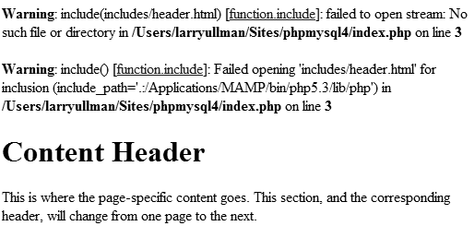
Including Multiple Files
include('/path/to/filename.html');
include_once('filename.php');
require('filename.php');
require_once('/path/to/filename.html');
Notes:
Use multiple files to break up longer script or to separate out reusable parts
PHP will treat the code in the included file as HTML unless it’s within PHP tags
You can use a relative or absolute path, so long as it’s correct
The file extension does not matter
The _once() versions are slower.
require() will create an error and terminate the script if it fails

Slide 5
Absolute vs Relative Paths
Absolute
Relative
Start at a fixed location, such as the Web root directory
Normally begin with C:\ or just /
The same absolute path is correct regardless of where the including file is
Start at the current location (i.e., the current file’s location)
Begin with a file name, a folder name, or a period
A relative path is only correct for files with the same relative positions

Slide 6
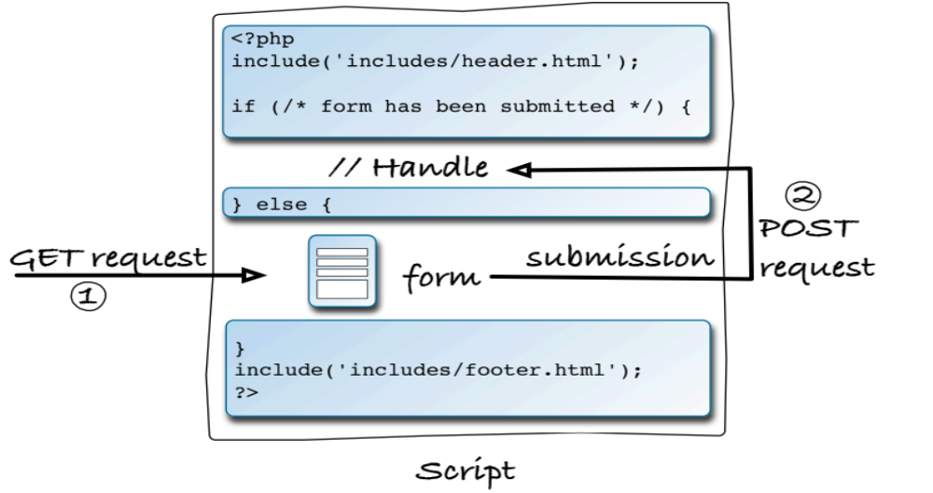
Displaying and Handling Forms
Notes:
Often nice to have the same page both display and handle an HTML form
To have the same page both display and handle a form, it must watch for the form submission.

Slide 7
Displaying and Handling Forms
if (/* form has been submitted */) {
// Handle the form.
} else {
// Display the form.
}
if ($_SERVER['REQUEST_METHOD'] == 'POST') {
// Handle the form.
} else {
// Display the form.
}
Notes:
One way of testing for a form’s submission is to check the server request method (assuming the form uses the POST method)

Slide 8
Making Sticky Forms
<input type="text" name="city" value="<?php echo $city; ?>" />
<input type="radio" name="gender" value="F" <?php if ($gender == 'F') {
echo 'checked="checked"';
} ?>/>
<textarea name="comments" rows="10" cols="50"><?php echo $comments; ?></textarea>
Notes:
A sticky form is simply a standard HTML form that remembers how you filled it out.
Use PHP to print the value of text inputs.
Use PHP to add “checked” to radio buttons

Slide 9

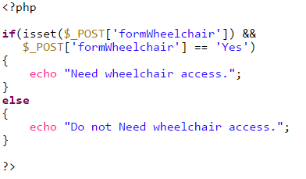
Passing information between Client and Server

Slide 10
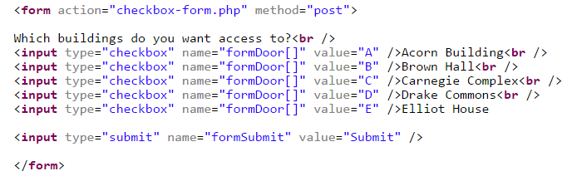
Passing information between Client and Server
On server side, $_POST['formDoor'] would be an array consisting of all the checked values. For example, {“A”, “B”, “C”}
Define a function to check whether a particular option is checked
Notes:
$_POST['formDoor']
_GET[]

Slide 11
Creating Your Own Functions
function function_name () {
// Function code.
}
function do_nothing() {
// Do nothing.
}
Notes:
The word “function” followed by the function name, followed by parentheses, followed by the function code within curly brackets.
The name can contain letters, numbers, and the underscore, but cannot begin with a number.
Function names in PHP are case-insensitive.

Slide 12
Good Uses of Functions
To associate repeated code with one function call
To separate out sensitive or complicated processes from other code
To make common code bits easier to reuse

Slide 13
Taking Arguments
function print_hello ($first, $last) {
// Function code.
}
print_hello ('Jimmy', 'Stewart');
$surname = 'Stewart';
print_hello ('Jimmy', $surname);
Notes:
Use variables in the function definition’s parentheses to create function arguments.
Arguments are used to pass data to the function when called.
The variables can use any valid variable name.
If all the arguments are not provided, a warning occurs.

Slide 14
Default Argument Values
function greet ($name, $msg = 'Hello') {
echo "$msg, $name!";
}
greet ($surname, $message);
greet ('Zoe');
greet ('Sam', 'Good evening');

Slide 15
Returning Values
function find_sign ($month, $day) {
// Function code.
return $sign;
}
How to return multiple values?
return array ( $var1, $var2);
list($v1, $v2) = some_func();
Notes:
Use the return statement
The return statement terminates the code execution at that point, so any code within a function after an executed return will never run.
A function can have multiple return statements (e.g., in a switch statement or conditional) but only one, at most, will ever be invoked.

Slide 16
Variable Scope
Page
Function
Global
Notes:
Variable scope is the realm in which a variable is available.
Function scope can also be called local.

Slide 17
Variable Scope
<?php
$a = 1; /* global scope */
function test()
{
echo $a; /* reference to local scope variable */
}
test();
?>

Slide 18
Function Variable Scope
function function_name() {
global $var;
}
$var = 20;
function_name(); // Function call.
//another way:
$GLOBALS[“var”]
Notes:
A function can only access a variable outside of a function if it is global or made to be global.

Slide 19
Static Variables
A static variable will not lose its value when the function exits and will still hold that value should the function be called again.
<?php
function keep_track() {
STATIC $count = 0;
$count++;
print $count;
print "<br />";
}
keep_track();
keep_track();
keep_track();
?>

Slide 20
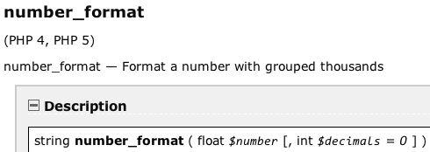
Reading the Manual
Notes:
When looking up functions in the PHP manual, you can first see the function name, then the versions of PHP it works in.
Then there’s the textual description.
Then an indicator of what type of value the function returns and how many and what kinds of arguments it expects. Optional arguments are shown in square brackets.

