Slide 1
PHP and MySQL for Dynamic Web Sites
4th Edition
Instructor’s Notes
Chapter 4 - Introduction to MySQL
Copyright © 2012 by Larry Ullman

Slide 2
Learning Outcomes
Generate valid and description names for database elements
Choose an appropriate column type
Explain the difference between CHAR and VARCHAR
Select proper column properties
Implement primary key indexes
Access a MySQL database using the mysql client
Access a MySQL database using phpMyAdmin

Slide 3
Naming Database Elements
Only letters, numbers, and the underscore
Cannot be the same as an existing SQL keyword
Treat as case-sensitive
Shorter than 64 characters
Unique within its realm (e.g., database or table)
Notes:
Whether or not the name is case-sensitive depends upon the OS and other factors.

Slide 4
Primary Column Types
Text
Numbers
Dates and times
Special types (ENUM and SET)

Slide 5
Specific Text Types
CHAR
VARCHAR
TINYTEXT
TEXT
MEDIUMTEXT
LONGTEXT
Notes:
Also, technically blobs, for storing binary data.
You should always choose the smallest option possible.
(2²⁴ − 1) ch
2^32 longtext

Slide 6
CHAR vs VARCHAR
CHAR
VARCHAR
Fixed length
Generally requires more disk space
Generally faster
Best used for values that will always be a fixed length
Variable length
Generally requires less disk space
Generally slower
Best used for values that will be of any length

Slide 7

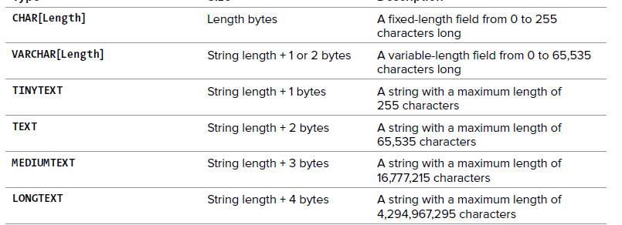

Slide 8
Specific Numeric Types
TINYINT
SMALLINT
MEDIUMINT
INT
BIGINT
FLOAT
DOUBLE
DECIMAL
Notes:
FLOAT, DOUBLE, and DECIMAL are for numbers with decimal points

Slide 9
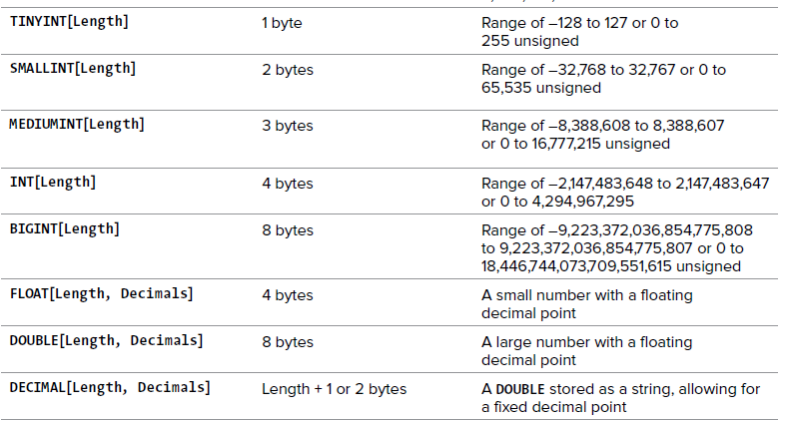

Slide 10
Specific Date and Time Types
DATE
DATETIME
TIMESTAMP
TIME
Notes:
Difference is in what each stores. More information requires more space. The TIMESTAMP is technically the seconds since the epoch.

Slide 11
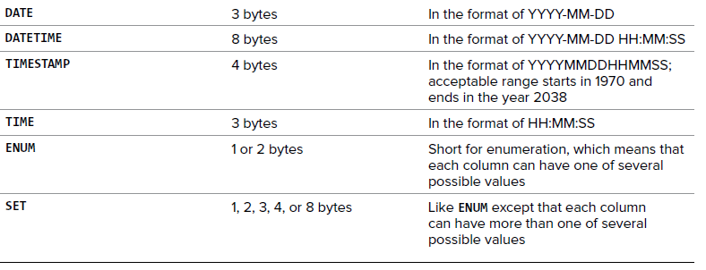

Slide 12
Important Column Properties
Length
NULL/NOT NULL
DEFAULT
UNSIGNED
ZEROFILL
AUTO_INCREMENT
Notes:
Best to use NOT NULL as much as possible.
Best to use UNSIGNED whenever appropriate for numbers.
AUTO_INCREMENT is used with primary key columns.
The DEFAULT value clause in a data type specification indicates a default value for a column.
declared as INT(4) ZEROFILL, a value of 5 is retrieved as 0005.

Slide 13
Primary Key
Must always have a value
The value must never change
The value must be unique for each record in the table
Almost always unsigned, not null integers
Use AUTO_INCREMENT to set the value
Notes:
Indexes are also called keys.
Used to improve performance
Every table should have a primary key column.

Slide 14
To Create a Storage in Database
1. Determine the database’s name.
2. Determine the table names.
3. Determine the column names for each table.
4. Determine types for columns.
5. Define Index, Restrictions etc.

Slide 15
Create Table
For example, you need to create a user table to store the following information:
Name (first and last name)
Email
User ID and password
Registration Date

Slide 16
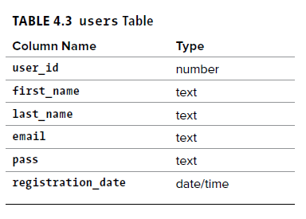
1. Identify whether a column should be a text, number, or date/time type
Name (first and last name)
Email
User ID and password
Registration Date

Slide 17
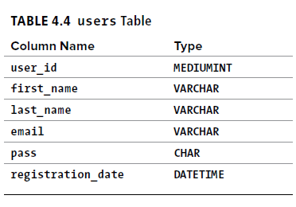
2. Choose the most appropriate subtype for each column

Slide 18
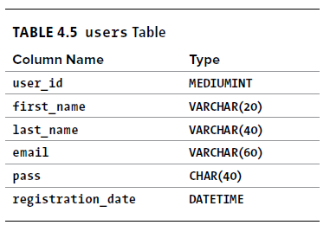
3. Set the maximum length for text columns
Notes:
Instead, for integers, the length dictates the display width; for decimals, the length is the total number of digits that can be stored.

Slide 19
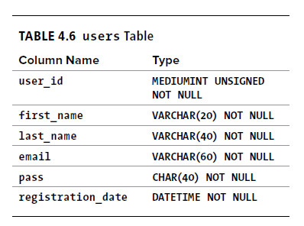
4. Consider other properties:
  Identify your primary key.
  Identify which columns cannot have a NULL value.
  Make any numeric type UNSIGNED if it won’t ever store negative numbers.
  Establish the default value for any column.
  Confirm the final column definitions
Notes:
The primary key is quixotically both
arbitrary and critically important. Almost
always a number value, the primary key
is a unique way to refer to a particular
record. For example, your phone number
has no inherent value but is unique to
you (your home or mobile phone).

Slide 20
MySQL also has several variants on the text types that allow for storing binary data. These types are BINARY, VARBINARY, TINYBLOB, MEDIUMBLOB, and LONGBLOB. Such types can be used for storing files or encrypted data.

Slide 21
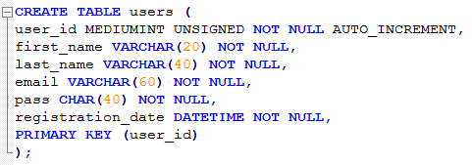

Slide 22
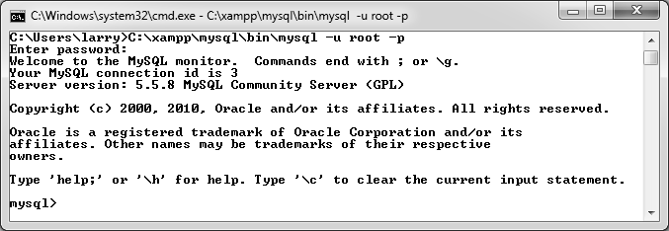
The mysql Client
mysql -u username -h hostname –p
>mysql –u test –h www.math-cs.ucmo.edu -p

Slide 23
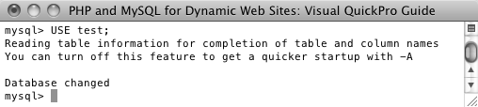
Selecting a Database
USE databasename;
Notes:
Commands are terminated with a semicolon
Type exit to leave.

Slide 24
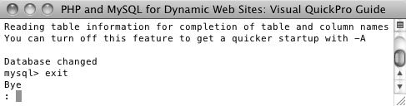
Leaving the mysql Client

Slide 25
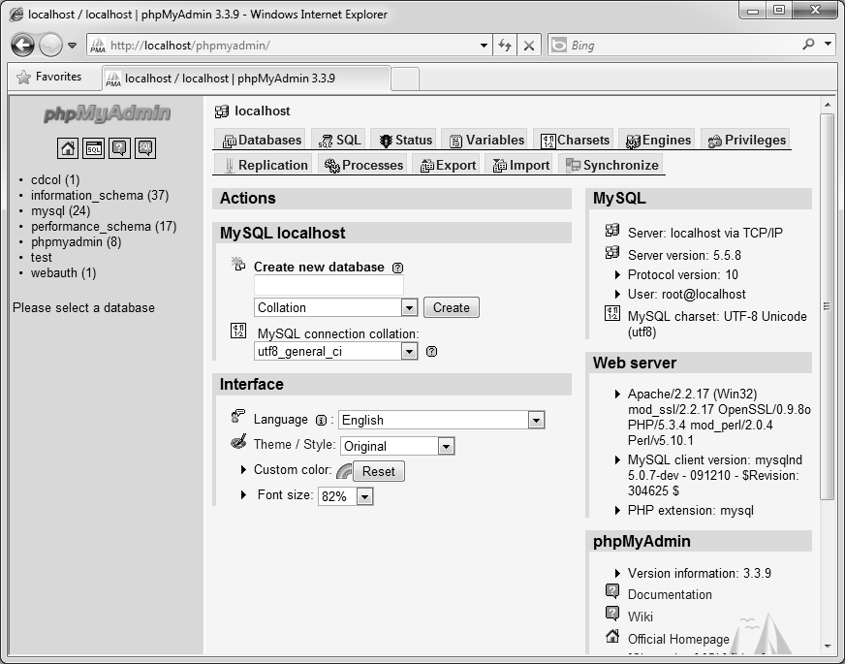
Using phpMyAdmin
www.math-cs.ucmo.edu/phpmyadmin
User: pma
Password: test
Notes:
phpMyAdmin is written in PHP and runs in the Web browser
phpMyAdmin provides clickable shortcuts to many common tasks, such as selecting all the records in a table or inserting a new record.

Slide 26
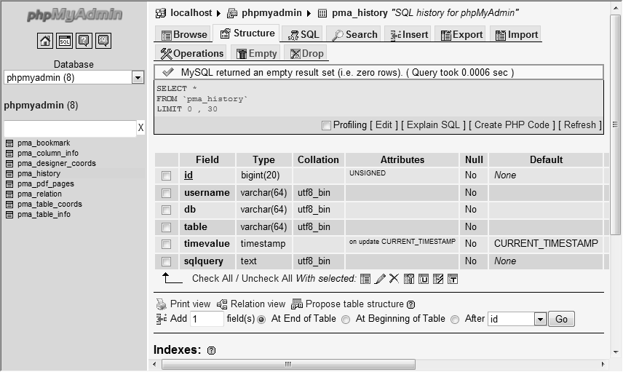
Selecting a Database
Notes:
Use the list of databases on the left to select a database
Use the list of tables to work with an individual table.

Slide 27
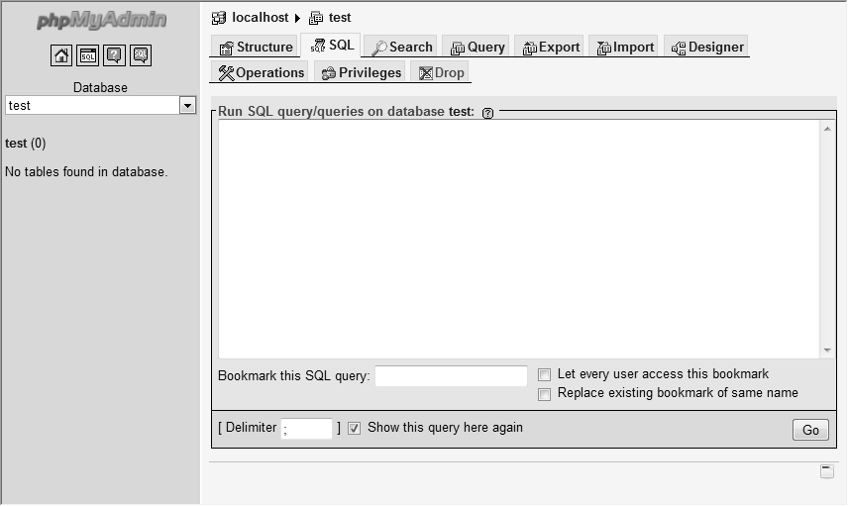
Running Queries
Notes:
Use the SQL tab to run queries, or the SQL popup window.

