Slide 1
PHP and MySQL for Dynamic Web Sites
4th Edition
Instructor’s Notes
Chapter 5: Introduction to SQL
Copyright © 2012 by Larry Ullman

Slide 2
Learning Outcomes
Create a database
Select a database to use
Create a table
List the tables in a database or columns in a table
Insert records into a table
Properly use quotation marks in queries
Fetch records from a table
Use conditionals
Recognize the MySQL operators

Slide 3
Learning Outcomes
Perform LIKE and NOT LIKE queries
Sort query results
Limit query results
Update existing data
Delete existing table rows
Make and use aliases
Invoke MySQL functions
Recognize many commonly used MySQL functions

Slide 4
Creating & Selecting Databases
CREATE DATABASE databasename
USE databasename
CREATE DATABASE sitename;
USE sitename;
Notes:
The CREATE command creates a new database.
The USE command selects the database to use.
You must have permission to do these things!

Slide 5
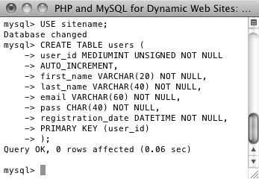
Creating Tables
CREATE TABLE tablename (
column1name description,
column2name description
…)
CREATE TABLE users (
user_id MEDIUMINT UNSIGNED NOT NULL
AUTO_INCREMENT,
first_name VARCHAR(20) NOT NULL,
last_name VARCHAR(40) NOT NULL,
email VARCHAR(60) NOT NULL,
pass CHAR(40) NOT NULL,
registration_date DATETIME NOT NULL,
PRIMARY KEY (user_id)
);
Notes:
CREATE command is used to make databases or tables.
In the table definition, separate each column definition by a comma.
SQL is case-insensitive, but capitalizing SQL terms is beneficial.

Slide 6
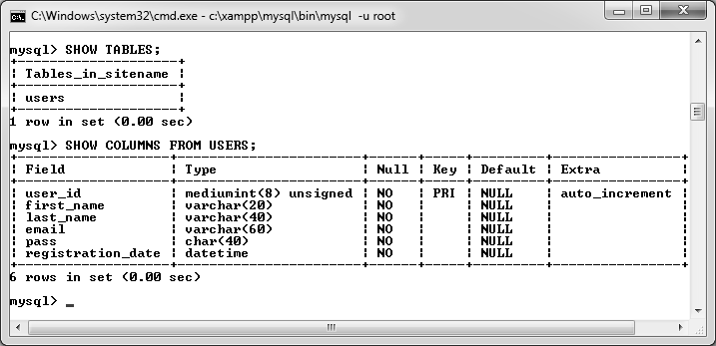
Showing Tables
SHOW TABLES;
SHOW COLUMNS FROM users;
Notes:
The SHOW command can list the tables in a database or columns in a table.

Slide 7
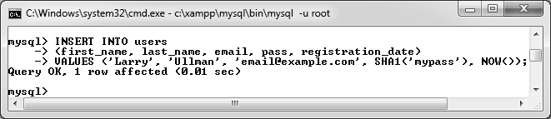
Inserting Records
INSERT INTO tablename (column1, column2…) VALUES (value1, value2 …)
INSERT INTO tablename (column4, column8) VALUES (valueX, valueY)
INSERT INTO tablename VALUES (value1, NULL, value2, value3, …)
INSERT INTO users
(first_name, last_name, email, pass, registration_date)
VALUES ('Larry', 'Ullman', 'email@example.com', SHA1('mypass'), NOW());
INSERT INTO users VALUES
(NULL, 'Zoe', 'Isabella', 'email2@example.com', SHA1('mojito'), NOW());
Notes:
Two ways of inserting records: naming the columns or not.

Slide 8
Quotes in Queries
Numeric values should not be quoted
String values must be quoted
Date and time values must be quoted
Functions cannot be quoted
The word NULL must not be quoted
Notes:
Single or double quotes does not matter, but you may need to escape instances of the same quotation mark within the string

Slide 9
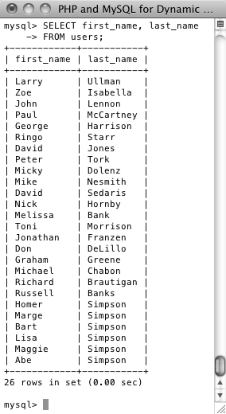
Selecting Data
SELECT which_columns FROM which_table
SELECT * FROM tablename
SELECT column1, column3 FROM tablename
SELECT * FROM users;
SELECT first_name, last_name
FROM users;
Notes:
The asterisk means all columns.
Normally best to be explicit and only request the columns needed.
The same column can be selected multiple times (e.g., in different formats).
You can select the columns in any order.

Slide 10
Using Conditionals
SELECT which_columns FROM which_table WHERE condition(s)
SELECT name FROM people WHERE birth_date = '2011-01-26';
SELECT * FROM items WHERE (price BETWEEN 10.00 AND 20.00) AND (quantity > 0);
SELECT * FROM cities WHERE (zip_code = 90210) OR (zip_code = 90211);
SELECT first_name FROM users WHERE last_name = 'Simpson’;
SELECT * FROM users WHERE email IS NULL;
SELECT user_id, first_name, last_name FROM users WHERE pass = SHA1('mypass');
Notes:
A lot of ways to write conditionals to change which rows are returned.

Slide 11
MySQL Operators
Operator | Meaning
= | Equals
< | Less than
> | Greater than
<= | Less than or equal to
>= | Greater than or equal to
!= | Not equal to
IS NOT NULL | Has a value
IS NULL | Has no known value
IS TRUE | Has a true value
IS FALSE | Has a false value
Notes:
Operators are normally used in conditionals.

Slide 12
MySQL Operators
Operator | Meaning
BETWEEN | Within a range
NOT BETWEEN | Outside of a range
IN | Found within a list of values
NOT IN | Not found within a list of values
OR | Where at least one of two conditionals is true
AND | Where both conditionals are true
NOT | Where the condition is not true
XOR | Where only one of two conditionals is true

Slide 13
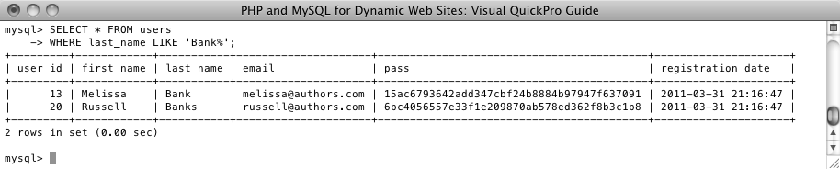
Using LIKE and NOT LIKE
SELECT * FROM users
WHERE last_name LIKE 'Smith%'
SELECT * FROM users
WHERE last_name LIKE 'Bank%’
SELECT first_name, last_name
FROM users WHERE
email NOT LIKE '%@authors.com'
Notes:
LIKE and NOT LIKE use two wildcard characters to make more flexible searches
_ match single character
% match zero or more characters

Slide 14
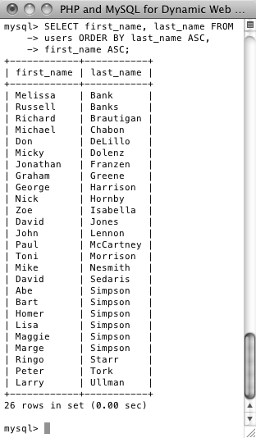
Sorting Query Results
SELECT * FROM tablename ORDER BY column
SELECT * FROM orders ORDER BY total
SELECT * FROM tablename ORDER BY column DESC
SELECT * FROM tablename ORDER BY column1, column2
SELECT * FROM tablename WHERE conditions
ORDER BY column
SELECT first_name, last_name FROM users
ORDER BY last_name;
SELECT first_name, last_name FROM
users ORDER BY last_name ASC,
first_name ASC;
Notes:
Query results are returned in a meaningless order by default.
Default order is ascending.
Text sorting depends upon the collation (to be explained in the next chapter).
You don’t have to select the column you are sorting by.

Slide 15
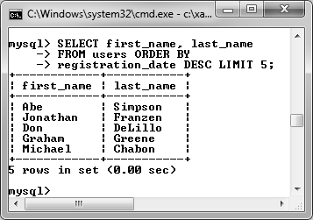
Limiting Query Results
SELECT * FROM tablename LIMIT x
SELECT * FROM tablename LIMIT 3
SELECT * FROM tablename LIMIT x, y
SELECT * FROM tablename LIMIT 10, 10
SELECT which_columns FROM tablename WHERE
conditions ORDER BY column LIMIT x
SELECT first_name, last_name
FROM users ORDER BY
registration_date DESC LIMIT 5;
SELECT first_name, last_name
FROM users ORDER BY
registration_date ASC LIMIT 1, 1;
Notes:
The LIMIT clause only returns a certain number of the results.
Almost always want to use ORDERY BY, too.
Can LIMIT how many are returned from a given point.
LIMIT x, y is used to paginate results.
10, 10 will be 11 to 20

Slide 16
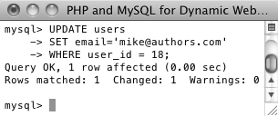
Updating Tables
UPDATE tablename SET column=value
UPDATE tablename SET column1=valueA, column5=valueB
UPDATE tablename SET column2=value WHERE column5=value
UPDATE users
SET email='mike@authors.com'
WHERE user_id = 18;
Notes:
You can update multiple columns at once.
Almost always want to use a WHERE clause.
Never change the primary key value!
The primary key column is almost always used as the basis of the conditional.

Slide 17
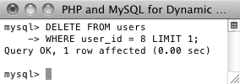
Deleting Rows
DELETE FROM tablename
DELETE FROM tablename WHERE condition
DELETE FROM users
WHERE user_id = 8 LIMIT 1;
TRUNCATE TABLE tablename
Notes:
Almost always want a WHERE clause.
Can also use LIMIT, if you want.
The primary key column is almost always used as the basis of the conditional.
Truncate clears out all the rows in a more proper manner
TRUNCATE is a DDL command.
TRUNCATE TABLE always locks the table and page but not each row.
Cannot use Where Condition.
It Removes all the data.
TRUNCATE TABLE cannot activate a trigger because the operation does not log individual row deletions.
Faster in performance wise, because it doesn't keep any logs.

Slide 18
Dropping Tables & Databases
DROP TABLE tablename
DROP DATABASE databasename

Slide 19
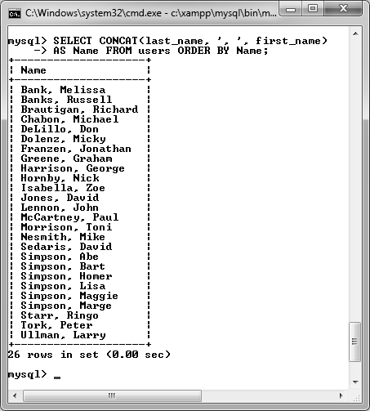
Aliases
SELECT registration_date AS reg
FROM users
SELECT first_name AS name
FROM users WHERE name='Sam'
Notes:
Case-sensitive
Normally very short
Be consistent

Slide 20
Using Functions
SELECT FUNCTION(column) FROM tablename
SELECT *, FUNCTION(column) FROM tablename
SELECT column1, FUNCTION(column2), column3 FROM tablename
List of functions can be found in text book.
Notes:
To apply a function to one column’s values while also selecting some other columns, you can write a query like either of these.
Functions can be used in INSERTs and UPDATEs to set a value or in SELECTs to change the formatting of a returned value.

Slide 21
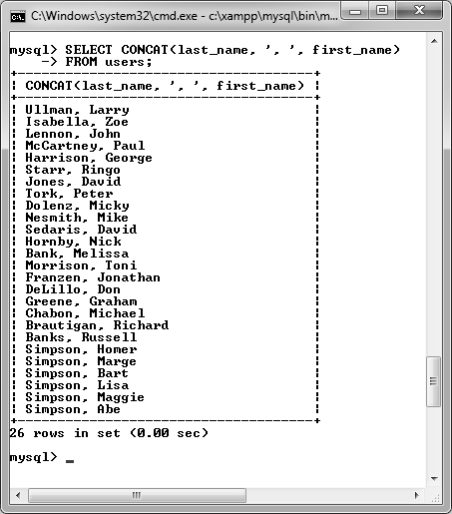
Text Functions
SELECT CONCAT(last_name, ', ', first_name)
FROM users;
SELECT CONCAT(last_name, ', ', first_name)
AS Name FROM users ORDER BY Name;
SELECT LENGTH(last_name) AS L,
last_name FROM users
ORDER BY L DESC LIMIT 1;

Slide 22
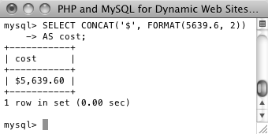
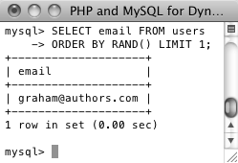
Numeric Functions
SELECT CONCAT('$', FORMAT(5639.6, 2))
AS cost;
SELECT email FROM users
ORDER BY RAND() LIMIT 1;
Notes:
Most arithmetic can be done using the arithmetic operators.
Also MySQL functions for other purposes.
The RAND() function can be used to retrieve a random record.

Slide 23
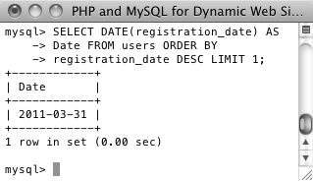
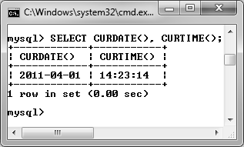
Date & Time Functions
SELECT DATE(registration_date) AS
Date FROM users ORDER BY
registration_date DESC LIMIT 1;
SELECT CURDATE(), CURTIME();
Notes:
Several functions for parsing out parts of a date or time value.

Slide 24
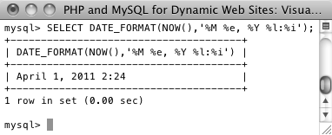
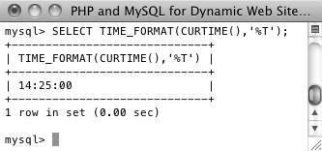
Formatting Dates & Times
SELECT DATE_FORMAT(NOW(),'%M %e, %Y %l:%i');
SELECT TIME_FORMAT(CURTIME(),'%T');
Notes:
Use DATE_FORMAT() and TIME_FORMAT() to return a date or time using a given syntax.

Slide 25
Other MySQL Functions
SHA1()
MD5()
NOW()
Read more about: Create stored functions or user defined functions.
Notes:
SHA1() creates a hash exactly 40 characters long
MD5() creates a hash exactly 32 characters long, but is less secure
NOW() returns the current date and time

Slide 26
Create Tables for Pizza Shop
Customer Name
Billing/Deliver Address
Order info: Crust, size, toppings, sides etc.
One table or multiple tables

