Slide 1
Advanced Software Engineering
ONLINE BANKING
By,
Aarati D. Sonawane
Naga Pooja Anne
Karunakar Yalla
Dheeraj Jampani
Guided by,
Prof. Hyung Bae Park

Slide 2
Major problems and Goal
Earlier in order to perform any banking task, a customer was required to be present physically.
Major Problems : Lack of security of data
Time consuming
More manpower
Needs manual calculation
Online Banking system enables bank users to access their accounts and general information about bank’s products and services from the comfort of your PC.

Slide 3
Advantages
Convenience
Accessibility
Efficiency
Transaction speed

Slide 4
Disadvantages
A need for skill to deal with computers and browsers
Many people who are not comfortable with computers and the internet, often find it difficult to use online banking
For beginners, online banking is really time-consuming
In many instances, a simple mistake, like clicking a wrong button, may create a big problem

Slide 5
Target Customers
People who have bank accounts
Small to Medium Businesses
Working people

Slide 6
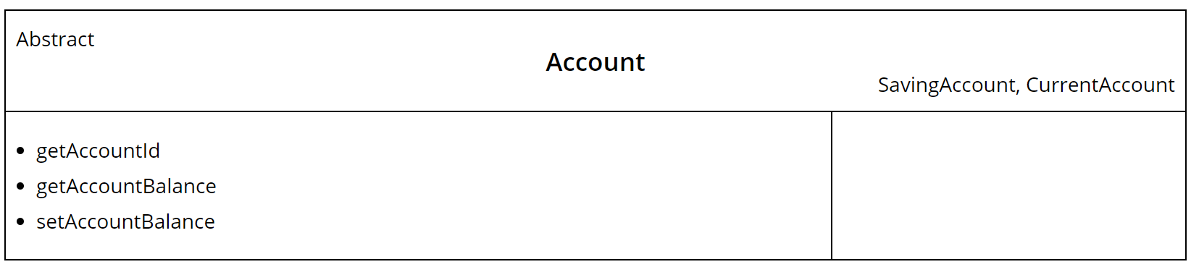
CRC card
Class-responsibility-collaboration
CRC cards contains
1) Name of class
2) Responsibility(Functionality)
3) List of classes it invokes (Collaboration)

Slide 7
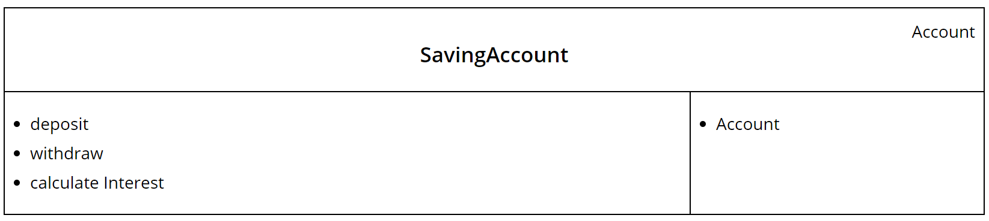
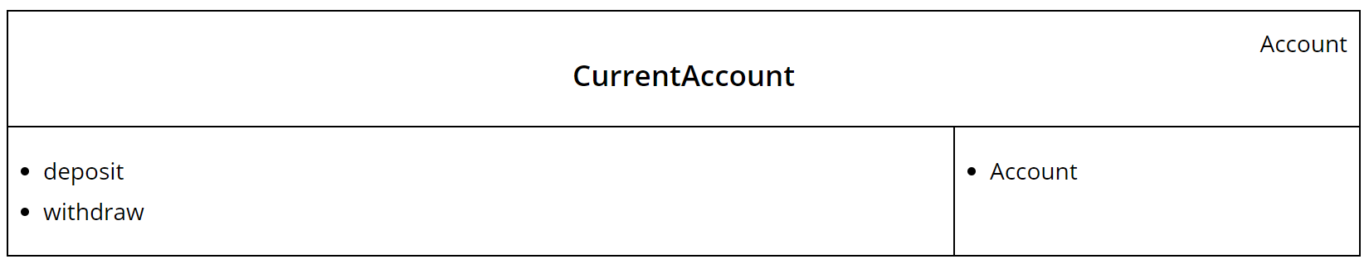
CRC card (contd)

