Slide 1
Lecture 1: Introduction
Dabin Ding

Slide 2
Demo 1
Observe a webpage and perform the following attacks:
  Display a file from the server. Password file?
  Discover the privileges of the web server
  Ping a system
  Shovel a shell, so you can run any command remotely.

Slide 3
Demo 2
Attack A Bank App, temper with bank accounts
You have an Android banking application that enables you to check your balances and the transfer funds between your own accounts.
You can’t select accounts that is not yours
GOAL:
  Steal money from someone else’s account
  Steal unlimited amount of money

Slide 4
Outline
Why is most software insecure?
Must consider security throughout lifecycle
Information security principles/terminology
Risk management/assurance cases
Weakness groupings

Slide 5
Why is most software insecure?
Few developers know how to develop secure sw
  Most schools don’t have it in their curricula
    If it is, it’s optional graduate level, not required undergrad
  Programming books/courses don’t teach it
  Some common operations intrinsically dangerous (esp. C)
  Most developers don’t think like an attacker
    “How could this be attacked?” – be slightly paranoid
  Developers don’t learn from others’ security mistakes
    Most vulnerabilities caused by same mistakes over 40+ years
    Focus on learning common errors… so you won’t make them
Customers can’t easily evaluate software security
Managers don’t always resource/train adequately
There are many other reasons, too.

Slide 6
Insecure software
Insecure software may:
  Release private/secret information
  Corrupt information
  Lose service
Costing:
  money
  time
  trust
  lives

Slide 7
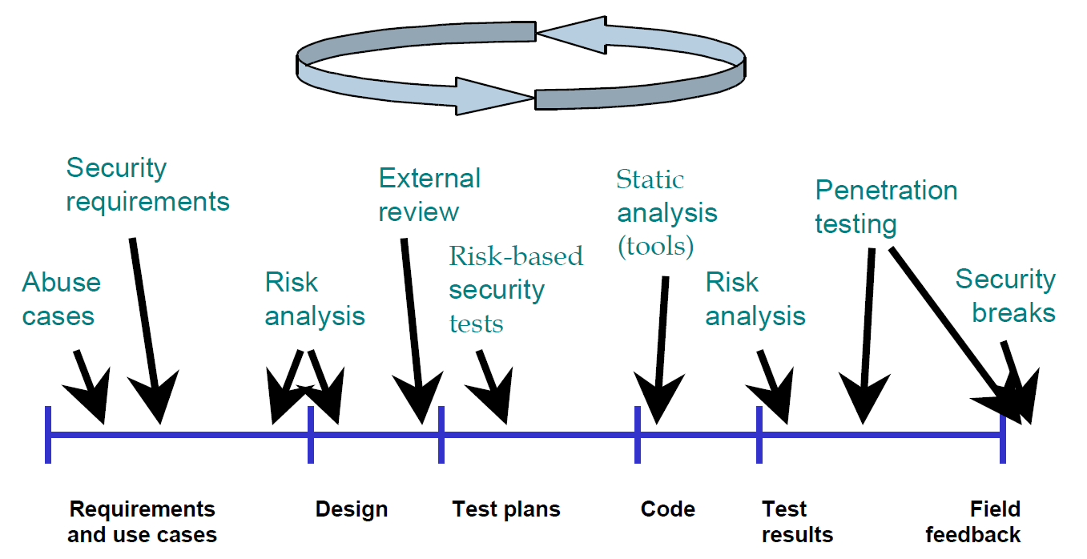
Must consider security throughout lifecycle
Developing secure software requires actions throughout lifecycle
  “Defense-in-breadth”
This class focuses on design & implementation (code, best practices)
Source: “Improving Security Across the Software Development Lifecycle – Task Force Report”, April 1, 2004. http://www.cyberpartnership.org/init.html; based on Gary McGraw 2004, IEEE Security and Privacy. Fair use asserted.

Slide 8
Information Security Principles and Terminology

Slide 9
Attacker, Cracker, Hacker
Attack: “Any kind of malicious activity that attempts to collect, disrupt, deny, degrade, or destroy information system resources or the information itself.” [National Information Assurance (IA) Glossary, CNSS 4009]
Attacker: Someone who attacks a system (without authorization)
Cracker: “an individual who attempts to access computer systems without authorization” (type of attacker) [RFC 1392]
Hacker: “A person who delights in having an intimate understanding of the internal workings of a system, computers and computer networks in particular” [RFC 1392]
  NOTE: Hacker ≠ attacker
  Most hackers don’t attack systems
  Many attackers aren’t hackers (might not be clever or knowledgeable)
  Common journalist mistake

Slide 10
Many types of attackers
Why “people” attack system?
Criminals (for money)
Terrorists
Governments
Crackers (often for pleasure)
…
We want to prevent their attacks from succeeding!
It is harder to defend vs. well-resourced adversary:
  What are their resources?
  What are they trying to do (so we can counter)?

Slide 11
Security objectives
Typical security objectives (CIA):
  Confidentiality: “No unauthorized read”
  Integrity: “No unauthorized modification (write/delete)”
  Availability: “Keeps working in presence of attack”
    vs. “Denial of Service” (DoS) attack
    “Distributed Denial of Service (DDoS)” attack is resource vs. resource
      Make harder to take down, recover quickly when stop(ped)
Sometimes separately-listed objectives:
  Non-repudiation (of sender and/or receiver)
  Privacy (e.g., protecting user identity)
  Auditing/accountability/logging
  Identity & [identity] authentication (I&A), authorization
    Last two abbreviated as AuthN and AuthZ
Notes:
nonrepudiation involves methods such as email tracking that are designed to ensure that the sender cannot deny having sent a message and/or that the recipient cannot deny having received it.

Slide 12
[User] Authentication
Proving the identity of a user (might be a program!)
Authentication is basis of an authorization decision
  All objectives depend on if you’re authorized
  So authentication is fundamental
Authentication approaches (first 3 traditional):
  Something you know ()
  Something you have ()
  Something you are ()
  Somebody you know (vouching) – often forgotten
Strong authentication uses more than one approach
Most common: Passwords (“something you know”) to prove username (identity)
passwords
key, token
biometrics
Notes:
“Fourth-Factor Authentication: Somebody You Know” by
John Brainard, Ari Juels, Ronald L. Rivest, Michael Szydlo, Moti Yung
CCS’06, October 30–November 3, 2006, Alexandria,Virginia, USA.
Copyright 2006 ACM1-59593-518-5/06/0010

Slide 13
All authentication systems have problems
First three authentication approaches can also be described as:
  Something you forgot
  Something you lost
  Something you cease to be
Be aware of each systems’ problems
  Choose approach(es) appropriate to task
Source: “Security” (post) by JasterBobaMereel (1102861), in reply to
Amazon Wants To Replace Passwords With Selfies and Videos Tuesday March 15, 2016 @09:33AM (#51699623)
https://it.slashdot.org/comments.pl?sid=8881629&cid=51699623

Slide 14
Password Problems
User-created passwords often easily guessed
  Often based on user name, personal traits, etc.
  Often based on dictionaries with trivial substitutions
  Often too short
Yet system-generated passwords often too hard to remember
How many passwords do you have to remember?
  If browser stores them, what if browser is subverted?
  If reuse, breaking into one breaks into many
Often passwords can be captured or discovered
  E.g., keyloggers, confuse users into thinking they’re on different site

Slide 15
Attackers vs. passwords
Capture password
  Keyloggers, network eavesdropping, shoulder surfing
  Break into server, capture passwords, reuse elsewhere
Brute force attack
  Try all combinations
Dictionary attacks
  Guess passwords using a password dictionary + permutations
  Password dictionaries widely available
    Include multiple human languages, terms from wide interests (e.g., Shakespeare and Star Trek), etc.
Notes:
Democratic National Committee (DNC) breach: Email 2016

Slide 16
Defending passwords
Encrypt connection carrying passwords
Require “good” passwords when user tries to set one
  Long enough, different symbol types, etc.
  Check against dictionaries
On server, don’t store passwords as clear text
  Store as “iterated salted hashes” so attacker cannot use directly
  We’ll discuss iterated salted hashes later in course (crypto)
Require occasional password changes
Make it hard for attacker to exploit “lost my password”
Alert user when the password is changed
  E.G., via email
Notes:
Questions here.

Slide 17
Alternatives to passwords
Algorithms
  One-time passwords
  Shared secret
  Public key cryptography
Hardware
Notes:
Various approaches for the generation of OTPs are listed below:
Based on time-synchronization between the authentication server and the client providing the password (OTPs are valid only for a short period of time)
Using a mathematical algorithm to generate a new password based on the previous password (OTPs are effectively a chain and must be used in a predefined order).
Using a mathematical algorithm where the new password is based on a challenge (e.g., a random number chosen by the authentication server or transaction details) and/or a counter.
special electronic security tokens that the user carries and that generate OTPs and show them using a small display
Mobile phone prompt.

Slide 18
One-time passwords
Generation and distributing
Pros:
  Counters network eavesdropping, shoulder surfing
  Cheap to implement; tiny state to store at server
Cons:
  Harder to distribute list
  Compromise of list allows impersonation
  Users hate them (when implemented by hand)
Notes:
There are also different ways to make the user aware of the next OTP to use. Some systems use special electronic security tokens that the user carries and that generate OTPs and show them using a small display. Other systems consist of software that runs on the user's mobile phone. Yet other systems generate OTPs on the server-side and send them to the user using an out-of-band channel such as SMS messaging. Finally, in some systems, OTPs are printed on paper that the user is required to carry.

Slide 19
Shared secret
User & server have shared secret
Authentication process:
  Server generates nonce (random number), sends to client
  Client encrypts nonce with secret, sends back
  Server also encrypts, compares with client value
  If same, user must know the secret – ok!
Pros:
  Prevents network eavesdropping
Cons:
  If secret compromised, user can be impersonated

Slide 20
Public key cryptography
Use “public key cryptography”
  User has two numbers, “public key” & “private key”
  Server knows public key of users
Authentication process:
  Server generates/sends random nonce to client
  Client encrypts nonce with private key, sends back
  Server decrypts with public key, if match, ok!
Pros: Provides non-repudiation of client key
Cons: If user’s private key compromised, user can be impersonated

Slide 21
Hardware devices
Challenge-response: Server sends number (nonce), devices receives and generates response, response sent back to server
    Could implement shared-secret or public key
Time-based challenge-response: Uses current time to determine what to send to server
    Server and token have to have time synchronized
Smartcards: Contains user credentials
    Better ones never yield credentials outside card

Slide 22
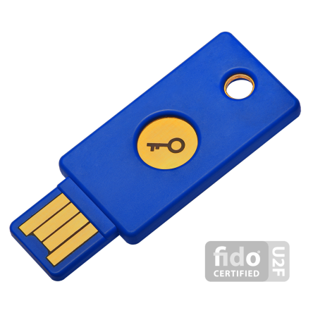
Example: YubiKey
YubiKey: Physical device, plugs into USB port, pretends to be (an additional) keyboard
User moves cursor to “password” position and presses button on Yubikey
On Button press, generates and “types in” a one-time password + ENTER
Notes:
Server verifies; if verifies, that password can’t be reused
Internally works on shared-secret key with AES
Shared secret used to encrypt a “serial number” that‘s incremented
Sources: http://lwn.net/Articles/409031/ http://yubico.com/products/yubikey/

Slide 23
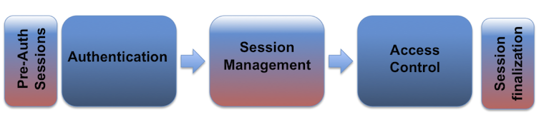
Web Authentication
HTTP is a stateless protocol
A web session is a sequence of network HTTP request and response transactions associated to the same user.

Slide 24
Demo how cookie and session id are exchanged using the CATS app.

Slide 25
Web Authentication
Modern and complex web applications require the retaining of information or status about each user for the duration of multiple requests.
Therefore, sessions provide the ability to establish variables – such as access rights and localization settings – which will apply to each and every interaction a user has with the web application for the duration of the session.

Slide 26
Web Authentication
Do we need to maintain sessions of anonymous users?
Yes or No, why?
Notes:
An example would be maintaining the user language preference

Slide 27
Web Authentication
The session ID or token binds the user authentication credentials (in the form of a user session) to the user HTTP traffic and the appropriate access controls
Once an authenticated session has been established. No passwords, biometrics are necessary for the following traffic.
Notes:
Once an authenticated session has been established, the session ID (or token) is temporarily equivalent to the strongest authentication method used by the application, such as username and password, passphrases, one-time passwords (OTP), client-based digital certificates, smartcards, or biometrics (such as fingerprint or eye retina).

Slide 28
Web Authentication
Session ID Properties
The session ID is a “name=value” pair
must be long enough to prevent brute force attacks
must be unpredictable (random enough) to prevent guessing attacks
must be meaningless to prevent information disclosure attacks

Slide 29
Web Authentication
Session Management
  Session Implementation
  Transportation
  Exchange
  Cookies
  Expire/Max-Age

Slide 30
Session Fixation
Session Fixation is an attack that permits an attacker to hijack a valid user session.
The attack explores a limitation in the way the web application manages the sessionID.

Slide 31
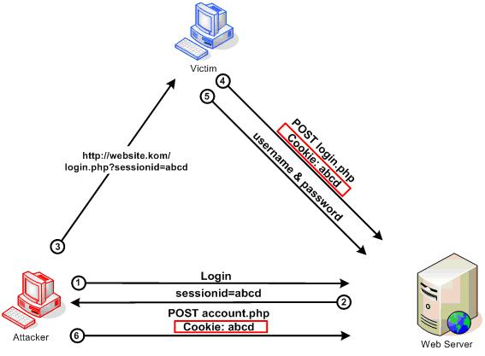
Session Fixation

Slide 32
Session Fixation
Common attacks
  Session token in the URL argument
  Session token in a hidden form field
  Session ID in a cookie
    Client-side script, using scripting to plant a session ID
    <META> tag, works if script is disabled
    HTTP header response

Slide 33
Client side scripting
<META>tag
http://website.com/<script>document.cookie=“sessionid=abcd”; </script>
http://website.com/<meta http-equiv=Set-Cookie content=“sessionid=abcd”>

Slide 34
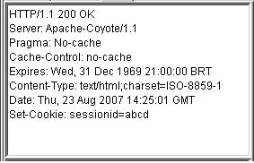
HTTP header response

Slide 35
How to Prevent Session Fixation Attack
Discard any existing session after any successful authentication, issue a new one
Works for most system, but not for ASP.net
For ASP.net, create your own session management or deal with session id renewing

Slide 36
Session Hijacking
The session hijacking attack consists of the exploitation of the web session control mechanism. The most commons are:
  Predictable session token
  Session Sniffing
  Client-side attacks (XSS, macilious Javascript codes, Trojans, etc)
  Man-in-the-middle attack
  Man-in-the-browser attack

Slide 37
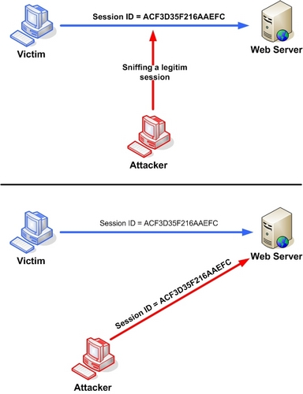
Session sniffing

Slide 38
Session hijacking
Cross-site script attack
www.math-cs.ucmo.edu/~dding/PHP/ch13/xss.php

Slide 39
Authorization
Once you have user identity and authentication, you can determine what they’re authorized to do
Discretionary Access Control
  Data has owner, owner decides who can do what
Mandatory Access Control
  Data has certain properties, some access rights cannot be granted even by owner (e.g., classification)
Role Based Access Control (RBAC)
  Assigns users into roles
  Access granted to the role, not directly to the user
  Sometimes membership restrictions (receiving clerk must not be purchasing agent)
Notes:
Dynamic Seperation of Duties relations differ from Static SD relations by the context in which these limitations are imposed, for example in a given session.
Bank operator: cashier can open cash drawer

Slide 40
Auditing/Accountability/Logging
What should be logged?
Record system actions, esp. security-relevant ones (e.g., log in)
Detect unusual activity that might signal attack or exploitation
  So you can take action: Disconnect that connection, take down system, prosecute, …
  May help recovery or preventing future exploitation (by knowing what happened)
  Operational systems often send logs elsewhere
    If system subverted, older log entries can’t be changed

Slide 41
Defense-in-depth/breadth
Defense in depth: Having multiple defense mechanisms (“layers”) in place, so that an attacker has to defeat multiple mechanisms to perform a successful attack
Defense in breadth: Applying approaches to develop secure software throughout the lifecycle

Slide 42
Some more terminologies
Threats
Risks
Weakness: A type of defect/flaw that might lead to a failure to meet security objectives
Vulnerability: “Weakness in an information system, system security procedures, internal controls, or implementation that could be exploited by a threat source” [CNSS 4009]
Notes:
Committee on National Security Systems
Risks can be managed
threats cannot be controlled

Slide 43
Weakness classifications
Software is vulnerable because of some weakness that is exploitable
  Typically vulnerability is unintentional
  Usually the weakness (type/kind of flaw) has occurred thousands of times before
We should spend time learning about weaknesses – so you won’t make the same mistakes
Many weakness classification systems exist
  Common Weakness Enumeration (CWE) – merged
  “Seven pernicious kingdoms”, etc.
  Key is to learn what these weaknesses are

Slide 44
Common Weakness Enumeration (CWE)
Common Weakness Enumeration (CWE) = list of software weaknesses
Weakness = Type of vulnerabilities
CWE-120 = Buffer Copy without Checking Size of Input (“Classic Buffer Overflow”)
Common naming system
  Useful as “common name” (e.g., tool coordination)
  Does have some structuring/organization (slices, graphs, parents/children)… but that’s not its strength
More info: http://cwe.mitre.org

Slide 45
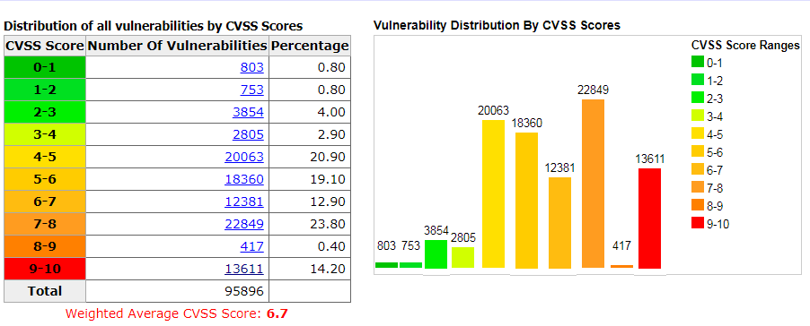
Common Vulnerabilities and Exposures (CVE)
CVE = list of publicly known cybersecurity vulnerabilities
Scores based on: vulnerable component, attack complexity, scope, impact, etc

Slide 46
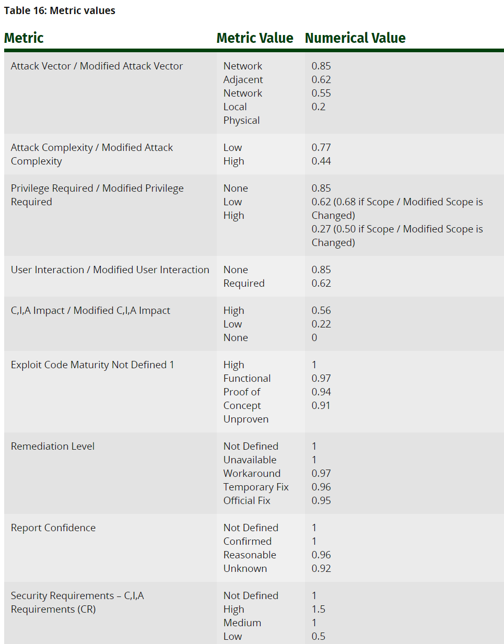


Slide 47
Seven Pernicious Kingdoms
Input Validation and Representation
API Abuse
Security Features
Time and State
Error Handling
Code Quality
Encapsulation
Source: Tsipenyuk, Chess, and McGraw,
“Seven Pernicious Kingdoms: A Taxonomy of Software Security Errors”,
Proceedings SSATTM, 2005

Slide 48
OWASP Top 10 (2013)
Security Risk | Covered in this course
A1: Injection | SQL injection, shell injection
A2: Broken Authentication and Session Management | Authentication
A3: Cross-Site Scripting (XSS) | XSS
A4: Insecure Direct Object References | Introduced in input validation
A5: Security Misconfiguration | None
A6: Sensitive Data Exposure | HTTPS
A7: Missing Function Level Access Control | Design (least privilege)
A8: Cross-Site Request Forgery (CSRF) | CSRF
A9: Using Components with Known Vulnerabilities | Design
A10: Unvalidated Redirects and Forwards | Design

Slide 49
CWE/SANS Top 25 Most Dangerous Software Errors (2011)
Rank | ID | Name
[1] | CWE-89 | Improper Neutralization of Special Elements used in an SQL Command ('SQL Injection')
[2] | CWE-78 | Improper Neutralization of Special Elements used in an OS Command ('OS Command Injection')
[3] | CWE-120 | Buffer Copy without Checking Size of Input ('Classic Buffer Overflow')
[4] | CWE-79 | Improper Neutralization of Input During Web Page Generation ('Cross-site Scripting')
[5] | CWE-306 | Missing Authentication for Critical Function
[6] | CWE-862 | Missing Authorization
[7] | CWE-798 | Use of Hard-coded Credentials
[8] | CWE-311 | Missing Encryption of Sensitive Data
[9] | CWE-434 | Unrestricted Upload of File with Dangerous Type
[10] | CWE-807 | Reliance on Untrusted Inputs in a Security Decision

Slide 50
Abstract view of a program
Program
Process Data
(Structured Program Internals)
Input
Output
Call-out to
other programs
(also consider
input & output issues)

Slide 51
Risk Management &
Assurance Cases

Slide 52
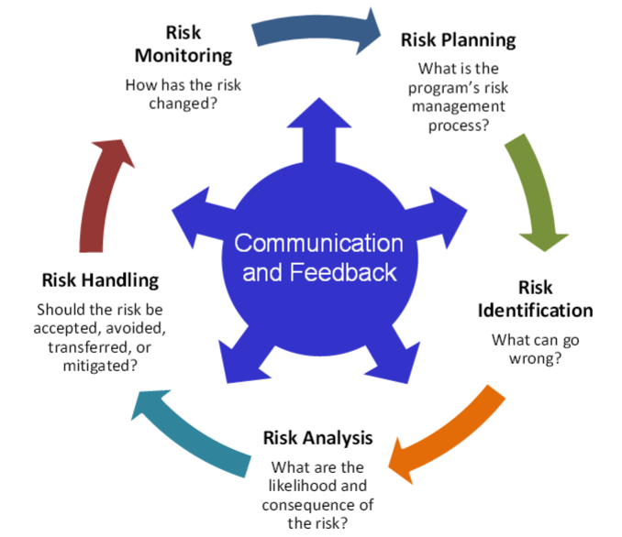
Risk Management should be part of entire system lifecycle
Risk management process:
Communication and consultation
Establishing the context
Risk assessment
  Risk identification
  Risk analysis
  Risk evaluation
Risk Treatment
Source: ISO 31000:2009
Source: DoD Risk, Issue, and Opportunity Management
Guide for Defense Acquisition Programs, June 2015
Potential impacts of security vulnerabilities are a risk
  Manage that risk as part of risk management
  If too complex to communicate, assurance case can help
Notes:
DoD Risk, Issue, and Opportunity Management Guide for Defense Acquisition Programs, June 2015
http://bbp.dau.mil/docs/RIO-Guide-Jun2015.pdf
The 2015 DoD document is an update of the Risk Management Guide for DoD Acquisition, DoD, August 2006

Slide 53
Possible risk responses
(with some of their names)
Avoid / eliminate
  Ensure risk can’t happen. Best, not always practical
Control / reduce / mitigate
  Limit system privileges so if attacker “takes over” a program, that program cannot do everything
  Limit data available on potentially-attacked system
  Detect/recover (quickly)
    Recover quickly when network denial-of-service ends
    Maintain protected backups, easy restore mechanism
Transfer / share (e.g., outsourcing, insurance)
Assume / accept / retain (budget for it!)
Notes:
Sources:
Risk Management Guide for DoD Acquisition, Sixth Edition (Version 1.0), 2006.
Dorfman, Mark S. (2007). Introduction to Risk Management and Insurance (9 ed.). Englewood Cliffs, N.J: Prentice Hall. ISBN 0-13-224227-3.

Slide 54
The key point about risks
You cannot eliminate all risks!
  Good goal, not always (affordably) achievable
You can manage them

Slide 55
Assurance case
(ISO/IEC 15026)
Assurance = Grounds for justified confidence that a claim has been/will be achieved (but how communicate that?)
ISO/IEC 15026-2:2011 specifies defines structure & contents of an assurance case
  Facilitates stakeholder communications, engineering decisions
  Typically for claims such as safety & security
An assurance case includes:
  Claim(s): Top-level claim(s) for a property of a system or product
  Arguments: Systematic argumentation justifying this claim
  Evidence/assumptions: evidence & explicit assumptions underlying argument

Slide 56
Structure of an assurance case
Claim
(Conclusions, uncertainty)
Argument
Justification of
Argument
Sub-claim
Evidence
Assumption
  “Arguing through multiple levels of subordinate claims, this structured argumentation connects the top-level claim to the evidence and assumptions.”

Slide 57
Security-specific example of an assurance case (moderate threat)
System is adequately secure against moderate threats
Off-the-shelf (OTS)/platform includes
OS, libraries, & services (e.g., RDBMS);
Discuss reputation, evaluation(s),
supply chain used, config hardening,
patch process, …
Claim:
System design counters or reduces impact of most vulnerabilities
Most vulnerabilities are due to likely/ common weaknesses (defect types), & custom sw is unlikely to have them
OTS/ platform is secure
System security verification found no issues
All un-trusted inputs id’d and checked by strict white-lists
Compo-nents given limited privilege, so break-ins less likely to have significant harm
Passwords stored as salted hashes, not clear text, so attacker cannot easily reuse them if acquired
Static analysis results ok
Dynamic analysis results ok
Identified list of likely weak-nesses
All developers trained in likely weaknesses & how to avoid them
All likely weak-nesses have specific counter-measures
…
All SQL statements prepared
Buffer overflows not possible in selected programming language

Slide 58
Summary
Most software are insecure
Security throughout lifecycle
Authentication & Authorization
Information security principles/terminology
Category of Vulnerabilities

