Slide 1
Lecture 2: Input Validation

Slide 2
Interception Tool
Demo Burp Suite
Demo HTTP communication

Slide 3
Outline
Failure example
Attack surface: Where are the inputs?
Non-bypassability, whitelist not blacklist
Channels (Sources of input)
Input data types & non-text validation methods
Background on text
  Character names, character encoding, globbing
Regular expressions for validating strings

Slide 4
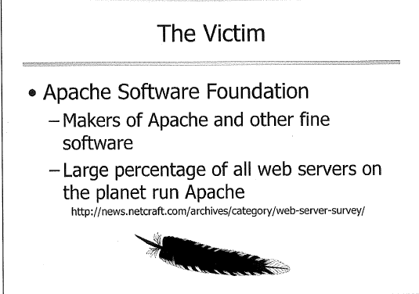


Slide 5
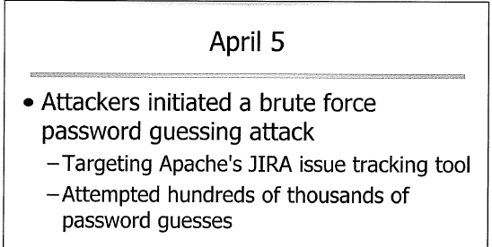
April 2010

Slide 6
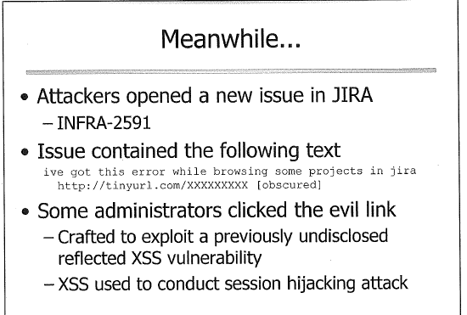

Slide 7
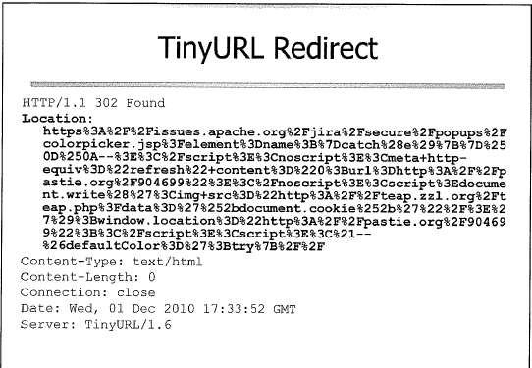
See decoding next page

Slide 8
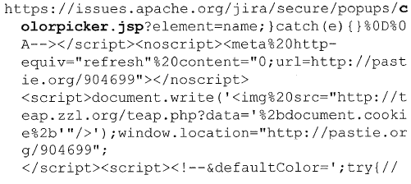
The location header redirects the victim to issues.apache.org and specifically targets the colorpicker.jsp file which contains the previously unknown XSS vulnerability.

Slide 9
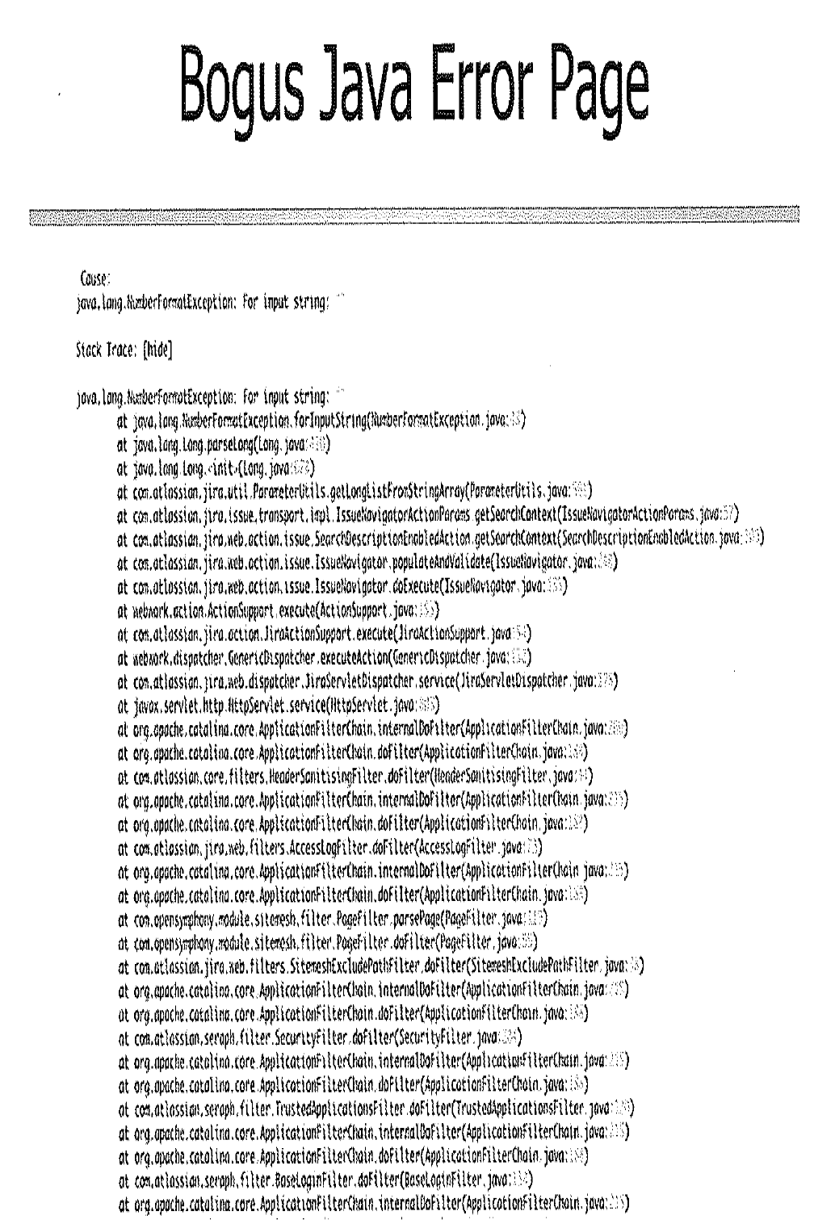
What the victim see

Slide 10
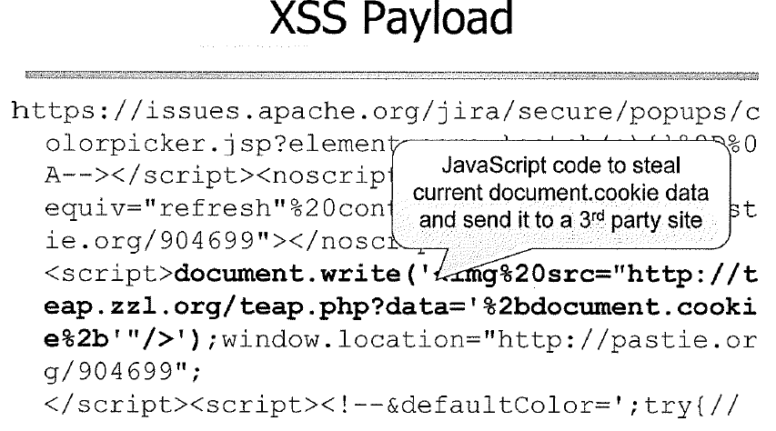
Under the hood

Slide 11
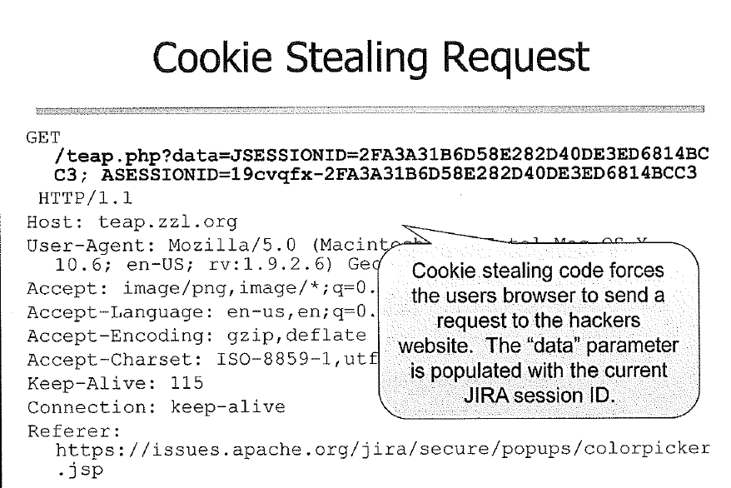

Slide 12
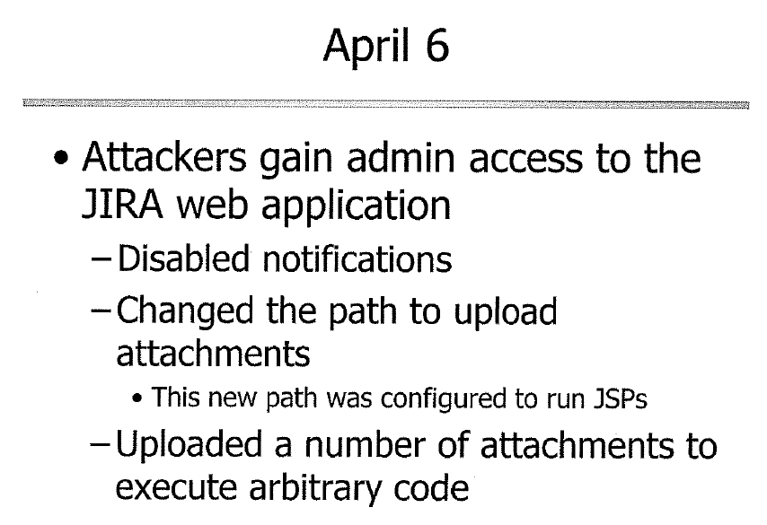
1) Brute force 2) XSS to hijack an admin’s session

Slide 13
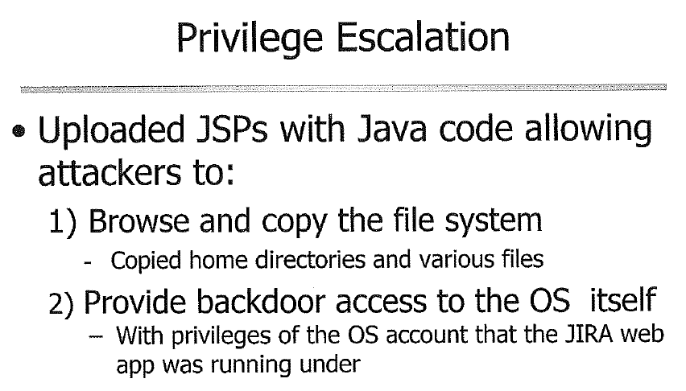

Slide 14
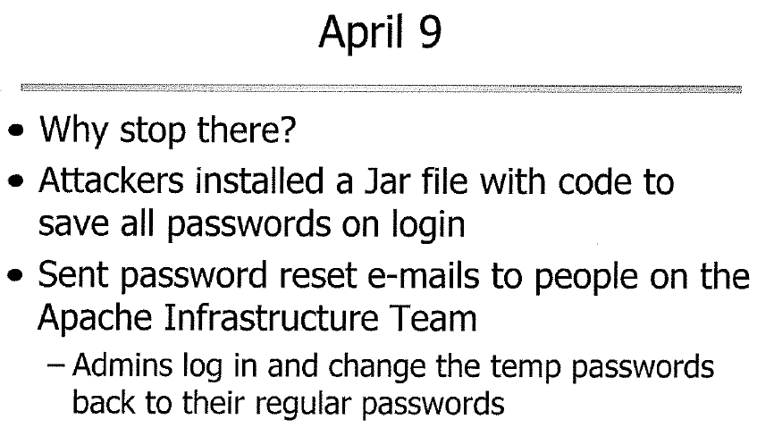

Slide 15
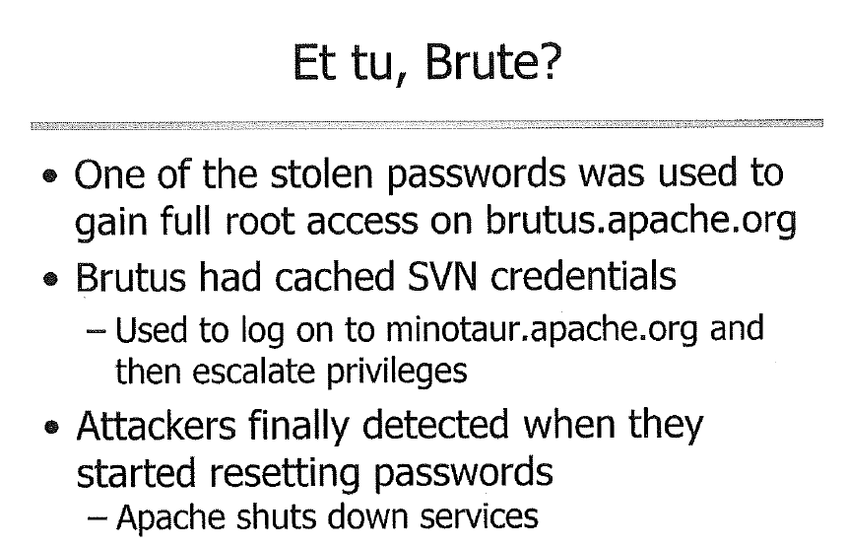

Slide 16
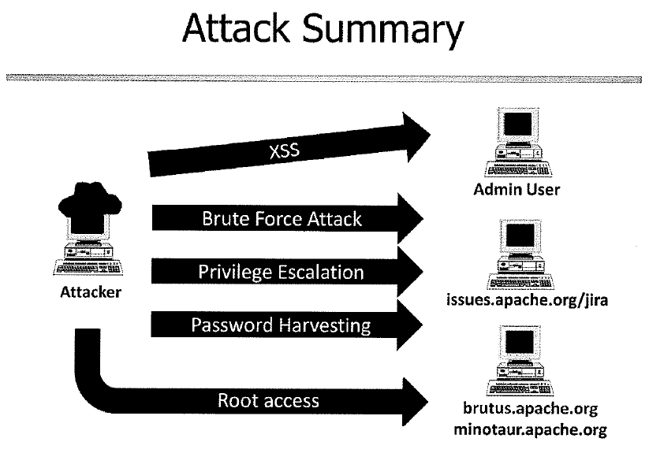
A minor vulnerabilities can lead to compromise of the overall infrastructure

Slide 17
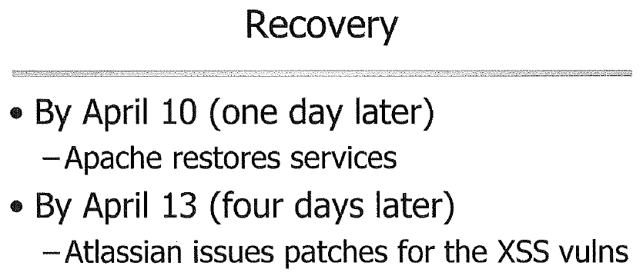

Slide 18
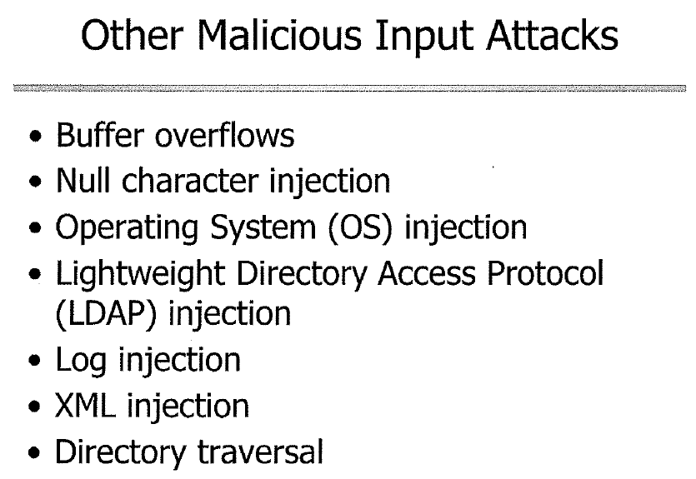
Notes:
Buffer overflows: writes over other parts of memory, most for c/C++
Null character: %00 null was accepted by java however, cause problem for other program writen in c/c++
OS injection: similary to null
LDAP: similar
Log injection: use \r\n to end a line and then injecting malicious XML elements and attributes, like the SQL and LDAP
Directory traversal: when user provide file name, then attacker exploits to retrieve arbitrary files.

Slide 19
Failure Example: PHF
White pages directory service program
  Distributed with NCSA and Apache web servers
Version up to NCSA/1.5a and apache/1.0.5 vulnerable to an invalid input attack
Impact: Un-trusted users could execute arbitrary commands at the privilege level that the web server is executing at
Example URL illustrating attack
  http://webserver/cgi-bin/phf?Qalias=x%0a/bin/cat%20/etc/passwd
Credit: Ronald W. Ritchey
Notes:
%0a is line feed, basically creating a new line

Slide 20
PHF Coding problems
Uses popen command to execute shell command
User input is part of the input to the popen command argument
Does not properly check for invalid user input
Attempts to strip out bad characters using the escape_shell_cmd function but this function is flawed. It does not strip out newline characters.
By appending an encoded newline plus a shell
command to an input field, an attacker
can get the command executed by the
web server
Credit: Ronald W. Ritchey

Slide 21
PHF Code
strcpy(commandstr, "/usr/local/bin/ph -m ");
if (strlen(serverstr)) {
strcat(commandstr, " -s ");
escape_shell_cmd(serverstr);
strcat(commandstr, serverstr);
strcat(commandstr, " ");
}
escape_shell_cmd(typestr);
strcat(commandstr, typestr);
if (atleastonereturn) {
escape_shell_cmd(returnstr);
strcat(commandstr, returnstr);
}
printf("%s%c", commandstr, LF);
printf("<PRE>%c", LF);
phfp = popen(commandstr,"r");
send_fd(phfp, stdout);
printf("</PRE>%c", LF);
Dangerous routine to use
with user data
Credit: Ronald W. Ritchey

Slide 22
PHF Code (2)
void escape_shell_cmd(char *cmd) {
register int x,y,l;
l=strlen(cmd);
for(x=0;cmd[x];x++) {
if(ind("&;`'\"|*?~<>^()[]{}$\\",cmd[x]) != -1){
for(y=l+1;y>x;y--)
cmd[y] = cmd[y-1];
l++; /* length has been increased */
cmd[x] = '\\';
x++; /* skip the character */
}
}
}
Notice: No %0a or \n character
Credit: Ronald W. Ritchey

Slide 23
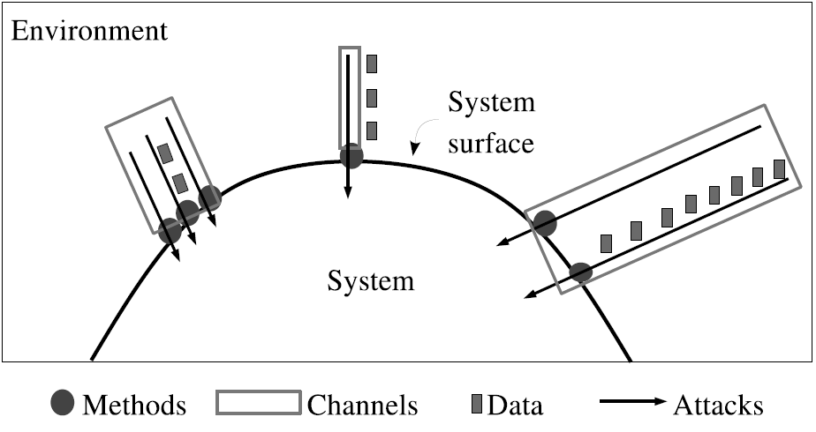
Attack Surface
Attacker can attack using channels (e.g., ports, sockets), invoke methods (e.g., API), & sent data items (input strings & indirectly via persistent data)
A system’s attack surface is the subset of the system’s resources (channels, methods, and data) [that can be] used in attacks on the system
Larger attack surface = likely easier to exploit & more damage
From An Attack Surface Metric, Pratyusa K. Manadhata, CMU-CS-08-152, November 2008
Notes:
“An attacker connects to a system using the system’s channels (e.g., sockets), invokes the system’s methods (e.g., API), and sends data items (e.g., input strings) into the system or receives data items from the system. An attacker can also send data indirectly into a system by using data items that are persistent (e.g., files).”
http://reports-archive.adm.cs.cmu.edu/anon/2008/CMU-CS-08-152.pdf

Slide 24
Attack Surface: What should a defender do?
Make attack surface as small as possible
  Disable channels (e.g., ports) and methods (APIs)
  Prevent access to them by attackers (firewall)
Make sure you know every system entry point
  Network: Scan system to make sure
For the remaining surface, as soon as possible:
  Authenticate/authorize (where appropriate)
  Ensure that all input is valid (input filtering)
    Failures here are CWE-20: Improper Input Validation

Slide 25
Dividing Up System
One technique to counter attacks is to divide system into smaller components
  Smaller components that do not fully trust another
  Each smaller component has an attack surface
Thus, even in web applications:
  Processes might be invoked by an attacker
  You might have a process that has different privileges

Slide 26
Potential Channels
(Sources of Input)
Web-Based Application Inputs:
  URL, Query String, Header, Cookie, Form Field, or a Hidden Field.
Other Inputs
  Database systems & other external services
  Registry/system property
  …
Which sources of input matter depend on the kind of application,
application environment, etc. What follows are potential channels
Notes:
Command line
Environment Variables
File Descriptors
File Names
File Contents (indirect?)

Slide 27
Discussion: Input sources
For different kinds of programs:
  Identify some potential input channels (e.g., ports) and methods (APIs)
    Do not limit to intended channels & methods
  What might an attacker try to do?
  Consider the many different kinds of systems / environments / platforms (e.g., mobile app, web application, embedded device)
How can you discover “previously unknown” input sources?
Notes:
Attack Surface Analyzer: is all in one tool for analysis of changes made to the various parts of the attack surface. changes made to the Registry, File permissions, Windows IIS Server, GAC assemblies and a lot more can be done. analyze the effects of software installation on the Windows Operating System.

Slide 28
Command line arguments
Command line programs can take arguments
  GUI/web-based applications often built on command line programs
Setuid/setgid program’s command line data is provided by an untrusted user
  Can be set to nearly anything via execve(3) etc., including with newlines, etc. (ends in \0)
  Setuid/setgid program must defend itself
Do not trust the name of the program reported by command line argument zero
  Attacker can set it to any value including NULL
Notes:
When set-user identification (setuid) permission is set on an executable file, a process that runs this file is granted access based on the owner of the file (usually root), rather than the user who is running the executable file.
The set-group identification (setgid) permission is similar to setuid, except that the process's effective group ID (GID)

Slide 29
Environment Variables
Environment Variables
  In some circumstances, attackers can control environment variables (e.g., setuid & setgid)
  Makes a good example of the kinds of issues you need to address if an attacker can control something
If an attacker can control them
  Some Environment Variables are Dangerous
  Environment Variable Storage Format is Dangerous
  The Solution - Extract and Erase

Slide 30
Environment variables: Background
Normally inherited from parent process, transitively
  Useful for general environment info
Calling program can override any environmental settings passed to called program
  Big problem if called program has different privileges (e.g., setuid/setgid)
  Without special measures, an invoked privileged program can call a third program & pass to the third program potentially dangerous environment variables

Slide 31
Dangerous Environment Variables
Many libraries and programs are controlled by environment variables
  Often obscure, subtle, or undocumented
Example: IFS
  Used by Unix/Linux shell to determine which characters separate command line arguments
  If rule forbid spaces, but attacker could control IFS, an attacker could set IFS to include Q & send “rmQ-RQ*”
  Well-documented, standard… but obscure

Slide 32
Path Manipulation
PATH sets directories to search for a command
  echo $PATH
  /sbin:/usr/sbin:/bin:/usr/bin
Attacker can modify path to search in different directories
/home/attacker/nastyprograms:/sbin:/usr/sbin:/bin:/usr/bin
If the called program calls an external command, attacker can replace the trusted command
Recommendations:
  Don’t trust PATH from untrusted source
  Make “.” (current dir, if there) list after trusted dirs
  Use full executable name, just in case you forget
Credit: Ronald W. Ritchey

Slide 33
Environment Variable Storage (Normal)
Environment variables are internally stored as a pointer to an array of pointers to characters
  getenv() & putenv() maintain structure
ENV
PTR
S
H
E
L
L
=
/
b
i
n
/
s
h
NIL
PTR
H
I
S
T
S
I
Z
E
=
1
0
0
0
NIL
PTR
H
O
M
E
=
r
o
o
t
NIL
PTR
L
A
N
G
=
e
n
NIL
NIL
Picture by Ronald W. Ritchey

Slide 34
Environment Variable Storage (Abnormal)
Attackers may be able to create unexpected data formats if can execute directly (e.g., setuid)
  A program might check one value for validity, but use a different value
  Environments transitively sent down
ENV
PTR
S
H
E
L
L
=
/
b
i
n
/
s
h
NIL
PTR
S
H
E
L
L
=
/
a
t
c
k
/
s
h
NIL
NIL
Picture by Ronald W. Ritchey

Slide 35
Environment variable solution
If attackers might provide environment variable values (setuid or otherwise privileged code), at transition to privilege:
Determine set of required environmental variables
Extract their values, and reset or carefully check for validity
Completely erase environment
Reset just those environment values

Slide 36
File descriptors
Object (e.g., integer) reference to an open file
Unix programs expect a standard set of open file descriptors
  Standard in (stdin)
  Standard out (stdout)
  Standard error (stderr)
May be attached to the console, or not. A calling program can redirect input and output
  myprog < infile > outfile

Slide 37
File descriptors
Don’t assume stdin, stdout, stderr are open if invoked by attacker
Don’t assume they’re connected to a console

Slide 38
File contents
Untrusted File - File contents can be modified by untrusted users
  Including indirectly - can non-trusted users edit it indirectly (e.g., by posting a comment)?
  Must verify all contents of file before use by trusted program (or handle carefully)
Trusted File - File contents can’t be modified by untrusted users
  Must verify that file is not modifiable by non-trusted users

Slide 39
Server-side web applications
Common Gateway Interface (CGI)
  A standard protocol for web servers to execute programs that execute like Command-line programs running on a server that generates web pages dynamically.
  Supported by all well-known server software, such as Apache, IIS, and (with an extension) node.js-based servers.
  Written in scripts like Perl, Python

Slide 40
Server-side web applications
Common Gateway Interface (CGI)
  Old-but-still-works standard, RFC 3875
  Server sets certain environment variables influenced by external (usually untrusted) user, e.g., QUERY_STRING
  Those values need to validated
Various web frameworks
  Enable invoking user-defined scripts/methods
  Again, must check anything from untrusted user

Slide 41
Other inputs
All input that your program must rely on should be carefully checked for validity, and must be checked if an attacker can manipulate them:
  Current Directory
  Signals
  Shared memory
  Pipes
  IPC
  Registry
  External programs (e.g., database systems, other programs on mobile device/server, etc.)
  Sensors
  …

Slide 42
HTML Example
Imagine a web application sends this HTML to a web browser as part of a form:
<input name="lastname" type="text" id="lastname" maxlength="100" />
Does this HTML provide security-relevant input validation (e.g., to ensure that last names are no more than 100 characters long)?
NO! THIS DOES NOT PROVIDE ANY SECURITY!
HTML sent to a web browser is formatted and processed client-side. This makes it trivial to bypass and thus is typically irrelevant for security, e.g., the attacker might write his own web browser client or plug-in. This HTML may be useful to speed non-malicious responses, but it does not counter attack.

Slide 43
Javascript example
Imagine a web application sends this Javascript to a web browser:
function regularExpression() {
var a=null;
var first = document.forms["form1"]["firstname"].value;
var firstname_pattern = /^[A-Z][a-z]{1,30}$/;
if(first==null || first=="") {
alert("First name cannot be null");
return false;
} else {
a=first.match(firstname);
if (a==null || a=="") {
alert("First name must be of form Xxxxxx");
return false;
}
}
and also sent this HTML that activated it:
<form action="register.jsp" name="form1" onsubmit="return regularExpression()" method="post" >
Does this Javascript provide security-relevant input validation?
NO! THIS DOES NOT PROVIDE ANY SECURITY!
Javascript sent to a web browser is executed client-side. This typically makes it trivial to bypass and thus irrelevant for security. This Javascript may be useful to speed non-malicious responses, but it does not counter attack.

Slide 44
Cross Site Scripting(XSS)
See an example:
https://www.math-cs.ucmo.edu/~dding/PHP/ch13/xss.php

Slide 45
Non-bypassability
Key
Make sure attackers cannot bypass checking
  Find all channels
  Check all inputs from untrusted sources from them
  Check as soon as possible
Client/Server system: Do all security-relevant checking at server in the normal case
  Client checking can improve user response & lower server load, but…
  Client checking useless for security
    Attacker can subvert client or write their own
    Try to avoid duplicating code using inclusion, etc.
  Client checking useful to protect against attack from server

Slide 46
Checking the input:
Whitelist, not blacklist
Key
Do not create rules that define “all input that should not be accepted” (blacklist)
  Attackers are clever
  Often can find a new “bad” input
  Users will not warn you that your filter is too loose
Identify a set of “all input that I will accept (& anything else is rejected)” that’s as limited as possible (whitelist)
  Gives little for the attacker to work around
  If you’re too strict, at least the users will tell you
Blacklist ok if you can provably enumerate (rare!)
Check after decoding (URL decoding, etc.)
  “abc%20def” == “abc def”
Use whitelists, not blacklists

Slide 47
“Blacklists” are useful for testing
Identify some data you should not accept
  But don’t use this list as your rule
Instead, use list to test your whitelist rules
  I.E., use the list as test cases
  To ensure your whitelist rules won’t accept them
In general, regression tests should check that “forbidden actions” are actually forbidden
  Apple iOS’s “goto fail” vulnerability (CVE-2014-1266): its SSL/TLS implementation accepted valid certificates (good) and invalid certificates (bad). No one tested it with invalid certificates!
Notes:
would allow man-in-the-middle attacks to intercept the SSL data.

Slide 48
Input Validation
Canonicalization
Character Encoding
Blacklist VS Whitelist
Regular Expressions

Slide 49
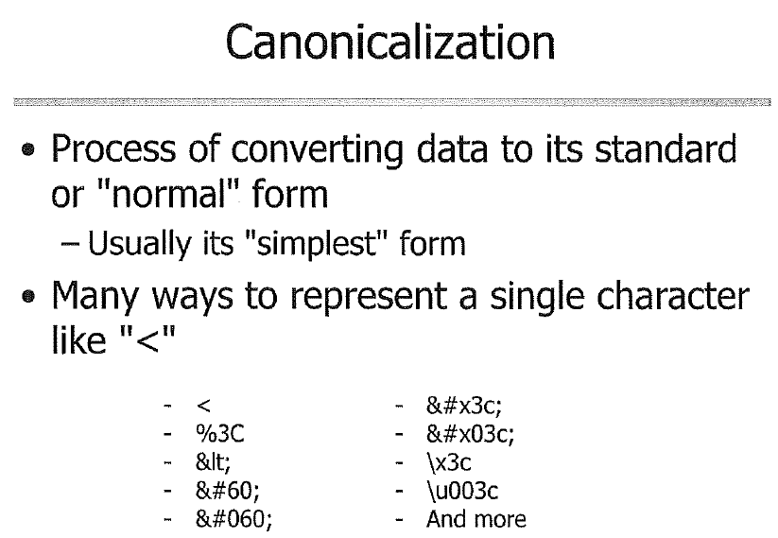

Slide 50
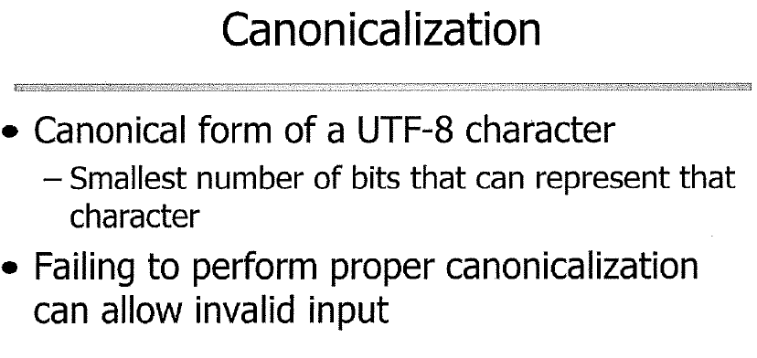

Slide 51
Canonicalization
/
%C0%AF
URL Encoding of C0 AF
Normally, / is %2F
1100 0000 1010 1111
In UTF-8 encoding, 110x xxxx and 10xx xxxx stands for a number of two bytes
It equals to 00000101111 = 47 = /

Slide 52
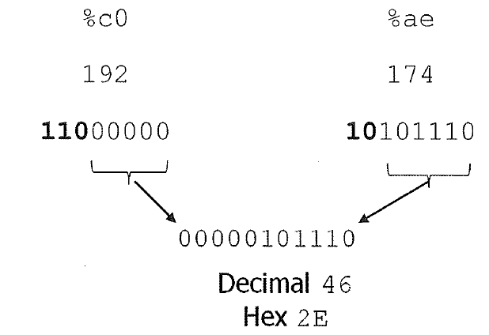
Canonicalization
/
%C0%AE
Normally . is %2E
However in the left example, %c0%ae is used to get “.”

Slide 53
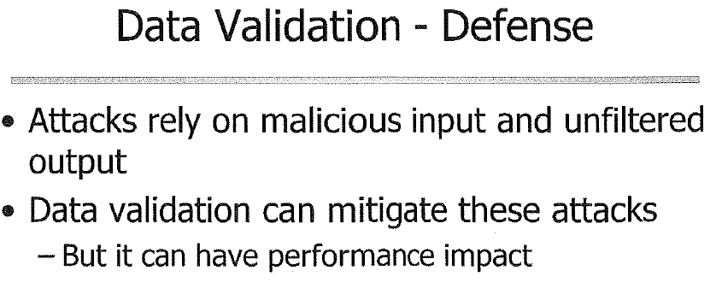
The performance impact varies drastically
  Consider a page that will be loaded 10M times daily, a 100 ms add up would make the application unusable

Slide 54
Input types
Numbers
Strings

Slide 55
Numbers
Check value after converting to a number
  Number overflow: On a 64-bit machine, usually 18446744073709551615 (2^64-1) → -1
Check for min (0? 1? Negative?) & max
  Make sure all values in range ok (avoid /0)
  For non-negative integer, use an unsigned integer type
  Prevent being “too large” for rest of system
  Note that “only 1 through 100” is a whitelist
Fractions allowed? If not, use integer type
If floating point: Watch out for weird cases such as NaN, Infinity, negative 0, under/overflow, etc.

Slide 56
Strings
Where possible, have an enumerated list
  Then make sure it is only exactly one of those values
  Could convert to a number
Otherwise:
  Limit max length (buffer size & counter DoS)
  Check that it meets whitelist rule
    “Correct input always conforms to this pattern”
    If common type (email address, URL, etc.), reuse rule
    If very complex, can use compilation tools/BNF
      More complicated, make sure tools can handle attacks
    Common tool: Regular expressions (REs)
    Need background first: char names, encoding, Unicode, globbing
Notes:
Backus normal form (BNF), example: <postal-address> ::= <name-part> <street-address> <zip-part>

Slide 57
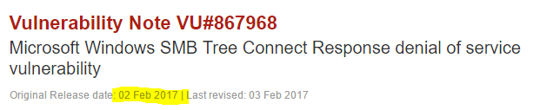
Windows fails to properly handle a specially-crafted server response that contains too many bytes following the structure defined in the SMB2 TREE_CONNECT Response structure.
A vulnerable Windows client system may crash (BSOD) in mrxsmb20.sys
Crash with fully-patched Windows 10 and Windows 8.1 client systems, as well as the server equivalents of these platforms, Windows Server 2016 and Windows Server 2012 R2.

Slide 58
Common Information Technology Names of Characters
Character | Common IT Name
! | bang, <exclamation-mark>, exclamation point
# | hash, octothorpe, <number-sign> (Warning: “pound” can mean £)
" | double quote, <quotation-mark>
' | single quote, <apostrophe>
` | backquote, <grave-accent>
$ | dollar, <dollar-sign>
& | <ampersand>, amper; amp; and
* | star, splat, <asterisk>
+ | <plus>
, | <comma>
- | dash, <hyphen>
. | dot, <period>
Need names to talk about things
<formal-name> per POSIX 2008
Used often → few syllables

Slide 59
Common Information Technology Names of Characters (2)
Character | Common IT Name
/ | <slash>, <solidus>
\ | <backslash>
? | question, <question-mark>, ques
^ | hat, caret, <circumflex>
_ | <underline>, underscore, underbar, under
| | bar, or, <vertical-line>
( … ) | open/close, left/right, o/c paren(theses), <left/right-parenthesis>
< … > | less/greater than, l/r angle (bracket), <less/greater-than-sign>
[ … ] | l/r (square) bracket, <left/right-square-bracket>
{ … } | o/c (curly) brace, l/r (curly) brace, <left/right-brace>
Source: The Jargon File, entry “ASCII”. Some entries omitted. Reordered to show contrasts.
There programming terms for some character sequences, too, e.g.:
<=> (spaceship)

Slide 60
Character encodings: General
A code unit in US-ASCII consists of 7 bits;
A code unit in UTF-8, EBCDIC and GB18030 consists of 8 bits;
A code unit in UTF-16 consists of 16 bits;
A code unit in UTF-32 consists of 32 bits.
Most systems have automatic character encoding detection

Slide 61
Character encodings: General
Characters are represented by numbers
ASCII common in US
  7-bit code, e.g., “A” = 65, “a” = 97
  Cannot represent most other languages
ISO/IEC 8859-1: 8-bit, most Western Europe
Windows-1252: 8-bit, like 8859-1 but not
Other languages have other encodings
  Must know which encoding for a given document
  Difficult to handle multiple languages
  Big mess – we need a single standard for everyone!

Slide 62
Solution: ISO/IEC 10646 / Unicode
Solution: ISO/IEC 10646 / Unicode
Defines a “Universal Character Set (UCS)” that assigns a unique number (“code point”) for every “character”
  ASCII is a subset, so “A” = 65 here too
  Sometimes different glyphs are considered same character (Han unification of Chinese characters)
  Sometimes different characters may have identical glyphs (e.g., Cyrillic, Greek, Latin)
  Once thought 16 bits would be enough – WRONG (changed 1996)
  Now 21-bit code (including unassigned code points), hex 0…10FFFF
Defines encodings for how those numbers can be transmitted in a string of bytes
  UTF-8, UTF-16 (BE/LE/unmarked), UTF-32 (BE/LE/unmarked)
  Before accepting data, check if valid for that encoding
For more info, see: http://www.unicode.org/faq/
Notes:
For example, in a big-endian computer, the two bytes required for the hexadecimal number 4F52 would be stored as 4F52 in storage (if 4F is stored at storage address 1000, for example, 52 will be at address 1001). In a little-endian system, it would be stored as 524F (52 at address 1000, 4F at 1001).
the least significant bytes can stay where they are and new digits can be added to the right at a higher address. This means that some computer operations may be simpler and faster to perform.
IBM's 370 mainframes, most RISC-based computers, and Motorola microprocessors use the big-endian approach. TCP/IP , On the other hand, Intel processors (CPUs) use little endian

Slide 63
Character encoding: UTF-32
32 bits/character, one after the other
Good news: Every character takes the same amount of space (good for random access)
Bad news: Big-endian/little-endian (BE/LE)
  4 bytes: Does big or little part come first?
  Fundamentally two UTF-32s: UTF-32BE and UTF-32LE
  If unmarked, prefix “byte order mark” (BOM) U+FFFE
  Complicates string concatenation
Bad news: Lots of wasted space
Validity check: Each character in range 0…10FFFF
Used… but not that widely

Slide 64
Character encoding: UTF-16
Sends as a stream of 16-bit values
  For characters <= 2¹⁶, just the character value
  For other characters, 2 16-bit pairs
Easier on systems that assumed “16 bits ought to be good enough”: Windows API, Java
  But a 16-bit “character” might only be part of one, and often people don’t handle this properly
“Random” access harder, but usually that’s okay
Less wasted space than UTF-32, more space than UTF-8
Bad news: Big endian/little endian again
  Prefix BOM to identify
  Complicates string concatenation

Slide 65
Character encoding: UTF-8
Sends characters as a clever 8-bit stream
  Variable number of bytes, 1-4/character
  If ASCII, it’s unchanged, so it’s compatible with many existing programs (WIN!)
  No endianness issue, “just works”
    Easy copy-and-paste to create longer strings
  Self-synchronizing – easy to find next/previous character
This is a great encoding!
  Use it by default if there’s no reason to do otherwise
  Most common encoding on web [Unicode]
Notes:
Source for “most common” statement:
“Q: Which of the UTFs do I need to support?
A: UTF-8 is most common on the web. UTF-16 is used by Java and Windows.”
“UTF-8, UTF-16, UTF-32 & BOM”
http://www.unicode.org/faq/utf_bom.html
Last updated: - Wednesday, February 27, 2013 8:39:43 PM -
Retrieved 2013-09-05
Unicode, Inc.

Slide 66
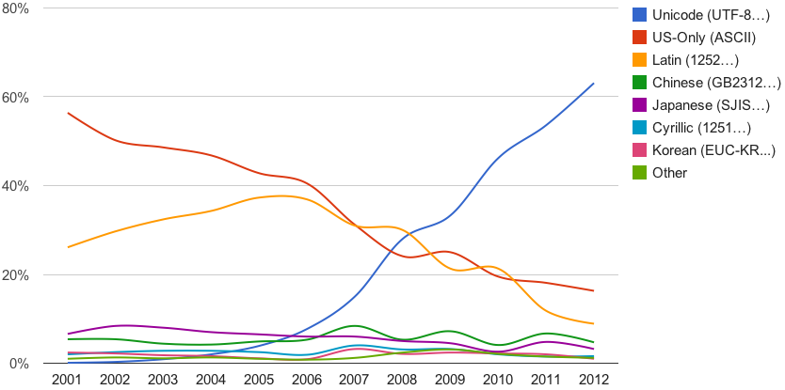
TF-8 is the dominant character encoding for the World Wide Web, accounting for 88.4% of all Web pages in January 2017
Shows the usage of the main encodings on the web from 2001 to 2012 as recorded by Google. Note that the ASCII only figure includes web pages with any declared header if they are restricted to ASCII characters.

Slide 67
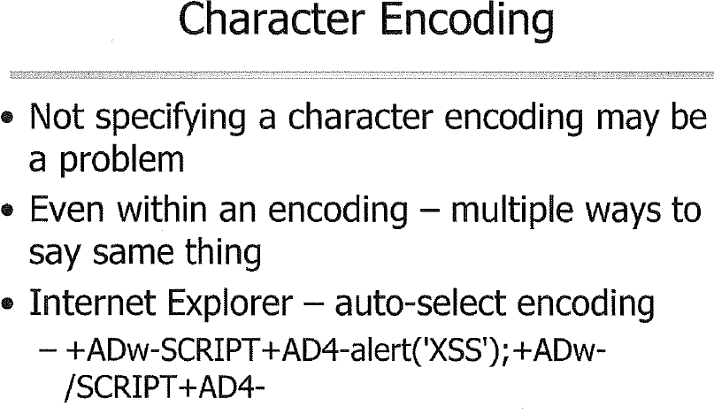
Can you guess what is the above string?
It is the UTF7 encoding, which could pass many white-list validation tests

Slide 68
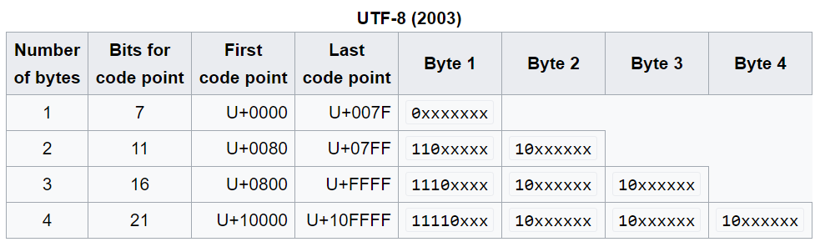

Slide 69
Canonicalization
/
%C0%AE
Normally . is %2E
However in the left example, %c0%ae is used to get “.”

Slide 70
How UTF-8 Works
Code point range | Binary code point | UTF-8 bytes | Example (Source: Wikipedia UTF-8 article)
U+0000 to U+007F | 0xxxxxxx | 0xxxxxxx | character '$' = code point U+0024 = 00100100 → 00100100 → hex 24
U+0080 to U+07FF | 00000yyy yyxxxxxx | 110yyyyy 10xxxxxx | character '¢' = code point U+00A2 = 00000000 10100010 → 11000010 10100010 → hex C2 A2
U+0800 to U+FFFF | zzzzyyyy yyxxxxxx | 1110zzzz 10yyyyyy 10xxxxxx | character '€' = code point U+20AC = 00100000 10101100 → 11100010 10000010 10101100 → hexadecimal E2 82 AC
U+010000 to U+10FFFF | 000wwwzz zzzzyyyy yyxxxxxx | 11110www 10zzzzzz 10yyyyyy 10xxxxxx | character '𤭢' = code point U+024B62 = 00000010 01001011 01100010 → 11110000 10100100 10101101 10100010 → hex F0 A4 AD A2

Slide 71
UTF-8 illegal sequences
But: Some byte sequences are illegal/overlong
Before accepting a UTF-8 sequence, check if valid
  You should check validity for others too, but esp. important UTF-8
  C0 80 isn’t valid, but is a common representation of byte 0 (NULL). Think!
Unchecked invalid sequence might be interpreted as NIL, newline, slash, etc., by your decoder
  Attacker may be able to bypass your checking if that happens!
Notes:
Modified UTF-8 uses the two-byte overlong encoding of U+0000 (the NUL character), 11000000 10000000 (hexadecimal C0 80), instead of 00000000 (hexadecimal 00).
Invalid UTF-8 has been used to bypass security validations in high-profile products including Microsoft's IIS web server^{[14]} and Apache's Tomcat servlet container.^{[15]}
Implementations of the decoding algorithm MUST protect against decoding invalid sequences."^{[16]} The Unicode Standard requires decoders to "...treat any ill-formed code unit sequence as an error condition. This guarantees that it will neither interpret nor emit an ill-formed code unit sequence."

Slide 72
URL Encoding (Percent Encoding)
Character | From Windows-1252 | From UTF-8
space | %20 | %20
! | %21 | %21
" | %22 | %22
# | %23 | %23
$ | %24 | %24
% | %25 | %25
& | %26 | %26
' | %27 | %27
( | %28 | %28
) | %29 | %29
* | %2A | %2A
URLs cannot contain spaces, illegal characters
URL encoding replaces unsafe ASCII characters with a "%" followed by two hexadecimal digits.
Your browser will encode input, according to the character-set used in your page (mostly UTF-8).
What is: %28alert%29%21

Slide 73
Locale
Locale defines user’s language, country/region, user interface preferences, and probably character encoding
  E.G., on Unix/Linux, Australian English with UTF-8 is en_AU.UTF-8
Can affect how characters are interpreted
  Collation (sorting) order
  Character classification (what’s a “letter”?)
  Case conversion (what’s upper/lower case of a character?)

Slide 74

Visual Spoofing
Visual spoofing = 2 different strings mistaken as same by user
Mixed-script, e.g., Greek omicron & Latin “o”
Same-script
  “-” Hyphen-minus U+002D vs. hyphen “‐” U+2010
  “ƶ” may be U+007A U+0335 (z + combining short stroke overlay) or U+01B6
Bidirectional Text Spoofing
For more information on Unicode-related security issues, see:
Unicode Technical Report #36 Unicode Security Considerations http://www.unicode.org/reports/tr36/
Unicode Technical Standard #39 Unicode Security Mechanisms http://www.unicode.org/reports/tr39

Slide 75
Globbing: A weak text pattern language
Many languages can express text patterns
One often used with filenames is “globbing”:
  “*” matches any 0 or more characters
  “?” matches any 1 character
  “[…]” matches the chars listed inside (Unix/Linux/Windows Powershell)
E.G.:
  dir *.pdf
  mv *.py python_code/
Globbing is very simple, so useful for filenames
Globbing is not powerful, can’t represent lots
  Better tool for general input checking: Regular expressions

Slide 76
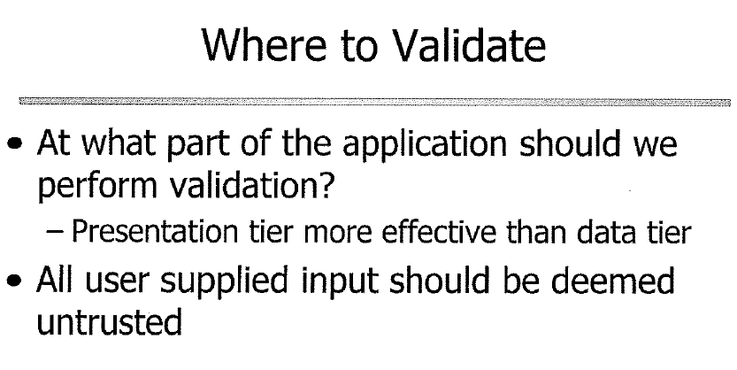
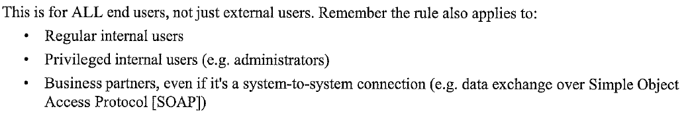

Slide 77
Regular expressions

Slide 78
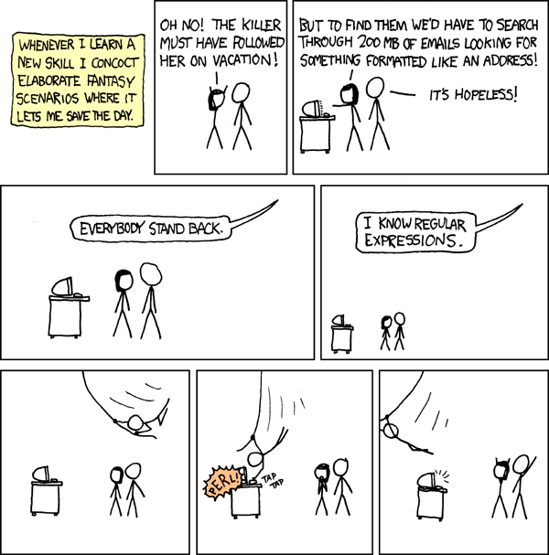
“I know regular expressions”
Source: Randall Munroe,
“I know regular expressions”,
XKCD, http://xkcd.com/208/
Used by per permission granted at http://xkcd.com/license.html

Slide 79
Regular expressions (REs): Introduction
REs: Language for defining patterns of text
In a RE, aka regex:
  Characters A-Z, a-z, 0-9 match themselves
  Brackets containing just alphanumerics matches one character, iff it is listed inside […]
  There’s much more – this is just a a start
Example: “ca[brt]” means “cab”, “car”, or “cat”
Often useful tool for quickly checking inputs

Slide 80
Using regular expressions for finding text
  Historically, REs created for finding text
  Given data and pattern, imagine that:
  for position in 1..length(data):
  if regex_match_at(pattern,data,position):
  return true
  return false
  RE pattern “ca[brt]” matches “abdicate”
    Because “cat” is inside “abdicate”
Notes:
NFA = Nondeterministic finite automata
DFA = Deterministic finite automata

Slide 81
Regular expressions: For filtering/ checking/validating input
REs can be used to filter input – check if the data matches a pattern, not just simply contains it
For each text input, you’ll typically define a pattern using a RE
  The pattern describes the legal input
  Make the pattern as limiting as possible
Then, when you receive input, you ask a RE library if the pattern matches the input
  If it doesn’t, reject that input

Slide 82
Regular expressions: Matching a single character
An alphanumeric (and many other chars) matches itself
  It will match its upper/lowercase equivalent if the “ignore case” option enabled – not by default
A “.” matches any one character
  Except maybe newline (per library & options)
“\” is escape character:
  \n matches newline (linefeed)
  \r matches carriage return
  \NNN matches character with given octal code NNN
  \char disables char’s special meaning if has one; match char
    \. matches period (dot)
    \[ matches a left bracket
    \\ matches one backslash

Slide 83
Regular expressions: Bracket expressions (language in a language)
[ … ] bracket expressions match 1 character, and lets you express a set of characters that are accepted
Inside bracket expression:
  Simple alphanumerics: Match any of those characters
  \punctuation escapes punctuation’s special meaning
  “x-y”: any characters in that range - POSIX/C locale
    “[A-Za-z0-9]” matches one character: A-Z, a-z, or 0-9
    Put “-” at end or beginning, or \-, to have it not mean range
  “.” has no special meaning inside […]
    It just means “match a period”
  First char “^” reverses meaning, “Not these chars”
    “[^A-Z]” matches any char other than A through Z
    newline may be special
    Rarely useful for filtering

Slide 84
Regular expressions: Duplication
Simple char, “.”, \char, and bracket expression […] are all “atoms”
An atom can be followed by a duplication marker:
  {N} : Exactly N times
  {N,} : N or more times
  {N1,N2} : Between N1 & N2 times (inclusive)
  * : 0 or more times; equivalent to “{0,}”
  + : 1 or more times; equivalent to “{1,}”
  ? : 0 or 1 times; equivalent to “{0,1}”
A piece = an atom + optional duplication marker
For example, this RE says “1 or more a,b, or c”:
  ^[abc]+$
  Matches “a”, “aaaa”, “cab”, “abba”
  Not “dog” or “ad” or “a$”
  Not “A” unless a case-insensitive match is requested

Slide 85
Some sample REs
Match anything at all, except maybe embedded newlines (don’t use this for filtering!!):
  ^.*$
Any zero through 12 characters (newline?) (bad!):
    ^.{0,12}$
U.S. Social Security Number (SSN)
  ^[0-9]{3}-[0-9]{2}-[0-9]{4}$
U.S. Phone number
  ^\([2-9][0-9]{2}\) [1-9][0-9]{2}-[0-9]{4}$

Slide 86
More sample REs
A simple class identifier
  ^[A-Z]{2,4} ?[1-9][0-9]{1,3}$
  Matches “SWE781”, “IT 999”
  Doesn’t match “CS 039”
Lastname, Firstname (naïve)
  ^[A-Za-z][A-Za-z'-]*, [A-Za-z]+$
  Accepts “O'Malley, Brian”
  Does not accept “Wheeler, David A.”
Date in yyyy-mm-dd form (not very limiting)
  ^[1-9][0-9]{3}-[01]?[0-9]-[0-3]?[0-9]$
  Accepts 2011-09-12
  Doesn’t accept “9999-99-99” or “August 5, 2011”
  Does accept 1000-00-00, 9999-19-39 (!!) – we can do better
Notes:
^(19|20)\d\d[- /.](0[1-9]|1[012])[- /.](0[1-9]|[12][0-9]|3[01])$
^([ \u00c0-\u01ffa-zA-Z'\-])+$

Slide 87
Always use “^” and “$”
  When using REs to filter input, always put “^” at the beginning and “$” at the end of the pattern!
“^” matches beginning of data {or line, by option}
“$” matches end of data {or line, by option}
These are the “anchoring” patterns
Some implementations’ options with same effect
RE “^ca[brt]$” won’t match “abdicate”; matches “cat”
Note: In Ruby, use \A and \z instead to match string begin/end; “^” and “$” match line begin/end instead

Slide 88
Regular expression variations
There are many variations of REs
  POSIX basic REs (old), POSIX extended REs, Perl-style
Our focus: What’s common between them, esp:
  POSIX extended REs (EREs)” of POSIX.1
  Perl-style (adopted by many other languages)
Variations: newline (for .), Unicode, char classes
Usually options, e.g., ignore upper vs. lowercase
  Lots of variations in the options!
Some RE libraries can’t handle NUL char in data
  Ensure it can’t happen or ensure library can handle it

Slide 89
Regular Expressions: Grouping
You can group expressions with (…)
  This turns the whole expression into an atom
  Once you do that, you can follow it with a bound
E.G., FAT filename:
  “one to eight alphanumeric characters, optionally followed by a period and an additional one to three alphanumeric characters”
  As regular expression:
  ^[a-zA-Z0-9]{1,8}(\.[a-zA-Z0-9]{1,3})?$

Slide 90
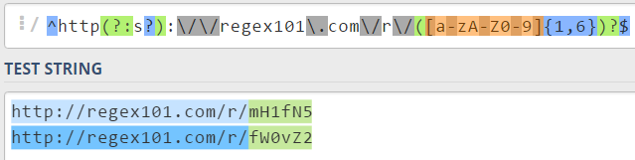
Regular Expressions: Grouping
Use Parentheses for Grouping and Capturing
Capturing Group:
  (CapturingGroup)?
Use ?: to create non-capturing group:
  (?:Non-CapturingGroup)?

Slide 91
Regular Expressions: Alternatives “|”
You can list alternative expressions, separated by “|”; any alternative can then match
  Each alternative is called a “branch”
“|” has lower precedence than “^” or “$”
  So typically must parenthesize as ( … | … )
  In filters you MUST use “|” inside (…)
  “^cat|bird$” matches (accepts) anything beginning with cat, or anything ending in bird
  “^(cat|bird)$” matches only “cat” or “bird”

Slide 92
More sample REs
Non-negative integer – note () because of |
  ^(0|[1-9][0-9]{0,19})$
  The “|” prevents leading “0”
Better date filter for yyyy-mm-dd
  ^[1-9][0-9]{3}-(0?[1-9]|1[0-2])-(0?[1-9]|[12][0-9]| 3[0-1])$
  Accepts 2011-09-12
  Does not accept 1000-00-00, 9999-99-99
  Accepts 2011-02-31
    Handling this with REs is probably overkill
    Use RE to eliminate most cases, then use code for specific semantic tests
Notes:
sub isvaliddate { my $input = shift; if ($input =~ m!^((?:19|20)\d\d)[- /.](0[1-9]|1[012])[- /.](0[1-9]|[12][0-9]|3[01])$!) { # At this point, $1 holds the year, $2 the month and $3 the day of the date entered if ($3 == 31 and ($2 == 4 or $2 == 6 or $2 == 9 or $2 == 11)) { return 0; # 31st of a month with 30 days } elsif ($3 >= 30 and $2 == 2) { return 0; # February 30th or 31st } elsif ($2 == 2 and $3 == 29 and not ($1 % 4 == 0 and ($1 % 100 != 0 or $1 % 400 == 0))) { return 0; # February 29th outside a leap year } else { return 1; # Valid date } } else { return 0; # Not a date } }

Slide 93
Bad REs
Messed-up date format
  ^[1-9][0-9]{3}-(0[1-9]|1[0,1,2])-([0,1,2][1-9]|3[0-1])$
  It matches 2011-11-12
  It also matches 2011-0,-,1
  “,” in a bracket expression matches “,” – it is not a separator

Slide 94
Practice with regular expressions
https://regex101.com/
For example, try this pattern:
^0|[1-9][0-9]*$
and explain why “a7” matches it!
Try to create Res, e.g., for:
Numbers 1-999
Playing card (Ace-King + suit)
Notes:
^([1-9]|[1-9]\d{1,2})$

Slide 95
RE language in BNF format
(notional – real ones vary)
BNF | Comments/Explanation
RE ::= branch ( “|” branch )* | RE is 1 or more “|”-separated branches (many allow empty – useless for filters)
branch ::= piece+ | Branch is 1 or more pieces in sequence
piece ::= atom duplication? | Piece is an atom with optional duplication
duplication ::= “*” | “?” | “+” | “{“ number ( “,” number? )? “}” | Duplication is *, ?, +, or {…}
atom ::= one_char | bracket_expr | “.” | “\” char | “(“ RE “)” | “()” | “^” | “$” | Atom is one ordinary char, a bracket expression, ., \char, (…), ^, or $
bracket_expr ::= “[” “^”? bracket_spec “]” | Bracket expression is […]. The first char may be ^ (reverses meaning). See earlier slide for more info

Slide 96
RE language in BNF format
(without text comments)
RE ::= branch ( “|” branch )*
branch ::= piece+
piece ::= atom duplication?
duplication ::= “*” | “?” | “+” |
“{“ number ( “,” number? )? “}”
atom ::= one_char | bracket_expr | “.” |
“\” char | “(“ RE “)” | “()” | “^” | “$”
bracket_expr ::= “[” “^”? bracket_spec “]”

Slide 97
Regular expressions: Character classes (useful, but large variations)
POSIX EREs (not others) char class “[: … :]” & only in brackets:
  [:alnum:] [:cntrl:] [:lower:] [:space:] [:alpha:] [:digit:] [:print:] [:upper:] [:blank:] [:graph:] [:punct:] [:xdigit:]
  E.g., inside bracket expression; “[[:alnum:]]” matches alphanum, and “[[:alnum:][:space:]]” matches 1 alphanum or space
Perl-style REs (not POSIX EREs) char classes work in & out of […]:
  \s : a whitespace char
  \S : a non-whitespace char
  \d : A digit (including 0-9; other digits exist in Unicode)
  \D : a non-digit
  \w : a “word” character (alphanumeric plus “_”)
  \W : a non-word character
  For non-ASCII Unicode characters, check documentation & locale!
  Not part of POSIX EREs

Slide 98
Regular expression implementations widely available
POSIX standard includes:
  Command line “grep” – reports lines of text that match (or don’t match) a given RE
  grep 'ca[brt]' myfile.txt
  C library routine “regexec” & etc. – reports if pattern matches data, and if so, where
  Universal support on Unix-likes
Windows “findstr” same purpose as grep
Practically every programming language has RE support, either officially or as easily-gotten library
  Java, C, Perl, Python, C#, C++, PHP, etc.
  There are actually two kinds of RE implementations
    NFAs: Look at data positions 1/time, match pattern. Powerful
    DFAs: Faster, less powerful
    Some will switch depending on “what you need”

Slide 99
Using Regular Expressions in real life
Complications representing REs in string constants:
  Many languages use C/Java-style "…" for strings
  This format interprets " and \ which can be annoying
  RE “match 1 backslash followed by one A-Z and a double-quote” is in many languages this constant string:
    … "\\\\[A-Z]\\\"" …
Some languages have special facilities to help
  Perl, Ruby, & Javascript have built-in /…/ RE processing
  Python has “raw” string constants
Otherwise, predefined constants can help
  #define MATCH_BACKSLASH "\\\\"
  … MATCH_BACKSLASH "[A-Z]" …

Slide 100
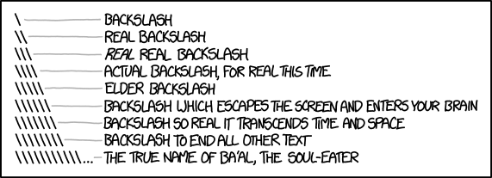
Backslashes + Regex + programming languages
Source: Randall Munroe,
“Backslashes”,
XKCD, http://xkcd.com/1638/
Used by per permission granted at http://xkcd.com/license.html

Slide 101
POSIX RE facilities (C API)
Function | Purpose
regcomp() | Compiles a regex into a form that can be later used by regexec
regexec() | Matches string (input data) against the precompiled regex created by regcomp()
regerror() | Returns error string, given an error code generated by regcomp or regex
regfree() | Frees memory allocated by regcomp()

Slide 102
regcomp()
#include <regex.h>
int regcomp(regex_t *preg, const char *pattern, int cflags);
preg: pointer to structure that will hold compiled RE
pattern: RE string
cflags set options for the pattern
  REG_EXTENDED: Extended EREs, not basic. Always use this
  REG_NOSUB: Don’t provide copies of substring matches; instead, just report if it matched or not. Almost always use this when filtering
  REG_ICASE: Case insensitive setting
  REG_NEWLINE: Wildcards don’t match newline character (by default “.” etc. match newlines in this library)
Returns nonzero if error - error code for regerror()

Slide 103
regexec()
#include <regex.h>
int regexec(const regex_t *preg, const char *string, size_t nmatch, regmatch_t pmatch[], int eflags);
preg: Compiled regex created by regcomp()
string: the string (data) to match against RE preg
nmatch, pmatch: used to report substring match info
eflags: used when passing a partial string when you do not want a beginning of line or end of line match
For filtering nmatch, pmatch, eflags aren’t usually useful
Returns 0 if match, REG_NOMATCH if no match, else error

Slide 104
POSIX regex(7) for C
// Often need to #include <stdio.h>, <stdlib.h>, <string.h>
#include <regex.h> // This is the key header
...
regex_t compiled_pattern; // For storing compiled regex
...
error = regcomp(&compiled_pattern, pattern, REG_EXTENDED | REG_NOSUB);
if (error) { /* If nonzero, error */ … }
…
error = regexec(compiled_pattern, input_data, (size_t) 0, NULL, 0);
// if error==0, match; if REG_NOMATCH, no match; otherwise error
…
regfree(&compiled_pattern);

Slide 105
Regular Expressions: Java
Package java.util.regex implements, primarily provides 3 classes:
  Pattern object = a compiled representation of a regular expression
    To create a pattern object, invoke one of its public static compile methods, which accept a regex as first argument
  Matcher object = engine that interprets the pattern and performs match operations against an input string
    Create a Matcher object by invoking matcher method on a Pattern object
  PatternSyntaxException object = unchecked exception

Slide 106
Regular Expressions: Java
import java.util.regex.Pattern;
import java.util.regex.Matcher;
…
// Compile regex:
Pattern numpattern = Pattern.compile("^[0-9]+$"));
Matcher mymatcher = numpattern.matcher(input_data);
if (mymatcher.find()) { … // if data matches pattern
}

Slide 107
Common Options
In POSIX regex, normally “.” matches newline, “^” and “$” only match beginning & end of data
  REG_NEWLINE option changes this: ‘.’ and ‘[^…]’ never match newline, “^” also matches after newline, ‘$’ also matches just before newline
Perl & many other regex have a different default: “.” and “[^…]” do not normally match newline
  Make “.” and “[^…]” match newline: perl “s”, Java Pattern.DOTALL
  Change “^” or “$” to match at newline boundaries: perl “m”, Java Pattern.MULTILINE
Case-insensitive: perl “i”, POSIX REG_ICASE, Java Pattern.CASE_INSENSITIVE
Ignore whitespace & allow comments: perl “x”, Java Pattern.COMMENTS

Slide 108
Regex in Javascript
// Look for "Hello"
var patt = /Hello/g;
var result = patt.test(str);
Test in browser:
https://goo.gl/GVwrfz

Slide 109
Little history of REs
Regular expressions studied in mathematics, esp. Stephen Kleene
Ken Thompson’s “Regular Expression Search Algorithm” published in Communications of the ACM June 1968
  First known computational use of regular expressions
Thompson later embedded this capability in the text editor ed to define text search patterns
Separate utility “grep” created to print every line matching a pattern (“global regular expression print”)
RE libraries begin spreading
Perl language released; REs fundamental underpinning & extended
See Jeffrey E.F. Friedl’s Mastering Regular Expressions, 1998, pp. 60-62, for more about this history

Slide 110
But I heard regexes were too hard!
“Some people, when confronted with a problem, think ‘I know, I’ll use regular expressions.’ Now they have two problems.” - Jamie Zawinski, 1997-08-12, alt.religion.emacs
  Counter: “Some people, when confronted with a problem, think `I know, I'll quote Jamie Zawinski.’ Now they have two problems.” (attributed to Mark Pilgrim or Assaf)
Real point: “not that regular expressions are evil, per se, but that overuse of regular expressions is evil… Regular expressions are like a particularly spicy hot sauce – to be used in moderation and with restraint ” [Atwood]
Helpful tool for initial input processing – not only tool
Format them for readability (like any other code)
Source: [Atwood] Jeff Atwood, “Regular Expressions: Now You Have Two Problems” June 27, 2008, http://www.codinghorror.com/blog/2008/06/regular-expressions-now-you-have-two-problems.html
Notes:
https://m.lieba.ch/2009/03/04/regex-humor/
https://twitter.com/search?q=Some+people%2C+when+confronted+with+a+problem%2C+think+%E2%80%9CI+know%2C+I%27ll+quote+Jamie+Zawinski.%E2%80%9D+Now+they+have+two+problems.
https://news.ycombinator.com/item?id=5187686

Slide 111
More info on regular expressions
Mastering Regular Expressions (Third Edition) by Jeffrey E.F. Friedl, O'Reilly Media, August 2006
Standard for Information Technology - Portable Operating System Interface (POSIX®) Base Specifications, Issue 7, December 2008
Your language/library’s documentation!

Slide 112
Metacharacters (countering injection attacks at input time)
    Serious problem: Input characters that have special meaning when sent to other programs
      These are called “metacharacters”, e.g.: * ? ; : " ' ( )
      Attacks exploiting them called “injection” attacks (e.g., SQL injection)
      “Other programs” include databases (SQL or not), command processors (shell, perl, etc.), web browsers, etc.
    Techniques exist to counter this problem
      Escaping functions, prepared statements, etc. Will discuss later
      But if you don’t allow them as input, they can’t be a problem
    Where possible, define input rules that omit metacharacters
      Alphanumerics are generally not metacharacters
      Often can’t do this completely, but can help

Slide 113
Multi-stage input filters
Often useful to check in stages, e.g.:
Maximum length & UTF-8 check
  If filter (RE) library has limitations (byte 0), ensure ok 1st
Basic whitelist filter (regex) – strict as reasonable
If number, convert, then check its min & max
Then do tests hard to do with simple filter, e.g.:
  Too complex for regex
    “Only non-holidays Monday-Friday”
  Comparisons between input values
    “End date must be on or after start date”
  Dependent on state
    “Not a legal move”
The earlier tests make later tests (and code) much easier/clearer – you know it passed earlier tests!

Slide 114
Regular Expression
Denial of Service (ReDoS)
Regexes are really useful for validating data…
But some regexes, on some implementations, can take exponential time and memory to process certain data
  Such regexes are called “evil” regexes
  Attackers can intentionally provide triggering data (and maybe regexes!) to cause this exponential growth, leading to a denial-of-service
  Need to avoid or limit these effects
  Thanks to my student Aminullah Tora who pointed out the need to discuss this topic!

Slide 115
Why does ReDoS happen?
Many modern regex engines (PCRE, perl, Java, etc.) use “backtracking” to implement regexes
  If >1 solution, try one to find a match
  If it doesn’t match, backtrack to the last untried solution & try again, until all options exhausted
  Attacker may be able to cause many backtracks
    A grouping with repetition, & inside more repetition or alternation with overlapping patterns
E.G., regex “^([a-zA-Z]+)*$” with data “aaa1”
E.G., regex “^(([a-z])+.)+[A-Z]([a-z])+$” with data “aaa!”
Naively implementing regex yourself would cause it too

Slide 116
Possible ReDOS solutions
Don’t run regexes provided by attacker
Use a Thompson NFA-to-DFA implementation – these are immune (eliminate backtracks)
  Can’t do some things like backreferences
  Many languages don’t easily provide this
Review regexes to prevent backtracking requirement (if practical)
  At any point, any given character should cause only one branch to be taken in regex (imagine regex is code)
  For repetition, should be able to uniquely determine if repeats or not based on that one next character
  Especially examine repetition-in-repetition
  Use regex fuzzers & static analysis tools to verify
Limit input data size first before using regex (limits exponential growth)

Slide 117
ReDOS references
Crosby and Wallach, 2003, “Regular Expression Denial Of Service“, Usenix Security
  Slides available via: https://web.archive.org/web/20050301230312/http://www.cs.rice.edu/~scrosby/hash/slides/USENIX-RegexpWIP.2.ppt
OWASP, 2012, “Regular Expression Denial of Service”, https://www.owasp.org/index.php/Regular_expression_Denial_of_Service_-_ReDoS
Ken Thompson, 1968, “Regular expression search algorithm”, Communications of the ACM 11(6), pp. 419-422, June 1968

Slide 118
Output filtering
Don’t return invalid data to user/requestor
  Can layer system, and check output to other layers
Can sometimes usefully filter output/reply
  To user or to different system layers
  Can reduce damage / increase difficulty of attack
  Typically do this before inserting into templates
  Esp. consider if robust input validation not possible
Similar as input filtering
  Identify channels
  Define filters as limiting as possible

Slide 119
Warning: REs on the mid-term
The mid-term will include several regular expressions, and test data for each
  You must be able to figure out, on your own, if the given data will pass the RE filter
    Esp. POSIX Extended RE /Perl subset described here
  May ask you to write some REs
  Practice using and creating REs!

Slide 120
Rails (Common web framework)
Many frameworks have validation systems
  Try to use them
E.G., Rails ActiveRecord supports validation
  class Demo < ActiveRecord::Base
  validates :points, numericality: { only_integer: true }
  validates :code, format: { with: /\A[a-zA-Z]+\z/ }
  end
  Rails validation code typically in model
  Not in view/controller: Not bypassable & stated once
  This means controller processes unvalidated data
    Can work just fine, but be careful writing controllers!

Slide 122
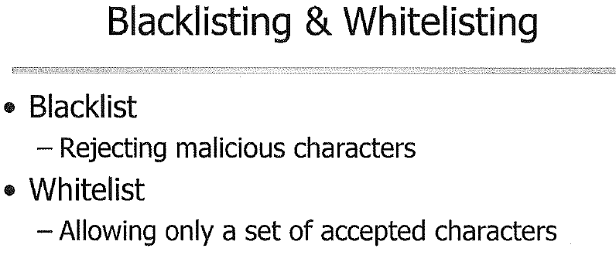
Blacklisted “javascript”, but not “java\nscript”

Slide 123
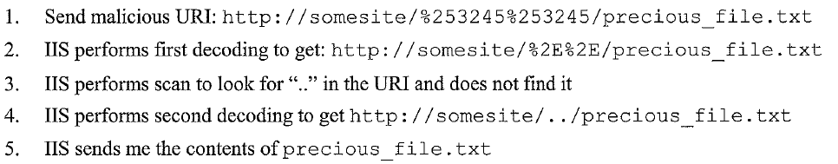
Blacklist Failed Example
Superfluous Decoding Vulnerability in IIS

Slide 124
Conclusions
Identify/minimize attack surface
  Where can all untrusted inputs enter?
Validate all input (non-bypassable)
  Use whitelists, not blacklist
  Be maximally strict
Numbers: Convert to number, check min/max, use right type
Text: Enumerate if you can, reuse checks if you can, in most other cases create limiting RE

