Slide 1
Lecture 4: Injection

Slide 2
Injection Attacks
Injection flaws allow attackers to relay malicious code through an application to another system. – By OWASP
These attacks include:
  calls to the operating system via system calls,
  the use of external programs via shell commands,
  as well as calls to backend databases via SQL (i.e., SQL injection).

Slide 3
Injection Attacks
  Whole scripts written in Perl, Python, and other languages can be injected into poorly designed applications and executed. Any time an application uses an interpreter of any type there is a danger of introducing an injection vulnerability.
>Javascript: eval(Input);
>Java
Runtime rt = Runtime.getRuntime();
rt.exec("cmd.exe /C doStuff.exe " +”-“ +myUid); // Call exe with userID

Slide 4
Injection Attacks
Many web applications use operating system features and external programs to perform their functions.
Sendmail is probably the most frequently invoked external program, but many other programs are used as well.
When a web application passes information from an HTTP request through as part of an external request, it must be carefully scrubbed.
Otherwise, the attacker can inject special (meta) characters, malicious commands, or command modifiers into the information and the web application will blindly pass these on to the external system for execution.

Slide 5
Injection Attacks
We will cover the following 3 injections attacks:
  Command Injection
  File Inclusion
  SQL Injection

Slide 6
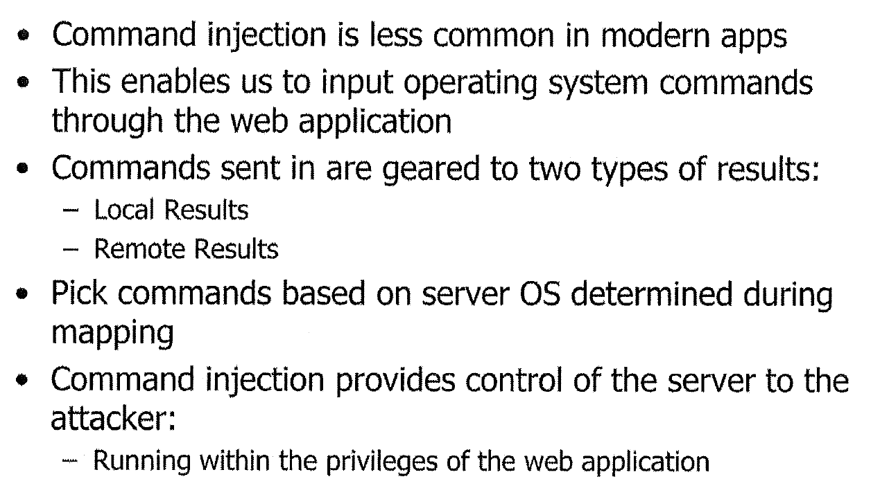
Command Injection

Slide 7
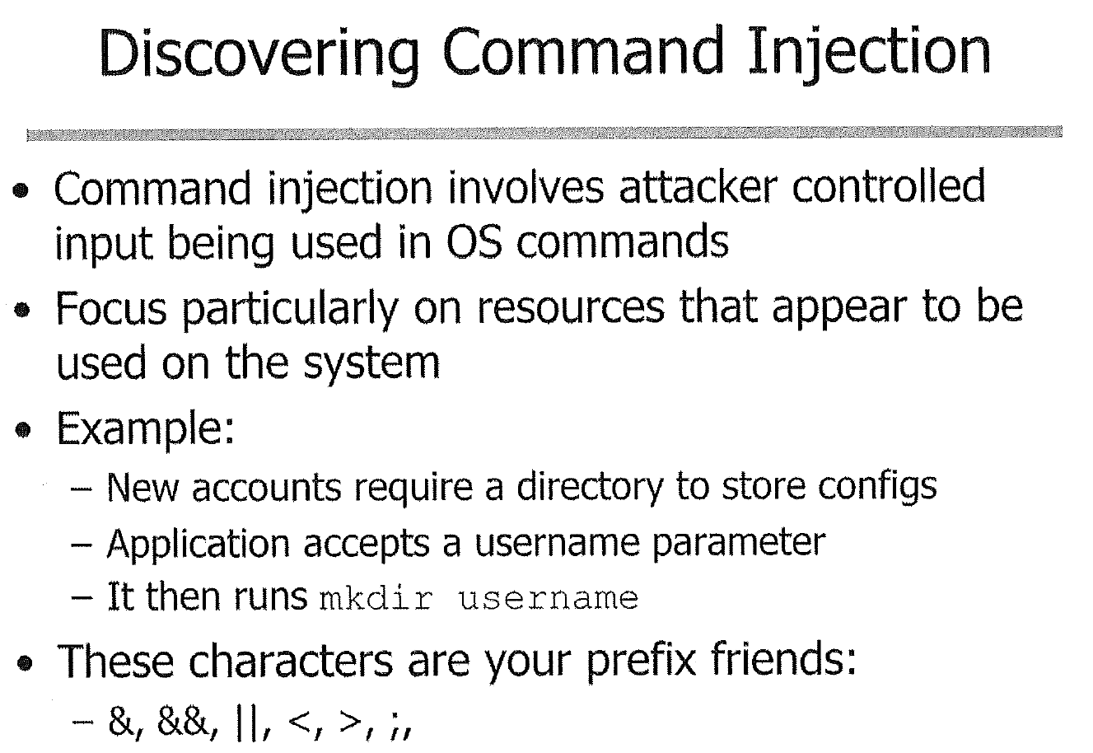

Notes:
<> io redirection
&& || and or
& background
; end of commands

Slide 8
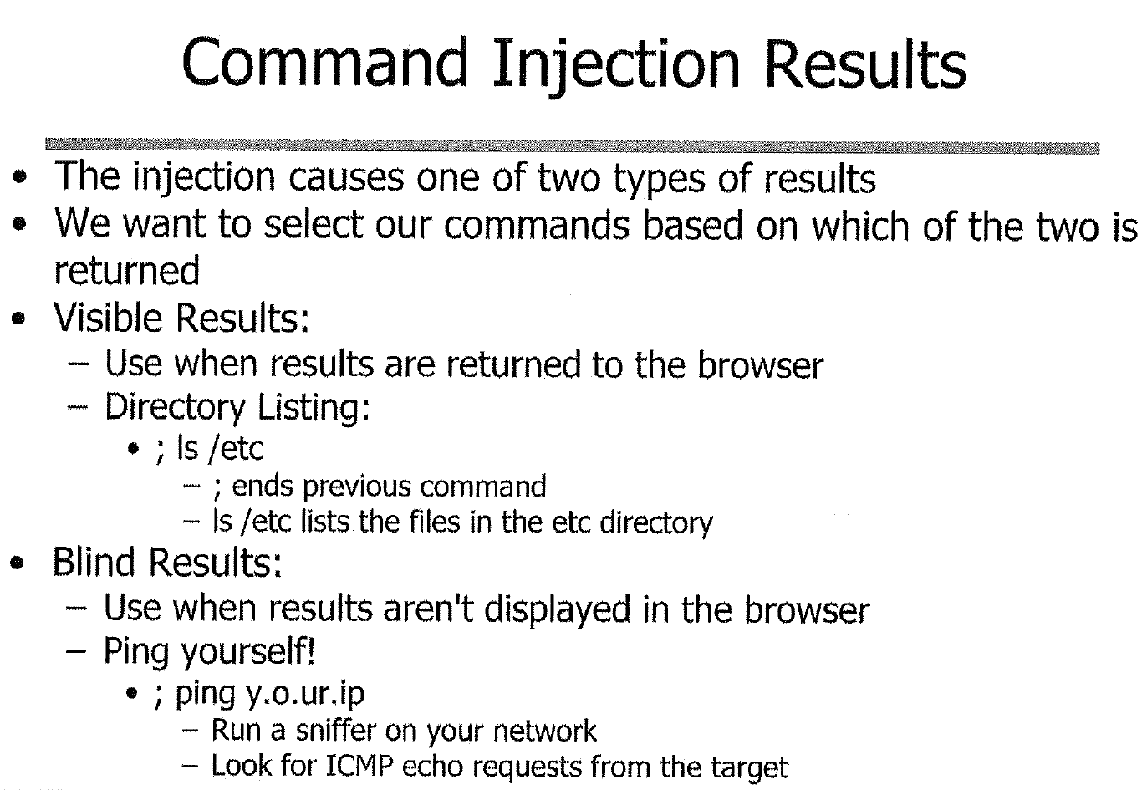

Slide 9
Common System Commands
ls – directory listing
cd – change to directory
cat – display file content to standard output
  Similarly: more, head, tail
id - Display the user and group ids of your current user.
ping - Send ICMP echo request to host
  ping –c3 127.0.0.1
nc – netcat, reads and writes data across network connections

Slide 10
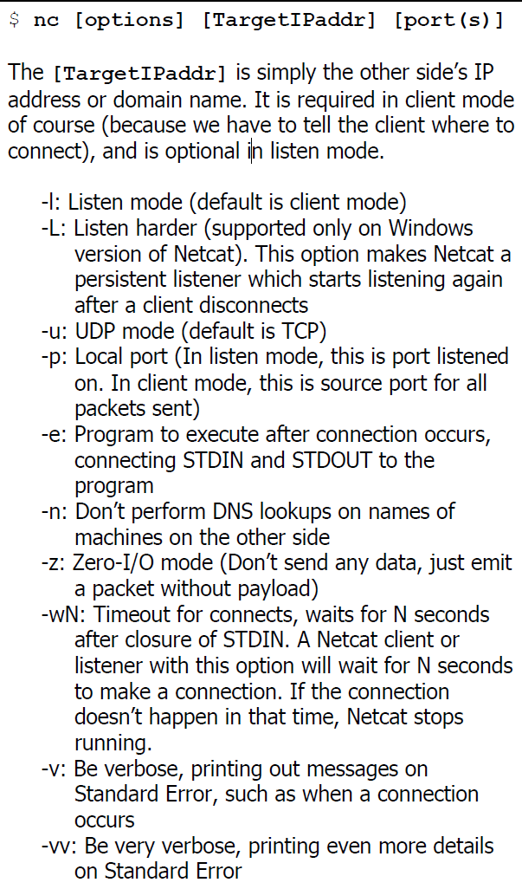

Slide 11
Lab 4 Command Injection
Target: Mutillidae->A1 Injection (other) -> Command Injection -> DNS Lookup
Goal:
  Display a file, eg the password file /etc/passwd
  Discover the privileges of the web server
  Ping a system
  Create a back door with nc command
Notes:
Book 3, page 47

Slide 12
File Inclusion Vulnerability
OWASP: The File Inclusion vulnerability allows an attacker to include a file, usually exploiting a "dynamic file inclusion" mechanisms implemented in the target application. The vulnerability occurs due to the use of user-supplied input without proper validation.

Slide 13
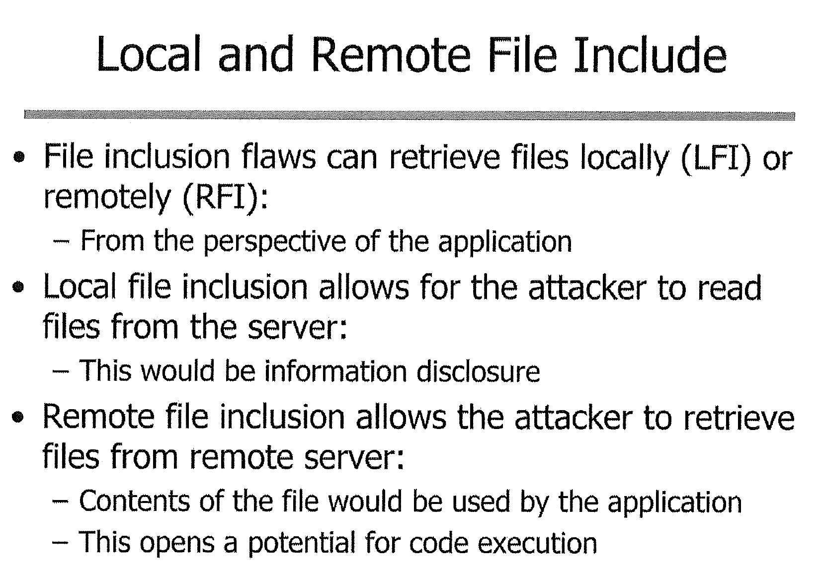


Attacker
RFI
LFI

Slide 14
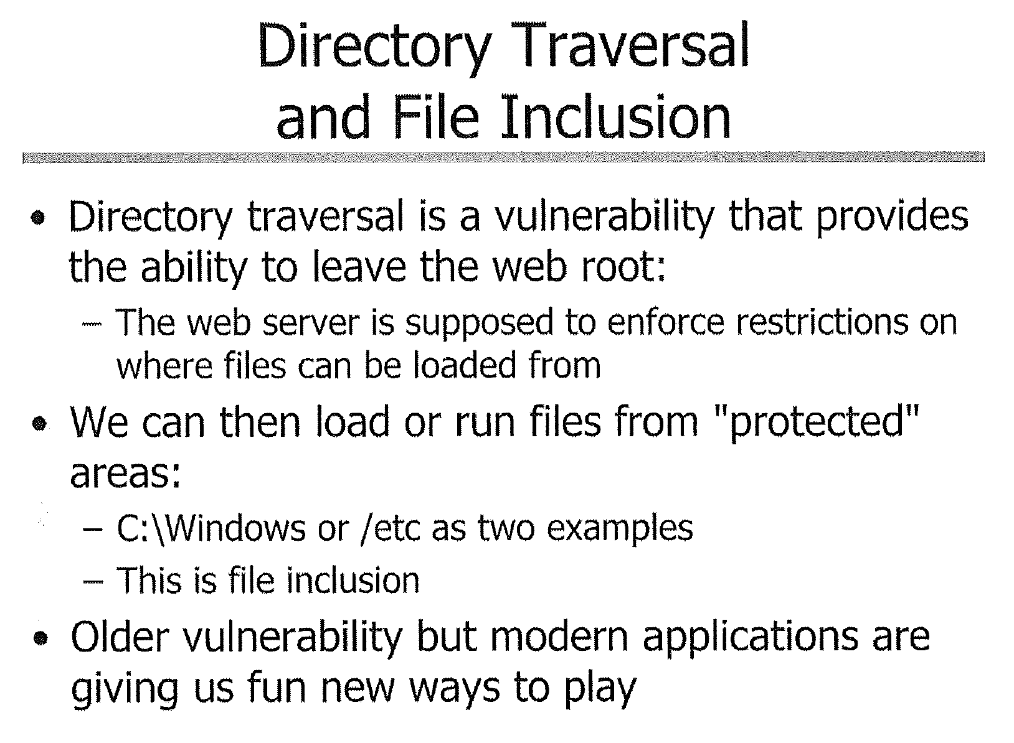

Slide 15
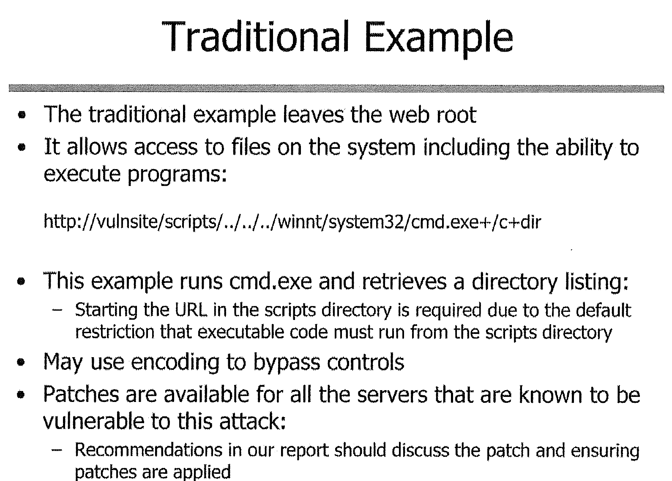

Slide 16
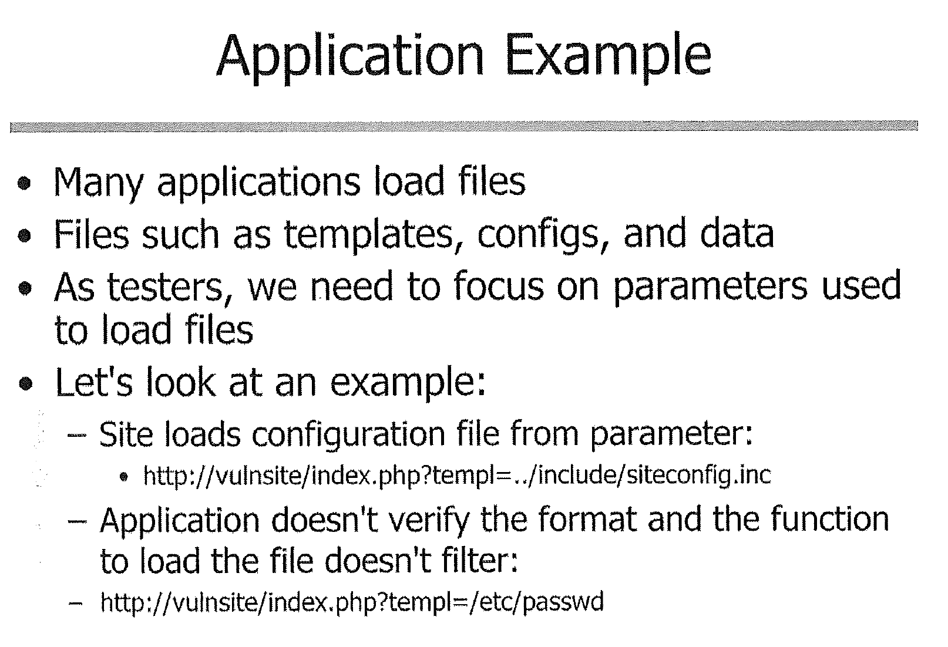

Slide 17
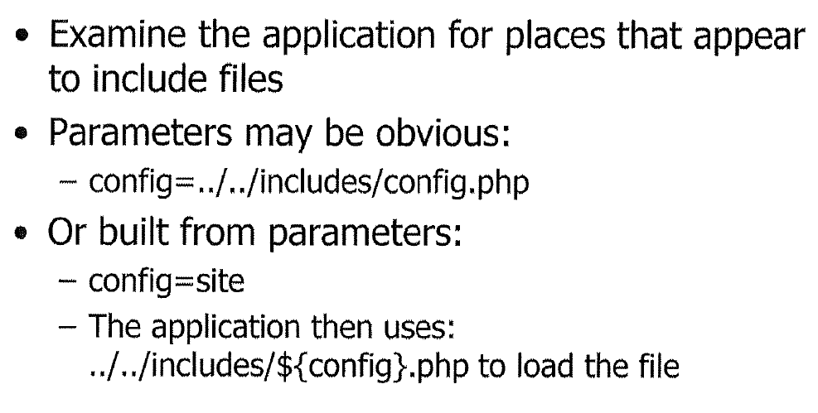
Testing File Inclusion

Slide 18
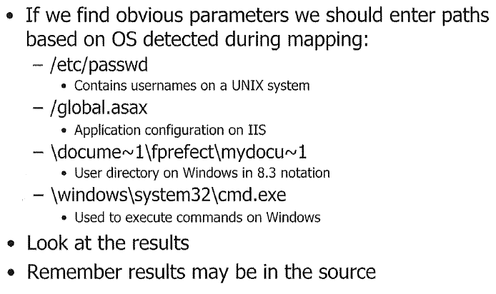
Obvious Parameters

Slide 19
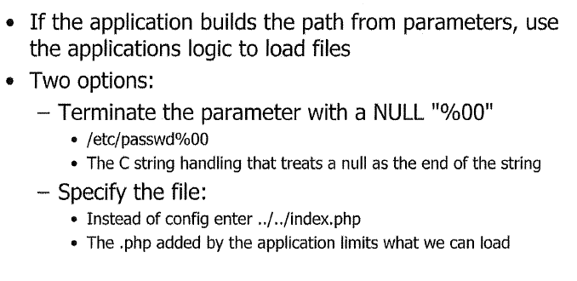

Slide 20
Lab 5 LFI & RFI
Goal: Perform both local and remote file inclusion exploits versus Mutillidae
Use a Local File Inclusion(LFI) exploit to view a local file
Use a Remote File Inclusion(RFI) exploit to load and run a PHP script
  You need to create PHP content, host it on a web server
Create a backdoor with nc command in your LFI script
Notes:
Page 67, Book 3

Slide 21
This wraps up the Directory Traversal and File Include Flaws

Slide 22
Introduction to SQL Injection
SQL Injection is the most well-know, significant of all web application flaws
  Even those with limited application security exposure are aware of SQL injection
One of the easier way to address from an application security perspective

Slide 23
Origin of SQL Injection
Applications employ relational data stores for a variety of reasons
  Mostly for data storage: add, update, retrieve, delete
The flaw originates from the application allowing user-supplied input to be dynamically employed in a generated SQL statement
  Examples???

Slide 24
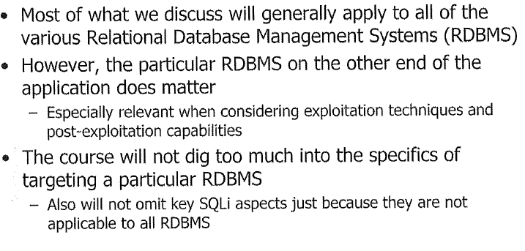
Relational Databases

Slide 25
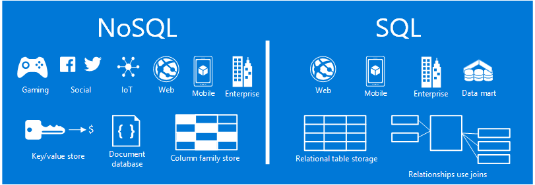
NoSQL Database
Large volumes of rapidly changing structured, semi-structured, and unstructured data
Agile sprints, quick schema iteration, and frequent code pushes
Object-oriented programming that is easy to use and flexible
Geographically distributed scale-out architecture instead of expensive, monolithic architecture

Slide 26
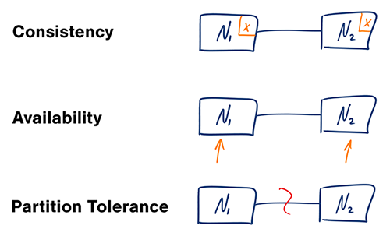
the CAP theorem:

Slide 27
Injection on NoSQL DB?
Payloads for NoSQL DB
NoSQL DB are fairly new concepts.
NoSQL databases provide looser consistency restrictions than traditional SQL databases.
By requiring fewer relational constraints and consistency checks, NoSQL databases often offer performance and scaling benefits.
Yet these databases are still potentially vulnerable to injection attacks, even if they aren't using the traditional SQL syntax.
, $where: '1 == 1'
$where: '1 == 1'
', $where: '1 == 1'
1, $where: '1 == 1'
{ $ne: 1 }
', $or: [ {}, { 'a':'a
' } ], $comment:'successful MongoDB injection'
db.injection.insert({success:1});
db.injection.insert({success:1});return 1;db.stores.mapReduce(function() { { emit(1,1
|| 1==1
' && this.password.match(/.*/)//+%00
' && this.passwordzz.match(/.*/)//+%00
'%20%26%26%20this.password.match(/.*/)//+%00
'%20%26%26%20this.passwordzz.match(/.*/)//+%00
{$gt: ''}
[$ne]=1
';sleep(5000);
';it=new%20Date();do{pt=new%20Date();}while(pt-it<5000);

Slide 28
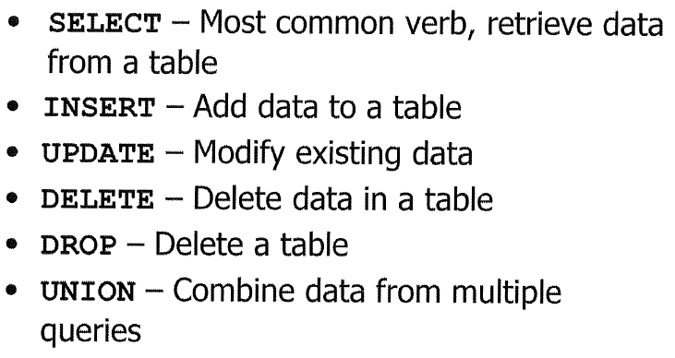
Key SQL Verbs

Slide 29
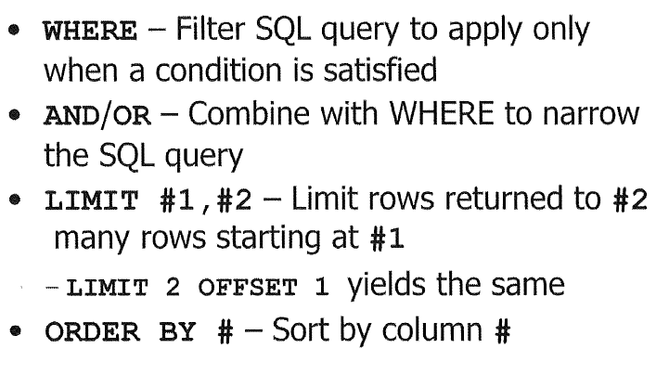
SQL Query Modifier

Slide 30
INSERT INTO shop VALUES (1,‘input1',input2);
SELECT * FROM account where username=‘input’ and password=‘input2’;
SELECT fName from account UNION SELECT lName from account2;

Slide 31
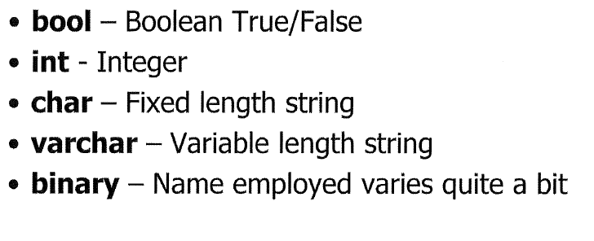
SQL Data Types

Slide 32
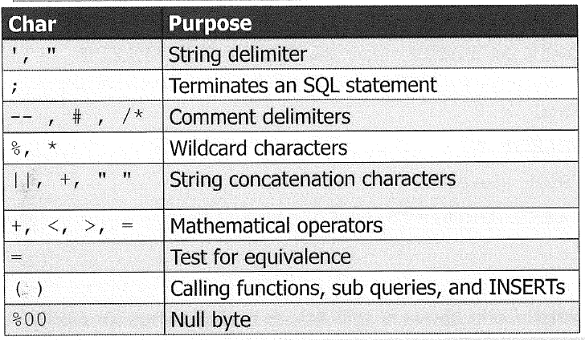
SQL Special Characters

Slide 33
SQL Injection Example: Code
An example server side PHP code that takes the value of a URL query parameter name as input to SQL select:
$sql = “ SELECT * from Users WHERE lname = ‘ $_GET[“name”]’ “;

Slide 34
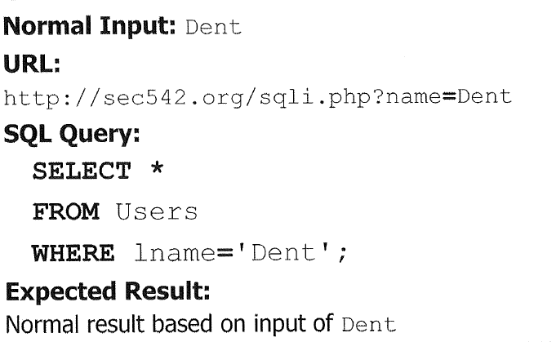
http://localhost/sqli.php?name=Dent

Slide 35
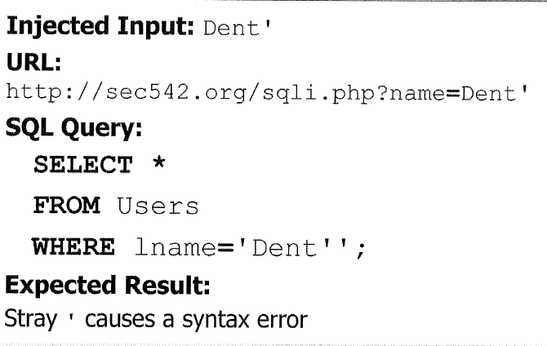
http://localhost/sqli.php?name=Dent’

Slide 36
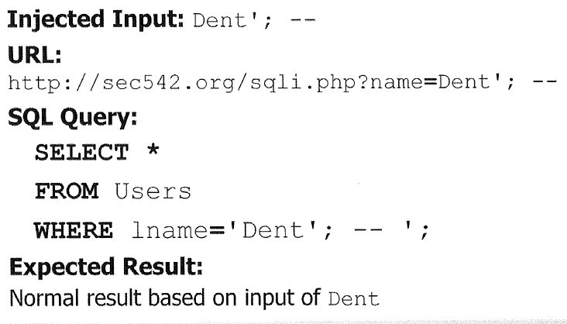
http://localhost/sqli.php?name=Dent’; --

Slide 37
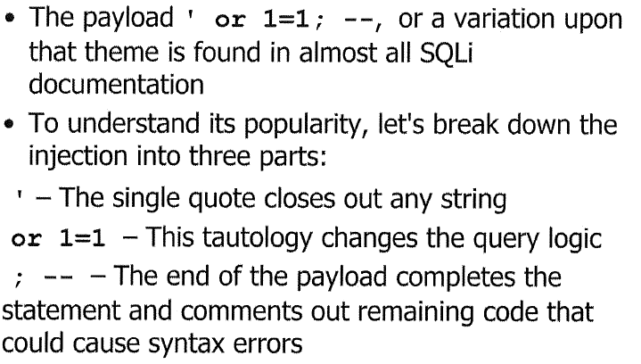
Most Well-known Payload:
‘ or 1=1; --

Slide 38
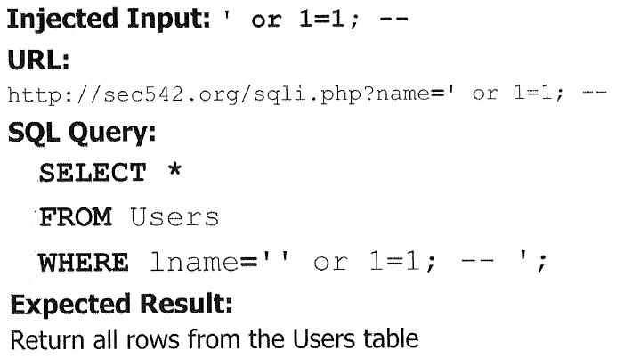
http://localhost/sqli.php?name=Dent’ or 1=1; --

Slide 39
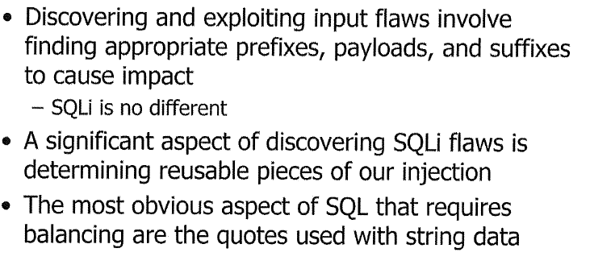
SQL Input Balancing

Slide 40
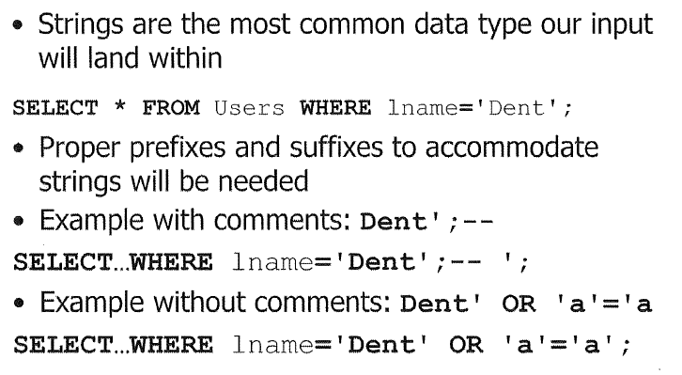
Quote Balancing

Slide 41
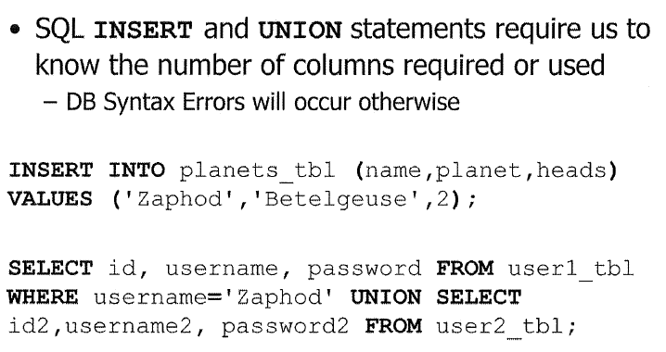
Balancing Column Numbers

Slide 42
Data Type Balancing
The data type should be compatible/convertible
  Numbers and strings are typically compatible for this purpose

Slide 43
Discovering SQL Injection
With the basic knowledge and familiarity with SQL, special characters, we will explore different types or classes of SQL injection flaws
We will look at various manifestations of SQL injection vulnerabilities

Slide 44
Input location
Where in application do we target SQL injection?
  Login
  HTTP requests: GET, POST payload
  HTTP cookie
  HTTP User-Agent
Which are blind? Which are visible?

Slide 45
In-Band/Inline SQLi
A SQL Injection flaw that allows attacker to see the result of injections.
  DB error messages
  Application errors
  Visible result
Simpler to discover
Easier to exploit

Slide 46
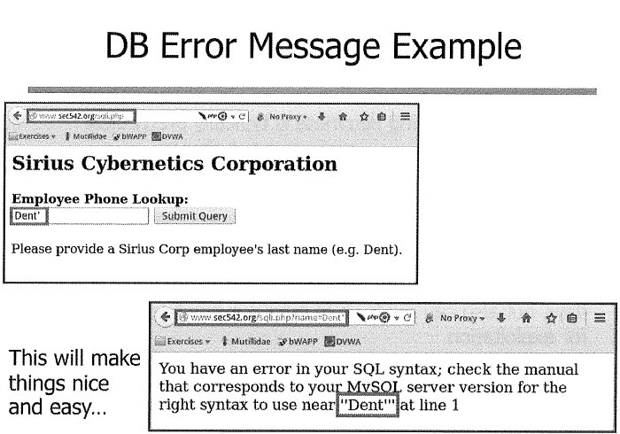

Slide 47
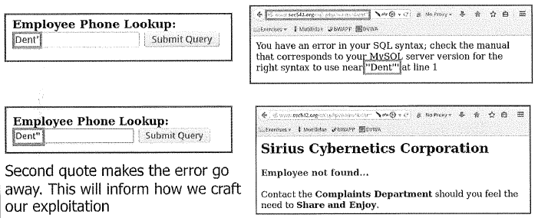
DB error message is a guide to successful exploitation.

Slide 48
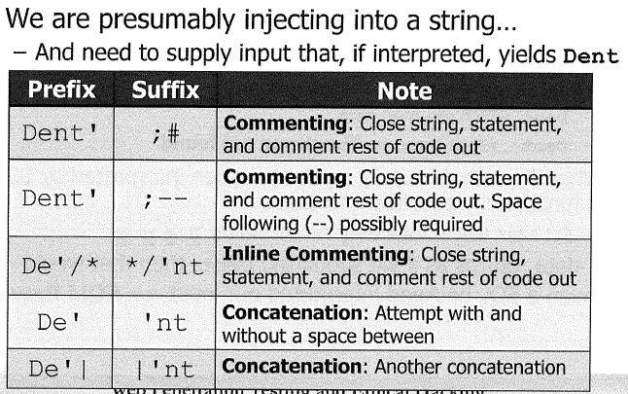
Application error
Supply input that when interpreted by SQL is functionally equivalent to normal input e.g. Dent

Slide 49
Inject For Comment
Comment delimiters ( --, /* */, #) can alllow injections to succeed that would otherwise fail
Injecting into the middle of a SQL statement/query causes problems, because we cannot change the rest of the SQL statement that follows
  Injecting comments can allow us to change the SQL being submitted without causing a syntax error

Slide 50
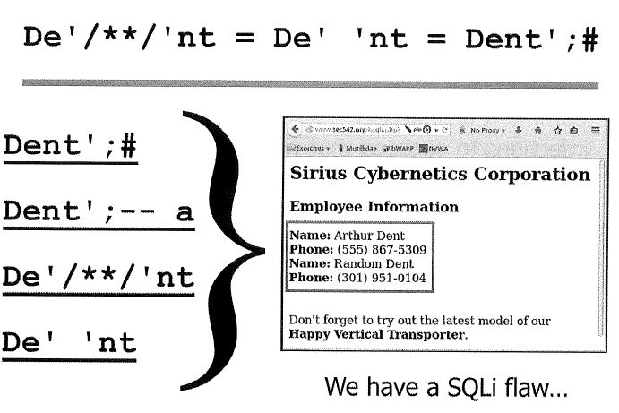

Slide 51
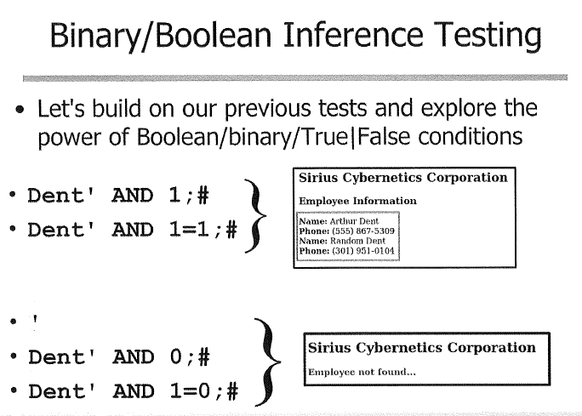

Slide 52
Blind SQLi
The result is not directly visible to the attacker
Many level of blindness
Consider an application that provides no discernible output or errors
  Timing based inference testing could still be a viable option for us
Challenge: how to observe the timing?

Slide 53
Blind Timing Inferences
Timing techniques use the responsiveness of the application for the inference by artificially inducing a delay when a condition evaluates
For example, these will introduce a 10 second delay:
  Sleep(10) –MySQL
  WAITFOR DELAY ‘0:0:10’ –MSSQL
  Other creative approaches exist to induce a delay

Slide 54
DB Fingerprinting
Determine the DB backend to guide injections
Use information from configuration gathering, error messages
Or using certain commands, functions, syntax, and defaults
  SELECT @@version (MySQL and MS SQL)
  String concatenation
    MySQL: ‘De’ ‘nt’, MS: ‘De’+’nt’, Oracle: ‘De’||’nt’
  Unique numeric functions
    MySQL: conection_id(), MS: @@pack_received, Oracle: BITAND(1,1)

Slide 55
Information_schema is an ANSI SQL92 standard database that can provide metadata about the database server
  Not all vendors support the Information_schema

Slide 56
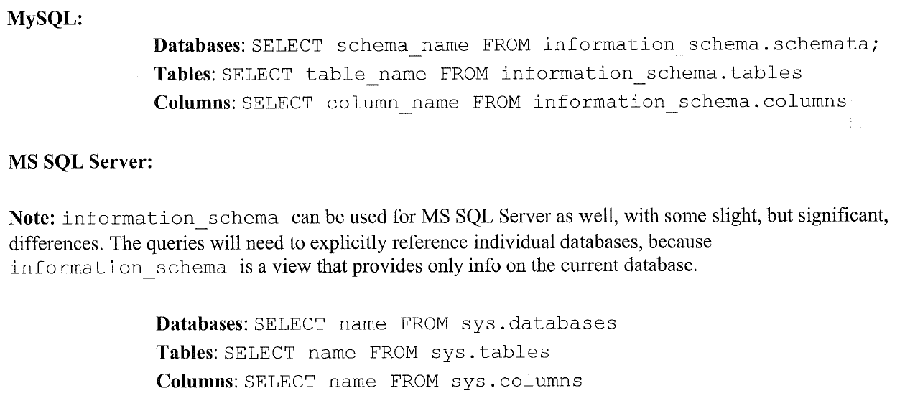
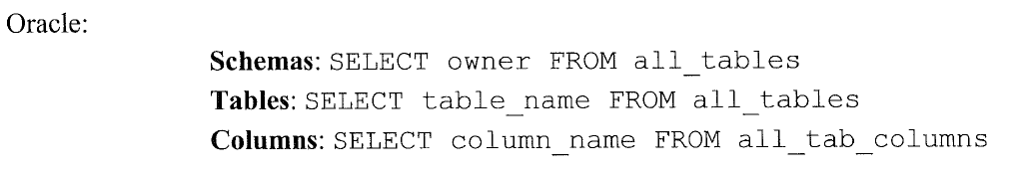
Databases/Tables/Columns

Slide 57
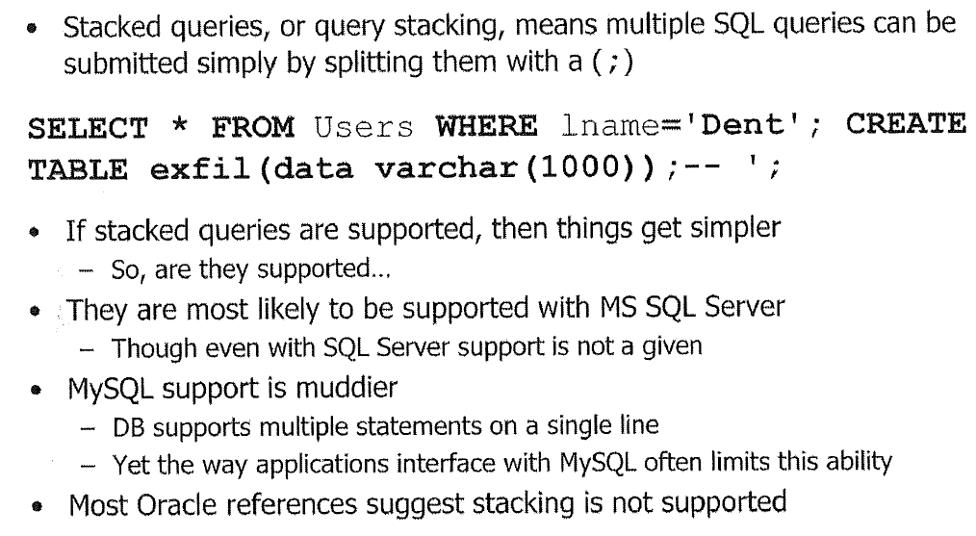
Stacked Queries

Slide 58
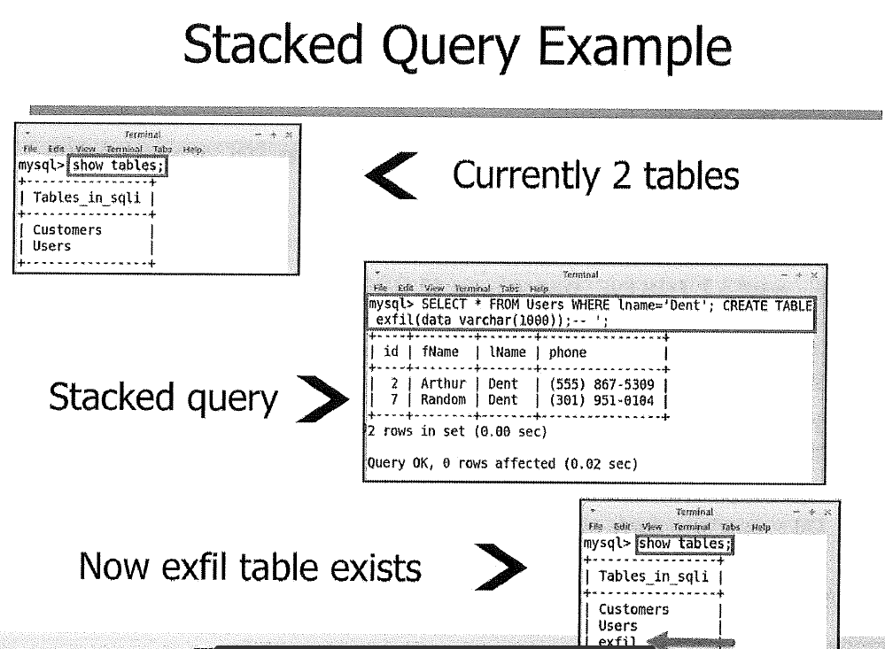

Slide 59
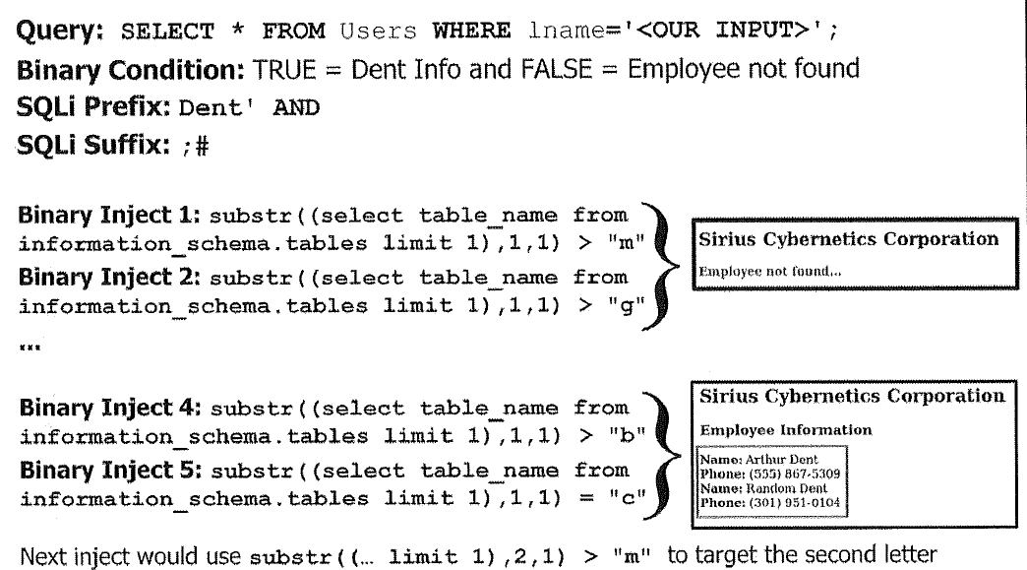
Blind Boolean Inference Exfiltration

Slide 60
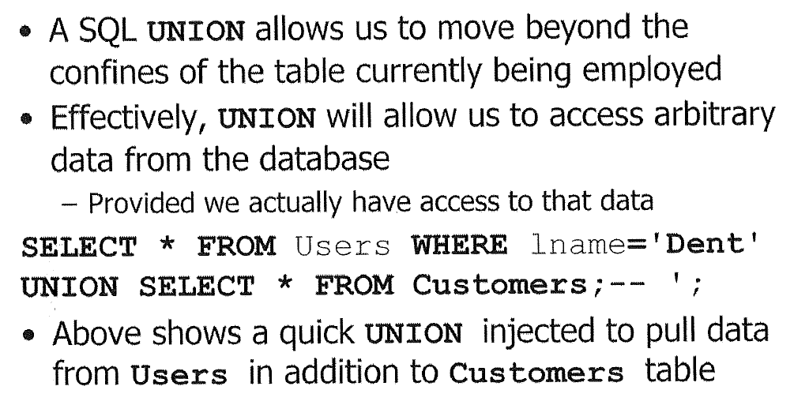
UNIONizing SQL Injection

Slide 61
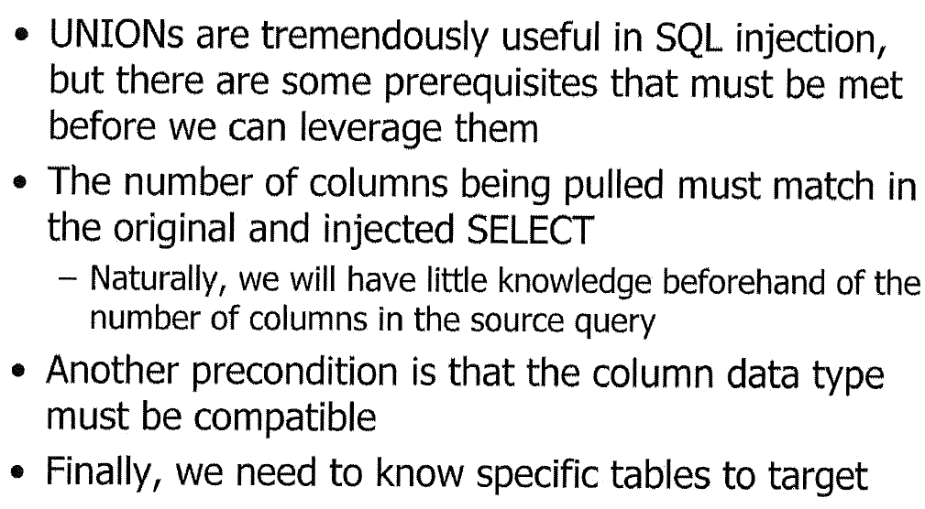
UNION Prerequisites

Slide 62
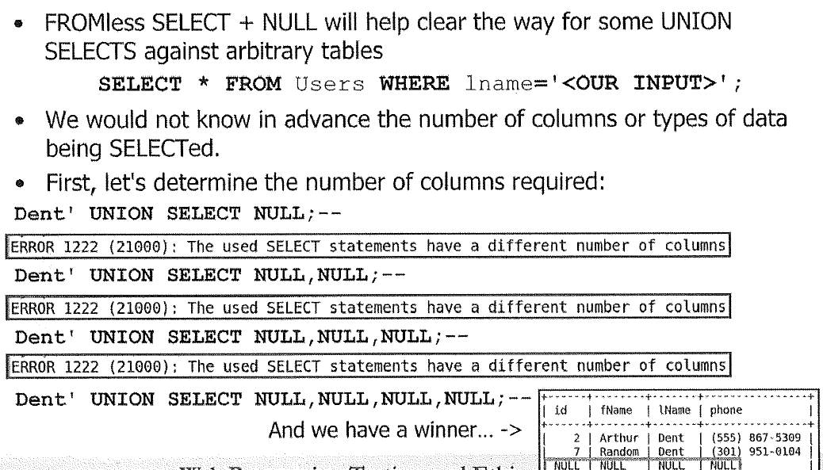
UNION + NULL

Slide 63
SQLi Potential Attacks
Deleting or altering valuable data
  Ransomware to encrypt critical DB data
Injecting data used as stored XSS payloads
DB privilege escalation
Reading files
  MySQL: LOAD_FILE()
  MS SQL: BULK INSERT
Writing files
  MySQL: INTO OUTFILE
OS interaction beyond files
  Use stored procedures to interface with OS

Slide 64
SQLi Cheat Sheets
Some of the SQL injection cheat sheets:
WebSec SQL injection knowledge base:
  https://websec.ca/kb/sql_injection
Pentestmonkey SQL Injection Cheat Sheets:
  http://pentestmonkey.net/cheat-sheet/sql-injection
SQL Injection Wiki Cheat Sheet
  http://www.sqlinjectionwiki.com/

Slide 65
LAB 6 SQLi
Exercise: Error-based SQL Injection
Target: http://localhost/sqli.php
Goal: Perform the following SQL injection activities
  Cause a DB error, eg. Display a DB error message
  Return data using comments
  Return data without comments
  Find out the number of columns by ORDER BY
  Force vulnerable query details to display
P120

Slide 66
LAB6 SQLi
Please see the step-by-step instructions on Blackboard.

Slide 67
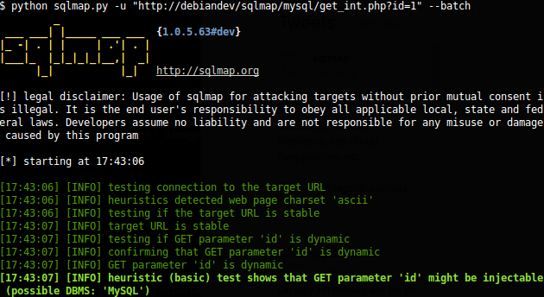
SQLi Tools
sqlmap: an open source, python-based, command-line SQL injection tool of awesomeness created by Bernardo Damele A.G.
The most important tool for SQL injection testing/exploitation

Slide 68
For all SQLi needs, sqlmap can do it:
Inline SQLi discovery/exploitation
Blind SQLi discovery/exploitation
Integrated with ZAP/Burp/Metasploit

Slide 69
Sqlmap + ZAP
Goals: employ sqlmap and ZAP to test and exploit an authenticated SQL injection flaw
  Manually test authenticated SQLi flaw using ZAP
  Integrate sqlmap as a ZAP application
    Provide sqlmap authentication information from ZAP
  Leverage sqlmap and ZAP together to exploit SQLi flaw

Slide 70
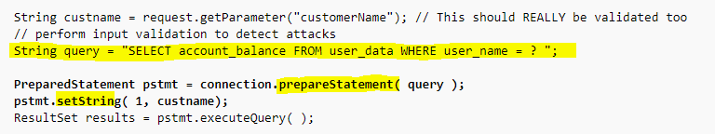
SQLi Prevention
1. Whitelist Input Validation/Escaping
2. Prepared Statements
3. Least Privilege
  Multiple DB users, different permissions

