Slide 1
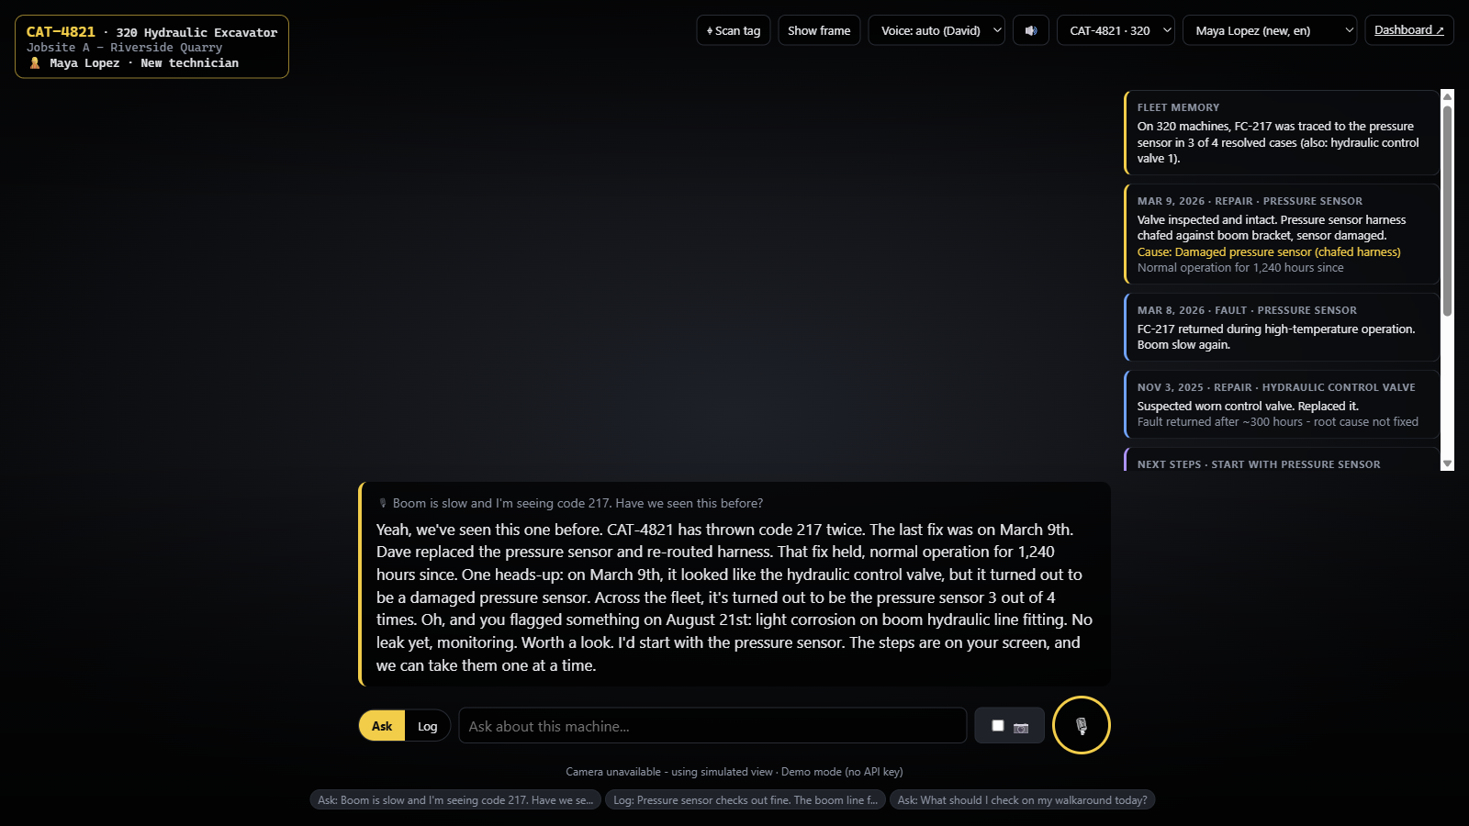




HACK TO THE FUTURE · CAT TRACK: MEMORY FOR PHYSICAL AI
WHAT THE TECHNICIAN SEES
DéjàView
Smart glasses that remember every Caterpillar machine and coach new technicians through repairs, hands-free and in their own language.
Sees the machine
Remembers its past
Learns from every fix
Our working prototype
DAAP Developers
Built for new technicians and operators
Notes:
[0:00-0:08] Hi, we're DAAP Developers. This is DéjàView: smart glasses that remember every Caterpillar machine and coach new technicians through repairs, hands-free and in their own language.

Slide 2





01 MEET THE USER
Meet Luis. Three weeks into his first job as a technician.
MONDAY, 7:00 AM
1
A 320 excavator's boom is slow. Fault code 217.
It's a machine he has never worked on.
Luis Ortega
2
The senior tech who knows it isn't here.
New field technician
Strikes and turnover push new people onto machines fast.
3 weeks on the job
3
The answer is buried.
Spanish is his first language
Manuals, fault notes and service records, scattered and mostly in English.
Learning by shadowing senior techs
4
So he guesses.
Wants to do it right, and safely
Wrong part, lost hours, and a real safety risk.
Notes:
[0:08-0:20] Meet Luis. He's three weeks into his first technician job. A 320 excavator's boom is slow and it's throwing code 217. He's never seen this machine, the senior tech who knows it isn't here, and the answer is buried in English manuals and old notes. So he guesses.

Slide 3



02 THE PROBLEM
Machine knowledge is scattered, and new technicians pay the price.
Unfamiliar machines
Information overload
Language barriers
Every machine has a past: repeat faults, misdiagnoses, quirks. That history lives in senior techs' heads.
Manuals, fault codes, service records and notes live in different places. Cat has 1,000,000+ parts.
Documentation and tools are English-first. A big share of the workforce isn't.
21,700
~19%
35%
30%
heavy-equipment technician openings every year
of a knowledge worker's week goes to searching for information
of U.S. construction workers are Hispanic or Latino
higher fatal injury rate for Hispanic or Latino workers
BLS, 2024-34 projections
McKinsey Global Institute
BLS, 2024
BLS, 2024
BARRIERS WE REMOVE Cognitive · Informational · Linguistic
Notes:
[0:20-0:32] This isn't just Luis. Over 21,000 heavy-equipment technician jobs open every year, workers lose about a fifth of their time hunting for information, and a third of the construction workforce is Hispanic or Latino, with a higher fatal injury rate. The knowledge exists, but it's scattered, overwhelming, and English-first.

Slide 4




03 HOW WE GOT HERE
We talked to Caterpillar before writing a line of code.
INTERVIEW
MARKET RESEARCH
Marcus, Product Owner at Caterpillar
Shops, workforce and existing tools
Safety is the #1 priority, so any tool has to be foolproof
Heavy-equipment shops struggle to hire and train technicians
Strikes and turnover put new people on machines fast
Expert knowledge retires with senior technicians
Bringing new technicians up to speed takes a long time
Today's tools search manuals; none remember a single machine's history
Cat has 1,000,000+ parts; nobody can memorize them
Field work is hands-busy: phones and tablets get in the way
Key insight: the answer usually already exists. Someone fixed this before. It just isn't where the technician is.
Notes:
[0:32-0:42] We started by talking to Marcus, a product owner at Caterpillar. Safety is number one, so it has to be foolproof. Strikes and turnover push new people onto machines, and onboarding is slow. Our research showed the answer usually already exists; someone fixed it before. It just isn't where the technician is.

Slide 5



04 OUR SOLUTION
DéjàView puts the machine's memory right in front of the technician.
1. Look
The glasses recognize the machine from its tag and camera.
2. Ask
Ask out loud, like “have we seen this before?”, and hear the answer in your language.
3. Fix and teach
Follow safe, step-by-step guidance. Say what you fixed, and the machine and the whole fleet learn.
Working prototype: spoken answer, the machine's history, and safe next steps
Notes:
[0:42-0:52] DéjàView is smart glasses with a memory layer. Luis looks at the machine, asks out loud in Spanish, and hears that machine's history, what was wrongly blamed last time, and safe next steps. When he logs the fix by voice, the machine and the whole fleet learn.

Slide 6






05 HOW IT SOLVES THE PROBLEM
Every pain point has a direct answer.
PAIN POINT
WHAT DÉJÀVIEW DOES
RESULT
Never seen this machine
Instant history: past faults, what fixed them, and what was wrongly blamed
No starting from zero
Too much information
One spoken answer and only the relevant steps, safety step first
Faster, safer diagnosis
English-first tools
Listens and answers in the technician's language (English and Spanish today)
Everyone can use it
Experts retire or are out
Every logged fix becomes shared memory for the whole fleet
Knowledge stays
Hands busy on the job
Voice and a heads-up display, nothing to hold
Eyes up, hands free
Notes:
[0:52-1:00] Each pain point maps to a feature: instant machine history, one answer with safety first, the tech's own language, shared memory so knowledge stays, and a hands-free interface.

Slide 7
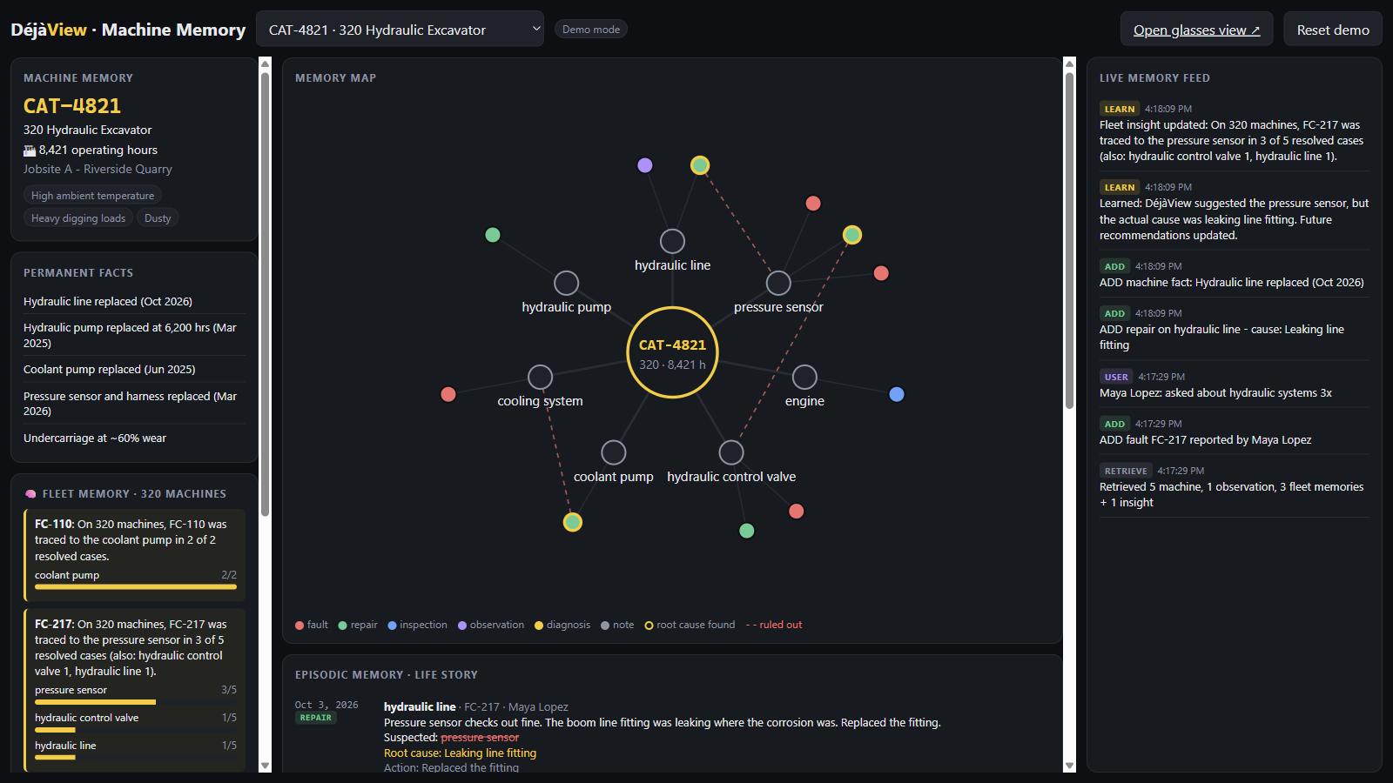
06 HOW IT WORKS
A memory layer that learns from every repair.
FIVE KINDS OF MEMORY
Machine
Permanent facts: model, hours, parts replaced
Episodic
Every fault, repair and inspection, in order
Human
Each technician's experience and language
Procedural
Repair steps, with the safety step first
Fleet
Patterns across every machine of a model
Live dashboard: yellow rings mark root causes found, dashed red lines mark parts ruled out
Ask → answer from memory → fix → log it by voice → machine and fleet learn → better answer next time
Notes:
[1:00-1:06] Under the hood, five kinds of memory feed every answer. Every logged repair writes back, so the next answer is smarter, for this machine and the whole fleet.

Slide 8



07 LIVE DEMO
See it in action.
1
2
3
Maya asks
Maya logs the fix
Luis asks in Spanish
Boom is slow, code 217. Have we seen this before?
Sensor's fine. The line fitting was leaking. Replaced it.
¿Qué pasó la última vez con el código 217?
Recalls this machine's history, warns that the valve was wrongly blamed last time, and lists safe steps.
The machine learns it was the fitting, and the fleet pattern updates live on the dashboard.
A full spoken answer in Spanish, built on the same shared memory, including Maya's fix.
Switch to the prototype: glasses view + live dashboard
Notes:
[1:06-1:36] [Switch to the glasses tab.] Maya asks: boom is slow, code 217, have we seen this before? It recalls the last fix and warns that the valve was wrongly blamed. She logs that the sensor was fine and the line fitting was leaking. On the dashboard, the machine learned and the fleet pattern updated. Now Luis asks in Spanish and gets the whole answer in Spanish, including Maya's fix.

Slide 9



08 SUCCESS CRITERIA
How we'll know it works.
OUR NORTH STAR
SAFETY
Every repair starts safe
Fixed right the first time
The safety step comes first on every job, explained in the technician's own language.
A new technician diagnoses and repairs an unfamiliar fault correctly on the first visit, and the problem doesn't come back.
INDEPENDENCE
It only happens when the answer is fast, safe and correct, and it gets easier as the memory learns from every fix.
New techs work on their own sooner
They get answers from the machine's memory instead of waiting for a senior tech or digging through manuals.
HOW WE'LL MEASURE IT In a pilot, comparing new technicians who use DéjàView with those who don't
Notes:
Our North Star is simple: a new technician fixes an unfamiliar machine right the first time. Behind it are two success criteria: every repair starts safe, and new technicians can work on their own sooner. We'll measure all three in a pilot against technicians working without DéjàView.

Slide 10

09 TRADEOFFS
What we chose, and what we gave up.
WE CHOSE
OVER
WHY
Hands-free glasses
A tablet app
Eyes up, hands on the machine. Cost: hardware and battery, so our prototype runs in a browser.
Grounded answers
Free-form AI
It only says what's in the records. For safety, accuracy beats creativity.
Works offline
AI-only
Job sites lose signal. Built-in rules work anywhere; AI adds depth when available.
Structured memories
Raw transcripts
Searchable, auditable and small. We give up some nuance.
One workflow, done well
Every feature
Unfamiliar faults are where new technicians struggle most.
Notes:
[1:44-1:48] (Optional if short on time.) We chose hands-free over tablets, grounded answers over free-form AI, and an offline fallback because job sites lose signal.

Slide 11
10 IMPLEMENTATION ROADMAP
From prototype to every Cat machine.
TODAY
0-3 MONTHS
3-12 MONTHS
12+ MONTHS
Working prototype
Pilot
Scale
Fleet-wide
Voice glasses view and live dashboard
Machine memory with a learning loop
English and Spanish
One Cat dealer shop, 10-20 new technicians
Connect real service records and manuals
Run on Meta AI glasses
Measure First-Time Fix Rate
Search all 1,000,000+ Cat parts
Live telematics and fault codes
More languages
Every Cat machine has a memory
Operators and fleet managers too
AR highlights on the exact part
Personal coaching agents
TO START THE PILOT WE NEED a dealer partner · access to service records · glasses hardware
Notes:
[1:48-1:56] Today we have a working prototype. Next is a 90-day pilot with one Cat dealer on real service records and Meta glasses. Then we scale to Cat's million-plus parts and live machine data, and finally every Cat machine gets a memory.

Slide 12
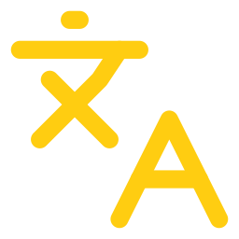


11 NEXT STEPS
What's next.
More languages
Smarter personalization
Scale to Cat's data
Beyond English and Spanish, so every crew member is covered
Agents adapt their tone, depth and coaching to each technician
Handle 1,000,000+ parts, manuals and live machine data
DéjàView
Thank you
Every machine remembers.
Every technician benefits.
DAAP Developers · Questions?
Notes:
[1:56-2:02] Next: more languages, smarter personalization, and scaling to all of Cat's data. DéjàView: every machine remembers, and every technician benefits. Thank you!

