Slide 1
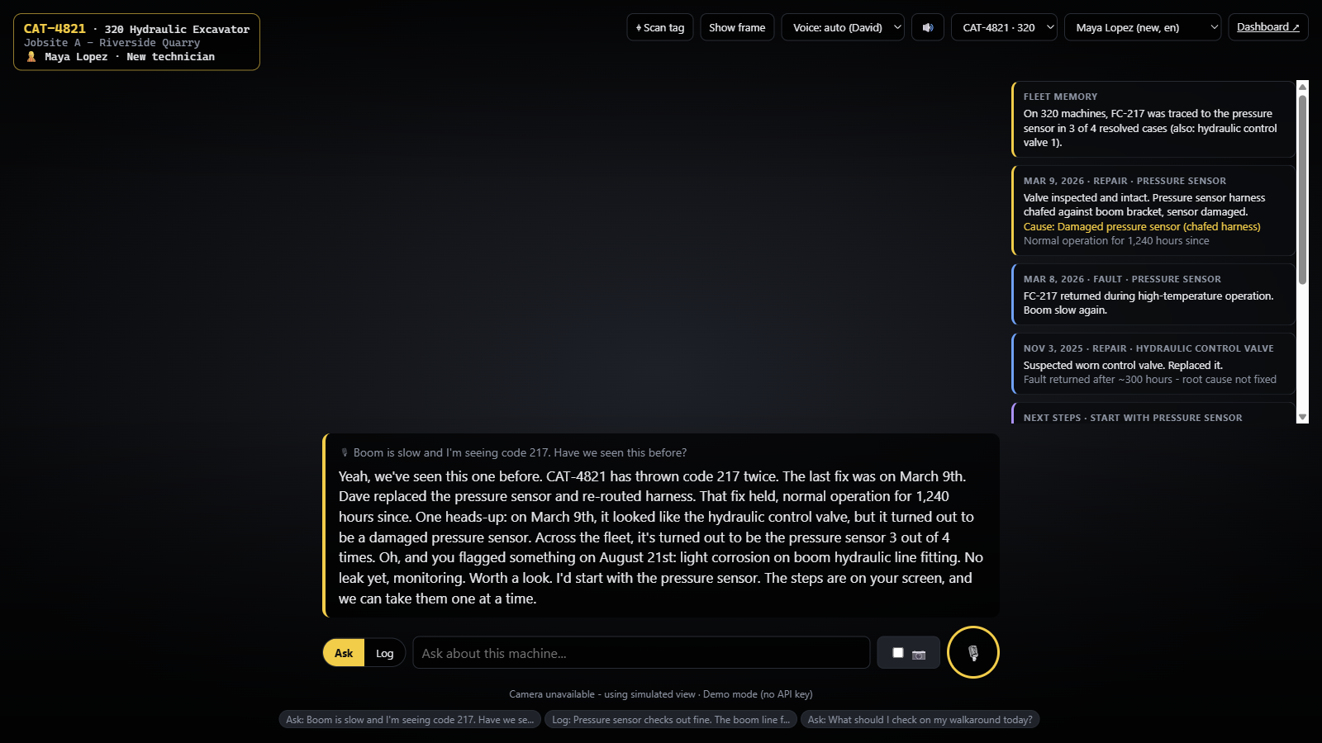




HACK TO THE FUTURE · CAT TRACK: MEMORY FOR PHYSICAL AI
WHAT THE TECHNICIAN SEES
DéjàView
Smart glasses that remember every Caterpillar machine and coach new technicians through repairs, hands-free and in their own language.
Sees the machine
Remembers its past
Learns from every fix
Our working prototype
DAAP Developers
Built for new technicians and operators
Notes:
[0:00-0:08] Hi, we're DAAP Developers. This is DéjàView: smart glasses that remember every Caterpillar machine and coach new technicians through repairs, hands-free and in their own language.

Slide 2





01 MEET THE USER
Meet Luis. Three weeks into his first job as a technician.
MONDAY, 7:00 AM
1
A 320 excavator's boom is slow. Fault code 217.
It's a machine he has never worked on.
Luis Ortega
2
The senior tech who knows it isn't here.
New field technician
Strikes and turnover push new people onto machines fast.
3 weeks on the job
3
The answer is buried.
Spanish is his first language
Manuals, fault notes and service records, scattered and mostly in English.
Learning by shadowing senior techs
4
So he guesses.
Wants to do it right, and safely
Wrong part, lost hours, and a real safety risk.
Notes:
[0:08-0:20] Meet Luis. He's three weeks into his first technician job. A 320 excavator's boom is slow and it's throwing code 217. He's never seen this machine, the senior tech who knows it isn't here, and the answer is buried in English manuals and old notes. So he guesses.

Slide 3



02 THE PROBLEM
Bottlenecks on jobsites stem from unfamiliarity
Unfamiliar machines
Information overload
Language barriers
Every machine has a past: repeat faults, misdiagnoses, quirks. That history lives in senior techs' heads.
Manuals, fault codes, service records and notes live in different places. Cat has 1,000,000+ parts.
Documentation and tools are English-first. A big share of the workforce isn't.
21,700
~19%
35%
26%
heavy-equipment technician openings every year
of work time is spent searching for information
of U.S. construction workers are Hispanic or Latino
higher fatal injury rate for Hispanic or Latino workers
BLS, 2024-34 projections
McKinsey Global Institute
BLS, 2024
BLS, 2023
BARRIERS WE REMOVE Cognitive · Informational · Linguistic
Notes:
[0:20-0:32] This isn't just Luis. Over 21,000 heavy-equipment technician jobs open every year, workers lose about a fifth of their time hunting for information, and a third of the construction workforce is Hispanic or Latino, with a higher fatal injury rate. The knowledge exists, but it's scattered, overwhelming, and English-first.

Slide 4



03 HOW WE GOT HERE
We talked to Caterpillar before jumping to any solutions`
INTERVIEW
INTERVIEW
Marcus, Lead Product Owner at Caterpillar
Gino, Lead Product Owner at Caterpillar
Safety is the #1 priority, so any tool has to be foolproof
Half of today’s representative were non-native English speakers
Strikes and turnover put new people on machines fast
New ESL employees tend to feel small early on
Bringing new technicians up to speed takes a long time
New hires are also prone to Impostor Syndrome
Cat has 1,000,000+ parts; nobody can memorize them
Key insight: the answer usually already exists. Someone fixed this before. It just isn't where the technician is.
Notes:
[0:32-0:42] We started by talking to Marcus, a product owner at Caterpillar. Safety is number one, so it has to be foolproof. Strikes and turnover push new people onto machines, and onboarding is slow. Our research showed the answer usually already exists; someone fixed it before. It just isn't where the technician is.

Slide 5



04 OUR SOLUTION
Introducing DéjàView Glasses, putting the machine's memory right in front of the technician’s eyes
1. Look
The glasses recognize the machine from its tag and camera.
2. Ask
Ask out loud, “have we seen this before?”, and hear the answer in your language.
3. Fix and teach
Follow safe, step-by-step guidance. Say what you fixed, and the machine and the whole fleet learn.
Notes:
[0:42-0:52] DéjàView is smart glasses with a memory layer. Luis looks at the machine, asks out loud in Spanish, and hears that machine's history, what was wrongly blamed last time, and safe next steps. When he logs the fix by voice, the machine and the whole fleet learn.

Slide 6
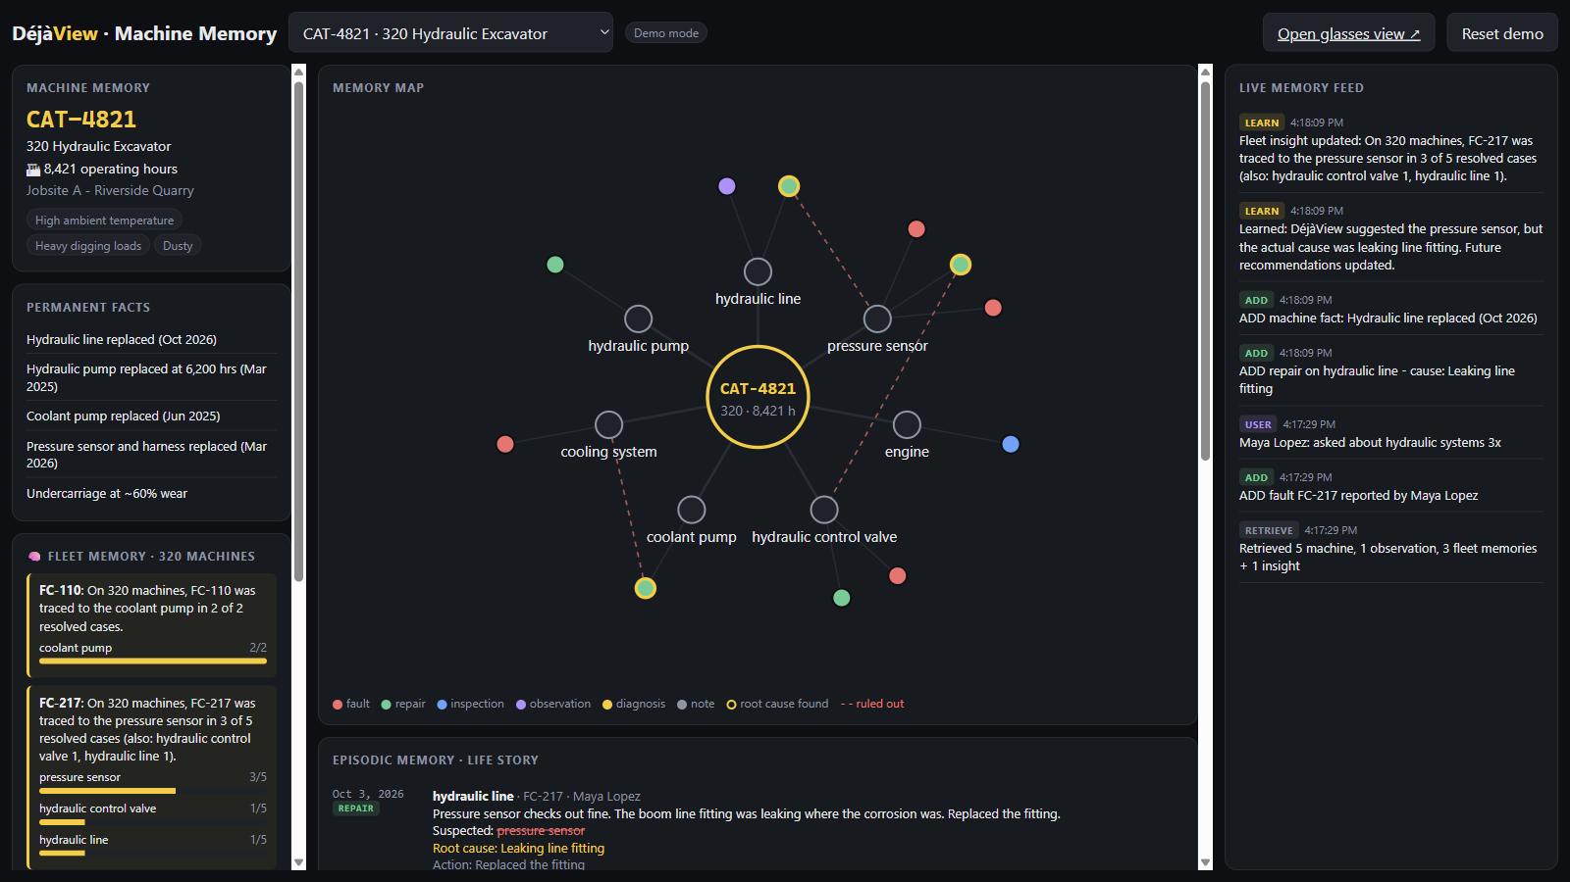
05 HOW IT WORKS
A memory layer that learns from every repair.
FIVE KINDS OF MEMORY
Machine
Permanent facts: model, hours, parts replaced
Episodic
Every fault, repair and inspection, in order
Human
Each technician's experience and language
Procedural
Repair steps, with the safety step first
Fleet
Patterns across every machine of a model
Live dashboard: yellow rings mark root causes found, dashed red lines mark parts ruled out
Ask → answer from memory → fix → log it by voice → machine and fleet learn → better answer next time
Notes:
[1:00-1:06] Under the hood, five kinds of memory feed every answer. Every logged repair writes back, so the next answer is smarter, for this machine and the whole fleet.

Slide 7



06 SUCCESS CRITERIA
Metrics towards success
OUR NORTH STAR
SAFETY
Every repair starts safe
Fixed right the first time
The safety step comes first on every job, explained in the technician's own language.
A new technician diagnoses and repairs an unfamiliar fault correctly on the first visit, and the problem doesn't come back.
EFFICIENCY
New techs work on their own sooner
Glasses streamline processes when
HOW WE'LL MEASURE IT In a pilot, comparing new technicians who use DéjàView with those who don't
Notes:
Our North Star is simple: a new technician fixes an unfamiliar machine right the first time. Behind it are two success criteria: every repair starts safe, and new technicians can work on their own sooner. We'll measure all three in a pilot against technicians working without DéjàView.

Slide 8
07 IMPLEMENTATION ROADMAP
Product timeline
TODAY
0-3 MONTHS
3-12 MONTHS
12+ MONTHS
Working prototype
Pilot
Scale
Fleet-wide
Voice glasses view and live dashboard
Machine memory with a learning loop
English and Spanish
One Cat dealer shop, 10-20 new technicians
Connect real service records and manuals
Run on Meta AI glasses
Measure First-Time Fix Rate
Search all 1,000,000+ Cat parts
Live telematics and fault codes
More languages
Every Cat machine has a memory
Operators and fleet managers too
AR highlights on the exact part
Personal coaching agents
Notes:
[1:48-1:56] Today we have a working prototype. Next is a 90-day pilot with one Cat dealer on real service records and Meta glasses. Then we scale to Cat's million-plus parts and live machine data, and finally every Cat machine gets a memory.

Slide 9
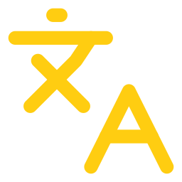


08 CONCLUSION
Taking the product further
More languages
Smarter personalization
Scale to Cat's data
Beyond English and Spanish, so every crew member is covered
Agents adapt their tone, depth and coaching to each technician
Handle 1,000,000+ parts, manuals and live machine data
DéjàView
Thank you
DAAP Developers · Questions?
Notes:
[1:56-2:02] Next: more languages, smarter personalization, and scaling to all of Cat's data. DéjàView: every machine remembers, and every technician benefits. Thank you!

