Slide 1

Team Name: RightWing
Team Leader Name: Aarav Gupta
Problem Statement: Intelligent Candidate Discovery - rank candidates the way a strong recruiter would, beyond keyword matching.

Slide 2
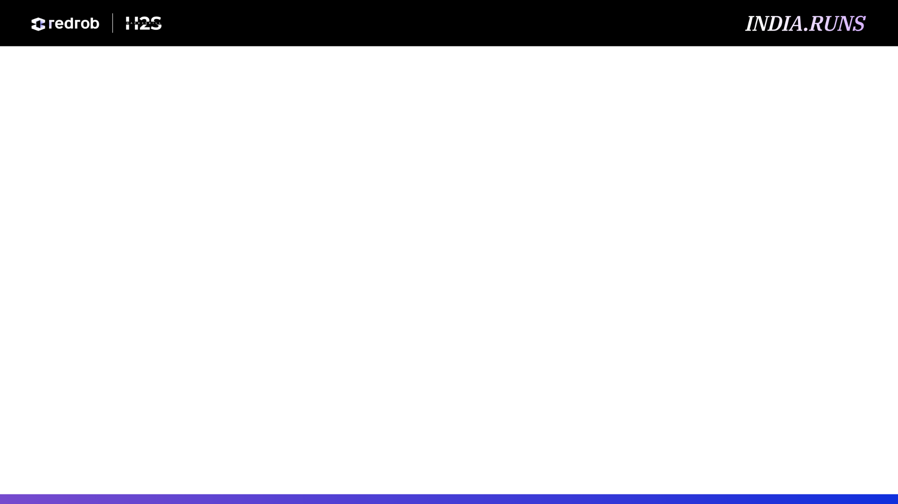
Solution Overview
RecruiterLens is a CPU-only candidate ranking system for Redrob's Senior AI Engineer role.
It builds an evidence graph from career history, skills, behavioral signals, logistics, and risk flags.
Career evidence outranks keyword overlap: shipped search, ranking, retrieval, and recommendation work matters most.
Trust-weighted skills use proficiency, duration, endorsements, and assessment scores.
Risk gates suppress keyword stuffers, services-only profiles, CV/speech-only profiles, and honeypot-style impossibilities.

Slide 3
JD Understanding & Candidate Evaluation
Target profile: 5-9 years, senior IC judgment, strong Python, product-company ML depth, and shipping bias.
Must-have evidence: production retrieval/search/ranking/recommendation systems, evaluation frameworks, and vector or hybrid search exposure.
Important logistics: Pune/Noida preferred, Indian tier-1 cities welcome, hybrid/flexible availability, and shorter notice periods.
Negative evidence: pure research, recent framework-only LLM demos, non-technical current roles, services-only careers, and unsupported skill stuffing.

Slide 4
Ranking Methodology
Stream candidates from JSONL and compute deterministic feature panels per profile.
Score career evidence, current role fit, trusted skill evidence, experience band, company context, logistics, and behavioral availability.
Apply hard caps when evidence is missing: skills alone cannot make a candidate top-tier.
Sort by final score with deterministic tie-breaks, then generate one fact-grounded reason per selected candidate.

Slide 5
Explainability & Data Validation
Every row includes a concise reason built only from observed candidate fields: title, years, evidence, response rate, notice, and location.
The diagnostics file exposes component scores and risk flags for auditability.
No LLM generates candidate reasoning during ranking, so there are no hallucinated skills or unsupported claims.
Official validation passes: exactly 100 rows, ranks 1-100, unique IDs, and non-increasing scores.

Slide 6
End-to-End Workflow
Read JD and candidate schema, then encode the role as a recruiter-lens scoring rubric.
Stream 100,000 JSONL profiles through feature extractors and risk gates.
Rank top 100 candidates and emit CSV with candidate_id, rank, score, and reasoning.
Validate with the bundled challenge script; export a matching XLSX for the portal.

Slide 7
System Architecture
JD Lens -> structured requirements: must-haves, nice-to-haves, negative evidence, logistics
Candidate Parser -> career roles, descriptions, skills, education, and Redrob behavioral signals
Evidence Scorers -> career fit, role fit, trusted skills, product context, experience, logistics, behavior
Risk Gates -> keyword stuffing, non-technical current role, services-only path, impossible timelines
Ranker + Reasoner -> deterministic top-100 CSV/XLSX with audit-ready candidate explanations

Slide 8
Results & Performance
Full 100,000-candidate run completes in about 90 seconds on local CPU in this workspace.
The official CSV validator passes without format, rank, duplicate, or score-order issues.
Top results are dominated by candidates with shipped ranking/search/retrieval/recommendation systems, not generic AI keyword lists.
The ranker uses no network, hosted APIs, GPU, or model downloads during inference.

Slide 9
Technologies Used
Python standard library for the reproducible ranker: json, csv, datetime, regex, dataclasses, and unittest.
Deterministic evidence dictionaries and risk gates instead of per-candidate LLM calls.
Artifact-tool used only for submission artifacts: XLSX formatting and PPTX generation.
No heavy dependencies keeps Stage 3 reproduction simple under the 5-minute CPU/no-network constraint.

Slide 10
Submission Assets
GitHub repository: https://github.com/aarav06gupta/redrob-recruiter-lens
Reproduce command: python rank.py --candidates ./candidates.jsonl --out ./submission.csv
Ranked outputs: outputs/redrob_submission.csv and outputs/redrob_submission.xlsx.
Audit files: outputs/redrob_diagnostics.csv, README.md, tests, and submission_metadata.yaml.
Sandbox link: TODO - deploy the same command in Hugging Face Spaces, Streamlit Cloud, Replit, Colab, Docker, or Binder.

Slide 11
