Slide 1

Bluestock Mutual Fund Analytics Capstone
Modernizing Data Architecture for Indian Retail Investors
Presenter: Aarav aggarwal

Slide 2
Problem & Objective
The Industry Context: The Indian Mutual Fund industry has crossed the Rs. 81L Crore AUM milestone.
The Problem:
Data Fragmentation: Raw AMFI data is inconsistent, non-standardized, and difficult for retail investors to parse.
Opaque Analytics: Retail investors lack accessible, institutional-grade risk metrics (VaR, CVaR, Sharpe Ratios) to make informed decisions.
The Objective:
Engineering: Build an automated, end-to-end data pipeline to transform raw files into a structured SQLite Star Schema.
Analytics: Deliver actionable, risk-adjusted insights and a dynamic recommendation engine.
Visualization: Provide an interactive dashboard to democratize market data for retail users.

Slide 3
Data Sources
Fund Master Data (01_fund_master.csv): Comprehensive metadata including AMC names, fund categories, and benchmark indices.
Historical Valuations (02_nav_history.csv): Daily Net Asset Value (NAV) data across the 2022–2026 period, forming the backbone for all risk and return modeling.
Investor Analytics (08_investor_transactions.csv): Millions of transaction logs covering SIPs, lumpsums, and redemptions, mapped to granular demographics (age, state, city-tier, and KYC status).
Performance Benchmarks (07_scheme_performance.csv): Aggregated metrics including multi-year CAGRs, Sharpe ratios, and standard deviations for comparative benchmarking.
Goal: Consolidate fragmented, raw inputs into a unified, high-integrity relational dataset.

Slide 4
Architecture
ETL Pipeline (Python/Pandas):
Automated extraction, cleaning, and transformation of raw CSV files.
Regex-based string cleaning and explicit data type casting (REAL, INTEGER) to prevent database parsing errors.
Database (SQLite3):
Star Schema architecture optimizing for performance.
Central dim_fund dimension table linked via Foreign Keys (amfi_code) to fact_nav, fact_transactions, and fact_performance tables.
Analytics Layer:
Pre-aggregated materialized views (e.g., aum_by_fund_house) designed to optimize Power BI rendering speed.
Automation:
Unified run_pipeline.py execution script ensuring end-to-end reproducibility of the data flow.

Slide 5
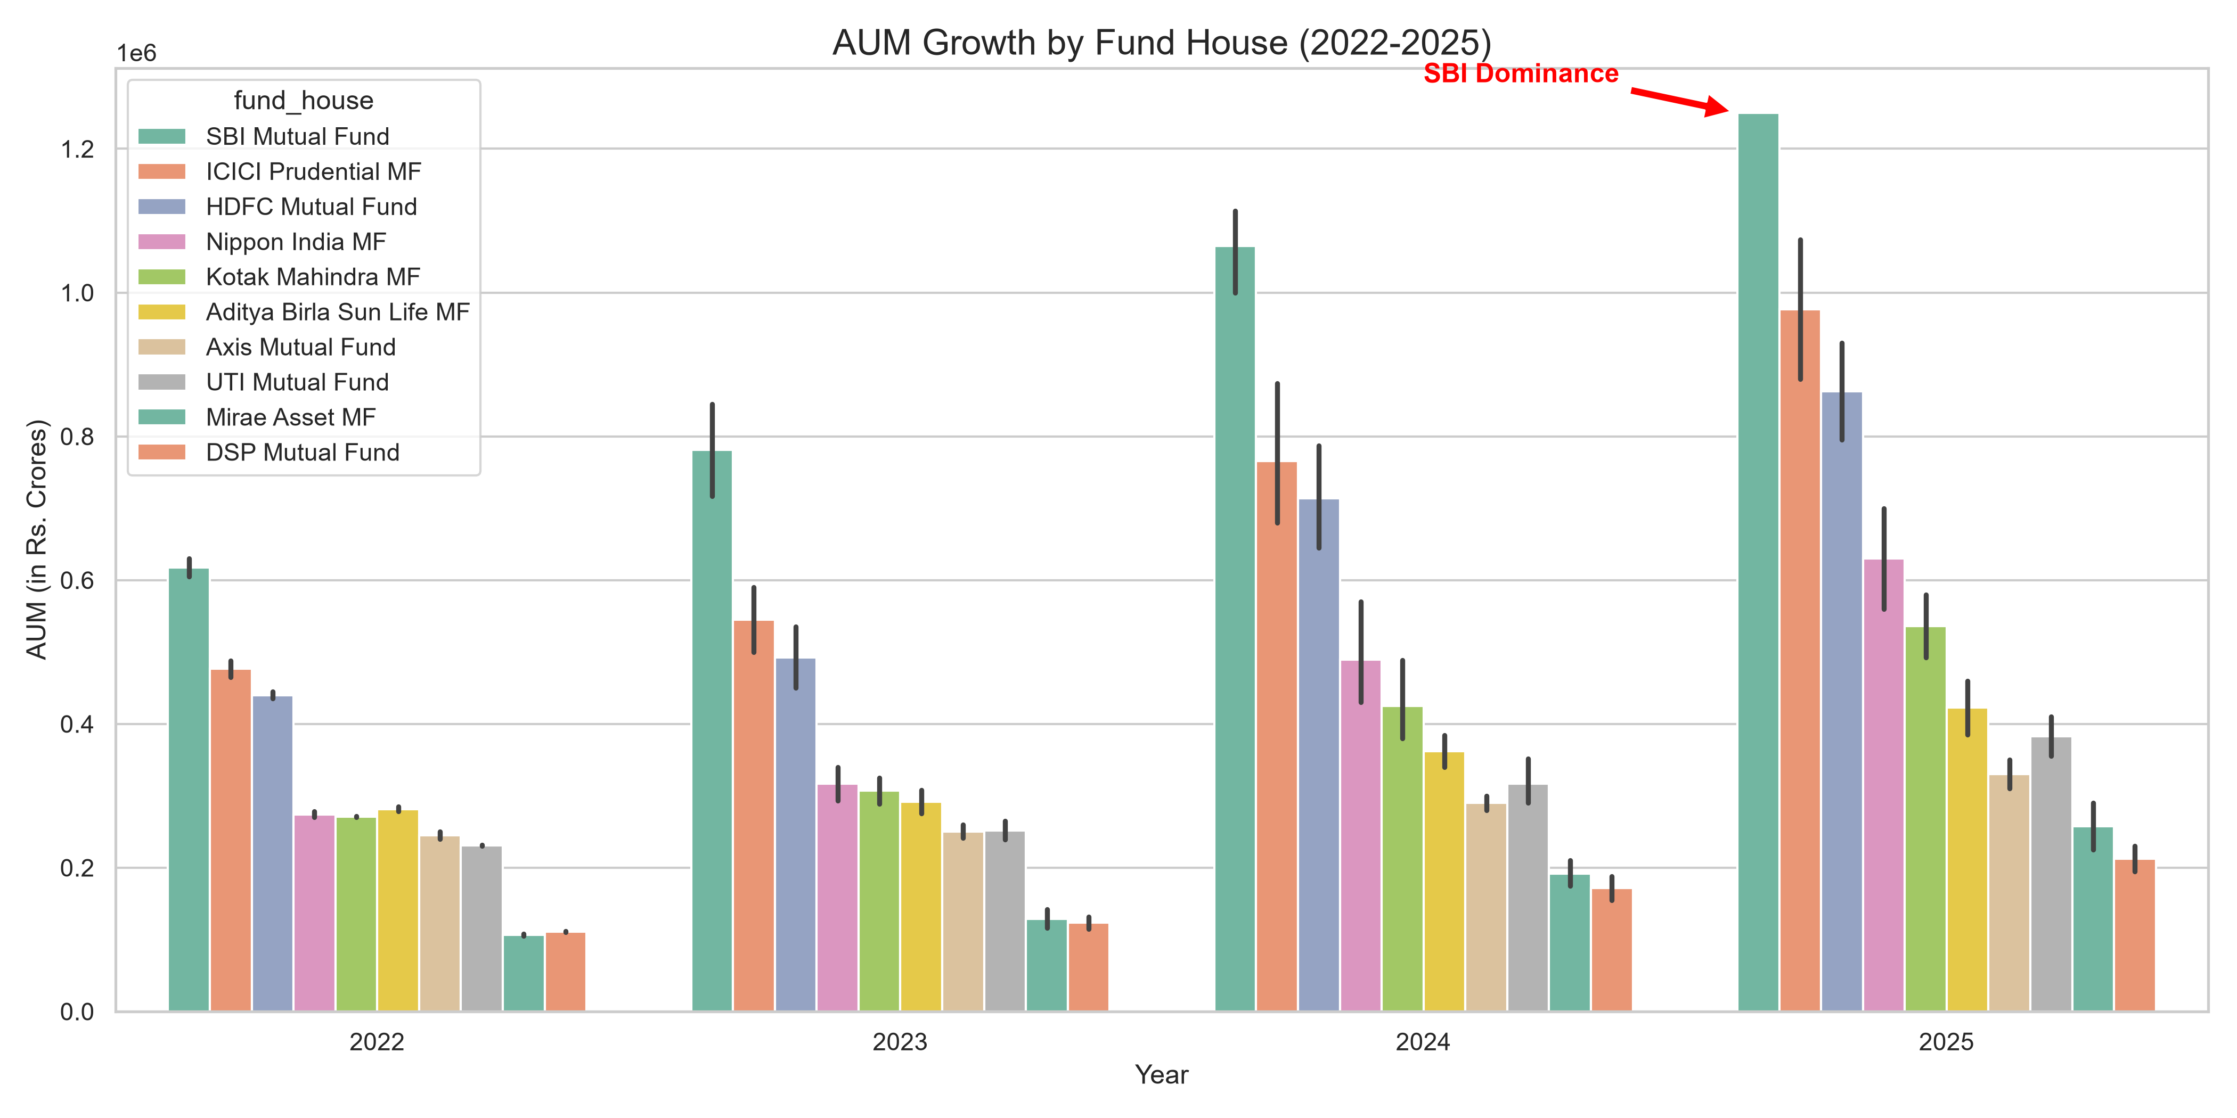
EDA Highlights - Industry Scale
. AUM Growth: The industry experienced aggressive capital acceleration, with SBI Mutual Fund establishing clear market dominance by surpassing 1.2 Million Rs. Crores in AUM by 2025.
Folio Expansion: There was an industry-wide surge in active retail investor accounts, growing from 13.26 Crore at the start of 2022 to 26.12 Crore by the end of 2025.
Market Concentration: While the AUM expanded industry-wide, the asset distribution remains highly consolidated at the top, with a small tier of major AMCs commanding the majority of the market share.

Slide 6
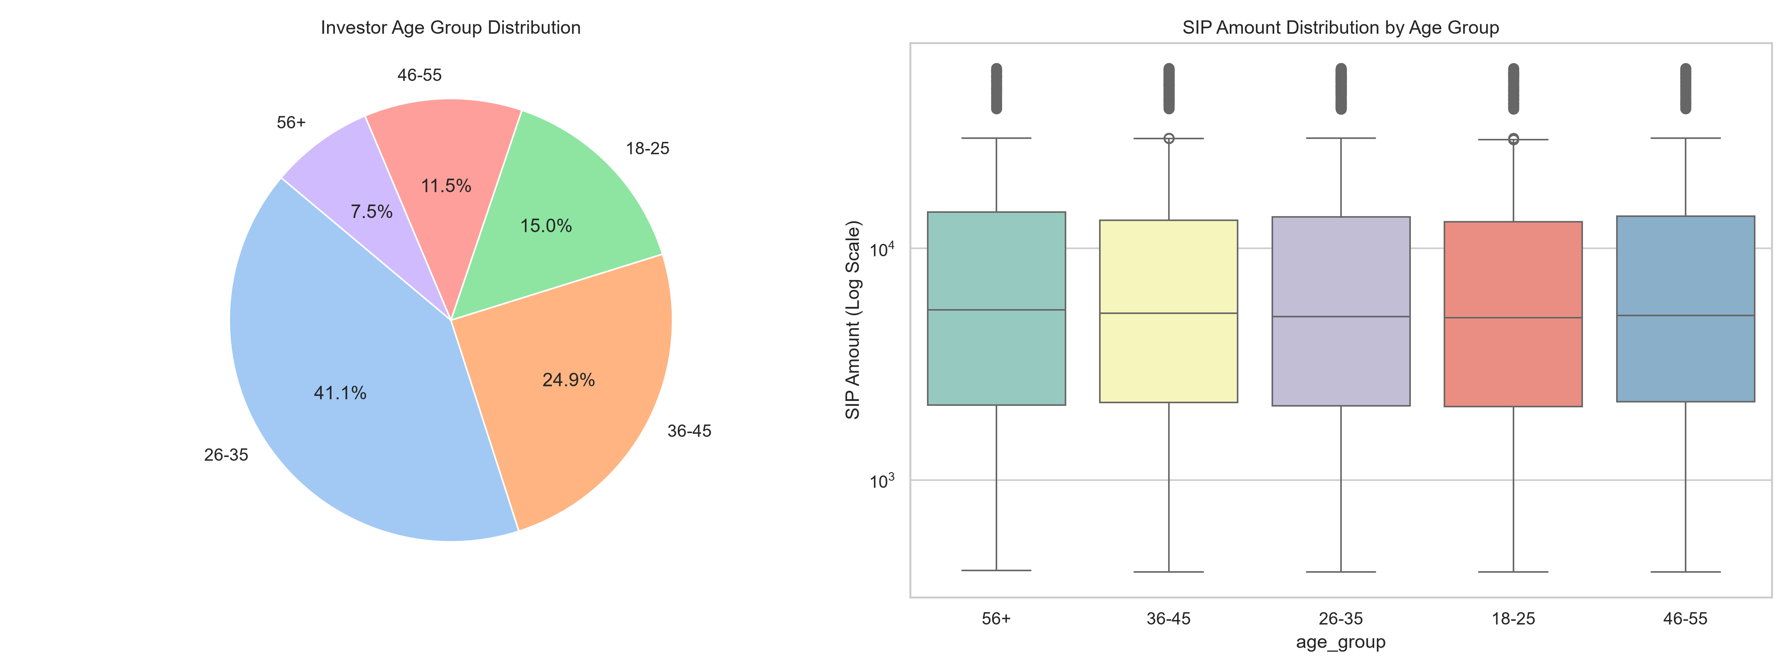
EDA Highlights - Investor Behavior
Age Demographic Engine: The 26–35 age bracket serves as the core driver of the retail investor base, accounting for 41.1% of all active accounts.
Regional Penetration:
Tier-30 (T30) cities maintain dominance, contributing 66.6% of total SIP capital.
Beyond-30 (B30) locations represent a growing footprint, with states like Madhya Pradesh and Punjab emerging as leaders in transaction volume, outpacing traditional financial hubs.
Transaction Dynamics: While younger cohorts drive transaction frequency, senior demographics (56+) maintain the highest average transaction value, signaling a two-tiered market participation model.

Slide 7
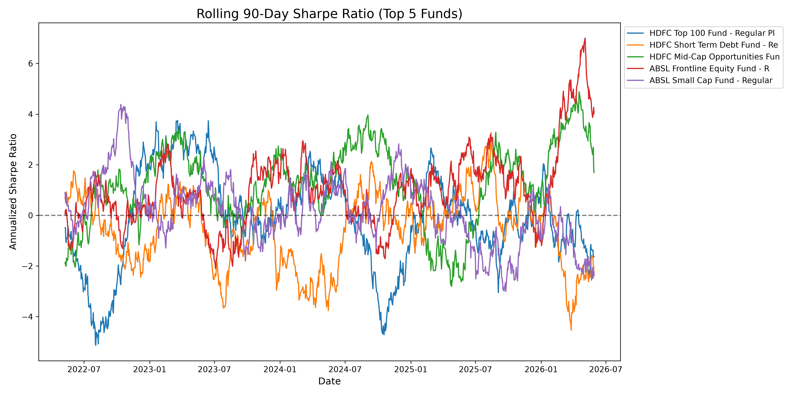
Performance Metrics – Risk-Adjusted Returns
Alpha Generation: Top-tier equity funds demonstrated strong alpha generation, with several schemes delivering over 150% cumulative returns across the 3-year trailing period, consistently outperforming the Nifty 50 benchmark.
Sharpe Ratio Volatility: The analysis of rolling 90-day Sharpe Ratios reveals that fund performance is highly cyclical. Even high-performing schemes show significant instability, moving between periods of extreme risk-adjusted outperformance and brief windows of capital erosion.
Investment Insight: The data suggests that high historical returns are frequently accompanied by substantial volatility, emphasizing the necessity of risk-adjusted metrics over absolute CAGR for retail selection

Slide 8
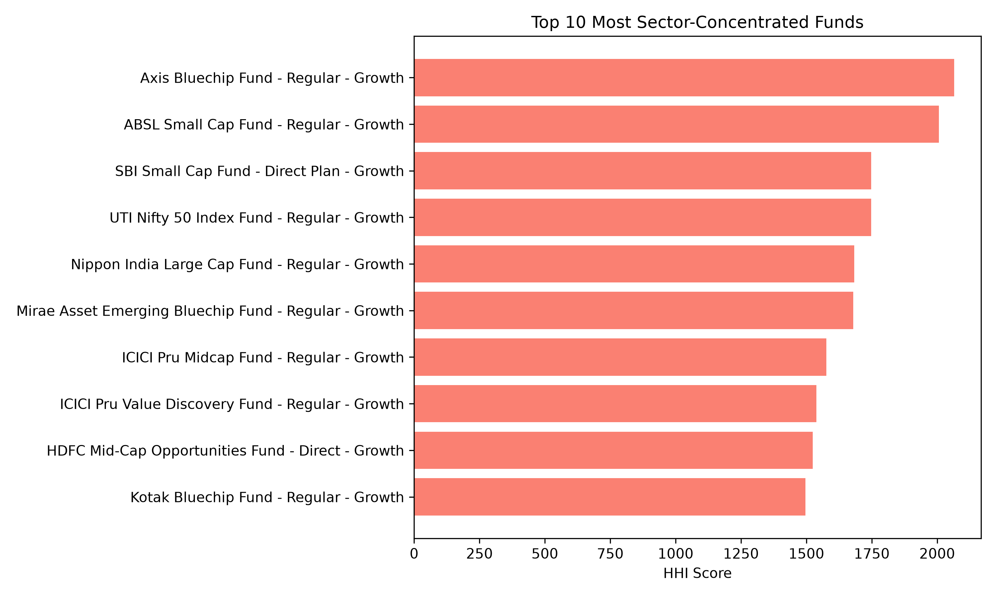
Performance Metrics – Tail Risk
Downside Vulnerability: Standard deviation provides an incomplete picture; our model implemented 95% Historical Value at Risk (VaR) to quantify true downside exposure.
Small-Cap Tail Risk: The data confirms that Small-Cap portfolios carry the highest extreme-risk burden. Funds like the SBI Small Cap and ABSL Small Cap recorded 95% VaR levels exceeding -2.6%, meaning a 5% probability of losing that amount in a single trading session.
Conditional VaR (CVaR): In extreme market stress scenarios (the worst 5% of trading days), CVaR figures for small-cap funds deteriorated to over -3.2%, highlighting the need for defensive hedging in aggressive equity portfolios.
Sector Concentration: HHI analysis identified significant sector clustering (Banking/IT/Pharma), indicating that portfolio risk is often driven by narrow sector bets rather than broad market movement.

Slide 9
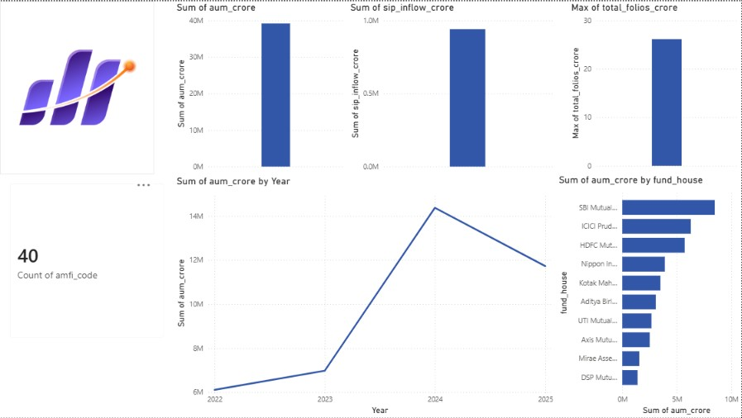
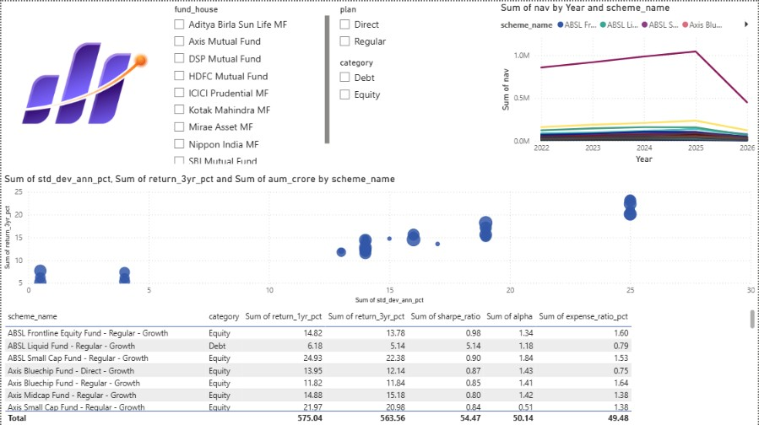
Dashboard Screenshots (Part 1)
Page 1: Industry Overview:
KPIs: Tracks critical industry health metrics, including Total AUM (approaching 40M Crores) and the 26.12 Crore Folio milestone.
Visualization: A time-series trendline visualizing the rapid AUM acceleration from 2022–2025, complemented by a bar chart ranking top Asset Management Companies (AMCs) like SBI, ICICI, and HDFC.
Page 2: Fund Performance Analysis:
Functionality: Features interactive "slice-and-dice" filters for AMC, plan type (Direct vs. Regular), and category.
Risk-Return Matrix: A scatter plot visualizing the trade-off between 3-year returns and annualized volatility, effectively mapping high-alpha "outperformers" against risk-heavy underperformers.

Slide 10
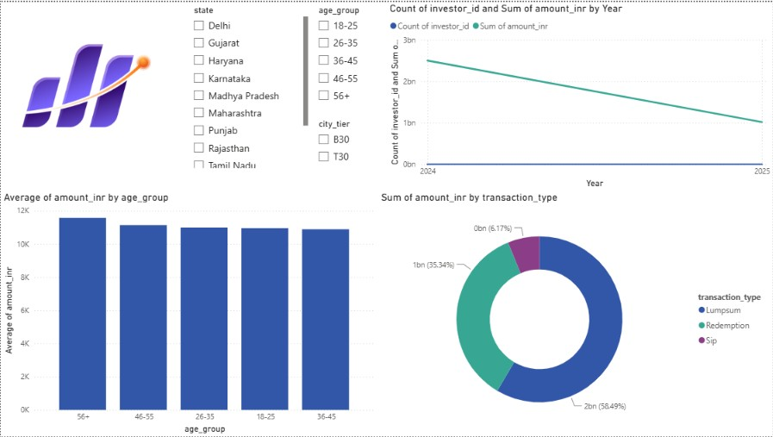
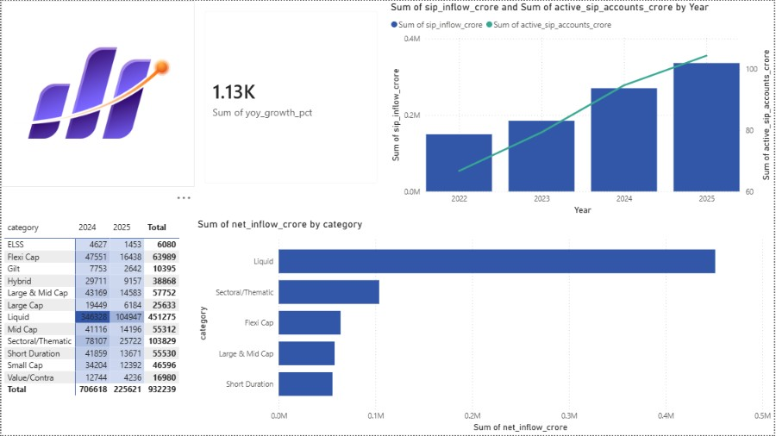
Dashboard Screenshots (Part 2)
Page 3: Market & Inflow Trends:
Capital Velocity: A dual-axis combo chart showcasing the direct correlation between the rise in Systematic Investment Plans (SIPs) and the growth of active investor accounts.
Category Heatmap: Visualizes net inflows across sectors, identifying Liquid funds as the primary drivers of consistent market liquidity, alongside strong volume in Sectoral and Flexi-cap categories.
Page 4: Investor Analytics:
Demographic Segmentation: A donut chart and trend analysis documenting that Lumpsum investments dominate absolute volume (58.49%), while SIPs form the critical, high-frequency recurring base.
Spatial Intelligence: A geographic distribution map contrasting capital contribution between T30 (Top 30) and B30 (Beyond 30) regions, highlighting untapped market opportunities in tier-2 and tier-3 cities.

Slide 11
Key Findings
Actionable Retention Logic: Analysis revealed that 97.8% of active investors experience a >35-day payment gap in their SIP cycles. We proposed a programmatic "Early Warning Intercept" system to flag these accounts for retention teams before they enter default.
Recommendation Engine: Developed a robust, risk-graded filtering engine that ranks assets using the Sharpe Ratio while suppressing high-volatility schemes based on their annualized Standard Deviation.
Geographic Opportunity: While T30 cities drive 66.6% of capital, the momentum in B30 states like Madhya Pradesh and Punjab indicates a massive, under-served market ripe for regional marketing penetration.
Future Architectural Roadmap:
Scale: Transitioning from local SQLite to cloud-native warehousing (PostgreSQL/BigQuery) to resolve write-locking and concurrency issues.
Real-Time: Replacing batch CSV processing with live AMFI API stream integration to eliminate data latency.

Slide 12
THANK-YOU
Project Summary: A comprehensive end-to-end data engineering and analytics solution for the Indian Mutual Fund industry, bridging raw data to actionable financial intelligence.
Thank You: Thank you for your time and for the opportunity to present this capstone project
Connect & Explore:
Github Repo: https://github.com/aaravaggarwal3535/Capstone-Project-I---Mutual-Fund-Analytics

