Slide 1

RideX
Carpooling that fits
your everyday commute
Bengaluru carpooling platform
Ideathon project presentation
RideX
01
Notes:
Ideathon submission. Current scope is a personal commute planner with example schedules.
Source: RideX source code and README, https://github.com/aaravchoudhary018/FireTech-

Slide 2
Why commuters need a better match
01
Route coordination
Two people may share a road without sharing a usable pickup point.
02
Timing and routine
Daily commutes need compatible departure windows and weekdays.
03
Fair cost sharing
Each passenger should contribute for the distance they share.
04
Trust before the trip
Clear identity status and user-controlled safety tools matter.
RideX
02
Notes:
Source: RideX source code and README, https://github.com/aaravchoudhary018/FireTech-

Slide 3
The RideX approach
01
Match the shared journey
Rank eligible schedules by route overlap and compatible timing.
02
Support recurring commutes
Save a single trip or plan journeys across selected weekdays.
03
Explain the fare
Split each shared segment among the people onboard.
04
Make safety visible
Show verification status, women-only preferences and SOS tools.
RideX
03
Notes:
Source: RideX source code and README, https://github.com/aaravchoudhary018/FireTech-

Slide 4
The commuter experience
01
Choose a journey
Select pickup, destination, date, time and flexibility.
02
Find matching schedules
See loading feedback, ranked results and the fare estimate.
03
Save a personal plan
Review a trip or recurring series in My trips.
04
Manage the journey
Cancel plans, enter progress or leave a completed-trip rating.
Current saves do not contact a driver or reserve a real seat.
RideX
04
Notes:
Source: RideX source code and README, https://github.com/aaravchoudhary018/FireTech-

Slide 5
Bengaluru location coverage
10 real pickup and destination options
Indiranagar Metro Station
Whitefield (Kadugodi) Metro Station
Cubbon Park Metro Station
UB City, Vittal Mallya Road
Pattanagere Metro Station
Majestic Metro Station
Jayanagar Metro Station
Koramangala, 80 Feet Road
Domlur Bus Stand
MG Road Metro Station
Passengers must agree on an exact, safe meeting point.
RideX
05
Notes:
The catalog contains real locations. Graph travel distances are estimates. Whitefield and Pattanagere lie outside the central core.
Source: RideX source code and README, https://github.com/aaravchoudhary018/FireTech-

Slide 6
Matching and distance-based fares
Matching rules
Fare calculation
Pickup and drop-off follow the driver’s route order.
Weekdays, departure windows and seats must match.
Preferences filter eligible schedules.
Each graph segment has a distance and vehicle cost.
The driver and passengers onboard share that segment.
The total uses integer paise to control rounding.
Fares use the planning graph. Google road distances do not yet update the estimate.
RideX
06
Notes:
Source: RideX source code and README, https://github.com/aaravchoudhary018/FireTech-

Slide 7
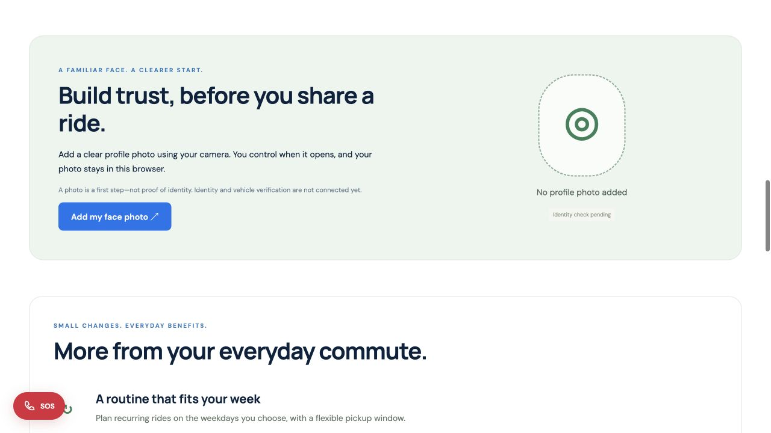
Trust and safety tools
Camera capture
Users choose when to add or remove their profile photo.
Emergency contact
Saved contact, call links and optional location copying.
Independent identity verification remains an integration requirement.
RideX
07
Notes:
Screenshot from the live RideX site. Profile photos remain browser-local. Photo capture does not verify identity. SOS does not dispatch an alert.
Source: RideX source code and README, https://github.com/aaravchoudhary018/FireTech-

Slide 8
Application architecture
01
Web interface
HTML, CSS and JavaScript for search, plans, profile and safety tools.
02
Journey dashboard
React 19 and Tailwind CSS 4, compiled with Vite 7.
03
Python services
Matching, fare rules, request validation and Google Routes proxy.
04
Planning storage
SQLite locally. Vercel uses isolated requests and a browser-owned snapshot.
RideX
08
Notes:
Source: RideX source code and README, https://github.com/aaravchoudhary018/FireTech-

Slide 9
Google Maps integration
01
Embedded map
Dark Google Maps styling and the TrafficLayer road overlay.
02
Routes and congestion
Google Routes supplies route geometry, distance, ETA and traffic intervals.
03
Credentials pending
Maps JavaScript and Routes API keys require a billing-enabled Cloud project.
04
Current fallback
An external Google Maps directions link works without embedded credentials.
Driver GPS and traffic-light countdown feeds are not connected.
RideX
09
Notes:
Source: RideX source code and README, https://github.com/aaravchoudhary018/FireTech-

Slide 10
Validation and current scope
17 Python tests
Next integrations
Matching and shared fares
Recurring plans and capacity
Cancellation, progress and ratings
Hosted visitor isolation
Location migration and map parsing
Authenticated users and shared storage
Driver acceptance and live GPS
Independent identity checks
Payments and emergency dispatch
Google provider checks with real keys
Existing driver schedules are examples. Hosted plans belong to the visitor’s browser.
RideX
10
Notes:
Source: RideX source code and README, https://github.com/aaravchoudhary018/FireTech-

Slide 11
Team
Six-member team
Tanmay Daga
tanmay-daga
Dibakar Das
dibakar704
Suryansh Singh
rsuryansh9026
Aarav Choudhary
aaravchoudhary018
Aman Verma (Aman-verma-crypto)
Avishkar Arvind Rathod
ayurathod4207-cyber
Individual contributions await team confirmation.
RideX
11
Notes:
Source: RideX source code and README, https://github.com/aaravchoudhary018/FireTech-

Slide 12
Project access and submission
Public GitHub repository
https://github.com/aaravchoudhary018/FireTech-
Live application
https://firetech-murex.vercel.app/
Each member must submit a public repository on their own account.
Confirm whether the event accepts forks before choosing that approach.
RideX
12
Notes:
Source: RideX source code and README, https://github.com/aaravchoudhary018/FireTech-

