Slide 1
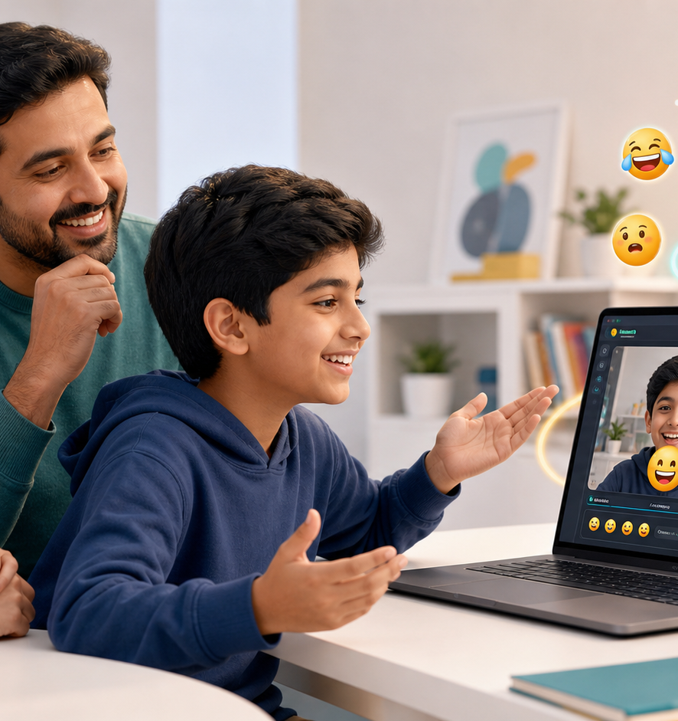
EMOJI CAMERA
A playful privacy-first camera demo
A browser app that detects facial expression, overlays a matching emoji, and lets students build a copyable emoji message.
Emoji Camera / 01

Slide 2
What the app does
It turns facial expressions into a simple, shareable emoji moment.
1
2
3
Opens the camera
Recognizes expression
Builds a message
Runs in the browser after permission is given.
Uses face detection scores for happy, surprised, sad, angry, and neutral.
Students add emojis into a message box and copy the final string.
Emoji Camera / 02

Slide 3
Live demo flow
Start
Detect
Compose
Copy
Camera permission appears
Emoji follows the face
Add current or tap emojis
Paste the finished emoji message
📷
→
🙂
→
💬
→
📋
Emoji Camera / 03

Slide 4
Privacy story for parents
What stays local
What gets saved
Camera processing happens in the browser. There is no login, no cloud account, and no video upload in this version.
Only a screenshot is saved, and only when the user presses Capture. Emoji messages are copied by the user.
Emoji Camera / 04

Slide 5
What changed after testing
Before
History and guide could overlap on narrow screens.
Fix
Separated composer, history, and guide into independent sections.
New
Added Camera off, Copy all, Backspace, and Clear controls.
Better
Stabilized expression changes so detection feels less jumpy.
Emoji Camera / 05

Slide 6
Honest limitations
Expression detection is useful for a demo, but not a perfect emotion reader.
Lighting matters
Angles matter
Some emojis are manual
Dim rooms and backlighting reduce accuracy.
Side-facing cameras and fast movement are harder.
Thinking, sleepy, and cool are better as tap-to-add choices.
Emoji Camera / 06

Slide 7
What parents should remember
It is a small, understandable AI project: camera input, browser ML, visible feedback, and a clear privacy boundary.
Next improvements: more stable detection, optional saved messages, and a clearer mobile-first polish pass.
Demo link
https://emojicam.pythonanywhere.com
Emoji Camera / 07

