Slide 1
AIR KEYBOARD
ARAVIND RAVI
Department of E.C.E.
PESIT Bangalore South Campus

Slide 2
Project Description/Features:
A keyboard that plays eight musical notes without touching the keys.
The keys are made up of sensors made to recognise hand movements up to 1 foot. This project is developed on the arduino platform.
Components used:
Atmega 328 (Arduino UNO)
IR Sensors (LM358n)
Speakers

Slide 3
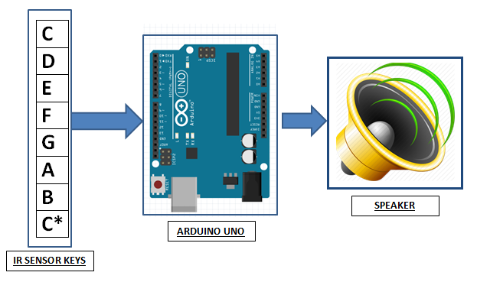
Block Diagram:
Atmega 328
Arduino UNO
IR Sensors
Speakers

Slide 4
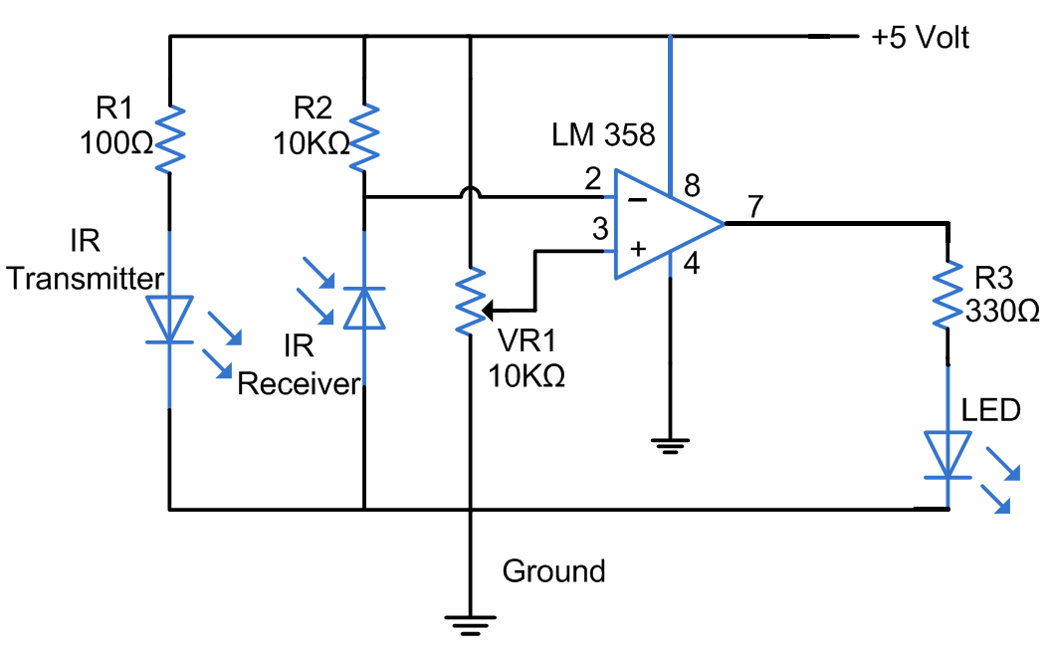
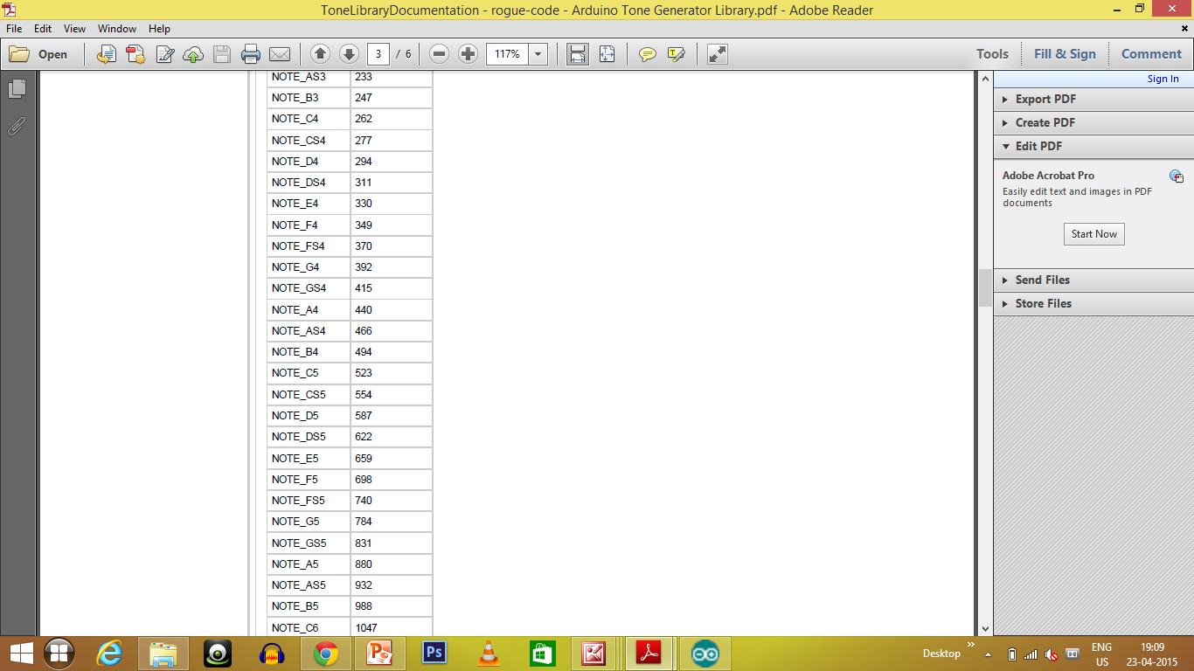
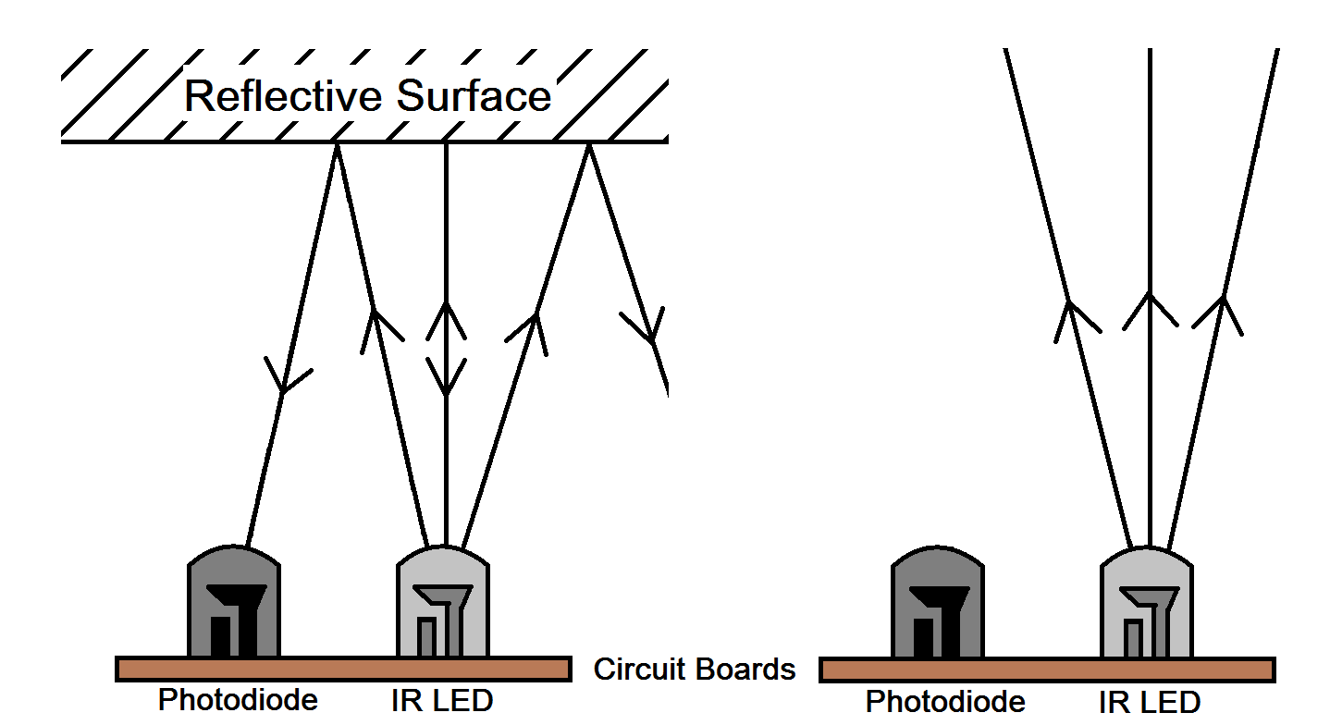
IR Sensor Circuit
Note with Corresponding Frequency
Working Principle

