Slide 1
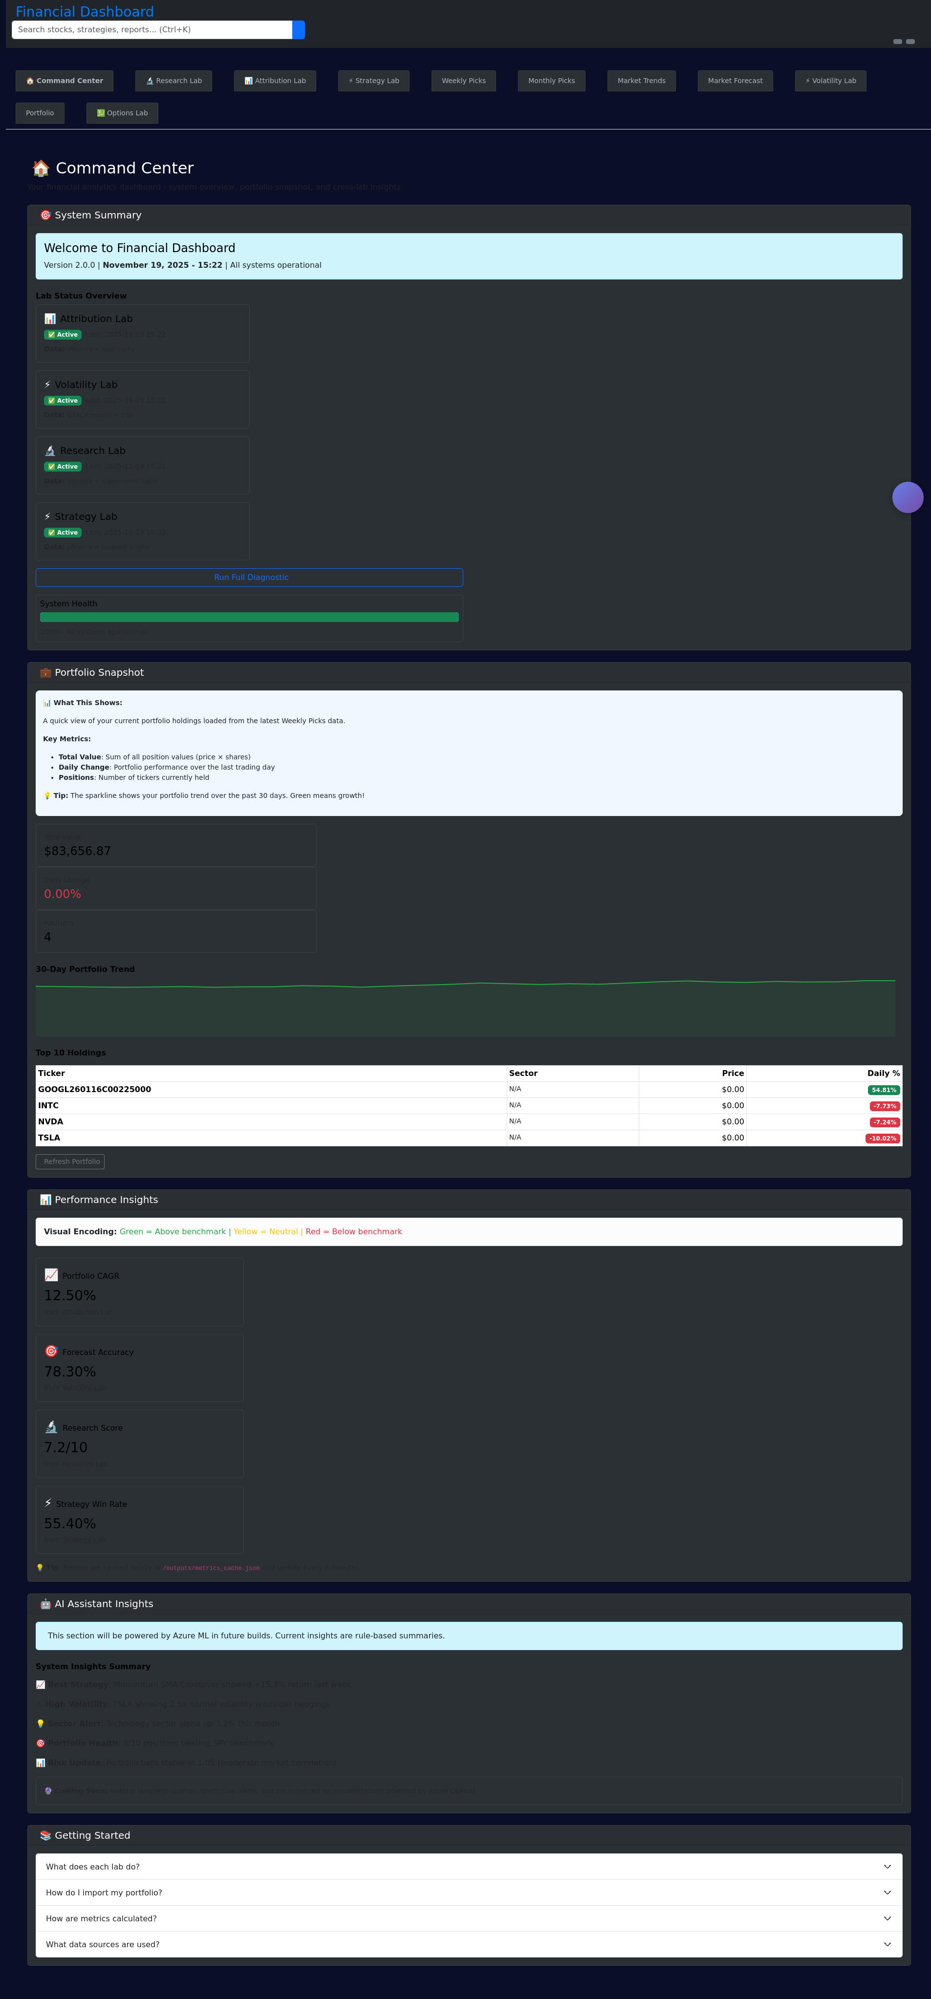
Shark Tank: Impact Data Analytics — Market Dashboard Demo
Team: [Your Names] • Course: Impact Data Analytics Innovation Challenge
Notes:
Quick introduction: who we are and what the pitch will cover (5-8 minute presentation).

Slide 2
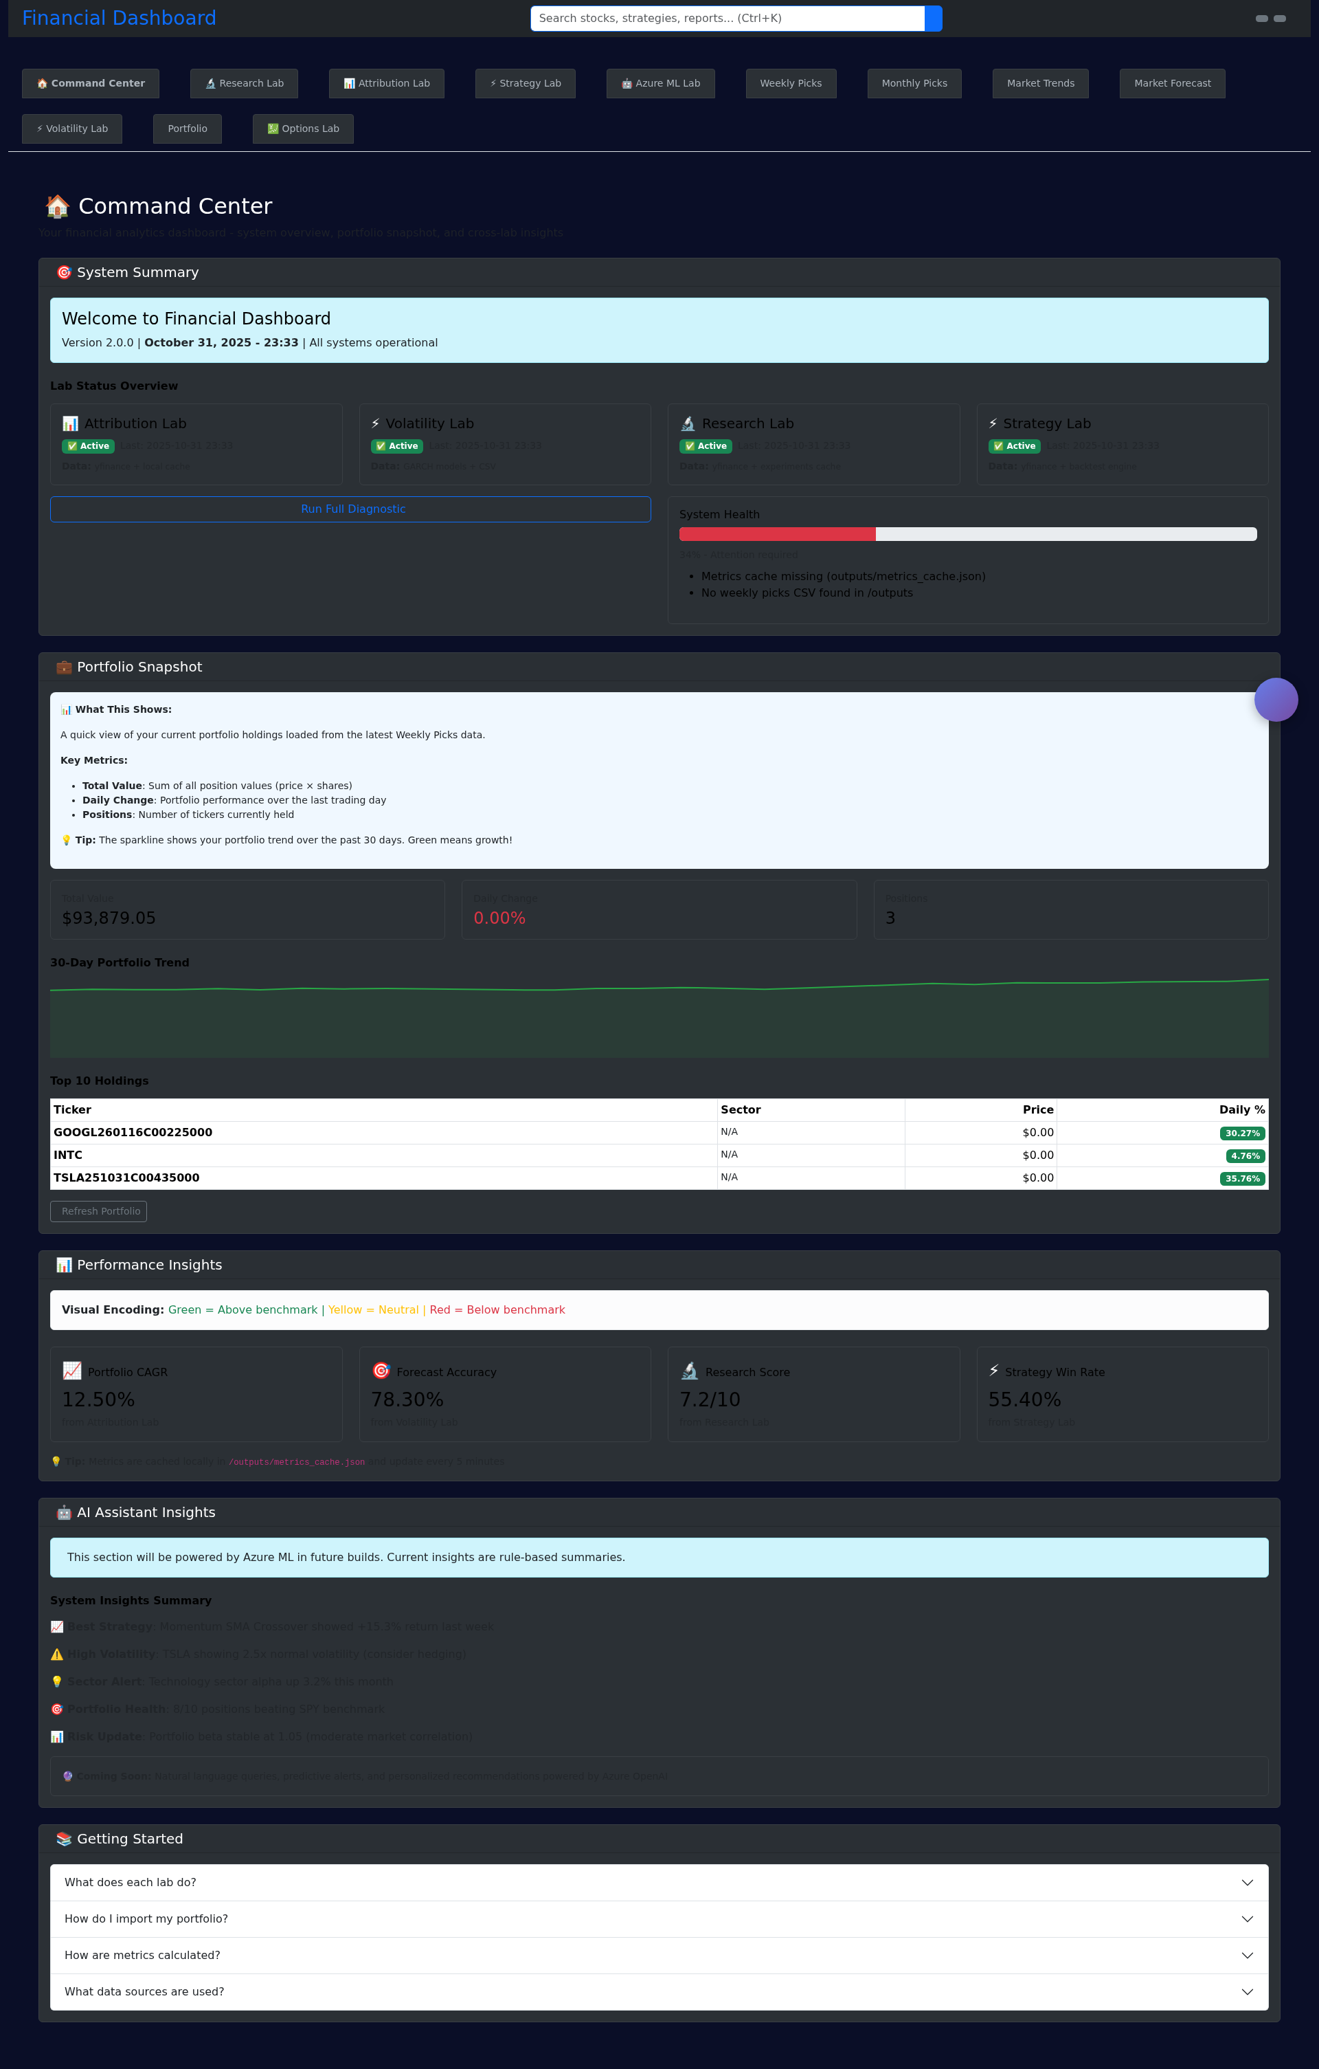
The Problem
Many community organizations and small businesses lack timely market insights to make data-driven decisions.
Manual research is slow, noisy, and often not tailored to local impact goals.
Decision-makers need accessible, actionable signals (not raw data).
Notes:
Explain why it matters: budget constraints, need for fast decisions, risk management. Give a concise example (e.g., a local nonprofit choosing investments for an endowment).

Slide 3
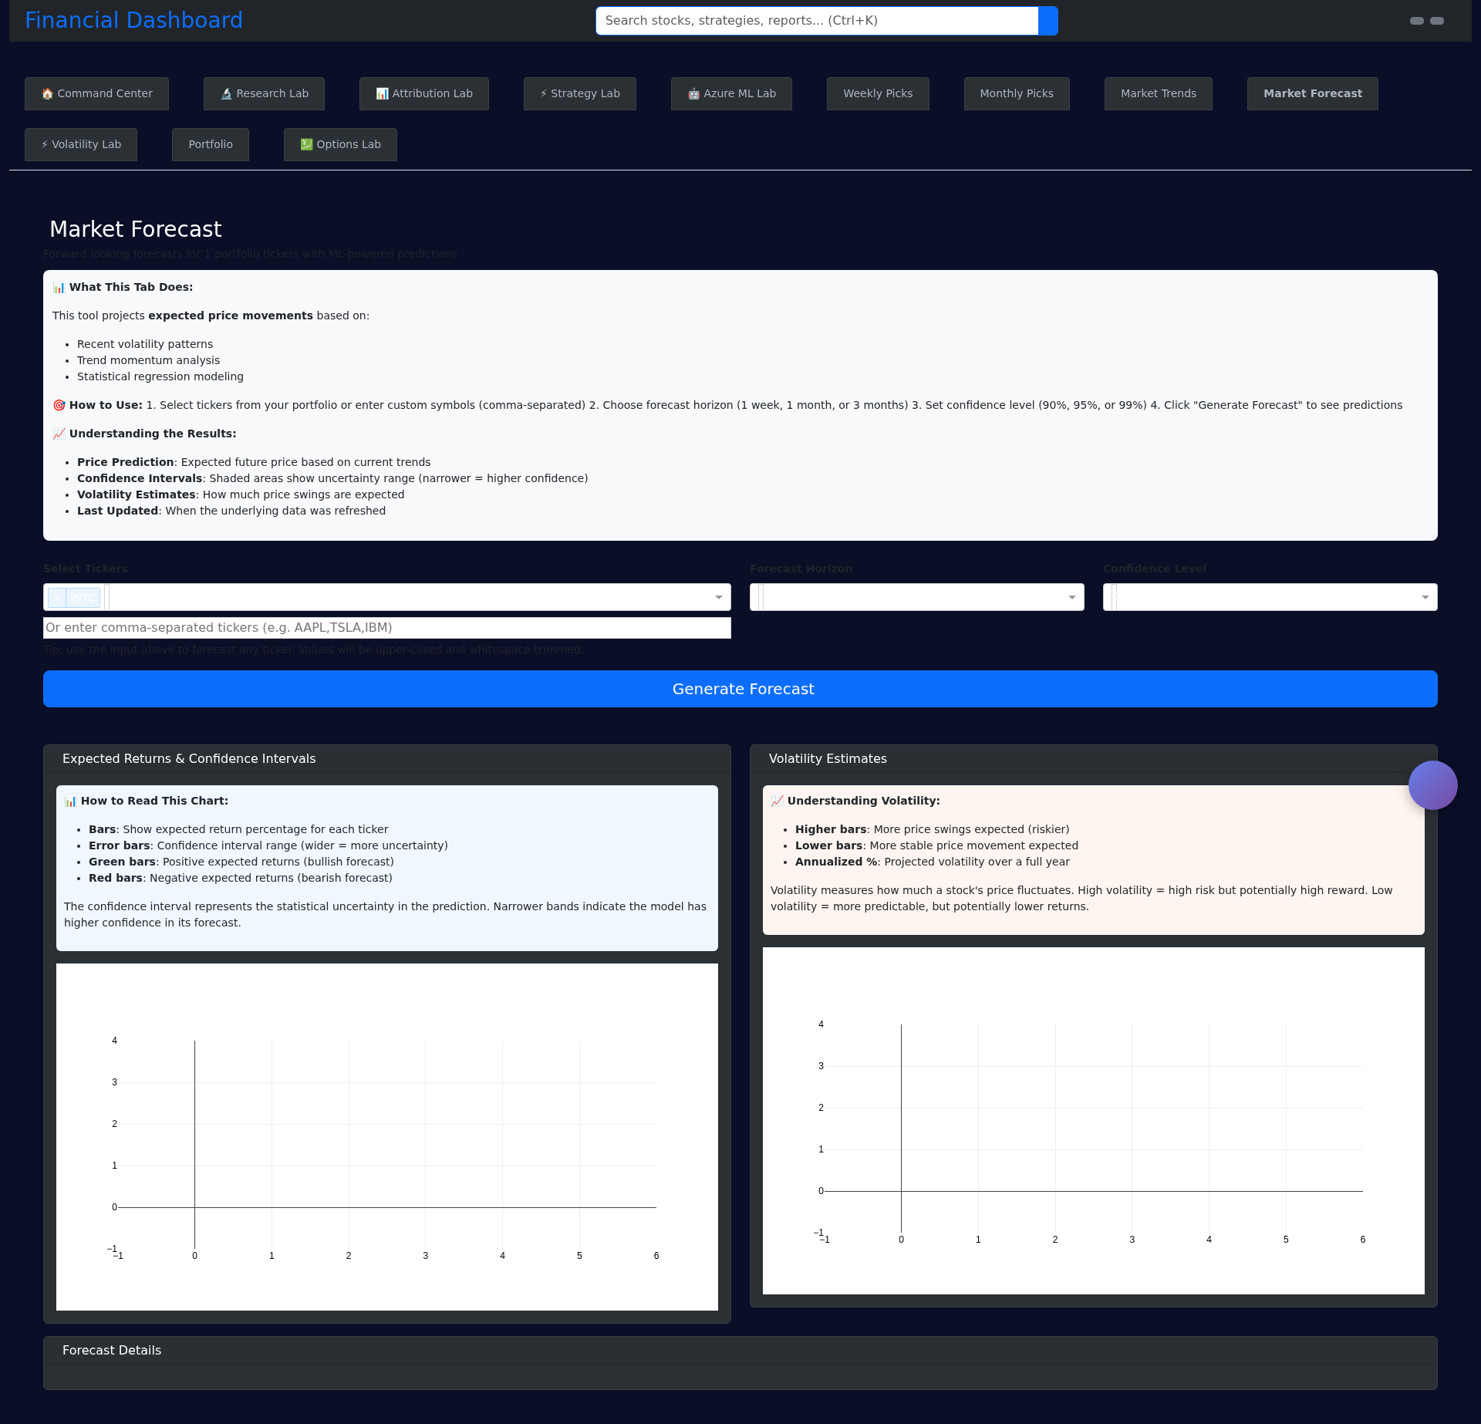
The Data
Market prices & time series (intraday / daily) — public APIs (yfinance, Finnhub).
Options data & implied volatility (for risk signals) — Alpaca / yfinance fallback / mock for demos.
Alternative signals: news sentiment, macro indicators, community-specific datasets.
Notes:
State sources and privacy/credentials plan. Mention that our dashboard already integrates yfinance, Finnhub, and (optionally) Alpaca in the codebase.

Slide 4
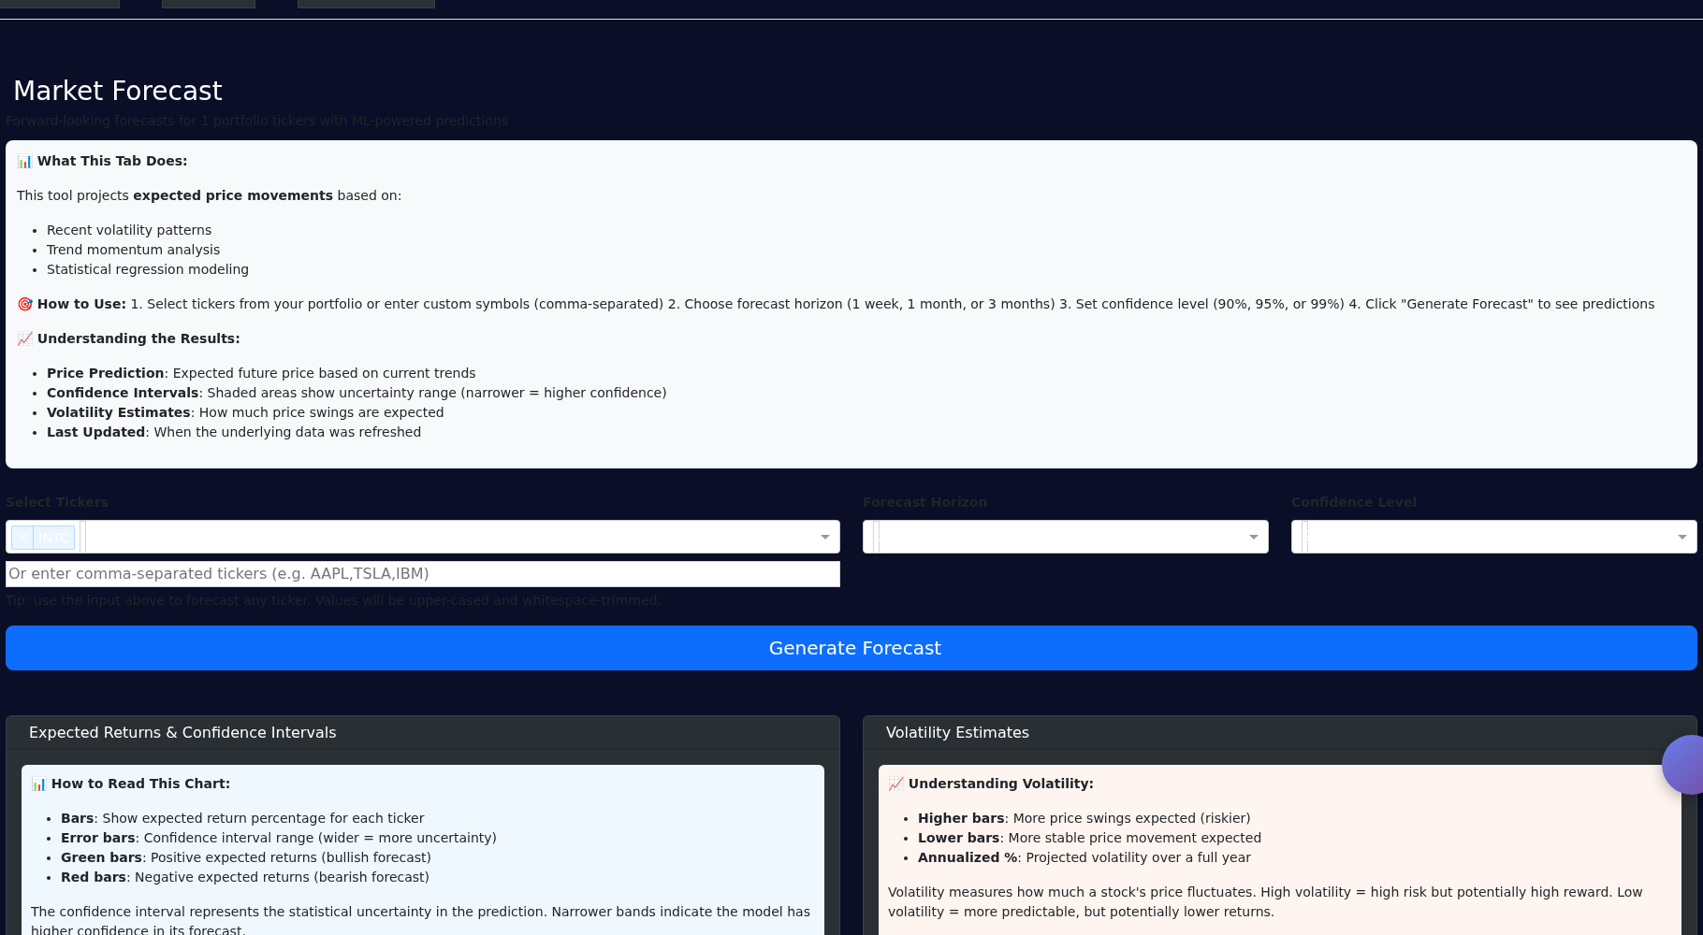
Analysis Approach
Real-time dashboards: monitor price, volatility, and options Greeks for risk-aware decisions.
Signal generation: detect momentum, volatility surges, option skew changes.
Interactive exploration: filter by ticker, expiration, and moneyness to assess risk exposure.
Notes:
High-level methods: time-series analysis, volatility surface visualization, lightweight ML for trends if needed. Keep methods understandable for judges.

Slide 5
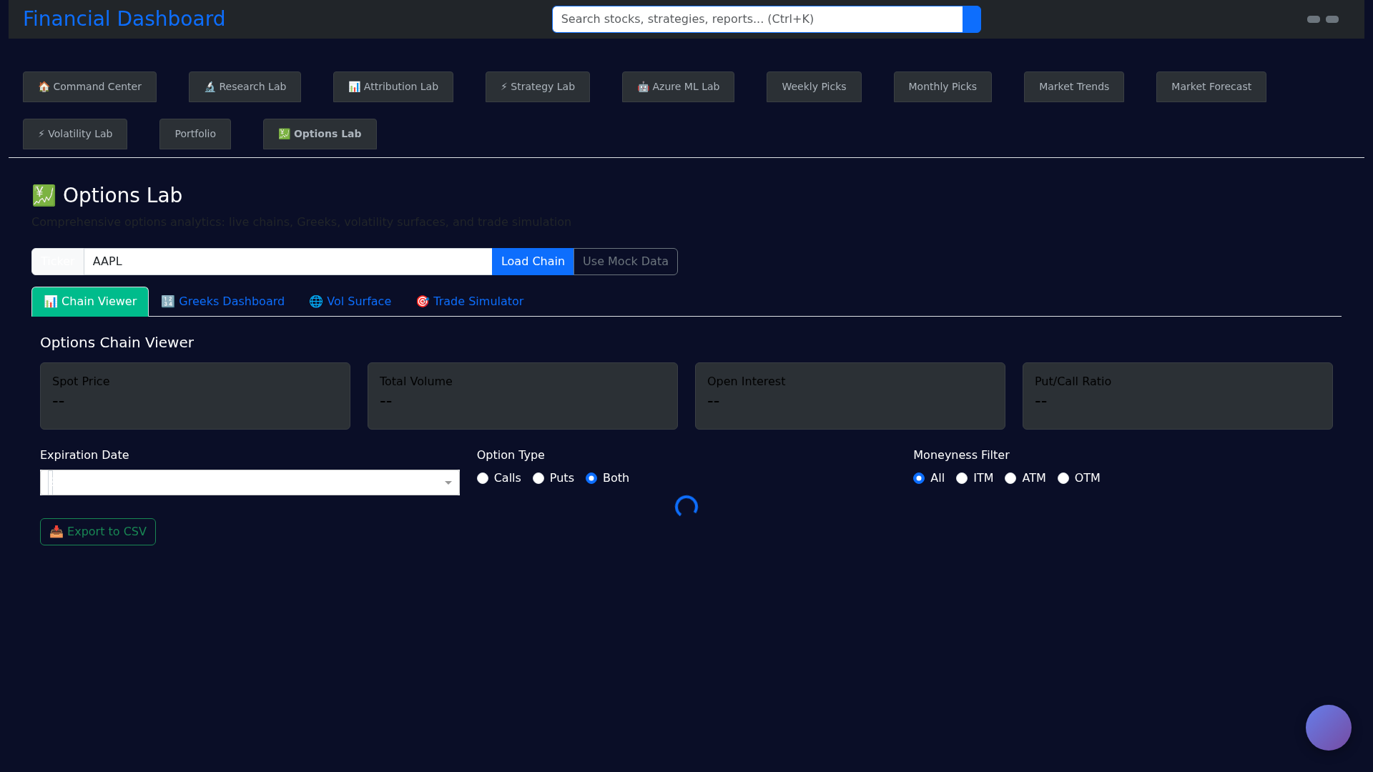
Our Solution — Market Dashboard
Interactive Dash app: tabs for Market Trends, Options Lab, Volatility Lab, Research Lab.
Options Lab: chain loader, Greeks, IV smile, vol-surface 3D visualization, trade simulator.
Actionable outputs: weekly/monthly picks, simple trade suggestions, exportable CSVs for reporting.
Notes:
Explain that the repo's dashboard will be used as the demo platform — point to the Options Lab tab for a hands-on demo.

Slide 6
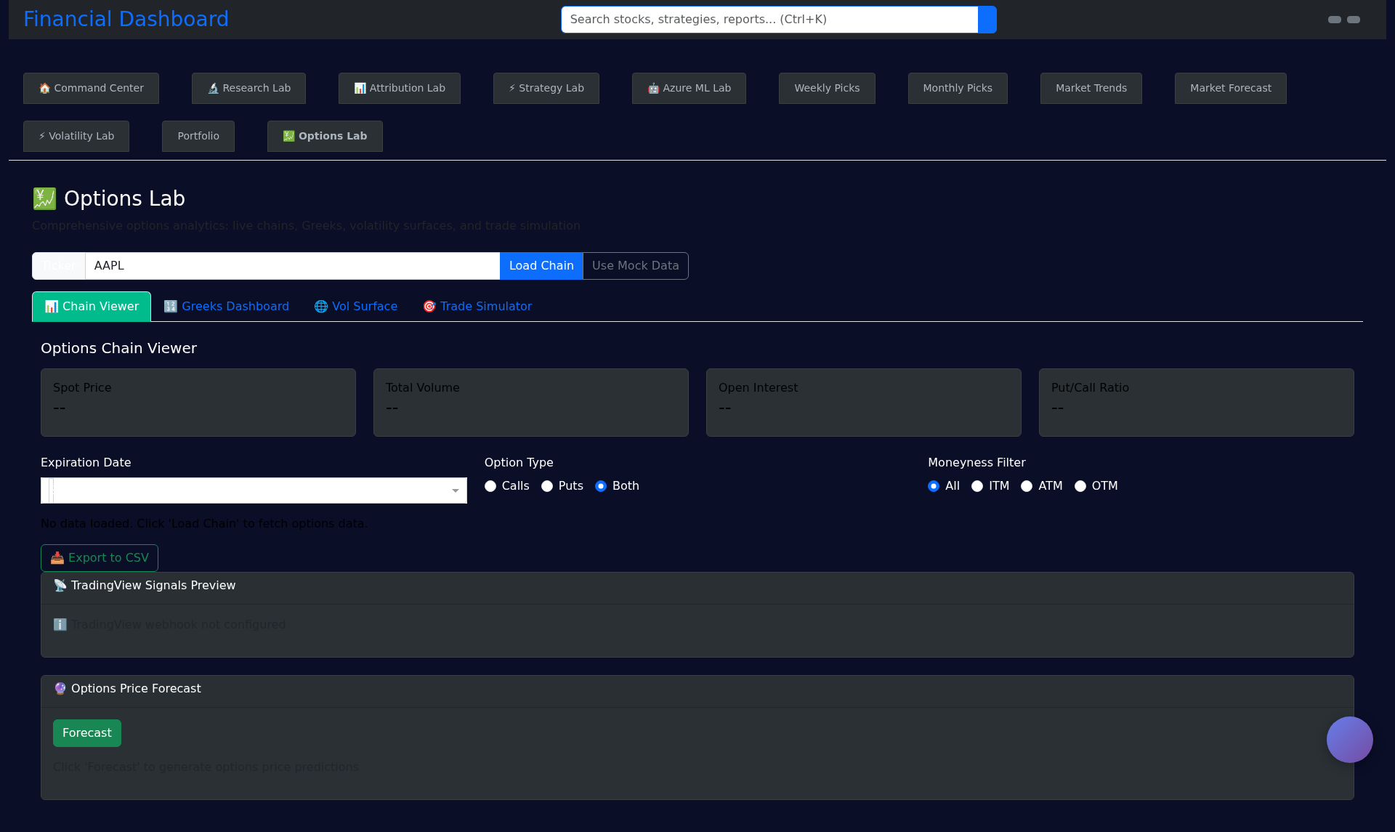
Notes:
Keep demo short and rehearsed. Mention fallback mock data to guarantee reproducible demo.

Slide 7
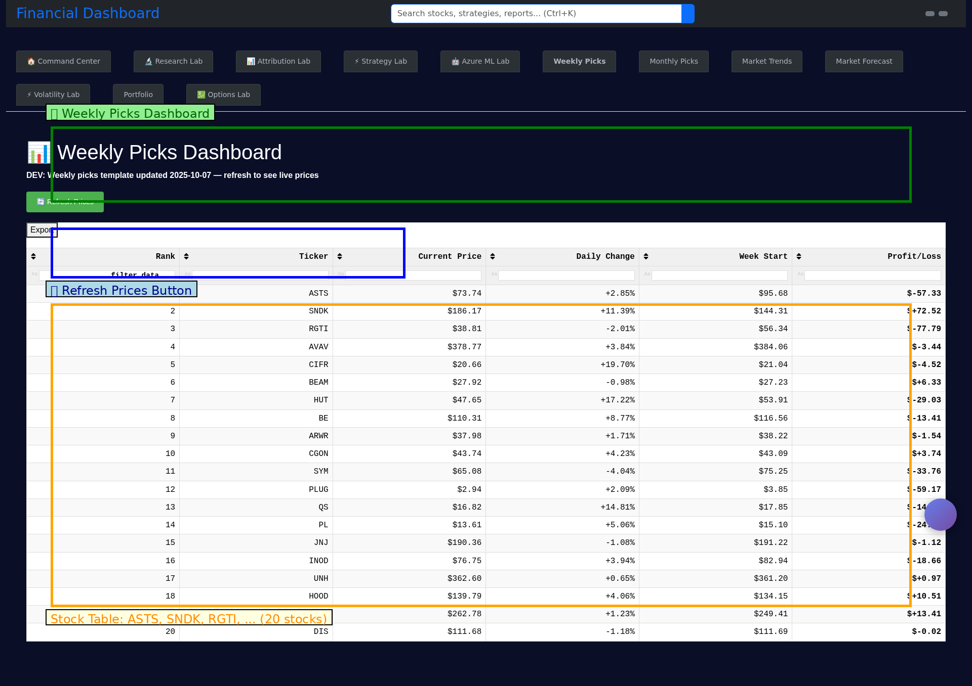
Impact & Metrics
Benefit: faster, data-driven decisions for small orgs and student teams.
Metrics: decision time reduction, accuracy of signal (precision/recall of recommended picks), user adoption.
Pilot goal: 3 partner orgs, 50 users, measure decisions influenced within 3 months.
Notes:
Tie metrics to measurable outcomes judges care about.

Slide 8
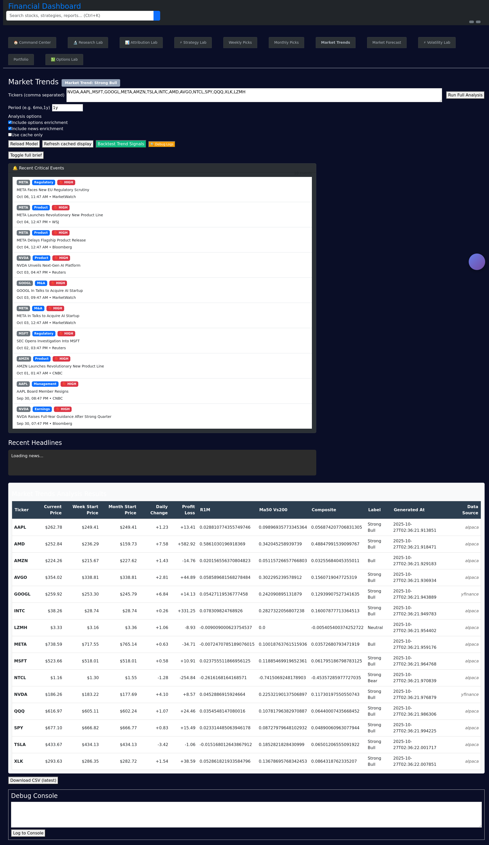
Technical Roadmap / Requirements
Minimum: Python environment, API keys optional (yfinance works for demo).
Dependencies: Dash, pandas, numpy, plotly, python-pptx (for this deck generation script).
Next steps: polish UI, add deterministic test data, integrate simple model for forecasts.
Notes:
Be clear about what you need (data, compute, time).

Slide 9
The Ask
$X in funding to build a pilot (data, cloud hosting, API credits).
Mentorship/partners to run a 3-month pilot with community orgs.
Support for UX polishing and creating training materials.
Notes:
Be specific and concise about resources and timeline.

Slide 10
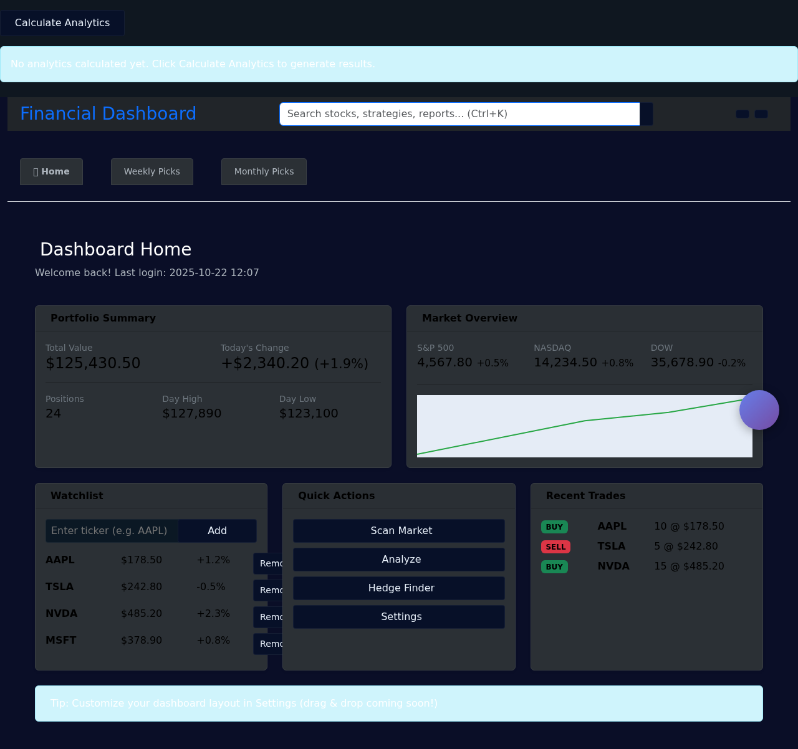
Closing — Why This Matters
Democratizes market analytics for small teams and community-impact projects.
Leverages data for measurable social and financial outcomes.
We can demo a working prototype in minutes using our dashboard.
Notes:
Strong close; invite questions and a live demo.

Slide 11
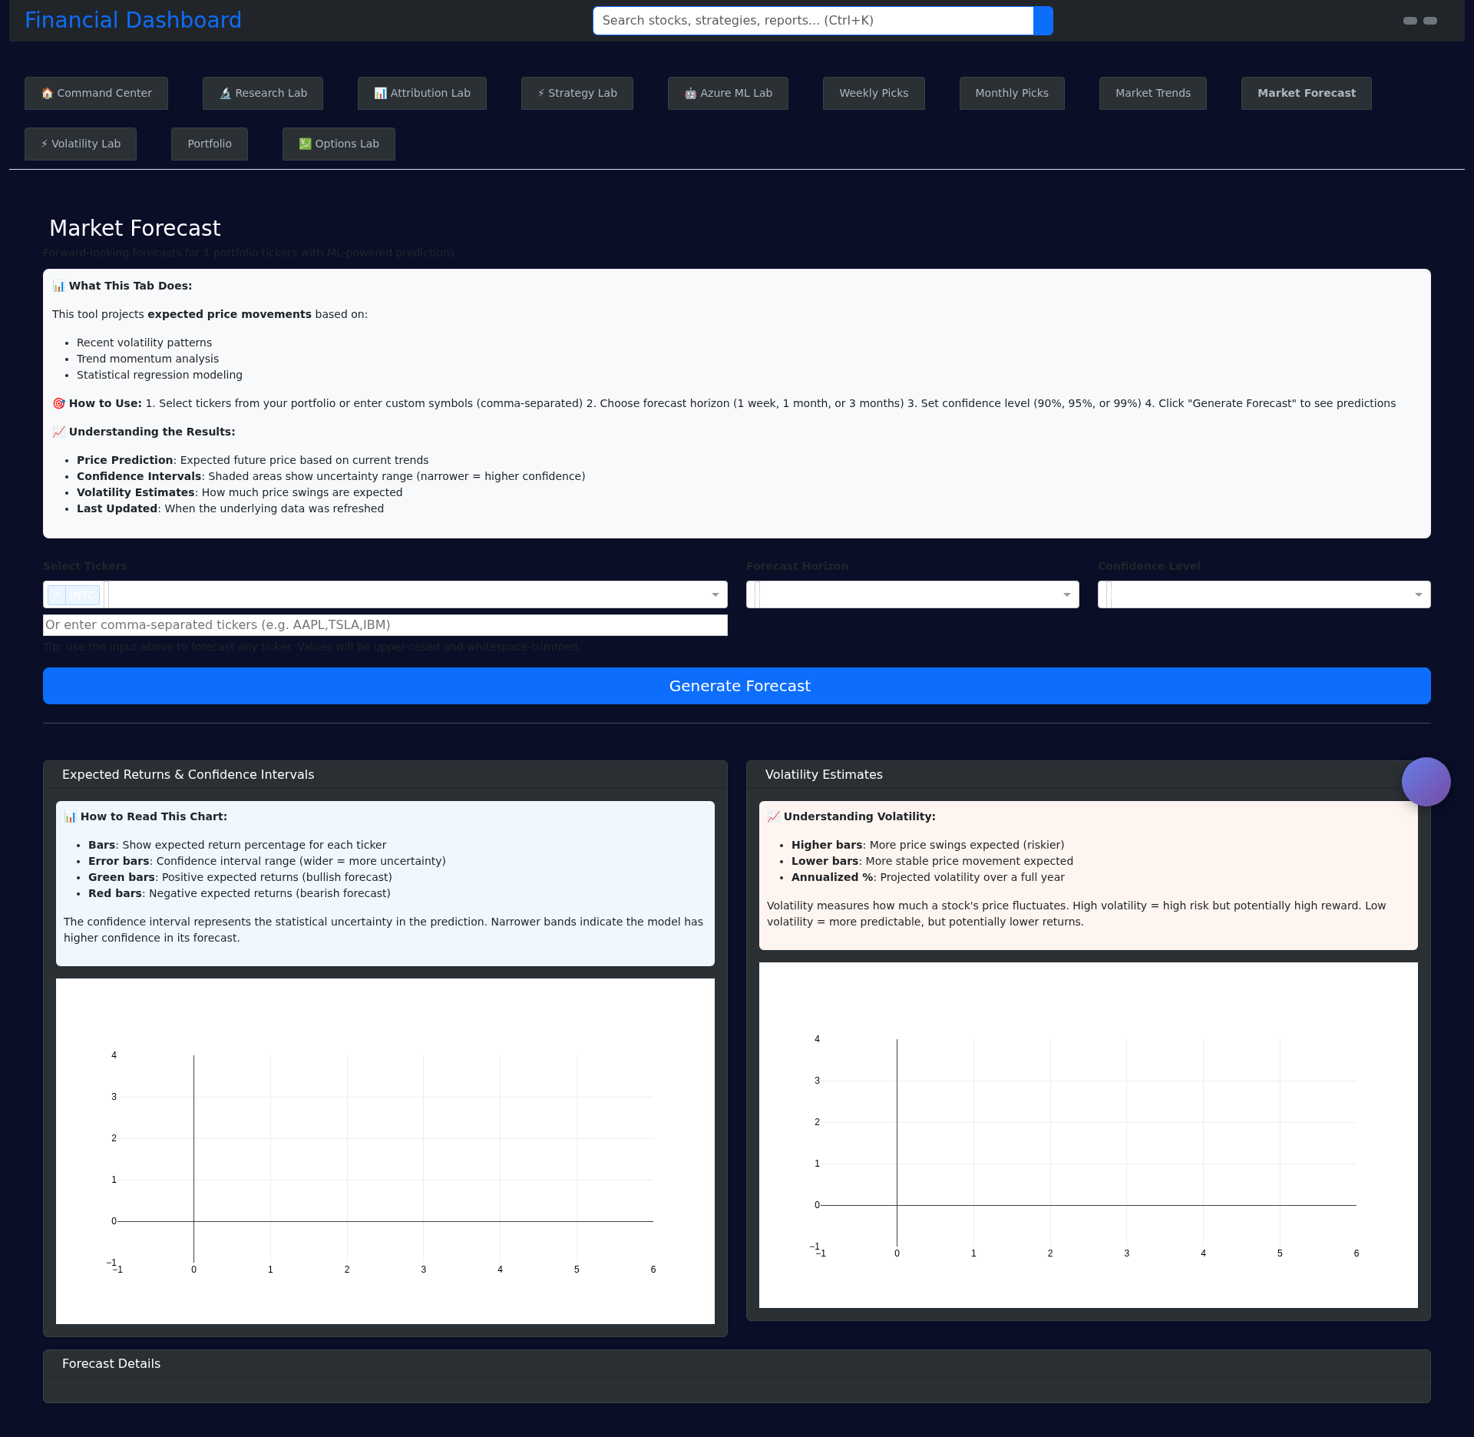
Appendix — Data Sources & Tech Stack
Data: yfinance, Finnhub, optional Alpaca (credentials managed via keys.env).
Stack: Dash, Flask, Plotly, pandas, numpy.
Repo: /financial_dashboard — tabs/options_lab has greeks and chain loader implementations.
Notes:
Optional slide for judges who ask technical questions.

