Slide 1
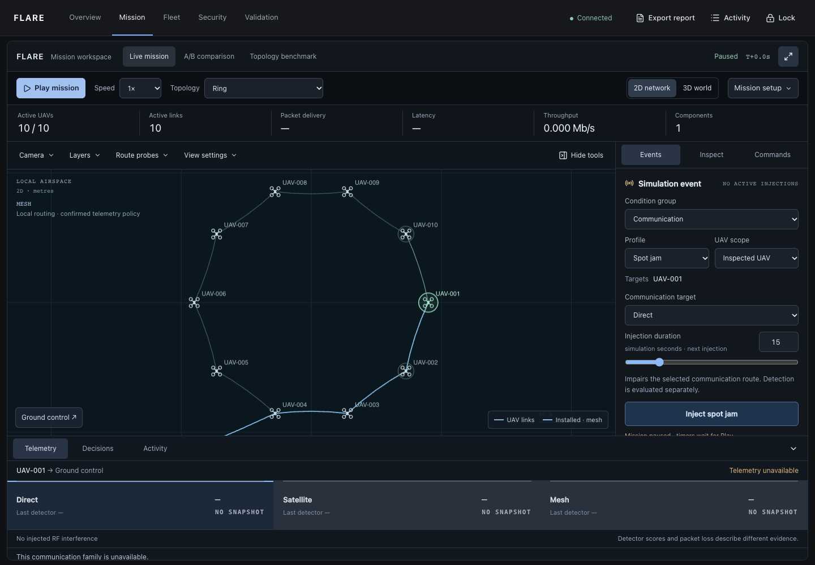
FLARE
Federated Learning and
Adaptive Rerouting Engine
Resilient UAV communication
in a controlled packet simulator
01
Notes:
0:00–0:25
SPEAKING SCRIPT
FLARE stands for Federated Learning and Adaptive Rerouting Engine. We built a research prototype to study resilient communication in UAV networks. Imagine drones inspecting a disaster area while communication conditions change. Useful sensing matters only if the observations can reach the operator. Our demonstration uses software UAVs and modeled packets.
FOLLOW-UP DETAIL
This is software simulation, not physical flight control or a satellite deployment. Intended applications include inspection, search and rescue, and environmental monitoring.
PROJECT SOURCES
review-preparation/README.md; simulation/swarm/engine.py; review-preparation/evidence/01-ring-paused.png

Slide 2
The communication and trust problem
A working radio link and a trustworthy participant are different requirements.
Changing radio conditions
A fixed route can keep using an impaired connection.
Competing route costs
Lowest threat alone ignores delay and switching cost.
Harmful model updates
Ordinary averaging can give a malicious update influence.
02
Notes:
0:25–0:55
SPEAKING SCRIPT
We focus on two failure paths. Interference can make a communication option unreliable. A compromised participant can also submit misleading traffic or a harmful training update. A fixed route adapts poorly when its link changes. Choosing only the lowest threat ignores delay and frequent switching. Ordinary federated averaging can give harmful updates too much influence. These are our comparison points, rather than a claim about every existing system.
FOLLOW-UP DETAIL
The contribution is an integrated and inspectable workflow. We do not claim to have invented federated learning, BiLSTM, DQN or SDN, or to have established novelty through a new systematic literature review.
PROJECT SOURCES
rl/evaluation.py; rl/reward.py; fl/aggregator.py; fl/trust.py

Slide 3
System architecture
One evidence trail connects observation to confirmed forwarding.
Measurements
Detector
DQN policy
Safety gate
Forwarding
Signal, delivery,
SINR, delay, loss
BiLSTM model
and traffic checks
Direct, Satellite,
Mesh or HOLD
Check constraints
and permit action
Compute hops
Confirm rules
Python simulator
Federated learning
Owns time, links, packet execution and outcomes.
Local training produces a shared candidate.
Deployment remains a separate validated step.
03
Notes:
0:55–1:35
SPEAKING SCRIPT
FLARE connects observation, threat assessment, adaptive policy, a safety check and confirmed forwarding. The Python simulator owns network state and packet outcomes. A BiLSTM reads recent measurements. DQN proposes a communication family, and deterministic safety rules constrain that proposal. The network engine separately computes the hops, while the controller confirms what it applied. FastAPI connects these services to the React workspace. Flower manages local training and aggregation. A completed round creates a candidate model, not an automatic deployment.
FOLLOW-UP DETAIL
The current v3 contract supports HOLD and an 18-value observation. Retained v2 has three route actions and a different all-unsafe fallback. Local SDN confirmation is logical simulator enforcement, not physical OpenFlow packet evidence.
PROJECT SOURCES
simulation/swarm/engine.py; fl/model.py; rl/agent.py; rl/safety.py; orchestrator/loop.py; api/server.py; sdn/mock_sdn.py; fl/server.py

Slide 4
Major modules
Threat detector
Reads recent measurement sequences and estimates risk.
Routing policy
Balances communication utility across available families.
Safety and controller
Constrain the proposal and confirm the applied state.
Learning protection
Validate updates and adjust their influence using trust.
Research workspace
Inspect packets, decisions and reproducible experiments.
04
Notes:
1:35–2:05
SPEAKING SCRIPT
The detector reads signal strength, delivery ratio, signal-to-interference ratio, latency and packet loss over a recent window. This is like reading a short history instead of one photograph. The routing policy acts as a dispatcher choosing a communication option. The network finds the feasible hops. Safety rules provide a final permission check. Separately, the learning server checks update consistency and trust, so every contributor does not automatically receive equal influence.
FOLLOW-UP DETAIL
Technologies: Python 3.11, PyTorch, Flower, Stable-Baselines3 DQN, FastAPI, React/TypeScript, Three.js and SQLite. Bidirectional processing stays within the already-observed sequence window. The model does not read future mission telemetry.
PROJECT SOURCES
fl/model.py; fl/trust.py; fl/aggregator.py; rl/agent.py; rl/safety.py; simulation/swarm/network.py; frontend-react/src/mission-simulation/SwarmCommandCenter.tsx

Slide 5
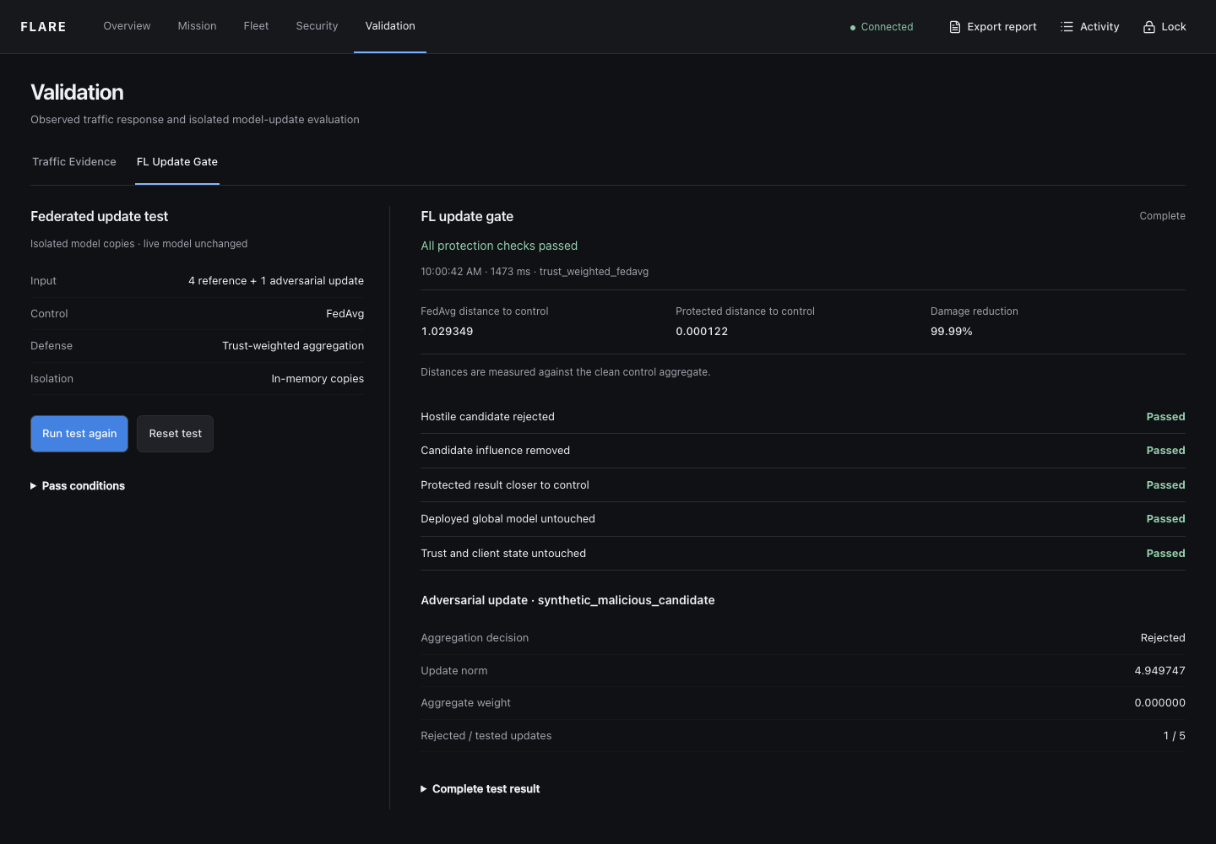
Protecting collaborative learning
Participants train locally
and exchange parameters.
The server checks update
consistency and historical trust.
Suspicious updates can
lose influence or be rejected.
One synthetic test on model copies. The deployed model remains unchanged.
05
Notes:
2:05–2:30
SPEAKING SCRIPT
Participants train locally and share model parameters. Before combining them, the server checks their size, direction, deviation and historical trust. Suspicious updates can receive less weight or be rejected. This screenshot shows the copied-model protection test rejecting a deliberately harmful update while leaving the deployed model unchanged. It verifies that specific protection path. It does not establish field detection accuracy or guarantee privacy by itself.
FOLLOW-UP DETAIL
The displayed damage reduction compares parameter distance to a clean control in this synthetic self-test. Do not call that number detector accuracy. Training and inference are separate. Advanced asynchronous/selection research settings do not yet demonstrate every advertised live effect.
PROJECT SOURCES
fl/client.py; fl/trust.py; fl/aggregator.py; review-preparation/evidence/07-update-gate.png; review-preparation/evidence/demo-result.json

Slide 6
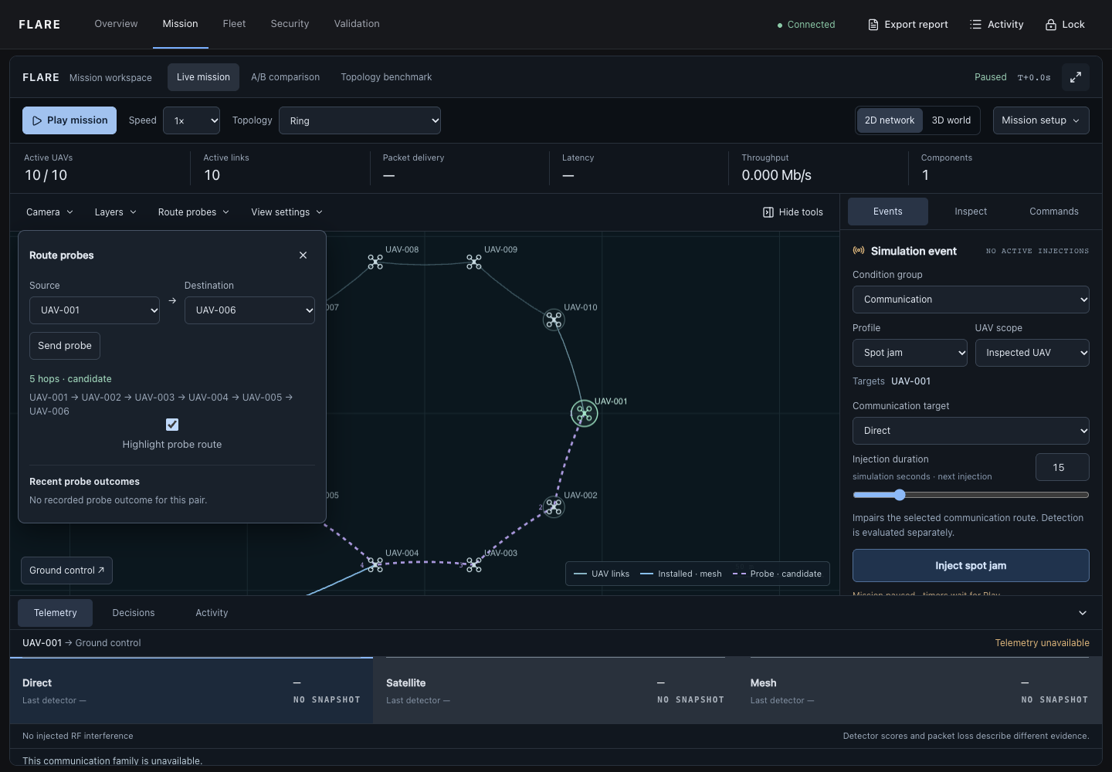
A complete working example
48.16 ms
Five-hop probe delivered
in simulation time
512 bytes
No retries
A 15-second Direct jam expires on the simulation clock.
Detection and installed forwarding remain separate observations.
06
Notes:
2:30–3:05
SPEAKING SCRIPT
In our rehearsal, a packet traveled from UAV-001 to UAV-006 through five Ring links. The backend recorded delivery after about 48 milliseconds of simulation time, with no retries. We then injected a fifteen-second Direct jam. We inspected the impairment, threat evidence and confirmed forwarding separately. Satellite was already installed before this injection, so continuing to use that alternative was the observed behavior. Pausing freezes the attack timer. Expiry ends the injected condition, while historical observations may remain.
FOLLOW-UP DETAIL
Recorded probe p1: 0.000000 to 0.04815747959331477 simulation seconds, five completed hops, 512 bytes, delivered. Never announce a Direct-to-Satellite switch unless the current runtime actually records that transition. A highlighted route alone does not prove packet delivery.
PROJECT SOURCES
review-preparation/evidence/demo-probe-result.json; review-preparation/evidence/02-multihop-candidate.png; review-preparation/evidence/demo-rehearsal.json; review-preparation/evidence/demo-result.json

Slide 7
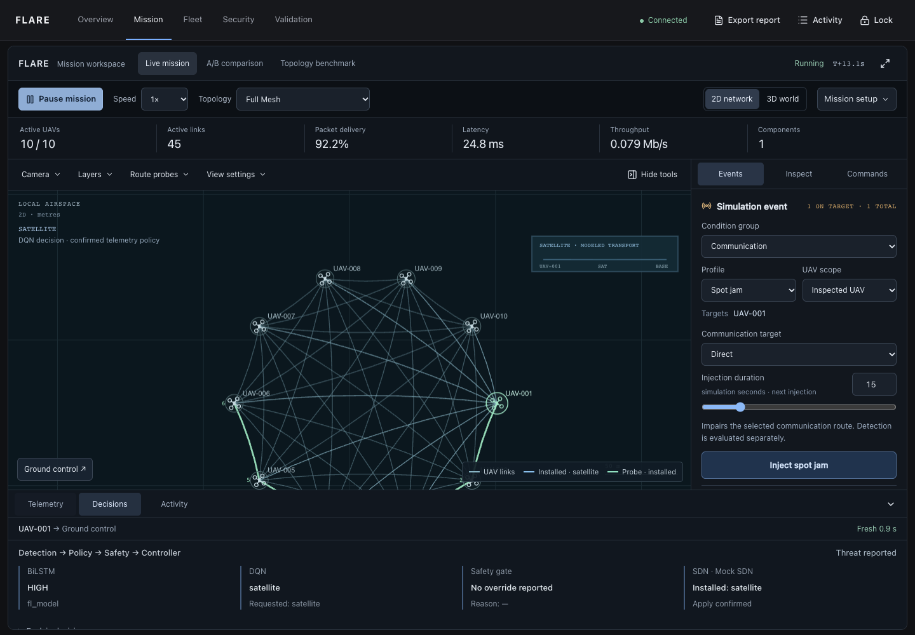
Research workspace
10 network topologies
2D and 3D views
of the same state
Packet probes and replay
Synchronized A/B runs
Topology changes preserve UAV positions. Comparisons use a fixed mesh reference policy.
07
Notes:
3:05–3:30
SPEAKING SCRIPT
The workspace offers ten topologies, two views of the same state, packet probes, replay and synchronized comparison. Topology and flight formation are independent, so changing the connection pattern does not move the drones. A/B experiments share external inputs and use a deterministic mesh reference policy. They exclude live DQN and satellite choices so that we can study topology fairly. The contribution is this connected workflow and its inspectable evidence trail.
FOLLOW-UP DETAIL
Ten primary configurations: Full Mesh, Partial Mesh, Star, Ring, Tree, Cluster Mesh, Grid, Random Geometric, Hybrid Mesh and Self-healing Mesh. Comparisons exclude ground-control transit between UAVs. The 3D site scenery is illustrative.
PROJECT SOURCES
frontend-react/src/mission-simulation/SwarmCommandCenter.tsx; frontend-react/src/mission-simulation/ExperimentPanel.tsx; simulation/swarm/topology.py; simulation/swarm/experiments.py; review-preparation/evidence/05-live-decision.png

Slide 8
Topology results show a trade-off
Full mesh
96.00% delivery
9.84 ms latency
Partial mesh
99.88% delivery
38.50 ms latency
Modeled packets, 30 UAVs, seed 42, normal scenario, 350 m range. Mesh reference routing.
08
Notes:
3:30–4:00
SPEAKING SCRIPT
These are measured packet outcomes from one seed of our topology benchmark. Full Mesh delivered 96 percent of the measured cohort with about 9.84 milliseconds average latency. Partial Mesh delivered about 99.88 percent, with average latency around 38.50 milliseconds. That illustrates a delivery and delay trade-off under this configuration. It does not establish a universal winner. We also ran seeds seven and ninety-nine and retained the per-run measurements.
FOLLOW-UP DETAIL
The full benchmark has 30 runs across ten topologies and seeds 7/42/99. Current implementation measures offered packets over simulation interval [5,60), a 55-second cohort, then drains TTL. Do not describe that as 60 measured seconds after warmup. These values exclude model inference. Reproducible result hash: 5f3c515883dc132929edce274307804757997ad178d9b3379c7c91bb63b0a98d.
PROJECT SOURCES
review-preparation/evidence/mesh-results.json; simulation/swarm/experiments.py

Slide 9
Routing policy comparison
10 paired episodes
500 steps each
Retained v2 policy
Synthetic environment
DQN exceeded static Direct and lowest-threat routing.
Its score was close to the myopic utility baseline.
Utility is a dimensionless test objective. It is not delivery ratio or detection accuracy.
09
Notes:
4:00–4:30
SPEAKING SCRIPT
This is a separate synthetic routing evaluation using our retained v2 checkpoint. Across ten paired episodes, DQN with safety achieved mean utility of 232.32, compared with 209.59 for lowest-threat routing and 119.94 for static Direct. The myopic utility baseline scored 231.79, which is close to DQN. We therefore do not claim DQN is universally best. This utility combines the experiment’s communication costs. It is not a percentage or a detection accuracy.
FOLLOW-UP DETAIL
Protocol: DronePathEnv, routing_qos_v2, base seed 42000, 10 episodes, 500 steps each, threshold 0.8, least-risk fallback when all routes unsafe. This retained v2 evaluation differs from current v3 live HOLD behavior. Never compare v2 and v3 reward magnitudes as if they share one scale.
PROJECT SOURCES
review-preparation/evidence/routing-evaluation.json; rl/evaluation.py

Slide 10
Conclusion and next steps
FLARE demonstrates an inspectable
communication-resilience workflow.
Demonstrated
Next validation
Modeled packet execution
Adaptive policy with safety checks
Protected model-update workflow
Representative radio data
Confidence calibration
Real wireless and enforcement tests
Current evidence supports a research prototype. Physical drone validation remains outstanding.
10
Notes:
4:30–5:00
SPEAKING SCRIPT
FLARE demonstrates an end-to-end workflow in controlled simulation. We can configure a condition, inspect measured evidence, examine the policy and verify the applied state. We do not claim physical drone validation or representative field accuracy. Important next steps are better radio data, confidence calibration, and independent wireless and packet-enforcement tests. Some advanced federation settings remain research paths. The main outcome is a reproducible platform for investigating resilience and explaining what the system actually did.
FOLLOW-UP DETAIL
The exhaustive application audit remains unfinished and has unresolved browser failures. Docker/Ryu/Mininet and ns-3 physical/emulated gates remain blocked by unavailable infrastructure. Rendering FPS met local targets, but 100-UAV simulation time lagged wall time. Do not describe the whole application or all research branches as passing.
PROJECT SOURCES
review-preparation/evidence/review-facts.json; review-preparation/README.md; scripts/audit_support.py

