Slide 1
DETERMINERS
SUBMITTED BY: AARAV MAHAJAN
IX-B
ROLL NO. 1
SUBMITTED TO: Ms SHIVANI BATRA Ma`am

Slide 2

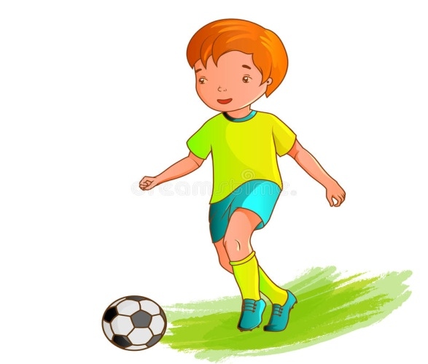
What are DETERMINERS ?
The words that are used before a noun or a phrase to determine whether it is specific or general are called as DETERMINERS.
There are two types of Determiners- specific or general. They introduce the noun and give the reader important information about it.
It is a one-rupee note.
Ben is an ambitious boy.

Slide 3
DETERMINERS
SPECIFIC
ARTICLES
DEMONSTRATIVES
GENERAL
ARTICLES
NUMERALS
DISTRIBUTIVES
INTERROGATIVES
DISTRIBUTIVES
INTERROGATIVES
POSSESSIVES
QUANTIFIERS

Slide 4
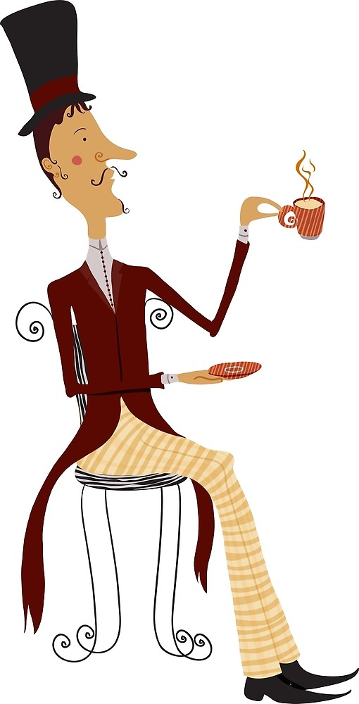
SPECIFIC DETERMINERS
THE DEFINITE ARTICLE:
Specific Determiners refer to a specific noun when the reader knows exactly which noun you are referring to.
The most frequently used specific determiner is ‘the’- which is often referred to as ‘the definite article’.
The English people drink a lot of tea.
We use ‘the’ because we are being specific about which people.

Slide 5


DISTRIBUTIVE DETERMINERS:
Distributive Determiners are specific.
They determine a “group or an individual within a group.”
Each
Every
Both
Each book had been put in its proper position.
Either
Neither
Both of us like the hills.

Slide 6

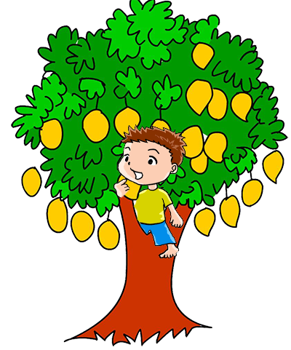
DEMONSTRATIVE DETERMINERS:
Demonstrative determiners are specific.
They relate to the location of the noun that you are describing.
this
these
This map is quite confusing.
those
that
These mangoes are sour.

Slide 7
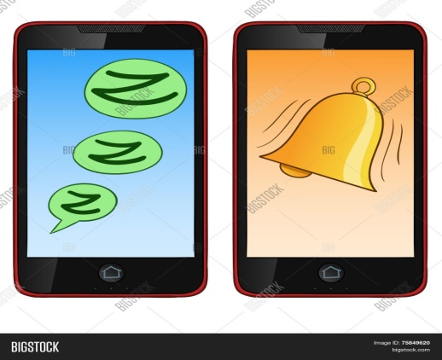
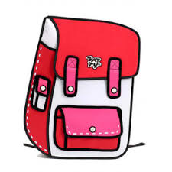

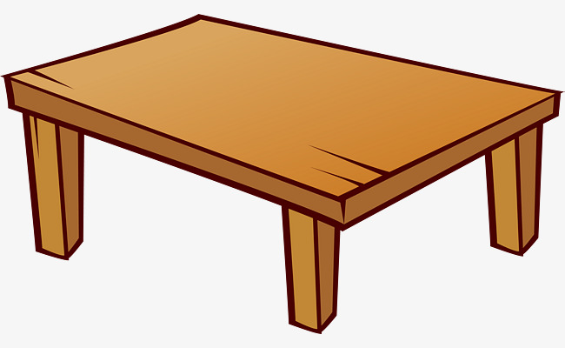
Numeral Determiners:
Numerals perform the function as a determiner when they appear before a noun to express quantity or sequence.
NUMERALS
CARDINALS
ORDINALS
(ONE,TWO,.....)
(FIRST,SECOND…)
I own two mobile phones.
Give me the first bag on the table.

Slide 8

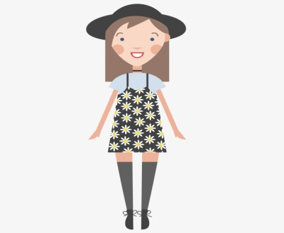
POSSESSIVE DETERMINERS:
A possessive is a word that shows that a certain thing or person belongs to somebody or something.
They function as adjectives or pronouns. When placed before nouns, they qualify them as adjectives.
Its
Their
Our
My
Our house is located in the best part of the town.
His
Your
Her
Her dress is always neat and clean.

Slide 9

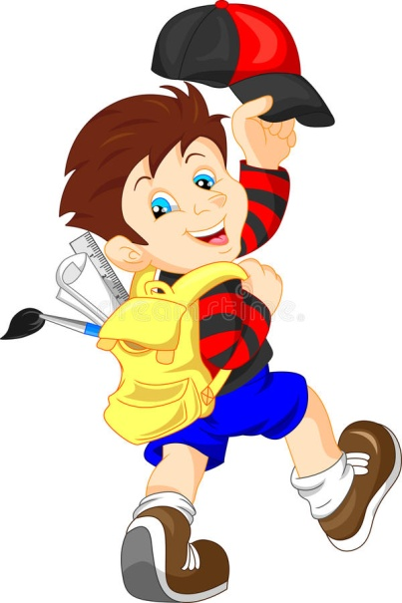
INTERROGATIVE DETERMINERS:
Interrogative determiners are specific.
Interrogatives are the words that determine a group/a specific thing by inquiring about them/it.
Which
Whose
Which book do you want?
Whose bag are you carrying?

Slide 10
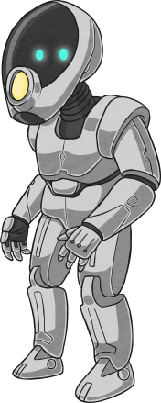
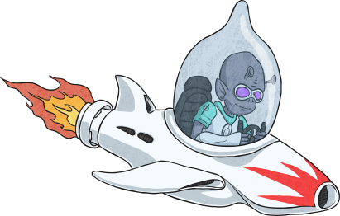
GENERAL DETERMINERS
INDEFINITE ARTICLES
General determiners don’t refer to a specific noun.
The most frequently used general determiners are ‘a’ or ‘an’- which are often referred to as ‘the indefinite article’.
A robot is made of steel.
An alien landed on our planet.
We use ‘a’ if we are talking generally about robots. If we were being specific about one particular robot then we would use the definite article ‘the’.
We use ‘an’ if the noun starts with a vowel (a, e, i , o or u) to make it easier to say.

Slide 11
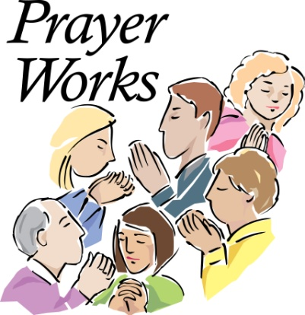

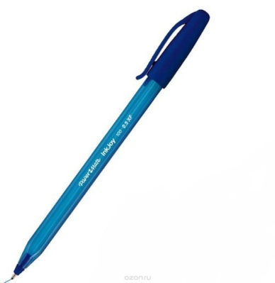
DISTRIBUTIVE DETERMINERS:
Distributive Determiners are also general.
Another
Enough
Most
Several
Other
Most people believe in God.
Can I have another pen?

Slide 12

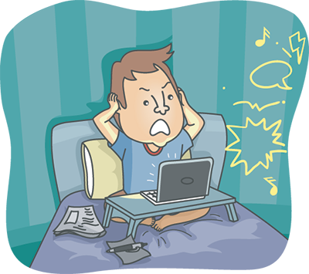
INTERROGATIVE DETERMINERS:
Interrogative determiners are also general.
What
What gadgets amaze you the most?
What is this noise about?

Slide 13
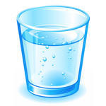

QUANTIFIER DETERMINERS:
Quantifiers determine the approximate number/amount of the plural/uncountable nouns.
Few
Much
Many
Please bring me some water.
Little
More
How much money do you need?
Less
Some

Slide 14



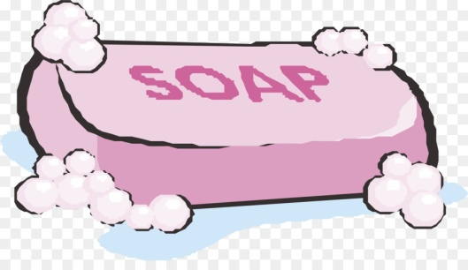
Some more examples of determiners:
An apple a day keeps the doctor away.
That girl won the championship.
Your scarf is fashionable.
I can manage a bath with any soap.

Slide 15


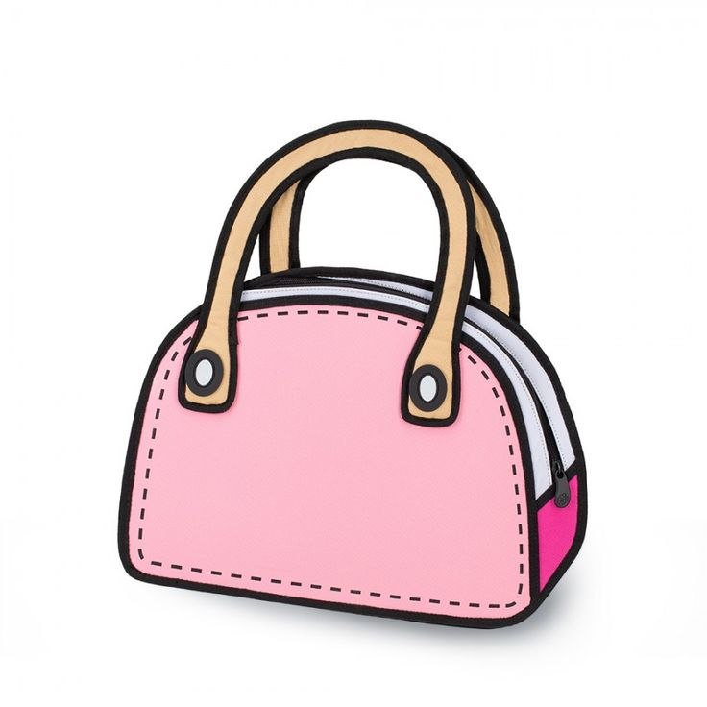
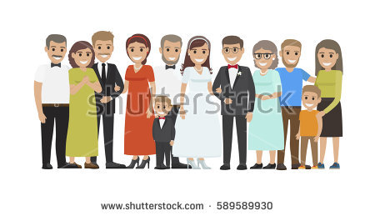
Add one teaspoon sugar to my tea.
Mary is an English woman.
This bag is quite expensive.
All the relatives had arrived for her wedding.

Slide 16
THANK YOU!!!

