Slide 1


SMART INDIA HACKATHON 2025
Problem Statement ID – SIH25226
Problem Statement Title - AI Tool for Early-Stage dementia detection.
Theme- MedTech / BioTech / HealthTech
PS Category- Software
Team ID-
Team Name - Codeholic

Slide 2


D-TECT
We are developing a tool that provides a dementia risk score based on user data.
This solution will help individuals, caregivers and healthcare providers identify potential risk early.
By offering actionable insights, it supports preventive measures, lifestyle adjustments and timely medical consultation, while enabling scalable monitoring across at-risk populations.
An AI-powered early dementia screening tool that uses speech analysis and gamified cognitive tests on a smartphone/tablet. It generates a risk score and detailed report for clinicians.
The tool provides a low-cost, accessible, and non-invasive method for detecting early dementia signs, timely intervention and empowers both doctors and caregivers with actionable insights, especially in rural or resource-limited areas.
Uniqueness
Unlike existing tools, this solution takes a multimodal AI approach tailored to Indian languages and cultural contexts.
This Photo by Unknown Author is licensed under CC BY-NC

Slide 3
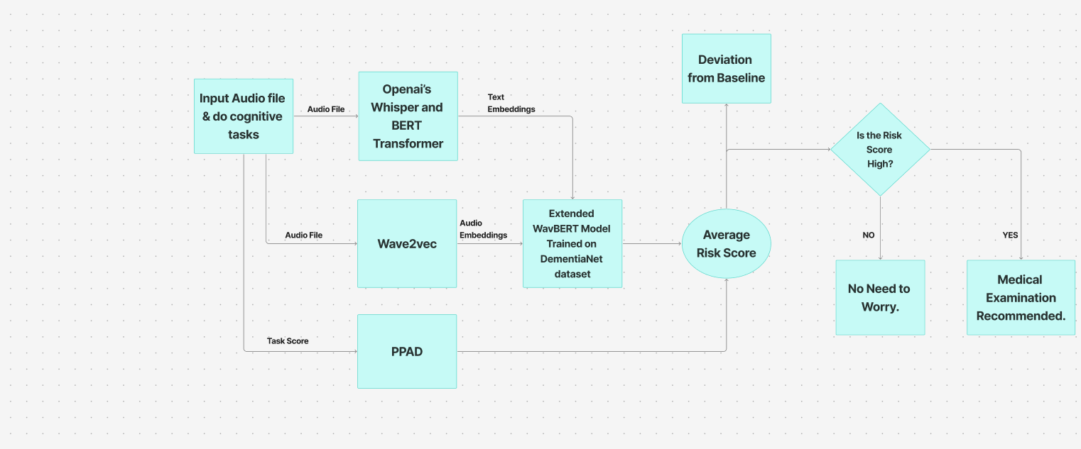
Technical Approach
CODEHOLIC
TECH STACK
Frontend: HTML/CSS/JS
Backend: NodeJS, ExpressJS
Database: Supabase
AI Models: WavBert, Whisper, PPAD
Libraries: JsPSych, MatplotLib
Hosting: AWS
Other: Git, Github

Slide 4


Feasibility and Viability
Codeholic
Analysis of the feasibility of the idea
Using proven AI models, Multimodal fusion feasible with more compute, Low-cost . Scalable via mobile/web apps.
Clinically Useful – Provides early-warning indicators to support doctors, enabling timely intervention without replacing formal diagnosis.
Economically Sustainable – Affordable alternative to costly scans/tests; scalable via subscription for hospitals and free/basic use for individuals.
Potential Challenges and Risks
Limited datasets in Indian languages, privacy of audio data. Requires Clinical data.
Strategies to overcome risks
Using multilingual pretrained models, Data anonymization, Clinical partnerships and Cloud APIs.

Slide 5

Impact and Benefits
CODEHOLIC
IMPACT ON TARGET AUDIENCE
Early Awareness:
Provides individuals and caregivers with an early indication of dementia risk, allowing them to get proper medical care in time.
Informed Decision Making:
Helps healthcare providers and families prioritize evaluations or interventions based on risk score, without replacing formal diagnosis.
Public Health Utility:
Enables identification of high-risk populations for preventive programs or awareness campaigns.
BENEFITS
Users can get risk assessments easily without undergoing complex medical tests.
Encourages early lifestyle adjustments and medical consultation before the worsening of symptoms.
By detecting potential dementia risk early on and taking required medical care can help reduction in cost of medical bills of the individuals.

Slide 6
Research and References
Codeholic
WavBert is a multimodal modal with a wave2bec based architecture.
Link for reference: https://pmc.ncbi.nlm.nih.gov/articles/PMC10102979/
Whisper is an AI model from OpenAI that converts audio to text useful for getting transcripts.
Reference: https://openai.com/index/whisper/
PPAD is a deep learning architecture based on Recurrent Neural Networks (RNN). Reference: https://github.com/bozdaglab/PPAD
The dataset we will use to train WavBert is DementiaNet.
Reference: https://github.com/shreyasgite/dementianet

