Slide 1
Using Machine Learning to Assist
Mutual-Fund Selection
Ranking Indian active-equity funds within their category
+2.4% / year vs a like-for-like benchmark | positive in all 7 back-test years | honestly validated
Aarav Singhal
Notes:
One line: 'I built an ML model that ranks Indian equity funds WITHIN their category to make fund selection easier for retail investors. It does not beat the market -- it beats a like-for-like peer benchmark by about 2.4% a year, and I validated that honestly.' Tune depth to the audience from here.

Slide 2
The problem: too many funds, one lazy heuristic
Hundreds of active equity funds, growing every year.
No retail investor can compare them all -- so most fall back on a single heuristic: pick whatever had the highest recent return.
Decades of evidence say that heuristic is unreliable -- past return alone barely predicts future out-performance.
The goal
Find real, repeatable patterns in fund data that rank funds by their likely next-3-year category-relative return -- and group them by risk -- so a retail investor gets a short, trustworthy shortlist instead of 300 tabs.
The goal
Notes:
Layperson: 'It's a shortlist, not a crystal ball.' Manager: framing the business problem -- decision support for selection. Quant: note the target is category-relative, so we're measuring selection skill, not market beta.

Slide 3
The foundation: a lot of clean historical data
Millions
2.5M+
Every
~250 / yr
NAV / AUM / TER rows from AMFI
portfolio holdings, historical & live
manager & tenure for active funds
funds per cohort, 2013-2022 (1,841 rows)
Two honest data problems I found and fixed:
1. TER (cost) data was unreliable before 2018 -> handled so it never leaks into the target.
2. A corrupted NAV showed a +4,367% 3-year return, poisoning the training target -> fixed with an outlier filter + trimmed benchmark (worst per-group error 1.85 -> 0.16).
Notes:
The corrupted-NAV fix is the credibility moment for a quant: shows we audit the target, not just the model. Manager: data governance was taken seriously. Layperson: 'garbage in, garbage out -- so I cleaned the garbage first.'

Slide 4
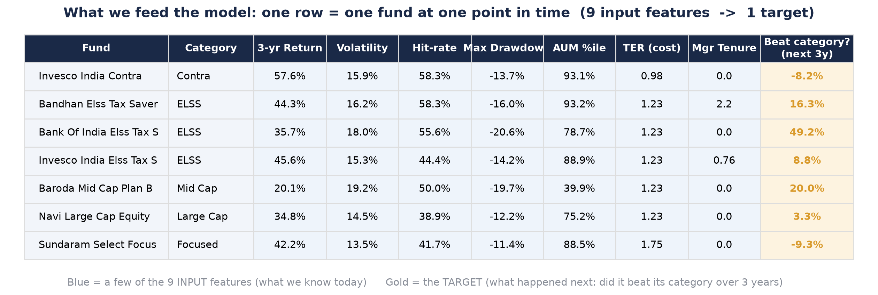
What we feed the model
One row = one fund at one moment. 9 input numbers we know today; 1 target = what happened next.
Takeaway: The model sees thousands of these rows and learns which combinations of the 9 numbers tend to beat the category.
Notes:
Walk them across ONE row. Layperson: 'each row is a fund's report card, plus what happened afterwards.' Quant: features are point-in-time; target is 3-yr forward category-relative alpha -- strictly out-of-sample by cohort.

Slide 5
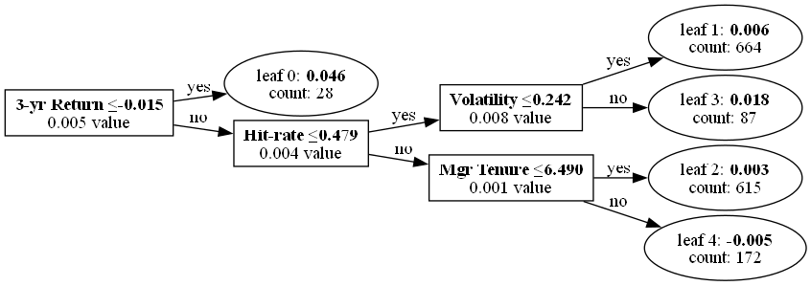
The model: gradient-boosted decision trees (LightGBM)
An ACTUAL tree from the trained model. It combines 50 shallow trees like this into one score.
Takeaway: Each tree asks yes/no questions about the 9 features; the model adds them up into 'how likely to beat its category'.
Notes:
Layperson: 'like a flowchart of yes/no questions.' Quant: 50 trees, depth 3, deliberately small to resist overfitting on ~1,800 rows; this is tree 0, note the top splits are 3-yr return and hit-rate -- consistent with the importance chart.

Slide 6
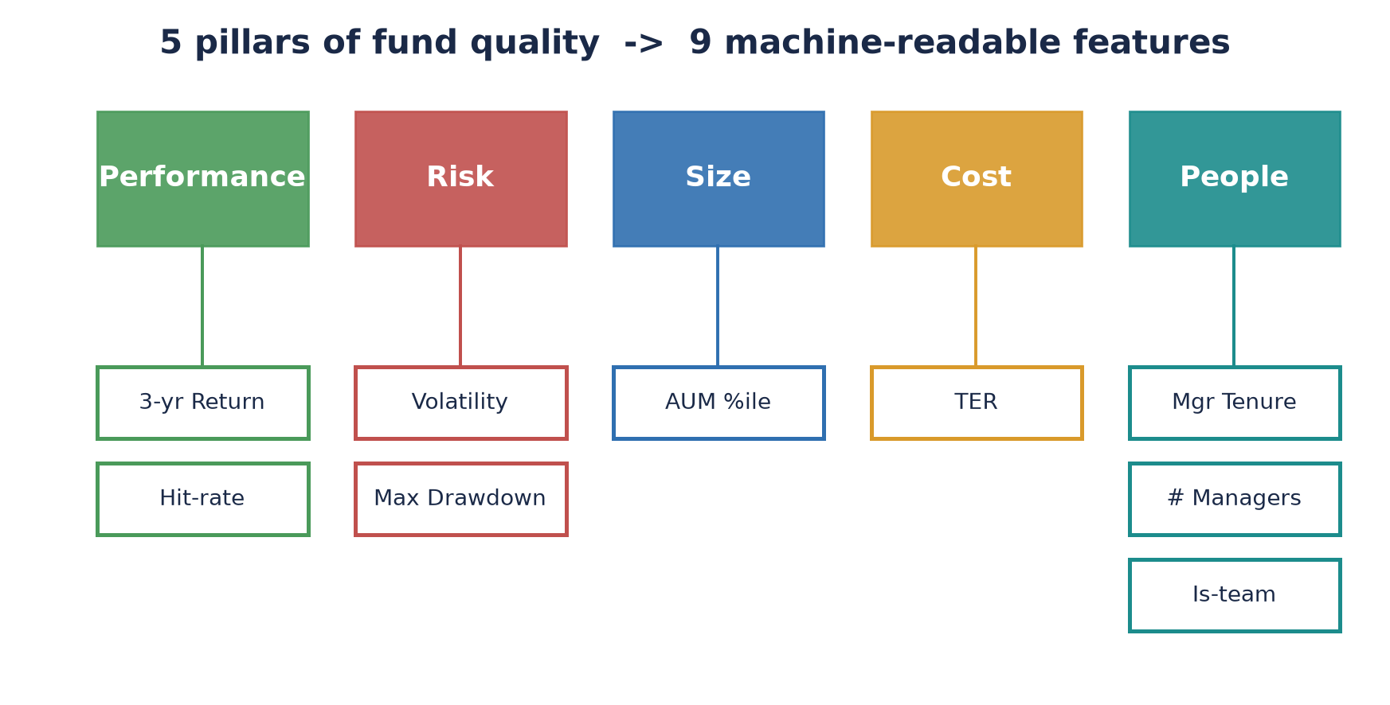
The 9 features come from 5 pillars of fund quality
Performance, Risk, Size, Cost, People -- each measured by concrete, machine-readable numbers.
Takeaway: Nothing exotic: the same things a thoughtful analyst checks, made consistent and comparable across ~250 funds.
Notes:
Manager: this maps to how a human analyst thinks -- defensible, explainable. Quant: features are cohort-standardised where needed; holdings-based features are future work (data-linkage gap).

Slide 7
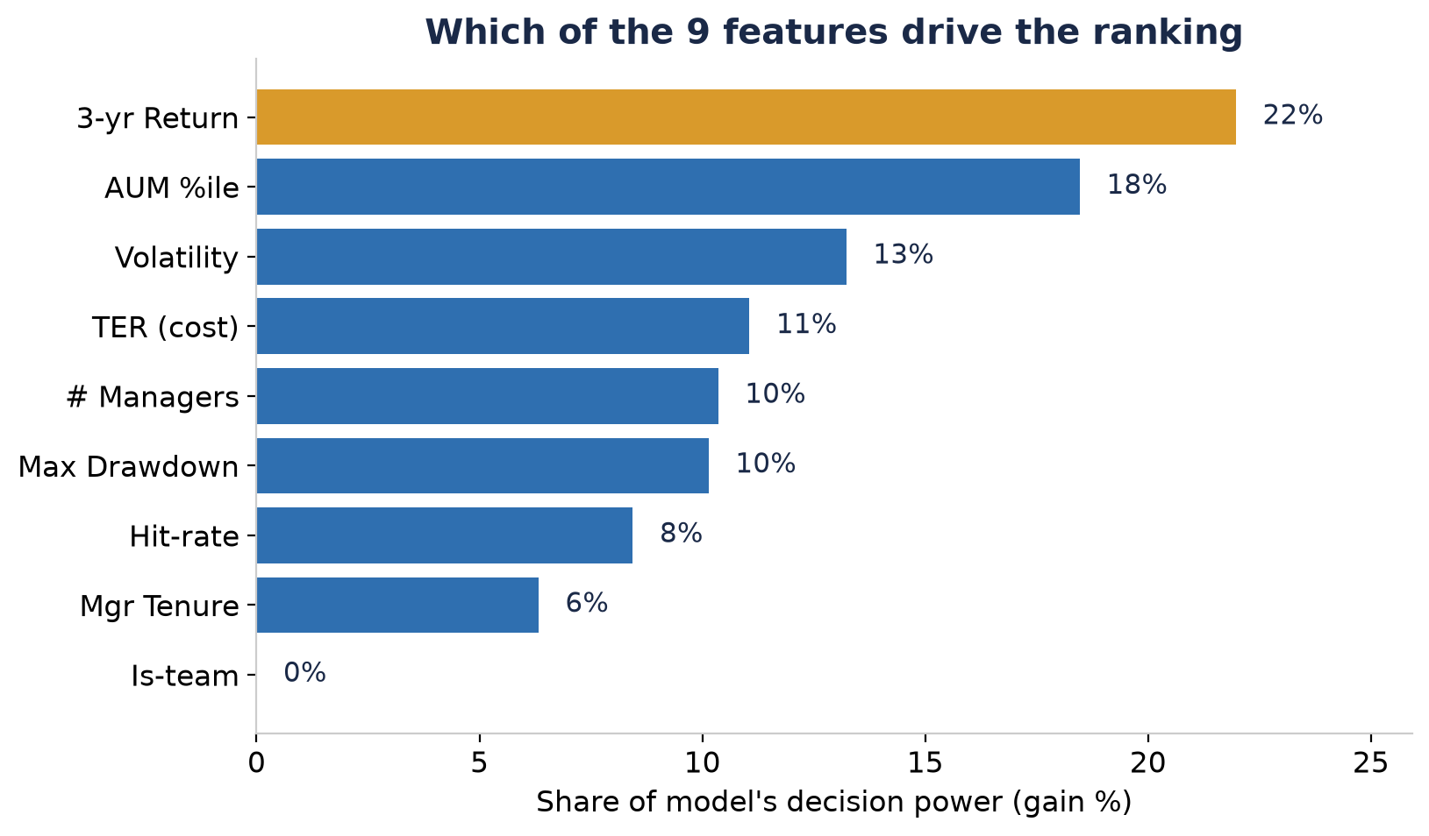
Which features actually drive the ranking
Gain-based importance from the trained model.
Takeaway: Past return and fund size lead -- but as the next slide shows, NOT in the direction most investors assume.
Notes:
Set up the twist: return and AUM matter most, but the RELATIONSHIP is inverse (mean reversion + small-fund effect). Is-team ~0% -> honestly, one feature earns its keep barely at all; kept for interpretability.

Slide 8
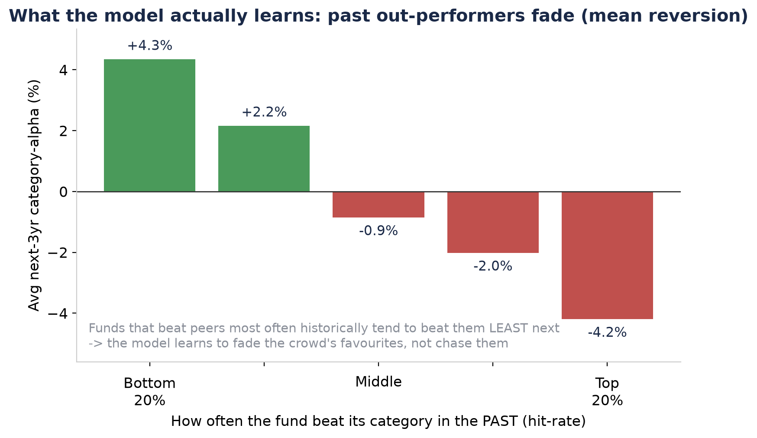
What the model actually learns: fade the favourites
Real, monotonic pattern in the data (not a hand-picked example).
Takeaway: Funds that beat their peers most often in the past tend to beat them LEAST next -- exactly why 'buy last year's winner' fails.
Notes:
THIS is the intellectually honest highlight. It directly proves the intro claim (past performance is unreliable). Quant: this is category-relative mean reversion + a small-fund tilt; it's also why ~30% of the edge is a size factor (later slide).

Slide 9
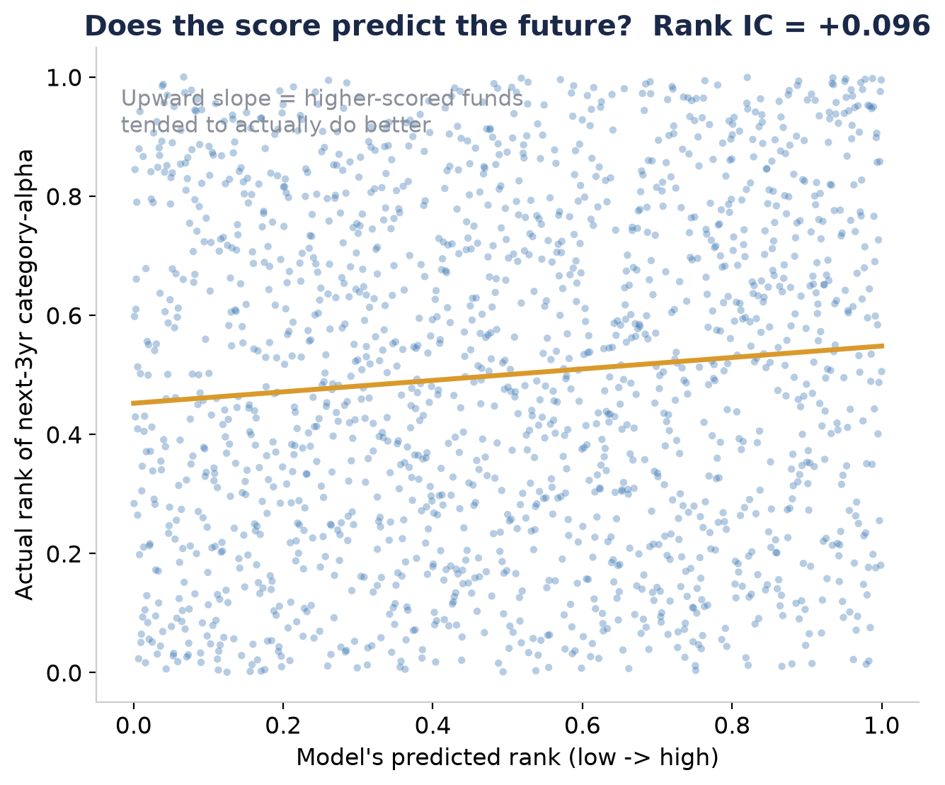
Does the score predict the future? (out-of-sample)
Walk-forward: train only on the past, predict the next cohort. Pooled across 2016-2022.
Takeaway: Rank IC = +0.096 (above +0.10 within-category). Weak per-fund, but real and consistent -- and it compounds across a portfolio.
Notes:
Be honest: the cloud is noisy -- one fund is nearly a coin-flip. IC ~0.1 is considered good in this field. Quant: permutation p<0.001; within-category IC up to +0.18. Layperson: 'slightly better than a coin flip, every year, adds up.'

Slide 10
How we tested the ranking: a fair back-test
The strategy fell out of the TEST, not the other way round.
To ask 'is the ranking real?', each year I:
- took the 5 core categories
(Small, Mid, Large, Flexi, ELSS)
- bought the top-2 funds per category
- rebalanced yearly, held >12 months (tax)
Benchmark: buy EVERY fund in those 5 categories, equally. A like-for-like peer.
Why category-neutral?
We don't know which category will win, so we hold all five equally.
That strips out market and style bets and isolates ONE thing: did picking the top-2 beat owning the whole category?
If yes, in every year, the ranking has genuine selection skill.
Notes:
Critical framing for a quant: the benchmark is category-MATCHED, so we measure pure selection, not size/style tilt. Manager: 'we compared like with like.' The strategy is just the experiment made investable.

Slide 11
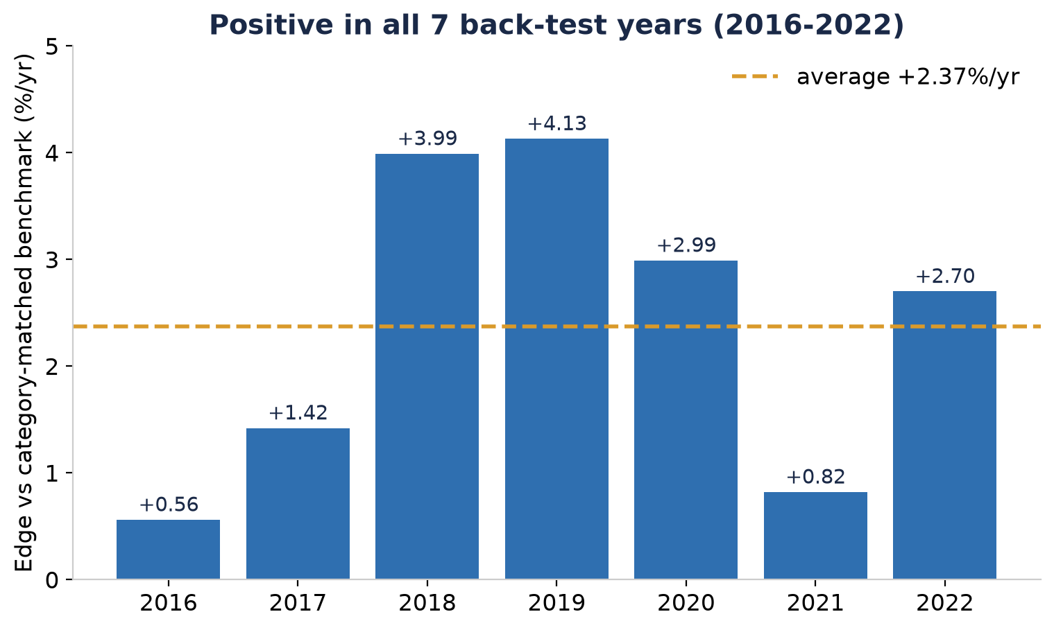
Result: positive in all 7 back-test years
Edge of the top-2-per-category portfolio over the category-matched benchmark, 2016-2022.
Takeaway: +2.37%/yr average, 7/7 years positive. Not one lucky year -- a consistent edge.
Notes:
7/7 is the headline. Quant: Newey-West t=3.30 (p~0.001) after correcting for overlapping windows; cohort block-bootstrap 95% CI [+1.37%, +3.36%]; sign test 7/7 p=0.008. Manager: consistency matters more than the average.

Slide 12
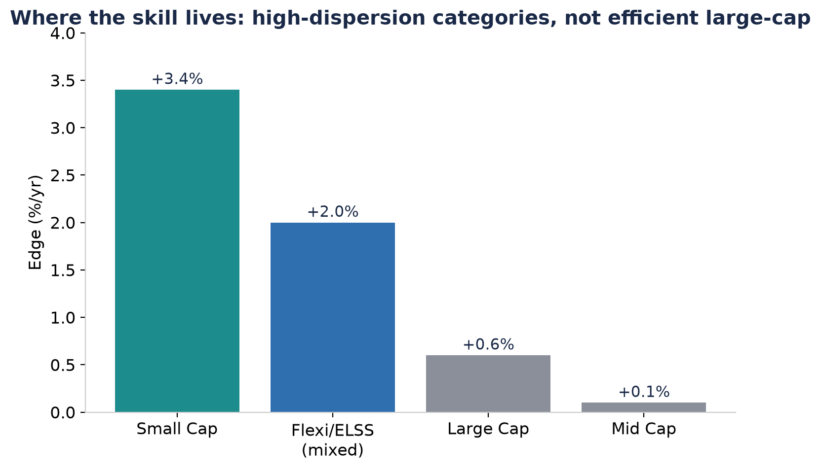
Where the skill lives (and where it doesn't)
Edge by category. Honesty: it is concentrated, not uniform.
Takeaway: Biggest in high-dispersion small-cap; near-zero in efficient large-cap where funds hug the index.
Notes:
Honesty slide. Manager: don't oversell large-cap. Quant: dispersion = opportunity; in efficient segments there's little to pick between funds. This also foreshadows the size-factor decomposition.

Slide 13
How I tried to DISPROVE it (assurance)
A result you didn't try to break isn't validated. I tried hard to break this one.
Negative control
Retrain on SCRAMBLED labels. A real model must beat that no-skill null -- ours does (p=0.000). The prototype's 'beats the market' claim FAILED this (p=0.125) and was dropped.
Red-team battery (6/6)
Portfolio size, model seed, leave-one-year-out, feature jackknife, 'is it just momentum?', and a 2,000-draw random-portfolio placebo -- all survived.
Harder benchmarks
Survives a cap-weighted peer (+3.45%/yr) and a size/momentum factor regression: +1.72%/yr is irreducible skill (t=4.26); ~30% was a size tilt, now separated out.
Live forward test
A real paper-trading account (real NAVs, daily marks) is now accumulating genuinely out-of-sample evidence.
Notes:
Negative control is a STANDARD method -- the novelty is only in applying it here, where fund back-tests usually skip it. The honest headline: I killed my own overclaim. That's what makes the surviving +1.72% skill believable.

Slide 14
What this is -- and what it is NOT
It IS
It is NOT
- A within-category selection edge:
~+2.4%/yr gross, ~+2.6% net of tax
- Consistent: 7/7 back-test years
- ~70% genuine skill after factors
- A decision-support shortlist for
choosing between peer funds
- Beating the market. If the market
falls, so does this.
- Uniform: near-zero in large-cap
- Proven across cycles: one country,
one bull-heavy era (2013-2025)
- Reliable without the >12-month
hold -- tax would erase a short flip
Notes:
The trust slide for EVERY audience. Say it plainly. Layperson: 'it will not protect you in a crash.' Manager: bounded, not oversold. Quant: relative, concentrated, single regime -- forward test is the only true out-of-sample mitigation.

Slide 15
What was actually shipped
Retail fund list
Every fund rated & tiered within its category -- the product a retail investor actually reads. Live on the website.
Strategy list
The validated top-2-per-category, 10-fund portfolio -- the proof, made investable.
Quality x Risk screener
A 2-D map with plain-English reasons for each fund (SHAP).
Live paper-trading
Forward test vs a category benchmark; annual rebalance + self-revalidation.
One-command maintenance
Yearly data refresh -> retrain -> regenerate all lists, self-checked.
Notes:
Manager: five concrete deliverables, not a notebook. Note retail list vs strategy list -- retail investors read the LIST, they don't have to follow our strategy (others may have better strategies).

Slide 16
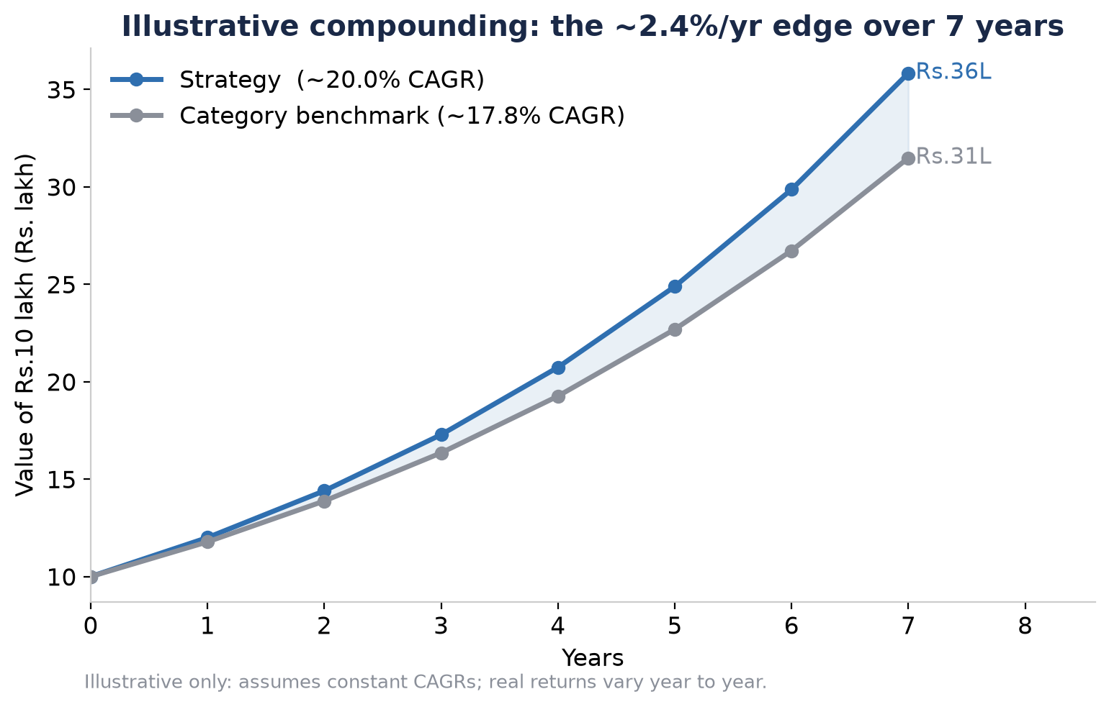
What ~2.4% a year is worth (illustrative)
Compounding a constant 20.0% vs 17.8% CAGR on Rs.10 lakh. Illustrative -- real returns vary yearly.
Takeaway: A modest annual edge, compounded and repeated across categories, is the whole game. Next: let the live paper-trade confirm it forward.
Notes:
Close. Layperson: small edge, compounded, matters. Manager next steps: continue paper trade (review quarterly), add each new cohort, close the holdings data-linkage gap (highest-potential unexplored signal). End on: honest, modest, real.

