Slide 1


MyHealth_Services
Aaresh Bachana Anish Churi Harshil Sheth

Slide 2
Project Summary
Java based stand-alone application which can be used in hospitals and clinics
Application can be used by:
Doctor
Patient
Clerk

Slide 3
Project Summary
Application can be used for
Creating and Scheduling Appointments
Request medical tests and getting notifications on completion of result computation
Viewing and paying medical bills off when added to the patient’s profile

Slide 4
Use Cases Implemented
User can login or create profile
Doctor creates schedule
Patient searches for doctor by name
Patient can book an appointment
Patient can request medical test
Doctor can approve medical test for the respective patient
Clerk notifies patient and doctor when results computed
Clerk can upload bills to patient profile
Patient can pay bills using authorization via database

Slide 5
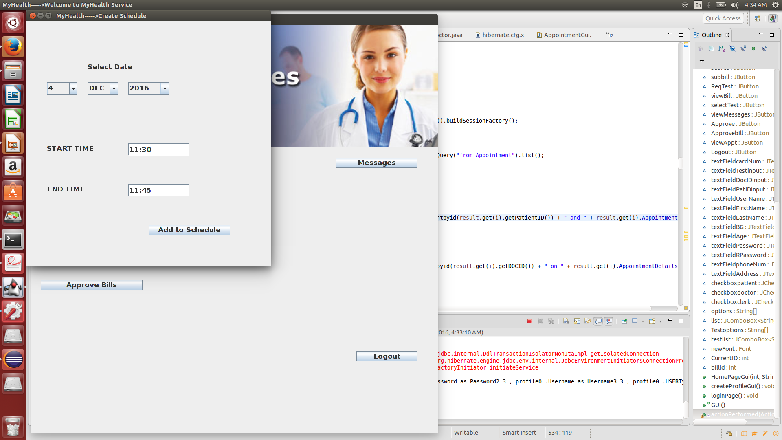
Use Cases
Doctor can create schedule

Slide 6
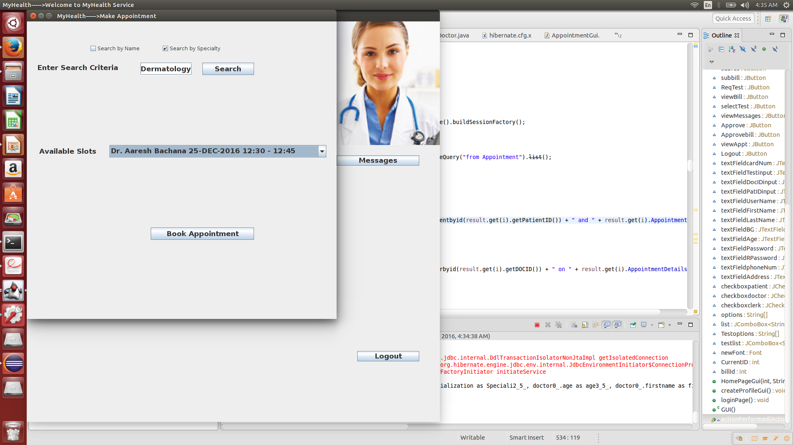
Use Cases
Patient can search for a certain doctor

Slide 7
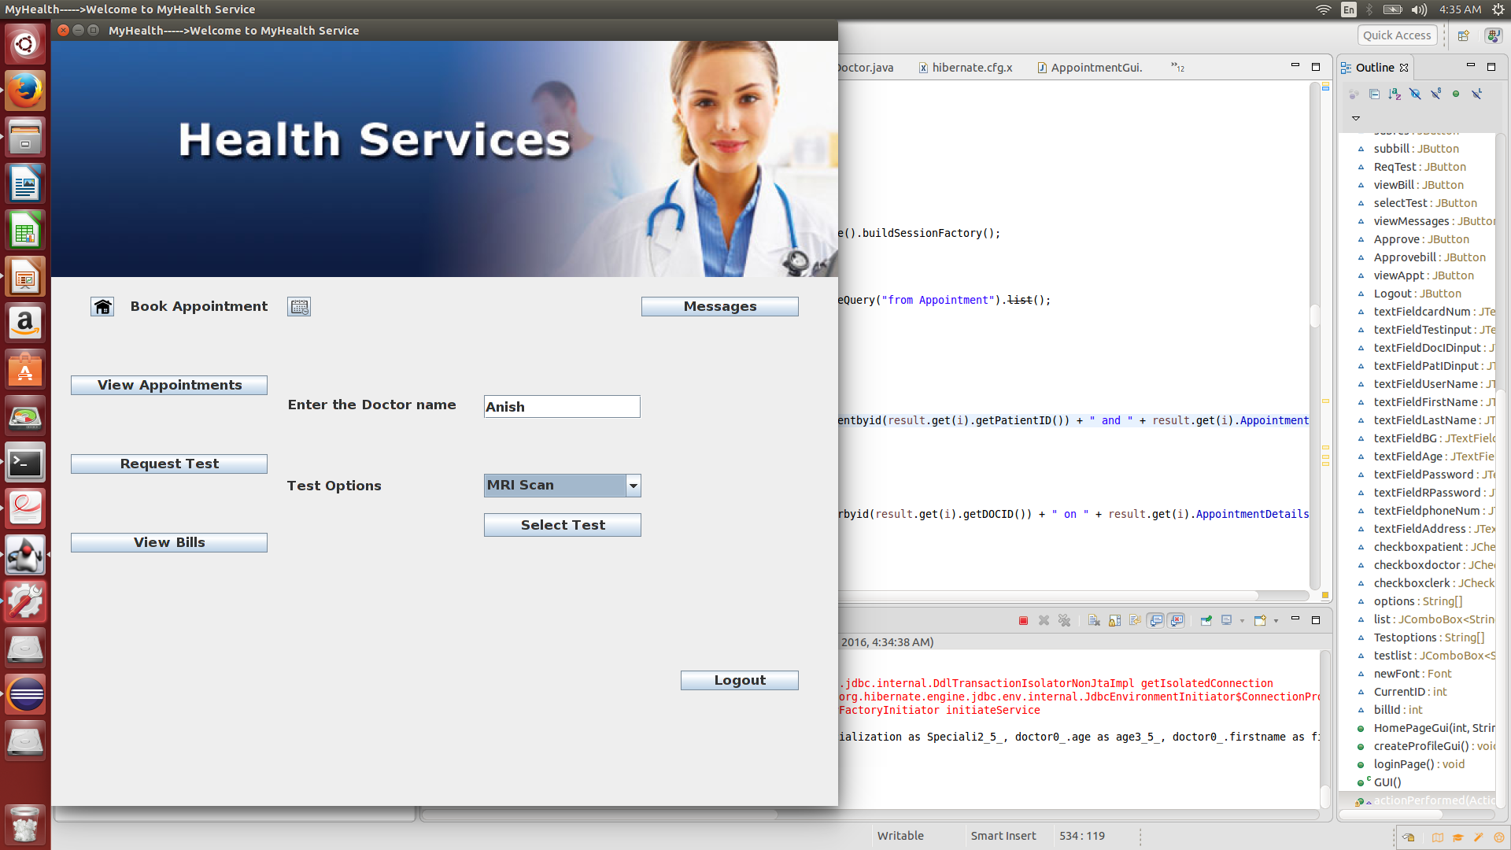
Use Cases
Patient can request medical test

Slide 8
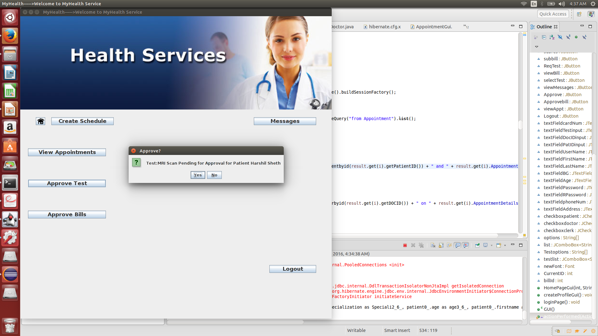
Use Cases
Doctor can approve medical test

Slide 9
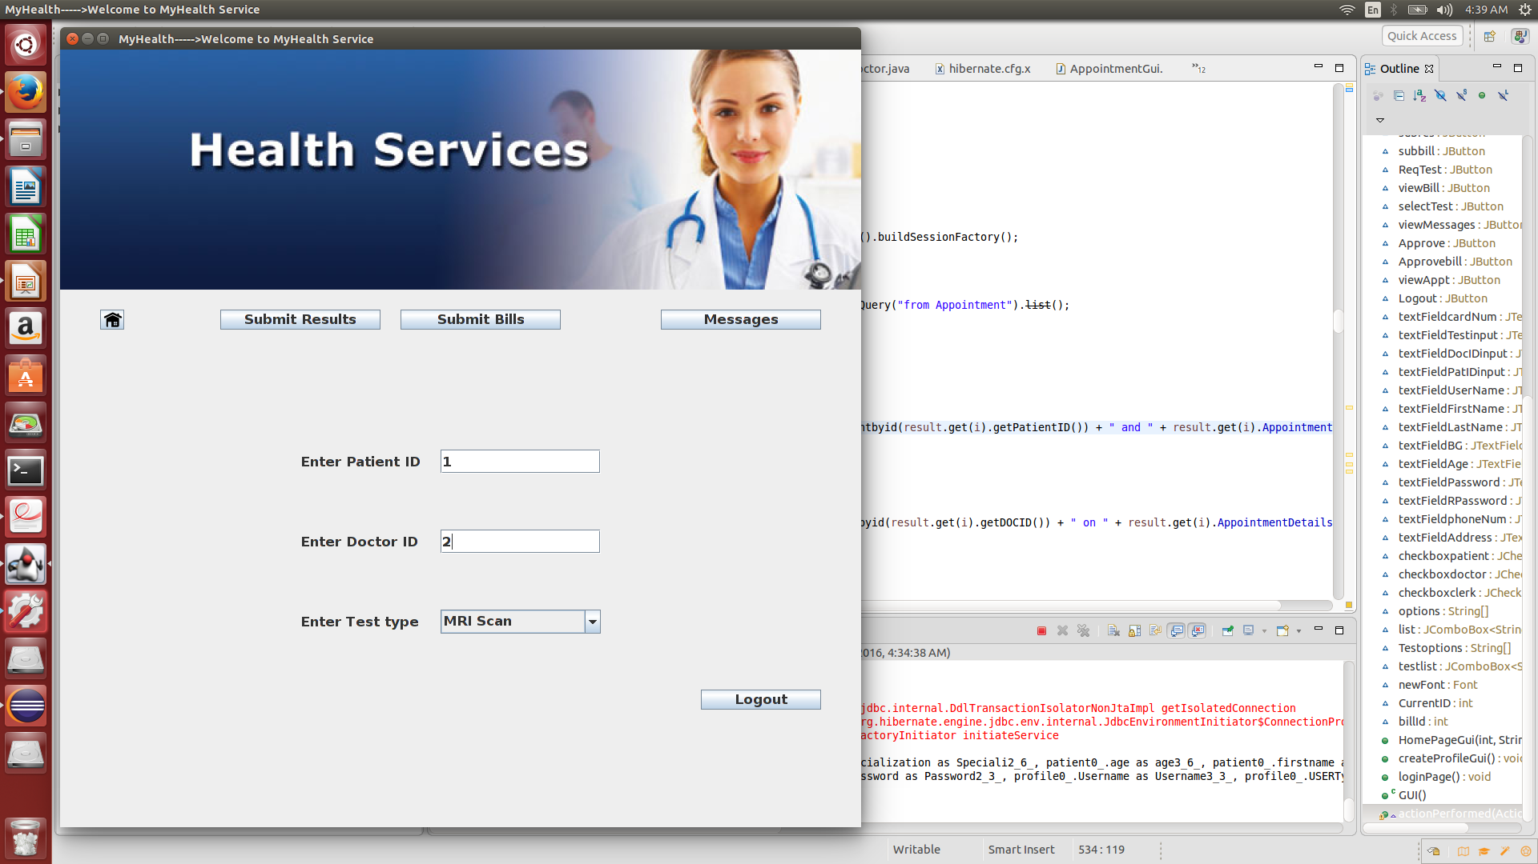
Use Cases
Clerk can upload bills

Slide 10
Use of Hibernate
Used MySQL database for storage of persistent data
Used Hibernate for mapping classes to the database
//Photo//

Slide 11
Hibernate Annotations
@Entity- Used for the class to be persisted.
@Id- Used to generate a unique id depending on the Strategy used in @GeneratedValue.
@GeneratedValue- Used to determine the strategy for the Id.(eg- GenerationType.IDENTITY)
@Column- Used to create different attribute columns in the database tables.
@MappedSuperclass- Used to not persist the abstract superclass.

Slide 12
Design Patterns

Slide 13
Refactoring

Slide 14
Future Development
Refactoring the code
Iterator Design Pattern
Observer Design Pattern
Strategy Design Pattern

Slide 15
Project Demo

