Slide 1
Reconstruction of strange attractors via inter-spike intervals
Àlex Arcas Cuerda &
Ramón Marc García Seuma

Slide 2
Index
Geometry from a Time Series
Reconstruction of Dynamical Systems from Interspike Intervals I :
Reconstruction of Dynamical Systems from Interspike Intervals II :
Results I : Topology
Results II : Predictability
Conlclusions

Slide 3
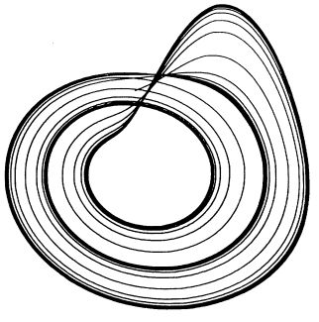
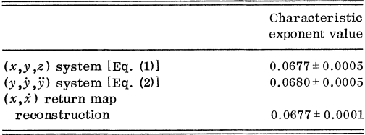
Geometry from a time series
Give insight into a dynamical system from a time series.
Reconstruction of the topology.
Characterization of the Liapunov exponent.
Procedure to find the dimensionality.
Some review.

Slide 4
Reconstruction of Dynamical Systems from Interspike Intervals I :

Slide 5
Reconstruction of Dynamical Systems from Interspike Intervals II :

Slide 6
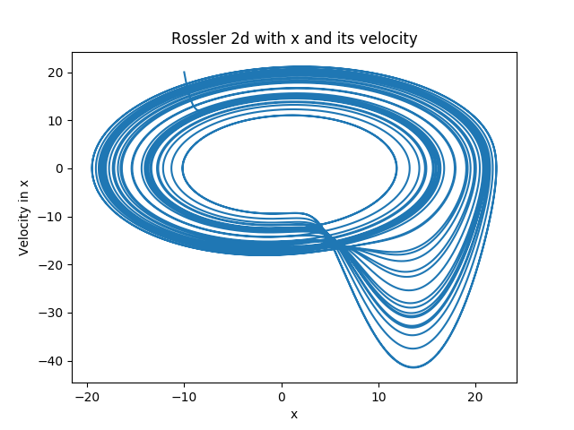
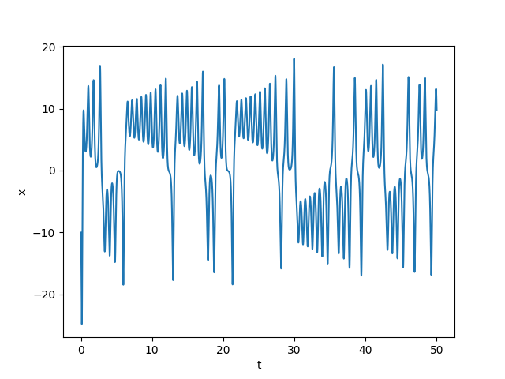
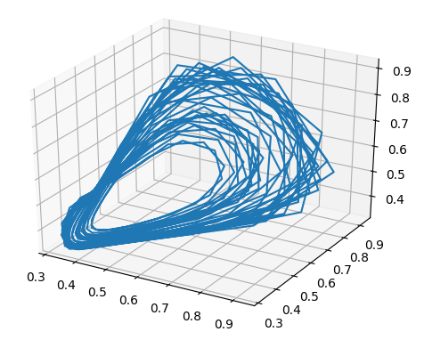
Results I : Topology
Reconstruction of trajectories : Rossler & Lorentz
Reconstruction of phase space : 2d & 3d

Slide 7
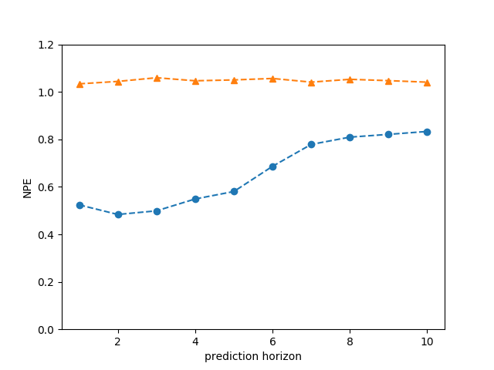
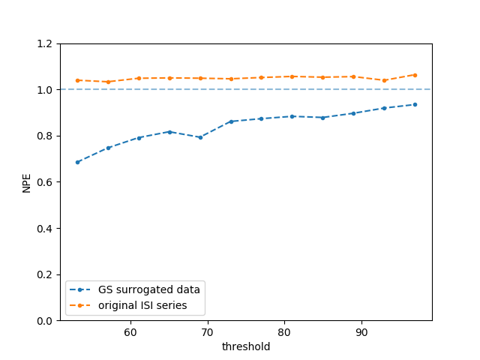
Results II : Predictability
Predictability assumption for NPE.
Calcul of NPE : Gaussian shuffle & ISIs series
Calcul of predictability limit: Gaussian shuffle & ISIs series

Slide 8
Conclusions

