Slide 1

01
ELECTRICITY BILL ANOMALY DETECTOR
Page
ELECTRICITY BILL
ANOMALY DETECTOR
Detecting unusual household energy consumption from smart-meter data
ELECTRICITY BILL ANOMALY DETECTOR

Slide 2
02
ELECTRICITY BILL ANOMALY DETECTOR
Page
THE PROBLEM
HOUSEHOLD BILLS SPIKE,
AND NO ONE KNOWS WHY
Unpredictable bills
No baseline
Manual tracking is tedious
A single unusually high reading can go unnoticed until the bill arrives.
Households rarely know what “normal” usage looks like for them.
Spotting a spike in raw meter numbers by eye is slow and unreliable.
Goal: automatically flag abnormal consumption per household and give people an easy way to see it.
ELECTRICITY BILL ANOMALY DETECTOR

Slide 3


03
ELECTRICITY BILL ANOMALY DETECTOR
Page
THE DATA
TWO DATA SOURCES
daily_dataset.csv
meter_readings.csv
Smart-meter readings aggregated per household, per day.
— LCLid (household ID)
— day
— energy_sum, energy_mean
— energy_min, energy_max
— energy_median, energy_std, energy_count
~1,048,575 rows
User-entered readings captured through the app's own form.
— timestamp, household_id, month
— meter_reading_kwh, bill_amount
— appliance, usage_hours_per_day
Grows as households log new readings
ELECTRICITY BILL ANOMALY DETECTOR

Slide 4
04
ELECTRICITY BILL ANOMALY DETECTOR
Page
PREPARING THE DATA
CLEANING BEFORE ANYTHING ELSE
01
→
02
→
03
→
04
Load & inspect
Type-correct
Drop invalid rows
Sort
Read the CSV, check shape, dtypes, and missing values.
Parse day to datetime, coerce energy_sum to numeric.
Remove duplicates and rows missing an ID, date, or reading.
Order by household and date so trends and windows are meaningful.
Implemented in load_and_clean_data() — electricity_anomaly_detector.py
ELECTRICITY BILL ANOMALY DETECTOR

Slide 5
05
ELECTRICITY BILL ANOMALY DETECTOR
Page
THE METHOD
FLAGGING WHAT FALLS OUTSIDE THE NORM
High Consumption
Low Consumption
upper bound = mean + k × std
energy_sum is above the household's upper bound.
lower bound = mean − k × std
energy_sum is below the household's lower bound.
k = 2 by default (adjustable). Everything else is classified Normal. anomaly_score = |value − mean| / std — used to rank the most extreme cases.
ELECTRICITY BILL ANOMALY DETECTOR

Slide 6
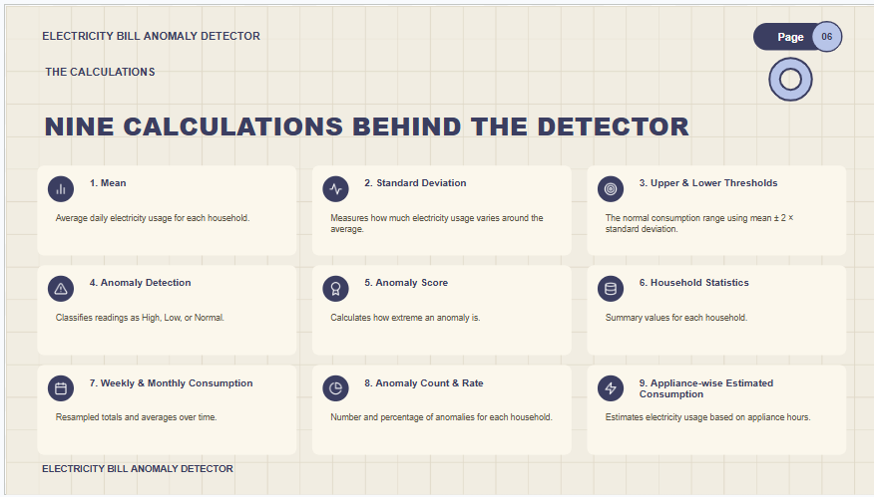

Slide 7






07
ELECTRICITY BILL ANOMALY DETECTOR
Page
ANALYSIS LAYER
WHAT THE ANALYSIS PRODUCES
Household stats
Weekly & monthly summaries
Household anomaly summary
mean, std, min, max, and total consumption per household
consumption resampled by week and by calendar month
anomaly count and anomaly rate (%) per household
Top anomalies
Date-range filtering
Single-household lookup
the most extreme readings, ranked by anomaly score
narrow any of the above to a chosen start/end date
isolate one household's full history by LCLid
ELECTRICITY BILL ANOMALY DETECTOR

Slide 8
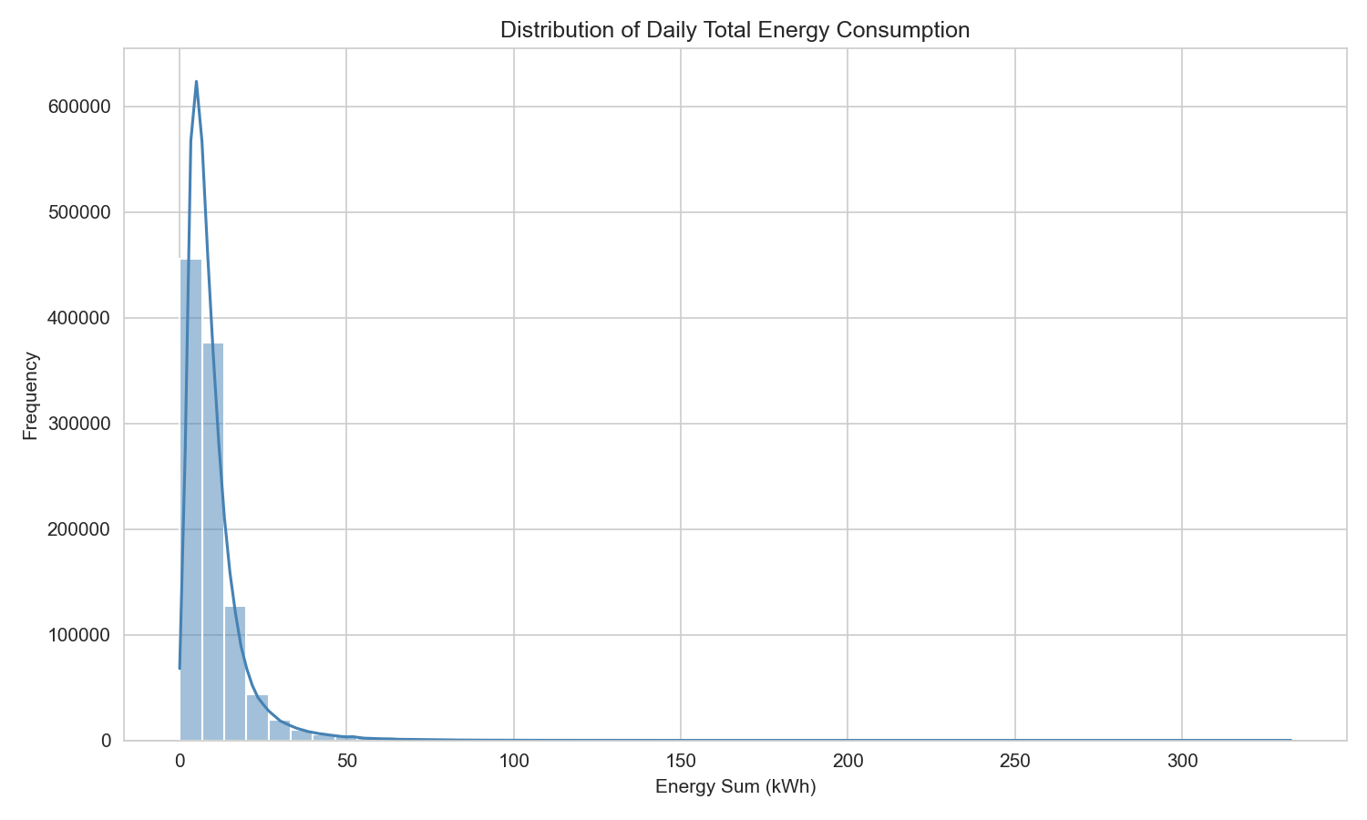
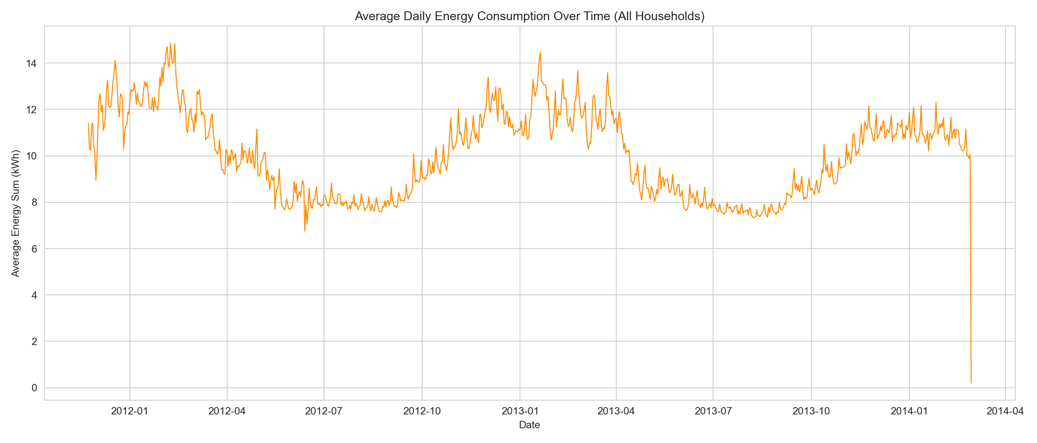
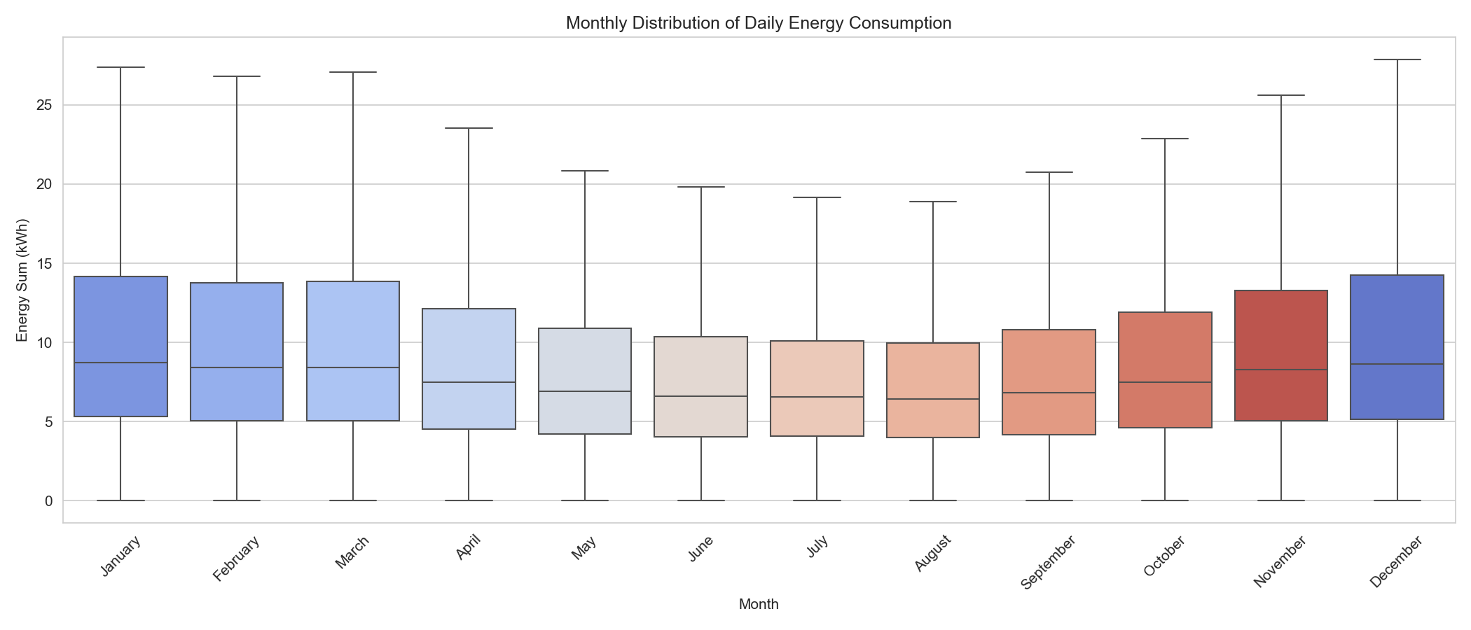
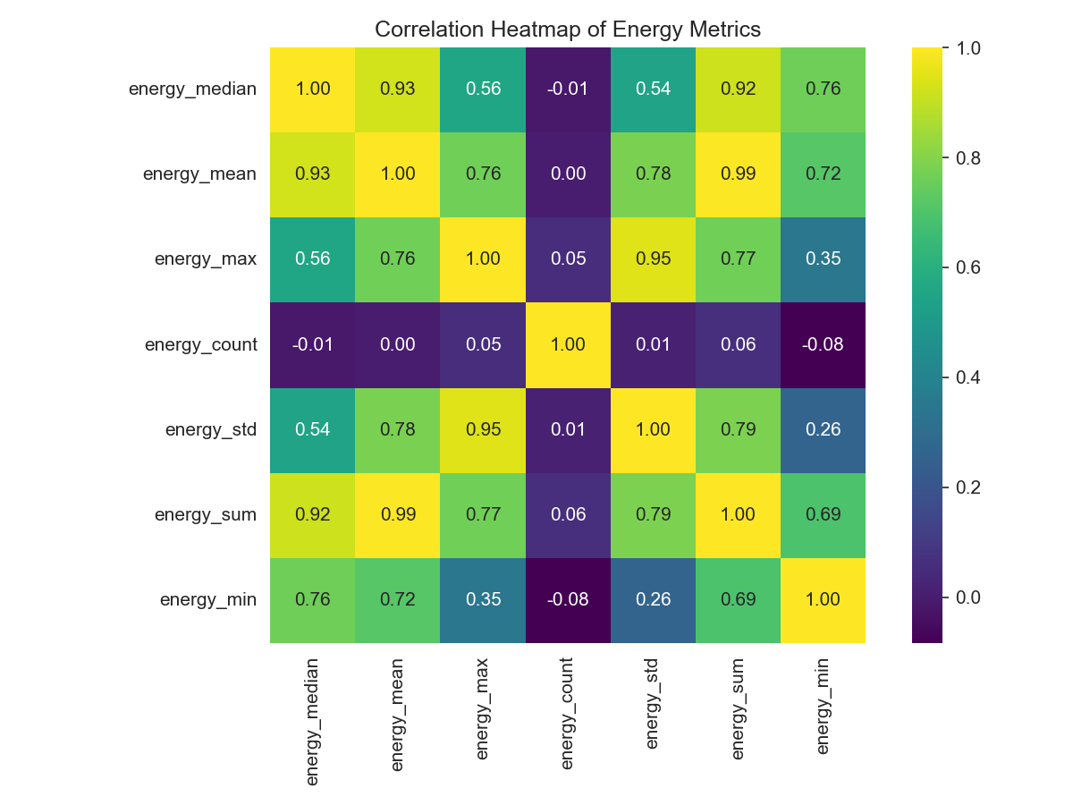
08
ELECTRICITY BILL ANOMALY DETECTOR
Page
VISUALIZATIONS
EIGHT WAYS TO LOOK AT THE DATA (1/2)
Energy Distribution
Daily Trend
Monthly Distribution
Correlation Heatmap
ELECTRICITY BILL ANOMALY DETECTOR

Slide 9
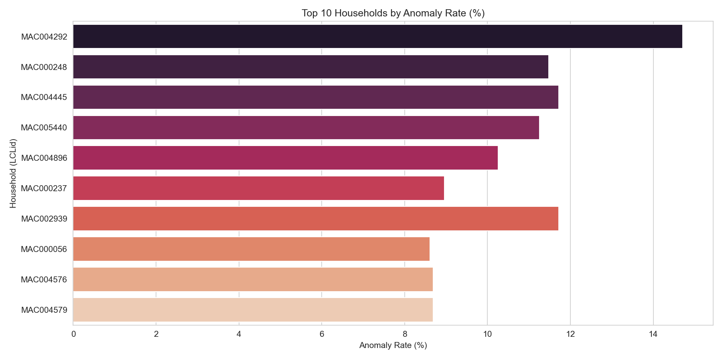
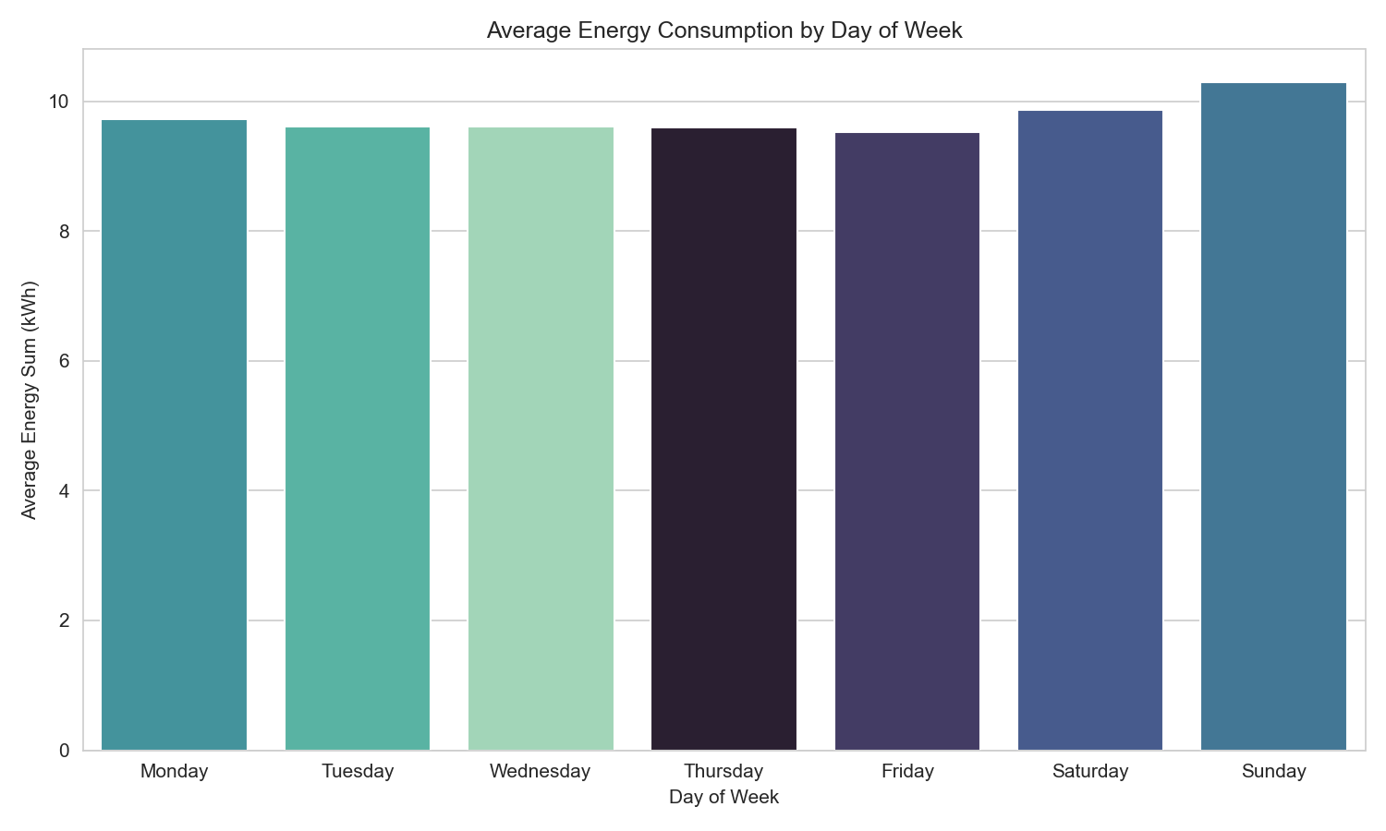
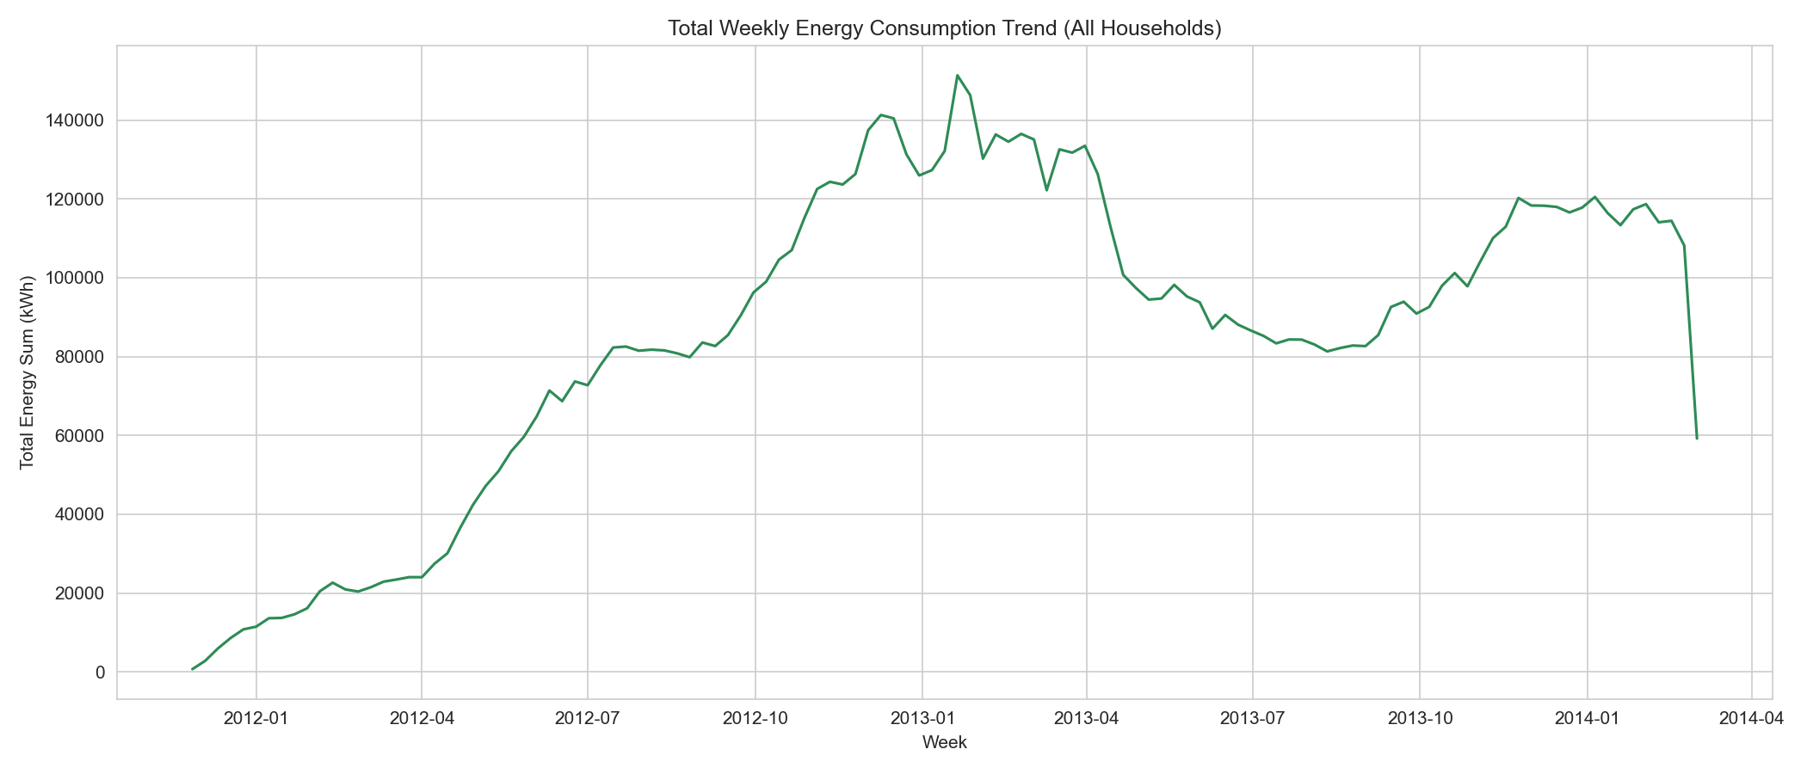
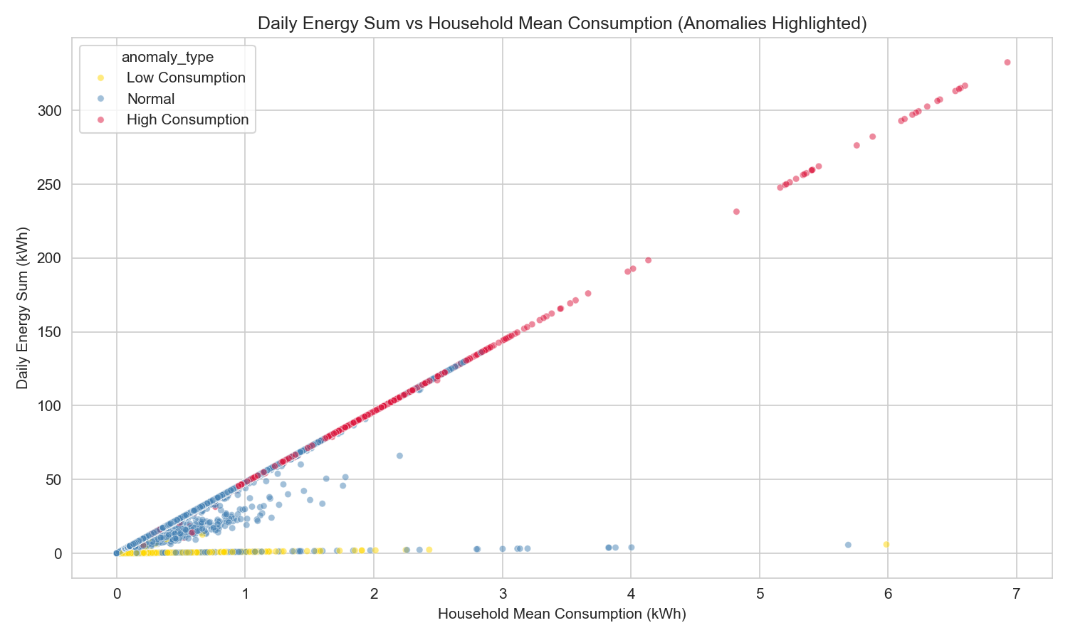
09
ELECTRICITY BILL ANOMALY DETECTOR
Page
VISUALIZATIONS
EIGHT WAYS TO LOOK AT THE DATA (2/2)
Top 10 Anomalous Households
Average by Day of Week
Weekly Trend
Anomaly Scatter Plot
ELECTRICITY BILL ANOMALY DETECTOR

Slide 10
10
ELECTRICITY BILL ANOMALY DETECTOR
Page
THE APPLICATION
A DESKTOP APP, NOT JUST A SCRIPT
Built with Tkinter (gui.py) on top of the analysis module.
1 Login
2 Dashboard
3 Meter Readings
Simple entry point into the app
Quick overview of household activity
Log a monthly reading, bill amount, and appliance usage
4 History
5 Household Analysis
6 Visualizations
Review every saved reading
Pick a household and date range, run the detector
All eight charts, embedded and interactive
ELECTRICITY BILL ANOMALY DETECTOR

Slide 11
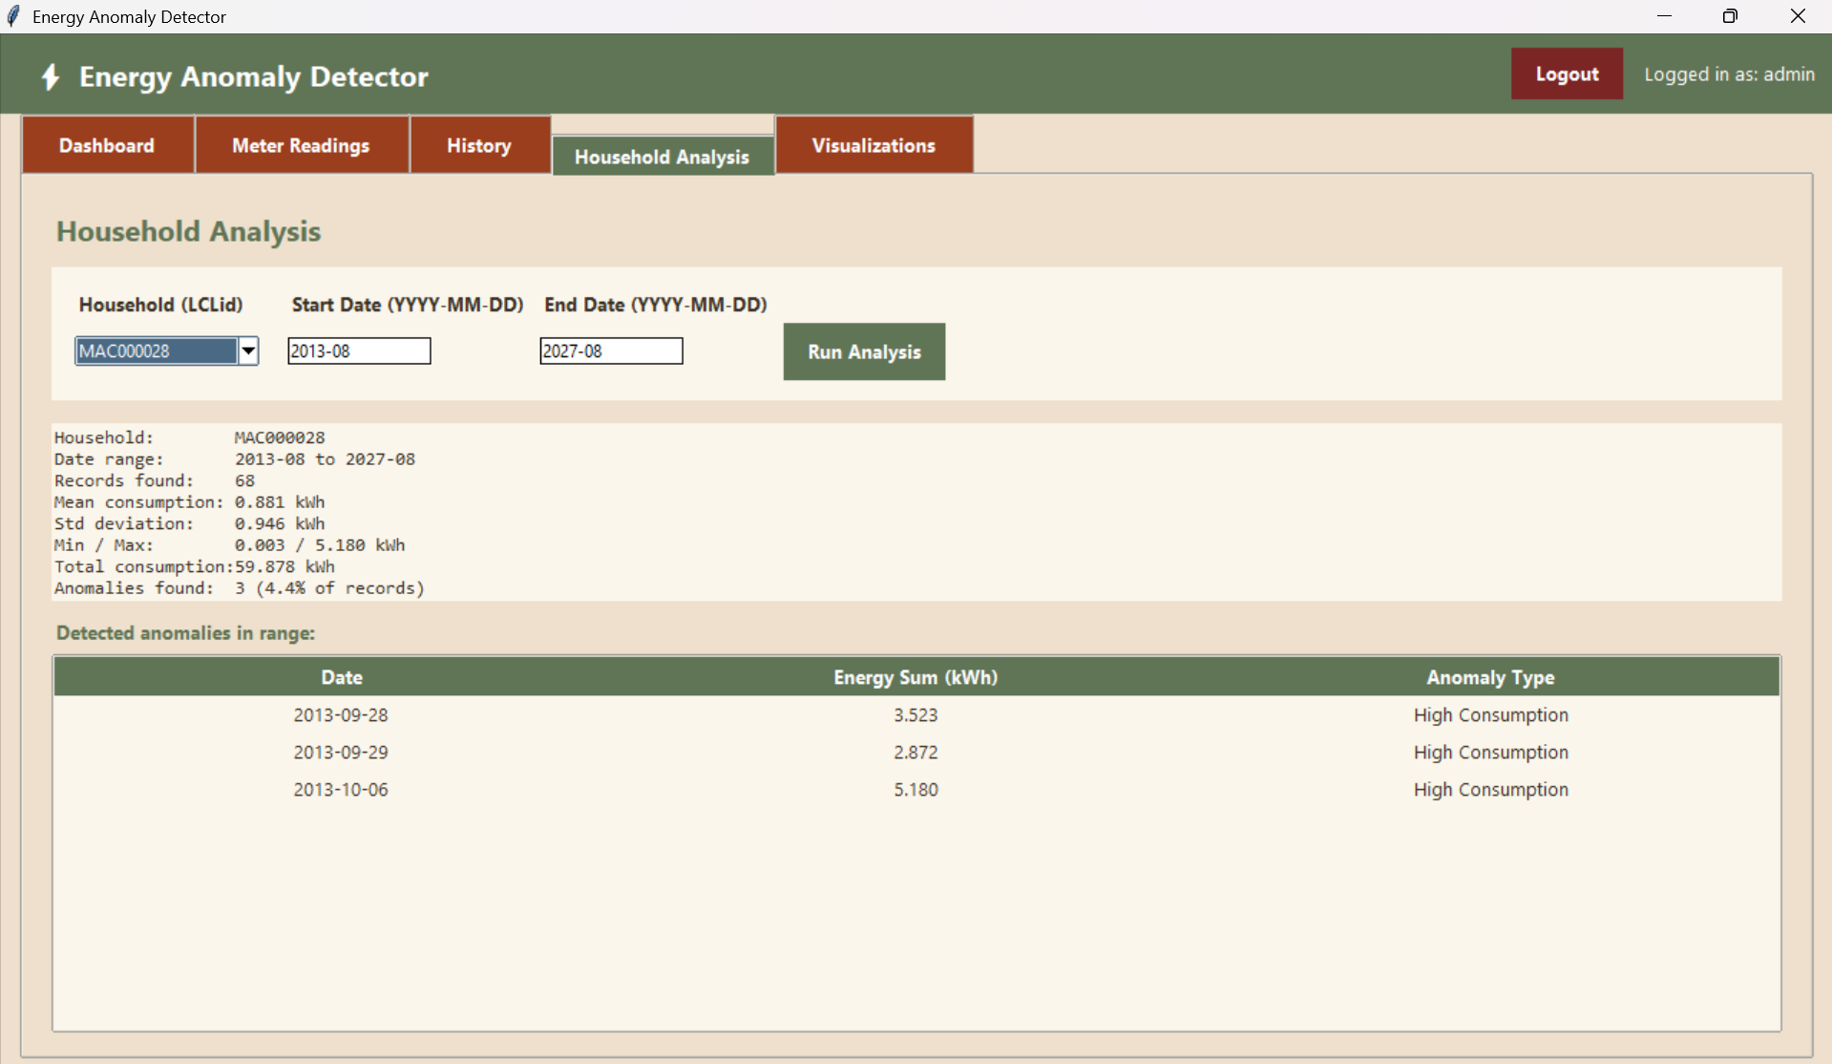
11
ELECTRICITY BILL ANOMALY DETECTOR
Page
THE APPLICATION
HOUSEHOLD ANALYSIS IN ACTION
ELECTRICITY BILL ANOMALY DETECTOR

Slide 12
12
ELECTRICITY BILL ANOMALY DETECTOR
Page
TAKEAWAYS
FROM RAW METER DATA TO A CLEAR SIGNAL
What this gives a household
Possible next steps
– A clean, deduplicated view of daily usage
– A statistical baseline unique to each household
– Automatic flags on unusually high or low days
– Charts and a simple app to explore it all
– Tune k per household instead of a fixed default
– Add seasonal / weather-adjusted baselines
– Send alerts when a new reading is anomalous
– Persist history to a proper database
Thank you
ELECTRICITY BILL ANOMALY DETECTOR

