Slide 1
Angular
Andrés Arcia Benavides

Slide 2
Our project
Let’s take a look…

Slide 3
What is Angular?
Angular is a development platform, built on TypeScript
A component-based framework
A collection of well-integrated libraries that cover a wide variety of features, including routing, forms management, client-server communication, and more
A suite of developer tools

Slide 4
Angular - Installation
Prerequisites:
Node.js (^18.19.1)
Visual Studio Code
Terminal
Install Angular CLI
npm install -g @angular/cli

Slide 5
Angular – Setup a project
Create a new project:
ng new <project-name>
Run the project:
npm start

Slide 6
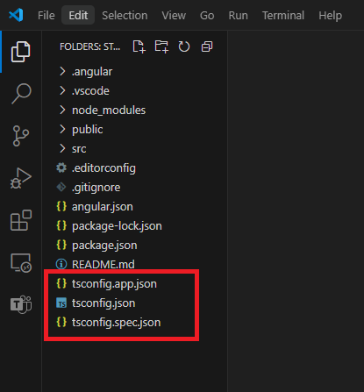
Angular – Project structure
TS configuration

Slide 7
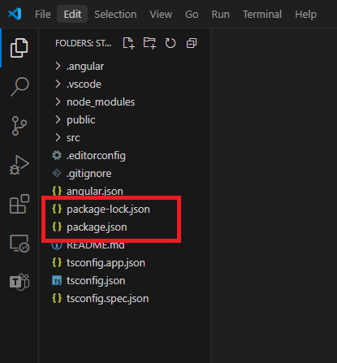
Angular – Project structure
NPM configuration

Slide 8
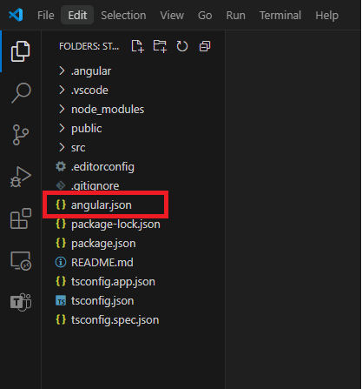
Angular – Project structure
Angular configuration
Angular CLI configuration

Slide 9
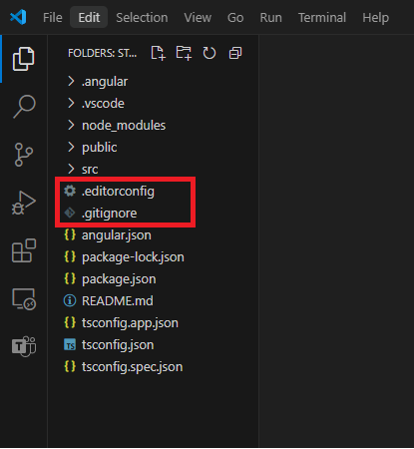
Angular – Project structure
Extra configurations
Git ignore settings
Editor custom configurations

Slide 10
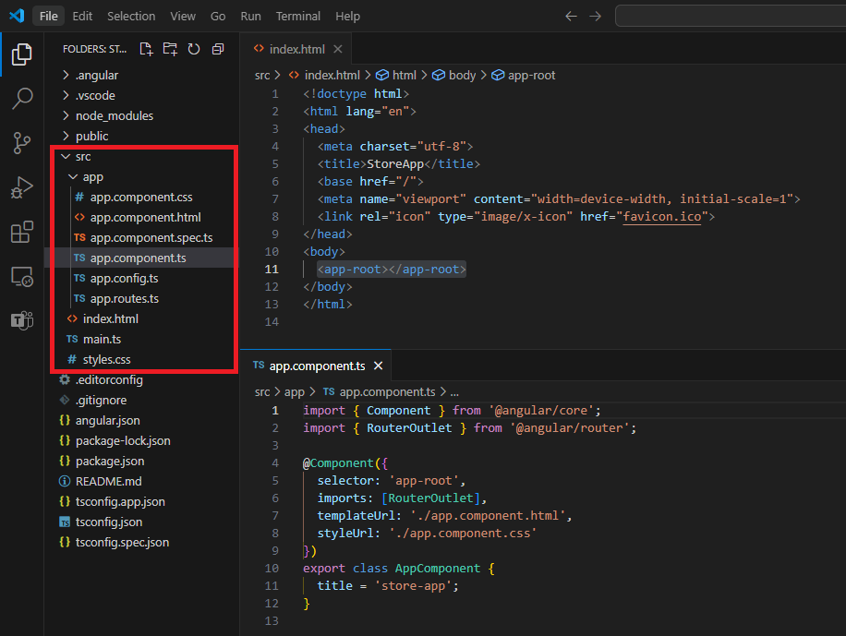
Angular – Project structure
“src” Folder

Slide 11
Wait!! – What is a decorator?
Decorators are a powerful syntactic feature in TS that allows you to add functionality or modify the behavior.
Decorators are essentially functions that applied using “@” symbols and they are called before the declaration you want to decorate.
Decorators for:
Class
Method
Accessor
Property
Parameter
Reference (https://www.typescriptlang.org/docs/handbook/decorators.html)

Slide 12
Angular - Components

Slide 13
Text Interpolation
By default, interpolation uses the double curly braces {{ and }} as delimiters.
Angular evaluates all expressions in double curly braces, converts the expression results to strings, and concatenates them with neighboring literal strings
e.g. <img alt="item" src="{{itemImageUrl}}">

Slide 14
Text Interpolation
By default, interpolation uses the double curly braces {{ and }} as delimiters.
Angular evaluates all expressions in double curly braces, converts the expression results to strings, and concatenates them with neighboring literal strings
e.g. <img alt="item" src="{{itemImageUrl}}">

Slide 15
Property Binding
Property binding moves a value in one direction, from a component's property into a target element property.
Enclose it in square brackets, [], which identifies the property as a target property
If you need to bind something other than a string to your directive/component property, you must use property binding
e.g. <img alt="item" [src]="itemImageUrl">

Slide 16
Sending data (@Input() / input())
“@Input()” is the legacy way to send data.
Child will use “@Input()” to decorate the property that will receive data.
e.g.
import { Component, Input } from '@angular/core’;
@Component({/*...*/})
export class ItemDetailComponent {
@Input() hero!: Hero;
@Input({required: true, transform: function(), alias: ' 'master'}) masterName = '';
}

Slide 17
Sending data (@Input() / input())
“input()” is the new way to send data.
Child will use “input()” to receive data.
e.g.
import {Component, input} from '@angular/core';
@Component({/*...*/})
export class CustomSlider {
hero = input(‘Batman’);
masterName = input.required<string>(‘’, { alias: ‘master’, transform function() });
}

Slide 18
Sending data back (@Output() / output())
“@Output()” is the legacy way to send data back.
e.g.
@Component({/*...*/})
export class ExpandablePanel {
@Output('valueChanged') panelClosed = new EventEmitter<string>();
}
this.panelClosed.emit(“Algo”);

Slide 19
Sending data back (@Output() / output())
“output()” is the new way to send data back.
The output function returns an OutputEmitterRef. You can emit an event by calling the emit method on the OutputEmitterRef.
Angular custom events do not bubble up the DOM.
e.g.
@Component({/*...*/})
export class ExpandablePanel {
panelClosed = output<string>({alias: 'valueChanged'});
}
this.panelClosed.emit(“Algo”);

Slide 20
Event Binding (1)
Event binding lets you listen for and respond to user actions such as keystrokes, mouse movements, clicks, and touches.
Syntax consists of a target event name within parentheses to the left of an equal sign, and a quoted template statement to the right.
e.g. <button (click)="onSave()">Save</button>

Slide 21
Event Binding (2)
A common way to handle events is to pass the event object, $event, to the method handling the event.
The target event determines the shape of the $event object.
Reference (https://developer.mozilla.org/en-US/docs/Web/API/Element#events )
e.g.
<input [value]="currentItem.name" (input)="currentItem.name=getValue($event)">
getValue(event: Event): string {
return (event.target as HTMLInputElement).value;
}

Slide 22
Component Lifecycle
A component's lifecycle is the sequence of steps that happen between the component's creation and its destruction.
The lifecycle starts when a component is instantiated, continues with change detection, and ends when the component template is removed from the DOM.
Angular gives us lifecycle hook methods to take advantage of events in the lifecycle.
Reference (https://developer.mozilla.org/en-US/docs/Web/API/Element#events )

Slide 23
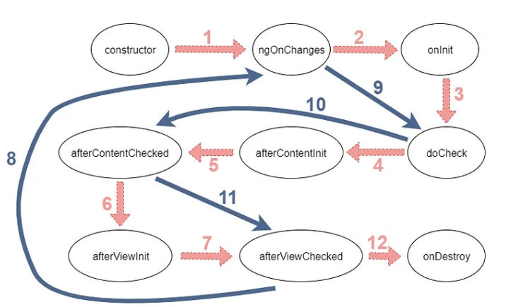
Component Lifecycle (Creation)
“Contructor”
Runs when Angular instantiates the component.
Method of a class for creating and initializing an object instance of that class.

Slide 24
Component Lifecycle (Detection)
“ngOnChanges”
Called before ngOnInit, only if you have an input value. If you don't have an input value, this method won't run.
When the input value resets or updates, this method will be triggered.
Making an HTTP request or something heavy here might affect your application’s performance.

Slide 25
Component Lifecycle (Change)
“ngOnInit”
Runs once after Angular has initialized all the component's inputs.
This method is called only once during the component lifecycle and is the most used hook in Angular.
It is called after the ngOnChanges method. Even if ngOnChanges is not called, it will still be called.
We can use ngOnInit for initialization tasks. This is a good place for fetching data from a server, and it’s a best practice.

Slide 26
Component Lifecycle (Detection)
“ngDoCheck”
this method is called almost every change detection, so you shouldn’t do heavy things here. It will be bad for your website’s performance.

Slide 27
Component Lifecycle (Detection)
“ngAfterContentInit”
This hook is called only once after the first ngDoCheck
Runs once after the component's content has been initialized
Catch this content with the ng-content tag in the child component

Slide 28
Component Lifecycle (Detection)
“ngAfterContentChecked”
Runs every time this component content has been checked for changes.
This hook will be called after ngAfterContentInit and after every ngDoCheck.
You may use this hook to react to changes in the projected content.
You shouldn’t do heavy things here because ngDoCheck triggers this hook

Slide 29
Component Lifecycle (Detection)
“ngAfterViewInit”
This hook is called only once after the first ngAfterContentChecked. With this hook, we understand that the component and child views are initialized.
This is the first time that we can access the ElementRef of the ViewChildren.

Slide 30
Component Lifecycle (Detection)
“ngAfterViewChecked”
This hook will be called after ngAfterViewInit and after every ngAfterContentChecked.
This is called after angular checked component views and its child views.
The triggering chain is like this; ngDoCheck → ngAfterContentChecked → ngAfterViewChecked so like others, this hook will be called almost every change detection. You shouldn’t make heavy operations in this method.

Slide 31
Component Lifecycle (Destruction)
“ngOnDestroy”
Runs once before the component is destroyed.

Slide 32
@if..@else-if…@else
Helps to control de flow in the UI
e.g.
@if (cartSubmitted()) {
<h2>You completed is submitted!</h2>
} @else-if (cartEmpty()) {
<h2No items in your cart</h2>
} @else {
<h2>{{getTotalItems()}} items in your cart</h2>
}

Slide 33
Directiva “ngIf”
Helps to control de flow in the UI similar to “@if”
e.g.
<div class="row“ *ngIf="cartItems().length > 0”>
<div class="col-7">
<app-cart-item-list [cartItems]="cartItems()"/>
</div>
</div>

Slide 34
@for
Helps to control de flow in the UI for loops
Track expression allows to maintain a relationship between your data and the DOM nodes on the page. Optimize performance by executing the minimum necessary DOM operations when the data changes
e.g.
@for (item of items(); track item.id) {
<li>
<app-cart-item-preview [item]=“item"/>
</li>
}

Slide 35
@for contextual variables
Variables that can help for some use cases:
$count: Number of items in a collection iterated over
$index: Index of the current row
$first: Whether the current row is the first row
$last: Whether the current row is the last row
$even: Whether the current row index is even
$odd: Whether the current row index is odd

Slide 36
@for contextual variables
e.g.
@for (item of items(); track item.id; let x = $index, e = $even, f = $first, l = $last) {
<li>
<app-cart-item-preview [item]=“item"/>
</li>
}

Slide 37
@for fallback
e.g.
@for (item of items(); track item.id) {
<li>
<app-cart-item-preview [item]=“item"/>
</li>
} @empty {
<li>No items.</li>
}

Slide 38
Directiva “ngFor”
e.g.
<div *ngFor="let item of items">{{ item.name }}</div>
e.g.
<div *ngFor="let item of items; let i=index; trackBy: item.id ">{{ item.name }} – index {{i}}</div>

Slide 39
@switch
The value of the conditional expression is compared to the case expression using the triple-equals (===) operator
e.g.
@switch (userPermissions) {
@case ('admin') {
<app-admin-dashboard />
} @case ('reviewer') {
<app-reviewer-dashboard />
} @default {
<app-viewer-dashboard />
}
}

Slide 40
Directiva “ngSwitch”
e.g.
<div [ngSwitch]=“item.color">
<app-item *ngSwitchCase=“’red'" [item]="item"></app-item>
<app-item *ngSwitchCase=“’white'" [item]="item"></app-item>
<app-item *ngSwitchCase=“’black'" [item]="item"></app-item>
<app-unknown *ngSwitchDefault [item]=“item"></app-unknown>
</div>

Slide 41
Pipes
Expressions that allows you to transform data declaratively in your template.
Pipes let you declare a transformation function once and then use that transformation across multiple templates.
Angular pipes use the vertical bar character (|), inspired by the Unix pipe.
e.g.
{{ this.orderItem().total | currency }}</p>

Slide 42
Custom Pipes
You can create custom pipes manually or with CLI.
With CLI you can generate it using command “ng generate pipe pipe-name”
e.g.
import { Pipe, PipeTransform } from '@angular/core';
@Pipe({
name: ‘firstLetterCase'
})
export class FirstLetterCasePipe implements PipeTransform {
transform(value: string, args: ‘UPPER’|’LOWER’): string {
const i = value.charAt(0);
const iTrasnformed = case === ‘UPPER’ ? i.toUpperCase() : i.toLowerCase();
return iTrasnformed + value.slice(1);
}
}

