Slide 1
Angular
Andrés Arcia Benavides

Slide 2
Our project
Let’s take a look…

Slide 3
What is Angular?
Angular is a development platform, built on TypeScript
A component-based framework
A collection of well-integrated libraries that cover a wide variety of features, including routing, forms management, client-server communication, and more
A suite of developer tools

Slide 4
Angular - Installation
Prerequisites:
Node.js (^18.19.1)
Visual Studio Code
Terminal
Install Angular CLI
npm install -g @angular/cli

Slide 5
Angular – Setup a project
Create a new project:
ng new <project-name>
Run the project:
npm start

Slide 6
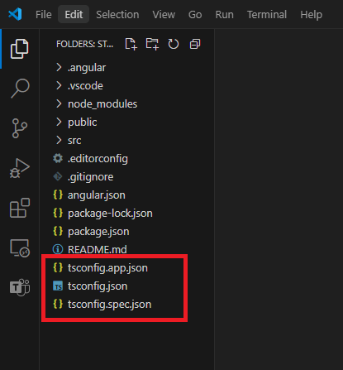
Angular – Project structure
TS configuration

Slide 7
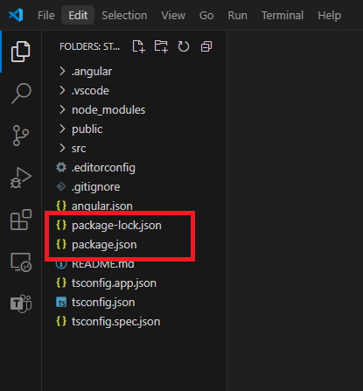
Angular – Project structure
NPM configuration

Slide 8
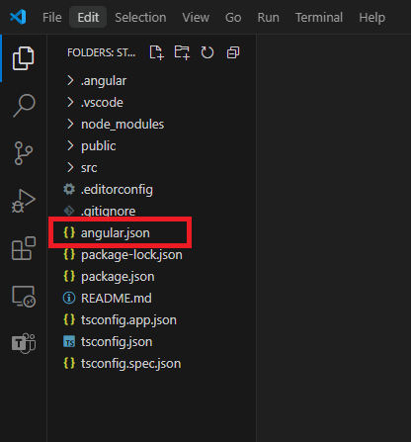
Angular – Project structure
Angular configuration
Angular CLI configuration

Slide 9
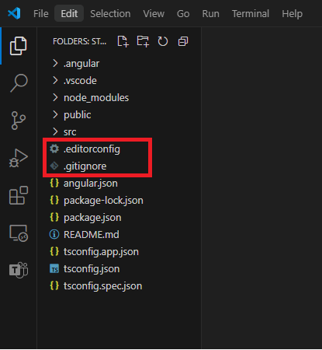
Angular – Project structure
Extra configurations
Git ignore settings
Editor custom configurations

Slide 10
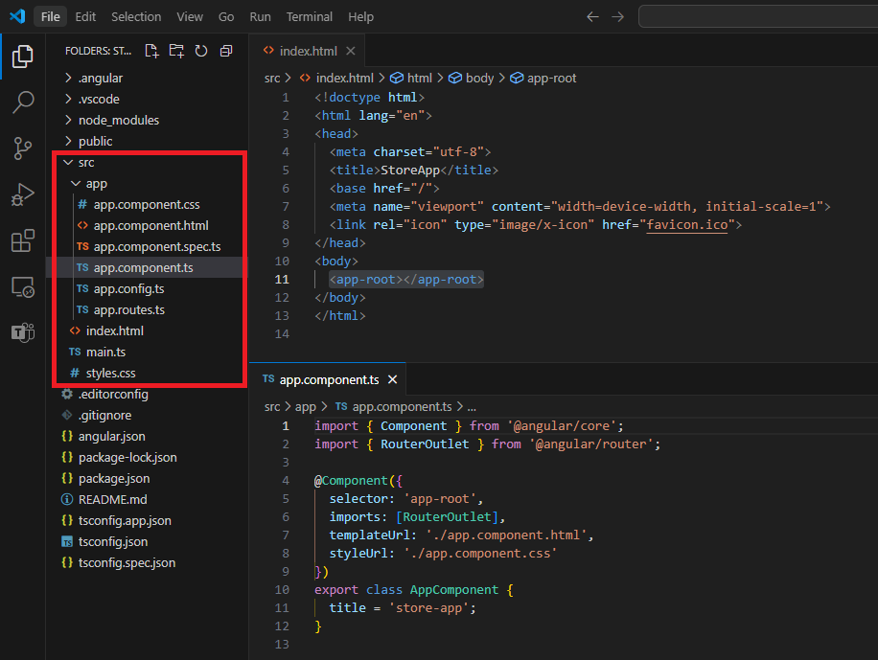
Angular – Project structure
“src” Folder

Slide 11
Wait!! – What is a decorator?
Decorators are a powerful syntactic feature in TS that allows you to add functionality or modify the behavior.
Decorators are essentially functions that applied using “@” symbols and they are called before the declaration you want to decorate.
Decorators for:
Class
Method
Accessor
Property
Parameter
Reference (https://www.typescriptlang.org/docs/handbook/decorators.html)

Slide 12
Angular - Components

Slide 13
Text Interpolation
By default, interpolation uses the double curly braces {{ and }} as delimiters.
Angular evaluates all expressions in double curly braces, converts the expression results to strings, and concatenates them with neighboring literal strings
e.g. <img alt="item" src="{{itemImageUrl}}">

Slide 14
Text Interpolation
By default, interpolation uses the double curly braces {{ and }} as delimiters.
Angular evaluates all expressions in double curly braces, converts the expression results to strings, and concatenates them with neighboring literal strings
e.g. <img alt="item" src="{{itemImageUrl}}">

Slide 15
Property Binding
Property binding moves a value in one direction, from a component's property into a target element property.
Enclose it in square brackets, [], which identifies the property as a target property
If you need to bind something other than a string to your directive/component property, you must use property binding
e.g. <img alt="item" [src]="itemImageUrl">

Slide 16
Sending data (@Input() / input())
“@Input()” is the legacy way to send data.
Child will use “@Input()” to decorate the property that will receive data.
e.g.
import { Component, Input } from '@angular/core’;
@Component({/*...*/})
export class ItemDetailComponent {
@Input() hero!: Hero;
@Input({required: true, transform: function(), alias: ' 'master'}) masterName = '';
}

Slide 17
Sending data (@Input() / input())
“input()” is the new way to send data.
Child will use “input()” to receive data.
e.g.
import {Component, input} from '@angular/core';
@Component({/*...*/})
export class CustomSlider {
hero = input(‘Batman’);
masterName = input.required<string>(‘’, { alias: ‘master’, transform function() });
}

Slide 18
Sending data back (@Output() / output())
“@Output()” is the legacy way to send data back.
e.g.
@Component({/*...*/})
export class ExpandablePanel {
@Output('valueChanged') panelClosed = new EventEmitter<string>();
}
this.panelClosed.emit(“Algo”);

Slide 19
Sending data back (@Output() / output())
“output()” is the new way to send data back.
The output function returns an OutputEmitterRef. You can emit an event by calling the emit method on the OutputEmitterRef.
Angular custom events do not bubble up the DOM.
e.g.
@Component({/*...*/})
export class ExpandablePanel {
panelClosed = output<string>({alias: 'valueChanged'});
}
this.panelClosed.emit(“Algo”);

Slide 20
Event Binding (1)
Event binding lets you listen for and respond to user actions such as keystrokes, mouse movements, clicks, and touches.
Syntax consists of a target event name within parentheses to the left of an equal sign, and a quoted template statement to the right.
e.g. <button (click)="onSave()">Save</button>

Slide 21
Event Binding (2)
A common way to handle events is to pass the event object, $event, to the method handling the event.
The target event determines the shape of the $event object.
Reference (https://developer.mozilla.org/en-US/docs/Web/API/Element#events )
e.g.
<input [value]="currentItem.name" (input)="currentItem.name=getValue($event)">
getValue(event: Event): string {
return (event.target as HTMLInputElement).value;
}

Slide 22
Component Lifecycle
A component's lifecycle is the sequence of steps that happen between the component's creation and its destruction.
Each step represents a different part of Angular's process for rendering components and checking them for updates over time.
A component's lifecycle is tightly connected to how Angular checks your components for changes over time.
Reference (https://developer.mozilla.org/en-US/docs/Web/API/Element#events )

Slide 23
Component Lifecycle (Creation)
“Contructor”
Runs when Angular instantiates the component.
Method of a class for creating and initializing an object instance of that class.

Slide 24
Component Lifecycle (Change)
“ngOnInit”
Runs once after Angular has initialized all the component's inputs.

Slide 25
Component Lifecycle (Detection)
“ngOnChanges”
Runs every time the component's inputs have changed.
“ngDoCheck”
Runs every time this component is checked for changes.
“ngAfterContentInit”
Runs once after the component's content has been initialized.

Slide 26
Component Lifecycle (Detection)
“ngAfterContentChecked”
Runs every time this component content has been checked for changes.
“ngAfterViewInit”
Runs once after the component's view has been initialized.
“ngAfterViewChecked”
Runs every time the component's view has been checked for changes.

Slide 27
Component Lifecycle (Rendering)
“afterNextRender”
Runs once the next time that all components have been rendered to the DOM.
“afterRender”
Runs every time all components have been rendered to the DOM.

Slide 28
Component Lifecycle (Destruction)
“ngOnDestroy”
Runs once before the component is destroyed.

Slide 29
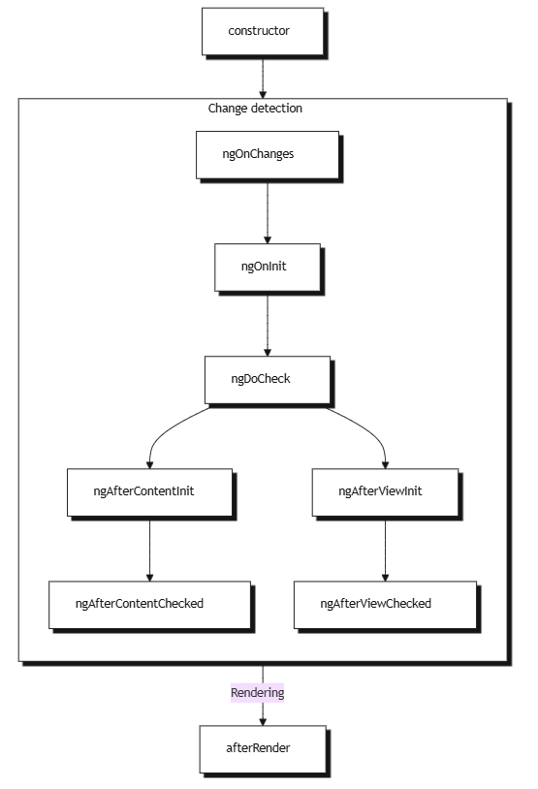
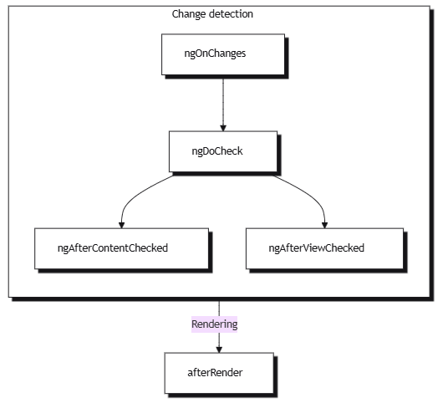
Component Lifecycle

