Slide 1
Angular
Andrés Arcia Benavides

Slide 2
Our project
Let’s take a look…

Slide 3
What is Angular?
Angular is a development platform, built on TypeScript
A component-based framework
A collection of well-integrated libraries that cover a wide variety of features, including routing, forms management, client-server communication, and more
A suite of developer tools

Slide 4
Angular - Installation
Prerequisites:
Node.js (^18.19.1)
Visual Studio Code
Terminal
Install Angular CLI
npm install -g @angular/cli

Slide 5
Angular – Setup a project
Create a new project:
ng new <project-name>
Run the project:
npm start

Slide 6
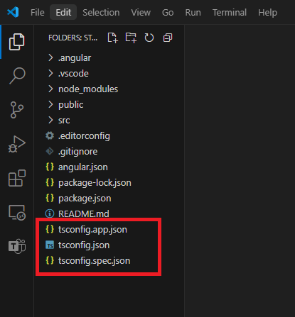
Angular – Project structure
TS configuration

Slide 7
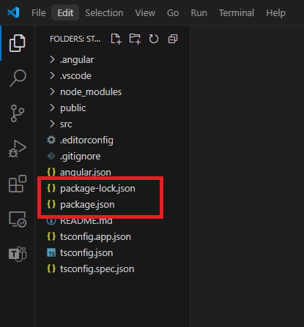
Angular – Project structure
NPM configuration

Slide 8
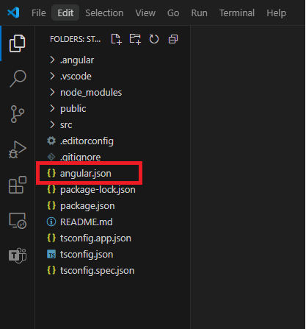
Angular – Project structure
Angular configuration
Angular CLI configuration

Slide 9
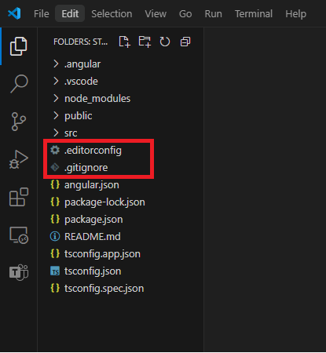
Angular – Project structure
Extra configurations
Git ignore settings
Editor custom configurations

Slide 10
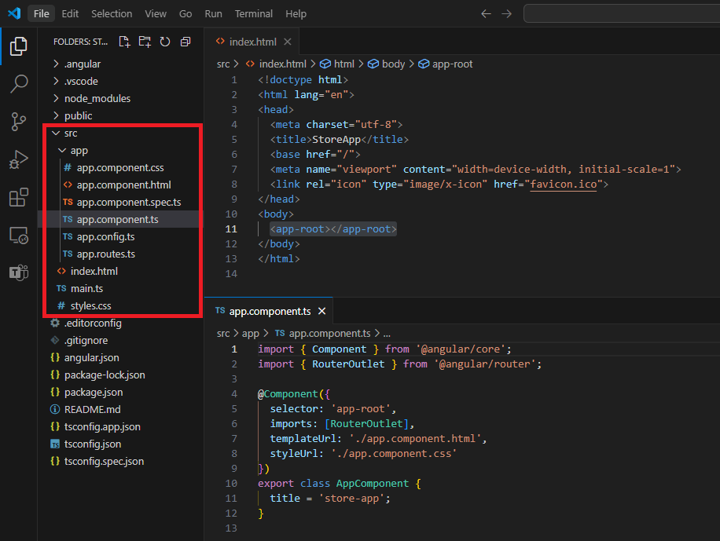
Angular – Project structure
“src” Folder

Slide 11
Wait!! – What is a decorator?
Decorators are a powerful syntactic feature in TS that allows you to add functionality or modify the behavior.
Decorators are essentially functions that applied using “@” symbols and they are called before the declaration you want to decorate.
Decorators for:
Class
Method
Accessor
Property
Parameter
Reference (https://www.typescriptlang.org/docs/handbook/decorators.html)

Slide 12
Angular - Components

Slide 13
Text Interpolation
By default, interpolation uses the double curly braces {{ and }} as delimiters.
Angular evaluates all expressions in double curly braces, converts the expression results to strings, and concatenates them with neighboring literal strings
e.g. <img alt="item" src="{{itemImageUrl}}">

Slide 14
Text Interpolation
By default, interpolation uses the double curly braces {{ and }} as delimiters.
Angular evaluates all expressions in double curly braces, converts the expression results to strings, and concatenates them with neighboring literal strings
e.g. <img alt="item" src="{{itemImageUrl}}">

Slide 15
Property Binding
Property binding moves a value in one direction, from a component's property into a target element property.
Enclose it in square brackets, [], which identifies the property as a target property
If you need to bind something other than a string to your directive/component property, you must use property binding
e.g. <img alt="item" [src]="itemImageUrl">

Slide 16
Sending data (@Input() / input())
“@Input()” is the legacy way to send data.
Child will use “@Input()” to decorate the property that will receive data.
e.g.
import { Component, Input } from '@angular/core’;
@Component({/*...*/})
export class ItemDetailComponent {
@Input() hero!: Hero;
@Input({required: true, transform: function(), alias: ' 'master'}) masterName = '';
}

Slide 17
Sending data (@Input() / input())
“input()” is the new way to send data.
Child will use “input()” to receive data.
e.g.
import {Component, input} from '@angular/core';
@Component({/*...*/})
export class CustomSlider {
hero = input(‘Batman’);
masterName = input.required<string>(‘’, { alias: ‘master’, transform function() });
}

Slide 18
Sending data back (@Output() / output())
“@Output()” is the legacy way to send data back.
e.g.
@Component({/*...*/})
export class ExpandablePanel {
@Output('valueChanged') panelClosed = new EventEmitter<string>();
}
this.panelClosed.emit(“Algo”);

Slide 19
Sending data back (@Output() / output())
“output()” is the new way to send data back.
The output function returns an OutputEmitterRef. You can emit an event by calling the emit method on the OutputEmitterRef.
Angular custom events do not bubble up the DOM.
e.g.
@Component({/*...*/})
export class ExpandablePanel {
panelClosed = output<string>({alias: 'valueChanged'});
}
this.panelClosed.emit(“Algo”);

Slide 20
Event Binding (1)
Event binding lets you listen for and respond to user actions such as keystrokes, mouse movements, clicks, and touches.
Syntax consists of a target event name within parentheses to the left of an equal sign, and a quoted template statement to the right.
e.g. <button (click)="onSave()">Save</button>

Slide 21
Event Binding (2)
A common way to handle events is to pass the event object, $event, to the method handling the event.
The target event determines the shape of the $event object.
Reference (https://developer.mozilla.org/en-US/docs/Web/API/Element#events )
e.g.
<input [value]="currentItem.name" (input)="currentItem.name=getValue($event)">
getValue(event: Event): string {
return (event.target as HTMLInputElement).value;
}

Slide 22
Component Lifecycle
A component's lifecycle is the sequence of steps that happen between the component's creation and its destruction.
The lifecycle starts when a component is instantiated, continues with change detection, and ends when the component template is removed from the DOM.
Angular gives us lifecycle hook methods to take advantage of events in the lifecycle.
Reference (https://developer.mozilla.org/en-US/docs/Web/API/Element#events )

Slide 23
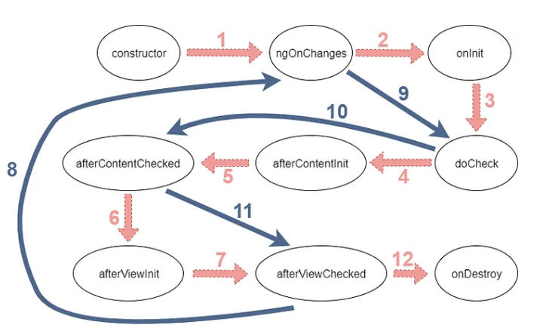
Component Lifecycle (Creation)
“Contructor”
Runs when Angular instantiates the component.
Method of a class for creating and initializing an object instance of that class.

Slide 24
Component Lifecycle (Detection)
“ngOnChanges”
Called before ngOnInit, only if you have an input value. If you don't have an input value, this method won't run.
When the input value resets or updates, this method will be triggered.
Making an HTTP request or something heavy here might affect your application’s performance.

Slide 25
Component Lifecycle (Change)
“ngOnInit”
Runs once after Angular has initialized all the component's inputs.
This method is called only once during the component lifecycle and is the most used hook in Angular.
It is called after the ngOnChanges method. Even if ngOnChanges is not called, it will still be called.
We can use ngOnInit for initialization tasks. This is a good place for fetching data from a server, and it’s a best practice.

Slide 26
Component Lifecycle (Detection)
“ngDoCheck”
this method is called almost every change detection, so you shouldn’t do heavy things here. It will be bad for your website’s performance.

Slide 27
Component Lifecycle (Detection)
“ngAfterContentInit”
This hook is called only once after the first ngDoCheck
Runs once after the component's content has been initialized
Catch this content with the ng-content tag in the child component

Slide 28
Component Lifecycle (Detection)
“ngAfterContentChecked”
Runs every time this component content has been checked for changes.
This hook will be called after ngAfterContentInit and after every ngDoCheck.
You may use this hook to react to changes in the projected content.
You shouldn’t do heavy things here because ngDoCheck triggers this hook

Slide 29
Component Lifecycle (Detection)
“ngAfterViewInit”
This hook is called only once after the first ngAfterContentChecked. With this hook, we understand that the component and child views are initialized.
This is the first time that we can access the ElementRef of the ViewChildren.

Slide 30
Component Lifecycle (Detection)
“ngAfterViewChecked”
This hook will be called after ngAfterViewInit and after every ngAfterContentChecked.
This is called after angular checked component views and its child views.
The triggering chain is like this; ngDoCheck → ngAfterContentChecked → ngAfterViewChecked so like others, this hook will be called almost every change detection. You shouldn’t make heavy operations in this method.

Slide 31
Component Lifecycle (Destruction)
“ngOnDestroy”
Runs once before the component is destroyed.

Slide 32
@if..@else-if…@else
Helps to control de flow in the UI
e.g.
@if (cartSubmitted()) {
<h2>You completed is submitted!</h2>
} @else-if (cartEmpty()) {
<h2No items in your cart</h2>
} @else {
<h2>{{getTotalItems()}} items in your cart</h2>
}

Slide 33
Directiva “ngIf”
Helps to control de flow in the UI similar to “@if”
e.g.
<div class="row“ *ngIf="cartItems().length > 0”>
<div class="col-7">
<app-cart-item-list [cartItems]="cartItems()"/>
</div>
</div>

Slide 34
@for
Helps to control de flow in the UI for loops
Track expression allows to maintain a relationship between your data and the DOM nodes on the page. Optimize performance by executing the minimum necessary DOM operations when the data changes
e.g.
@for (item of items(); track item.id) {
<li>
<app-cart-item-preview [item]=“item"/>
</li>
}

Slide 35
@for contextual variables
Variables that can help for some use cases:
$count: Number of items in a collection iterated over
$index: Index of the current row
$first: Whether the current row is the first row
$last: Whether the current row is the last row
$even: Whether the current row index is even
$odd: Whether the current row index is odd

Slide 36
@for contextual variables
e.g.
@for (item of items(); track item.id; let x = $index, e = $even, f = $first, l = $last) {
<li>
<app-cart-item-preview [item]=“item"/>
</li>
}

Slide 37
@for fallback
e.g.
@for (item of items(); track item.id) {
<li>
<app-cart-item-preview [item]=“item"/>
</li>
} @empty {
<li>No items.</li>
}

Slide 38
Directiva “ngFor”
e.g.
<div *ngFor="let item of items">{{ item.name }}</div>
e.g.
<div *ngFor="let item of items; let i=index; trackBy: item.id ">{{ item.name }} – index {{i}}</div>

Slide 39
@switch
The value of the conditional expression is compared to the case expression using the triple-equals (===) operator
e.g.
@switch (userPermissions) {
@case ('admin') {
<app-admin-dashboard />
} @case ('reviewer') {
<app-reviewer-dashboard />
} @default {
<app-viewer-dashboard />
}
}

Slide 40
Directiva “ngSwitch”
e.g.
<div [ngSwitch]=“item.color">
<app-item *ngSwitchCase=“’red'" [item]="item"></app-item>
<app-item *ngSwitchCase=“’white'" [item]="item"></app-item>
<app-item *ngSwitchCase=“’black'" [item]="item"></app-item>
<app-unknown *ngSwitchDefault [item]=“item"></app-unknown>
</div>

Slide 41
Pipes
Expressions that allows you to transform data declaratively in your template.
Pipes let you declare a transformation function once and then use that transformation across multiple templates.
Angular pipes use the vertical bar character (|), inspired by the Unix pipe.
e.g.
{{ this.orderItem().total | currency }}</p>

Slide 42
Custom Pipes
You can create custom pipes manually or with CLI.
With CLI you can generate it using command “ng generate pipe pipe-name”
e.g.
import { Pipe, PipeTransform } from '@angular/core';
@Pipe({
name: ‘firstLetterCase'
})
export class FirstLetterCasePipe implements PipeTransform {
transform(value: string, args: ‘UPPER’|’LOWER’): string {
const i = value.charAt(0);
const iTrasnformed = case === ‘UPPER’ ? i.toUpperCase() : i.toLowerCase();
return iTrasnformed + value.slice(1);
}
}

Slide 43
NgRX
State management library.
Inspired by REDUX (popular state management library)
Follows “UNI Directional Data Flow” principle
Provides the building blocks to manage the state of the application in a predictable and scalable manner
Building blocks:
Actions
Reducers
Effects
Selectors

Slide 44
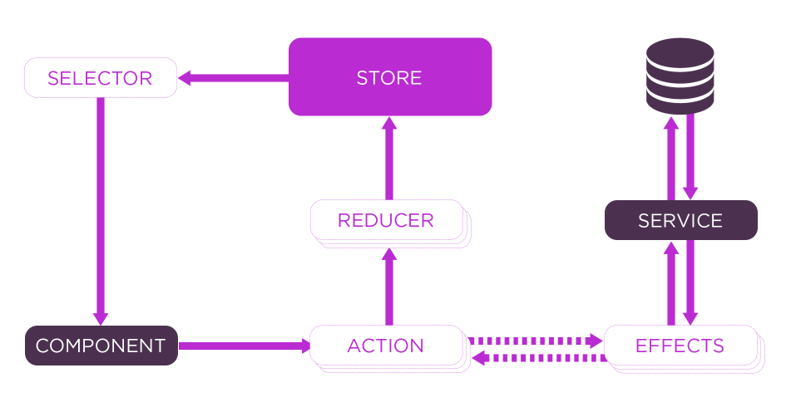
NgRX

Slide 45
NgRX - Store
Application State is saved in “Store”
Create a “uni-directional data flow” cycle from store to the component
Store is mainly for managing global state across an entire application

Slide 46
NgRX - Selectors
Selectors are pure functions used for obtaining slices of store state
To select a piece of state based on data you can pass props to the selector function
Keep in mind that a selector only keeps the previous input arguments in its cache
Selectors empower you to compose a read model for your application state (Command Query Responsibility Segregation (CQRS)) Reference
NgRx separates the read model (selectors) from the write model (reducers)

Slide 47
NgRX - Actions
Actions describe unique events that are dispatched from components and services
Actions help you to understand how events are handled in your application
An Action in NgRx is made up of a simple interface interface Action { type: string; }

Slide 48
NgRX - Reducers
Reducers in NgRx are responsible for handling transitions from one state to the next state in your application
Reducer functions handle these transitions by determining which actions to handle based on the action's type
Reducers handle each state transition synchronously
Each reducer function takes the latest Action dispatched, the current state, and determines whether to return a newly modified state or the original state

Slide 49
NgRX - Effects
Effects use streams to provide new sources of actions to reduce state based on external interactions
Effects provide a way to interact with services and isolate them from the components
Effects isolate side effects from components, allowing for more pure components that select state and dispatch actions.
Effects are long-running services that listen to an observable of every action dispatched from the Store.
Effects filter those actions based on the type of action they are interested in.
Effects perform tasks, which are synchronous or asynchronous and return a new action.

Slide 50
NgRX – A dummy example!
Requirement:
Component request data
Component shows a spinner while “Loading”
External service provide response (Success or Fail)
Component react accordingly:
If success: “Data” is shown
If fails: “Error” is shown

Slide 51
NgRX – A dummy example!
Sequence of events:
1. Component request data via Action
2. Reducer handles Action to modify Store with the following:
“Error” is clear, new request is handled
“Loading” is set TRUE to show status
“Data” is clear to request new
3. Component receives updates via “Loading” Selector
2.1 Effect intercepts action and execute data fetch process
2.2 External service responses data
2.3 Effect completes process and execute new success or fail Action
4. Reducer handles Action to modify Store to do the following:
If “Success”: “Error” is omitted, “Loading” is set FALSE, “Data” is set
If “Fails”: “Error” is set, “Loading” is set FALSE, “Data” is NOT set
5. Component receives the updates via Selectors

Slide 52
NgRX – A dummy example!
3
5
2
4
2.2
2.1
1
2.3

Slide 53
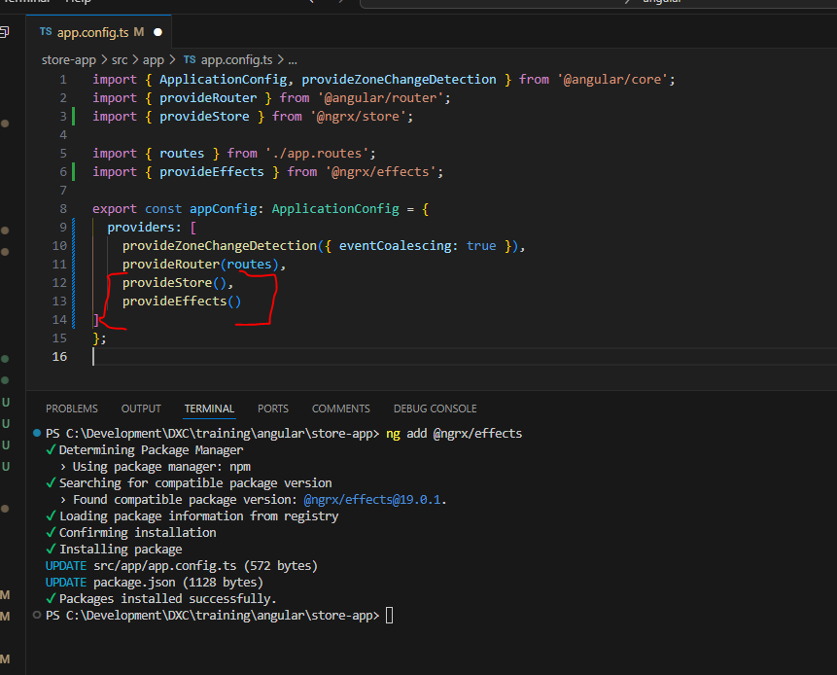
NgRX - Setup
Install packages with ng CLI: ng add @ngrx/store ng add @ngrx/effects

