Slide 1
JS - Origins
Andrés Arcia Benavides

Slide 2
JS - Origins
Created in 10 days by Brendan Eich in 1985 for Netscape
Originally called Mocha, then LiveScript, and later JavaScript was declared the official name in December ’95
Some history of JS (https://www.youtube.com/watch?v=Sh6lK57Cuk4&ab_channel=Fireship)

Slide 3
JS - Origins
JS, ECMAScript, ES5, ES6, ES2015, ES2016, ES2017, ES2018???
ECMA International
JavaScript is a general-purpose scripting language that conforms to the ECMAScript specification, latest specification
ECMA does not implement but specify how it should be
Many browsers behave different
To check what is supported and what does not caniuse.com
Mozilla Developer Network

Slide 4
TS - Origins
Andrés Arcia Benavides

Slide 5
TS - Origins
TypeScript is a “flavor” or “variant” of JavaScript
Some history of TS (https://www.youtube.com/watch?v=U6s2pdxebSo&t=441s&ab_channel=OfferZenOrigins)

Slide 6
JS - Disadvantages
Maintainability degree is very high
There are no variable types
Very difficult to see errors at writing time
No auto-completion
Example ../examples/1.1_Origins

Slide 7
JS – Common Issues
Undefined variables
Undefined properties
Variables, classes and functions overwriting
Code collision

Slide 8
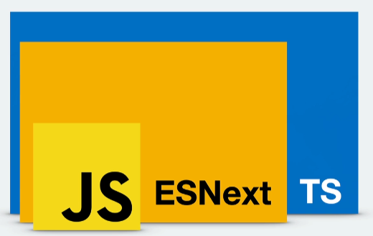
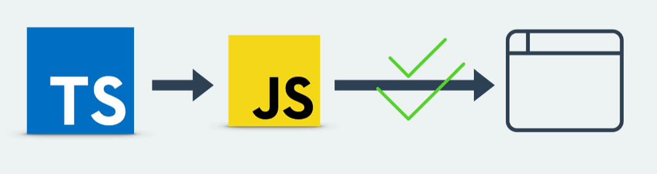
How does TS work?
JS + (few things) = TS (Super set of JS)
TS cannot be executed automatically in browsers
TS requires to be “transpiled” to be executed by JS engines

Slide 9
JS and TS – State of the Art
Developer Ecosystem 2023 results (https://www.jetbrains.com/lp/devecosystem-2023/languages/)
TS Bible (https://www.typescriptlang.org/docs/handbook/intro.html)

Slide 10
Installation
Node JS (https://nodejs.org/en/download/package-manager)
Visual Studio Code (https://code.visualstudio.com/download)
Google Chrome (https://www.google.com/chrome/)

Slide 11
Installation - Global
TypeScript (https://www.typescriptlang.org/download/)
In a command type: “npm install -g typescript”
Check installation with “tsc --version”
Example ../examples/1.2_HelloWorld
Example ../examples/1.3_TSConfig

