Slide 1
TS - Origins
Andrés Arcia Benavides

Slide 2
JS and TS - Origins
Created in 10 days by Brendan Eich in 1985 for Netscape
Originally called Mocha, then LiveScript, and later JavaScript was declared the official name in December ’95
JavaScript is a general-purpose scripting language that conforms to the ECMAScript specification
Some history of JS (https://www.youtube.com/watch?v=Sh6lK57Cuk4&ab_channel=Fireship)

Slide 3
JS and TS - Origins
TypeScript is a “flavor” or “variant” of JavaScript
JavaScript (also known as ECMAScript) started its life as a simple scripting language for browsers
Some history of TS (https://www.youtube.com/watch?v=U6s2pdxebSo&t=441s&ab_channel=OfferZenOrigins)

Slide 4
JS - Disadvantages
Maintainability degree is very high
There are no variable types
Very difficult to see errors at writing time
No auto-completion
Example ../examples/1.1_Origins

Slide 5
JS – Common Issues
Undefined variables
Undefined properties
Variables, classes and functions overwriting
Code collision

Slide 6
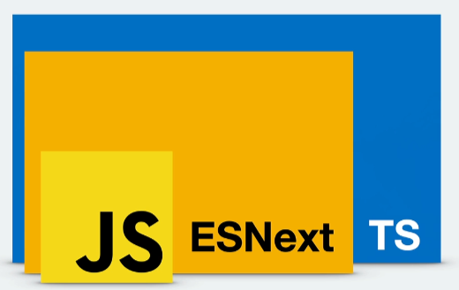
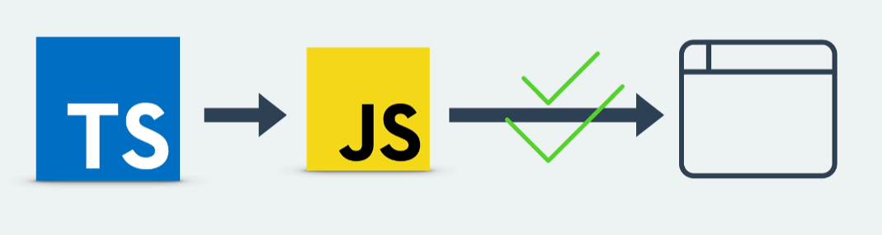
How does TS work?
JS + (few things) = TS (Super set of JS)
TS cannot be executed automatically in browsers
TS requires to be “transpiled” to be executed by JS engines

Slide 7
JS and TS – State of the Art
Developer Ecosystem 2023 results (https://www.jetbrains.com/lp/devecosystem-2023/languages/)
TS Bible (https://www.typescriptlang.org/docs/handbook/intro.html)

Slide 8
Installation
Node JS (https://nodejs.org/en/download/package-manager)
Visual Studio Code (https://code.visualstudio.com/download)
Google Chrome (https://www.google.com/chrome/)

Slide 9
Installation - Global
TypeScript (https://www.typescriptlang.org/download/)
In a command type: “npm install -g typescript”
Check installation with “tsc --version”
Example ../examples/1.2_HelloWorld
Example ../examples/1.3_TSConfig

