Slide 1
Bridge Risk Assessment
A Data-Driven Workshop Using the Texas National Bridge Inventory
Civil & Natural Resources Engineering
University of Canterbury
Data Analysis Workshop | 2025 | Interactive Session
Notes:
Welcome to the Bridge Risk Assessment workshop. Today we will work through a complete data analysis pipeline: loading real infrastructure data from the FHWA National Bridge Inventory, computing composite risk scores, and exploring the results interactively. By the end of this session, you will have hands-on experience with an open dataset that is used by every state transport agency in the United States. The skills transfer directly to asset management practice.

Slide 2
Why Bridge Risk Matters
I-35W Mississippi River bridge collapse (2007) -- 13 fatalities, rated 'structurally deficient'
Fern Hollow Bridge, Pittsburgh (2022) -- collapsed hours before presidential visit
Morandi Bridge, Genoa (2018) -- 43 deaths; cable-stayed span failed during routine traffic
Common thread: deterioration was documented, but not acted on in time
Question: How do we move from documenting deficiency to prioritising intervention?
2
Notes:
These three bridge failures illustrate why risk assessment matters. In each case, inspection data showed deterioration before collapse. The I-35W bridge had been rated structurally deficient for over a decade. The lesson is not that we lack data -- the NBI collects detailed condition ratings on every public bridge. The problem is translating that data into prioritised action. With tens of thousands of bridges in a single state, agencies need a systematic framework to decide where to allocate limited inspection and rehabilitation budgets. That is exactly what we build today.

Slide 3
The Prioritisation Problem
56,951 structures in Texas alone
Limited annual maintenance budgets
Condition ratings are necessary but insufficient
Age and traffic exposure amplify structural risk
Need: a composite metric for ranking
Metric | What It Captures | Limitation
Condition rating | Current physical state | Snapshot; no trend
Bridge age | Cumulative deterioration | Ignores maintenance
Traffic (ADT) | Loading & consequences | Not structural
Composite score | All three factors | Weight selection
3
Notes:
Texas has the largest bridge inventory in the United States. Inspecting and maintaining nearly 57,000 structures requires systematic prioritisation. Condition ratings alone tell you what is wrong now, but not how urgently it needs attention. A bridge rated 5 out of 9 on a quiet rural road is very different from one rated 5 on an interstate carrying 200,000 vehicles per day. Age matters because older bridges have accumulated more fatigue cycles and environmental exposure. The composite score we develop today combines all three dimensions into a single ranking metric.

Slide 4
Workshop Roadmap
1. Understand the NBI dataset and key variables
2. Learn the three risk components: condition, age, traffic
3. Compute a weighted composite risk score
4. Classify bridges into risk tiers
5. Interpret results: maps, distributions, and county patterns
6. Explore interactively: adjust weights, compare scenarios
4
Notes:
Here is our roadmap. We begin with the data -- understanding what the NBI records and how to clean it. Then we define three risk sub-scores, each normalised between zero and one. We combine them using a weighted formula and classify every bridge into Low, Moderate, High, or Critical tiers. The bulk of the session covers interpreting the results through maps, scatter plots, and distributions. Finally, you will use the interactive explorer tool to adjust the weights yourself and see how the risk landscape changes. Each step builds on the last.

Slide 5
The National Bridge Inventory
Maintained by FHWA; updated annually
Every public highway bridge in the U.S.
123 columns per record
Texas 2025: 56,951 structures
Publicly available (open data)
NBI Column | Description | Type
STRUCTURE_NUMBER_008 | Unique bridge ID | String
DECK_COND_058 | Deck condition (0-9) | Integer
SUPERSTRUCTURE_COND_059 | Superstructure condition | Integer
SUBSTRUCTURE_COND_060 | Substructure condition | Integer
CULVERT_COND_062 | Culvert condition | Integer
YEAR_BUILT_027 | Year of construction | Integer
ADT_029 | Average daily traffic | Integer
LAT_016 / LONG_017 | Coordinates (DDMMSSCC) | Packed int
5
Notes:
The National Bridge Inventory is one of the most comprehensive infrastructure datasets in the world. Every state, federal agency, and tribal government submits annual inspection data to the FHWA. Each record captures 123 fields covering identification, location, structural details, condition ratings, and traffic. The condition ratings use a zero-to-nine scale where nine is excellent and zero means the component has failed. Coordinates are encoded in a packed integer format that we need to convert to decimal degrees. All key analysis columns are 100 percent populated in the Texas file, making it ideal for teaching.

Slide 6
Risk Component 1: Structural Condition
condition_risk = ( 9 - min_rating ) / 9
min_rating = minimum of deck, super, sub, culvert
Inverted scale: rating 9 -> risk 0.0 (best)
Rating 0 -> risk 1.0 (worst / failed)
'N' values (not applicable) treated as NaN
Rating | Meaning | Risk
9 | Excellent | 0.00
7 | Good | 0.22
5 | Fair | 0.44
4 | Poor (FHWA threshold) | 0.56
2 | Critical | 0.78
0 | Failed | 1.00
6
Notes:
The first risk component captures current structural condition. The NBI rates four bridge components -- deck, superstructure, substructure, and culvert -- on a zero-to-nine scale. We take the minimum across all applicable ratings, because the weakest component governs structural adequacy. Then we invert the scale so that higher values mean higher risk. A bridge rated 9 in excellent condition gets condition risk of zero. One rated 4, the FHWA Poor threshold, gets 0.56. This linear inversion is simple but effective -- it preserves the ordinality of the NBI scale while mapping it to a consistent zero-to-one risk range.

Slide 7
Risk Component 2: Age Beyond Design Life
age_risk = min( age / 50, 1.0 )
age = 2025 - year_built
Design life = 50 years (standard assumption)
Linear increase from 0 at age 0 to 1.0 at age 50
Capped at 1.0 -- a 100-year-old bridge is not 'twice as risky' as a 50-year-old
43.8% of Texas bridges exceed 50-year design life
Example: built 1970 -> age 55 -> age_risk = min(55/50, 1.0) = 1.0
7
Notes:
The second component captures age-related deterioration. We normalise bridge age against a 50-year design life, which is the standard assumption in U.S. bridge engineering. The key design choice is the cap at 1.0. Without capping, a 125-year-old bridge would get an age risk of 2.5, which would dominate the composite score and make the other components irrelevant. The cap says: once a bridge has exceeded its design life, it is at maximum age risk regardless of how far past 50 years it is. This is a deliberate modelling choice -- additional age beyond the design life is already reflected in the condition ratings from ongoing inspections.

Slide 8
Risk Component 3: Traffic Exposure
traffic_risk = log1p( ADT ) / log1p( max_ADT )
ADT = average daily traffic (vehicles/day)
Texas range: 0 to 810,110
log1p compresses 5 orders of magnitude
log1p(0) = 0: unused bridges get zero traffic risk
Captures consequence of failure, not structural state
ADT | Context | Traffic Risk
10 | Rural ranch road | 0.017
500 | Farm-to-market road | 0.046
5,000 | Urban arterial | 0.063
50,000 | Urban freeway | 0.079
200,000 | Major interstate | 0.090
810,110 | IH-35 (max in TX) | 0.100
8
Notes:
The third component captures traffic exposure as a proxy for consequence of failure. A bridge in poor condition on a quiet road is less urgent than one carrying 200,000 vehicles per day. We use log-one-plus rather than raw ADT because traffic spans five orders of magnitude. Without the log transform, linear normalisation would compress 95 percent of bridges near zero and only differentiate the top few percent. The log transform gives meaningful separation across the full range. Note that traffic risk is not a structural measure -- it captures how many people are affected if something goes wrong, which is essential for prioritisation.

Slide 9
Composite Risk Score
risk_score = 0.30 x condition + 0.30 x age + 0.40 x traffic
All sub-scores normalised to [0, 1] before combining
Traffic weighted highest (0.40): emphasises public safety consequence
Condition and age receive equal weight at 0.30 each
Composite score bounded: 0.0 (no risk) to 1.0 (maximum risk)
Weights are adjustable -- you will experiment with alternatives
9
Notes:
The composite score is a simple weighted sum of the three sub-scores. Traffic receives the highest weight at 0.40 because it captures the public safety consequence -- a failing bridge carrying 200,000 vehicles per day is a far greater concern than one carrying 200. Condition and age each get 0.30. This weighting is a modelling choice, not a physical law. Different agencies might weight condition more heavily if their priority is structural health, or weight age more if they are planning long-term capital budgets. In the hands-on session, you will experiment with different weight combinations and see how the risk landscape changes.

Slide 10
Risk Tier Classification
Tier | Score Range | Texas Count | Percentage | Action Level
Low | 0.00 - 0.24 | 1,548 | 2.7% | Routine monitoring
Moderate | 0.25 - 0.49 | 20,127 | 35.3% | Scheduled inspection
High | 0.50 - 0.74 | 34,966 | 61.4% | Priority assessment
Critical | 0.75 - 1.00 | 310 | 0.5% | Immediate review
61.9% of Texas bridges score High or Critical
Only 1.2% are rated 'Poor' by condition alone -- the composite reveals latent risk
10
Notes:
We classify the continuous risk score into four actionable tiers. The thresholds at 0.25, 0.50, and 0.75 divide the zero-to-one range into equal quarters. The Texas results show that 61.4 percent of bridges fall in the High tier, with the bulk of the inventory concentrated there. Only 0.5 percent reach Critical, but 61.9 percent are High or Critical -- far more than the 1.2 percent that condition ratings alone flag as Poor. The discrepancy is the key finding: condition ratings understate risk because they do not account for age and traffic exposure.

Slide 11
Results Summary
Metric | Value
Total bridges analysed | 56,951
Mean risk score | 0.52
Median risk score | 0.55
Bridges rated Poor (min_cond <= 4) | 680 (1.2%)
Bridges exceeding 50-year design life | 24,951 (43.8%)
High-traffic Poor bridges (ADT > 50k) | 18
Oldest bridge | 1900 (County 217, 125 years)
Highest risk score | 0.826 (County 245, built 1962)
11
Notes:
Here are the headline numbers. The mean risk score of 0.52 places the average Texas bridge in the High tier. The median of 0.55 is close behind. With traffic weighted at 40 percent, the model shifts risk toward high-ADT urban corridors. The gap between the 1.2 percent rated Poor by condition alone and the 61.9 percent scoring High or Critical by the composite is the central finding. Eighteen bridges in Poor condition carry over 50,000 vehicles per day, mostly on IH-45 and IH-35E in the Houston and Dallas-Fort Worth metro areas. These represent the highest-consequence structures.

Slide 12
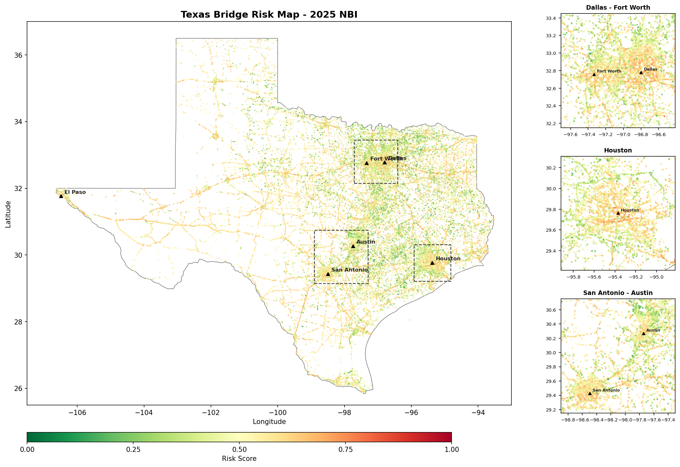
Geographic Distribution of Risk
Clear east-west gradient
Highest risk in rural East Texas
Older road networks (1930s-1960s)
Metro areas show mixed patterns
Western TX: sparser, newer infrastructure
Figure 1. Composite risk scores for 56,951 Texas structures with metro insets.
12
Notes:
The risk map reveals a pronounced east-to-west gradient. The highest-risk structures concentrate in eastern Texas, east of the I-35 corridor, in regions like the Piney Woods and Gulf Coast. These areas contain the state's oldest road networks, many built during federal highway expansion in the 1930s through 1960s. Rural farm-to-market road bridges in counties like Polk and Limestone show particularly high risk. The metro insets show that even within cities, legacy interstate segments from the 1950s appear as high-risk clusters embedded in otherwise lower-risk networks.

Slide 13
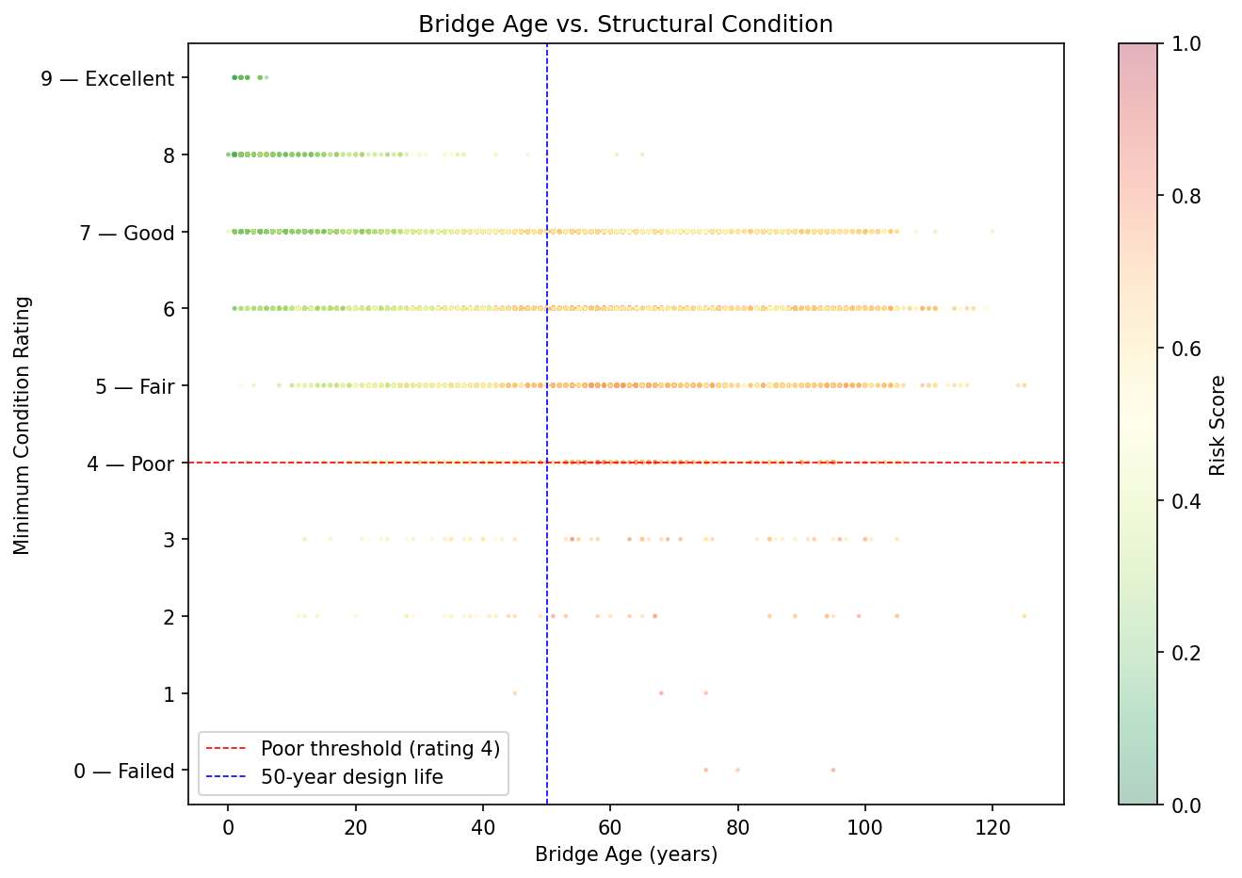
Key Finding: Age Does Not Predict Condition
43.8% exceed 50-year design life
Only 1.5% of aged bridges rate as Poor
Dense clustering at ratings 6-7 across all ages
Maintenance sustains condition -- but for how long?
Upper-right quadrant = latent risk zone
Figure 2. Bridge age vs. min condition rating. Dashed lines: FHWA Poor threshold (4) and 50-year design life.
13
Notes:
This is arguably the most important figure. It shows that bridge age does not strongly predict condition in the Texas inventory. Nearly 44 percent of bridges have exceeded their 50-year design life, but only 1.5 percent of those are rated Poor. Most cluster at ratings 6 and 7, which is satisfactory, even at ages of 80 or 100 years. This suggests that sustained maintenance has been effective at preserving condition. However, this also creates a latent risk zone: these bridges are acceptable today but vulnerable if maintenance budgets decline. The composite score captures this risk; condition ratings alone do not.

Slide 14
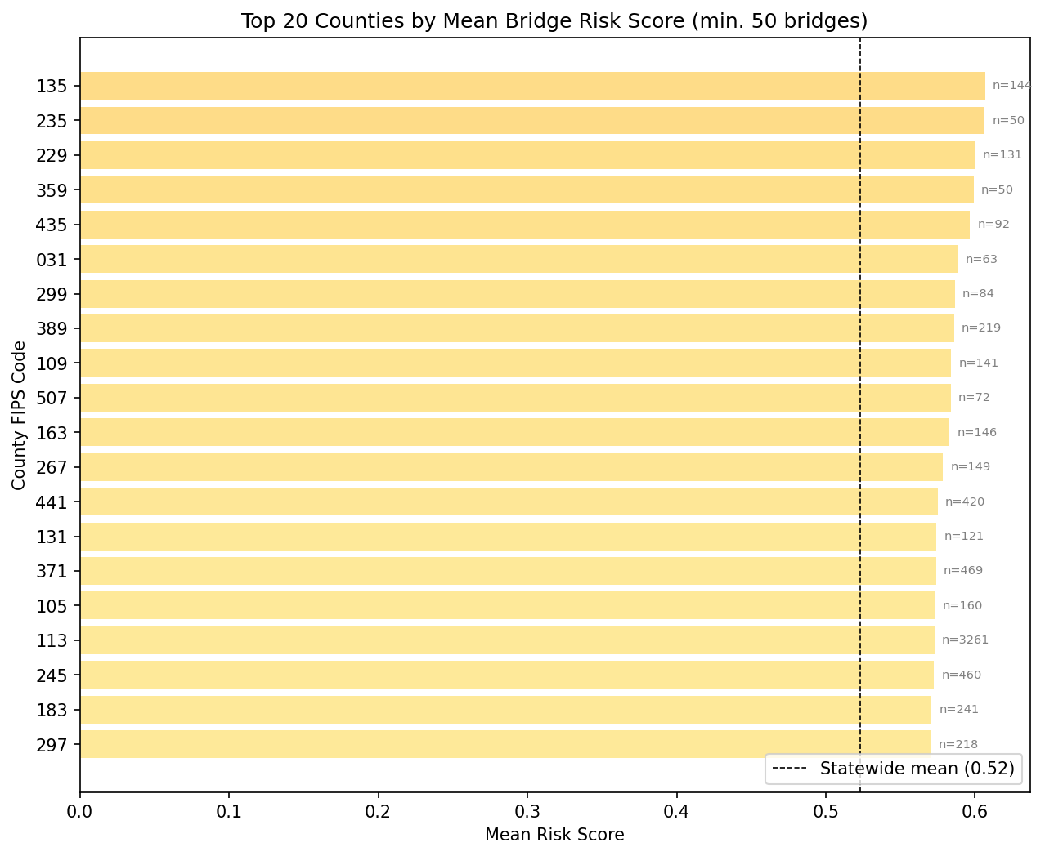
County-Level Risk Patterns
Top 20 counties by mean risk (min. 50 bridges)
All exceed the statewide mean of 0.60
County 235 (Irion) highest at 0.77
Predominantly rural counties
Larger counties (Harris, Tarrant) have more total risk but lower mean
Suggests funding disparity: rural vs urban
Figure 4. Top 20 counties by mean composite risk score, filtered to min. 50 bridges.
14
Notes:
The county analysis shows that the highest mean risk scores are in rural counties. All 20 counties in this chart exceed the statewide mean. This is consistent with the geographic pattern: rural East Texas counties have older bridge stocks and receive less maintenance investment per structure than urban areas. Large metro counties like Harris and Tarrant have more bridges in absolute terms but their mean risk is lower because new construction dilutes the average. This urban-rural disparity has direct implications for equitable funding allocation.

Slide 15
Model Limitations
Cross-sectional snapshot: no deterioration trajectory or trend analysis
Equal-interval tier boundaries (0.25) are arbitrary; no empirical calibration
Weights are expert-assigned, not empirically derived from failure data
NBI condition ratings are subjective: inter-inspector variability is documented
Traffic data (ADT) may lag actual volumes; does not capture peak-hour loading
No integration with maintenance expenditure or material-specific decay models
Geographic analysis uses county aggregation; sub-county patterns may differ
15
Notes:
Every model has limitations, and it is important to be transparent about them. This is a single-year snapshot; we cannot track how risk changes over time without multi-year data. The tier boundaries and weights are modelling choices, not empirically calibrated thresholds. NBI ratings are assigned by inspectors in the field and have documented variability between inspectors. Traffic data may be several years old and does not capture peak-hour conditions. A production system would need to integrate maintenance records, material-specific deterioration models, and longitudinal rating trajectories.

Slide 16
Discussion Questions
Should condition, age, or traffic receive the highest weight? Why?
How would you validate this model against actual bridge failures?
What additional data would improve the risk assessment?
Should rural and urban bridges be scored with the same formula?
How would you communicate these results to a non-technical audience?
What ethical considerations arise when prioritising some communities over others?
16
Notes:
These questions are designed to stimulate critical thinking about modelling choices. There is no single correct answer to the weighting question -- it depends on agency priorities. Validation against actual failures is essential but difficult because bridge collapses are rare events. Additional data could include maintenance records, seismic zone classification, or climate exposure indices. The urban-rural question is particularly relevant given the funding disparity we observed. Finally, risk prioritisation is inherently an ethical exercise: deprioritising one bridge means accepting higher risk for the community that depends on it.

Slide 17
Hands-On: Interactive Risk Explorer
Open bridge_risk_explorer.html in your browser
Task 1: Default Weights
Set weights to Condition=30, Age=30, Traffic=40 (default)
Record: total Critical bridges, mean risk score, geographic pattern
Task 2: Condition-Heavy Scenario
Set weights to Condition=80, Age=10, Traffic=10
How does the Critical count change? Which counties move in/out of the top 20?
Task 3: No-Traffic Comparison
Set Traffic slider to 0 (Condition=60, Age=40, Traffic=0)
Compare to Task 1: do urban or rural bridges benefit more from removing traffic?
17
Notes:
This is the hands-on portion. Open the bridge risk explorer HTML file in your browser. It loads all 56,951 bridges and lets you adjust the risk weights in real time. Task 1 establishes a baseline using the default weights of 30/30/40. Task 2 asks you to heavily weight condition -- this will reduce the number of Critical bridges because most bridges have acceptable condition ratings. Task 3 removes traffic entirely, which should shift the risk pattern away from urban interstates and toward older rural structures. Compare the three scenarios and prepare to discuss what weight combination you would recommend to a state transport agency.

