Slide 1
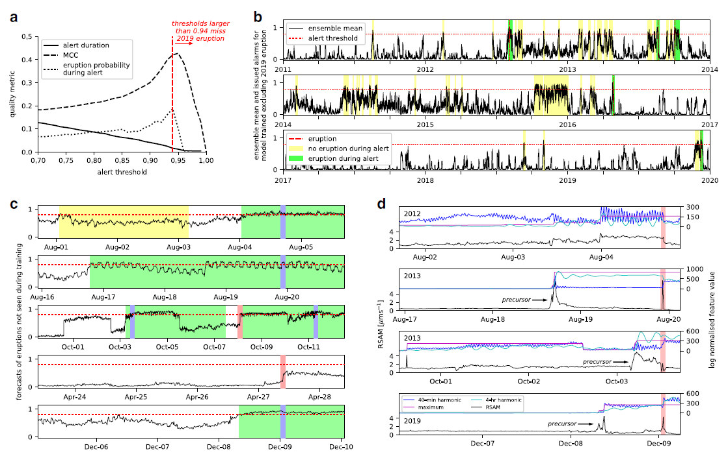
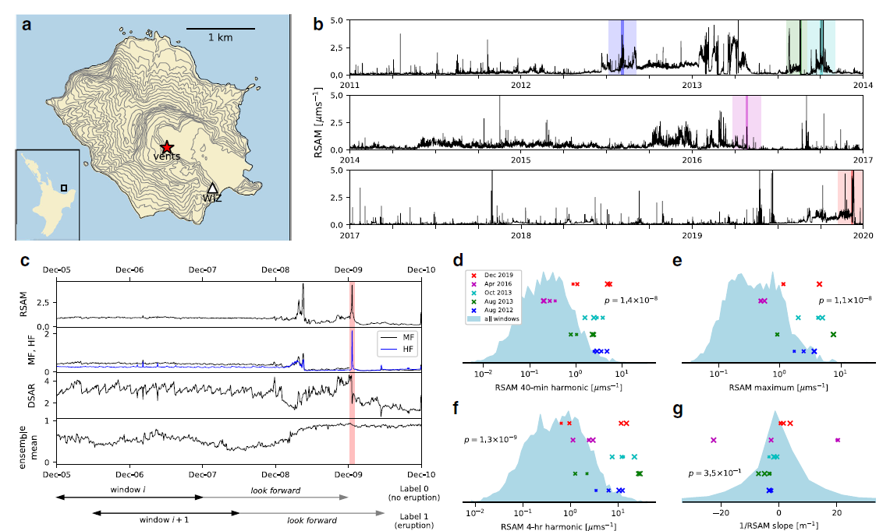
Method review: Eruption forecasting using machine learning and time series feature engineering
Time-series:
RSAM
HF
MF
DSAR
Labelling windows:
‘1’ eruption
‘0’ no eruption
Forecast using model and new incoming data (windows)
Training several decision trees:
Random forest model
Current model working for Whakaari
Calculations of Features: Statistical pars of time series every 10 min for 2 day windows
Dempsey et al. 2020: Automatic precursor recognition and real-time forecasting of sudden explosive volcanic eruptions at Whakaari, New Zealand
Notes:
RSAM: 2 and 5Hz
MF: 4.5 and 8Hz
HF: 8 and 16Hz
DSAR was computed by integrating the MF and HF signals, computing the average
absolute signal over 10-min windows, and then taking the ratio of the two quantities,

Slide 2
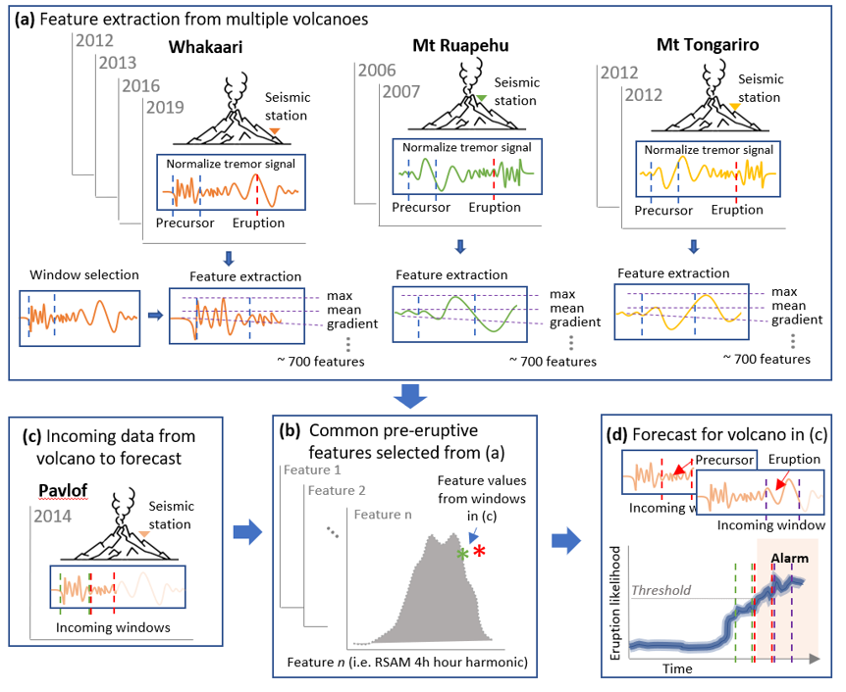
Next step: Transfer learning from data-rich volcanos to data-poor volcanoes.
Challenges:
High quality database for several eruptions.
Correlation between eruptions.
Training models with multiple eruptions.
Incorporate weights during training based on prior knowledge of eruption similarity.
Test forecasting performance for multiple volcanoes.
Other challenges mostly resolved:
Filtering earthquakes
From ensemble mean threshold to probability
Classification of quiet and unrest periods
Overall target: Increase eruption probability during an alert (reduce false positives)
Generalized forecasting model

Slide 3
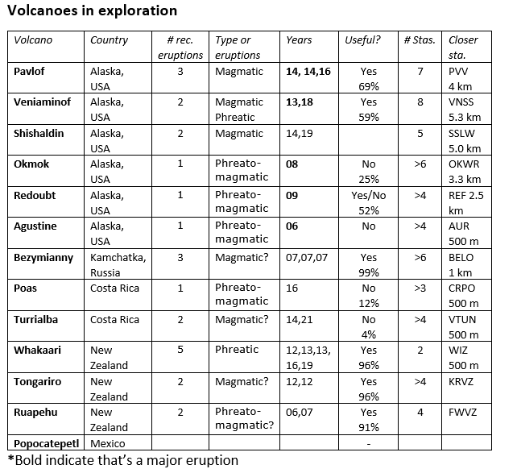
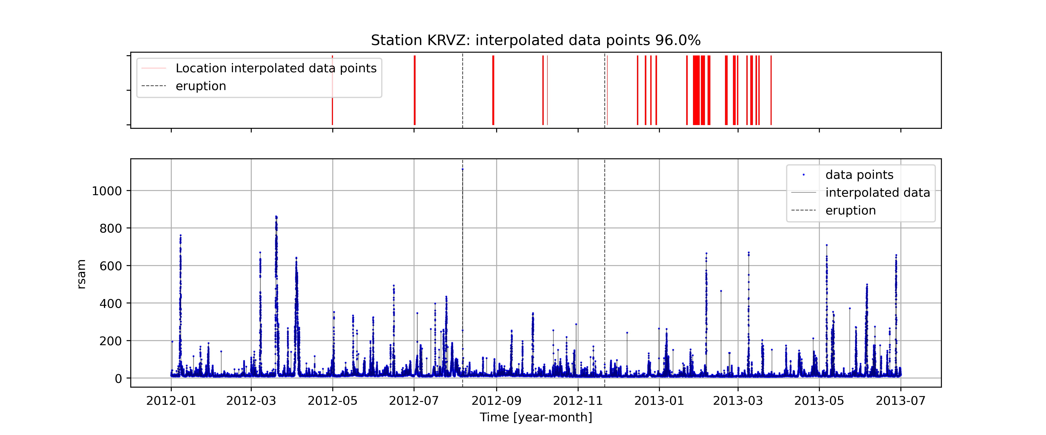
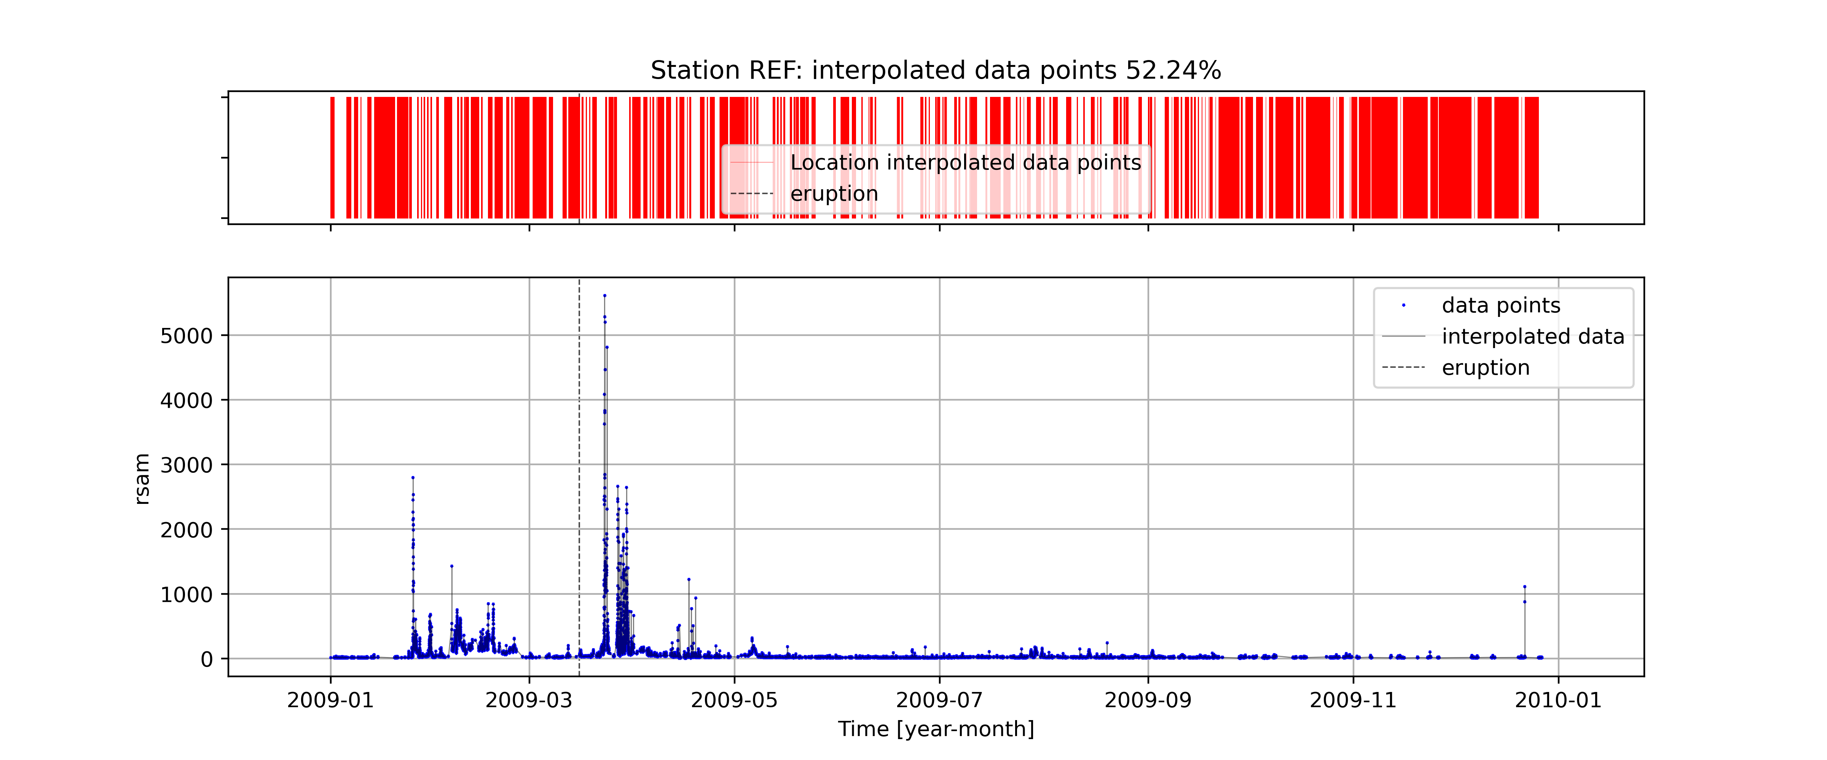
State of the art in transfer learning: Eruption catalogue (from the Iris database)
Tongariro data: 96% of data for period of interest
Redoubt data: 52% of data for period of interest
So far…
- Whakaari (5 eruptions)
- Ruapehu (3 eruptions)
- Tongariro (2 eruptions)
- Pavlof (3 eruptions)
- Veniaminof (2 eruptions)
- Bezymianny (3 eruptions)

Slide 4
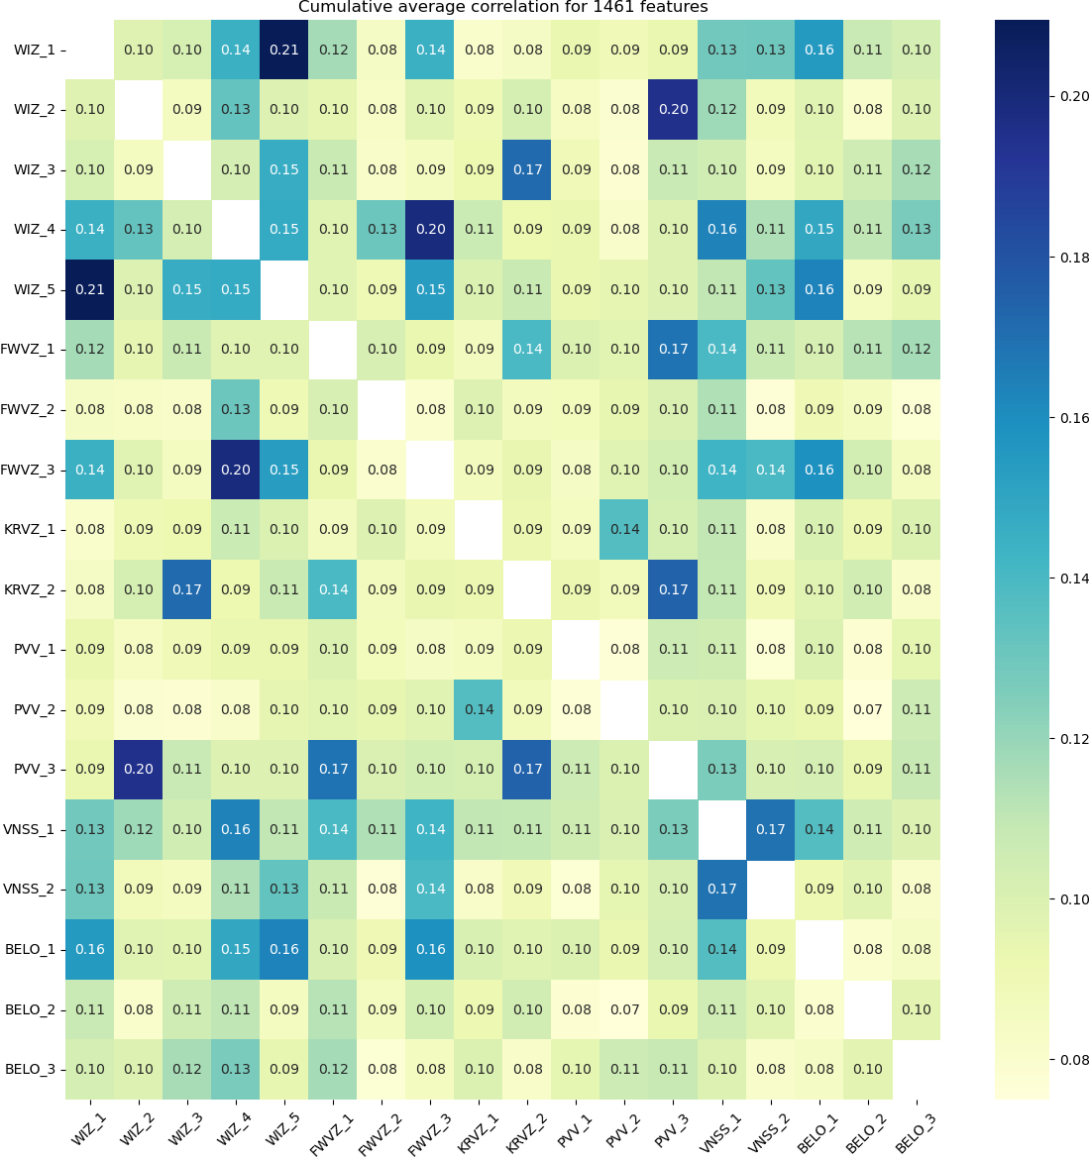
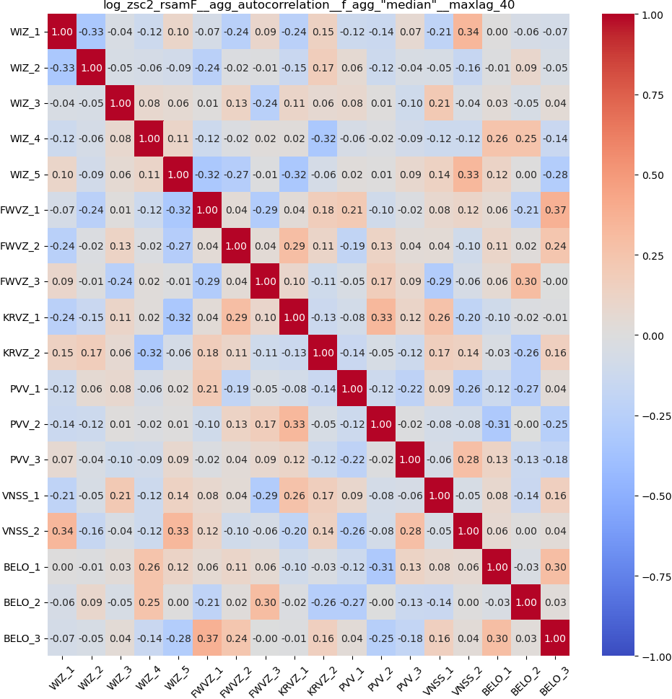
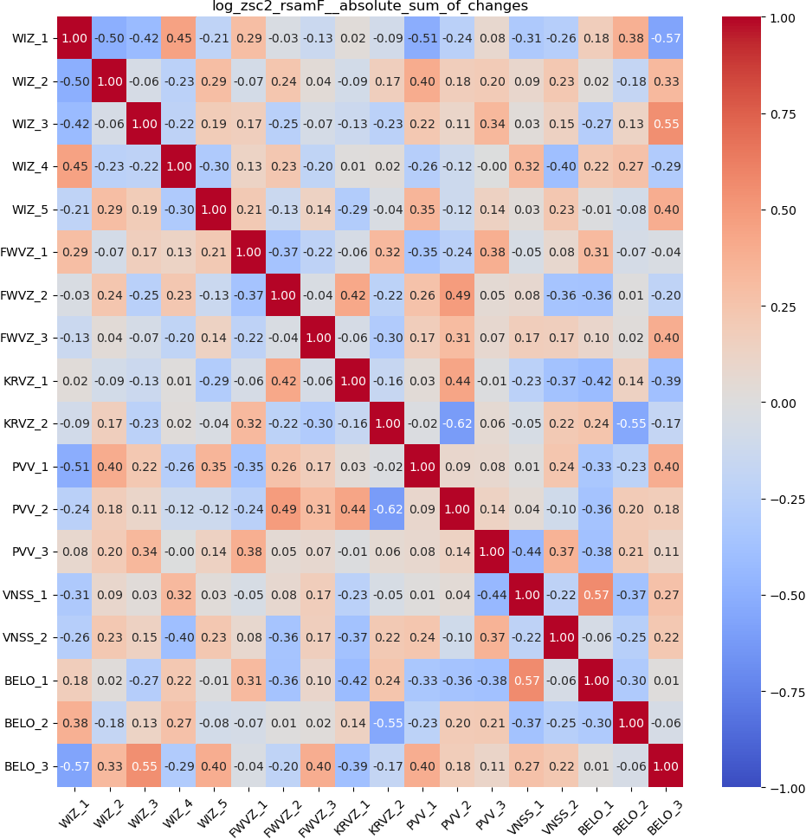

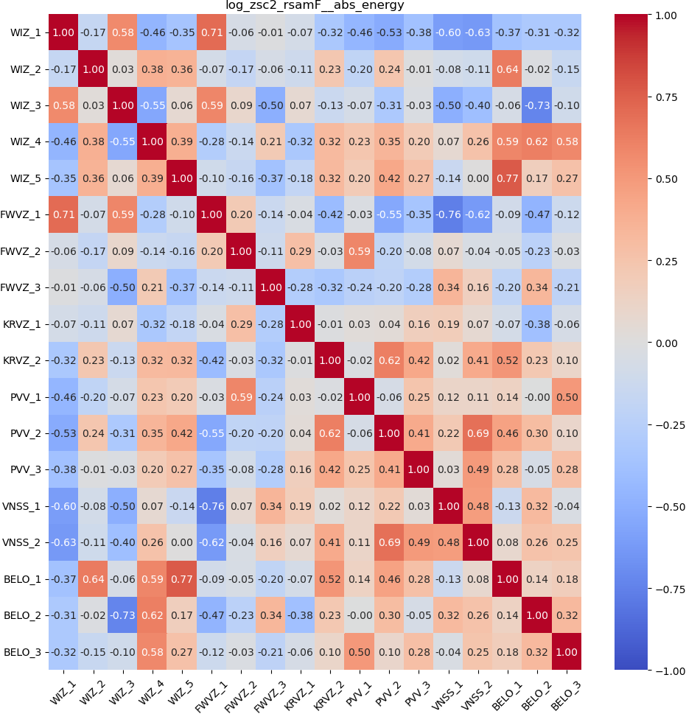

State of the art in transfer learning: Exploring eruptions correlation
Cumulative average correlation for 1500 features
- Features from one month before eruptions (every 10 min).
- Correlation coefficient between eruptions for each feature.
…
Next steps: Clustering…

Slide 5
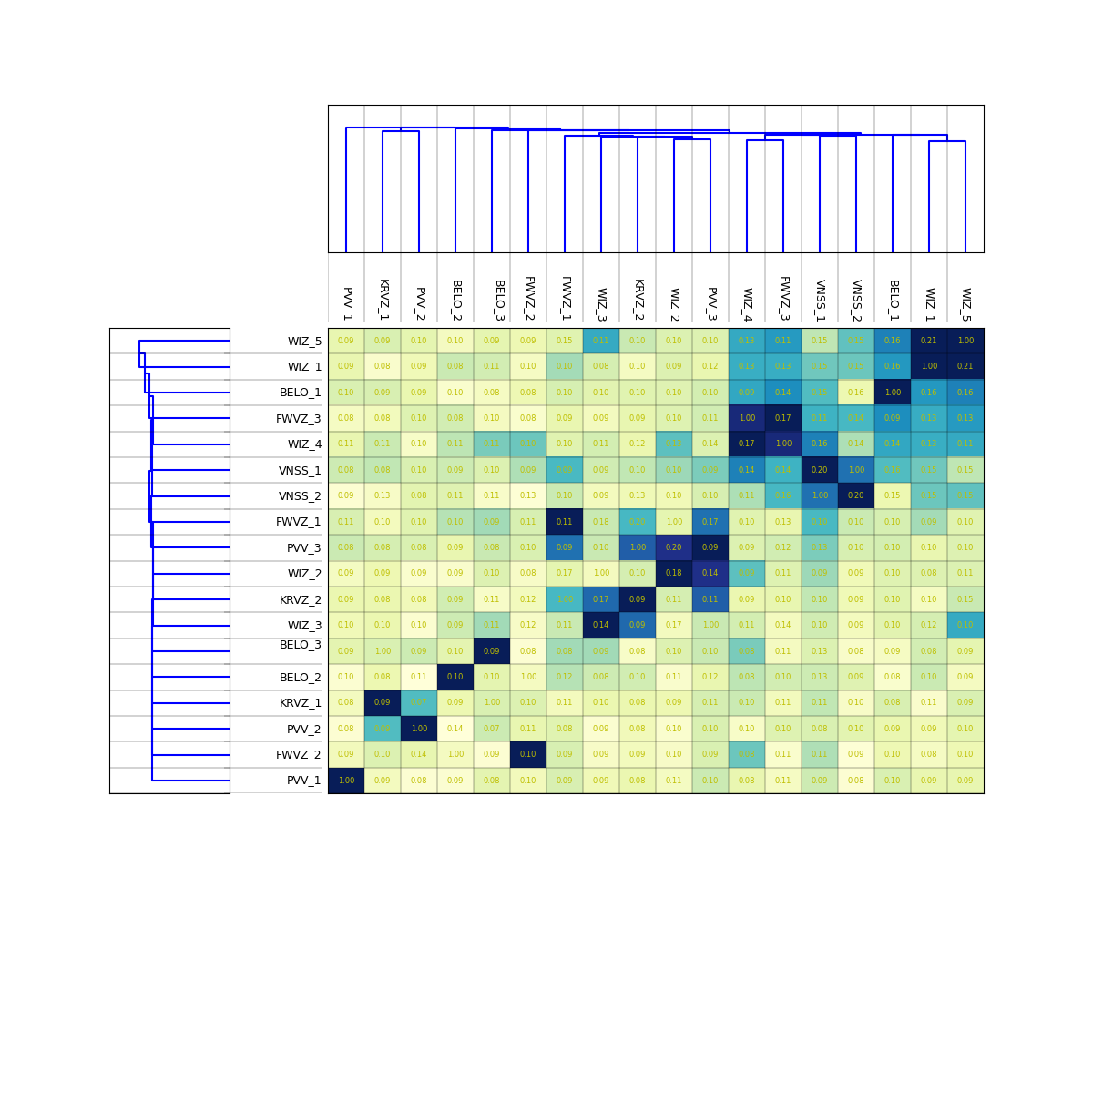
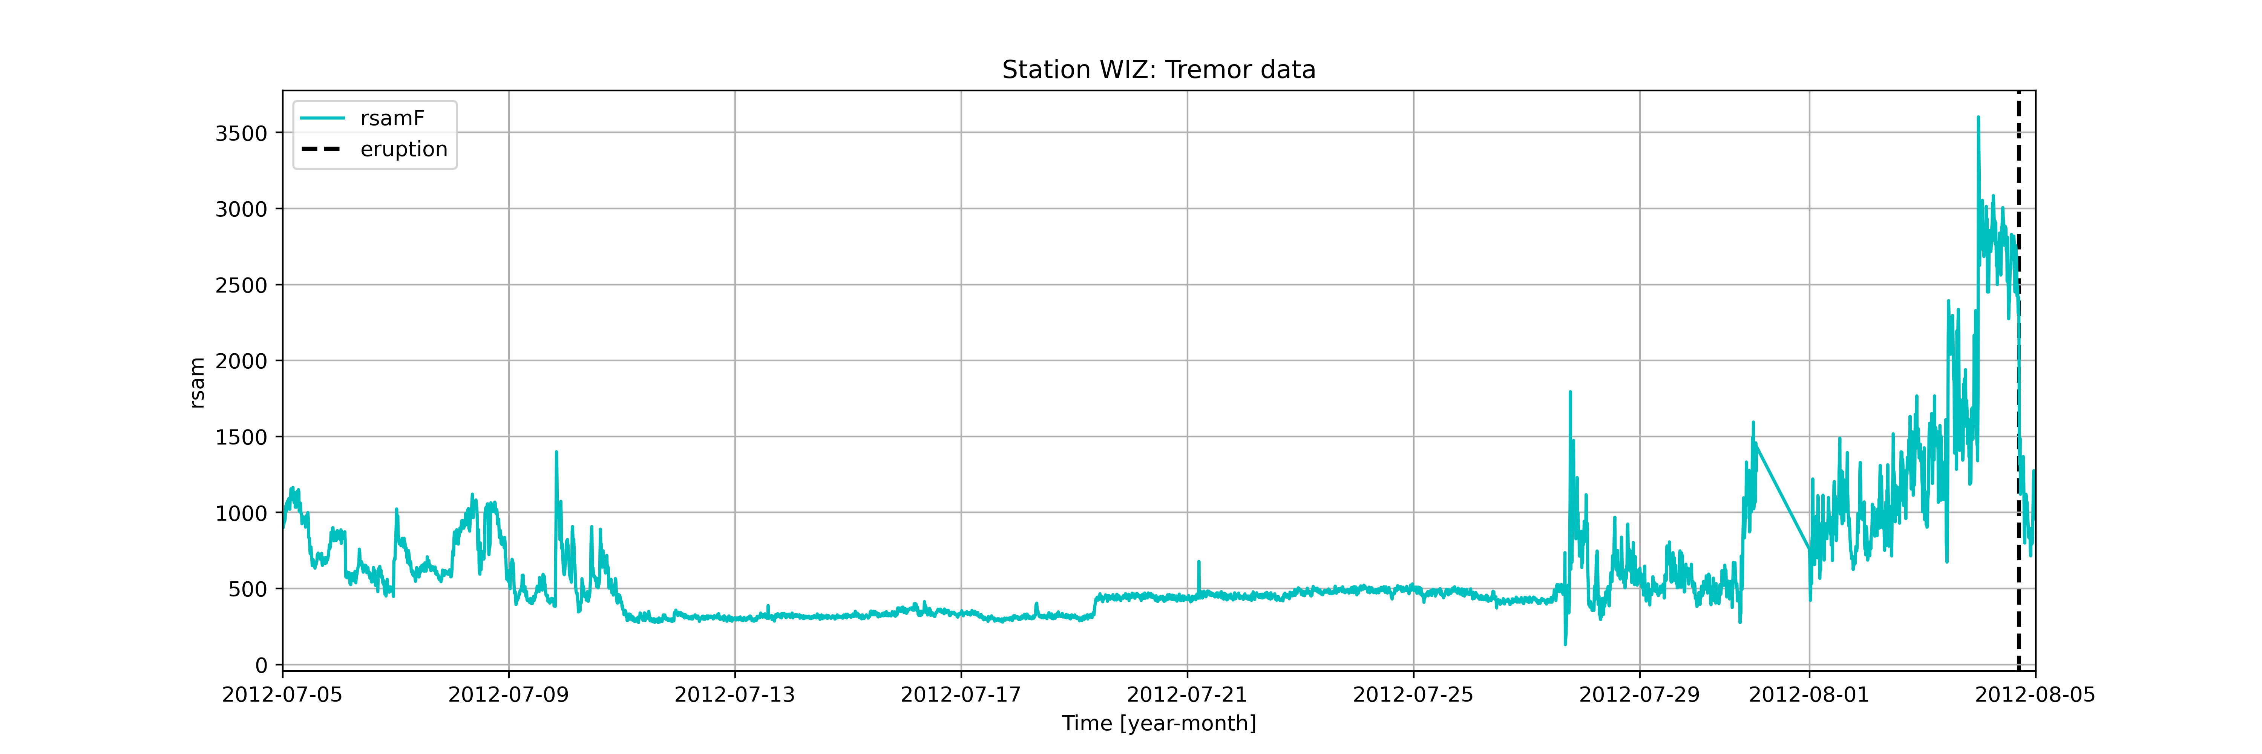
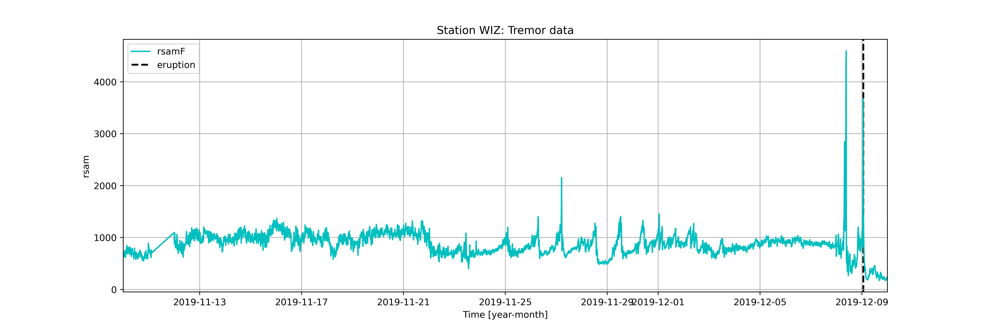
State of the art in transfer learning: Clustering eruptions by correlation coefficient
Dendrogram: helps to identify clusters
Whakaari eruption 1: 2012-08-04
Whakaari eruption 5: 2019-12-09

Slide 6
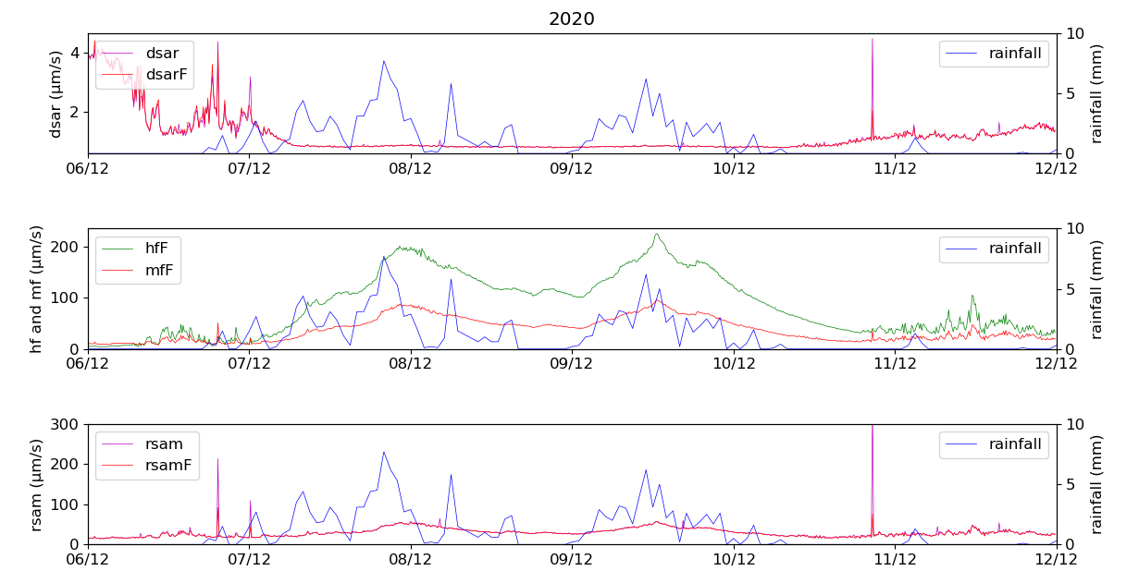
Bonus…
- Training models to identify noise from storms and lift chairs (Ruapehu ski field)
Project of Tom Waldin and William Gao (fourth year engineering students)
DSAR suppressed during heavy rain
(Ruapehu data)

