Slide 1

HSV Adjustment Tool
Computer Vision – Assignment 1
Group 3 :
Abdelrahman Mohamed & Ahmed Hassan
Deggendorf Institute of Technology – Summer Semester 2025

Slide 2
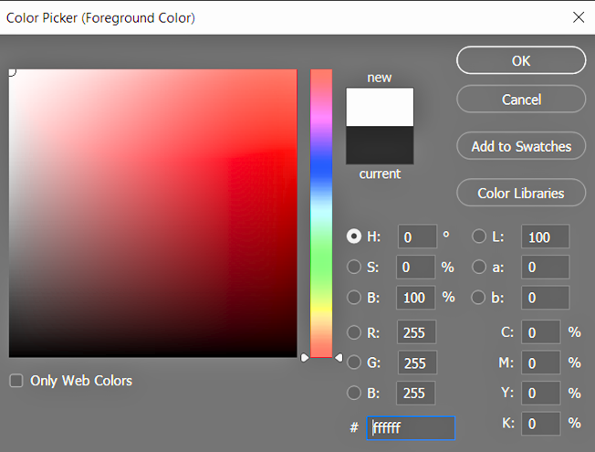
RGB vs HSV Color Spaces
Why HSV instead of RGB?
RGB (Red, Green, Blue):
Additive color model used by screens and cameras.
Represents colors by mixing intensities of red, green, and blue channels.
HSV (Hue, Saturation, Value):
Hue: The color type (0–360°).
Saturation: Color purity or intensity (0–100%).
Value: Brightness (0–100%).
Why HSV instead of RGB?
• HSV better matches human color perception.
• Easier to adjust colors meaningfully (e.g., change brightness without changing the color).
2

Slide 3



RGB to HSV Conversion:
Done using OpenCV’s cv2.cvtColor() function.
Converts image into Hue, Saturation, Value channels.
Hue and Value Adjustment:
Hue shifted by a configurable angle (0–360°).
Value adjusted using gamma correction (0.5–4.0x).
HSV to RGB Conversion:
Implemented using two methods:
Loop-based method (pixel-by-pixel).
Matrix-based method (using NumPy operations).
GUI Design:
Built with Qt Designer’s drag-and-drop interface.
PyQt6 used for dynamic interaction with images.
Technical Background
3

Slide 4

Code Highlights
Static Program – StaticProgram.py:
GUI Application – GUIProgram.py:
Code Documentation:
Special Features:
Fully documented with Doxygen comments.
HTML documentation generated for both programs.
Input image handling.
Output saving (PNG/JPG).
GUI real-time sliders.
Performance benchmarking (Loop vs Matrix).
Simple CLI-based implementation.
Accepts input image, hue shift, value exponent, and outputs result.
Optimization techniques reduce computational time by 30%.PyQt6-based graphical interface.
Allows real-time adjustments of Hue and Value.
4

Slide 5
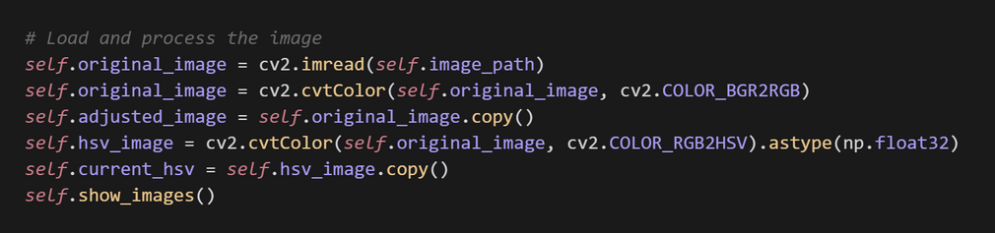
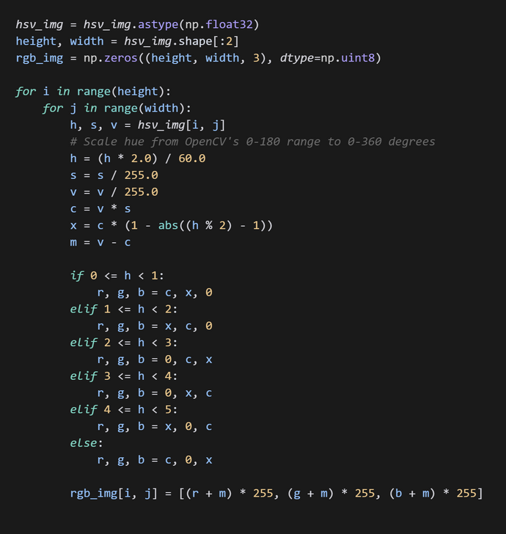
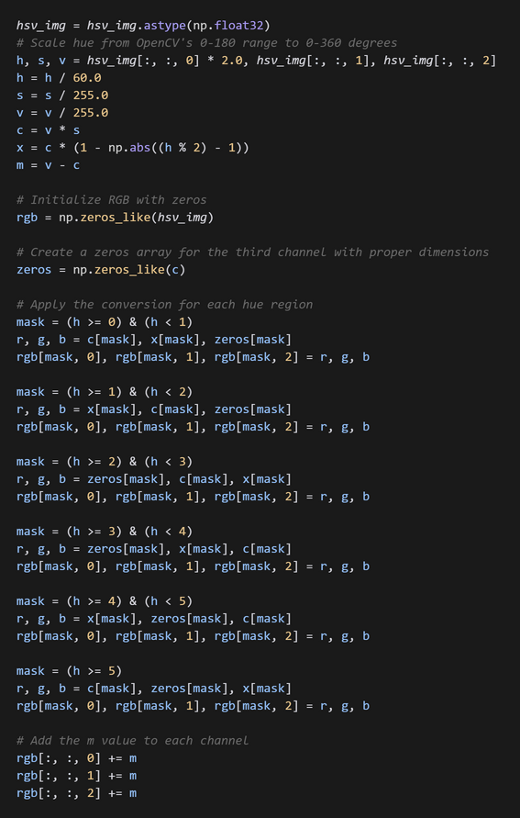
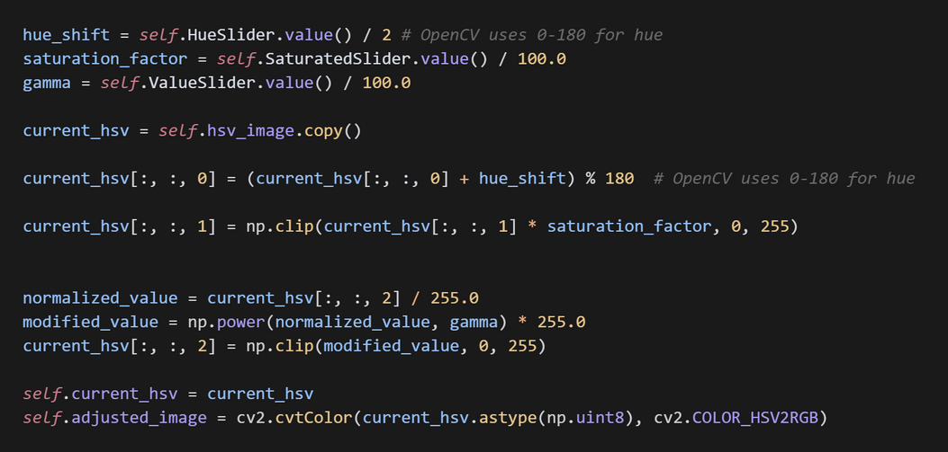
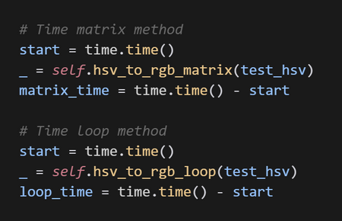
Code Highlights (Code Previews)
Convert RGB to HSV (OpenCV built-in)
HSV ➔ RGB Loop-based Conversion
HSV ➔ RGB Matrix-based Conversion
Edit Hue and Value Channels
Performance Comparison
5

Slide 6
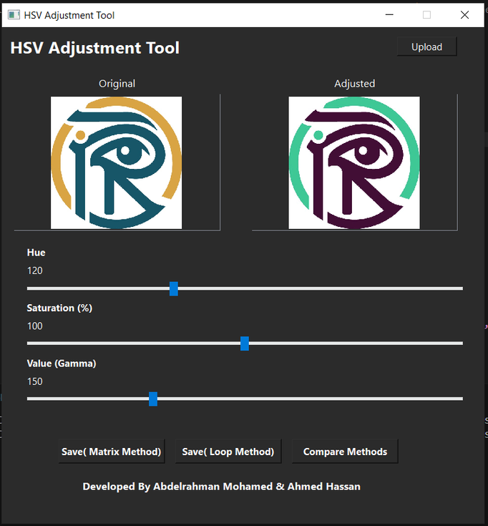
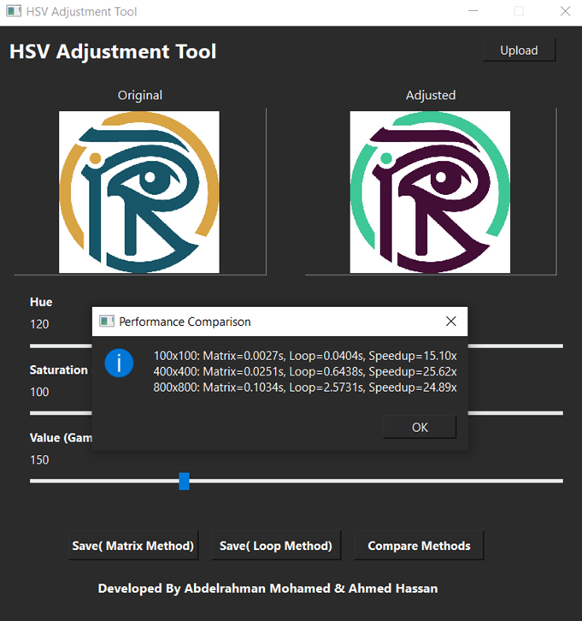
Results & Performance
Input vs Output Images:
GUI Application Dashboard:
Performance Comparison:
Observations:
Matrix method is ~50x faster than Loop method.
Benchmarked on images of different sizes.
atrix-based operations are ideal for large images.
Loop method mainly used for educational demonstration.
Visual comparison after applying HSV adjustments.
Real-time image preview with Hue and Value sliders.
Easy upload and save functionality.
6

Slide 7

Thank You!
Email
abdelrahman.mohamed2@stud.th-deg.de
Social media
https://www.linkedin.com/in/aaref5720/
7

