Slide 1
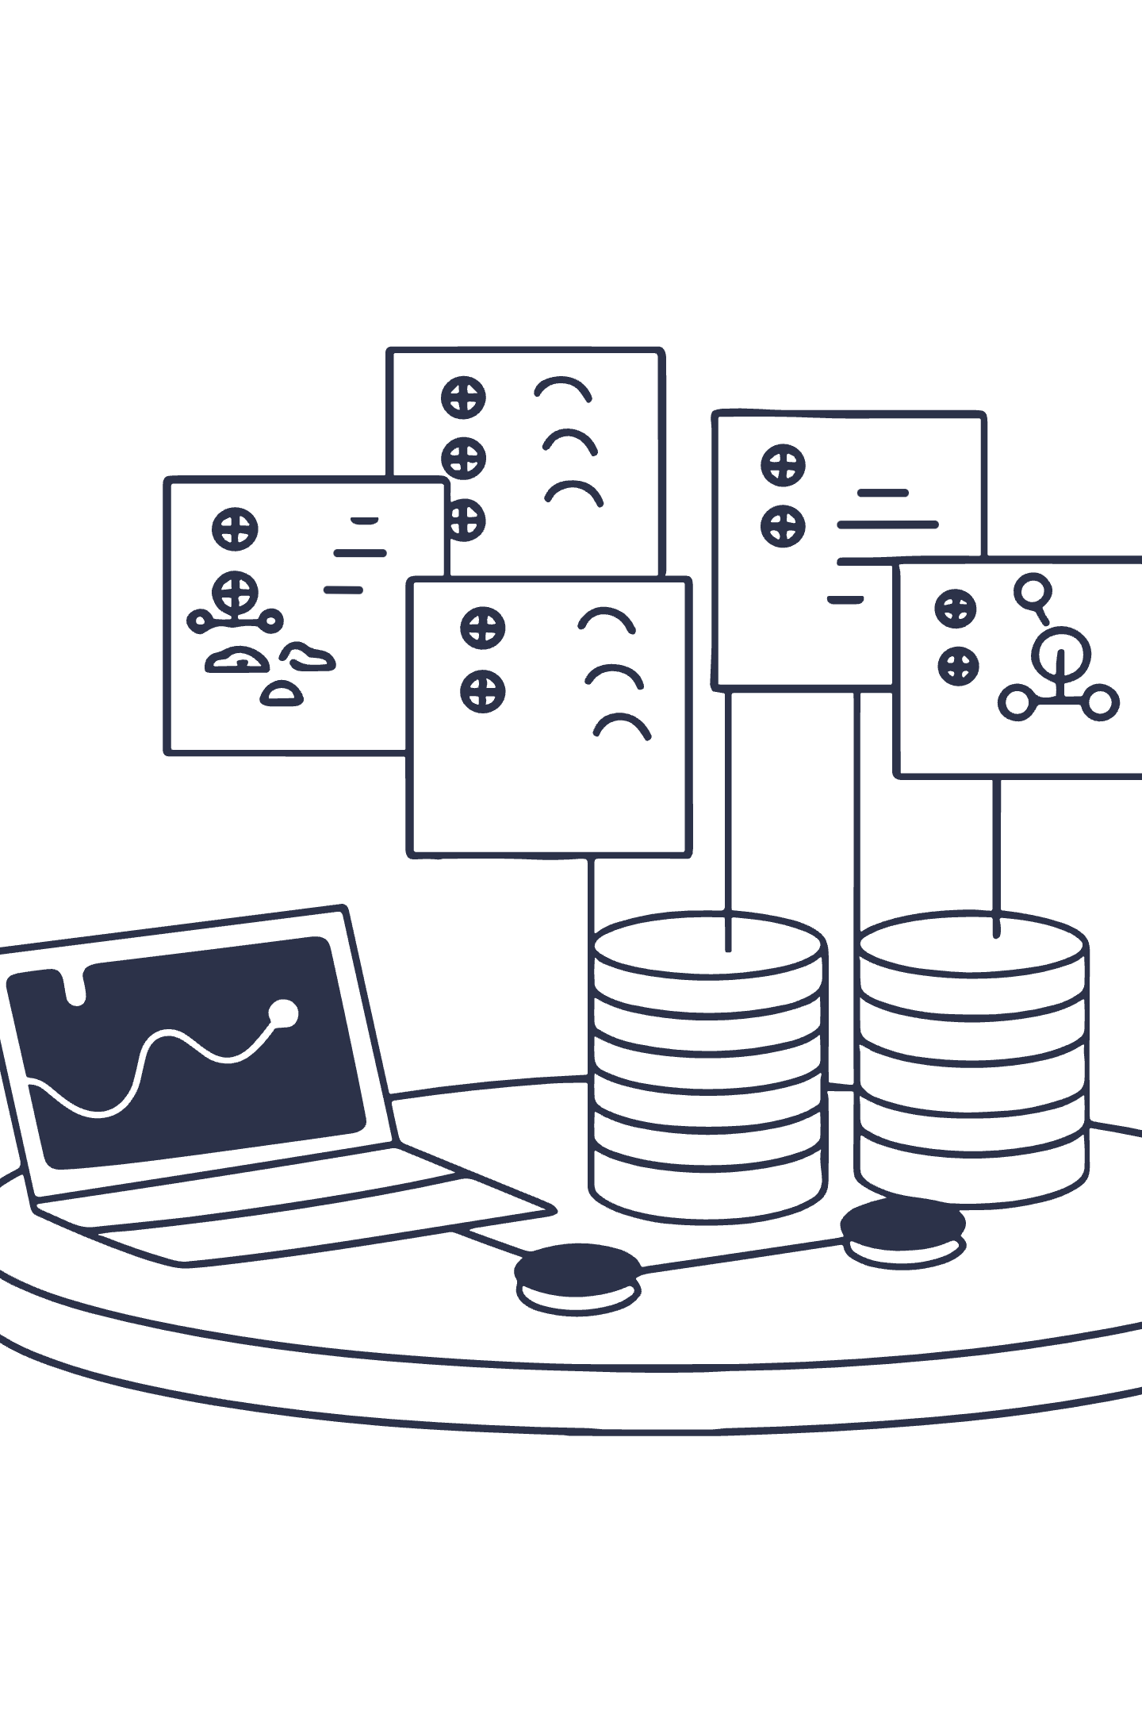
Machine Learning Workflow Overview: From Data to Deployment
A comprehensive guide to building, deploying, and maintaining production-grade machine learning systems

Slide 2




Chapter 1: Setting the Stage — Why a Workflow Matters
Clarity and Focus
Repeatability
Risk Mitigation
Machine learning workflows provide structure that keeps teams aligned on objectives, preventing scope creep and wasted effort.
Standardized processes enable consistent results across projects and make it easier to iterate and improve over time.
Without a workflow, projects risk inefficiency, costly errors, and poor outcomes that fail to deliver business value.

Slide 3

Defining the Problem and Objectives
Start with Clarity
Every successful ML project begins with a well-defined business or research question that addresses a real need.
Example: Predicting customer churn to reduce revenue loss and improve retention strategies.
01
02
03
Identify the Business Problem
Define Success Metrics
Assess Feasibility
Frame the challenge in terms of measurable business impact
Establish clear KPIs that align ML goals with organizational objectives
Evaluate data availability, technical requirements, and resource constraints

Slide 4

Chapter 2
Data Engineering — The Foundation of ML
High-quality data engineering is the cornerstone of any successful machine learning project. Without solid foundations, even the most sophisticated algorithms will fail to deliver meaningful results.

Slide 5

Data Collection: Gathering the Right Inputs
Internal Databases
External APIs
Public Datasets
Customer records, transaction logs, and operational data stored in company systems
Third-party data sources, social media feeds, and real-time streaming services
Government databases, research repositories, and open-source data collections
Pro Tip: Using customer transaction logs combined with web activity data provides rich behavioral insights for churn prediction models.

Slide 6

Data Exploration and Validation
Understanding Your Data
Profiling data reveals critical insights about distributions, patterns, and potential issues before modeling begins.
Statistical summaries: min, max, mean, median
Missing value patterns and frequencies
Outlier detection and anomaly identification
Data type validation and schema consistency
Detecting inconsistencies early in the workflow prevents costly errors downstream and saves significant time during model development.

Slide 7
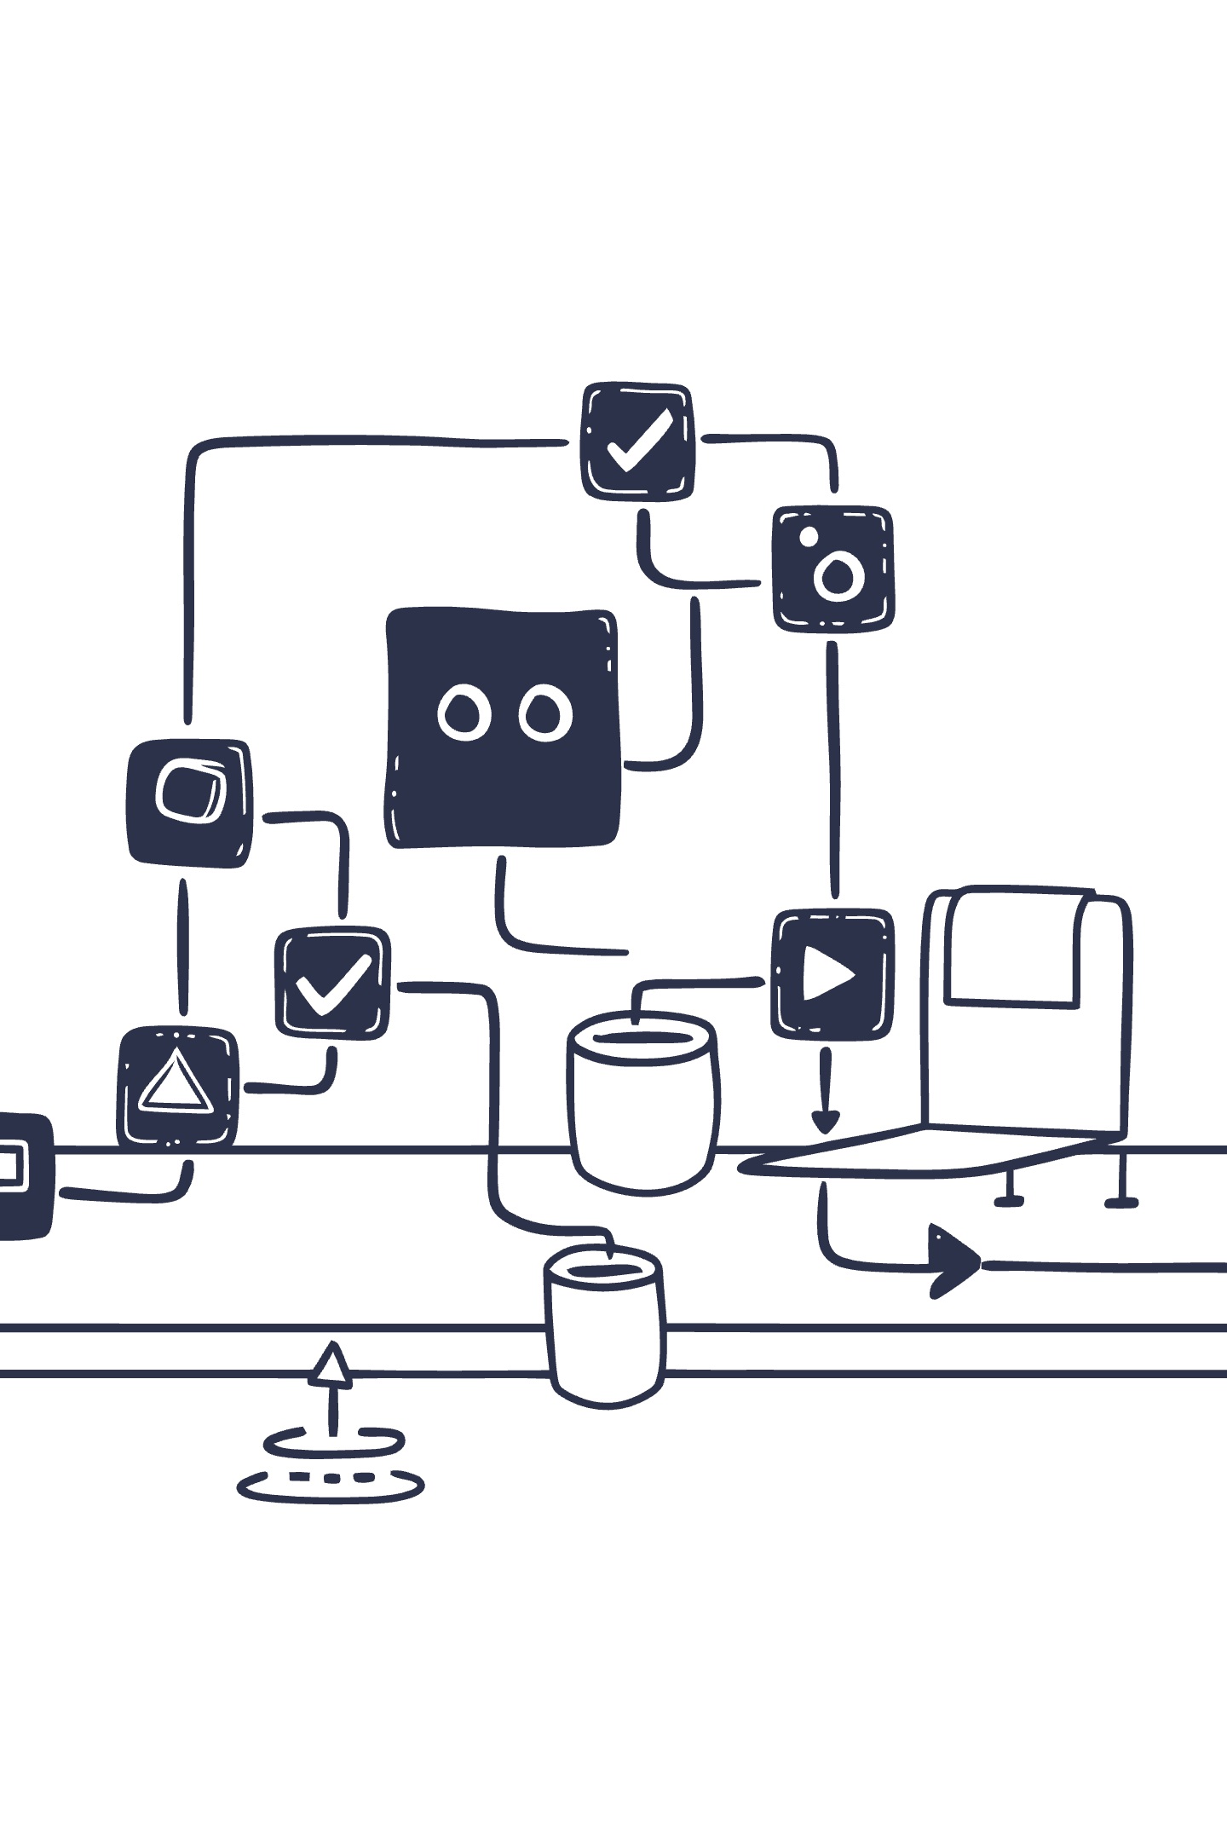



Data Cleaning and Wrangling
Handle Missing Values
Imputation strategies, deletion rules, or forward-fill techniques based on data patterns
Correct Errors
Fix typos, standardize formats, and resolve data entry mistakes
Transform Data
Normalize, scale, and reformat fields for consistency across the dataset
Real-world example: Imputing missing customer ages using median values by segment, or normalizing text fields like product categories to ensure consistent naming conventions.
This step is often the most time-consuming in the ML workflow but remains absolutely critical to model success.

Slide 8

Data Labeling and Splitting
Data Labeling
Assigning ground truth categories or outcomes to data points for supervised learning tasks.
Manual annotation by domain experts
Programmatic labeling using business rules
Semi-supervised approaches for efficiency
Dataset Splitting
Dividing data into distinct sets to ensure robust model evaluation and prevent overfitting.
Training set: 60-80% for model learning
Validation set: 10-20% for tuning
Test set: 10-20% for final evaluation

Slide 9

Chapter 3
Model Engineering — Building Intelligence
Model engineering transforms prepared data into predictive intelligence through careful feature design, algorithm selection, and iterative refinement.

Slide 10

Feature Engineering and Selection
Crafting Meaningful Inputs
Feature engineering transforms raw data into variables that machine learning algorithms can effectively learn from.
Key techniques:
Aggregation: Customer lifetime value
Temporal: Days since last purchase
Behavioral: Average session duration
Categorical: One-hot encoding regions
Example: Customer Churn
Selection Benefits
Extracting customer tenure in months, average purchase frequency, product diversity score, and support ticket count as predictive features.
Choosing the most relevant features improves model accuracy while reducing complexity, training time, and risk of overfitting.

Slide 11


Model Evaluation and Testing
94%
89%
92%
Accuracy
Precision
Recall
Overall correctness of predictions
Positive predictions that are correct
Actual positives correctly identified
0.91
F1 Score
Harmonic mean of precision and recall
Unbiased Assessment
Using holdout test sets that the model has never seen ensures performance metrics reflect real-world generalization ability.
Example: Analyzing confusion matrices for classification tasks reveals where the model excels and where it struggles, guiding further refinement.

Slide 12





Evaluation Metrics Formula
Notes:
Scenario 1: Email Spam Classifier
Precision matters more: Minimizing false positives is critical to avoid classifying important emails as spam.
Scenario 2: Cancer Detection
Recall matters more: Minimizing false negatives ensures that no cases of cancer go undetected.

Slide 13

Chapter 4
Deployment and Monitoring — From Lab to Real World
Successful deployment bridges the gap between experimental models and production systems that deliver continuous business value.

Slide 14
Model Deployment Strategies
Web Services & APIs
Serverless Functions
Embedded Systems
RESTful endpoints for real-time predictions accessible from any application
Event-driven deployments with automatic scaling and minimal infrastructure overhead
On-device inference for low-latency applications in IoT and mobile environments
Real-world example: Deploying a fraud detection model as an API endpoint that processes transactions in milliseconds, considering latency requirements, scalability for peak loads, and security protocols for sensitive financial data.

Slide 15

Continuous Monitoring and Maintenance
Vigilance in Production
Models degrade over time as data distributions shift and patterns evolve in the real world.
Performance tracking: Monitor accuracy, latency, and error rates continuously
Drift detection: Identify when input data or model predictions diverge from expected patterns
Retraining cycles: Update models with fresh data to maintain predictive power
Initial Deployment
Trigger Retraining
Model launches with baseline performance metrics established
Automatically collect new data and initiate model updates when thresholds are exceeded
1
2
3
4
Monitor Performance
Validate & Deploy
Track key metrics and detect anomalies or degradation signals
Test updated model and seamlessly swap into production
Governance and compliance are essential—maintain audit trails, ensure model explainability, and adhere to regulatory requirements throughout the model lifecycle.

Slide 16




Automation and MLOps Integration
Automated Pipelines
Faster Iteration
Reproducibility
End-to-end workflows that handle data ingestion, preprocessing, training, and deployment without manual intervention
Reduce cycle time from idea to production, enabling rapid experimentation and continuous improvement
Version control for data, code, and models ensures consistent results and easy rollback capabilities
Leading Platforms
MLOps integration reduces manual errors, improves collaboration between data science and engineering teams, and accelerates time-to-value for machine learning initiatives.
Kubeflow: Kubernetes-native ML workflows
MLflow: Experiment tracking and model registry
Vertex AI: Managed end-to-end ML platform
Azure ML: Enterprise MLOps with governance

Slide 17
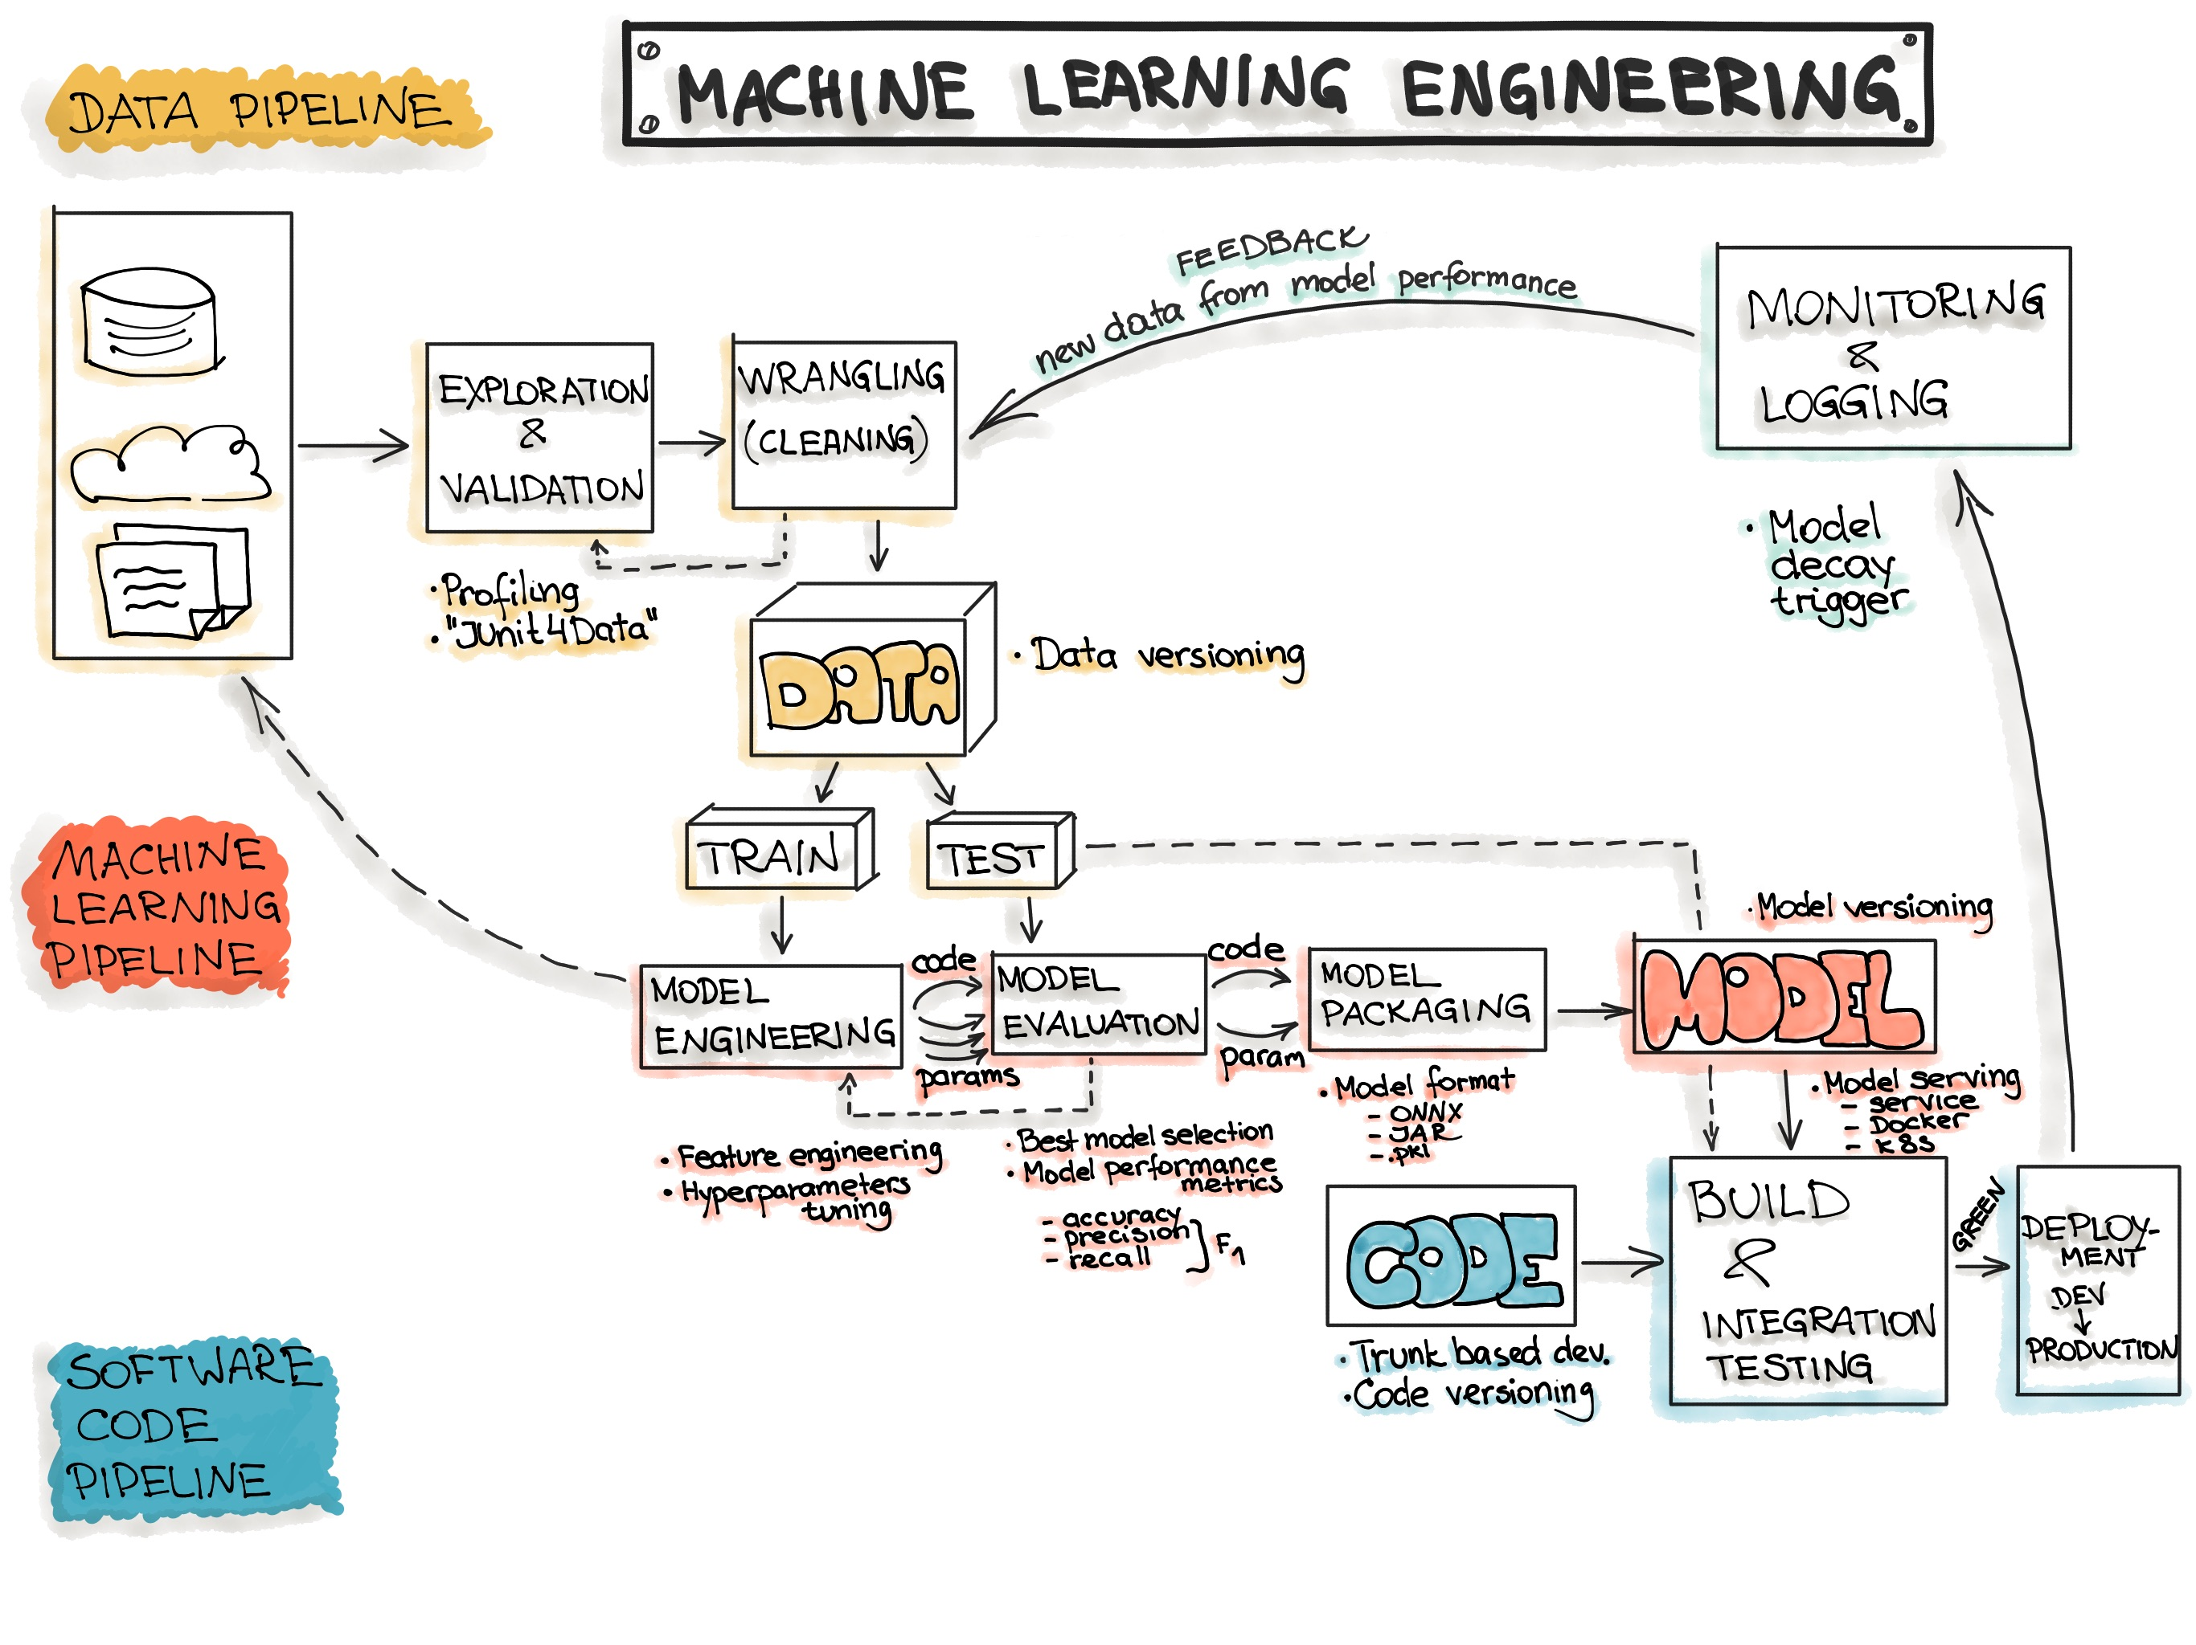
Reference: End-to-end Machine Learning Workflow. https://ml-ops.org/content/end-to-end-ml-workflow

Slide 18

Chapter 5: Challenges and Best Practices
Data Bias
Overfitting
Historical biases in training data can perpetuate unfair outcomes. Regular audits and diverse data sources help mitigate this risk.
Models that memorize training data fail to generalize. Use regularization, cross-validation, and appropriate model complexity.
Lack of Interpretability
Black-box models create trust issues. Employ explainable AI techniques and document model decisions for stakeholders.
Cross-Functional Collaboration
Ethical Considerations
Success requires seamless teamwork between data scientists, ML engineers, domain experts, and business stakeholders throughout the entire workflow.
Transparency, fairness, privacy protection, and accountability must be embedded in every stage of the ML workflow.

Slide 19

Conclusion: Mastering the Machine Learning Workflow
Clear Goals
Quality Data
Well-defined objectives aligned with business value
Clean, relevant, and properly prepared datasets
Rigorous Testing
Ongoing Care
Comprehensive evaluation and validation processes
Continuous monitoring and model maintenance
A disciplined, well-structured workflow transforms raw data into impactful solutions that deliver measurable business value and drive innovation.
Embrace these workflows, invest in the right tools and practices, and foster collaboration across teams to unlock the full potential of machine learning in your organization. The journey from data to deployment is complex, but with the right approach, it becomes a repeatable process for creating intelligent systems that make a real difference.

