Slide 1

Supervised Learning in Machine Learning: Teaching Machines to Predict
Discover how machines learn to make intelligent predictions by learning from examples, transforming the way we solve complex problems across industries.

Slide 2

Chapter 1
What is Supervised Learning?
Understanding the foundation of predictive machine learning and how labeled data guides algorithms to make accurate decisions.

Slide 3



The Essence of Supervised Learning
Learning from Examples
A machine learning technique that uses labeled data to teach algorithms, showing them the correct answers so they can learn patterns.
The Ultimate Goal
To predict outcomes accurately on new, unseen data by generalizing from the patterns learned during training.

Slide 4


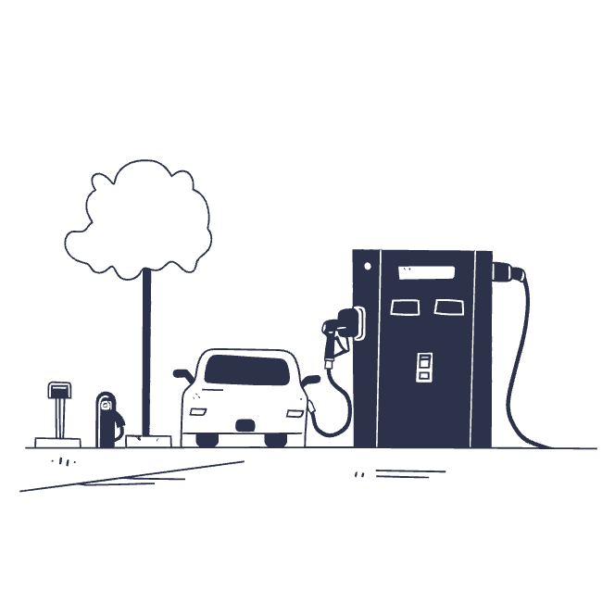
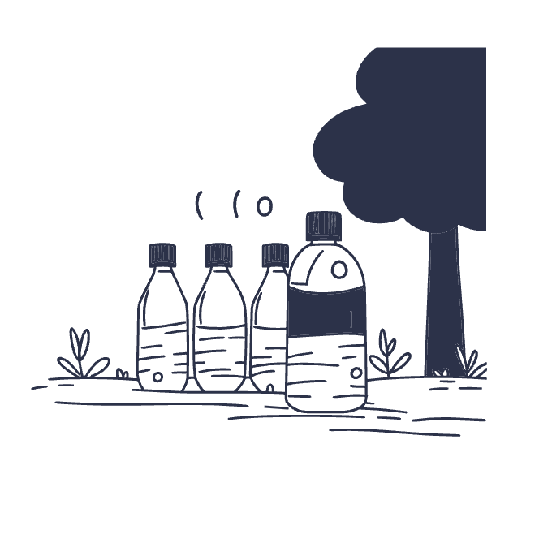


Labeled Data in Action
Each piece of training data comes with its correct answer—these labels are the foundation that enables supervised learning algorithms to understand patterns and make predictions.

Slide 5



How Supervised Learning Works: The Big Picture
Collect & Label Data
Train Models
Evaluate & Refine
Gather data points and assign correct answers (labels) to create your training foundation.
Feed labeled examples to algorithms so they learn the patterns linking inputs to outputs.
Test predictions on new data and fine-tune the model for better accuracy and reliability.

Slide 6

Chapter 2
The Supervised Learning Workflow
A systematic approach to building accurate predictive models from raw data to deployment.

Slide 7
Step 1: Define the Problem
What Are We Predicting?
Classification Example
Every successful supervised learning project starts with a clear problem definition. Are you detecting spam emails, recognizing images, or forecasting prices?
Spam detection: email is spam or not spam
The problem type determines everything that follows—from the data you collect to the algorithms you choose.
Recognition Example
Image recognition: identifying objects in photos
Regression Example
Price forecasting: predicting future values

Slide 8
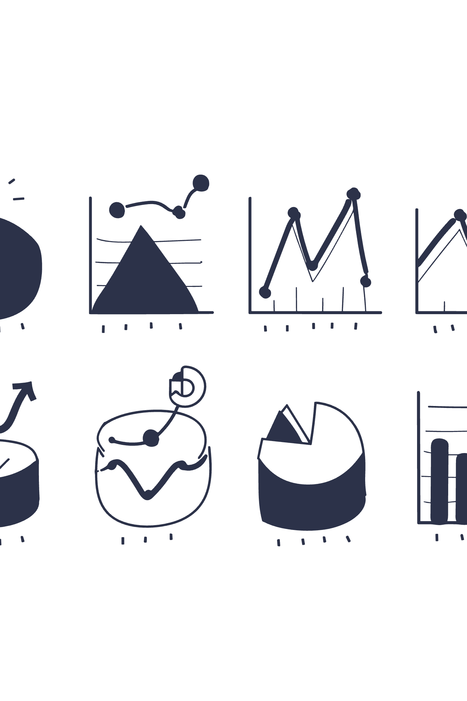
Step 2: Data Collection and Labeling
01
02
Gather Data
Assign Labels
Collect information from sensors, databases, user interactions, and other relevant sources.
Attach the correct answer or "ground truth" to each data point—this is what the model will learn from.
03
Ensure Quality
High-quality, accurate labels are essential—better labels lead to better model predictions and more reliable outcomes.

Slide 9
Step 3: Model Training and Evaluation
Feed Labeled Data
Validate Performance
Input your prepared dataset into the chosen algorithm to begin the learning process.
Use validation data to fine-tune hyperparameters and prevent overfitting.
1
2
3
4
Adjust Parameters
Test Accuracy
The model iteratively adjusts its internal parameters to minimize prediction errors.
Assess final performance on unseen test data to verify the model is ready for deployment.

Slide 10
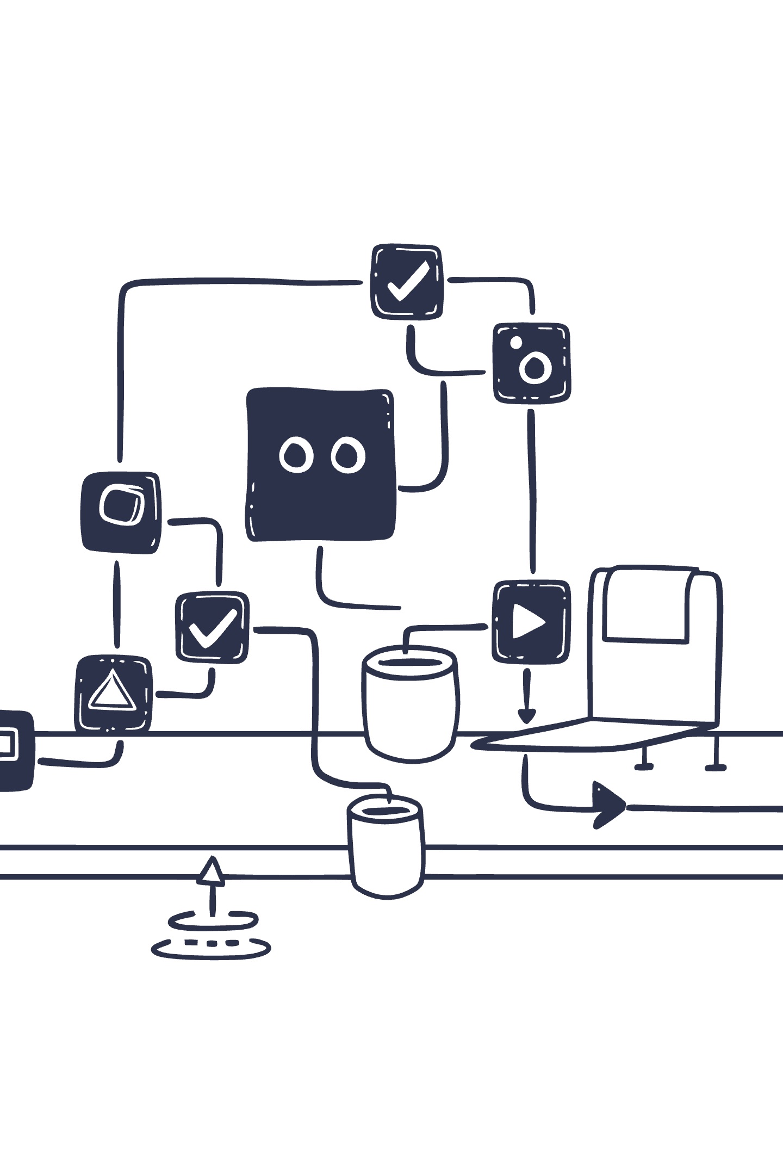
Chapter 3
Types of Supervised Learning Tasks
Understanding the two main categories of supervised learning problems and when to use each approach.

Slide 11


Classification: Sorting Into Categories
Predicting Discrete Labels
Classification tasks involve assigning data points to specific categories or classes. The output is always a label from a predefined set of possibilities.
Common Applications
Spam vs. legitimate email
Disease diagnosis: healthy vs. diseased
Real Example: Email spam filters learn from thousands of labeled emails to automatically identify and block junk mail, improving accuracy over time.
Image recognition: identifying objects in photos
Sentiment analysis: positive, neutral, or negative

Slide 12
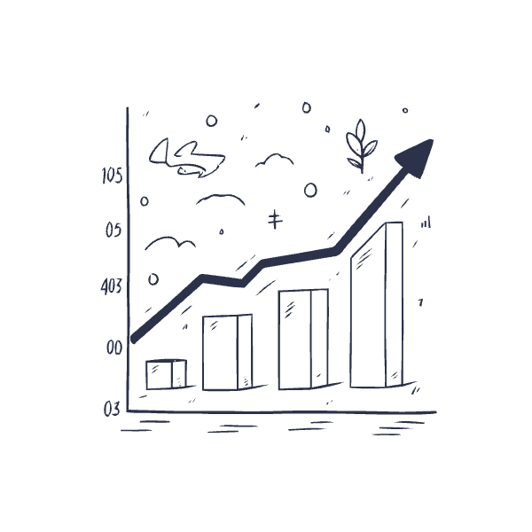


Regression: Predicting Continuous Values
Predicting Numerical Outcomes
Regression models predict continuous numerical values rather than discrete categories. The output can be any number within a range.
Typical Use Cases
House price estimation based on features
Stock market value forecasting
Temperature or weather predictions
Salary estimation from years of experience
Example: Predicting a person's salary based on their years of experience, education level, and job role—the output is a specific dollar amount.

Slide 13

Chapter 4
Popular Algorithms in Supervised Learning
Exploring the diverse toolkit of algorithms that power supervised learning, from simple trees to complex neural networks.

Slide 14
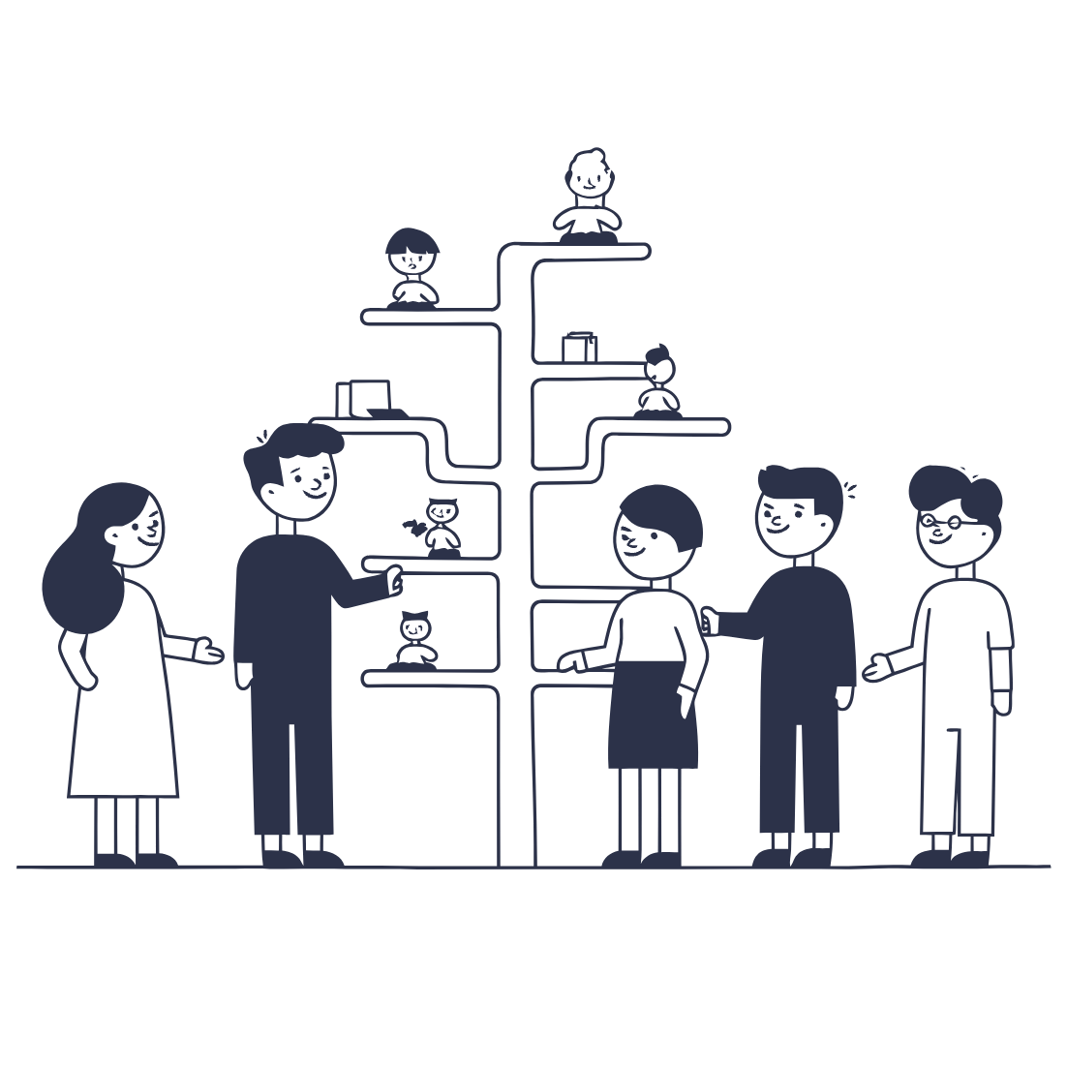


Common Algorithms
Decision Trees
Support Vector Machines
Neural Networks
Intuitive flowchart-like models that make decisions by asking a series of yes/no questions, splitting data at each branch.
Powerful algorithms that find the optimal boundary separating different classes in high-dimensional space.
Layered models inspired by the human brain, exceptionally powerful for complex data like images, text, and speech.

Slide 15

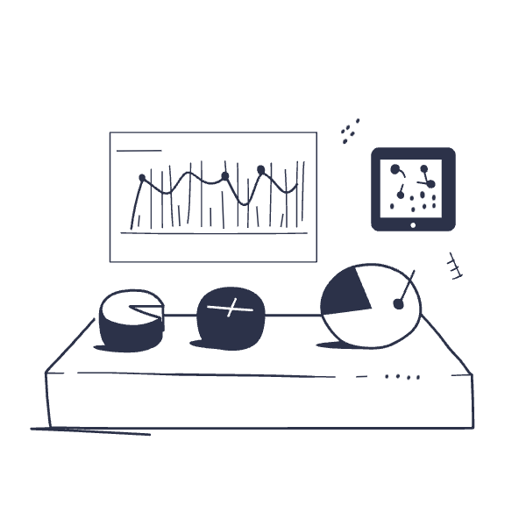
Training Techniques
Gradient Descent
An iterative optimization method that gradually adjusts model parameters by following the slope of the error function, systematically minimizing prediction mistakes.
Cross-Validation
A robust testing technique that evaluates models on different subsets of data, ensuring the model generalizes well and avoiding the pitfall of overfitting to training data.

Slide 16

Chapter 5
Real-World Applications and Impact
From healthcare diagnostics to personalized recommendations, supervised learning is transforming industries and improving lives.

Slide 17
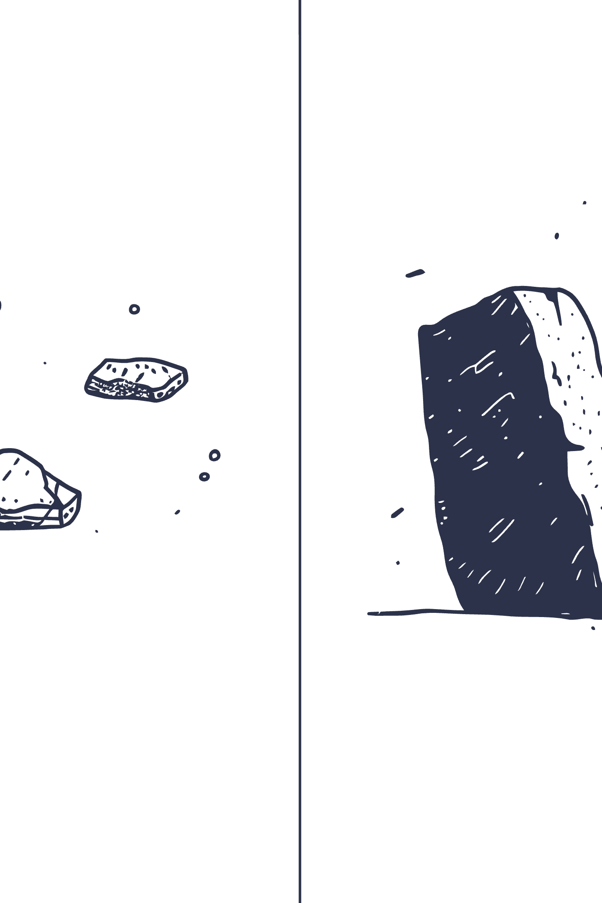



Everyday Uses of Supervised Learning
Healthcare Revolution
Diagnosing diseases from medical images like X-rays and MRIs with accuracy rivaling expert radiologists, enabling earlier detection and better patient outcomes.
Financial Risk Management
Predicting loan defaults and credit risk to help financial institutions make smarter lending decisions and protect against losses.
Personalized E-commerce
Recommending products based on customer behavior and preferences, increasing engagement and creating tailored shopping experiences.

Slide 18




The Future of Supervised Learning
Continuous Learning
Models that continuously improve over time by learning from new data, adapting to changing patterns and staying relevant.
AI Integration
Combining supervised learning with reinforcement learning and unsupervised learning to create more powerful, versatile AI systems.
Real-Time Decisions
Expanding into more complex, real-time decision-making systems that can respond instantly to dynamic environments and urgent situations.

Slide 19
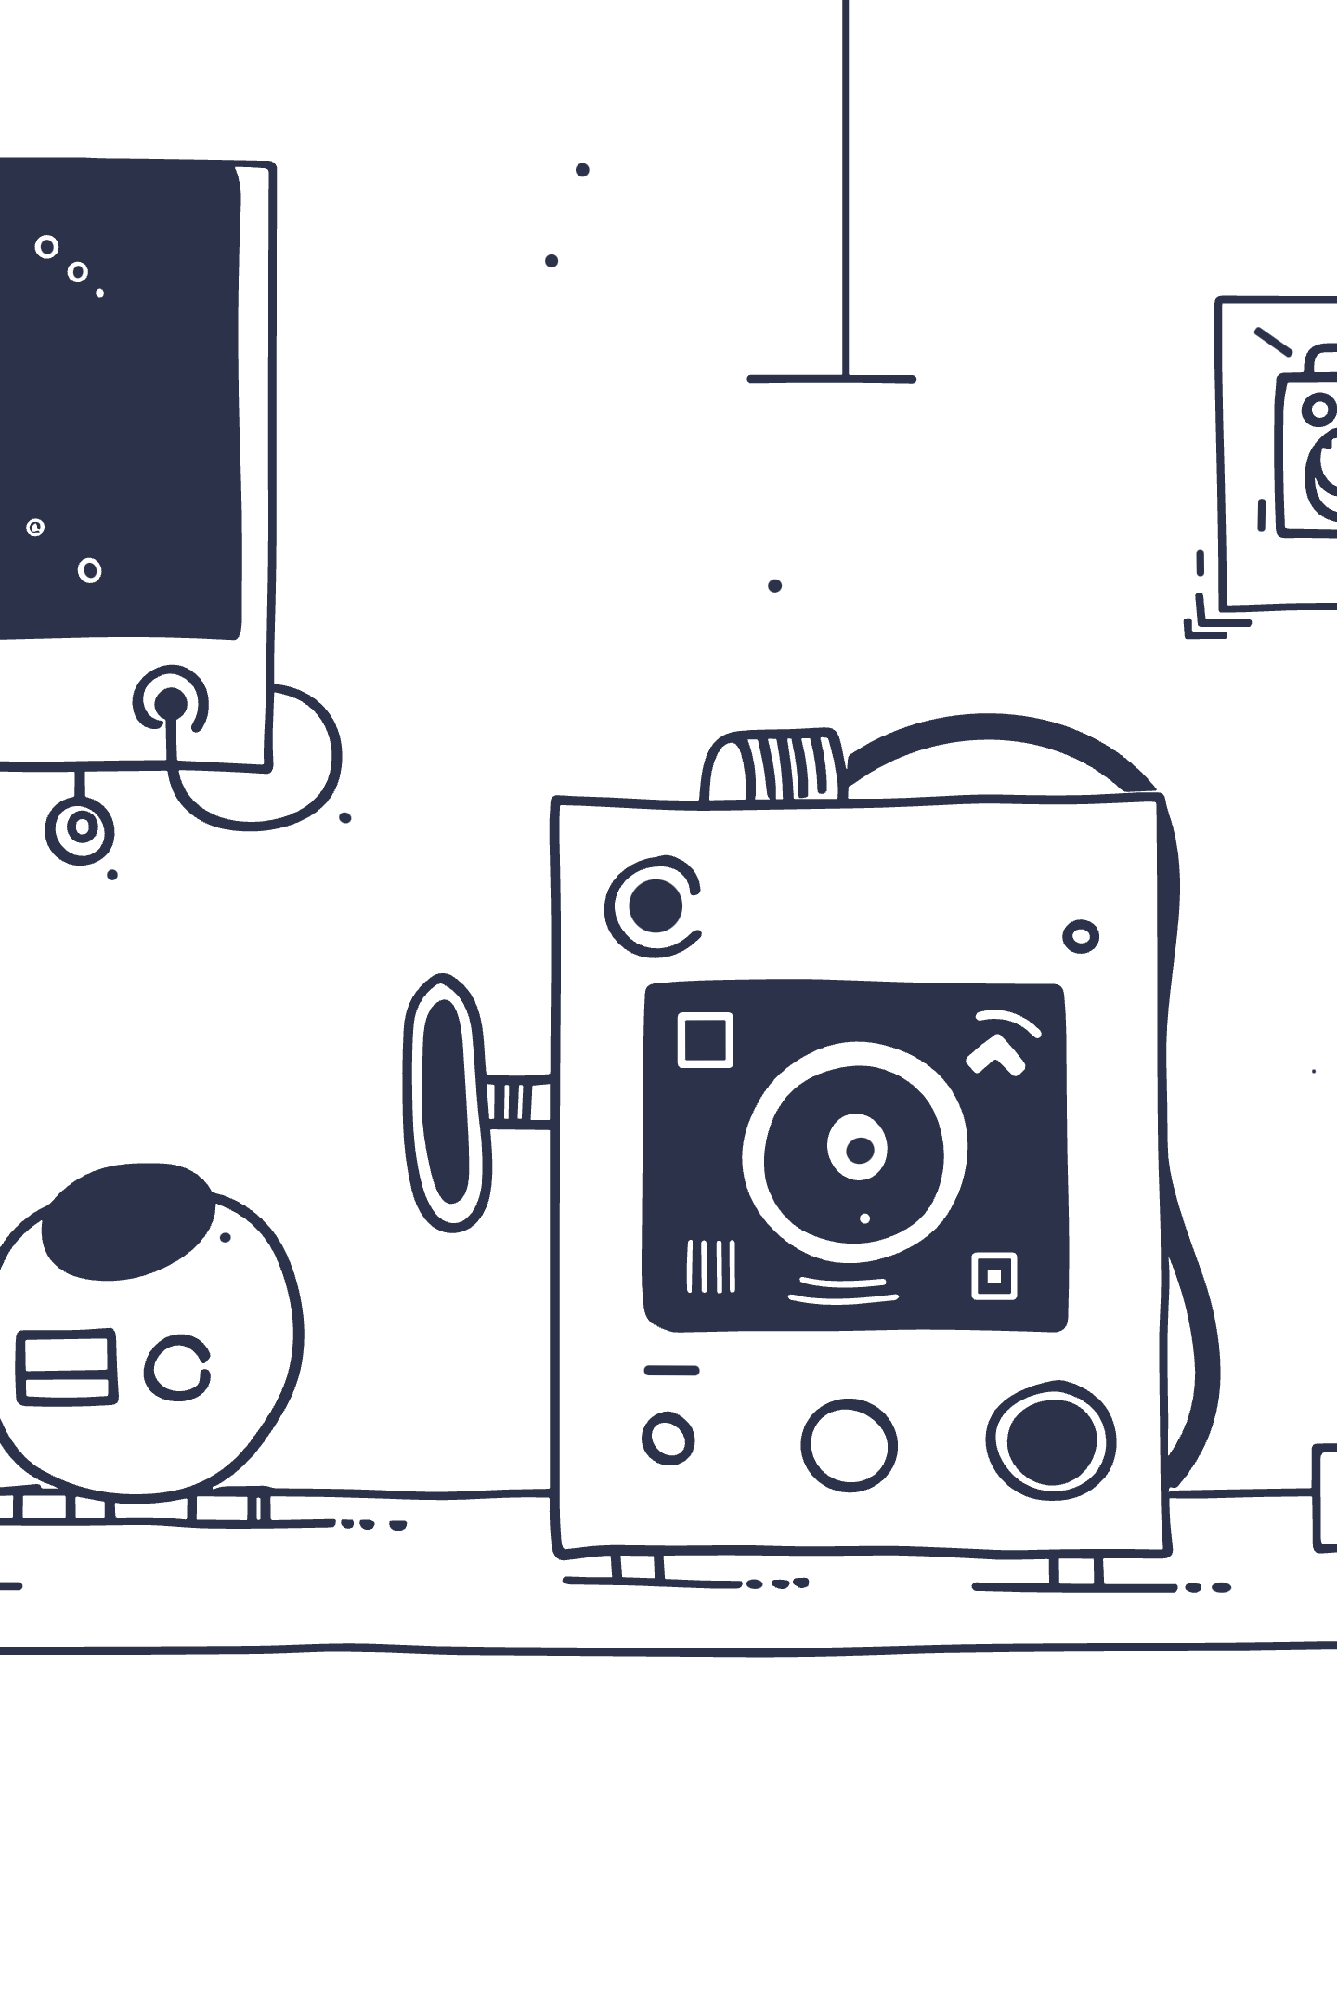
Conclusion: Empowering Decisions with Supervised Learning
Data to Predictions
Innovation Backbone
Supervised learning transforms raw, unstructured data into actionable predictions that drive intelligent decision-making.
It serves as the backbone of countless AI-powered innovations that are actively shaping our modern world every day.
Journey Begins
The journey from labeled data to smart, reliable predictions is just beginning—the possibilities are limitless.
The true power of supervised learning lies not just in what machines can predict today, but in how they'll help us solve tomorrow's challenges.

