Slide 1

Understanding Machine Learning Accuracy: Confusion Matrix & Cross-Validation
Evaluating machine learning models goes far beyond simple accuracy scores. Discover powerful techniques that reveal the true performance of your models and help build more reliable AI systems.

Slide 2
Why Accuracy Alone Can Be Misleading
The Accuracy Formula
The Hidden Problem
Classic Example
Accuracy = (Correct Predictions) / (Total Predictions)
High accuracy can mask poor performance on minority classes, creating a false sense of security
A model predicting "no disease" 99% of the time achieves 99% accuracy but catastrophically misses all sick patients
Simple to calculate, but dangerously incomplete for imbalanced datasets

Slide 3
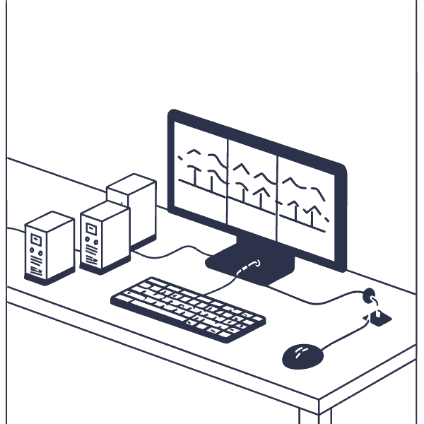
Introducing the Confusion Matrix: The Model's Report Card
What It Reveals
The confusion matrix is a powerful diagnostic tool that breaks down your model's predictions into four critical categories, revealing exactly where it succeeds and fails.
Visualizes True Positives (TP), False Positives (FP), True Negatives (TN), False Negatives (FN)
Shows precise error patterns beyond simple accuracy
Essential for understanding classification performance in depth

Slide 4
Anatomy of a Confusion Matrix
1
2
True Positives (TP)
False Positives (FP)
Correct positive predictions — for example, sick patients correctly diagnosed with the disease
Incorrect positive predictions — healthy patients wrongly diagnosed as sick (Type I error)
3
4
True Negatives (TN)
False Negatives (FN)
Correct negative predictions — healthy patients correctly identified as disease-free
Missed positive cases — sick patients incorrectly labeled as healthy (Type II error, often most dangerous)

Slide 5

Confusion Matrix Visualization
Clear Visual Performance
Identifying Confusion
Heatmaps make patterns instantly recognizable, with darker colors indicating higher prediction frequencies
Off-diagonal cells reveal which classes your model confuses with each other, guiding improvements

Slide 6

Key Metrics Derived from Confusion Matrix
4
Essential Metrics
Four powerful measures derived from the matrix
Precision
Recall (Sensitivity)
TP / (TP + FP)
TP / (TP + FN)
How reliable are positive predictions? Critical when false alarms are costly.
How many actual positives are detected? Vital when missing cases is dangerous.
F1 Score
Accuracy
Harmonic Mean
(TP + TN) / Total
Balances precision and recall into a single score for overall performance assessment.
Overall correctness, useful when classes are balanced.

Slide 7

Real-World Impact: Medical Diagnosis Example
False Negatives: Critical Misses
False Positives: Unnecessary Burden
Missing a sick patient (FN) can mean delayed treatment, disease progression, or worse. In cancer screening, this is the most dangerous error type.
Incorrectly diagnosing a healthy patient (FP) causes unnecessary anxiety, follow-up tests, and healthcare costs.
Strategic Model Tuning
The confusion matrix guides threshold adjustments to minimize whichever error type is most costly for your specific application.

Slide 8

The Problem with Single Train-Test Splits
Unreliable Estimates
A single train-test split can give you a misleadingly lucky or unlucky estimate of model performance, depending entirely on how the data happens to be divided.
Model might overfit or underfit based on specific data partition
Performance varies significantly with different random splits
Solution needed: A more robust, reliable evaluation methodology
No way to know if results are representative
High variance in evaluation metrics

Slide 9
Cross-Validation: The Gold Standard for Model Evaluation
01
02
03
Split Data into K Folds
Train on K-1 Folds
Test on Remaining Fold
Divide dataset into k equal parts (typically 5 or 10 folds)
Use k-1 folds for training the model
Evaluate on the held-out fold
04
05
Rotate Through All Folds
Average Results
Repeat k times, each fold used once as test set
Compute mean performance for stable estimate

Slide 10
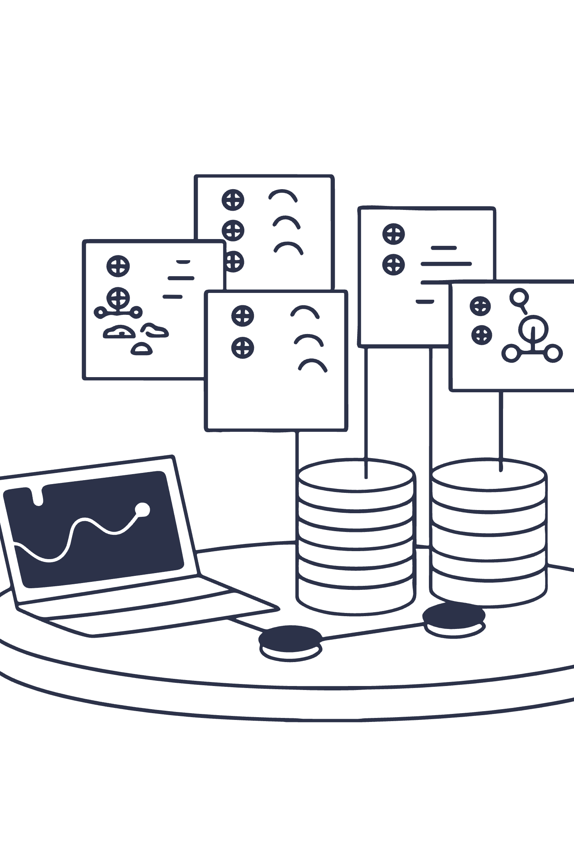
Visualizing K-Fold Cross-Validation
Iterative Process
Reduced Variance
Each fold takes its turn as the test set, ensuring every data point is evaluated
Averaging across folds dramatically reduces performance estimate variance
Overfitting Detection
Helps identify if your model memorizes training data instead of learning patterns

Slide 11
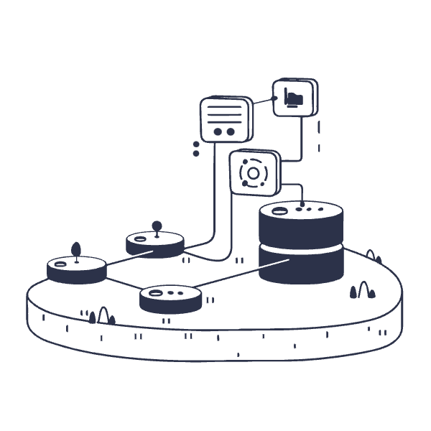
Combining Confusion Matrix with Cross-Validation
The Power of Integration
By generating a confusion matrix for each fold's test predictions and aggregating them, you achieve both detailed error analysis and robust validation.
Generate confusion matrix for each fold
Sum matrices across all folds
Analyze aggregate patterns
Calculate metrics with confidence intervals
This combination provides the most comprehensive and reliable assessment of classification model performance.

Slide 12
Python Implementation Example
from sklearn.model_selection import cross_val_predict
from sklearn.metrics import confusion_matrix
from sklearn.ensemble import RandomForestClassifier
# Initialize model
model = RandomForestClassifier(n_estimators=100)
# Get predictions from cross-validation
y_pred = cross_val_predict(model, X, y, cv=10)
# Generate confusion matrix
cm = confusion_matrix(y, y_pred)
print("Confusion Matrix:\n", cm)
# Calculate metrics
TP = cm[1,1]
FP = cm[0,1]
FN = cm[1,0]
TN = cm[0,0]
precision = TP / (TP + FP)
recall = TP / (TP + FN)
f1_score = 2 * (precision * recall) / (precision + recall)
print(f"Precision: {precision:.3f}")
print(f"Recall: {recall:.3f}")
print(f"F1-Score: {f1_score:.3f}")

