Slide 1
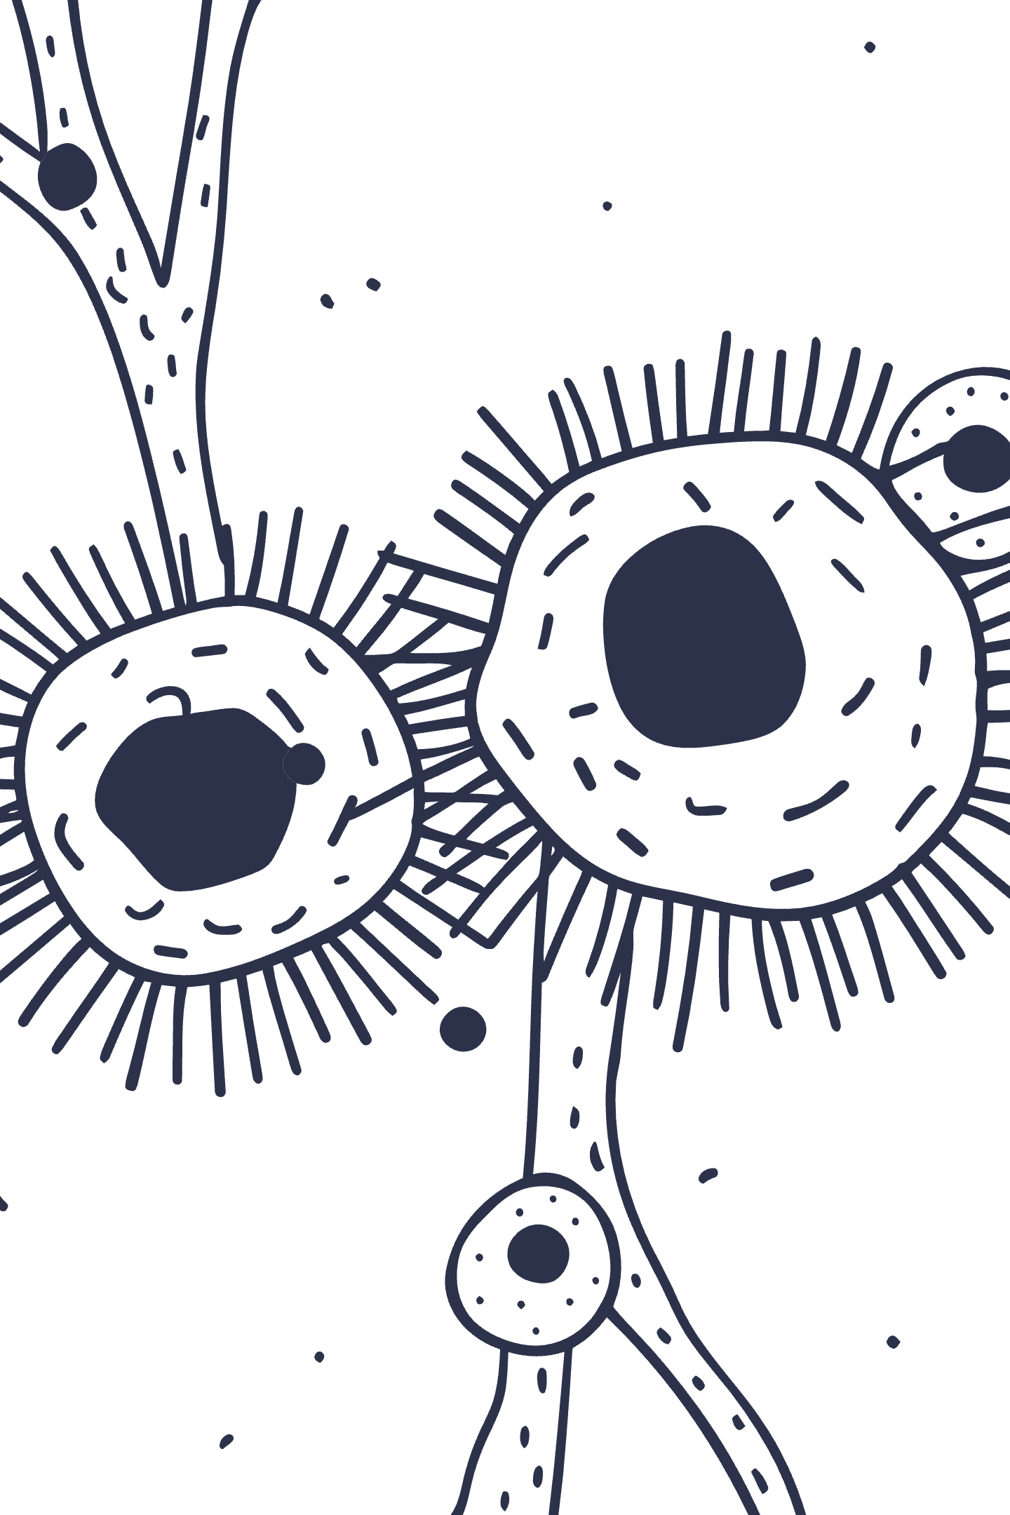
Introduction to Unsupervised Learning in Machine Learning
Discover how machines learn to find hidden patterns and structures in data without human guidance, unlocking insights from the vast ocean of unlabeled information.

Slide 2

What is Unsupervised Learning?
Unsupervised learning is a powerful type of machine learning where models learn from unlabeled data without explicit human guidance. The algorithm discovers hidden patterns, structures, or natural groupings on its own.
Unlike supervised learning, there are no predefined labels or output categories—the model explores the data landscape independently, revealing insights that might otherwise remain hidden.

Slide 3

Supervised vs. Unsupervised Learning
Supervised Learning
Unsupervised Learning
Learns from labeled input-output pairs with clear answers
Works with raw data to find patterns without predefined answers
Requires human-annotated data
Example: Images tagged as "cat" or "dog"
No labels or guidance needed
Model learns to predict specific outcomes
Example: Grouping animals by features without knowing species names
Model discovers structure independently

Slide 4




How Does Unsupervised Learning Work?
Collect Data
Apply Algorithms
Gather unlabeled, raw data such as weather measurements, customer transactions, or sensor readings
Use computational methods to detect similarities, differences, or associations within the data
Organize Patterns
Extract Insights
Model structures data into clusters, rules, or reduced dimensions automatically
Humans interpret the discovered groupings or patterns to gain actionable insights

Slide 5
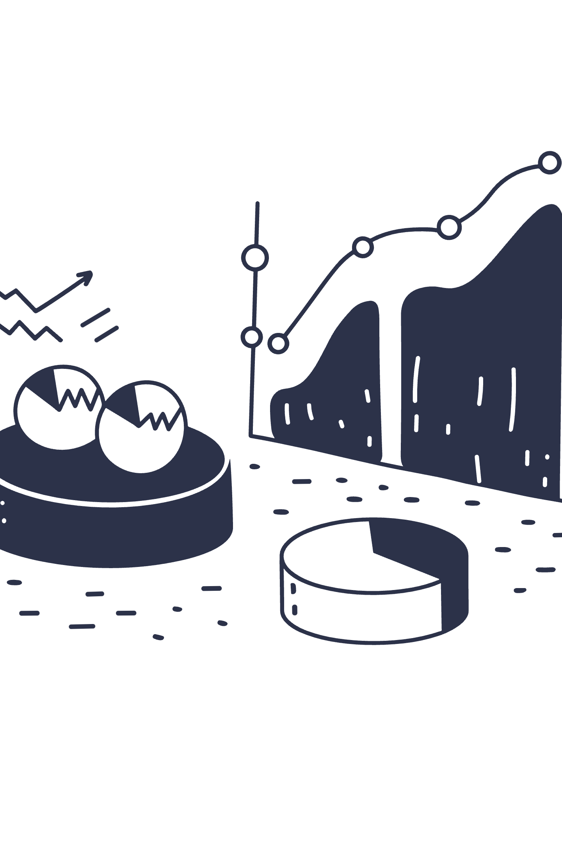
Main Types of Unsupervised Learning Methods
1
2
Clustering
Association Rule Learning
Groups data points by similarity using algorithms like K-Means, Hierarchical clustering, and DBSCAN. Perfect for customer segmentation and pattern discovery.
Finds interesting relationships between variables in large datasets. Commonly used in market basket analysis and recommendation systems.
3
Dimensionality Reduction
Simplifies complex data by reducing features while preserving essential structure. Techniques like PCA enable visualization and faster processing.

Slide 6

Clustering: Discovering Natural Groups
Real-World Example
Customer segmentation for targeted marketing campaigns
K-Means Clustering
Partitions data into K distinct groups based on feature similarity and centroid distance
Hierarchical Clustering
Builds nested groups in a tree-like structure, revealing relationships at multiple levels
DBSCAN
Identifies clusters in dense regions while effectively ignoring outliers and noise

Slide 7

Association Rule Learning
Finding Hidden Relationships in Data
Market Basket Analysis
"90% of customers who buy bread also buy butter"
This insight drives strategic product placement and promotional bundling in retail environments.
Apriori Algorithm
Identifies frequent itemsets and generates powerful "if-then" association rules from transaction data.
Retailers use these patterns to optimize store layouts and increase cross-selling opportunities.

Slide 8




Dimensionality Reduction
Simplifying Complex Data
Dimensionality reduction transforms high-dimensional data into fewer dimensions while preserving the most important structural information.
Principal Component Analysis (PCA)
Transforms thousands of features into a handful of key components that capture maximum variance
Visualization Benefits
Enables visualization of complex datasets in 2D or 3D space for human interpretation
Performance Boost
Dramatically speeds up machine learning algorithms and reduces computational requirements

Slide 9
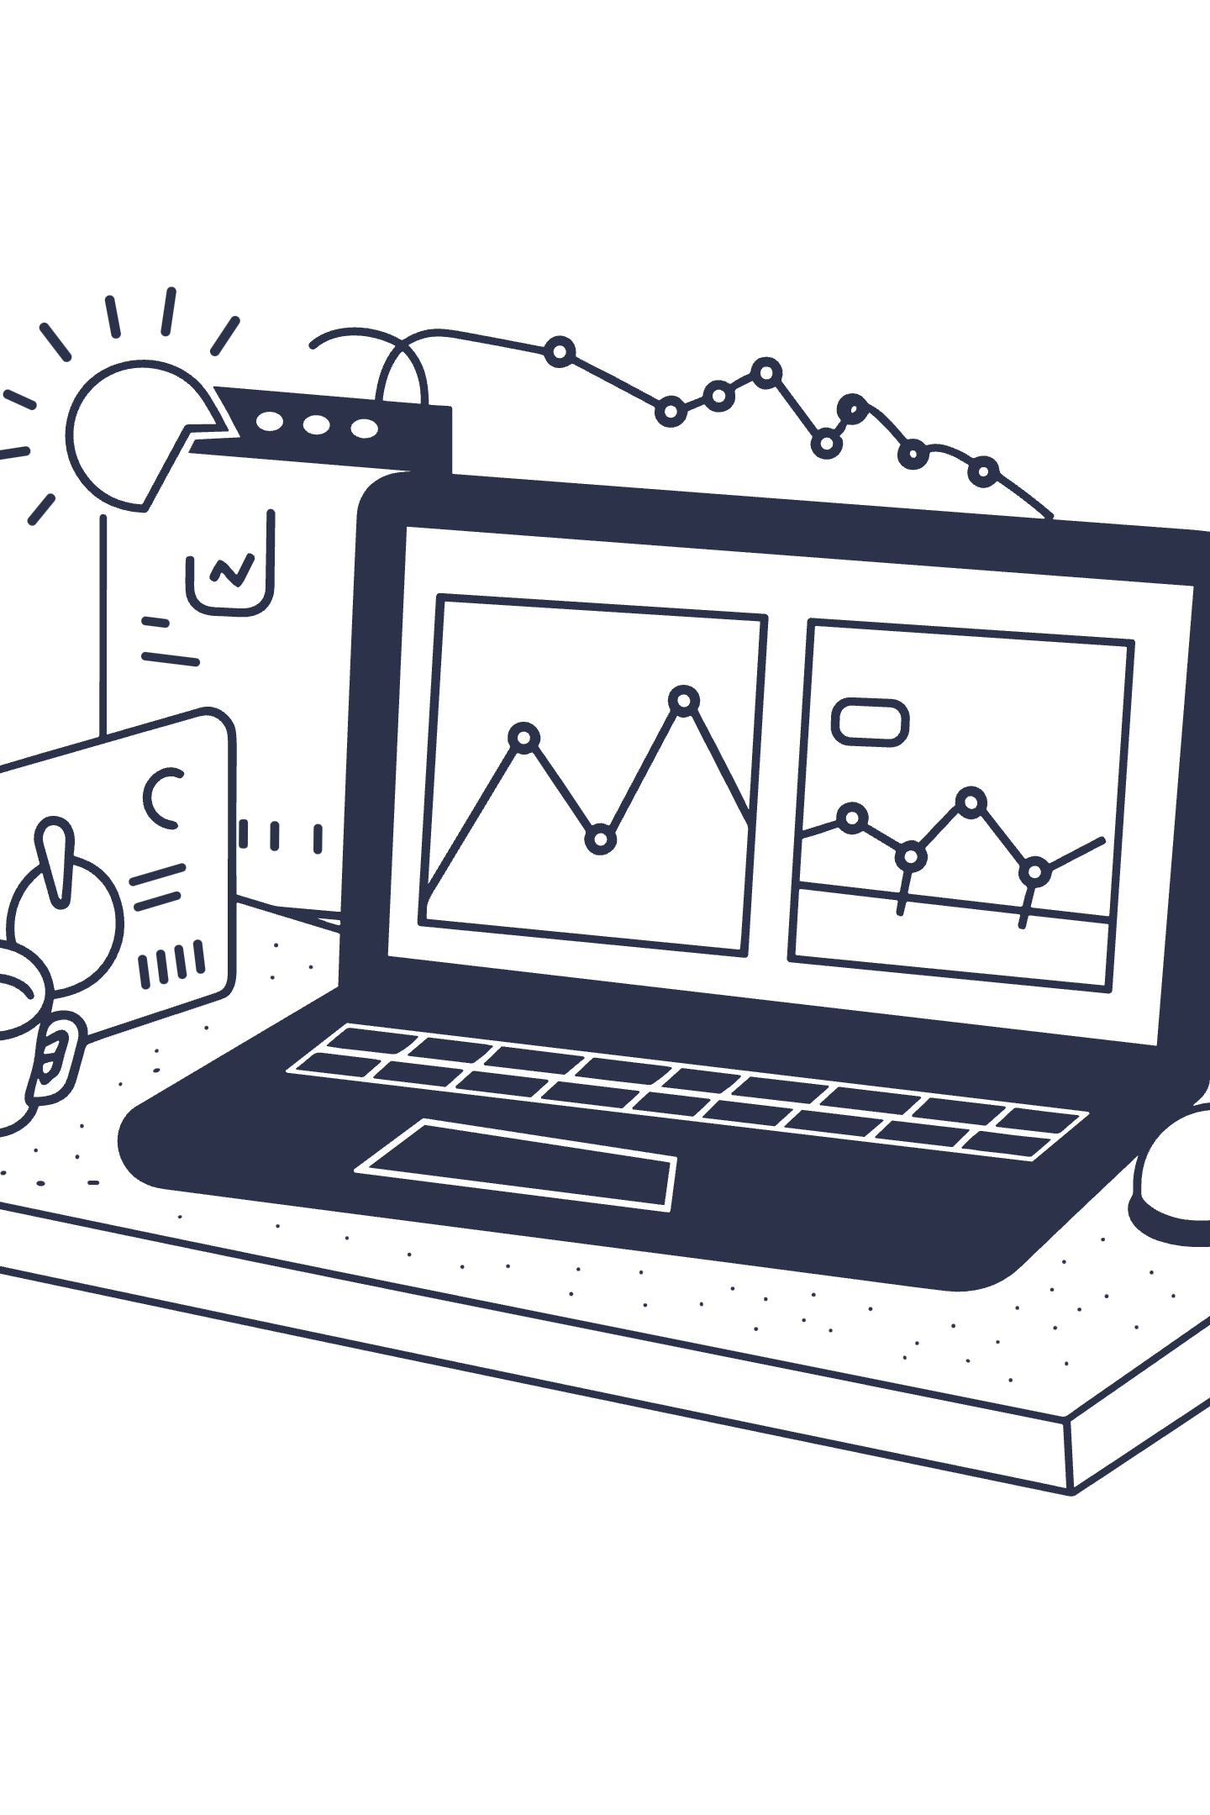




Real-World Applications
Fraud Detection
Identifies unusual transaction patterns and suspicious activity by detecting anomalous clusters that deviate from normal behavior.
Image Recognition
Groups similar images without labels, enabling automatic photo organization and content-based search systems.
Customer Analytics
Analyzes behavior patterns to deliver personalized recommendations and tailored user experiences.
Anomaly Detection
Spots irregularities in network security, manufacturing processes, and system monitoring applications.

Slide 10
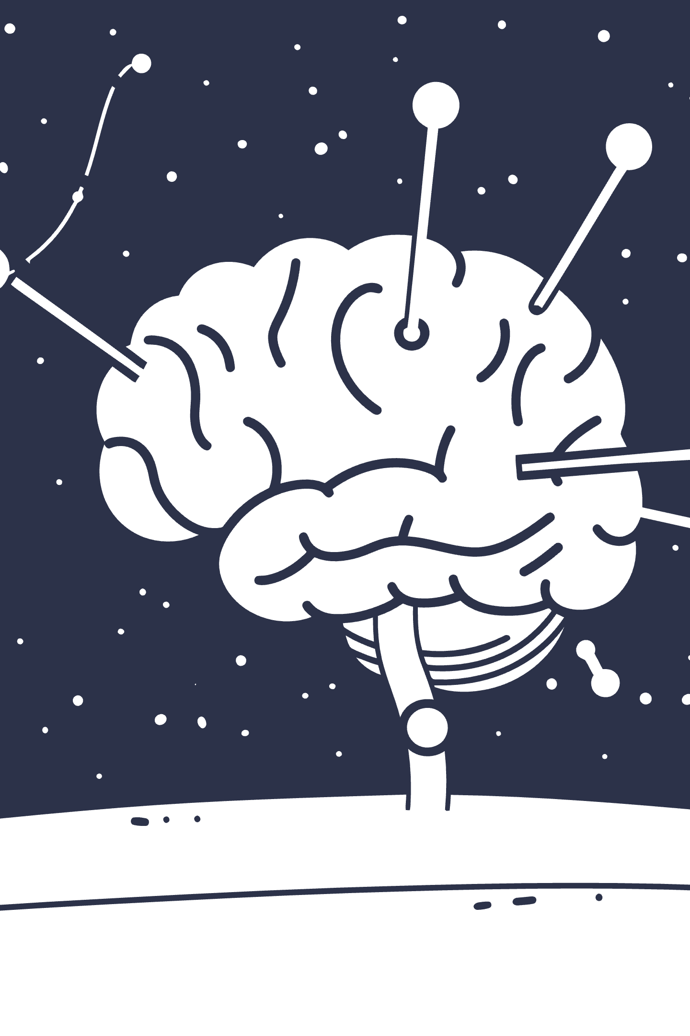




The Future of Unsupervised Learning
Massive Unlabeled Datasets
Growing importance as the volume of unlabeled data continues to explode across industries
Generative AI Advances
Breakthroughs in generative models and self-supervised learning are pushing boundaries
Unlocking Insights
Critical for discovering patterns where manual labeling is prohibitively costly or impossible
Human-Like Learning
Empowering AI systems to learn more naturally by discovering patterns independently

