Slide 1
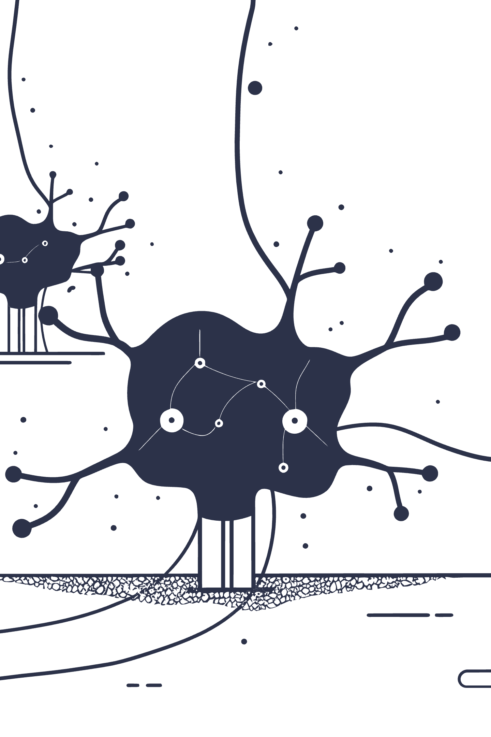
Machine Learning: Clustering and Dimensionality Reduction Unveiled
Discovering hidden patterns and structures in complex data through powerful unsupervised learning techniques

Slide 2
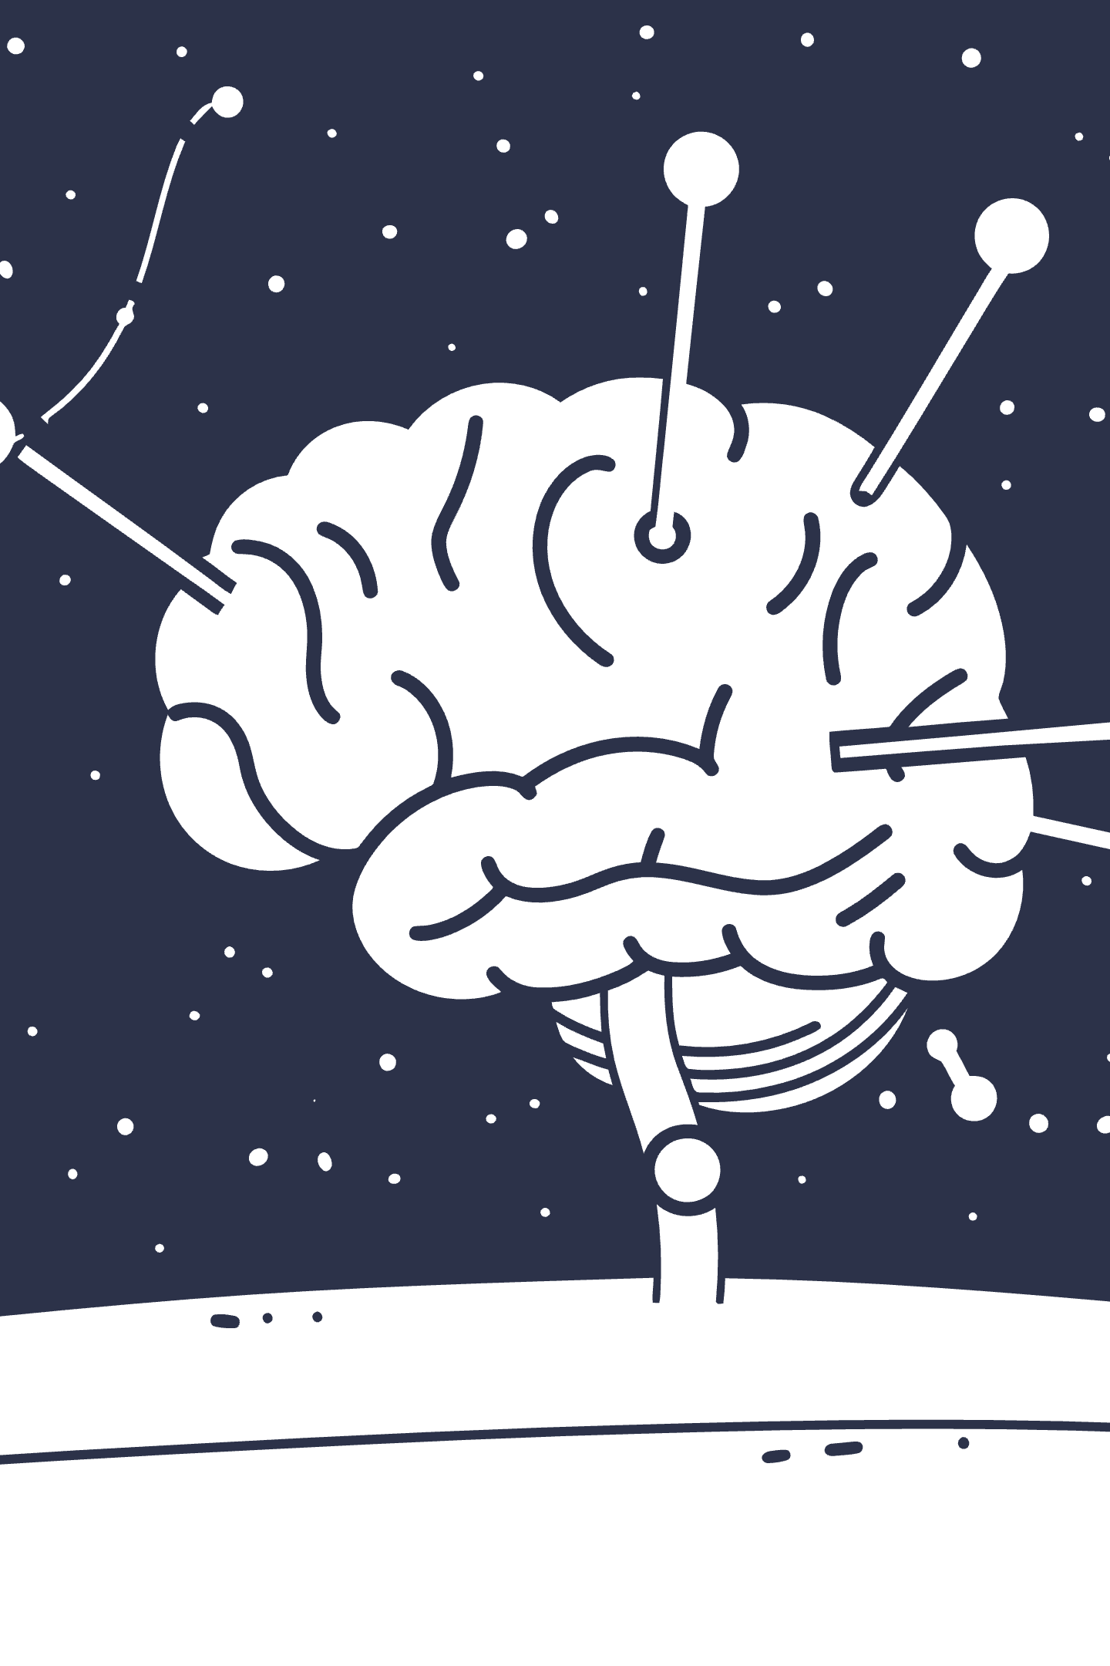
Chapter 1: The Power of Unsupervised Learning
Pattern Discovery
Real-World Impact
Unsupervised learning lets machines find hidden patterns without labeled data, uncovering insights humans might miss
Key for analyzing complex, unlabeled datasets in fields from cybersecurity to bioinformatics and beyond
Two Core Pillars
Clustering groups similar data points together; Dimensionality Reduction simplifies data representation

Slide 3

Why Unsupervised Learning Matters Today
$1.8T
Transforming Industries
Unsupervised methods enable breakthrough insights where labeling is impossible or prohibitively costly, opening new frontiers in data analysis.
AI Market by 2030
Projected global market size
38.8%
These techniques form the foundation for anomaly detection, sophisticated recommendation systems, and exploratory data analysis across sectors.
ML Growth Rate
Compound annual growth rate

Slide 4
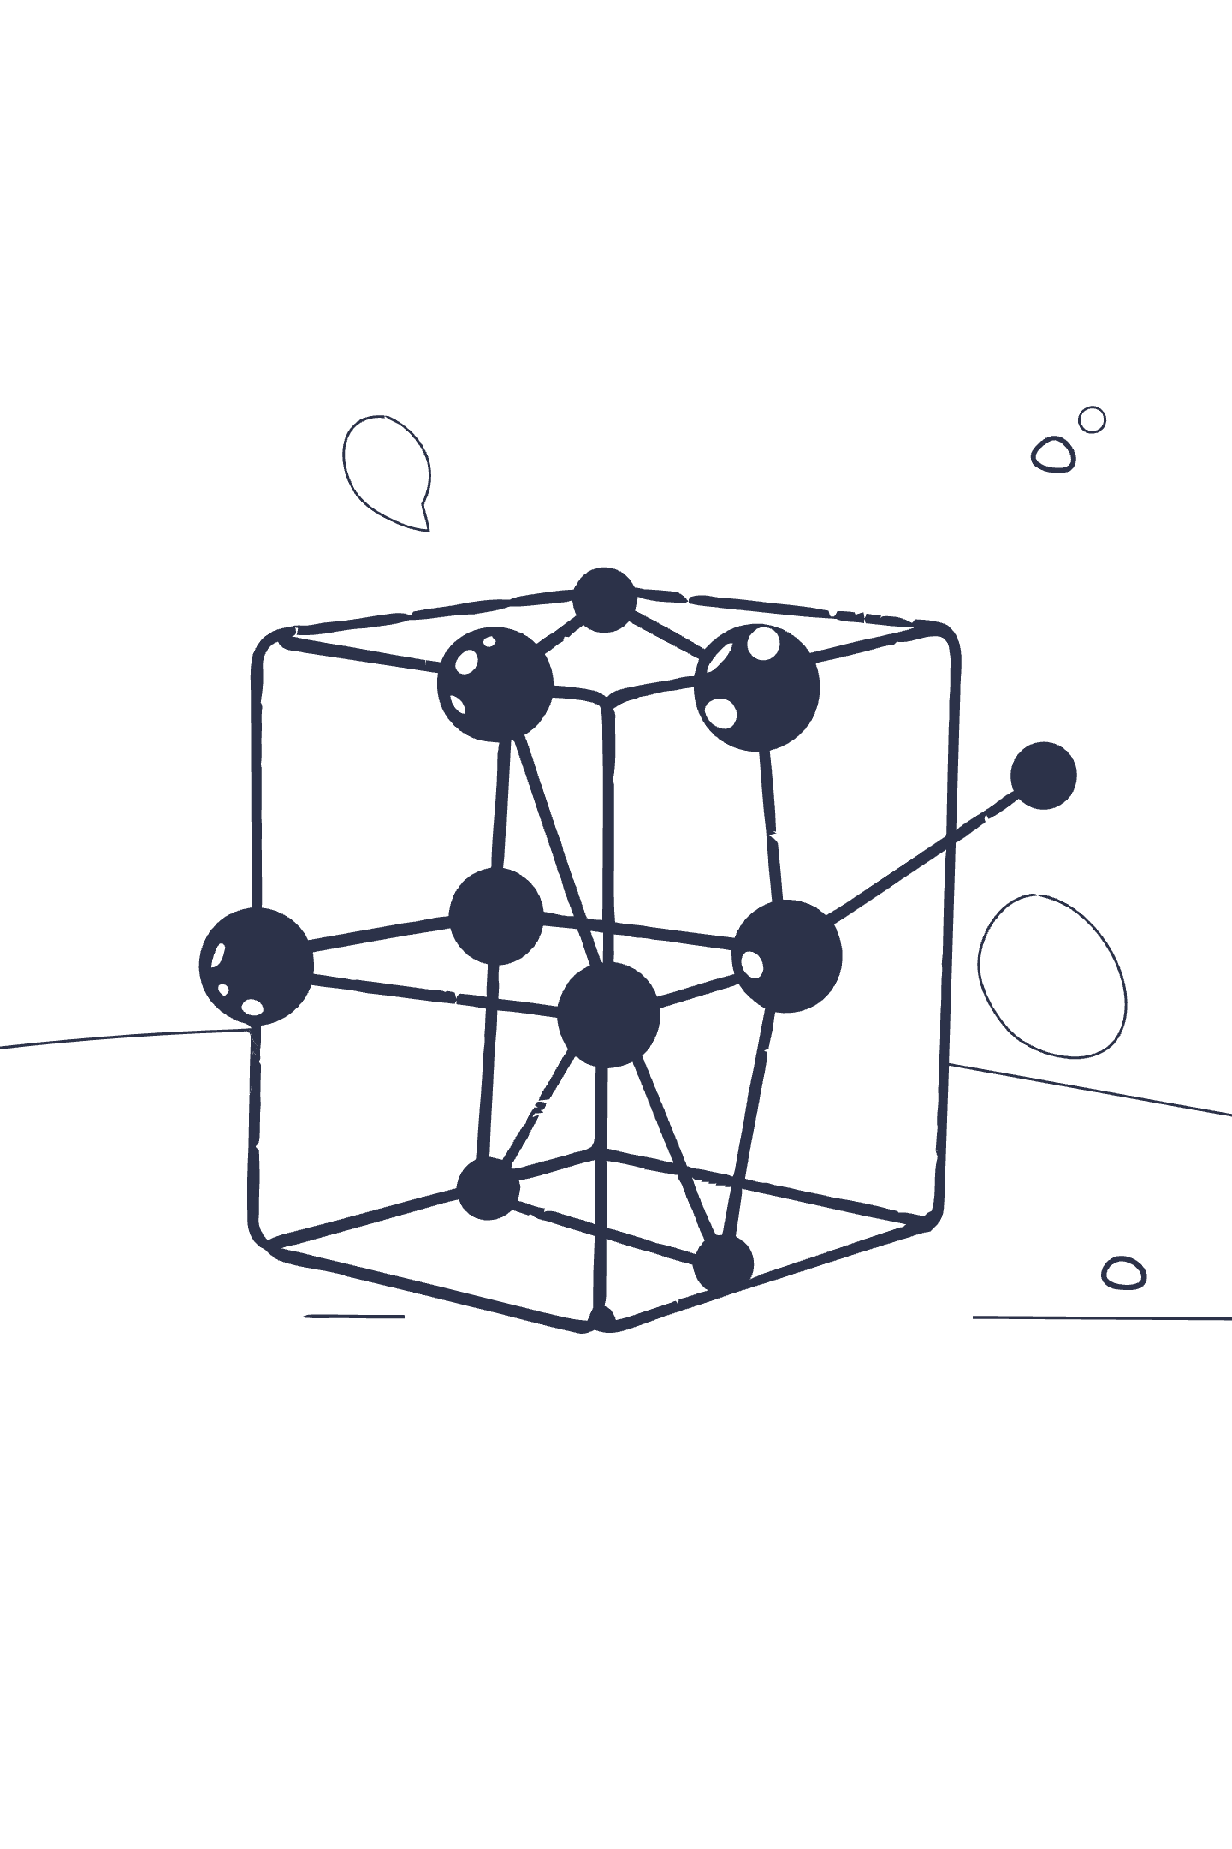
Chapter 2: Clustering — Grouping the Unknown
Discovering Natural Groups
Clustering partitions data into meaningful groups based on similarity without requiring prior labels or supervision
Unlocking Hidden Insights
Enables discovery of natural groupings, customer segments, anomaly clusters, and patterns that weren't previously obvious
Two Main Approaches
Partitioning methods like K-Means divide data into distinct clusters; Hierarchical clustering builds nested cluster trees

Slide 5
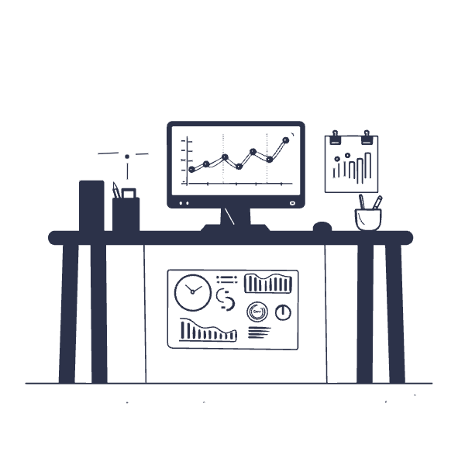

K-Means Clustering: The Workhorse
How It Works
K-Means assigns data points to K clusters by minimizing the distance to cluster centroids, creating clear boundaries between groups.
01
Initialize Centroids
Randomly place K cluster centers
02
Assign Points
Group data by nearest centroid
03
Update Centers
Recalculate centroid positions
Key Advantage: Widely used for its simplicity, speed, and exceptional scalability in handling large datasets
04
Iterate
Repeat until convergence

Slide 6




Hierarchical Clustering: Building a Tree of Clusters
Merge Closest Pairs
Individual Points
Combine the two nearest clusters iteratively
Start with each data point as its own cluster
Visualize Results
Build Hierarchy
Produces dendrograms showing all cluster merges
Create nested structure of cluster relationships
This agglomerative approach proves especially useful when the number of clusters is unknown or when clusters have a naturally nested structure.

Slide 7
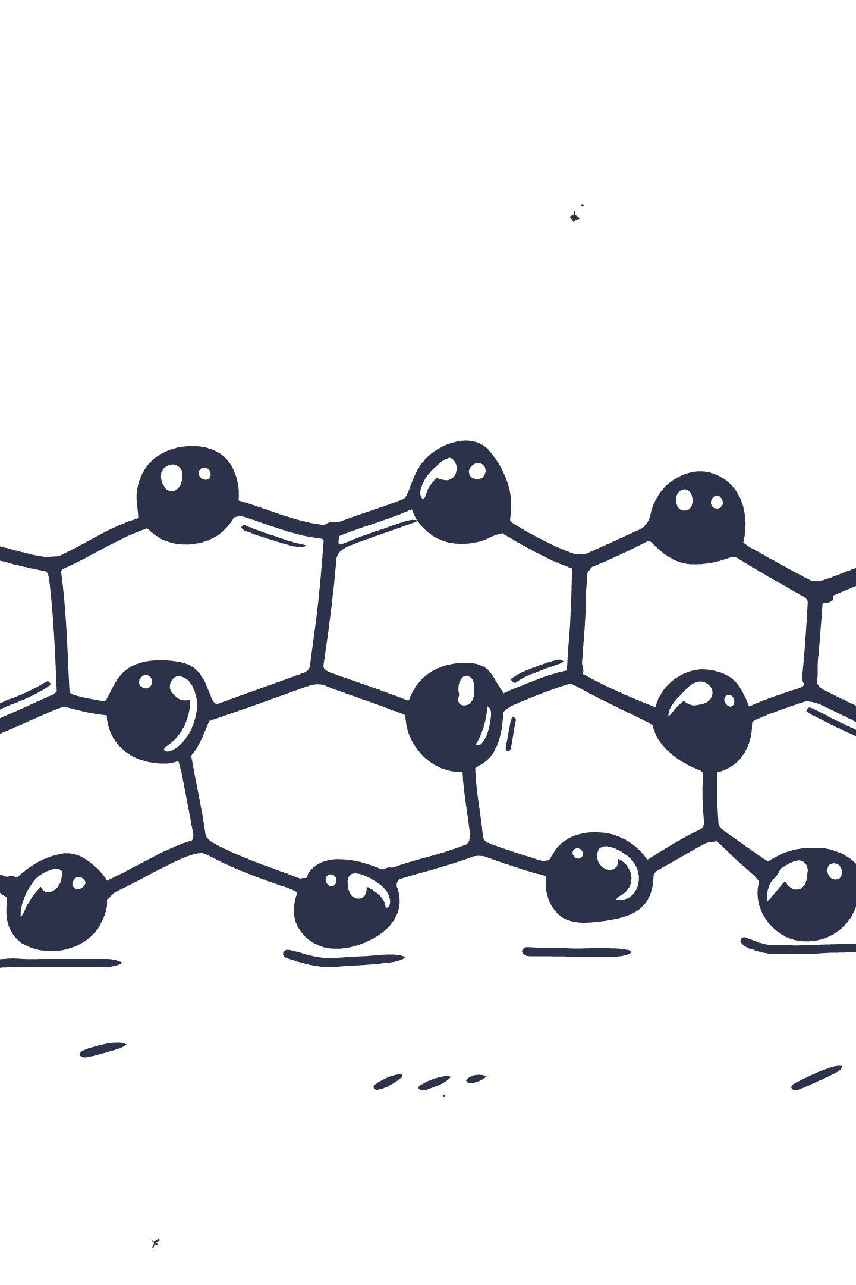
Dendrogram Visualization
A dendrogram reveals the hierarchical relationship between clusters, showing how data points progressively merge into larger groups. The height of each branch indicates the distance at which clusters combine.

Slide 8

Chapter 3: Dimensionality Reduction — Simplifying Complexity
The Challenge
The Solution
High-dimensional data can be noisy, redundant, and nearly impossible to visualize effectively, obscuring meaningful patterns
Dimensionality reduction projects data into fewer dimensions while preserving the most important information and structure
Two Main Strategies
Feature Selection chooses the most relevant existing features; Feature Extraction creates new meaningful features from combinations

Slide 9
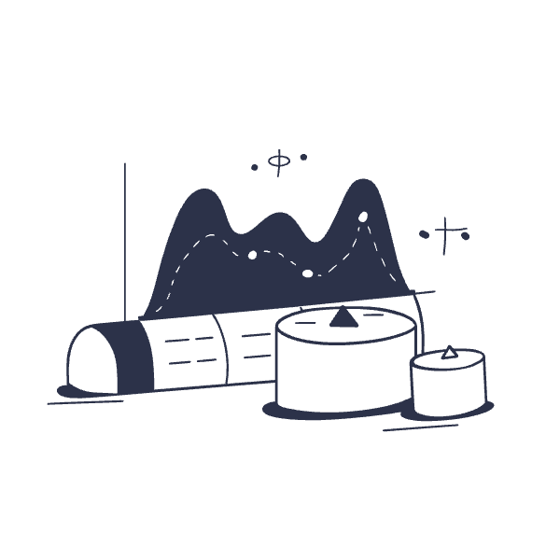
Principal Component Analysis (PCA): The Classic Technique
Maximum Variance Capture
PCA finds new axes called principal components that capture the maximum variance in your data, revealing the directions of greatest variability.
Uncorrelated Transformation
It transforms original features into uncorrelated components ranked by importance, eliminating redundancy and noise.
Practical Benefits
Enables intuitive 2D/3D visualization
Speeds up downstream ML algorithms
Reduces storage requirements

Slide 10



Beyond PCA: Nonlinear Techniques like t-SNE and UMAP
t-SNE Excellence
UMAP Advantages
Manifold Discovery
t-Distributed Stochastic Neighbor Embedding excels at visualizing complex data clusters in 2D or 3D space, preserving local neighborhood structures beautifully
Uniform Manifold Approximation and Projection preserves both local and global data structure, offering faster computation and better scalability than t-SNE
Both techniques reveal hidden data manifolds and nonlinear patterns that linear methods like PCA simply cannot capture

Slide 11

Dimensionality Reduction in Action
The transformation from high-dimensional space to 2D reveals hidden structure. Original data (left) appears as an incomprehensible cloud, while PCA and UMAP projections (right) expose distinct clusters and relationships.

Slide 12








Chapter 4: Clustering vs Dimensionality Reduction — Complementary, Not the Same
Clustering
Reduction
Explicitly groups similar data points together into distinct categories
Transforms data representation into fewer dimensions
Pipeline
Synergy
Using PCA or UMAP before K-Means improves cluster quality dramatically
Reduction enhances clustering by removing noise and redundancy

Slide 13
Real-World Applications
Customer Segmentation
Anomaly Detection
Image Recognition
Clustering identifies distinct buyer personas and behaviors, while PCA reduces feature overload from hundreds of customer attributes to actionable insights
Dimensionality reduction highlights outliers in high-dimensional security data, and clustering isolates suspicious activity patterns for investigation
Feature extraction reduces massive pixel data to manageable representations, enabling clustering to group visually similar images efficiently

Slide 14

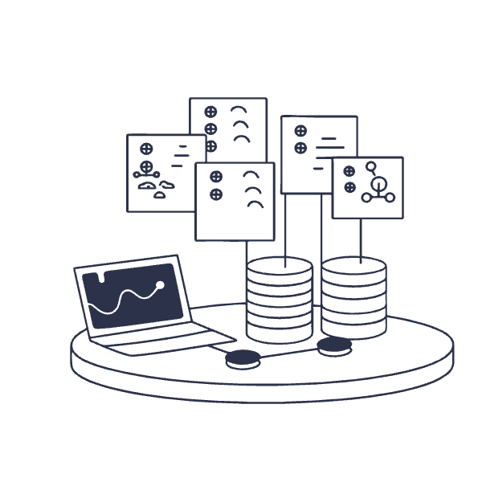

Cutting-Edge Advances and Tools
Industry-Standard Libraries
Next-Generation Methods
Scikit-learn offers robust, production-ready implementations of K-Means, Agglomerative Clustering, and PCA that power ML pipelines worldwide.
UMAP is rapidly gaining popularity for scalable nonlinear dimension reduction, outperforming t-SNE in both speed and quality.
Pro Tip: Integration pipelines that combine reduction and clustering stages unlock powerful insights that neither technique achieves alone

Slide 15



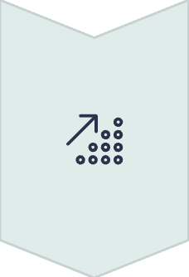
Conclusion: Harnessing the Magic of Unsupervised Learning
Unlock Hidden Insights
Clustering and dimensionality reduction reveal patterns and structures in unlabeled data that traditional methods miss
Simplify Complexity
Together, these techniques transform overwhelming high-dimensional data into understandable, actionable knowledge
Empower Smart Solutions
Mastering these techniques empowers you to build more intelligent AI solutions across every industry
Ready to explore your data's hidden stories?

