Slide 1

Evaluating Unsupervised Machine Learning Metrics
A comprehensive guide to assessing model performance when ground truth is unavailable

Slide 2
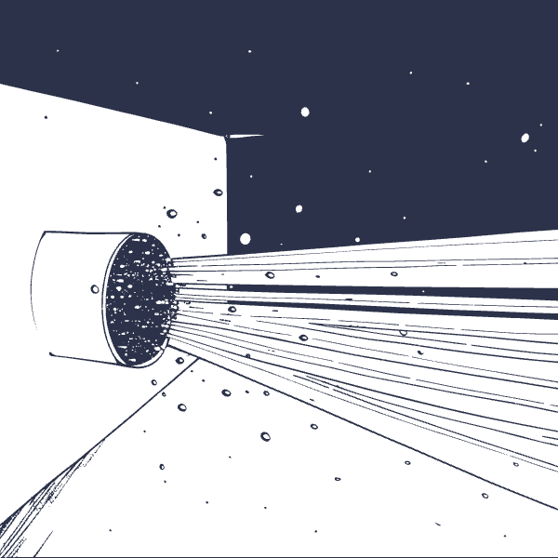
The Challenge of Evaluation in Unsupervised Learning
The Core Problem
Unlike supervised learning, unsupervised models operate without labeled data to validate their outputs. This creates a fundamental challenge: how do we measure success when we don't know what "correct" looks like?
Models discover hidden patterns, group similar data points, and create representations—but without ground truth, evaluation becomes an art as much as a science.
No Ground Truth Labels
Pattern Discovery
Meaningful Validation
Cannot directly compare results to known correct answers
Models autonomously identify structure without supervision
Must determine if discovered patterns have real-world significance

Slide 3



Key Approaches to Evaluation
Three fundamental methodologies enable us to assess unsupervised learning quality, each with distinct advantages and use cases.
Internal Metrics
External Metrics
Proxy Tasks
Leverage only the data itself to assess cluster quality
Compare results against ground truth when available
Test learned representations on downstream applications
Measure cohesion within clusters
Requires labeled validation data
Apply features to supervised tasks
Provides direct accuracy measures
Evaluate separation between clusters
Judge quality by performance gains
Rare in pure unsupervised contexts
No external labels required
Real-world validation approach

Slide 4


Silhouette Coefficient: Intuition & Formula
Understanding the Metric
The Silhouette Coefficient measures how well each data point fits within its assigned cluster by comparing intra-cluster cohesion to inter-cluster separation.
Interpretation: Values range from -1 to +1, where positive values indicate good cluster assignment, values near 0 suggest borderline cases, and negative values indicate likely misclassification.
Formula: SC = (b - a) / max(a, b)
where a = average distance to same-cluster points
and b = average distance to nearest other cluster
-1
0
+1
0.78
Poor Clustering
Borderline
Excellent
Example: Point A
Point likely assigned to wrong cluster
Point sits between clusters
Point perfectly matches its cluster
Strong cluster membership detected

Slide 5

Calinski-Harabasz Index: Cluster Separation Ratio
The Calinski-Harabasz Index evaluates clustering quality by measuring the ratio of between-cluster dispersion to within-cluster dispersion. This variance-based approach rewards tight, well-separated clusters.
01
02
Calculate Between-Cluster Variance
Calculate Within-Cluster Variance
Measure how spread out cluster centers are from the global centroid
Measure how tightly points cluster around their respective centers
03
04
Compute the Ratio
Interpret Results
CH = Between-cluster variance / Within-cluster variance
Higher values indicate denser, better-separated clusters
Example Interpretation: A CH score of 1.5 suggests relatively good cluster separation, with between-cluster distances moderately exceeding within-cluster compactness.

Slide 6
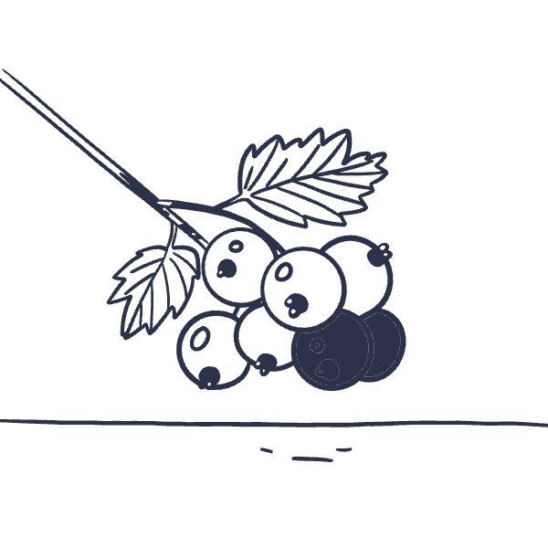




Davies-Bouldin Index: Average Cluster Similarity
Lower is Better
Unlike most metrics, the Davies-Bouldin Index uses an inverse scale—lower values indicate superior clustering with minimal overlap between groups.
This metric assesses the average similarity between each cluster and its most similar neighbor, penalizing configurations where clusters are too close together or internally scattered.
Measure Intra-Cluster Distance
Measure Inter-Cluster Distance
Calculate average distance of points within each cluster
Find distances between cluster centroids
Compute Ratios
Average Similarity
Divide intra-cluster by inter-cluster distances
Zero is ideal; closer to zero means better separation

Slide 7


The Elbow Method & WCSS: Finding Optimal Cluster Count
One of the most practical challenges in clustering is determining the optimal number of clusters k. The Elbow Method provides an intuitive, visual approach to this problem.
Within-Cluster Sum of Squares (WCSS)
WCSS measures the total squared distance of all points to their assigned cluster centroid. As we increase k, WCSS naturally decreases—but at what point do additional clusters stop providing meaningful improvement?
The "Elbow" Point: The curve's inflection point where adding more clusters yields diminishing returns, indicating the optimal balance between model complexity and cluster quality.
Plot WCSS
Select k
Calculate for k = 1 to n
Choose optimal clusters
1
2
3
4
Identify Elbow
Validate
Find curve inflection
Verify with other metrics

Slide 8
Beyond Metrics: Practical Considerations
Effective unsupervised learning evaluation transcends mathematical formulas. Context, domain knowledge, and strategic metric combination determine true model success.
No Universal Solution
Multi-Metric Validation
Different datasets and objectives require different metrics. A metric that works well for compact, spherical clusters may fail for irregular shapes or varying densities.
Combine multiple evaluation approaches to build confidence. If Silhouette, Calinski-Harabasz, and domain validation all align, you likely have meaningful clusters.
Visualization is Critical
Downstream Task Performance
Use dimensionality reduction (t-SNE, UMAP) to visually inspect clusters. Sometimes what looks good mathematically doesn't make intuitive sense—and vice versa.
The ultimate test: do learned representations improve real-world applications? Use clustering results in classification, recommendation, or other tasks to validate practical utility.

Slide 9

Limitations & Theoretical Insights
Kleinberg's Impossibility Theorem
A fundamental result in clustering theory proves that no single clustering algorithm can simultaneously satisfy three intuitive properties: scale-invariance, consistency, and richness.
This theorem reveals that perfect clustering evaluation is mathematically impossible—trade-offs are inevitable, and context determines which properties matter most for your application.
Metric Disagreement
Context Dependency
Active Research Area
Different metrics often provide conflicting recommendations. Silhouette might prefer fewer clusters while Calinski-Harabasz suggests more. This isn't a bug—it's a feature reflecting different notions of cluster quality.
Evaluation quality depends on data characteristics, cluster shapes, density variations, and application requirements. What works for customer segmentation may fail for anomaly detection.
Unsupervised evaluation remains at the frontier of machine learning research. New metrics, validation approaches, and theoretical frameworks continue to emerge.

Slide 10

Summary & Recommendations
1
Core Metric Toolkit
Employ Silhouette Coefficient, Calinski-Harabasz Index, and Davies-Bouldin Index as your foundational evaluation suite. Each captures different aspects of cluster quality.
2
Optimal Cluster Selection
Apply the Elbow Method with WCSS to guide initial cluster count decisions, then validate with multiple metrics and domain expertise.
3
Validation Strategy
Combine quantitative metrics with qualitative domain knowledge, visualization, and downstream task performance for robust validation.
4
Embrace Iteration
Treat evaluation as an iterative, exploratory process rather than seeking absolute answers. Experiment, validate, and refine based on your specific context.

