Slide 1
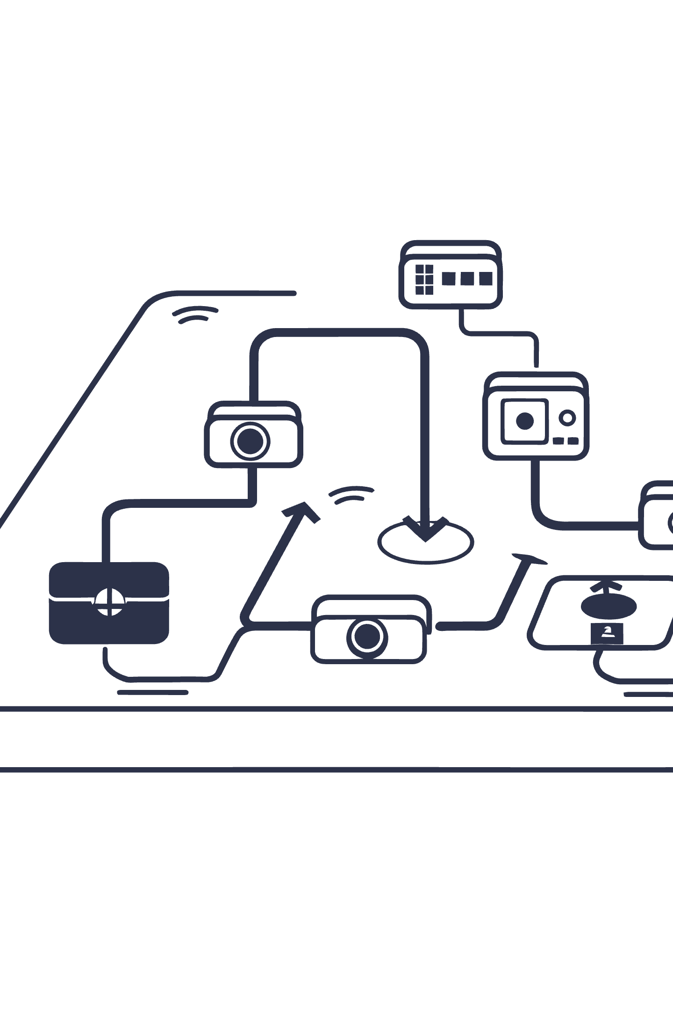
Building a Machine Learning Workflow with Label Studio & TensorFlow
A comprehensive guide to creating an efficient, scalable ML workflow that combines powerful annotation tools with world-class deep learning frameworks.

Slide 2
Why Combine Label Studio and TensorFlow?
Label Studio
TensorFlow
Synergy
Open-source, flexible data labeling platform supporting images, text, audio, and video with customizable annotation interfaces.
Powerful, Python-centric deep learning framework offering robust tools for model training, deployment, and inference at scale.
Together they streamline the entire pipeline: data annotation, model training, and automated labeling in one seamless workflow.
This integration accelerates your path from raw data to production-ready AI models while maintaining high quality through human-in-the-loop verification.

Slide 3

Step 1: Set Up Label Studio for Data Annotation
01
Install & Configure
Deploy Label Studio via self-hosted instance or managed cloud service based on your security and scalability needs.
02
Create Custom Project
Design labeling interfaces tailored to your specific data type—whether bounding boxes for images or entities for text.
03
Import Raw Data
Upload images, text documents, audio files, or video for annotation by your team.
04
Manage Quality
Collaborate with annotators, implement review workflows, and ensure consistent, high-quality labels.

Slide 4
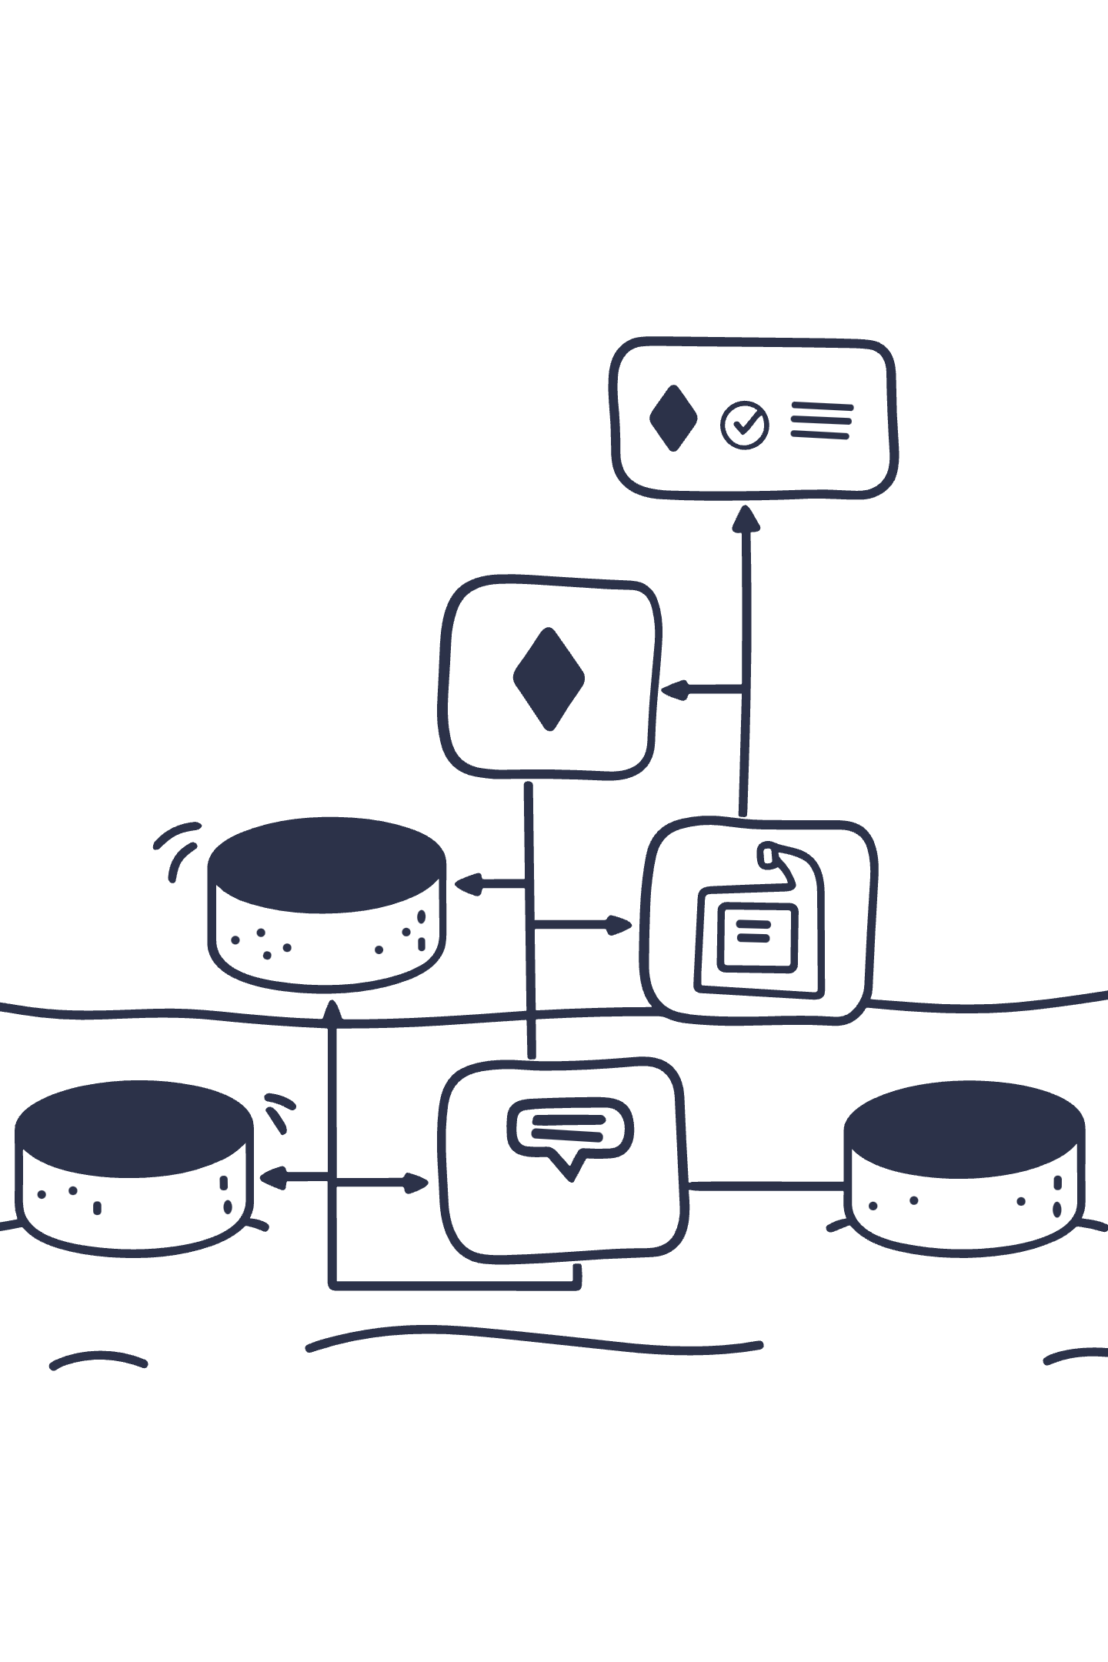
Step 2: Export Labeled Data for Model Training
Flexible Export Formats
Automated Extraction
Export annotations in TensorFlow-compatible formats including JSON, CSV, COCO, YOLO, and custom schemas that fit your pipeline requirements.
Leverage Label Studio's API or Python SDK to programmatically extract labeled data, enabling seamless integration with your training scripts.
Version Control
Track annotation iterations and dataset improvements over time, ensuring reproducibility and the ability to compare model performance across versions.

Slide 5

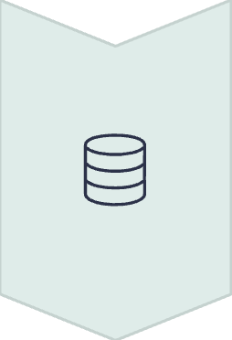



Step 3: Train Your TensorFlow Model
Load Data Pipeline
Integrate labeled data into TensorFlow's tf.data API for efficient batching and preprocessing.
Prototype & Fine-Tune
Rapidly experiment with architectures using TensorFlow's extensive model zoo and transfer learning capabilities.
Scale Training
Leverage distributed training and data parallelism for efficient processing of large datasets.
Save Models
Export trained models in SavedModel or TFLite formats for deployment and future retraining cycles.

Slide 6
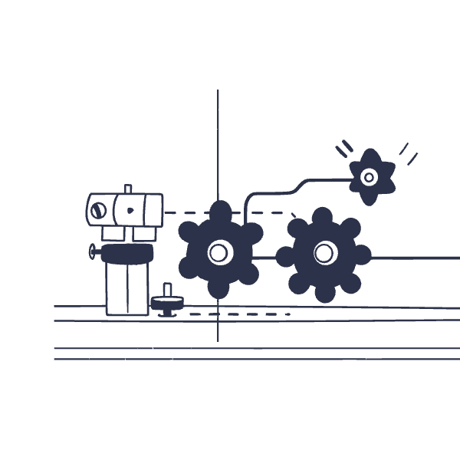
Step 4: Integrate TensorFlow Model Back into Label Studio
Deploy ML Backend
Connect your trained TensorFlow model as a machine learning backend within Label Studio, enabling intelligent prediction-assisted annotation.
Auto-Labeling Magic
Model predictions automatically pre-label new incoming data, dramatically accelerating annotation speed and reducing manual effort.
Human-in-the-Loop
Confidence scores flag uncertain predictions for expert human review, ensuring quality while maintaining efficiency.

Slide 7






Step 5: Continuous Learning & Active Learning Workflow
Smart Sample Selection
Active learning algorithms identify difficult or ambiguous samples that provide maximum learning value.
Iterative Retraining
Continuously retrain TensorFlow models with newly verified human annotations to improve accuracy.
Efficiency Gains
Reduce manual labeling workload by 60-80% while steadily improving model performance with each cycle.

Slide 8




Benefits of This Integrated Workflow
Accelerated Development
Superior Quality
Scalable Pipeline
Maximum Flexibility
Expert human review ensures training data accuracy while machine learning handles routine cases.
Repeatable, automated workflow scales from prototype to enterprise deployment seamlessly.
Adapts to diverse data types, annotation schemas, and project requirements with minimal reconfiguration.
Semi-automated labeling cuts dataset creation time significantly, getting you to production faster.

Slide 9




Real-World Use Cases
Computer Vision
Natural Language Processing
Audio & Speech
Object detection projects using bounding boxes labeled in Label Studio, then trained with TensorFlow's object detection API for autonomous vehicles, retail analytics, and security systems.
Text classification and named entity recognition datasets annotated efficiently with model-assisted labeling, powering sentiment analysis, content moderation, and information extraction.
Speech recognition datasets transcribed and refined through iterative retraining, enabling voice assistants, call center automation, and accessibility solutions.

Slide 10

Get Started Today
1
2
3
Explore Label Studio
Master TensorFlow
Build Your Pipeline
Visit labelstud.io/guide/ml for comprehensive documentation, tutorials, and best practices for data annotation.
Leverage the extensive ecosystem at tensorflow.org for model development, training optimization, and deployment guides.
Combine human expertise with intelligent automation to create faster, smarter AI solutions that scale with your business needs.
Ready to transform your ML workflow? Start building today and experience the power of integrated annotation and training pipelines.

