Slide 1
MODULE 5 · VIDEO 5.6
5.6
Run the once-only exchange, live
PNEA issues a credential and pre-fills identity from PNIA and enrolment from PLR — a real cross-server call, the data asked once.
standalone video · voice-over on text slides and a recorded demonstration
Notes:
Title card — the cold open. The hosts name the module, the video number, the title and the single message on this slide; no scripted narration. Hold until the opener begins; the opener is narrated on the next slide.

Slide 2
WHERE WE START
The moment the whole framework exists for.
A learner gives one number; the state fetches the rest.
Recorded from the running federation, exactly as it ran.
5.6 · Run the once-only exchange, live
www.itu.int
Notes:
VO: This is the moment the whole framework exists for: a learner applies for a credential, gives one number, and the state fetches the rest. What you are about to see was recorded from the running federation, exactly as it ran.

Slide 3
One call — identity from PNIA, enrolment from PLR
PNIA
The identity authority
Returns the identity
PNEA
The examination authority
Pre-fills the application — no paper proof
THE LEARNER
Applies for a credential
Gives a national ID — once
over the bus
PLR
The learner registry
Returns the enrolment
Without once-only, the learner brings paper proof of both. With it, the learner is asked once.
5.6 · Run the once-only exchange, live
Notes:
VO: Here is the call you are about to watch. A learner applies for a credential at PNEA, the examination authority. Without once-only, the learner brings paper proof of identity and of enrolment. With it, PNEA fetches the identity from PNIA and the enrolment from PLR, over the bus.
Production cue: the picture of what the recording shows. The frames that follow map onto these boxes.

Slide 4
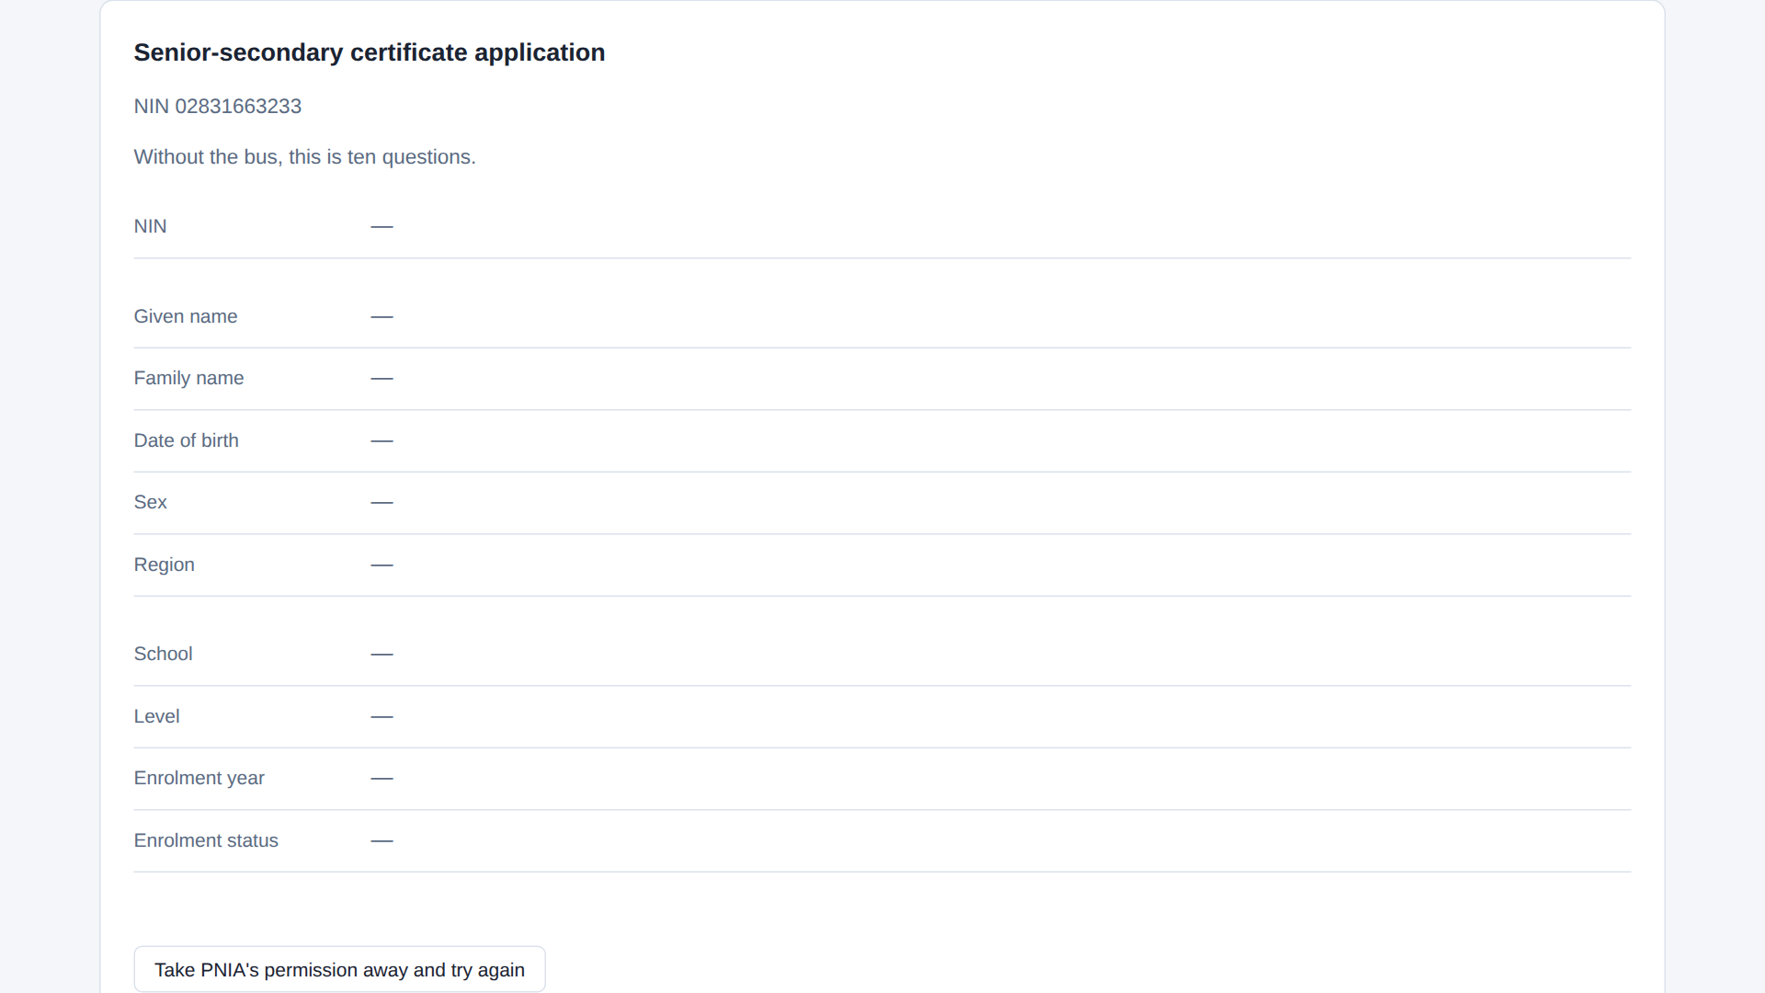
Before the bus: ten blank rows
Ten blank rows: without the bus, ten questions to answer.
captured from the demonstration federation · X-Road 7.7.0 · pack 771c946 · 2026-09-13
5.6 · Run the once-only exchange, live
Notes:
VO: The form before the call: ten rows, all blank. Without the bus, that is ten questions the learner answers, and two sets of paper proof.

Slide 5
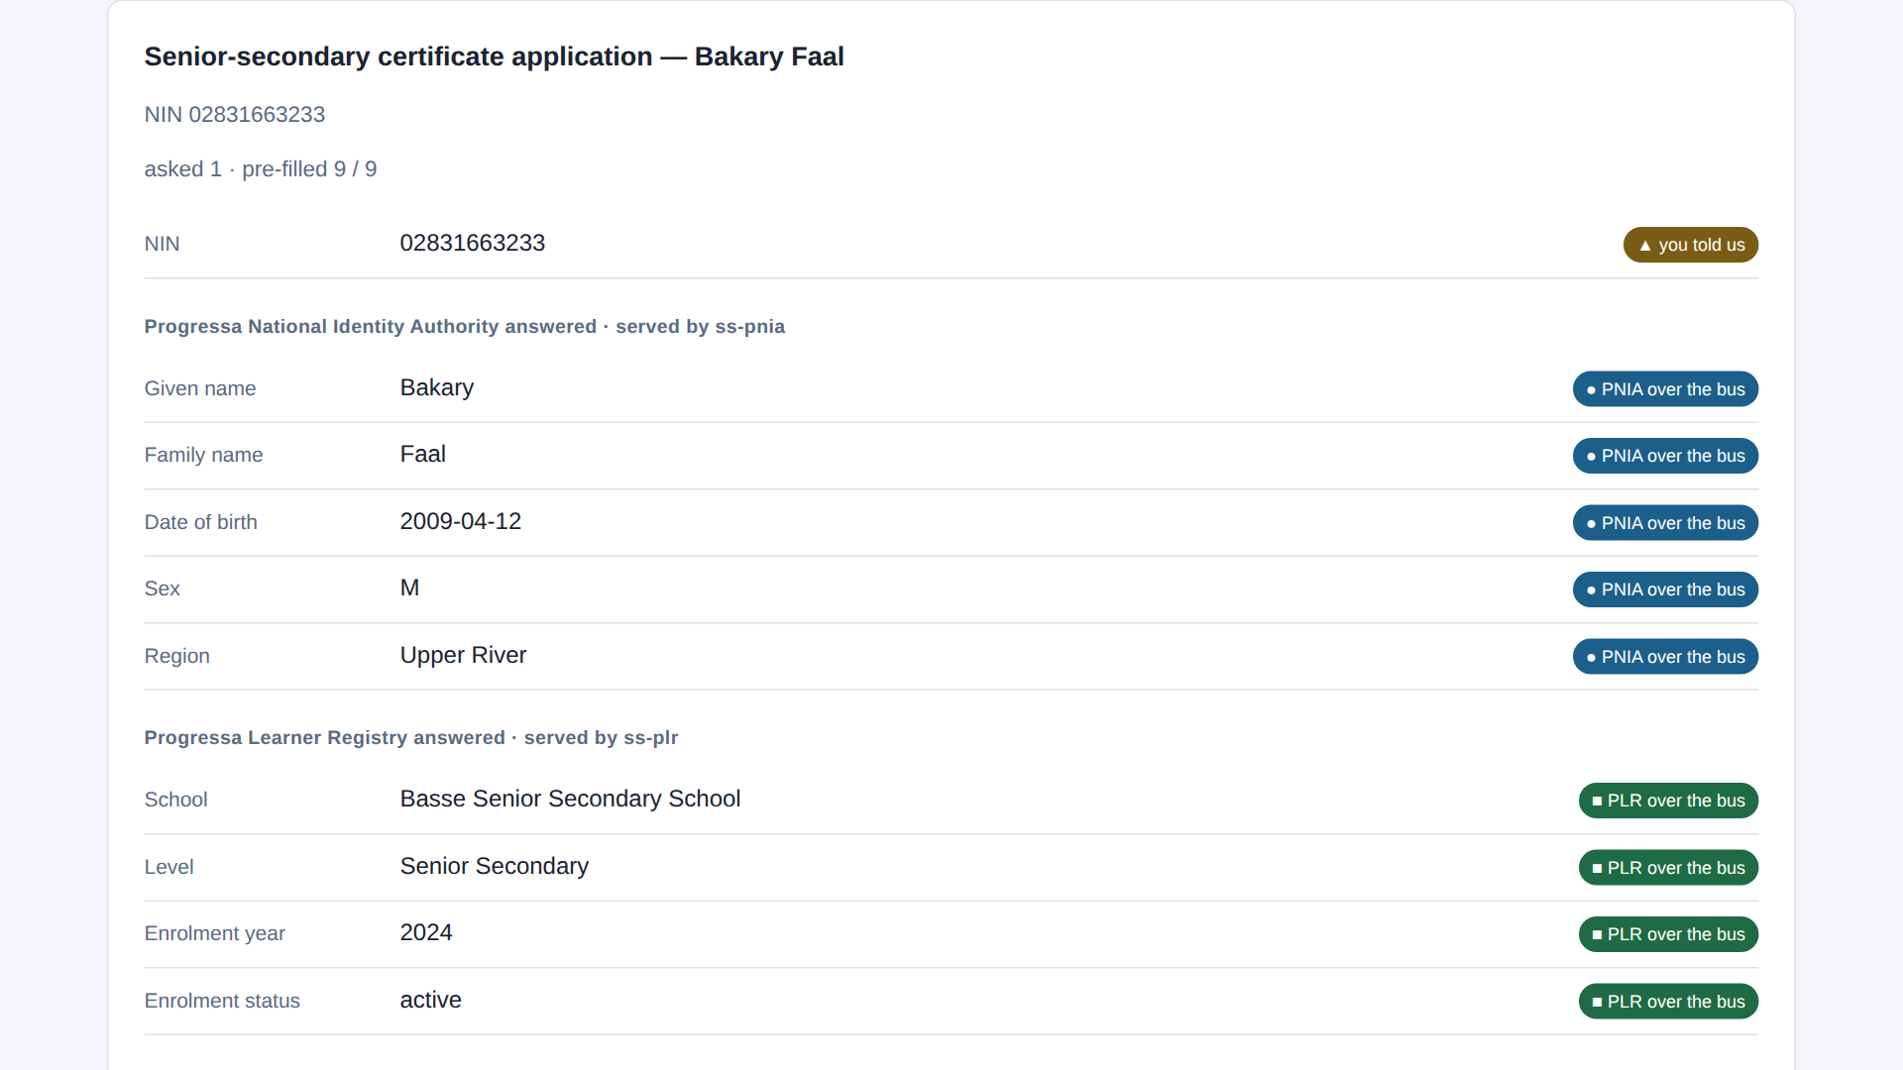
One question asked, nine rows filled
Nine fields arrive the learner was never asked for.
captured from the demonstration federation · X-Road 7.7.0 · pack 771c946 · 2026-09-13
5.6 · Run the once-only exchange, live
Notes:
VO: The same form once the learner gives the national ID. Nine rows fill in: five from PNIA, four from PLR, each labelled with its source. One question asked, nine fetched.

Slide 6
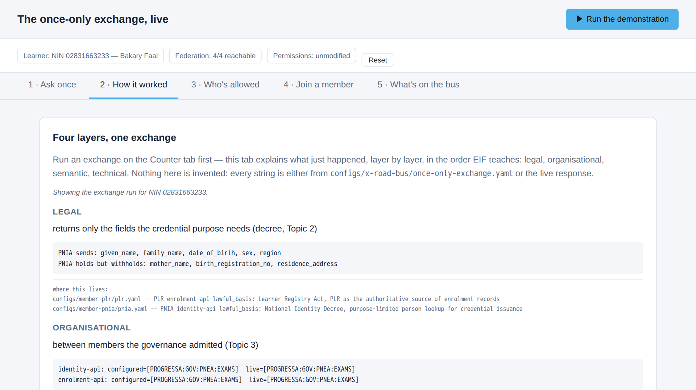
What PNIA sends — and what it withholds
Legal, organisational, semantic, technical — read off the live response.
captured from the demonstration federation · X-Road 7.7.0 · pack 771c946 · 2026-09-13
5.6 · Run the once-only exchange, live
Notes:
VO: The second tab reads the same exchange by layer. In the legal pane, PNIA sends five fields and names three it holds but withholds: a mother's name, a birth registration number, an address. The purpose does not need them.

Slide 7
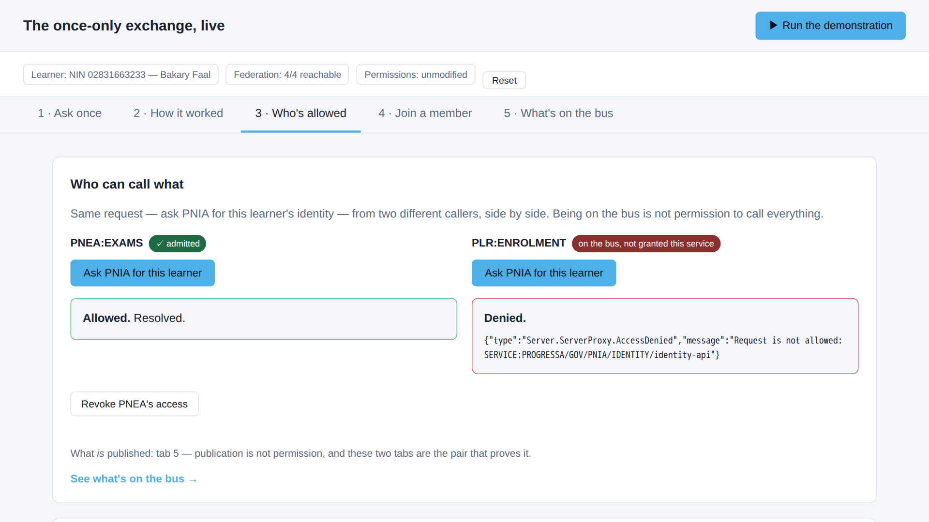
Same question, two callers, two answers
PNEA: allowed. PLR, asking the identical question: AccessDenied.
captured from the demonstration federation · X-Road 7.7.0 · pack 771c946 · 2026-09-13
5.6 · Run the once-only exchange, live
Notes:
VO: The third tab asks PNIA the identical question from two callers. PNEA is allowed. PLR, a member of the same bus, gets an access-denied fault from PNIA's access list. Being on the bus is not permission.

Slide 8
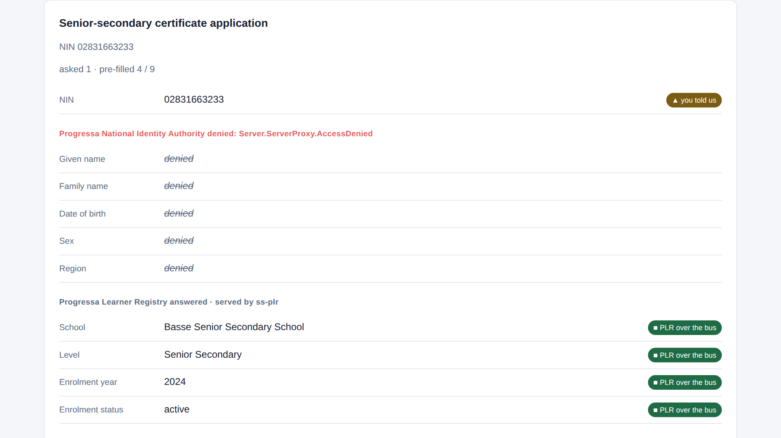
One grant withdrawn, one source broken
Grant withdrawn: the PNIA half fails, PLR still fills. Grant back: whole again.
captured from the demonstration federation · X-Road 7.7.0 · pack 771c946 · 2026-09-13
5.6 · Run the once-only exchange, live
Notes:
CLIP: C6-break-restore.mp4
VO: Now the operator withdraws PNEA's permission and runs the form again. Within seconds the PNIA rows are denied, while the PLR rows still fill: one grant withdrawn, one source broken. Restore it, and the form is whole.

Slide 9
The application, with every field's source
out/application-02831663233.json — the assembled application, one line per field
field value source
nin 02831663233 citizen — the one thing asked
given_name Bakary PNIA identity-api over the bus
family_name Faal PNIA identity-api over the bus
date_of_birth 2009-04-12 PNIA identity-api over the bus
sex M PNIA identity-api over the bus
region Upper River PNIA identity-api over the bus
school Basse Senior Secondary School PLR enrolment-api over the bus
level Senior Secondary PLR enrolment-api over the bus
enrolment_year 2024 PLR enrolment-api over the bus
status active PLR enrolment-api over the bus
The application on disk: where every field came from.
captured from the demonstration federation · X-Road 7.7.0 · pack 771c946 · 2026-09-13
5.6 · Run the once-only exchange, live
Notes:
VO: The exchange is also written to disk as the assembled application: one line per field, each with its source. The national ID is the only line the citizen supplied.

Slide 10
Six acceptance checks, all green
$ scripts/acceptance.sh --summary --only 2.6
2.6.1 PASS happy path — both cross-server calls resolve
2.6.2 PASS right learner — fields match the seeded record
2.6.3 PASS asked once — NIN is the only citizen field; bus pre-fills exactly the rest
2.6.4 PASS negative — PROGRESSA/GOV/PLR/ENROLMENT (via its own SS ss-plr) denied by the provider ACL
2.6.5 PASS negative — NIN absent from PLR yields a clean 404, not silence
2.6.6 PASS field conformance — both responses carry exactly the fields their contract declares (G5.9)
Checks 2.6.1 to 2.6.6 green — the technical half of the go-live approval.
captured from the demonstration federation · X-Road 7.7.0 · pack 771c946 · 2026-09-13
5.6 · Run the once-only exchange, live
Notes:
VO: Last, the acceptance script runs this exchange as six checks: the call, the right learner, asked once, the denial, a clean not-found, and field conformance. All six pass — the technical half of go-live approval.

Slide 11
IN ONE SENTENCE
One field asked, nine fetched, only what the purpose needs — and six acceptance checks green.
Do this on your own sector. Script and verify the once-only exchange (the acceptance check).
The prompt in the companion material gives you a given/when/then acceptance script with a negative check, mapped to the four layers. Before the next video.
5.6 · Run the once-only exchange, live
www.itu.int
Notes:
PRACTICE BOX (on-screen only — never read it, never paraphrase it, never point at it). It replaces the narrated handoff: this video ends on the recap and the Sources slide.
VO: So the exchange is shown, not explained: one field asked, nine fetched, only what the purpose needs, a denial the access list enforces, six checks green. That is the framework, running.

Slide 12
Sources
• PAERA v1.0 — §5.2, Principle #5 (Once-Only)
• NIIS X-Road (niis.org)
• The Linkup demonstration federation
Find the link in the description.
5.6 · Run the once-only exchange, live
Notes:
Sources slide, held ~5 seconds at the end of the video. Links are compiled into the YouTube description per ITU convention; no URLs read aloud.

