Slide 1
MODULE 5 · VIDEO 5.4
5.4
Admit a member to the bus
An agency is admitted by a validated request and a recorded committee decision — then the join runs itself and proves itself with a real call.
standalone video · voice-over on text slides and a recorded demonstration
Notes:
Title card — the cold open. The hosts name the module, the video number, the title and the single message on this slide; no scripted narration. Hold until the opener begins; the opener is narrated on the next slide.

Slide 2
WHERE WE START
Everything so far was preparation. This step admits an agency.
The agency applies, a validator checks it, the operator admits it by citing a decision.
Then the join runs itself — and proves itself with a real call.
5.4 · Admit a member to the bus
www.itu.int
Notes:
VO: Everything so far has been preparation — the plan, the Member Requirements, the Service-Level Agreement. This step admits an agency to the bus. It produces real configuration, and nobody types that configuration by hand: the agency applies, the operator admits it, and the join runs itself.

Slide 3
Admission produces two configuration artefacts
THE SUBSYSTEM — WHO IT IS
The member's registered identity on the bus.
Member class, member code, subsystem code — what the bus routes a call by.
THE ACCESS-CONTROL LIST — WHO MAY CALL IT
Which other members may call its services.
Granted deliberately, service by service.
Being on the bus does not mean everyone may call everything.
5.4 · Admit a member to the bus
Notes:
VO: Admitting a member produces two configuration artefacts. The subsystem is the member's identity on the bus — its member class, member code and subsystem code, the identifiers a call is routed by. The access-control list says which other members may call each of its services. Being on the bus does not mean everyone may call everything.

Slide 4
One pattern for every member, wrapped in a repeatable process
REQUIREMENTS
Is the agency ready?
APPROVAL
The RACI names who approves
ADMISSION
The decision, recorded
REGISTRATION
The configuration, written
CONFORMANCE
The gate before going live
FIRST SERVICE
Live
video 5.2
Module 3
video 5.4
video 5.4
video 5.4
The twentieth agency is admitted as cleanly as the second.
5.4 · Admit a member to the bus
Notes:
VO: The same pattern admits every member, wrapped in a repeatable process. The Member Requirements confirm the agency is ready. The RACI names the body that approves. Admission records that decision. Registration writes the configuration. A conformance test is the gate, and then the first service goes live.

Slide 5
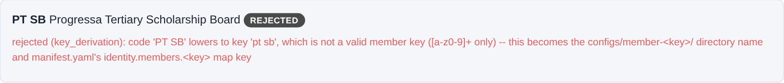
First: a member code with a space is refused
A member code with a space: refused before anything reaches the bus.
captured from the demonstration federation · X-Road 7.7.0 · pack a28b74c · 2026-09-30
5.4 · Admit a member to the bus
Notes:
VO: First, a join request whose member code has a space in it. The validator refuses it before anything reaches the bus, and says which characters a member key may use.

Slide 6
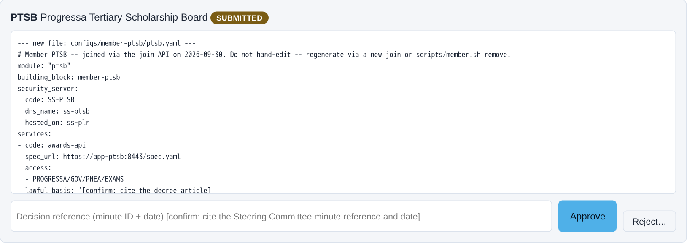
Second: the request, and the diff it would write
The request and the exact diff it would write — nothing written yet.
captured from the demonstration federation · X-Road 7.7.0 · pack a28b74c · 2026-09-30
5.4 · Admit a member to the bus
Notes:
VO: Second, the corrected request from the tertiary scholarship board, PTSB. The screen shows the exact files the join would write — its member configuration and the federation manifest — and nothing is written yet.

Slide 7
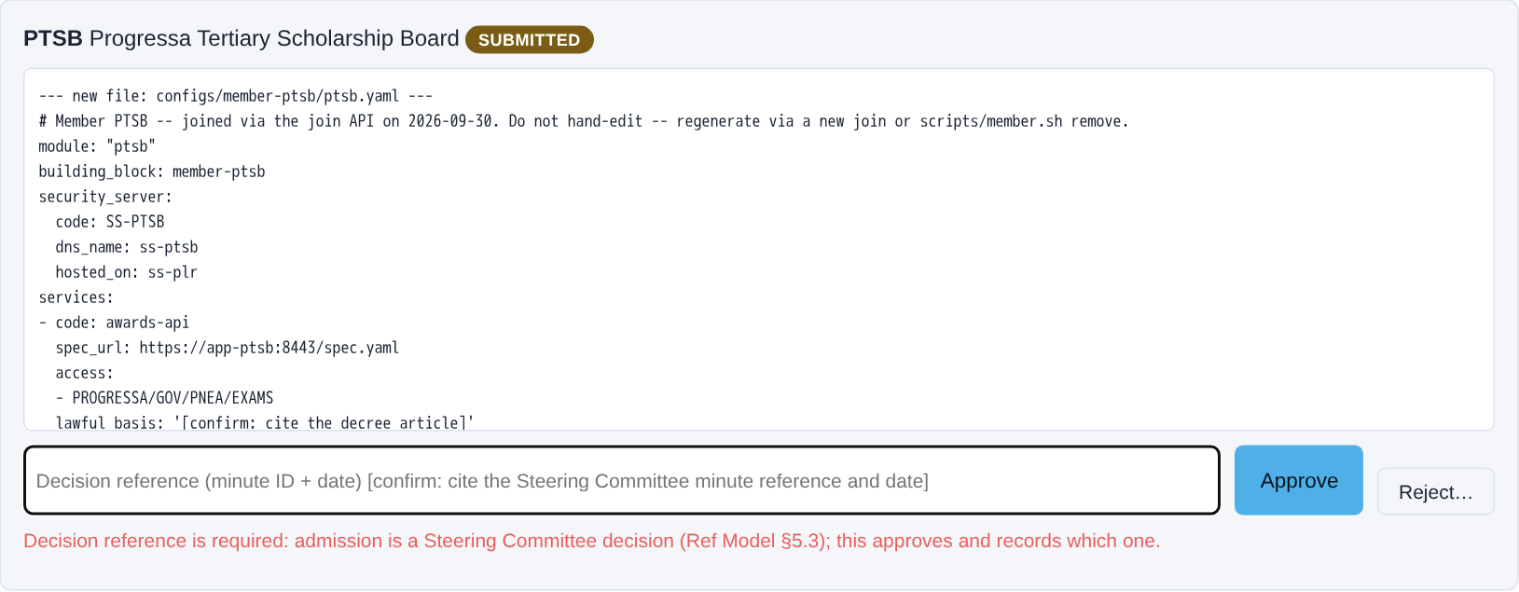
Third: approve without a minute — refused
Approve without a minute reference: refused. Admission is a committee decision.
captured from the demonstration federation · X-Road 7.7.0 · pack a28b74c · 2026-09-30
5.4 · Admit a member to the bus
Notes:
VO: Third, the operator tries to approve it with the decision reference left empty. Refused: admission is a committee decision, and the join cannot run ahead of it.

Slide 8
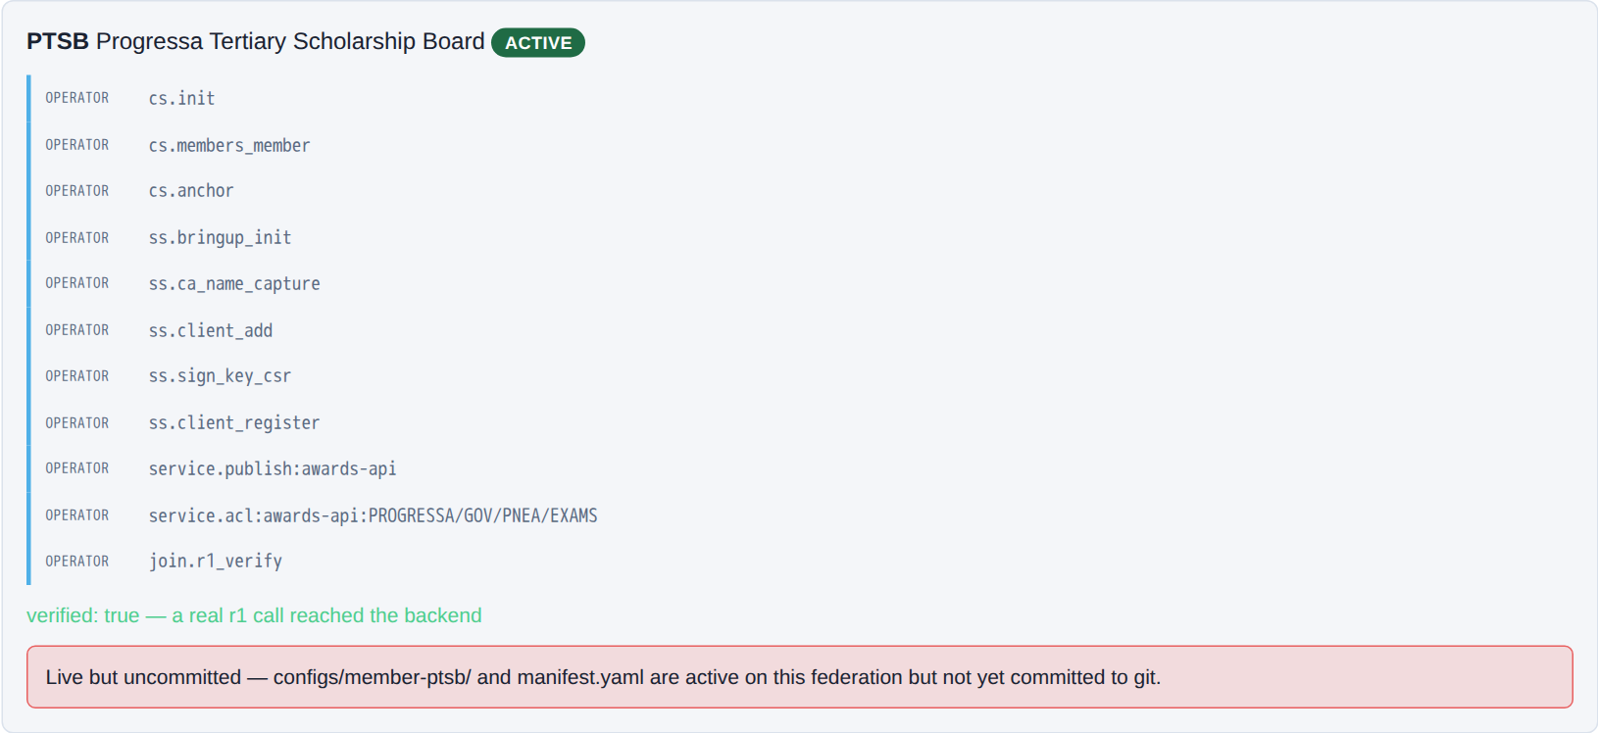
Fourth: the join runs itself, then proves the backend answers
Minute RIHA-2026-001 recorded: the steps run themselves, then a real call proves the backend answers.
captured from the demonstration federation · X-Road 7.7.0 · pack a28b74c · 2026-09-30
5.4 · Admit a member to the bus
Notes:
CLIP: J3-join.mp4
VO: Fourth, the operator enters the committee's minute reference and approves. The steps run themselves — the member and its server registered, its certificate, its service published, its access granted — and then a real call proves the backend answers.

Slide 9
Fifth: the admission record
$ cat onboarding/ptsb/01-admission.md
# Admission -- G1
The admission decision itself is taken outside this system (Ref Model §5.3's Steering Committee) -- this f…
| Field | Value |
| --- | --- |
| Join request id | `2zNu5ioIviU` |
| Decision reference | RIHA-2026-001 |
| Approved at | 2026-09-30T18:11:08.786950+00:00 |
| Approving role | operator |
The admission record: which decision admitted PTSB, and when.
captured from the demonstration federation · X-Road 7.7.0 · pack a28b74c · 2026-09-30
5.4 · Admit a member to the bus
Notes:
VO: Fifth, the admission record the join leaves behind: the request, the decision reference that admitted it, and when.

Slide 10
Sixth: on the bus, hosted, and proved
$ scripts/member.sh list
KEY ORIGIN SERVER UI REST
plr canonical ss-plr 127.0.0.1:3000 127.0.0.1:3080
pnea canonical ss-pnea 127.0.0.1:2000 127.0.0.1:2080
pnia canonical ss-pnia 127.0.0.1:5100 127.0.0.1:5180
ptsb joined ss-plr 127.0.0.1:3000 127.0.0.1:3080
$ scripts/acceptance.sh --summary --only 2.7
2.7.1 PASS join-api deploys and reports healthy
2.7.2 PASS spec-fetcher reachable from join-api, admin :4000 (cs) NOT reachable from spec-fetcher
2.7.r1(PTSB.awards-api) PASS PROGRESSA/GOV/PNEA/EXAMS r1 call to awards-api reaches the backend (no X-Ro…
2.7.deny(PTSB.awards-api) PASS PROGRESSA/GOV/PNIA/IDENTITY (via its own SS ss-pnia) denied by the provid…
2.7.fields(PTSB.awards-api) PASS PROGRESSA/GOV/PNEA/EXAMS r1 call to awards-api carries exactly its cont…
2.7.catalogue(PTSB.awards-api) PASS PTSB's awards-api appears in GET /catalogue
Reachable by PNEA, refused to everyone else, exactly the contract's fields, listed on the bus.
captured from the demonstration federation · X-Road 7.7.0 · pack a28b74c · 2026-09-30
5.4 · Admit a member to the bus
Notes:
VO: Sixth, the proof. The scholarship board is listed as a joined member, hosted on the learner registry's server. And the acceptance checks pass: the examination authority reaches its service, every other caller is refused, the response carries exactly the contract's fields, and the service is listed on the bus.

Slide 11
Conformance is the gate between registration and going live
It proves it meets the standards portfolio
Its server, its certificates and its services do what the framework requires.
Checked in proportion to the risk
Self-assessment for the routine, a third-party check for high-risk, the operator's test suite.
Not a certificate for life
Re-tested every two years, and on every change to a binding standard.
The step programmes skip in a hurry — and discover when one member's data breaks everyone's.
5.4 · Admit a member to the bus
Notes:
VO: Registration is not the last gate. Before its first service goes live, the member proves conformance against the standards portfolio: a self-assessment for routine services, a third-party check for high-risk ones, or the operator's own test suite. And it is re-tested every two years, and whenever a binding standard changes.

Slide 12
IN ONE SENTENCE
An agency is admitted by a validated request and a recorded decision — then the join runs itself, proves itself, and a conformance test gates its first service.
Do this on your own sector. Generate the X-Road member registration (subsystem + ACL).
The prompt in the companion material gives you the subsystem registration and access-control list with [confirm] placeholders, and an onboarding checklist. Before the next video.
5.4 · Admit a member to the bus
www.itu.int
Notes:
PRACTICE BOX (on-screen only — never read it, never paraphrase it, never point at it). It replaces the narrated handoff: this video ends on the recap and the Sources slide.
VO: So admitting a member is where onboarding becomes configuration: a validated request, an approval that cites the committee's decision, a join that runs itself and proves itself with a real call, and a conformance test before the first service goes live.

Slide 13
Sources
• NIIS X-Road member and subsystem registration (niis.org)
• X-Road access-control list configuration
• The Linkup demonstration federation
Find the link in the description.
5.4 · Admit a member to the bus
Notes:
Sources slide, held ~5 seconds at the end of the video. Links are compiled into the YouTube description per ITU convention; no URLs read aloud.

