Slide 1
MODULE 5 · VIDEO 5.6
5.6
Run the once-only exchange, live
PNEA issues a credential and pre-fills identity from PNIA and enrolment from PLR — a real cross-server call, the data asked once.
standalone video · voice-over on text slides and a recorded demonstration
Notes:
Title card — the cold open. The hosts name the module, the video number, the title and the single message on this slide; no scripted narration. Hold until the opener begins; the opener is narrated on the next slide.

Slide 2
WHERE WE START
The moment the whole framework exists for.
The examination authority asks the learner once and fetches the rest.
Recorded from the running federation, exactly as it ran.
5.6 · Run the once-only exchange, live
www.itu.int
Notes:
VO: This is the exchange the whole framework exists for: the examination authority issues a credential and fetches the learner's identity and enrolment itself, asking the learner once. What follows was recorded from the running federation.

Slide 3
One call — identity from PNIA, enrolment from PLR
PNIA
The identity authority
Returns the identity
PNEA
The examination authority
Pre-fills the application — no paper proof
THE LEARNER
Applies for a credential
Gives a national ID — once
over the bus
PLR
The learner registry
Returns the enrolment
Without once-only, the learner brings paper proof of both. With it, the learner is asked once.
5.6 · Run the once-only exchange, live
Notes:
VO: This is the call on screen. The examination authority, PNEA, receives a learner's credential application. Without once-only, PNEA would ask the learner for paper proof of identity and of enrolment. With it, PNEA fetches the identity from the identity authority, PNIA, and the enrolment from the learner registry, PLR, over the bus.
Production cue: the picture of what the recording shows. The frames that follow map onto these boxes.

Slide 4
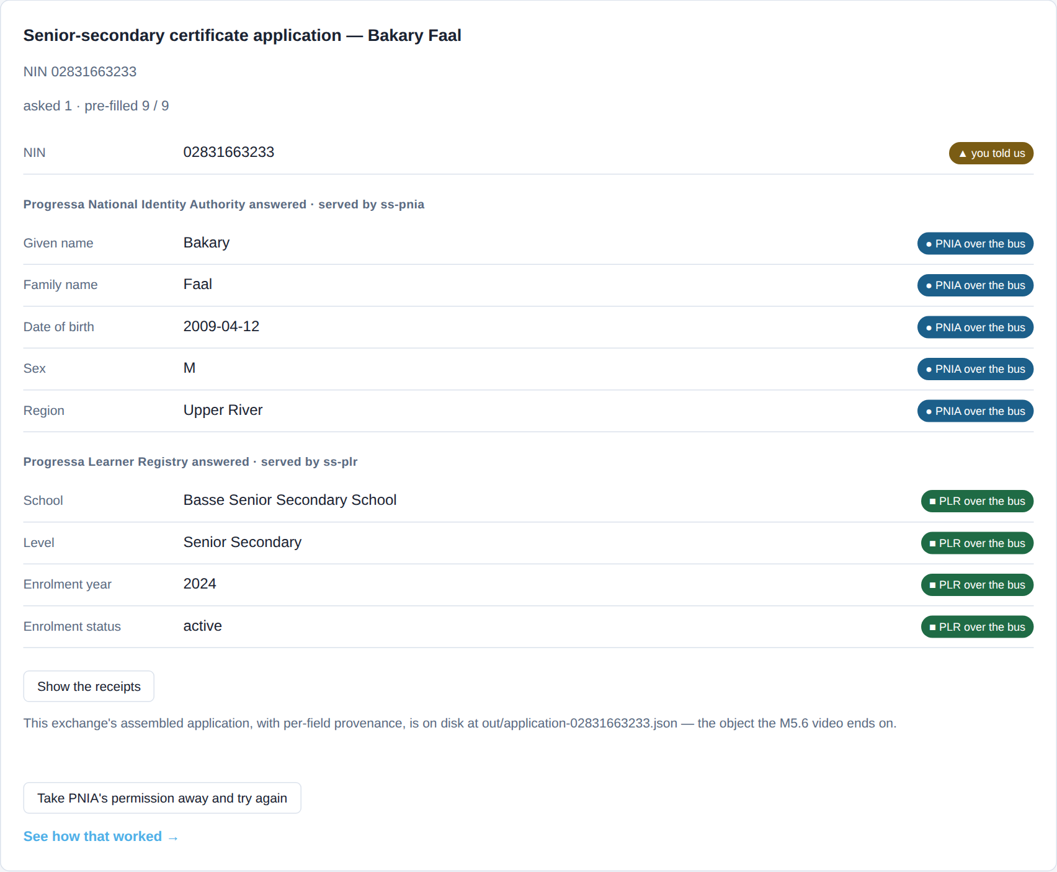
First: ten blank rows, then nine filled
Ten blank rows before the call; nine filled after it, each labelled with its source.
captured from the demonstration federation · X-Road 7.7.0 · pack a28b74c · 2026-09-30
5.6 · Run the once-only exchange, live
Notes:
VO: First, the form before and after the call. Before, ten rows, all blank: ten questions the learner answers, and two sets of paper proof. Once PNEA has the learner's national ID, nine rows fill in: five from the identity authority, PNIA, four from the learner registry, PLR, each labelled with its source. One question asked, nine fetched.

Slide 5
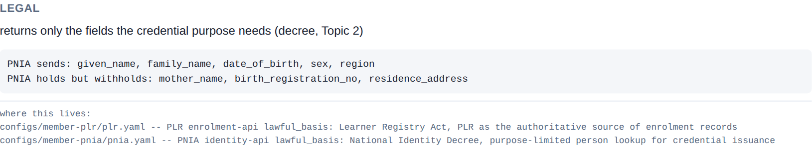
Second: what PNIA sends — and what it withholds
Legal, organisational, semantic, technical — read off the live response.
captured from the demonstration federation · X-Road 7.7.0 · pack a28b74c · 2026-09-30
5.6 · Run the once-only exchange, live
Notes:
VO: Second, the second tab reads the exchange by layer. In the legal pane, the identity authority, PNIA, sends five fields and names three it holds but withholds: a mother's name, a birth registration number, an address. The purpose does not need them.

Slide 6
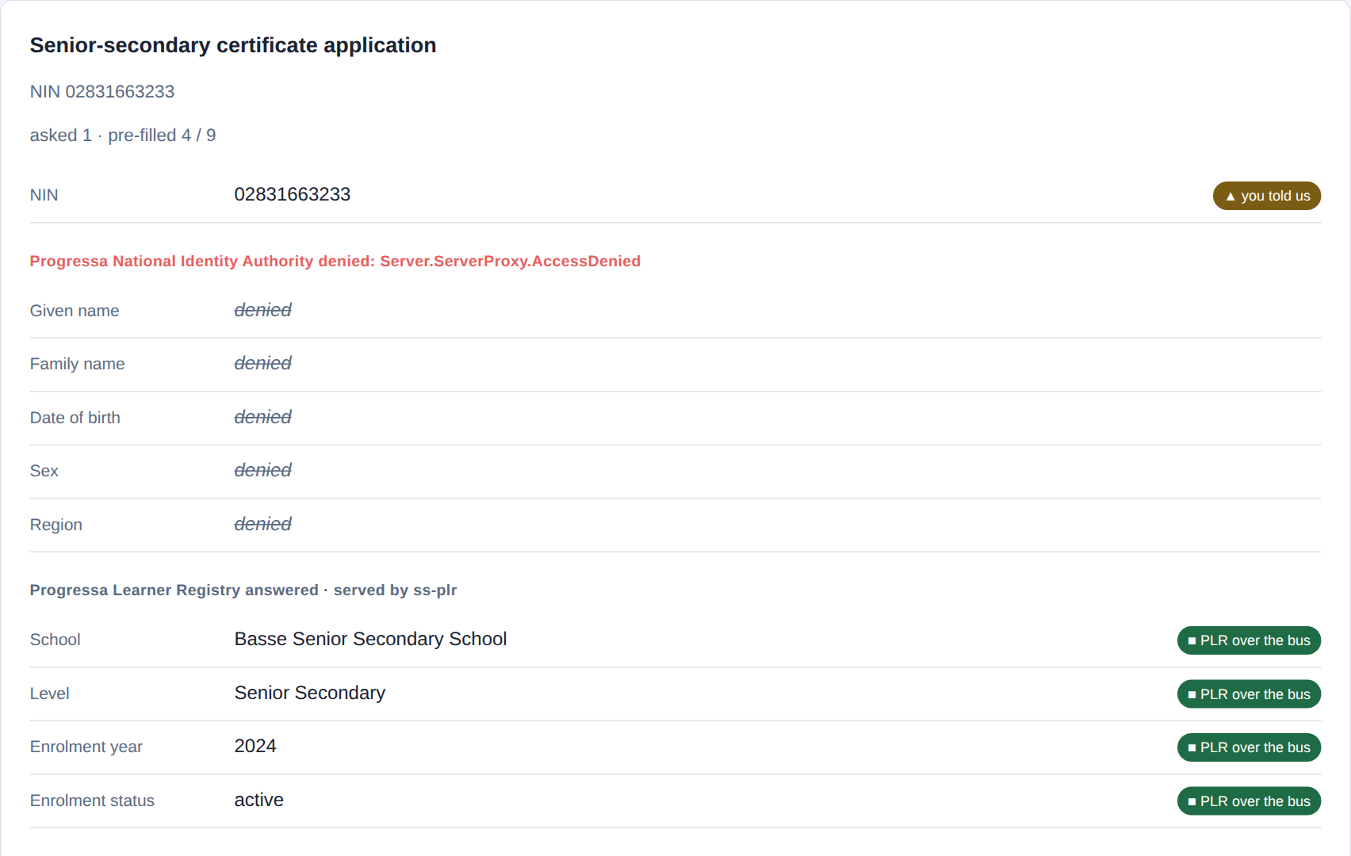
Third: allowed, refused, then cut off
Asked twice: allowed, refused. Grant withdrawn: the identity half fails, enrolment still fills.
captured from the demonstration federation · X-Road 7.7.0 · pack a28b74c · 2026-09-30
5.6 · Run the once-only exchange, live
Notes:
CLIP: C6-break-restore.mp4
VO: Third, permission. Asked the identical question, the examination authority, PNEA, is allowed, and the learner registry, PLR, is refused by the identity authority's access list. Then the operator withdraws the examination authority's permission: within seconds the identity rows are denied while the enrolment rows still fill. Restore it, and the form is whole. Being on the bus is not permission.

Slide 7
Fourth: on disk, and six checks green
out/application-02831663233.json — the assembled application, one line per field
field value source
nin 02831663233 citizen — the one thing asked
given_name Bakary PNIA identity-api over the bus
family_name Faal PNIA identity-api over the bus
date_of_birth 2009-04-12 PNIA identity-api over the bus
sex M PNIA identity-api over the bus
region Upper River PNIA identity-api over the bus
school Basse Senior Secondary School PLR enrolment-api over the bus
level Senior Secondary PLR enrolment-api over the bus
enrolment_year 2024 PLR enrolment-api over the bus
status active PLR enrolment-api over the bus
$ scripts/acceptance.sh --summary --only 2.6
2.6.1 PASS happy path — both cross-server calls resolve
2.6.2 PASS right learner — fields match the seeded record
2.6.3 PASS asked once — NIN is the only citizen field; bus pre-fills exactly the rest
2.6.4 PASS negative — PROGRESSA/GOV/PLR/ENROLMENT (via its own SS ss-plr) denied by the provider ACL
2.6.5 PASS negative — NIN absent from PLR yields a clean 404, not silence
2.6.6 PASS field conformance — both responses carry exactly the fields their contract declares (G5.9)
The application on disk, every field's source; checks 2.6.1 to 2.6.6 green.
captured from the demonstration federation · X-Road 7.7.0 · pack a28b74c · 2026-09-30
5.6 · Run the once-only exchange, live
Notes:
VO: Fourth, the record and the proof. The exchange is written to disk as the assembled application, one line per field with its source; the national ID is the only line the citizen supplied. And the acceptance script runs the exchange as six checks: the call, the right learner, asked once, the denial, a clean not-found, and field conformance. All six pass: the technical half of go-live approval.

Slide 8
IN ONE SENTENCE
One field asked, nine fetched, only what the purpose needs — and six acceptance checks green.
Do this on your own sector. Script and verify the once-only exchange (the acceptance check).
The prompt in the companion material gives you a given/when/then acceptance script with a negative check, mapped to the four layers. Before the next video.
5.6 · Run the once-only exchange, live
www.itu.int
Notes:
PRACTICE BOX (on-screen only — never read it, never paraphrase it, never point at it). It replaces the narrated handoff: this video ends on the recap and the Sources slide.
VO: So the exchange is shown, not explained: one field asked, nine fetched, only what the purpose needs, a denial the access list enforces, six checks green. That is the framework, running.

Slide 9
Sources
• PAERA v1.0 — §5.2, Principle #5 (Once-Only)
• NIIS X-Road (niis.org)
• The Linkup demonstration federation
Find the link in the description.
5.6 · Run the once-only exchange, live
Notes:
Sources slide, held ~5 seconds at the end of the video. Links are compiled into the YouTube description per ITU convention; no URLs read aloud.

