Slide 1


FROM PLAN TO A RUNNING FRAMEWORK
Stand it up, prove it,
run it
A plan a funder can approve
Members admitted, and conforming
Government Interoperability Framework · Module 5
Ten standalone videos that take the framework live: the four-phase plan a funder can approve, the Member Requirements and the SLA, registering a member, standing up the federation, the once-only exchange running for real, the road to production — then watching the bus, keeping the documents consistent, and carrying it to the next sector.
A federation, stood up
One call — the learner asked once
Length: ~47 mins across 10 videos (5.1 – 5.10)
Target audience: Chief or senior architect · integration lead · agency technical lead — and, for 5.9–5.10, the strategist
Watched, consistent, portable
4 phases · 2 go-live approvals · 1 call that proves it
Notes:
Cover for the combined Module 5 deck. Each section that follows is one standalone ~4–5 minute video. 5.1 to 5.8 are for the Architect who builds and runs the bus; 5.9 and 5.10 return to the Strategist and close the knowledge product.

Slide 2
Module 5 — ten videos
5.1 Plan the build in four phases ~5 min
5.2 The Member Requirements ~4 min
5.3 The SLA — connected to dependable ~4 min
5.4 Admit a member to the bus ~5 min
5.5 Stand up the federation ~5 min
5.6 Run the once-only exchange, live ~3 min
5.7 From demonstration to production ~5 min
5.8 Watch the bus — monitoring ~5 min
5.9 Keep the documents consistent ~5 min
5.10 Carry it to the next sector ~4 min
Plan it so a funder can approve it, admit members who are ready, and prove it with one real call.
Then run it: watch the bus, keep the documents honest, and reuse it for every sector after.
Notes:
Navigation slide for the combined deck; the videos ship standalone on YouTube. 5.1 is the plan. 5.2 to 5.4 onboard a member. 5.5 and 5.6 stand the federation up and prove it. 5.7 is the road to production. 5.8 to 5.10 run the framework and carry it on.

Slide 3
MODULE 5 · VIDEO 5.1
5.1
Plan the build in four phases
Foundation, Pilot, Expansion, Optimisation — four phases with decision gates, an honest calendar, and the four plans beside the schedule that a funder actually reads.
standalone video · voice-over on text slides
Notes:
Title card — the cold open. The hosts name the module, the video number, the title and the single message on this slide; no scripted narration. Hold until the opener begins; the opener is narrated on the next slide.

Slide 4
WHERE WE START
You do not onboard a whole government at once.
Four phases, each delivering something real.
A decision gate before the next phase is funded.
5.1 · Plan the build in four phases
www.itu.int
Notes:
VO: You do not onboard a whole government at once. You build the framework in four phases, each delivering something real, each with a decision gate before the next is funded — a pattern drawn from how Estonia and others actually built their buses.
Retrieval prompt — ask before playing on: from the start of the build, how long until the first citizen-visible once-only exchange? Answer on the next slide: about a year.

Slide 5
Four phases, a gate at each, on an honest calendar
BEFORE MONTH 0
The groundwork: decree, governance, architecture, standards
A year to eighteen months of work
PHASE 1 · MONTHS 0–6
Foundation
Platform and trust anchor live
Two pilot members
PHASE 2 · MONTHS 7–12
Pilot and Validation
First cross-ministry once-only exchanges
Five members
PHASE 3 · MONTHS 13–18
Expansion
First-wave sectors covered
Fifteen members, 20+ services
PHASE 4 · MONTHS 19–24
Optimisation
Performance, the long tail, the next wave
a go / no-go gate — the next phase is funded only if this one delivered
First citizen-visible once-only exchange: about a year in. National coverage: a four-to-six-year programme — say so on day one.
5.1 · Plan the build in four phases
Notes:
VO: First, the honest calendar. The four build phases start when the foundation is laid — the decree, the governance, the architecture and the standards portfolio — and that groundwork is itself a year to eighteen months of team effort, longer in calendar time because legislative and budget cycles do not hurry. Then the phases. Phase one, Foundation, months zero to six — the central platform and its trust anchor go live, two pilot members connect, the first services run. Phase two, Pilot and Validation, seven to twelve — the first real cross-ministry once-only exchanges go live, the first five members are on, conformance testing is operating. Phase three, Expansion, thirteen to eighteen — the first-wave sectors are covered: fifteen members, twenty or more services. Phase four, Optimisation, nineteen to twenty-four — performance, the long tail, the next wave of sectors. So the first citizen-visible once-only exchange lands about a year into the build, and the first real milestone — the platform running with a handful of member services — two to three years from the day the programme starts. National coverage is a four-to-six-year programme. Say that to your minister on day one; it is the number that keeps the programme funded when the launch enthusiasm fades. Each phase ends with a decision gate: a go or no-go where the funder and the Steering Committee confirm the phase actually delivered before the next is funded.
Production cue: this slide answers the retrieval prompt set on the opener. Reveal the groundwork first, then the phases left to right.

Slide 6
Phase one builds the bus once — everything after reuses it
Every later phase and every agency that joins consumes that one investment.
That is what a funder should see in the plan.
A funder paying for a national platform, not a project.
5.1 · Plan the build in four phases
Notes:
VO: The phasing protects the re-use logic: phase one builds the shared bus once, and every phase and every agency after it reuses that one investment. A funder who sees that is paying for a national platform, not a project.

Slide 7
These build phases are not the enterprise-architecture lifecycle
THE FIVE-PHASE LIFECYCLE
Produced your plan.
Designs the target.
THE FOUR BUILD PHASES
Build the bus.
Run inside the lifecycle's final phase.
Same word, two different things — keep them apart in every briefing.
5.1 · Plan the build in four phases
Notes:
VO: One caution, because the words collide: these four build phases are not the five-phase enterprise-architecture lifecycle that produced your plan. That lifecycle designs the target; this schedule builds the bus, inside its final phase.

Slide 8
The plan is five documents, not one schedule
1
The phased schedule
Outcomes, a go / no-go gate and the risks, per phase.
2
The investment plan
Capital and running costs, benchmarked — and the state's line to run what a donor built.
3
The procurement plan
One lot per domain, never one big-bang contract; the platform bought as an accepted result.
4
The workforce plan
The operator from eight to fifteen people towards thirty to eighty; a focal point per member.
5
The risk register and the success metrics
Members, services, transactions, uptime, onboarding time, satisfaction.
A cost frame a funder can check is a cost frame a funder can approve.
5.1 · Plan the build in four phases
Notes:
VO: Second, the plan is five documents, not one schedule. The phased schedule — for each phase its outcomes, its gate, its risks. The investment plan — capital and running costs across the years, benchmarked against what comparable platforms cost, and with the state's own budget line for running whatever a donor built, because the commonest failure is a platform funded to launch and not to operate. The procurement plan — one lot per domain, sequenced across the phases, and never a single big-bang contract that hands the architecture to whichever vendor wins; the platform itself is bought as a working, accepted result, with acceptance tests and penalties, against the framework's rules as mandatory requirements. The workforce plan — the operator grows from a first team of eight to fifteen towards thirty to eighty at national scale, and every member needs a named technical focal point. And the risk register with the success metrics — members onboarded, services registered, transactions a quarter, uptime, how long onboarding takes, member satisfaction — reviewed at every gate. A cost frame a funder can check is a cost frame a funder can approve.
Production cue: the pivotal slide of this video. Hold it a beat longer.

Slide 9
IN ONE SENTENCE
Four phases after the foundation, a gate at each, an honest calendar, and the four plans beside the schedule — a programme a funder can approve.
Do this on your own sector. Draft your implementation plan — the phased schedule and the four plans beside it.
The prompt in the companion material gives you the phased schedule plus the investment, procurement, workforce and risk plans. Before the next video.
5.1 · Plan the build in four phases
www.itu.int
Notes:
PRACTICE BOX (on-screen only — never read it, never paraphrase it, never point at it). It replaces the narrated handoff: this video ends on the recap and the Sources slide.
VO: So you plan the build in four phases — Foundation, Pilot, Expansion, Optimisation — each with a gate and a benchmarked cost, on a calendar you have told the truth about, with the investment, procurement, workforce and risk plans beside the schedule. That is what turns an ambition into a fundable programme.

Slide 10
Sources
• Estonia — X-Road build-out (cost and timeline benchmark)
• ITU DPI Safeguards
• NIIS X-Road implementation guidance (niis.org)
Find the link in the description.
5.1 · Plan the build in four phases
Notes:
Sources slide, held ~5 seconds at the end of the video. Links are compiled into the YouTube description per ITU convention; no URLs read aloud.

Slide 11
MODULE 5 · VIDEO 5.2
5.2
State what a member must have — the Member Requirements
The Member Requirements template tells an agency exactly what it must have before it can join — no surprises at go-live.
standalone video · voice-over on text slides
Notes:
Title card — the cold open. The hosts name the module, the video number, the title and the single message on this slide; no scripted narration. Hold until the opener begins; the opener is narrated on the next slide.

Slide 12
WHERE WE START
The fastest way to wreck an onboarding: find out on go-live day.
No security server. No adopted standards. No lawful basis.
State what a member must have — and check it weeks ahead.
5.2 · State what a member must have — the Member Requirements
www.itu.int
Notes:
VO: The fastest way to wreck an onboarding schedule is to discover, on go-live day, that the joining agency is not actually ready — no security server, no adopted standards, no lawful basis. The Member Requirements template prevents that. It states, up front, exactly what an agency must have in place before it can join, so readiness is checked weeks ahead, not discovered at the deadline.

Slide 13
Six things a member must have before it joins
1
A security server
Its gateway at the edge.
2
A registered identity on the bus
Its subsystem.
3
The standards portfolio, adopted
So its services speak the framework's language.
4
Its data cleaned and conformed to the schema
Stale or malformed data poisons every exchange.
5
A lawful basis for its exchanges
From the decree.
6
A named technical contact
Someone who can fix things when they break.
Miss any one, and the agency is not ready — however willing it is.
5.2 · State what a member must have — the Member Requirements
Notes:
VO: The requirements are concrete. A security server — the gateway device at the agency's edge. A registered identity on the bus — its subsystem. The standards portfolio adopted, so its services speak the framework's language. Its data cleaned and conformed to the agreed schema, because a member with stale or malformed data poisons every exchange that uses it. A lawful basis for the exchanges it will take part in, drawn from the decree. And a named technical contact who can actually fix things when they break. Miss any one, and the agency is not ready, however willing it is.

Slide 14
Readiness becomes a checklist, not a judgement
The agency works the list and either meets each item or does not — no architect guessing whether someone seems ready.
That objectivity lets you schedule onboarding with confidence, and keeps a half-ready member from breaking the exchanges it touches.
And the list says "not yet" for you.
5.2 · State what a member must have — the Member Requirements
Notes:
VO: The template turns readiness from a judgement call into an objective checklist. Instead of an architect deciding, agency by agency, whether someone seems ready, the agency works through the list and either meets each item or does not. That objectivity is what lets you schedule onboarding with confidence, and it protects the framework from a member that joins half-ready and breaks the exchanges it touches. It also takes the awkwardness out of saying 'not yet' — the list says it for you.
Production cue: the pivotal slide of this video. Hold it a beat longer.

Slide 15
The Member Requirements are the front end of onboarding
REQUIREMENTS
Is the agency ready?
APPROVAL
The RACI names who approves
ADMISSION
The decision, recorded
REGISTRATION
The configuration, written
CONFORMANCE
The gate before going live
FIRST SERVICE
Live
video 5.2
Module 3
video 5.4
video 5.4
video 5.4
The six answers travel in the join request — checked before anyone approves it.
5.2 · State what a member must have — the Member Requirements
Notes:
VO: And the checklist is not a separate form that gets filed and forgotten. In the build pack it is the front of the join request itself: the six answers travel in the request an applying agency submits, and they are checked before any operator can approve it. Two things sit beside it on purpose — the signed membership agreement and the named data-protection officer — and the pack says plainly where it does not hold them. An agency that passes the Member Requirements is an agency ready to be registered on the bus, which is the technical step that admits it.

Slide 16
One agency's answers, rendered into its record
Security Server in place
yes
Registered identity on the bus
yes
Standards portfolio adopted
yes
Data cleaned and conformed to the schema
yes
Lawful basis for its exchanges
statutory function
Named technical contact
Head of IT, PNEA
Six items, stated by the applicant, rendered into its record.
captured from the demonstration federation · X-Road 7.7.0 · pack a28b74c · 2026-09-30
5.2 · State what a member must have — the Member Requirements
Notes:
VO: Here is one such record, the examination authority's, rendered from its join request: each of the six items with what the agency stated, down to the named contact, its Head of IT.

Slide 17
IN ONE SENTENCE
A Member Requirements checklist makes readiness objective and checkable weeks before go-live — so onboarding is scheduled, not gambled.
Do this on your own sector. Draft the Member Requirements checklist.
The prompt in the companion material gives you a reusable Member Requirements checklist with evidence and a readiness verdict. Before the next video.
5.2 · State what a member must have — the Member Requirements
www.itu.int
Notes:
PRACTICE BOX (on-screen only — never read it, never paraphrase it, never point at it). It replaces the narrated handoff: this video ends on the recap and the Sources slide.
VO: So before any agency is registered on the bus, it passes the Member Requirements: a security server, a registered identity, the standards adopted, clean data, a lawful basis, a named contact. The checklist makes readiness objective, lets you schedule onboarding instead of gambling on it, and is reused for every member that follows.

Slide 18
Sources
• NIIS X-Road member requirements and onboarding (niis.org)
• EU European Interoperability Framework (EIF)
Find the link in the description.
5.2 · State what a member must have — the Member Requirements
Notes:
Sources slide, held ~5 seconds at the end of the video. Links are compiled into the YouTube description per ITU convention; no URLs read aloud.

Slide 19
MODULE 5 · VIDEO 5.3
5.3
Make 'connected' mean 'dependable' — the SLA
A Service-Level Agreement turns 'connected' into 'dependable' — the template makes it a fill-in, not a negotiation from scratch.
standalone video · voice-over on text slides
Notes:
Title card — the cold open. The hosts name the module, the video number, the title and the single message on this slide; no scripted narration. Hold until the opener begins; the opener is narrated on the next slide.

Slide 20
WHERE WE START
Connected is not the same as dependable.
Up most of the time, slow to answer, and nobody to call when it breaks.
The Service-Level Agreement turns connected into dependable.
5.3 · Make 'connected' mean 'dependable' — the SLA
www.itu.int
Notes:
VO: A member being connected is not the same as a member being dependable. A service that is up most of the time, answers slowly, and has no one to call when it breaks is connected but useless to a consumer whose citizen service depends on it at the moment it runs. The Service-Level Agreement is what turns connected into dependable — and a template turns writing one from a negotiation into a fill-in.

Slide 21
The SLA sets five numbers a consumer can rely on
Availability
The uptime the provider commits to.
Response time
How fast a call returns.
Support hours
When there is someone to help.
Incident response
Who to call when it fails — and how fast they respond.
Change notice
How much warning before the service changes.
The numbers that turn a connection into a dependency.
5.3 · Make 'connected' mean 'dependable' — the SLA
Notes:
VO: The SLA sets the numbers a consumer can rely on. Availability — the uptime the provider commits to. Response time — how fast a call returns. Support hours — when there is someone to help. Incident response — who to call when the service fails, and how quickly they will respond. And change notice — how much warning a provider gives before changing the service, so no consumer is caught out by a surprise change. These are the numbers that turn a connection into a dependency a consumer can build a real citizen service on.

Slide 22
The SLA makes the member obligations specific
THE OBLIGATION SAYS
"A member meets service levels."
In principle — a wish.
THE SLA SAYS
Specific numbers, agreed and signed.
A commitment the Operating Authority can hold a member to.
One SLA per published service — a member that only consumes signs none.
5.3 · Make 'connected' mean 'dependable' — the SLA
Notes:
VO: The SLA operationalises the member obligations from the governance module. Those obligations said, in principle, that a member meets service levels; the SLA is where the service levels become specific numbers, agreed and signed. Without the SLA, 'meets service levels' is a wish. With it, it is a commitment the Operating Authority can hold a member to — and a number a consumer can plan around. And the SLA belongs to a service, not to a member: every service a provider publishes carries its own, and a member that only consumes publishes nothing, so it signs none.

Slide 23
Set the numbers with the provider, not for them
A target the provider cannot meet is a target it will quietly ignore.
Agree numbers it can genuinely hit, raise them as the platform matures — and reuse the template for every service on the bus.
An SLA everyone ignores is worse than none.
5.3 · Make 'connected' mean 'dependable' — the SLA
Notes:
VO: One rule of fairness, and it is the rule that actually gets SLAs signed: set the numbers with the provider, not for them. A target the provider cannot meet is a target the provider will quietly ignore, and an SLA everyone ignores is worse than none. Agree numbers the provider can genuinely hit — and raise them over time as the platform matures — and the SLA becomes real rather than decorative. The template then makes it fast: fill in the targets for each service, agree them with the provider, sign, and reuse the same template for every service on the bus.
Production cue: the pivotal slide of this video. Hold it a beat longer.

Slide 24
One service's SLA, as signed
Availability
99.5% monthly uptime
Response time
4 business hours; 1 hour for a P1 incident
Support hours
Mon-Fri 08:00-18:00 ICT
Incident response
P1 acknowledged within 1 hour, resolution target 8 hours
Change notice
5 business days for a planned change
Five terms, one record per published service.
captured from the demonstration federation · X-Road 7.7.0 · pack a28b74c · 2026-09-30
5.3 · Make 'connected' mean 'dependable' — the SLA
Notes:
VO: Here is one, signed for the learner registry's enrolment service: ninety-nine and a half per cent monthly availability, weekday support hours, the most serious incidents acknowledged within an hour and resolved within eight, and five business days' notice before a planned change.

Slide 25
IN ONE SENTENCE
The SLA is the numbers that make a connection dependable — agreed with the provider, signed, and reused for every service.
Do this on your own sector. Draft the Service-Level Agreement template.
The prompt in the companion material gives you an SLA template with pilot and production targets per service. Before the next video.
5.3 · Make 'connected' mean 'dependable' — the SLA
www.itu.int
Notes:
PRACTICE BOX (on-screen only — never read it, never paraphrase it, never point at it). It replaces the narrated handoff: this video ends on the recap and the Sources slide.
VO: So the Service-Level Agreement is what turns a connected member into a dependable one. Availability, response time, support, incident response, change notice — the numbers a consumer can rely on, made specific from the governance obligations, agreed with the provider so they are real, and captured in a template you reuse for every service. That is the difference between a bus that works in a demonstration and one a country can run citizen services on.

Slide 26
Sources
• NIIS X-Road service-level guidance (niis.org)
• The member obligations — Module 3
• EU European Interoperability Framework (EIF)
Find the link in the description.
5.3 · Make 'connected' mean 'dependable' — the SLA
Notes:
Sources slide, held ~5 seconds at the end of the video. Links are compiled into the YouTube description per ITU convention; no URLs read aloud.

Slide 27
MODULE 5 · VIDEO 5.4
5.4
Admit a member to the bus
An agency is admitted by a validated request and a recorded committee decision — then the join runs itself and proves itself with a real call.
standalone video · voice-over on text slides and a recorded demonstration
Notes:
Title card — the cold open. The hosts name the module, the video number, the title and the single message on this slide; no scripted narration. Hold until the opener begins; the opener is narrated on the next slide.

Slide 28
WHERE WE START
Everything so far was preparation. This step admits an agency.
The agency applies, a validator checks it, the operator admits it by citing a decision.
Then the join runs itself — and proves itself with a real call.
5.4 · Admit a member to the bus
www.itu.int
Notes:
VO: Everything so far has been preparation — the plan, the Member Requirements, the Service-Level Agreement. This step admits an agency to the bus. It produces real configuration, and nobody types that configuration by hand: the agency applies, the operator admits it, and the join runs itself.

Slide 29
Admission produces two configuration artefacts
THE SUBSYSTEM — WHO IT IS
The member's registered identity on the bus.
Member class, member code, subsystem code — what the bus routes a call by.
THE ACCESS-CONTROL LIST — WHO MAY CALL IT
Which other members may call its services.
Granted deliberately, service by service.
Being on the bus does not mean everyone may call everything.
5.4 · Admit a member to the bus
Notes:
VO: Admitting a member produces two configuration artefacts. The subsystem is the member's identity on the bus — its member class, member code and subsystem code, the identifiers a call is routed by. The access-control list says which other members may call each of its services. Being on the bus does not mean everyone may call everything.

Slide 30
One pattern for every member, wrapped in a repeatable process
REQUIREMENTS
Is the agency ready?
APPROVAL
The RACI names who approves
ADMISSION
The decision, recorded
REGISTRATION
The configuration, written
CONFORMANCE
The gate before going live
FIRST SERVICE
Live
video 5.2
Module 3
video 5.4
video 5.4
video 5.4
The twentieth agency is admitted as cleanly as the second.
5.4 · Admit a member to the bus
Notes:
VO: The same pattern admits every member, wrapped in a repeatable process. The Member Requirements confirm the agency is ready. The RACI names the body that approves. Admission records that decision. Registration writes the configuration. A conformance test is the gate, and then the first service goes live.

Slide 31
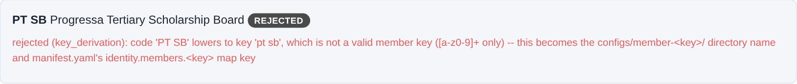
First: a member code with a space is refused
A member code with a space: refused before anything reaches the bus.
captured from the demonstration federation · X-Road 7.7.0 · pack a28b74c · 2026-09-30
5.4 · Admit a member to the bus
Notes:
VO: First, a join request whose member code has a space in it. The validator refuses it before anything reaches the bus, and says which characters a member key may use.

Slide 32
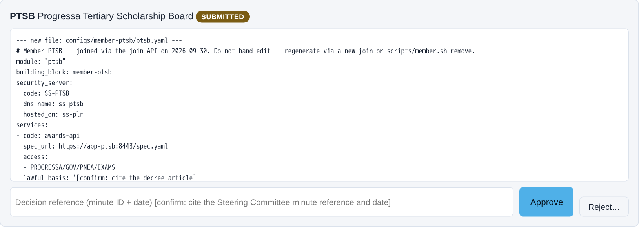
Second: the request, and the diff it would write
The request and the exact diff it would write — nothing written yet.
captured from the demonstration federation · X-Road 7.7.0 · pack a28b74c · 2026-09-30
5.4 · Admit a member to the bus
Notes:
VO: Second, the corrected request from the tertiary scholarship board, PTSB. The screen shows the exact files the join would write — its member configuration and the federation manifest — and nothing is written yet.

Slide 33
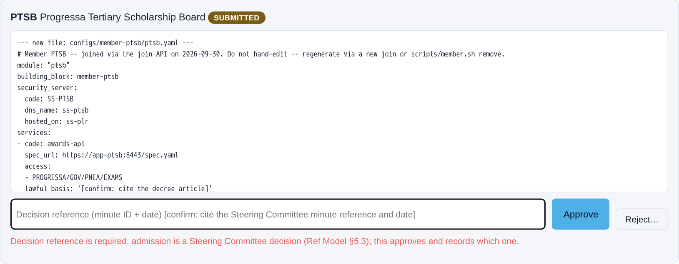
Third: approve without a minute — refused
Approve without a minute reference: refused. Admission is a committee decision.
captured from the demonstration federation · X-Road 7.7.0 · pack a28b74c · 2026-09-30
5.4 · Admit a member to the bus
Notes:
VO: Third, the operator tries to approve it with the decision reference left empty. Refused: admission is a committee decision, and the join cannot run ahead of it.

Slide 34
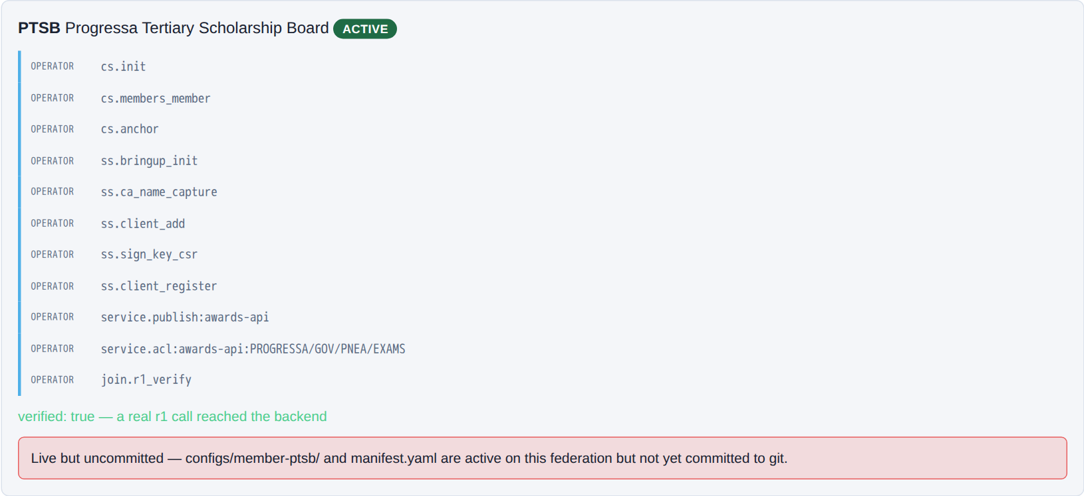
Fourth: the join runs itself, then proves the backend answers
Minute RIHA-2026-001 recorded: the steps run themselves, then a real call proves the backend answers.
captured from the demonstration federation · X-Road 7.7.0 · pack a28b74c · 2026-09-30
5.4 · Admit a member to the bus
Notes:
CLIP: J3-join.mp4
VO: Fourth, the operator enters the committee's minute reference and approves. The steps run themselves — the member and its server registered, its certificate, its service published, its access granted — and then a real call proves the backend answers.

Slide 35
Fifth: the admission record
$ cat onboarding/ptsb/01-admission.md
# Admission -- G1
The admission decision itself is taken outside this system (Ref Model §5.3's Steering Committee) -- this f…
| Field | Value |
| --- | --- |
| Join request id | `2zNu5ioIviU` |
| Decision reference | RIHA-2026-001 |
| Approved at | 2026-09-30T18:11:08.786950+00:00 |
| Approving role | operator |
The admission record: which decision admitted PTSB, and when.
captured from the demonstration federation · X-Road 7.7.0 · pack a28b74c · 2026-09-30
5.4 · Admit a member to the bus
Notes:
VO: Fifth, the admission record the join leaves behind: the request, the decision reference that admitted it, and when.

Slide 36
Sixth: on the bus, hosted, and proved
$ scripts/member.sh list
KEY ORIGIN SERVER UI REST
plr canonical ss-plr 127.0.0.1:3000 127.0.0.1:3080
pnea canonical ss-pnea 127.0.0.1:2000 127.0.0.1:2080
pnia canonical ss-pnia 127.0.0.1:5100 127.0.0.1:5180
ptsb joined ss-plr 127.0.0.1:3000 127.0.0.1:3080
$ scripts/acceptance.sh --summary --only 2.7
2.7.1 PASS join-api deploys and reports healthy
2.7.2 PASS spec-fetcher reachable from join-api, admin :4000 (cs) NOT reachable from spec-fetcher
2.7.r1(PTSB.awards-api) PASS PROGRESSA/GOV/PNEA/EXAMS r1 call to awards-api reaches the backend (no X-Ro…
2.7.deny(PTSB.awards-api) PASS PROGRESSA/GOV/PNIA/IDENTITY (via its own SS ss-pnia) denied by the provid…
2.7.fields(PTSB.awards-api) PASS PROGRESSA/GOV/PNEA/EXAMS r1 call to awards-api carries exactly its cont…
2.7.catalogue(PTSB.awards-api) PASS PTSB's awards-api appears in GET /catalogue
Reachable by PNEA, refused to everyone else, exactly the contract's fields, listed on the bus.
captured from the demonstration federation · X-Road 7.7.0 · pack a28b74c · 2026-09-30
5.4 · Admit a member to the bus
Notes:
VO: Sixth, the proof. The scholarship board is listed as a joined member, hosted on the learner registry's server. And the acceptance checks pass: the examination authority reaches its service, every other caller is refused, the response carries exactly the contract's fields, and the service is listed on the bus.

Slide 37
Conformance is the gate between registration and going live
It proves it meets the standards portfolio
Its server, its certificates and its services do what the framework requires.
Checked in proportion to the risk
Self-assessment for the routine, a third-party check for high-risk, the operator's test suite.
Not a certificate for life
Re-tested every two years, and on every change to a binding standard.
The step programmes skip in a hurry — and discover when one member's data breaks everyone's.
5.4 · Admit a member to the bus
Notes:
VO: Registration is not the last gate. Before its first service goes live, the member proves conformance against the standards portfolio: a self-assessment for routine services, a third-party check for high-risk ones, or the operator's own test suite. And it is re-tested every two years, and whenever a binding standard changes.

Slide 38
IN ONE SENTENCE
An agency is admitted by a validated request and a recorded decision — then the join runs itself, proves itself, and a conformance test gates its first service.
Do this on your own sector. Generate the X-Road member registration (subsystem + ACL).
The prompt in the companion material gives you the subsystem registration and access-control list with [confirm] placeholders, and an onboarding checklist. Before the next video.
5.4 · Admit a member to the bus
www.itu.int
Notes:
PRACTICE BOX (on-screen only — never read it, never paraphrase it, never point at it). It replaces the narrated handoff: this video ends on the recap and the Sources slide.
VO: So admitting a member is where onboarding becomes configuration: a validated request, an approval that cites the committee's decision, a join that runs itself and proves itself with a real call, and a conformance test before the first service goes live.

Slide 39
Sources
• NIIS X-Road member and subsystem registration (niis.org)
• X-Road access-control list configuration
• The Linkup demonstration federation
Find the link in the description.
5.4 · Admit a member to the bus
Notes:
Sources slide, held ~5 seconds at the end of the video. Links are compiled into the YouTube description per ITU convention; no URLs read aloud.

Slide 40
MODULE 5 · VIDEO 5.5
5.5
Stand up the federation
Central Server, Test CA, four Security Servers — the Linkup federation, stood up from the run book and shown healthy, registered and granted exactly.
standalone video · voice-over on text slides and a recorded demonstration
Notes:
Title card — the cold open. The hosts name the module, the video number, the title and the single message on this slide; no scripted narration. Hold until the opener begins; the opener is narrated on the next slide.

Slide 41
WHERE WE START
Now the live platform the members connect to.
A small set of components, each with a clear job.
Brought up from a run book, so anyone with the build pack can reproduce it.
5.5 · Stand up the federation
www.itu.int
Notes:
VO: With the members admitted, they need the platform they connect to: the federation. For the demonstration it is Linkup, an X-Road federation on a single host. It has a small set of components, each with one job, and it is brought up from a run book, so anyone with the build pack can reproduce it.

Slide 42
One registry, one gateway per member, one trust anchor
CENTRAL SERVER — OPERATED BY PDGA
The registry of members and services — every security server checks with it.
TEST CA — THE TRUST ANCHOR
Issues the certificates. A real CA in production.
each Security Server registers with the Central Server and receives its certificate from the Test CA
PDGA
Security Server
the federation owner
PNEA
Security Server
the examination authority
PLR
Security Server
the learner registry
PNIA
Security Server
the identity authority
The Security Servers carry the trust burden at each edge.
5.5 · Stand up the federation
Notes:
VO: The federation has three kinds of component. The Central Server, operated by PDGA, is the registry of members and services that every security server checks with. The four Security Servers — PDGA's, as the owner, and one each for PNEA, PLR and PNIA — are the gateways that carry the trust burden at each member's edge. And the Test CA issues the certificates they prove who they are with; in production, a real certification authority.
On screen: the member list and the hosting line live in MEMBERS and HOSTING at the top of the build script.

Slide 43
Bring it up from the run book, in order
1
The Central Server
The registry every other component checks with.
2
The Test CA, with certificate status and time-stamping
Registered as trust services.
3
The members on the registry, then the anchor
The configuration every server imports.
4
Each Security Server
Its certificate — and its registration approved on the Central Server.
5
The services and the grants
What each member publishes, and who may call it.
For the demonstration, Linkup runs on a single host — a laptop or one VM — in sandboxed containers, sized for cross-agency calls, not production volumes.
5.5 · Stand up the federation
Notes:
VO: Standing it up is a run-book exercise, in order. The Central Server first. Then the Test CA, with its certificate-status and time-stamping services. Then the members on the registry, and the configuration anchor every server imports. Then each Security Server: its certificate, and its registration, approved explicitly on the Central Server — the technical footprint of the admission decision. Then the services, and the grants that say who may call them.

Slide 44
First: six containers, all healthy
$ docker compose ps --format "{{.Name}} {{.Health}}"
cs healthy
ca healthy
ss-pdga healthy
ss-plr healthy
ss-pnea healthy
ss-pnia healthy
One Central Server, one Test CA, four Security Servers — all healthy.
captured from the demonstration federation · X-Road 7.7.0 · pack a28b74c · 2026-09-30
5.5 · Stand up the federation
Notes:
VO: First, the containers: one Central Server, one Test CA, and four Security Servers, all reporting healthy.

Slide 45
Second: from zero to running, measured
$ scripts/demo.sh
step 0 -- scripts/preflight.sh (host dependencies, .env, clock, RAM)
step 1 -- scripts/gen-secrets.sh (a real .env, mode 600)
step 2 -- scripts/deploy.sh (the federation, from zero)
step 3 -- scripts/seed.sh (Progressa demonstration data)
step 4 -- scripts/acceptance.sh (the once-only exchange proves itself)
$ cat out/deploy-timings.txt # measured by scripts/deploy.sh
containers healthy 100 s · Hurl run 290 s · total 390 s
From zero to a running federation: measured, not estimated.
captured from the demonstration federation · X-Road 7.7.0 · pack a28b74c · 2026-09-30
5.5 · Stand up the federation
Notes:
VO: Second, the run book itself: five steps, from checking the host to the exchange proving itself. The deploy times itself: on the recorded run, about a hundred seconds until the containers were healthy, and six and a half minutes in all, from zero to a running federation.

Slide 46
Third: three members, each behind its own server
$ scripts/member.sh list
KEY ORIGIN SERVER UI REST
plr canonical ss-plr 127.0.0.1:3000 127.0.0.1:3080
pnea canonical ss-pnea 127.0.0.1:2000 127.0.0.1:2080
pnia canonical ss-pnia 127.0.0.1:5100 127.0.0.1:5180
Three members, each behind its own Security Server.
captured from the demonstration federation · X-Road 7.7.0 · pack a28b74c · 2026-09-30
5.5 · Stand up the federation
Notes:
VO: Third, the members: the learner registry, the examination authority and the identity authority, each behind its own Security Server.

Slide 47
Fourth: registered, grants exact, monitoring running
$ scripts/acceptance.sh --summary --only 2.x
2.x.addons(ss-pdga) PASS operational + environmental monitoring add-ons RUNNING on ss-pdga
2.x.addons(ss-pnea) PASS operational + environmental monitoring add-ons RUNNING on ss-pnea
2.x.addons(ss-plr) PASS operational + environmental monitoring add-ons RUNNING on ss-plr
2.x.addons(ss-pnia) PASS operational + environmental monitoring add-ons RUNNING on ss-pnia
2.x(PLR:ENROLMENT) PASS client REGISTERED on ss-plr
2.x(PNEA:EXAMS) PASS client REGISTERED on ss-pnea
2.x(PNIA:IDENTITY) PASS client REGISTERED on ss-pnia
2.x.acl(identity-api) PASS identity-api grants exactly PROGRESSA:GOV:PNEA:EXAMS
2.x.acl(enrolment-api) PASS enrolment-api grants exactly PROGRESSA:GOV:PNEA:EXAMS
2.x.catalogue(PROGRESSA/GOV/PLR/ENROLMENT/enrolment-api) PASS PROGRESSA/GOV/PLR/ENROLMENT/enrolment-api'…
2.x.catalogue(PROGRESSA/GOV/PNIA/IDENTITY/identity-api) PASS PROGRESSA/GOV/PNIA/IDENTITY/identity-api's …
Registered on the Central Server, grants exact, monitoring add-ons running — the federation is real.
captured from the demonstration federation · X-Road 7.7.0 · pack a28b74c · 2026-09-30
5.5 · Stand up the federation
Notes:
VO: Fourth, the checks: each member's client registered on its own server, each service granting exactly the examination authority and no one else, each catalogue entry linking its service-level agreement, and the monitoring add-ons running on all four servers.

Slide 48
IN ONE SENTENCE
Central Server, Test CA, four Security Servers — stood up from the run book, in order, and shown running, registered and granted exactly.
Do this on your own sector. Draft the federation stand-up run book.
The prompt in the companion material gives you an ordered, reproducible stand-up run book with production-difference notes. Before the next video.
5.5 · Stand up the federation
www.itu.int
Notes:
PRACTICE BOX (on-screen only — never read it, never paraphrase it, never point at it). It replaces the narrated handoff: this video ends on the recap and the Sources slide.
VO: So the federation is brought up from a run book, in order, and then shown to be real: every server healthy, every member registered, every grant exact. The bus exists, and it is ready to carry a real call.

Slide 49
Sources
• NIIS X-Road federation — Central Server, Security Server, Test CA (niis.org)
• The Linkup demonstration federation
Find the link in the description.
5.5 · Stand up the federation
Notes:
Sources slide, held ~5 seconds at the end of the video. Links are compiled into the YouTube description per ITU convention; no URLs read aloud.

Slide 50
MODULE 5 · VIDEO 5.6
5.6
Run the once-only exchange, live
PNEA issues a credential and pre-fills identity from PNIA and enrolment from PLR — a real cross-server call, the data asked once.
standalone video · voice-over on text slides and a recorded demonstration
Notes:
Title card — the cold open. The hosts name the module, the video number, the title and the single message on this slide; no scripted narration. Hold until the opener begins; the opener is narrated on the next slide.

Slide 51
WHERE WE START
The moment the whole framework exists for.
The examination authority asks the learner once and fetches the rest.
Recorded from the running federation, exactly as it ran.
5.6 · Run the once-only exchange, live
www.itu.int
Notes:
VO: This is the exchange the whole framework exists for: the examination authority issues a credential and fetches the learner's identity and enrolment itself, asking the learner once. What follows was recorded from the running federation.

Slide 52
One call — identity from PNIA, enrolment from PLR
PNIA
The identity authority
Returns the identity
PNEA
The examination authority
Pre-fills the application — no paper proof
THE LEARNER
Applies for a credential
Gives a national ID — once
over the bus
PLR
The learner registry
Returns the enrolment
Without once-only, the learner brings paper proof of both. With it, the learner is asked once.
5.6 · Run the once-only exchange, live
Notes:
VO: This is the call on screen. The examination authority, PNEA, receives a learner's credential application. Without once-only, PNEA would ask the learner for paper proof of identity and of enrolment. With it, PNEA fetches the identity from the identity authority, PNIA, and the enrolment from the learner registry, PLR, over the bus.
Production cue: the picture of what the recording shows. The frames that follow map onto these boxes.

Slide 53
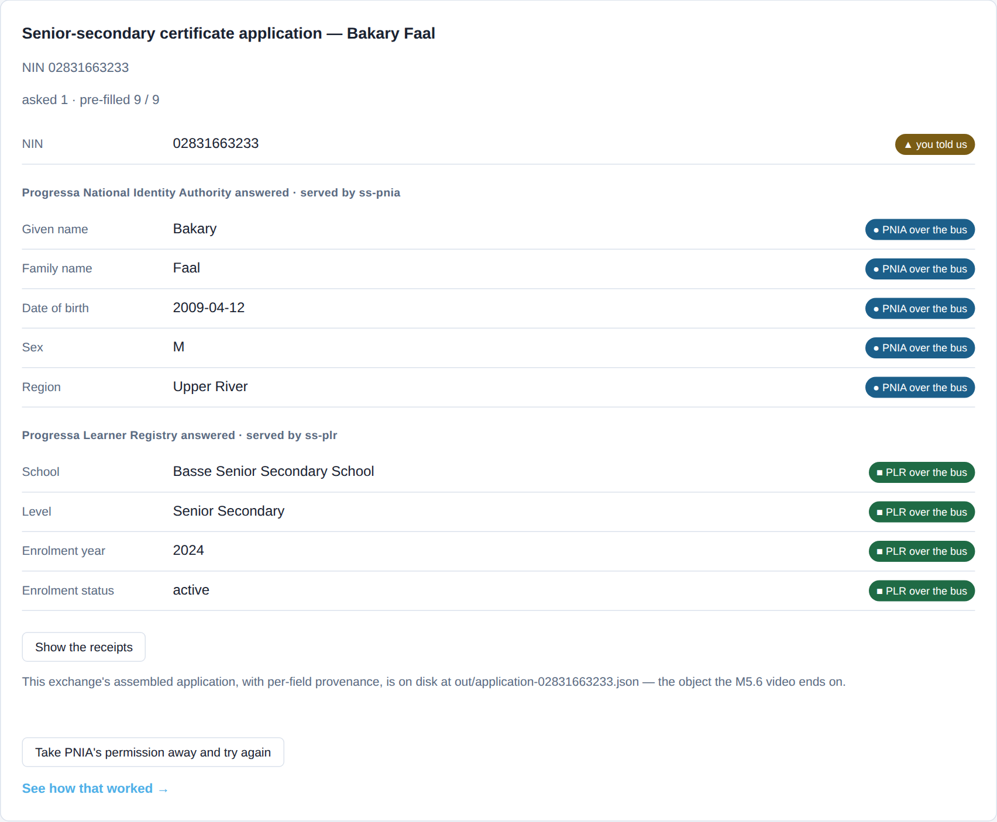
First: ten blank rows, then nine filled
Ten blank rows before the call; nine filled after it, each labelled with its source.
captured from the demonstration federation · X-Road 7.7.0 · pack a28b74c · 2026-09-30
5.6 · Run the once-only exchange, live
Notes:
VO: First, the form before and after the call. Before, ten rows, all blank: ten questions the learner answers, and two sets of paper proof. Once PNEA has the learner's national ID, nine rows fill in: five from the identity authority, PNIA, four from the learner registry, PLR, each labelled with its source. One question asked, nine fetched.

Slide 54
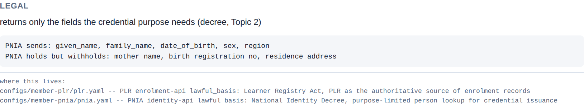
Second: what PNIA sends — and what it withholds
Legal, organisational, semantic, technical — read off the live response.
captured from the demonstration federation · X-Road 7.7.0 · pack a28b74c · 2026-09-30
5.6 · Run the once-only exchange, live
Notes:
VO: Second, the second tab reads the exchange by layer. In the legal pane, the identity authority, PNIA, sends five fields and names three it holds but withholds: a mother's name, a birth registration number, an address. The purpose does not need them.

Slide 55
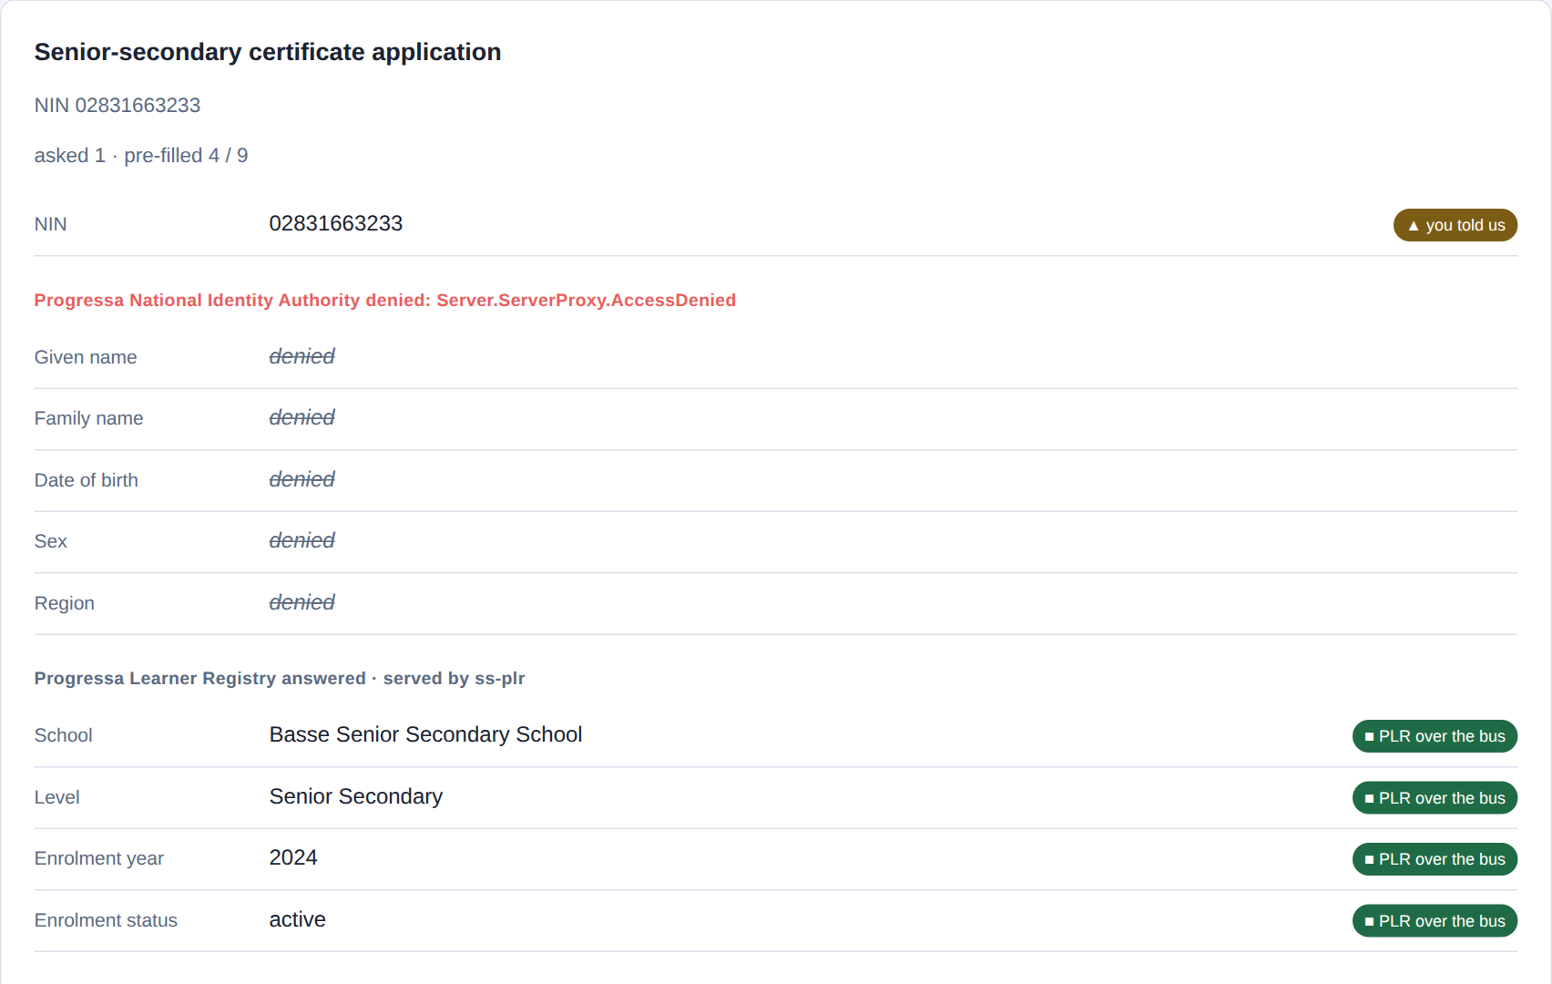
Third: allowed, refused, then cut off
Asked twice: allowed, refused. Grant withdrawn: the identity half fails, enrolment still fills.
captured from the demonstration federation · X-Road 7.7.0 · pack a28b74c · 2026-09-30
5.6 · Run the once-only exchange, live
Notes:
CLIP: C6-break-restore.mp4
VO: Third, permission. Asked the identical question, the examination authority, PNEA, is allowed, and the learner registry, PLR, is refused by the identity authority's access list. Then the operator withdraws the examination authority's permission: within seconds the identity rows are denied while the enrolment rows still fill. Restore it, and the form is whole. Being on the bus is not permission.

Slide 56
Fourth: on disk, and six checks green
out/application-02831663233.json — the assembled application, one line per field
field value source
nin 02831663233 citizen — the one thing asked
given_name Bakary PNIA identity-api over the bus
family_name Faal PNIA identity-api over the bus
date_of_birth 2009-04-12 PNIA identity-api over the bus
sex M PNIA identity-api over the bus
region Upper River PNIA identity-api over the bus
school Basse Senior Secondary School PLR enrolment-api over the bus
level Senior Secondary PLR enrolment-api over the bus
enrolment_year 2024 PLR enrolment-api over the bus
status active PLR enrolment-api over the bus
$ scripts/acceptance.sh --summary --only 2.6
2.6.1 PASS happy path — both cross-server calls resolve
2.6.2 PASS right learner — fields match the seeded record
2.6.3 PASS asked once — NIN is the only citizen field; bus pre-fills exactly the rest
2.6.4 PASS negative — PROGRESSA/GOV/PLR/ENROLMENT (via its own SS ss-plr) denied by the provider ACL
2.6.5 PASS negative — NIN absent from PLR yields a clean 404, not silence
2.6.6 PASS field conformance — both responses carry exactly the fields their contract declares (G5.9)
The application on disk, every field's source; checks 2.6.1 to 2.6.6 green.
captured from the demonstration federation · X-Road 7.7.0 · pack a28b74c · 2026-09-30
5.6 · Run the once-only exchange, live
Notes:
VO: Fourth, the record and the proof. The exchange is written to disk as the assembled application, one line per field with its source; the national ID is the only line the citizen supplied. And the acceptance script runs the exchange as six checks: the call, the right learner, asked once, the denial, a clean not-found, and field conformance. All six pass: the technical half of go-live approval.

Slide 57
IN ONE SENTENCE
One field asked, nine fetched, only what the purpose needs — and six acceptance checks green.
Do this on your own sector. Script and verify the once-only exchange (the acceptance check).
The prompt in the companion material gives you a given/when/then acceptance script with a negative check, mapped to the four layers. Before the next video.
5.6 · Run the once-only exchange, live
www.itu.int
Notes:
PRACTICE BOX (on-screen only — never read it, never paraphrase it, never point at it). It replaces the narrated handoff: this video ends on the recap and the Sources slide.
VO: So the exchange is shown, not explained: one field asked, nine fetched, only what the purpose needs, a denial the access list enforces, six checks green. That is the framework, running.

Slide 58
Sources
• PAERA v1.0 — §5.2, Principle #5 (Once-Only)
• NIIS X-Road (niis.org)
• The Linkup demonstration federation
Find the link in the description.
5.6 · Run the once-only exchange, live
Notes:
Sources slide, held ~5 seconds at the end of the video. Links are compiled into the YouTube description per ITU convention; no URLs read aloud.

Slide 59
MODULE 5 · VIDEO 5.7
5.7
From demonstration to production
What changes between the sandboxed Linkup demonstration and a production-grade federation a country would actually run.
standalone video · voice-over on text slides
Notes:
Title card — the cold open. The hosts name the module, the video number, the title and the single message on this slide; no scripted narration. Hold until the opener begins; the opener is narrated on the next slide.

Slide 60
WHERE WE START
The demonstration proves the pattern. It is not production.
Know exactly what changes before go-live.
After go-live is when the gap is most expensive to discover.
5.7 · From demonstration to production
www.itu.int
Notes:
VO: The demonstration proves the pattern. It is not, and must not be mistaken for, a production system. The architect's last job in this module is to know exactly what changes between the demonstration and a production-grade federation, so the country plans and budgets for that gap rather than discovering it after go-live — which is the moment it is most expensive to discover.

Slide 61
Production adds seven things around the same configuration
THE DEMONSTRATION
Everything on one VM, in sandboxed containers
A Test CA
A handful of demonstration calls
PRODUCTION
Separate, sized hosts
A real certification authority
High availability and redundancy
Real monitoring and alerting
Capacity for real volumes
Round-the-clock operational support
Security hardening and audit
Specific, and plannable.
5.7 · From demonstration to production
Notes:
VO: The differences are specific. The demonstration runs everything on one VM; production separates the components onto real, sized hosts. The demonstration uses a Test CA; production uses a real certification authority. Production adds high availability and redundancy, so a failed component does not stop the bus. It adds real monitoring and alerting, so problems are caught before citizens notice them. It is sized for real transaction volumes, not a handful of demonstration calls. It has round-the-clock operational support — the Operating Authority's standing team. And it is security-hardened and audited to the standard a national platform carrying citizen data must meet.

Slide 62
The shape of the configuration does not change
The subsystem registrations, the service descriptions, the semantic map — the same in production.
Production changes the scale, the resilience and the operations around them, not the design.
Production is the same pattern, hardened — so the demonstration de-risks the build.
5.7 · From demonstration to production
Notes:
VO: Here is the reassuring part, and it is the point of building a demonstration at all: none of this changes the shape of the configuration. The subsystem registrations, the service descriptions, the semantic map — they are the same in production. Production changes the scale, the resilience and the operations around the configuration, not the design of it. So the demonstration genuinely de-risks the production build. You have proven the pattern works; production is the same pattern, hardened and operated. The later phases of your four-phase plan are exactly where that production build is funded and delivered, against the cost frame.
Production cue: the pivotal slide of this video. Hold it a beat longer.

Slide 63
Retire the legacy links the bus replaces — agency by agency
STAND UP
The new once-only exchange
PARALLEL-RUN
Beside the agency's old point-to-point link
CONFIRM
The two agree
CUT OVER
Switch the consumers across, decommission the old link
Left alone, you run both — worse than either. This is the step that ends the sprawl.
5.7 · From demonstration to production
Notes:
VO: There is one more production task, and it does not appear on the hardening list because it concerns the old world rather than the new: migrating each agency off the legacy point-to-point links the bus replaces, and retiring them. A new bus does not retire the old links by itself — left alone, you run both, which is worse than either. So per agency the pattern is parallel-run then cut over: stand up the new once-only exchange, run it beside the agency's existing point-to-point link until you have confirmed the two agree, then switch the consumers across and decommission the old link. Retiring those links is the step that actually ends the point-to-point sprawl Module 1 diagnosed — schedule it, agency by agency, in the multi-agency phase of the plan, with a migration-and-retirement step in each onboarding.

Slide 64
The demonstration names its own gap
implemented
41 · 54%
simulated
6 · 8%
named absence
24 · 32%
out of scope
4 · 5%
**total**
**75**
What this demonstration is honest about: 41 implemented, 6 simulated, 24 named absences, 4 out of scope.
captured from the demonstration federation · X-Road 7.7.0 · pack a28b74c · 2026-09-30
5.7 · From demonstration to production
Notes:
VO: The demonstration is honest about its own gap. Its conformance record sorts seventy-five clauses: forty-one implemented, six simulated, twenty-four named as absent, and four out of scope. That list is where the production plan starts.

Slide 65
Never ship the demonstration as production
PERFECT FOR
Proving the pattern.
A sandboxed single-VM federation with a test CA.
WRONG FOR
Carrying real citizen data at scale.
Anything a country has to run.
Know the gap, plan it into the phased roadmap, budget it with the cost frame.
5.7 · From demonstration to production
Notes:
VO: The one thing not to do is ship the demonstration as production. A sandboxed single-VM federation with a test certification authority is perfect for proving the pattern and wrong for carrying real citizen data at scale. Know the gap, plan it into the phased roadmap, budget it with the cost frame — and the move from demonstration to production becomes an engineering exercise the team can plan, not a surprise that derails go-live.

Slide 66
IN ONE SENTENCE
Production is the demonstration's pattern, hardened — separate hosts, a real CA, high availability, monitoring, support. Plan the gap; do not ship the demo.
Do this on your own sector. Build the demonstration-to-production gap checklist.
The prompt in the companion material gives you a gap checklist mapped to the phased plan and cost frame. Before the next video.
5.7 · From demonstration to production
www.itu.int
Notes:
PRACTICE BOX (on-screen only — never read it, never paraphrase it, never point at it). It replaces the narrated handoff: this video ends on the recap and the Sources slide.
VO: So you close the implementation module by being honest about the gap between demonstration and production. Separate hosts, a real certification authority, high availability, monitoring, capacity, support, hardening — the production differences are specific and plannable. The configuration's shape does not change, so the demonstration de-risks the build. Plan the gap into the roadmap, budget it with the cost frame, and never ship the demonstration as the production platform. That is how a proven pattern becomes a system a country runs.

Slide 67
Sources
• NIIS X-Road production and operations guidance (niis.org)
• ITU DPI Safeguards
Find the link in the description.
5.7 · From demonstration to production
Notes:
Sources slide, held ~5 seconds at the end of the video. Links are compiled into the YouTube description per ITU convention; no URLs read aloud.

Slide 68
MODULE 5 · VIDEO 5.8
5.8
Watch the bus — monitoring and anomaly detection
Point Claude at the real bus logs to spot a failing or unusual exchange before a citizen does.
standalone video · voice-over on text slides
Notes:
Title card — the cold open. The hosts name the module, the video number, the title and the single message on this slide; no scripted narration. Hold until the opener begins; the opener is narrated on the next slide.

Slide 69
WHERE WE START
A running bus is not finished. It is operating, every day.
Every call leaves a trace in the logs.
Reading them by hand does not scale past a few services.
5.8 · Watch the bus — monitoring and anomaly detection
www.itu.int
Notes:
VO: A production bus needs real monitoring and alerting, and this is what that monitoring is for. A running bus is not finished — it is operating, every day. Every call leaves a trace in the logs: success or failure, fast or slow, who called whom. Reading those logs by hand does not scale past a few services. The monitoring play points Claude at the real bus logs and turns them into something a Strategist can act on — a plain-language picture of the bus's health, and a flag when something looks wrong.

Slide 70
The logs hold the operational truth
Which exchanges ran, and which failed
And how often.
Latency
Whether calls are getting slower — a service under strain.
Unusual patterns
A spike, a new caller, a surge at three in the morning.
Compliance
Which members still meet the binding standards, and which are drifting.
The metadata of exchanges — never their contents.
5.8 · Watch the bus — monitoring and anomaly detection
Notes:
VO: The logs hold the operational truth. Which exchanges ran and which failed, and how often. Whether calls are getting slower — a sign of a service under strain. And unusual patterns — a sudden spike, an agency calling a service it never called before, a surge of activity at three in the morning. The play reads all of this and writes a plain-language health report, flagging the things that deserve a human's attention this week.

Slide 71
Two loops: health every day, compliance every quarter
DAILY — OPERATIONAL HEALTH
A failing service caught before a citizen is turned away.
A slowdown addressed before it becomes an outage.
QUARTERLY — MEMBER COMPLIANCE
To the Steering Committee each quarter, the Council each year.
To citizens twice a year, where transparency policy asks.
Monitoring that reaches a governance table is accountability. The rest is a dashboard.
5.8 · Watch the bus — monitoring and anomaly detection
Notes:
VO: The value is early warning. A failing service, caught in the logs, is fixed before a citizen standing at a counter is turned away. A creeping slowdown, spotted early, is addressed before it becomes an outage. The Operating Authority's team uses this to watch a growing federation without drowning in raw logs — the AI does the reading, the team does the acting. That is what lets a small operations team keep a hundred-service bus healthy. And the same reading serves a second, slower loop. Operational health is watched daily; member compliance is reviewed quarterly — which members still meet the binding standards, whose conformance has lapsed, what breaches occurred and what was done. That review goes to the Steering Committee each quarter, to the Council each year, and, where the country's transparency policy asks for it, to citizens twice a year. Monitoring that never reaches a governance table is a dashboard; monitoring that does is accountability.
Production cue: the pivotal slide of this video. Hold it a beat longer.

Slide 72
Two safeguards that are not optional
THE AI FLAGS, A HUMAN INVESTIGATES
An anomaly is a question to look into.
Not a verdict to act on automatically.
NO CITIZEN DATA IN THE PROMPT
Which service, success or failure, how fast.
A monitoring tool that ingests citizen data becomes the risk.
Monitor the traffic, never the cargo.
5.8 · Watch the bus — monitoring and anomaly detection
Notes:
VO: Two safeguards matter here, and neither is optional. The AI flags; a human investigates — an anomaly is a question to look into, not a verdict to act on automatically. And, critically, the logs you feed the play must carry no citizen personal data. You monitor the metadata of exchanges — which service, success or failure, how fast — not the contents of what was exchanged. A monitoring tool that ingested citizen data would itself become a data-protection risk, the very thing the framework exists to prevent. Monitor the traffic, never the cargo.

Slide 73
IN ONE SENTENCE
The logs hold the bus's health — the AI makes it legible, a human acts on the flags, and citizen data never enters the prompt.
Do this on your own sector. Summarise bus health and flag anomalies from the logs.
The prompt in the companion material gives you a health summary plus a prioritised list of anomalies to investigate. Before the next video.
5.8 · Watch the bus — monitoring and anomaly detection
www.itu.int
Notes:
PRACTICE BOX (on-screen only — never read it, never paraphrase it, never point at it). It replaces the narrated handoff: this video ends on the recap and the Sources slide.
VO: So monitoring is how a framework stays healthy as it grows from one exchange to hundreds. The bus tells you how it is doing, in its logs; the AI play makes that legible; the Operating Authority acts on the flags; and citizen data never enters the prompt. Monitoring is the difference between a federation someone is watching and one that fails silently until a citizen complains.

Slide 74
Sources
• NIIS X-Road monitoring and operational logs (niis.org)
• The Linkup demonstration federation
• ITU DPI Safeguards
Find the link in the description.
5.8 · Watch the bus — monitoring and anomaly detection
Notes:
Sources slide, held ~5 seconds at the end of the video. Links are compiled into the YouTube description per ITU convention; no URLs read aloud.

Slide 75
MODULE 5 · VIDEO 5.9
5.9
Keep the documents honest — the consistency cross-check
Keep the decree, the Governance Pack and the standards portfolio saying the same thing — a cross-check that catches drift across the three.
standalone video · voice-over on text slides
Notes:
Title card — the cold open. The hosts name the module, the video number, the title and the single message on this slide; no scripted narration. Hold until the opener begins; the opener is narrated on the next slide.

Slide 76
WHERE WE START
Three documents that must agree — and, left alone, drift apart.
The decree, the Governance Pack, the standards portfolio.
Find the contradictions before a reviewer does.
5.9 · Keep the documents honest — the consistency cross-check
www.itu.int
Notes:
VO: A mature framework produces three big documents that must agree with each other: the decree, which is the legal layer; the Governance Pack, which is the organisational layer; and the standards portfolio, which is the technical layer. The trouble is that, separately maintained, they drift apart over time — a standard updated in the portfolio but not reflected in the decree, a role the Governance Pack renames but the decree still names the old way. The consistency cross-check reads the three for contradictions before a reviewer or a member finds them for you.

Slide 77
Drift is specific and predictable
1
A standard updated in the portfolio
But the decree still references the old version.
2
A body in the RACI
That the Governance Pack no longer describes.
3
An exchange the decree authorises
That no service implements — or a service the decree never authorised.
4
One term, three meanings
"Member", "service", "authority" — used slightly differently in each.
Each one quietly undermines the framework the moment someone notices.
5.9 · Keep the documents honest — the consistency cross-check
Notes:
VO: Drift is specific and predictable. The standards portfolio adopts a new version, but the decree still references the old one. The RACI names a body the Governance Pack no longer describes. The decree authorises an exchange that no service in the catalogue implements, or a service exists that the decree never authorised. And the same term — 'member', 'service', 'authority' — is used to mean slightly different things in the three documents. Each of these is a contradiction that quietly undermines the framework's credibility the moment someone notices it.

Slide 78
Read the three together — before a reviewer does
THE DECREE
The legal layer
THE CROSS-CHECK
Reads all three documents together.
Reports where they disagree, and on what.
Bus monitoring watches the traffic; this watches the documents.
THE GOVERNANCE PACK
The organisational layer
THE STANDARDS PORTFOLIO
The technical layer
Caught by you — not by a Ministry of Justice reviewer, a joining member or an auditor.
5.9 · Keep the documents honest — the consistency cross-check
Notes:
VO: The play reads all three documents and reports the contradictions — where they disagree, and on what. It is the document analogue of the bus monitoring in the previous video: instead of watching the live traffic, it watches the documents for inconsistency. The value is catching drift before a Ministry of Justice reviewer, a joining member, or an auditor catches it for you — because a framework whose own three foundational documents contradict each other loses trust faster than almost anything else can cost it.
Production cue: the pivotal slide of this video. Hold it a beat longer.

Slide 79
The AI finds the drift — a person decides which is right
Whether the catalogue or the decree is correct is a judgement with legal and governance consequences.
So the play never edits the decree on its own. Run it whenever any of the three changes.
Consistency is a direction, not an automatic edit.
5.9 · Keep the documents honest — the consistency cross-check
Notes:
VO: The safeguard is the same shape as always. The AI flags the contradiction; a human decides which of the three documents is correct and fixes it. The play does not edit the decree on its own, because deciding whether the catalogue or the decree is right is a judgement with legal and governance consequences. The play finds the drift; a person resolves it. Run it whenever any of the three documents changes, and the framework's documents stay honest with each other as it evolves.

Slide 80
IN ONE SENTENCE
Cross-check the decree, the Governance Pack and the standards portfolio — the AI finds the drift, a human resolves which document is right.
Do this on your own sector. Cross-check the decree, Governance Pack and standards portfolio for drift.
The prompt in the companion material gives you a contradiction table with a human question for each, ordered by risk. Before the next video.
5.9 · Keep the documents honest — the consistency cross-check
www.itu.int
Notes:
PRACTICE BOX (on-screen only — never read it, never paraphrase it, never point at it). It replaces the narrated handoff: this video ends on the recap and the Sources slide.
VO: So the consistency cross-check keeps the framework's three foundational documents telling the same story. The AI reads the decree, the Governance Pack and the standards portfolio together and flags where they have drifted apart; a human decides which is right and fixes it. Run it on every change, and you catch the contradictions yourself, before the reviewer, the member or the auditor does.

Slide 81
Sources
• The decree — Module 2
• The Governance Pack — Module 3
• The standards portfolio — Module 4
• EU European Interoperability Framework (EIF)
Find the link in the description.
5.9 · Keep the documents honest — the consistency cross-check
Notes:
Sources slide, held ~5 seconds at the end of the video. Links are compiled into the YouTube description per ITU convention; no URLs read aloud.

Slide 82
MODULE 5 · VIDEO 5.10
5.10
Carry the framework to the next sector
The same four-layer framework stands up interoperability beyond education — the method is sector-portable, and the second sector is cheaper than the first.
standalone video · voice-over on text slides
Notes:
Title card — the cold open. The hosts name the module, the video number, the title and the single message on this slide; no scripted narration. Hold until the opener begins; the opener is narrated on the next slide.

Slide 83
WHERE WE START
The framework was built on education. It is not education-specific.
Know what carries to the next sector unchanged, and what is new.
Get that split right, and the second sector pays only for its own vocabularies and services.
5.10 · Carry the framework to the next sector
www.itu.int
Notes:
VO: Everything in this knowledge product was demonstrated on education — Progressa's schools, learners and credentials. But the framework is not education-specific, and now that it runs, the most important thing a Strategist can know is exactly which parts carry to the next sector unchanged and which parts are new. Get that split right, and the second sector pays only for its own vocabularies and services.

Slide 84
Two things are new per sector — the rest carries unchanged
CARRIES UNCHANGED
The four layers
The decree pattern
The governance — tiers, RACI, Operating Authority
The standards portfolio
The bus itself, already running
NEW PER SECTOR
The semantic layer — its vocabularies
The specific exchanges and services
Whichever sector goes first pays for the platform. The next is cheaper either way.
5.10 · Carry the framework to the next sector
Notes:
VO: Split the framework in two. What carries unchanged to health, or agriculture, or social protection: the four-layer model, the decree pattern, the governance — the tiers, the RACI, the Operating Authority — the standards portfolio, and the bus itself, already built and running. What is genuinely new per sector: the semantic layer, because health speaks a different vocabulary than education, and the specific exchanges and services that sector needs. That — the vocabularies and the services — is the whole of the difference. And a word on order. This knowledge product demonstrated on education because the worked case was to hand; most countries sequence the framework the other way round. The first wave is usually tax, civil registration, the business register and health — high-volume, foundational reference data that every other sector reads — with education, justice, social protection and customs in the second wave. Whichever sector goes first pays for the platform; the rule that the next is cheaper holds either way.
Production cue: the pivotal slide of this video. Hold it a beat longer.

Slide 85
A planned framework gets cheaper with every sector
The first sector pays for the bus, the governance and the legal mandate.
The second reuses all of it and pays only for its own semantics and services; the third reuses more still.
A set of separate sector projects never gets cheaper.
5.10 · Carry the framework to the next sector
Notes:
VO: And this is the re-use argument at the scale of the whole framework. The first sector pays to build the bus, the governance and the legal mandate; the second sector reuses all of it and pays only for its own semantics and services; the third reuses more still. This is exactly the whole-of-government planning logic from the very first module, now visible across sectors: build the shared platform once, and every sector after consumes it. The second sector is cheaper than the first, and the third cheaper than the second — and only a framework built deliberately, for the whole of government, makes that compounding possible. A set of separate sector projects never gets cheaper; a planned framework does.

Slide 86
The portability map is the next sector's business case
Here is what we reuse — most of it.
Here is the small, sector-specific part we build new.
The investment a strategist can defend for a decade.
5.10 · Carry the framework to the next sector
Notes:
VO: Portability is built in on purpose, and it is not a footnote — it is the reason an interoperability framework is worth its cost. A platform that served only education would be hard to justify; a platform that serves education first and then every other sector, each paying only for its own vocabularies and services, is the investment a strategist can defend for a decade. So when you take the next sector to your minister, bring the portability map: here is what we reuse, which is most of it, and here is the small, sector-specific part we build new. That map gets cheaper to make every time, and it is the business case for the next sector.

Slide 87
IN ONE SENTENCE
The framework is sector-portable — build the platform once, reuse it everywhere, and the next sector is cheaper than the last.
Do this on your own sector. Map your framework's sector-portable vs sector-specific parts for a new sector.
The prompt in the companion material gives you a sector-portability map (reused / new) plus a minister-ready business case. Before the next video.
5.10 · Carry the framework to the next sector
www.itu.int
Notes:
PRACTICE BOX (on-screen only — never read it, never paraphrase it, never point at it). It replaces the narrated handoff: this video ends on the recap and the Sources slide.
VO: So the framework you built for education is sector-portable. Most of it — the bus, the governance, the legal mandate, the standards — carries unchanged; only the vocabularies and the services are new per sector. Build the platform once, reuse it everywhere, and let every sector after the first be cheaper than the one before. That compounding re-use is the framework's lasting value.

Slide 88
Sources
• Terms of Reference §4.4 — sector portability
• EU European Interoperability Framework — the four-layer model
• PAERA v1.0 — §3.4.3 (Interoperability framing)
Find the link in the description.
5.10 · Carry the framework to the next sector
Notes:
Sources slide, held ~5 seconds at the end of the video. Links are compiled into the YouTube description per ITU convention; no URLs read aloud.

Slide 89
Notes:
Closing slide for the combined deck. Individual videos end on their sources slide instead.

