Slide 1


WHAT THIS MODULE SETTLES
Why digital services go wrong,
and the method that prevents it
Three places a service gets lost
Three rules for a supplier
KP4 · Designing Digital Government Services · Module 1
Five standalone videos for the manager who commissions a service: where an agreed service gets lost, three rules to hold a supplier to, why a named question beats a guess, the twelve documents of the method, and who writes, checks and accepts each.
A named question, not a guess
Twelve documents, in order
Length: ~25 mins across 5 videos (1.1 – 1.5)
Target audience: The public-sector manager who commissions a service, judges the offer and accepts the result
A named person accepts
3 places · 3 rules · 12 documents
Notes:
Cover for the combined Module 1 deck. Each section that follows is one standalone ~5 minute video. Module 1 is the Strategist-facing entry point to KP4: the manager who commissions a digital public service, judges the supplier's offer, convenes the review and answers to the minister and the donor. Nothing is generated in this module.

Slide 2
Module 1 — five videos
1.1 Where an agreed service gets lost ~5 min
1.2 Three rules you can hold a supplier to ~5 min
1.3 A question with a name on it ~5 min
1.4 Twelve documents, request to running service ~5 min
1.5 Who writes, who checks, who accepts ~5 min
An agreed service is lost where a question was not decided, an answer not passed on, or a rule not enforced.
Twelve documents, each accepted by a named person before the next is begun, close those places.
Notes:
Navigation slide for the combined deck; the videos ship standalone. 1.1 and 1.2 are the why: where a service gets lost and the rules that stop it. 1.3 to 1.5 are the method: named questions, the twelve documents, and who accepts each.

Slide 3
MODULE 1 · VIDEO 1.1
1.1
Where an agreed service gets lost
An agreed service is lost at three places: a question nobody decided, an answer nobody passed on, a rule nobody enforced.
standalone video · voice-over on text slides
Notes:
Title card — the cold open. The hosts name the module, the video number, the title and the single message on this slide; no scripted narration. Hold until the opener begins; the opener is narrated on the next slide.

Slide 4
WHERE WE START
The service that arrives is not the one they agreed.
Your minister agreed a service with the officials who will run it.
A year later, you will be asked why it changed.
There is an answer you can give, and it has three parts.
1.1 · Where an agreed service gets lost
www.itu.int
Notes:
VO: Your minister agreed a service with the officials who will run it. A year later, the service that arrives is not the one they agreed. You will be asked why. There is an answer you can give, and it has three parts.

Slide 5
Between what was agreed and what runs
Every question about the service is answered by somebody.
If nobody is made to ask it, it is answered at the keyboard, without a record.
1.1 · Where an agreed service gets lost
Notes:
VO: Between what officials agree and what a system does, there is a wide space. In that space, every question about the service must be answered by somebody. What happens when an applicant leaves a document out? Which body keeps the institution's address? If nothing forces those questions into the open, they are still answered: quietly, by whoever is at the keyboard that day, and with no record. The service is delivered. It simply does not do what anybody agreed it would do.
Slide specification: Sets the problem in the listener's terms. Text-only.

Slide 6
Three places a service gets lost
1
A question nobody decided.
2
An answer nobody passed on.
3
A rule nobody enforced.
1.1 · Where an agreed service gets lost
Notes:
VO: The SDD method, short for specification-driven development, names three places where this happens. First, a question nobody decided: the people who agreed the service never settled a point, so the builder settled it alone, or nobody did. Second, an answer nobody passed on: somebody decided, but the decision never reached the document or the person who needed it. Third, a rule nobody enforced: the rule was written down, but no check, no person and no program held anyone to it.
Slide specification: The core payload. The three rows stay on screen in this order; the same wording returns on slide 5.

Slide 7
One institution, two counters
March: Harbourview University College applies to PHEQA.
June: entered in PHEQA's register as INS-00217.
September: MoEYS asks for the same particulars on its own form.
Two weeks later: why does your address differ from PHEQA's?
1.1 · Where an agreed service gets lost
Notes:
VO: Here is how it looked in Progressa. Harbourview University College, a private institution, applied to PHEQA, the quality authority, for its licence. In June PHEQA entered it in the register of institutions, under the number INS-00217. In September MoEYS, the ministry of education, asked for the same particulars on its own form. The college had moved its office in August and told PHEQA, but not the ministry. So the ministry asked why the two addresses differed. In the college registrar's words: everybody had agreed, in the national strategy, that an institution gives its particulars to the state once. We gave them twice and were then asked to explain the difference.
Slide specification: Progressa's names as the plan gives them. No logos, no emblems, no picture of a building.

Slide 8
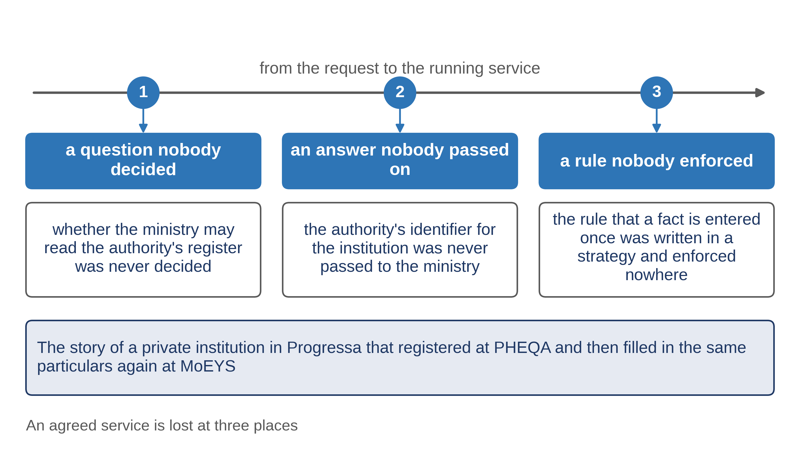
Each loss, placed
1.1 · Where an agreed service gets lost
Notes:
VO: Now place each loss. Nobody ever decided whether MoEYS may read PHEQA's register, so the ministry built its own form and asked again. That is a question nobody decided. PHEQA gave the college a number, but nobody passed it to MoEYS, so the ministry's form had no place for it and could not look the college up. That is an answer nobody passed on. And the rule that a fact is entered once was written in the national strategy, but no document of either project tested it, and no review asked about it. That is a rule nobody enforced.
Slide specification: Figure F2, its slide variant (figures/slides/F2_three-places.png, drawn by the figure's own program in slide mode): the three places on the way from the request to the running service, each with the loss of the worked example under it, in the same words as slide 3; boxes, arrows and words only, no imagery and no person on screen. The rows are its text equivalent. Calibration item: a drawn figure under ITU's text-only rule.

Slide 9
None of the three is a programming error
Each loss is a decision about the service: never made, never written where it was needed, or never checked.
A silence that is named, owned and counted is a specification.
1.1 · Where an agreed service gets lost
Notes:
VO: Notice what is missing from this story: a programming error. Each loss is a decision about the service that was never made, never written into the right document, or never checked. That is why the method states its purpose in one sentence. A silence that is named, owned and counted is a specification. A silence filled in with a plausible answer is a fault dressed as a specification. The method's documents exist to close the three places, so that you can tell your minister where a service was lost, and what must change.
Slide specification: The method's sentence, set apart in larger body text. Text-only.

Slide 10
IN ONE SENTENCE
An agreed service is lost at three places: a question nobody decided, an answer nobody passed on, a rule nobody enforced.
Do this on your own sector. Place each problem of a past project at one of the three places.
The prompt in the companion material gives you a table of the project's problems, each placed at one of the three places with one line of reason. Before the next video.
1.1 · Where an agreed service gets lost
www.itu.int
Notes:
PRACTICE BOX (on-screen only — never read it, never paraphrase it, never point at it). It replaces the narrated handoff: this video ends on the recap.
VO: When a service goes wrong, ask where it was lost: a question nobody decided, an answer nobody passed on, or a rule nobody enforced. Then fix that place.
Slide specification: The single message, word for word. No sources slide follows: this subtopic cites no external source.

Slide 11
MODULE 1 · VIDEO 1.2
1.2
Three rules you can hold a supplier to
Review a story, not a list; measure against a list the design did not write; end one check on the running system.
standalone video · voice-over on text slides
Notes:
Title card — the cold open. The hosts name the module, the video number, the title and the single message on this slide; no scripted narration. Hold until the opener begins; the opener is narrated on the next slide.

Slide 12
WHERE WE START
A long, confident proposal lands on your desk.
It promises a complete service.
Before you sign: will you be able to check what you are buying?
1.2 · Three rules you can hold a supplier to
www.itu.int
Notes:
VO: A supplier's proposal lands on your desk. It is long, it is confident, and it promises a complete service. Before you sign, three rules tell you whether you will be able to check what you are buying.

Slide 13
Rule 1: review a story, not a list
Officials agree to what a person does, step by step, and what they see at each step.
A list can be complete and still impossible to review.
1.2 · Three rules you can hold a supplier to
Notes:
VO: The first rule: officials review a story, not a list. A list of eighty decisions can be complete and still impossible to review, because nobody can see what is missing from a list. A story shows it: a step with no response, a person who never appears again, a way of going wrong that nobody mentions. So officials agree to what a person does, step by step, and what that person sees at each step. The part a program later reads is taken from the story, never the other way round.
Slide specification: Rule 1. Text-only.

Slide 14
A story is the shared picture
PAERA: enterprise architecture is a set of documents that bridges the gap between business and IT, so that both can plan.
For one service, the story with its screens is that bridge.
1.2 · Three rules you can hold a supplier to
Notes:
VO: PAERA, GovStack's reference architecture for public administration, describes enterprise architecture as a set of documents meant to bridge the communication gap between business and IT, so that both sides can plan together. For one service, a story with its screens does that job. The registrar recognises her own work in it, and the builder can build from it. A list of one hundred and forty fields is shared by nobody: the registrar cannot read it, and the builder never needed her signature on it.
Slide specification: The shared picture between the policy side and the technical side. PAERA is named in plain text; no GovStack logo.

Slide 15
Rule 2: measure against a list the design did not write
Write down what was asked before any design exists.
A list written from the design always matches the design.
1.2 · Three rules you can hold a supplier to
Notes:
VO: The second rule: measure the design against a list the design did not write. If the list of what must be covered is drawn up from the design itself, the design will always look complete. This is the most common way a project reports full coverage of a system that is missing half of what it needed. So the list of what was asked is written first, in the customer's own words, before any design exists.
Slide specification: Rule 2. Text-only.

Slide 16
Rule 3: end one check on the running system
Documents can agree with each other and still describe something that does not work.
At least one check ends with a real person finishing a real task.
1.2 · Three rules you can hold a supplier to
Notes:
VO: The third rule: end at least one check on the running system. Checks that compare one document with another are needed, but they share a blind spot. A set of documents can agree with each other perfectly and still describe something that does not work. So at least one check ends outside the documents: a real person finishes a real task, on the system the service will run on.
Slide specification: Rule 3. Text-only.

Slide 17
A proposal for PHEQA, read against the rules
Officials sign a data dictionary, a list of 140 fields.
PHEQA accepts the stories and a walk-through its officials can click.
Requirements written from the approved design.
A register of what PHEQA asked, accepted before any design.
Testing ends on the supplier's test server.
Acceptance ends when a PHEQA officer, signed in through PNIA, finishes a real task on PHEQA's own installation.
1.2 · Three rules you can hold a supplier to
Notes:
VO: In Progressa, PHEQA, the quality authority for higher education, received a proposal for its registration service. It asked officials to sign a data dictionary: a list of one hundred and forty fields, the boxes its screens would hold. It promised a requirements list written from the approved design. And its testing would end on the supplier's own test server, which nobody from PHEQA uses. Each shortfall becomes a clause. PHEQA accepts stories and a walk-through, linked pages its officials click through, not fields. A register of what PHEQA asked is accepted before any design. And acceptance ends when a registration officer finishes a real task on PHEQA's own installation.
Slide specification: Progressa's names as the plan gives them. The arrow is a plain-text character, not a graphic.

Slide 18
IN ONE SENTENCE
Review a story, not a list; measure against a list the design did not write; end one check on the running system.
Do this on your own sector. Test a supplier's proposal against the three rules.
The prompt in the companion material gives you a table of where the proposal falls short of the three rules, with the proposal's own words for each. Before the next video.
1.2 · Three rules you can hold a supplier to
www.itu.int
Notes:
PRACTICE BOX (on-screen only — never read it, never paraphrase it, never point at it). It replaces the narrated handoff: this video ends on the recap.
VO: Before you sign a proposal, find three things: what officials approve, what the design is measured against, and where testing ends. If any is the supplier's own, write the clause.
Slide specification: The single message, word for word.

Slide 19
Sources
• PAERA, the Public Administration Ecosystem Reference Architecture, version 1.0 (GovStack, 2024), section 2.3, Role of Enterprise Architecture
Find the link in the description.
1.2 · Three rules you can hold a supplier to
Notes:
Sources slide, held ~5 seconds at the end of the video. Links are compiled into the YouTube description per ITU convention; no URLs read aloud.

Slide 20
MODULE 1 · VIDEO 1.3
1.3
A question with a name on it is part of the specification
An open question with an owner and a date is acceptable; a question answered by a guess is a fault.
standalone video · voice-over on text slides
Notes:
Title card — the cold open. The hosts name the module, the video number, the title and the single message on this slide; no scripted narration. Hold until the opener begins; the opener is narrated on the next slide.

Slide 21
WHERE WE START
Every line looks certain. That is the moment to be careful.
A line that looks certain may be a guess.
And nobody can tell a guess from a fact.
1.3 · A question with a name on it is part of the specification
www.itu.int
Notes:
VO: You are asked to sign a specification. Every line in it looks certain. That is the moment to be careful, because a line that looks certain may be a guess, and nobody can tell a guess from a fact.

Slide 22
The appeal period, written as a guess
An institution may appeal within 30 days of PHEQA's decision. After 30 days the self-service no longer offers the appeal.
Nobody gave the figure.
1.3 · A question with a name on it is part of the specification
Notes:
VO: In Progressa, a supplier's analyst was writing the part of PHEQA's service in which an institution appeals against a decision of the quality authority. Progressa's regulations give the right to appeal, but the text the analyst had did not say within how long. The analyst needed a number to draw the screens, so the draft said thirty days. Nobody gave that figure. It looks like a fact, and it will be built as a fact: on day thirty-one, the self-service refuses the appeal.
Slide specification: The draft line in quotation, as plain text. No screenshot of a document.

Slide 23
What the guess costs
If the true period is longer, the system turns a lawful appeal away.
Nobody can tell which figures were given and which were guessed.
1.3 · A question with a name on it is part of the specification
Notes:
VO: If the true period is longer, an institution with a lawful appeal is turned away by the system, and nobody knows why the system says thirty. The guess may even be right. It is still a fault, and a worse one than a blank would have been, because a blank is visible and a guess is not. Nobody reading the document can tell which of its figures were given and which were invented to keep the work moving.
Slide specification: Text-only.

Slide 24
The same line, as a named question
The appeal period: to be confirmed by the Registrar of PHEQA by 15 November 2026.
Open question 7 of 9 of this document.
1.3 · A question with a name on it is part of the specification
Notes:
VO: Now the same line, written under the SDD method. An institution may appeal within the appeal period. The appeal period is to be confirmed by the Registrar of PHEQA by the fifteenth of November. And the document counts it: open question seven of nine. This version is not weaker. It is more complete. It says exactly what is not yet known, who will settle it and by when. The builder builds everything else and leaves the one figure to a setting the Registrar fills in.
Slide specification: Set beside slide 2 in the same layout, so the two versions can be compared.

Slide 25
Three questions before you sign
1
Can someone build from it without asking anything?
2
Was the review held?
3
Is every remaining gap named, owned and counted?
1.3 · A question with a name on it is part of the specification
Notes:
VO: Before you sign, ask three questions. First: could the builder work from this document alone, without working anything out and without asking anybody anything, apart from the named open questions? Second: was the review held, with the owner of the document, the builder and the official who will live with the result in the room? Third: is every remaining gap named, owned and counted? When all three answers are yes, the document is good enough to sign.
Slide specification: The manager's test of good enough. Text-only.

Slide 26
Where to look in a draft
Figures, periods, roles and rules with no source beside them.
Ask of each one: where did this come from?
1.3 · A question with a name on it is part of the specification
Notes:
VO: When you read a draft, look for figures, periods, roles and rules with no source beside them. Ask of each one where it came from. An honest answer is either a source, or a name and a date. And be wary of a draft with no open questions at all. In a new service, that is a warning, not a result: it usually means that somebody answered the hard questions alone.
Slide specification: Text-only.

Slide 27
IN ONE SENTENCE
An open question with an owner and a date is acceptable; a question answered by a guess is a fault.
Do this on your own sector. Find the guessed answers in a draft specification.
The prompt in the companion material gives you a list of the guessed answers in the draft, each turned into a named question with a proposed owner. Before the next video.
1.3 · A question with a name on it is part of the specification
www.itu.int
Notes:
PRACTICE BOX (on-screen only — never read it, never paraphrase it, never point at it). It replaces the narrated handoff: this video ends on the recap.
VO: A question with an owner and a date belongs in a document you sign. A guessed answer does not, even when the guess turns out right.
Slide specification: The single message, word for word. No sources slide follows: this subtopic cites no external source.

Slide 28
MODULE 1 · VIDEO 1.4
1.4
Twelve documents from the request to the running service
Each document has a writer, an input, an output, a person who accepts it and a check, in a fixed order.
standalone video · voice-over on text slides
Notes:
Title card — the cold open. The hosts name the module, the video number, the title and the single message on this slide; no scripted narration. Hold until the opener begins; the opener is narrated on the next slide.

Slide 29
WHERE WE START
"The design is finished." What does that mean?
The method answers with twelve documents, in a fixed order.
And it shows where in that order you must say yes.
1.4 · Twelve documents from the request to the running service
www.itu.int
Notes:
VO: When a supplier says the design is finished, you need to know what that means. The SDD method answers with twelve documents, in a fixed order, and it tells you where in that order you must say yes.

Slide 30
Five things written against every document
Who writes it.
What goes in.
What comes out.
Who accepts it.
How it is checked.
1.4 · Twelve documents from the request to the running service
Notes:
VO: Every one of the twelve documents has five things written against it. Who writes it. What goes in: the earlier documents it is made from. What comes out. The person who accepts it before the next one is begun. And how it is checked: by a program, against an earlier document, or by a person with a checklist. The order is fixed because some documents exist to measure others, and a measure written after the thing it measures is not a measure.
Slide specification: The five columns of the table every document fills. Text-only.

Slide 31
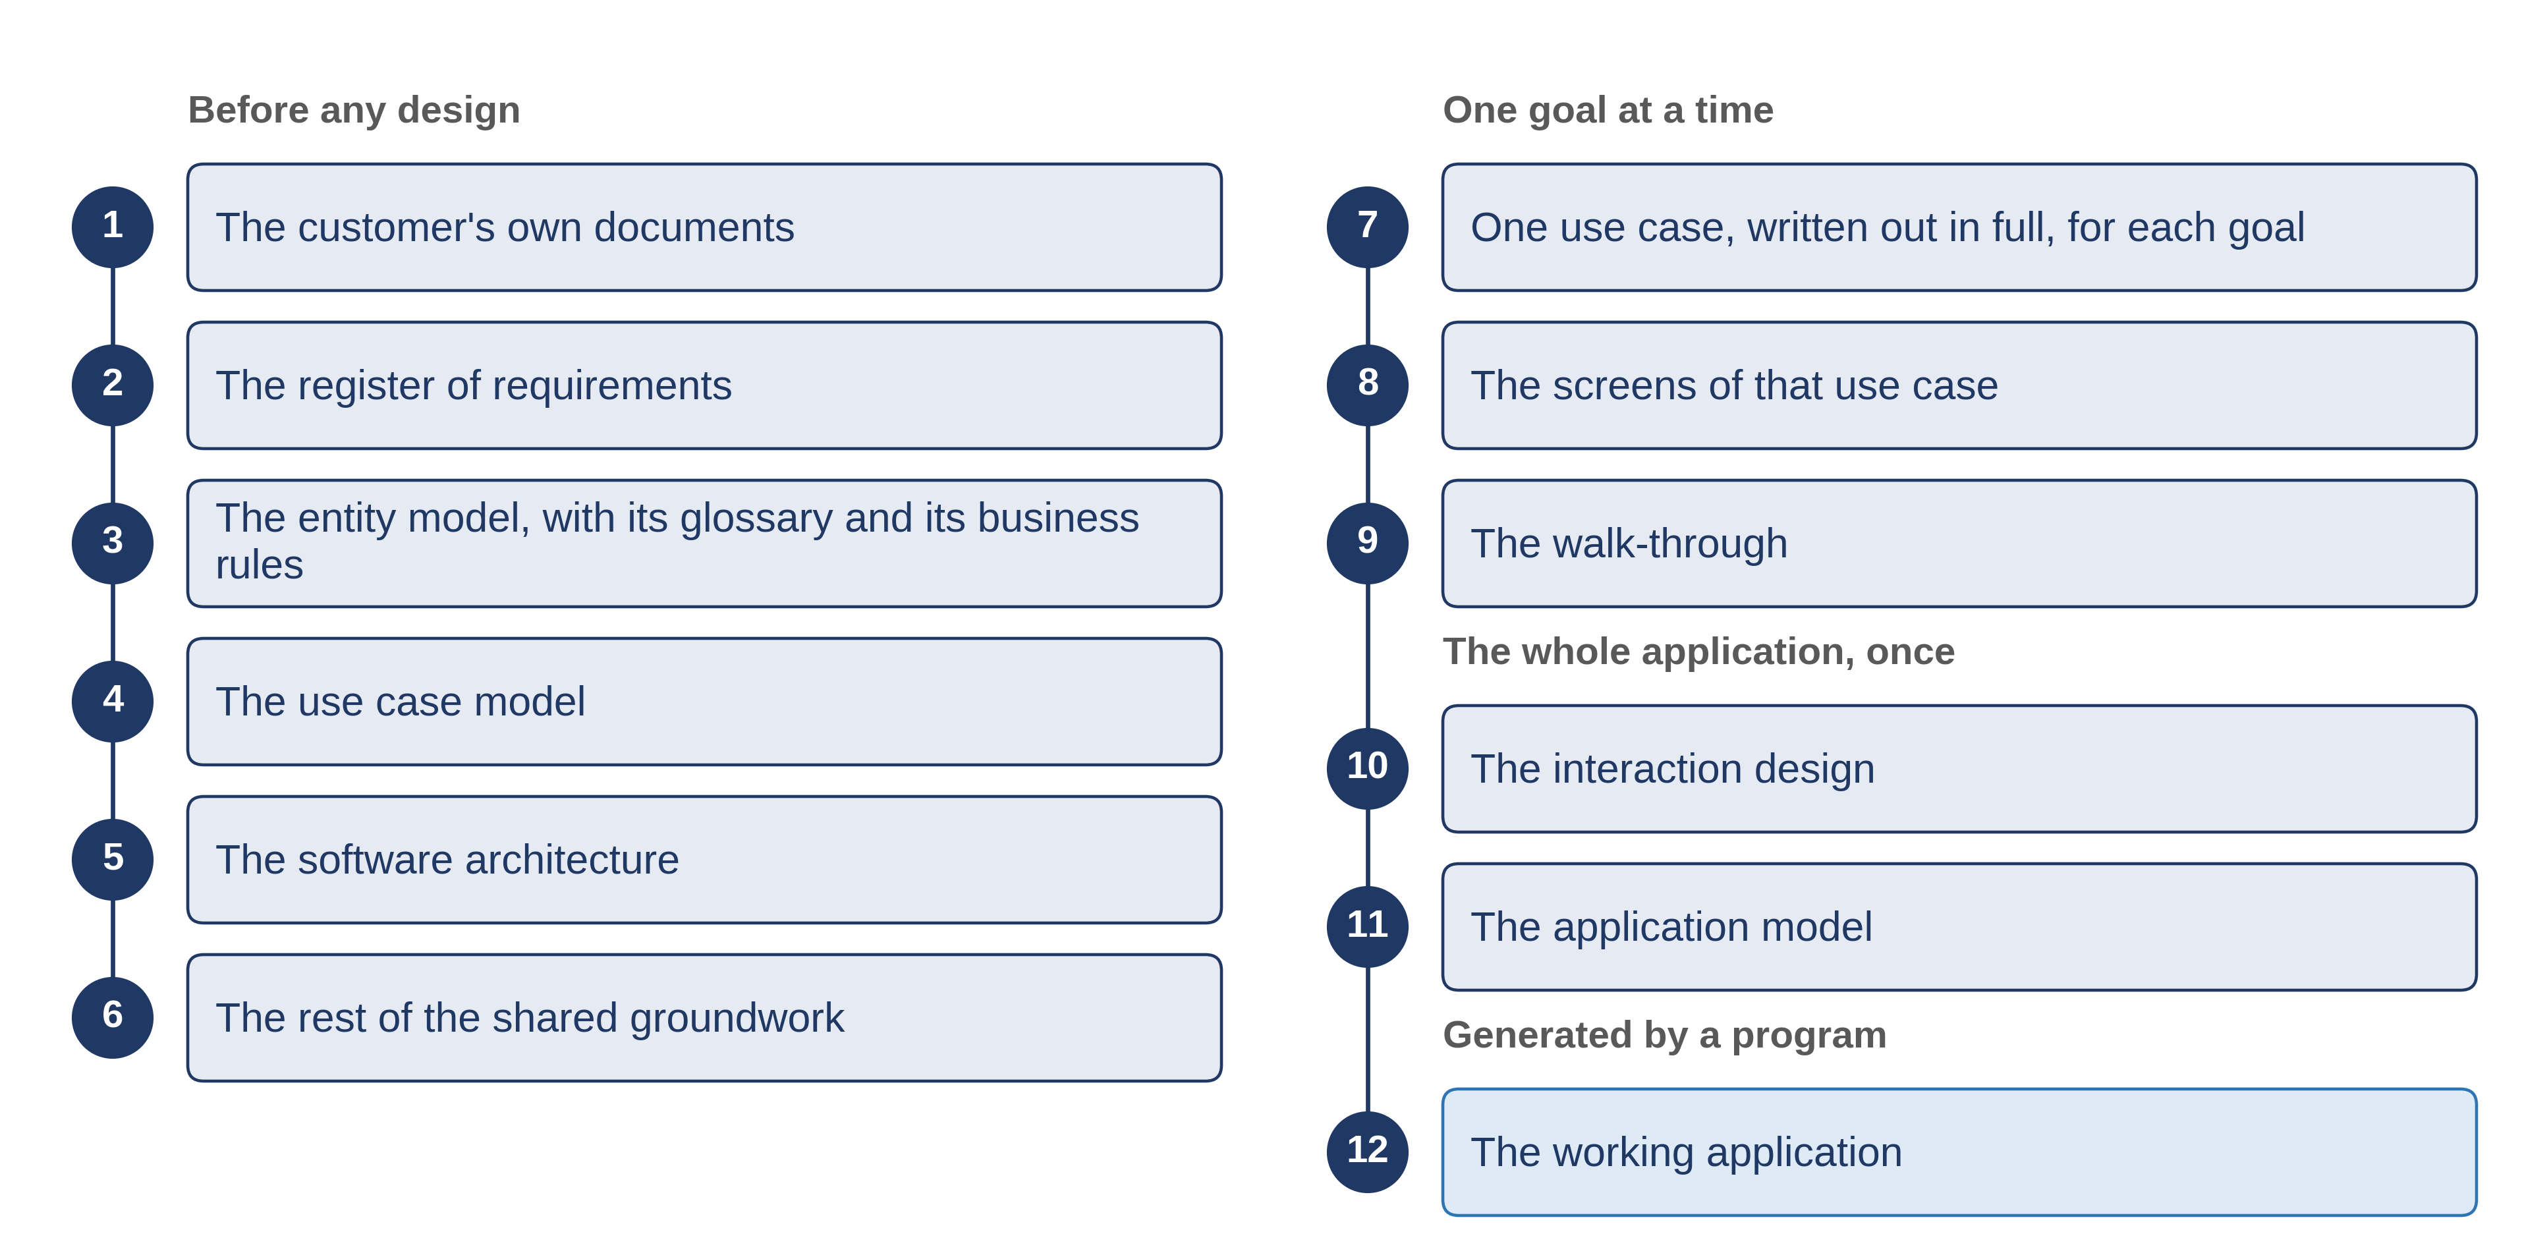
Twelve documents, in a fixed order
Written once for the whole sector, before the first: the catalogue of services.
1.4 · Twelve documents from the request to the running service
Notes:
VO: The first six are written before anything is designed. First, the customer's own documents: the law, the mandate and the requests, kept as received and never edited. Second, the register of what was asked, one entry for each separate thing. Third, the records the service keeps, and whose each fact is. Fourth, every goal people have in the service, each tied to what was asked. Fifth, the architecture: what the service is built on, and what crosses its boundary. Sixth, the states, settings and code lists every goal shares; a code list is a fixed list of choices, such as the kinds of institution. Before all six, a catalogue of the sector's services is written once for the whole sector; it is not one of the twelve.
VO: The next three are written for each goal in turn: the goal as a story with every way it can fail, the screens worked out from that story, and a walk-through that officials can click. Then come two documents for the whole application: the interaction design, which settles once how officers pick, find, move and act, and the application model, the one file a program reads. The twelfth is the working application. Nobody writes it. A program generates it from the model, and nobody edits it by hand.
Slide specification: Figure F3, its slide variant (figures/slides/F3_twelve-documents.png, drawn by the figure's own program in slide mode): the twelve names numbered 1 to 12 in two columns of six under four headings (before any design; one goal at a time; the whole application, once; generated by a program); the documents are named by what they are for, no file names; the footer says the catalogue is not one of the twelve; boxes, arrows and words only, no imagery and no person on screen. The rows are its text equivalent. Calibration item: a drawn figure under ITU's text-only rule.

Slide 32
Filled for PHEQA's registration of institutions
The register: an AI assistant extracts it; the supplier's analyst rules on each entry; the Registrar of PHEQA accepts.
The screens of a goal: the analyst who wrote the goal; the review of three people decides.
The application model: an AI assistant writes it; the head of the ICT unit approves.
The working application: a registration officer finishes a real task on it.
1.4 · Twelve documents from the request to the running service
Notes:
VO: In Progressa, PHEQA filled this table for its registration of institutions. For the register, an AI assistant extracts the entries, the supplier's analyst rules on each one, and the Registrar of PHEQA accepts it. For the screens of a goal, three people decide at a review: the owner of the screens, the builder, and the head of the registration desk. For the application model, the head of PHEQA's ICT unit approves it after reading what it assumed. And the working application is accepted when a registration officer finishes a real task on it.
Slide specification: An extract of the filled table; the full table of twelve is in the written guide. Progressa's names as the plan gives them.

Slide 33
Nine points where PHEQA says yes
Nine points where a person in PHEQA must say yes before the work goes on.
Two documents written by nobody: the walk-through and the working application.
1.4 · Twelve documents from the request to the running service
Notes:
VO: Count the points where a person in PHEQA must say yes before the work goes on. There are nine. At each one, the next document is written from what was accepted, not from what was proposed. Two documents are written by nobody: a program produces the walk-through and the working application. Now lay your own project's documents beside the twelve. A missing row is a decision nobody will take in writing. A row with no point of acceptance is a place where the supplier, not your organisation, decides.
Slide specification: The figure nine is counted from the filled table of the worked example. Text-only.

Slide 34
IN ONE SENTENCE
Each document has a writer, an input, an output, a person who accepts it and a check, in a fixed order.
Do this on your own sector. Map your project's documents onto the twelve.
The prompt in the companion material gives you a map of the project's documents against the twelve, with what is missing, duplicated or out of order. Before the next video.
1.4 · Twelve documents from the request to the running service
www.itu.int
Notes:
PRACTICE BOX (on-screen only — never read it, never paraphrase it, never point at it). It replaces the narrated handoff: this video ends on the recap.
VO: Twelve documents, in a fixed order. For each one, ask who writes it, what goes in, what comes out, who accepts it and how it is checked.
Slide specification: The single message, word for word. No sources slide follows: this subtopic cites no external source.

Slide 35
MODULE 1 · VIDEO 1.5
1.5
Who writes, who checks, who accepts
The AI assistant may draft; a named person accepts, amends or sets aside each proposal, and only what was accepted stands.
standalone video · voice-over on text slides
Notes:
Title card — the cold open. The hosts name the module, the video number, the title and the single message on this slide; no scripted narration. Hold until the opener begins; the opener is narrated on the next slide.

Slide 36
WHERE WE START
If a machine wrote it, who is answerable for it?
An AI assistant can draft a register of requirements in an afternoon.
That is real help. Your minister will still ask the question.
1.5 · Who writes, who checks, who accepts
www.itu.int
Notes:
VO: An AI assistant can draft a register of requirements in an afternoon. That is real help. It also raises a question your minister will ask: if a machine wrote it, who is answerable for it?

Slide 37
The assistant proposes; a person rules
For each proposal: accepted, amended or set aside.
The document holds only what was accepted.
1.5 · Who writes, who checks, who accepts
Notes:
VO: The SDD method's answer is simple. An AI assistant may draft any document a person would otherwise draft. It proposes; it never decides. A named person rules on each thing it proposes, and says one of three words: accepted, amended or set aside. The document then holds only what that person accepted, in that person's words. A draft is never accepted because it reads well. It is accepted line by line, by somebody whose name is on it, and who can be asked about it later.
Slide specification: The three words in bold body text. Text-only.

Slide 38
Where the source is silent, the assistant must say so
A gap becomes a question with an owner.
Never a plausible answer.
1.5 · Who writes, who checks, who accepts
Notes:
VO: Inventing something plausible is the thing an assistant does best. So the method binds it with one rule: a gap is recorded as a question with an owner, and never filled with an invented answer. When an official's text is silent, the assistant does not guess a figure to keep the work moving. It writes the question down, and a person decides who must answer it and by when. Every invented answer it avoids is one less fault hidden in the service.
Slide specification: Text-only.

Slide 39
Three roles for every document
Writes. Checks. Accepts.
The writer never accepts alone.
The assistant never accepts.
1.5 · Who writes, who checks, who accepts
Notes:
VO: For each of the twelve documents, three roles are named. Someone writes it. Someone else checks it. And a named person accepts it. In PHEQA's project in Progressa, the supplier's analyst and an AI assistant write. A second analyst of the supplier checks. The Registrar of PHEQA accepts, or the head of PHEQA's ICT unit for the technical documents. And the head of the registration desk sits at every review of something an officer will use.
Slide specification: Text-only. No picture of a person or a robot.

Slide 40
Where the assistant writes, in PHEQA's project
The register: the assistant extracts; the analyst rules; the Registrar accepts.
The shared settings and lists: the analyst with the assistant; the owner of each setting accepts.
One goal as a story: the assistant drafts; the analyst rules; the Registrar accepts at the review.
The application model: the assistant writes and must refuse to guess; the head of the ICT unit accepts.
1.5 · Who writes, who checks, who accepts
Notes:
VO: In four of PHEQA's documents, an AI assistant does the writing. It extracts the register of what was asked. It helps write the shared settings and lists. It drafts each goal as a story. And it writes the application model, the file a program reads, under the rule that it must refuse to guess. In each of the four, a named person rules on what it wrote, and a different named person accepts it: the Registrar, the owner of each setting, or the head of the ICT unit.
Slide specification: An extract of the table of the worked example; the full table of twelve is in the written guide. Progressa's names as the plan gives them.

Slide 41
Three checks on the table
1
No row ends with the assistant.
2
The writer never accepts alone.
3
The person who will live with it is in the room.
1.5 · Who writes, who checks, who accepts
Notes:
VO: Ask your supplier for this table before the first document is written, and check three things. No row ends with the assistant. In no row does the writer accept alone: where a writer sits at a review, as the owner of the screens does, two other people must agree. And at every review of something an officer will use, the person who will live with the result sits beside the owner and the builder. If a cell under 'accepts' names the supplier, or names nobody, that decision has not been given to anyone in your organisation.
Slide specification: Text-only.

Slide 42
IN ONE SENTENCE
The AI assistant may draft; a named person accepts, amends or sets aside each proposal, and only what was accepted stands.
Do this on your own sector. Draft who writes, checks and accepts each document.
The prompt in the companion material gives you a table of who writes, checks and accepts each of the twelve documents for your project team. Before the next video.
1.5 · Who writes, who checks, who accepts
www.itu.int
Notes:
PRACTICE BOX (on-screen only — never read it, never paraphrase it, never point at it). It replaces the narrated handoff: this video ends on the recap.
VO: An assistant may draft any document. A named person rules on each line, and only what that person accepted stands.
Slide specification: The single message, word for word. No sources slide follows: this subtopic cites no external source.

Slide 43
Notes:
Closing slide for the combined deck. Individual videos end on their recap or sources slide instead.

