Slide 1
MODULE 2 · VIDEO 2.1
2.1
One catalogue of the sector's services, and the blocks they share
List every service the sector's bodies owe once, with what each rests on, before you specify any one of them.
standalone video · voice-over on text slides
Notes:
Title card — the cold open. The hosts name the module, the video number, the title and the single message on this slide; no scripted narration. Hold until the opener begins; the opener is narrated on the next slide.

Slide 2
WHERE WE START
Before you say yes to one system, ask for one page.
A donor offers to fund a new licensing system for your quality authority.
The page: every service your sector owes, and what each one rests on.
2.1 · One catalogue of the sector's services, and the blocks they share
www.itu.int
Notes:
VO: A donor offers to fund a new licensing system for your quality authority. Before you say yes, ask for one page the donor has not asked for: every service your sector owes, and what each one rests on.

Slide 3
One catalogue, written once for the sector
The service.
The body that owes it.
How it runs today.
The shared blocks it cannot run without.
2.1 · One catalogue of the sector's services, and the blocks they share
Notes:
VO: That page is the sector's catalogue of services. It lists every service the sector's bodies owe to the public, once, before anyone specifies any one of them. Each row gives four things: the service, the body that owes it, how it runs today, and the shared blocks it cannot run without. The catalogue is written for the whole sector, not for one project. It comes before the first document of any single service, so that no project decides alone what the sector will share.
Slide specification: The core payload. Text-only list.

Slide 4
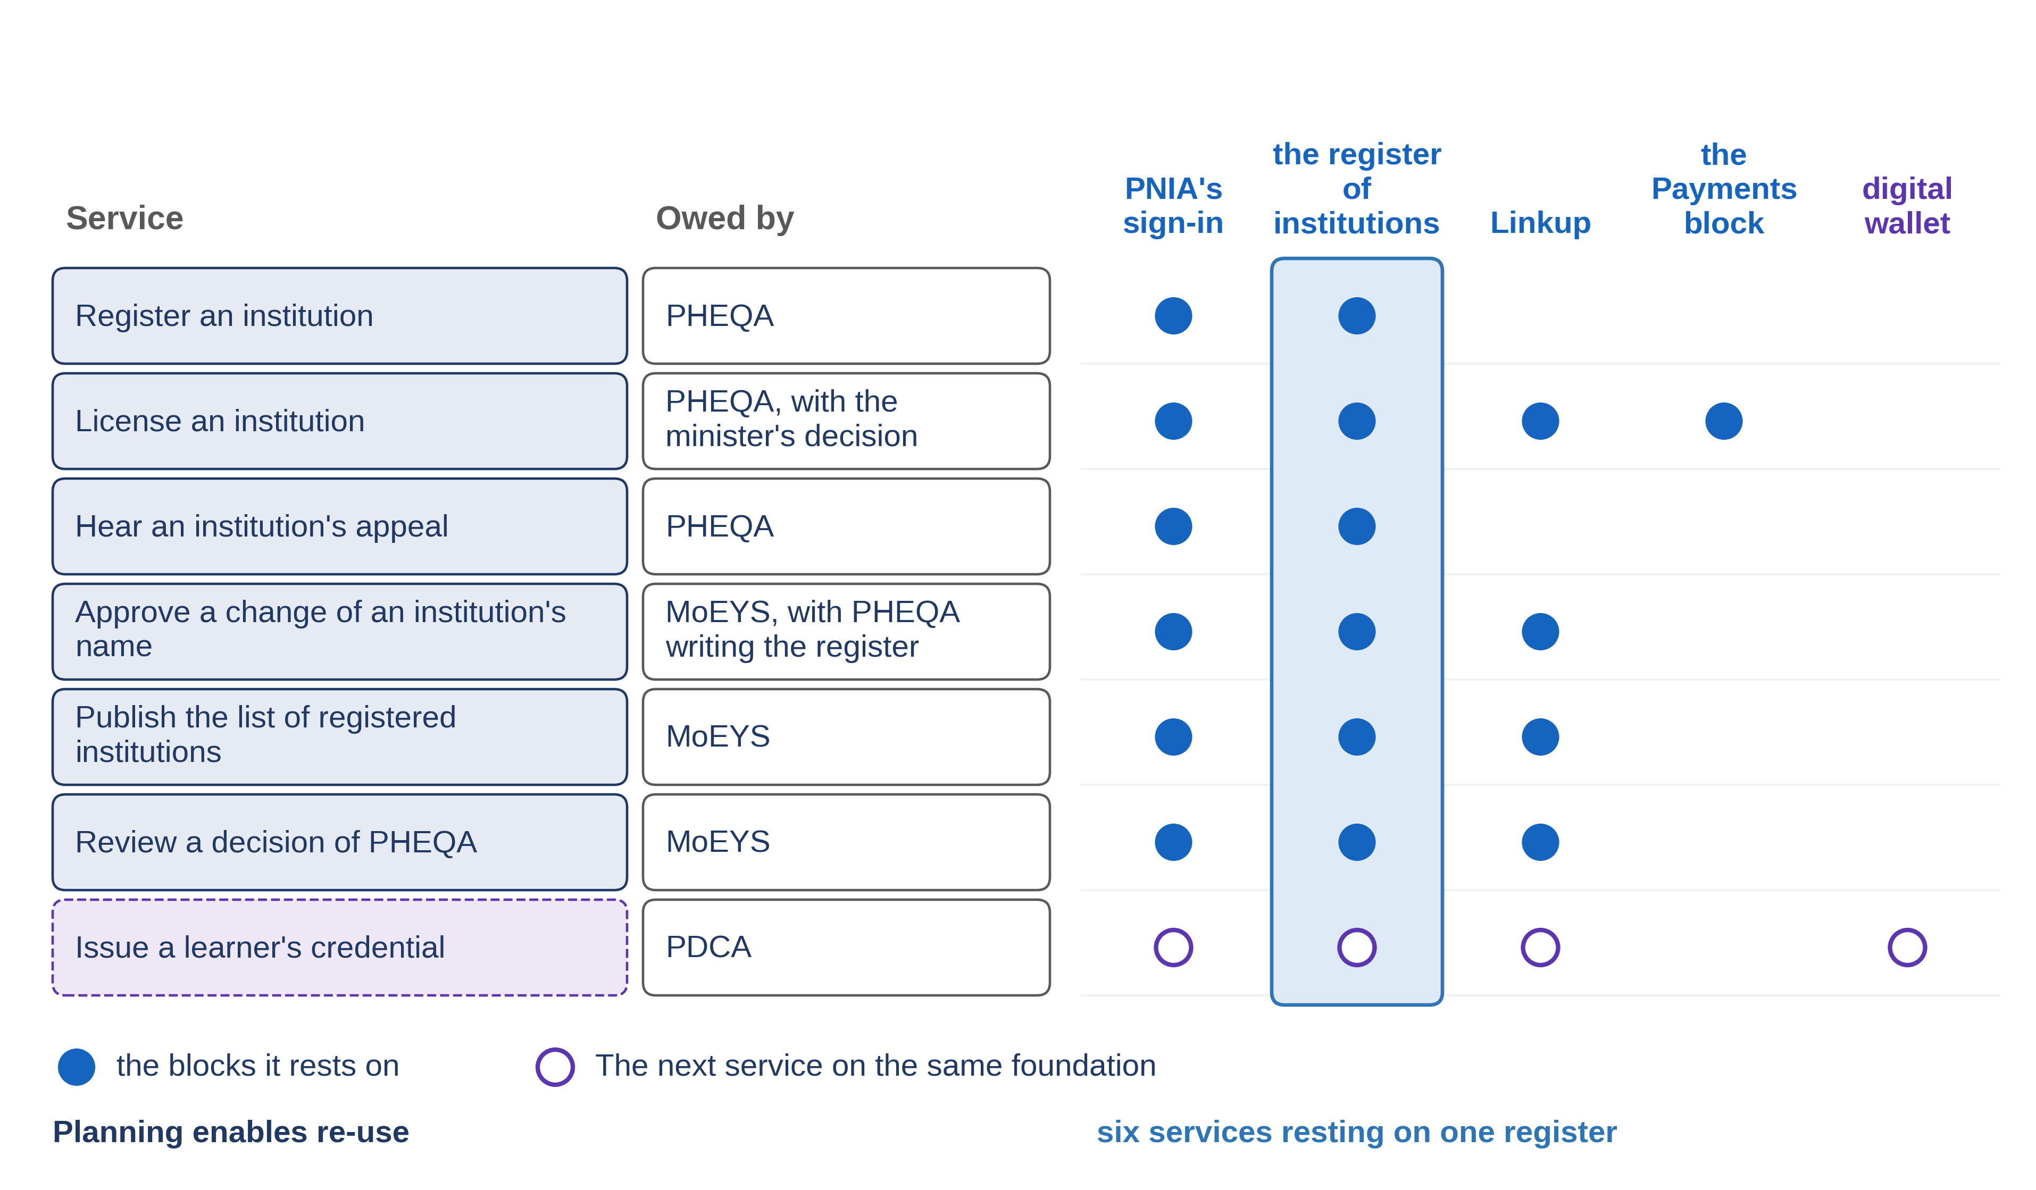
Progressa's higher-education services
2.1 · One catalogue of the sector's services, and the blocks they share
Notes:
VO: Here is Progressa's catalogue for higher education. The quality authority, PHEQA, owes three services: registering an institution, licensing it, and hearing its appeal. The ministry, MoEYS, owes three more: approving a change of an institution's name, publishing the list of registered institutions in the Gazette, and reviewing a decision of PHEQA. The credentials authority, PDCA, will owe the seventh, a learner's credential. Today most of them run on paper, by letter, or from a spreadsheet at the registration desk.
Slide specification: Figure F5, its slide variant (figures/slides/F5_sector-catalogue.png, drawn by the figure's own program in slide mode): the catalogue as a table, the seven services and the bodies that owe them with a column for each shared block and the register's column picked out, so that slide 4 can be read down a column; Progressa's names as the plan gives them, no logos, no emblems; boxes, arrows and words only, no imagery and no person on screen. The rows are its text equivalent. Calibration item: a drawn figure under ITU's text-only rule.

Slide 5
Read down one column
The register of institutions: one service writes it; six rest on it, five now and one later.
PNIA's sign-in: six services now, the seventh later.
One service in a column: a project's tool. Many: the sector's infrastructure.
2.1 · One catalogue of the sector's services, and the blocks they share
Notes:
VO: Now read the catalogue down one column, the register of institutions. The first service writes it. Every one of the other six rests on it: five now, and the learner's credential later. Read the column of PNIA's sign-in the same way. Six services rest on it now, and the seventh will, and none of them needs its own way of knowing who a person is. A block with one service in its column is a project's tool. A block with many is the sector's infrastructure.
Slide specification: The drawn catalogue with its columns is figure F5 of the written guide; the slide stays text-only.

Slide 6
Why only the sector sees it
INSIDE ONE PROJECT
Its own list is always faster.
ACROSS THE SECTOR
One register paid for, six services carried.
2.1 · One catalogue of the sector's services, and the blocks they share
Notes:
VO: Inside one project, building your own list of institutions is always faster than agreeing to read somebody else's. That is not a failure of discipline. It is what a project is paid to do, and it is how one donor comes to fund a register at the authority while another funds a separate list at the ministry. Procurement rules can make each contract cheaper, but only planning for the whole sector makes re-use possible. If each service keeps its own list, Progressa pays for seven lists and spends years making them agree.
Slide specification: Carries the structural argument that planning enables re-use. Text boxes side by side are allowed; labels in plain text.

Slide 7
What the published sources say
UNDP: a set of foundational digital systems; from fragmented systems to shared infrastructure.
UNDP compendium: shared digital systems at societal scale; digital identity, digital payments, consent-based data sharing.
PAERA: DPI is not neutral and shapes what can be built on top of it.
2.1 · One catalogue of the sector's services, and the blocks they share
Notes:
VO: The published sources point the same way. The UNDP calls digital public infrastructure a set of foundational digital systems, and says that moving from fragmented systems to shared digital infrastructure requires more than new software: it demands improved governance, funding and institutional responsibilities. Its compendium describes digital public infrastructure as a set of shared digital systems that give access to services at societal scale, and names three categories: digital identity, digital payments and consent-based data sharing. PAERA, GovStack's reference architecture, adds that DPI is not neutral and shapes what can be built on top of it. The catalogue is where your sector decides that foundation, before a project decides it for you.
Slide specification: Each phrase is the source's own wording or a close paraphrase marked as such on the written page.

Slide 8
IN ONE SENTENCE
List every service the sector's bodies owe once, with what each rests on, before you specify any one of them.
Do this on your own sector. Draft the sector's catalogue of services from its mandate.
The prompt in the companion material gives you a draft catalogue of the sector's services, each row with its mandate sentence and the blocks it rests on. Before the next video.
2.1 · One catalogue of the sector's services, and the blocks they share
www.itu.int
Notes:
PRACTICE BOX (on-screen only — never read it, never paraphrase it, never point at it). It replaces the narrated handoff: this video ends on the recap.
VO: Before you approve the first project, ask for the catalogue and look down each column. A block that many services rest on should be planned and funded for the sector.
Slide specification: The single message, word for word.

Slide 9
Sources
• UNDP, 'Digital public infrastructure', web page
• UNDP, Accelerating the SDGs through Digital Public Infrastructure: A Compendium of the Potential of Digital Public Infrastructure, 21 August 2023, pages 3 and 4 ('Introduction' and 'Understanding DPI')
• PAERA version 1.0, GovStack, section 2.6
Find the link in the description.
2.1 · One catalogue of the sector's services, and the blocks they share
Notes:
Sources slide, held ~5 seconds at the end of the video. Links are compiled into the YouTube description per ITU convention; no URLs read aloud.

