Slide 1
MODULE 3 · VIDEO 3.2
3.2
Every way it can go wrong, written down
A story is finished only when every failure has its own ending.
standalone video · voice-over on text slides
Notes:
Title card — the cold open. The hosts name the module, the video number, the title and the single message on this slide; no scripted narration. Hold until the opener begins; the opener is narrated on the next slide.

Slide 2
WHERE WE START
A service is judged on its bad days.
The sign-in that does not answer. The document left out. The payment that never arrives.
If nobody wrote down what happens then, the builder decides, alone.
3.2 · Every way it can go wrong, written down
www.itu.int
Notes:
VO: A service is judged on its bad days: the sign-in that does not answer, the document left out, the payment that never arrives. If nobody wrote down what happens then, the builder decides, alone and under deadline.

Slide 3
Each failure, written down
The step it leaves.
What the system notices.
What the system does.
How the story ends: in failure, in success, or back to a named step.
3.2 · Every way it can go wrong, written down
Notes:
VO: For each failure, the story says what the system notices, what it does, and how the story ends. There are only three endings: the goal fails, the goal still succeeds, or the person goes back to a named step of the main story. For each ending, the story also says which of the authority's guarantees still holds. A failure without its own ending is a decision left to the builder.
Slide specification: The core payload. The three endings are kept on screen.

Slide 4
Kinds of failure the Registration specification names
Rules on each field: required, a number within limits, a date, a file of the right size and type.
A field checked against another body's records, through its interface.
A test that everything required is there before the application can be sent.
3.2 · Every way it can go wrong, written down
Notes:
VO: The GovStack Registration specification names the checks a registration service makes. There are rules on each field: whether it is required, a number within limits, a date, a file of the right size and type. A field can be checked against another body's records. And the system checks that everything required is there, and should not let an applicant send an application that is incomplete. Every check that can fail needs its ending in the story.
Slide specification: Paraphrased from sections 6.3.3.1 to 6.3.3.3 of the specification; not marked as quotations.

Slide 5
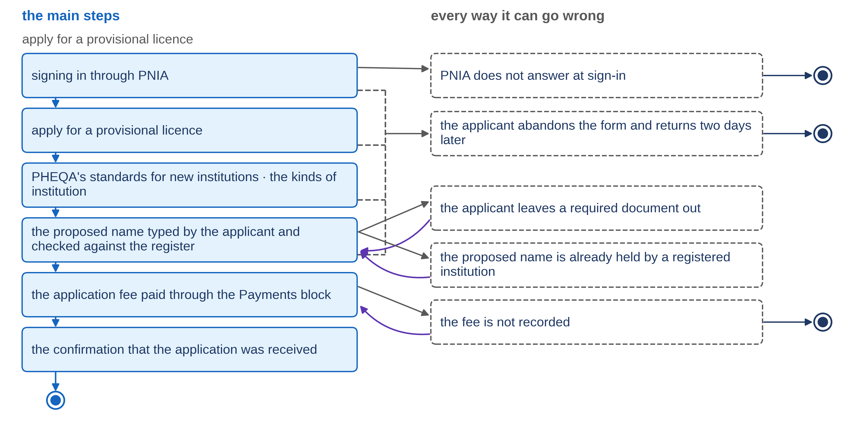
Progressa: five failures, five endings
3.2 · Every way it can go wrong, written down
Notes:
VO: Here are the five failures of PHEQA's goal. PNIA does not answer at sign-in: the applicant is told that nothing has started. The evidence of funding is left out: the system names it and keeps everything else. The proposed name is already held: the system shows which registered institution holds it. The fee is not confirmed: the application is not made. And the applicant who leaves and returns two days later finds nothing kept. Whatever the failure, PHEQA's guarantee holds: no application is recorded unless the applicant confirmed it and paid.
Slide specification: Figure F8, its slide variant (figures/slides/F8_story-and-failures.png, drawn by the figure's own program in slide mode): the main steps down the left, each failure beside the step it leaves, an arrow back into the step the story returns to or the ring-and-dot mark where it ends; boxes, arrows and words only, no imagery and no person on screen. The rows are its text equivalent. Calibration item: a drawn figure under ITU's text-only rule.

Slide 6
Two endings were decisions
Fee not confirmed: no application at all. Decided by the head of the registration desk.
No drafts kept in the first version; an applicant who stops loses what was typed. Decided by the Registrar, and kept as an open question.
3.2 · Every way it can go wrong, written down
Notes:
VO: Three of those endings follow from the story. Two were decisions an official had to take. Should an application wait for its fee? The head of the registration desk said no: a waiting application would be a third state that no other goal uses and nobody asked for. Should half-finished applications be kept as drafts? The Registrar said not in the first version, and recorded the cost: an applicant who stops loses what was typed. That question stays open, and the Registrar owns it.
Slide specification: Roles, never persons.

Slide 7
Before you accept a story
Count the endings. A story with only a success ending is not finished.
For each failure, ask who decided its ending.
A list of failures is a start, not a claim that all were found.
3.2 · Every way it can go wrong, written down
Notes:
VO: Before you accept a story, count its endings. A story with only a success ending is not finished. Then, for each failure, ask who decided the ending. If the answer is the builder, the decision was taken by the wrong person. An AI assistant can propose the first list of failures, step by step, and officials accept or set aside each one. But no list is complete. The walk-through and the review are where more failures are found.
Slide specification: Text-only list.

Slide 8
IN ONE SENTENCE
A story is finished only when every failure has its own ending.
Do this on your own sector. Propose the failures of each step, for the official to decide.
The prompt in the companion material gives you a table of failures for each step, each with a proposed ending for the official to accept or set aside. Before the next video.
3.2 · Every way it can go wrong, written down
www.itu.int
Notes:
PRACTICE BOX (on-screen only — never read it, never paraphrase it, never point at it). It replaces the narrated handoff: this video ends on the recap.
VO: Ask what happens when each step fails. If the story has no answer, the builder will choose one. Write the ending down before anything is built.
Slide specification: The single message, word for word.

Slide 9
Sources
• GovStack Registration Building Block specification, edition 23Q4 (version history to 1.0), sections 6.3.3.1, 6.3.3.2 and 6.3.3.3
Find the link in the description.
3.2 · Every way it can go wrong, written down
Notes:
Sources slide, held ~5 seconds at the end of the video. Links are compiled into the YouTube description per ITU convention; no URLs read aloud.

