Slide 1
MODULE 3 · VIDEO 3.3
3.3
Screens worked out from the story, every value with its source
Each screen serves a step; each value on it says where it comes from.
standalone video · voice-over on text slides
Notes:
Title card — the cold open. The hosts name the module, the video number, the title and the single message on this slide; no scripted narration. Hold until the opener begins; the opener is narrated on the next slide.

Slide 2
WHERE WE START
A screen built from a list of fields explains nothing.
A screen worked out from the story shows what a person needs at that step.
And it says where each value on it comes from.
3.3 · Screens worked out from the story, every value with its source
www.itu.int
Notes:
VO: A screen designed from a list of fields shows everything and explains nothing. A screen worked out from the story shows what a person needs at that step, and says where each value on it comes from.

Slide 3
Walk the story, not the list of records
A step where the person asks, states, gives or confirms something gets a screen.
A step that is wholly the system's gets one only if the person must read something.
Two steps share a screen when nothing the system does stands between them.
3.3 · Screens worked out from the story, every value with its source
Notes:
VO: The screens are worked out after the story is written, by walking it step by step. A step where the person asks, states, gives or confirms something gets a screen. A step that is wholly the system's gets a screen only if it shows something the person must read before going on. Two steps share a screen when nothing the system does stands between them. So every screen serves a step, and you can say which one.
Slide specification: Text-only list.

Slide 4
Every value has one of four sources
Taken from another body.
Chosen from a list.
Read from what the authority keeps.
Entered here, with the reason no other place has it.
3.3 · Screens worked out from the story, every value with its source
Notes:
VO: Every value on every screen comes from one of four places. It is taken from another body, such as the identity authority or the Payments block. It is chosen from a list kept once for the whole service. It is read from a record or a setting the authority already keeps. Or it is entered here, typed by the person, and then the screen record says why no other place has it.
Slide specification: The core payload. Kept on screen while the voice-over names each source.

Slide 5
Progressa: five screens
S1
Ask to apply for a provisional licence (step 2).
S2
Read PHEQA's standards and state the kind of institution (steps 3 and 4).
S3
Give the particulars (steps 5 and 6, and two failures).
S4
Confirm and pay (step 8, and one failure).
S5
See the application received (step 9).
3.3 · Screens worked out from the story, every value with its source
Notes:
VO: PHEQA's goal, to apply for a provisional licence, has five screens. The first asks to apply. The second shows PHEQA's standards and asks for the kind of institution. The third takes the particulars, and also serves two failures: a document left out, and a name already held. The fourth confirms and takes the fee. The fifth shows the application received. Each screen names the steps and the failures it serves.
Slide specification: Screen labels S1 to S5 as the worked example gives them.

Slide 6
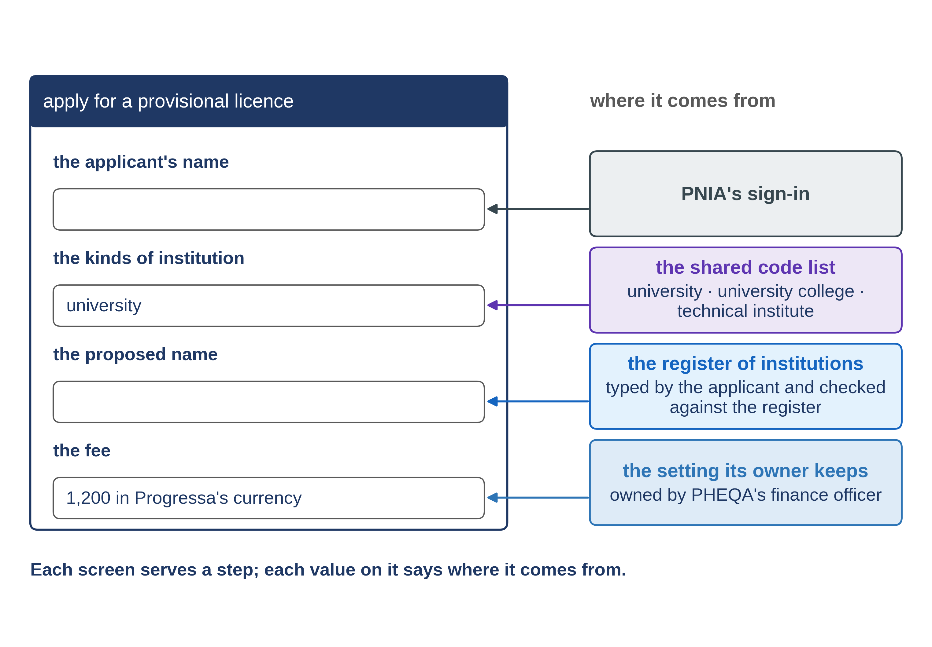
Where each value comes from
3.3 · Screens worked out from the story, every value with its source
Notes:
VO: Now point at values. The applicant's name is taken from PNIA's sign-in; nobody types it. The kind of institution is chosen from PHEQA's shared list of three, kept once in the shared groundwork and re-used by every goal that asks for a kind. The fee is read from the setting that PHEQA's finance officer owns. The proposed name is entered here, because no other body knows it yet, and it is checked against the register of institutions.
Slide specification: Figure F9, its slide variant (figures/slides/F9_screen-sources.png, drawn by the figure's own program in slide mode): the third screen of the goal with its four values and, beside each, the place it comes from; boxes, arrows and words only, no imagery and no person on screen. The rows are its text equivalent. Calibration item: a drawn figure under ITU's text-only rule.

Slide 7
The published picture of screens and fields
Screens in order: a guide, the applicant's form, the upload of documents, the payment, and a send screen.
Each field: a name, a type, and whether it must be filled. Lists are reusable across all services in the same installation.
3.3 · Screens worked out from the story, every value with its source
Notes:
VO: The GovStack Registration specification describes the same work from the builder's side. An analyst creates the screens and their order: a guide, the applicant's form, the upload of documents, the payment, and a send screen. Each field has a name, a type, and whether it must be filled. Lists, which the specification calls catalogues, are reusable across all services in the same installation. Progressa's five screens follow much the same order.
Slide specification: Paraphrased from sections 6.3.2.1 and 6.3.2.2; the five screens are named in the specification's order.

Slide 8
The check against the story
Every step and every failure is served by a screen.
Every value comes from a record, setting or list the story names.
Struck out: the applicant's phone number, which no list names.
3.3 · Screens worked out from the story, every value with its source
Notes:
VO: The screens are checked against four lists the story wrote: its steps, its failures, the records it reads or changes, and the settings and lists it uses. In Progressa's first draft, the third screen asked for the applicant's phone number. No list of the story names it, and PNIA does not release it. It was struck out, and a question went to the Registrar: does PHEQA need to telephone an applicant?
Slide specification: Text-only.

Slide 9
IN ONE SENTENCE
Each screen serves a step; each value on it says where it comes from.
Do this on your own sector. List the screens of a story and the source of every value.
The prompt in the companion material gives you a table of screens, one for each step that needs one, with the source of every value and the values with no source marked. Before the next video.
3.3 · Screens worked out from the story, every value with its source
www.itu.int
Notes:
PRACTICE BOX (on-screen only — never read it, never paraphrase it, never point at it). It replaces the narrated handoff: this video ends on the recap.
VO: Point at any value on any screen and ask where it comes from. There should be one of four answers. Anything else is a question for the story's owner.
Slide specification: The single message, word for word.

Slide 10
Sources
• GovStack Registration Building Block specification, edition 23Q4 (version history to 1.0), sections 6.3.2.1 and 6.3.2.2
Find the link in the description.
3.3 · Screens worked out from the story, every value with its source
Notes:
Sources slide, held ~5 seconds at the end of the video. Links are compiled into the YouTube description per ITU convention; no URLs read aloud.

